Slide 1

EIFL GENERAL ASSEMBLY 2021
  Rima Kupryte
  20 – 21 October 2021
  Online
  www.eifl.net

Slide 2
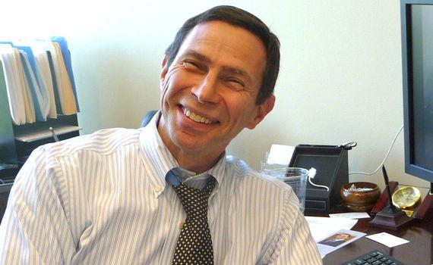
EIFL Management Board
Thank you to Arnold Hirshon, who is leaving our Board

Slide 3

EIFL Management Board
New Board member:
Colleen Campbell, who leads external engagement in the Open Access transition at the Max Planck Digital Library, Max Planck Society, Germany

Slide 4
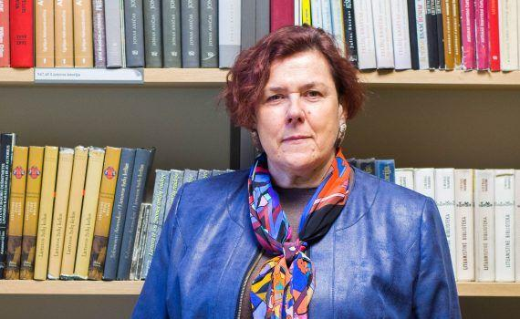
EIFL Management Board
New Chairperson:
Emilija Banionyte,
President of the
Lithuanian Research
Library Consortium

Slide 5


Strategy 2021 - 2023
Advance a fair and sustainable transition from paywalled to open access content
Support research, teaching and learning
Foster digital transformation of public library services
https://www.eifl.net/resources/eifl-strategic-plan-2021-2023

Slide 6

Advance the transition
to open access content
Advance a fair and sustainable transition from paywalled to open access content. Strategy includes -
Encouraging authors from EIFL partner countries to publish in open access
Advocating with publishers,
institutions and funders to
provide open access to journal
articles through repositories

Slide 7



Publishing articles in
open access
Agreements with 12 publishers for free / discounted Article Processing Charges (APCs)
Agreements include open access publishing in more than 2,500 journals
Agreements contributed to a 62% increase in open access publishing with four publishers from 2019 to 2020

Slide 8
Making articles available in
open access repositories
4 more universities in Kenya set up open access repositories: Amref International University, Alupe University College, University of Kabianga, Laikipia University
  Total of 60 open access repositories in Kenya
Same 4 universities drafted open access policies
  Will be 25 universities in Kenya with open access policies
Identified hundreds of articles published in closed access; helped repository managers deposit in open access repositories

Slide 9
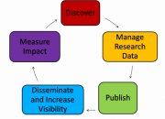
Support research,
teaching & learning
EIFL Digital Research Literacy Training
Programme Outline for Librarians
Resource for training researchers and students
16 topics covering research cycle
Online courses, tutorials, webinars, presentations & training slides
12 webinars on each topic; practical advice for trainers
Almost 1,000 downloads from EIFL’s website
Available in EIFL Resources: https://bit.ly/3vlqBfk

Slide 10


Support research,
teaching & learning
‘Access to Knowledge and the Right to Research’ project strengthened our advocacy at WIPO
Advocating for fair copyright limitations and exceptions for libraries and archives that support -
Online learning
Text and data mining
Cross-border exchange of material, and
Rights to digital preservation

Slide 11

Digital transformation of
public library services
Started project, ‘Digital skills & inclusion
through libraries in Uganda’
Training librarians to become ICT trainers in 25 public and community libraries across Uganda
Newly-trained librarians have started ICT training for women and youth in their communities

Slide 12
THANK YOU!
Rima Kupryte
Director
rima.kupryte@eifl.net
www.eifl.net

