Slide 1
Open Educational Resources: What they are, where to find them?
Maha Bali, PhD
bali[@]aucegypt.edu
Associate Professor of Practice, Center for Learning and Teaching,
American University in Cairo
June 17, 2014

Slide 2
OER
What are they?
Ways to use them
Creative Commons
OER Commons
MERLOT

Slide 3
What are OERs?
teaching and learning materials that you may freely use and reuse, without charge;
authored or created by an individual or organization that chooses to retain few, if any, ownership rights.
Adapted from OER Commons: http://www.oercommons.org/about

Slide 4
What are OERs? Cont’d
For some of these resources:
  download & share with colleagues and students
  download, edit & then re-post it as a remixed work.
OER often have a Creative Commons or GNU license that state specifically how the material may be used, reused, adapted, and shared.
Adapted from OER Commons: http://www.oercommons.org/about

Slide 5
Examples of OERs
Full university courses, complete with readings, videos of lectures, homework assignments, and lecture notes.
Interactive mini-lessons and simulations about a specific topic, such as math or physics.
Adaptations of existing open work.
Electronic textbooks that are peer-reviewed and frequently updated.
Elementary school and high school (K-12) lesson plans, worksheets, and activities that are aligned with state standards.
Quoted from OER Commons: http://www.oercommons.org/about

Slide 6
Ways to Use Them
Supplemental material for students to use outside class
Include in your own class
Adapt and re-use as substantive parts of class
Note: you can consider contributing your own material as OER; or if you come across OER material that is not on one of the repositories, you could submit it

Slide 7
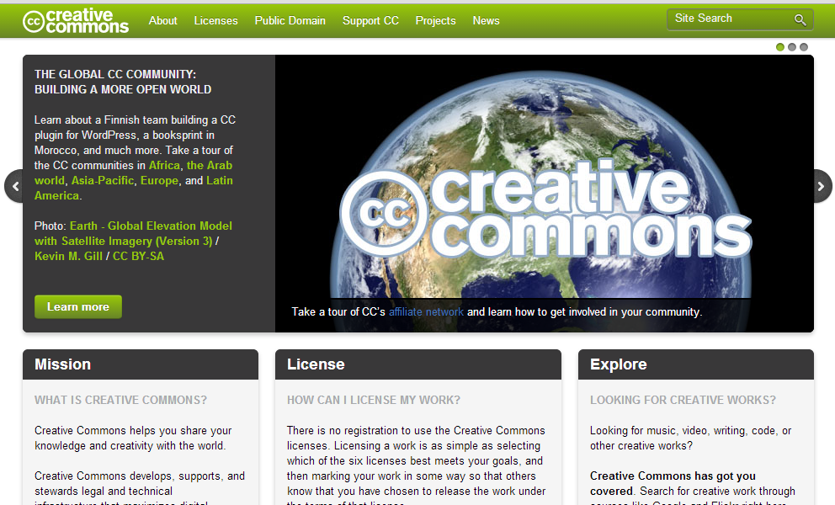
Creative Commons

Slide 8
Why not search Google or CC?
Search not necessarily narrowed by “educational” (though CC has an OER tag section)
Miss the community aspect of evaluating the work
I still search via CC for things like images, etc.

Slide 9

http://www.oercommons.org/

Slide 10
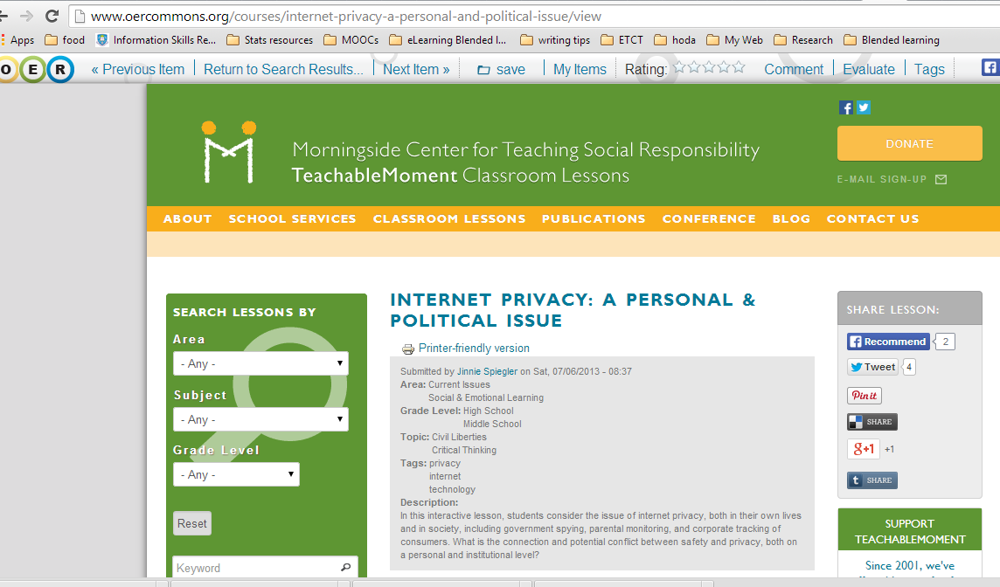

Slide 11
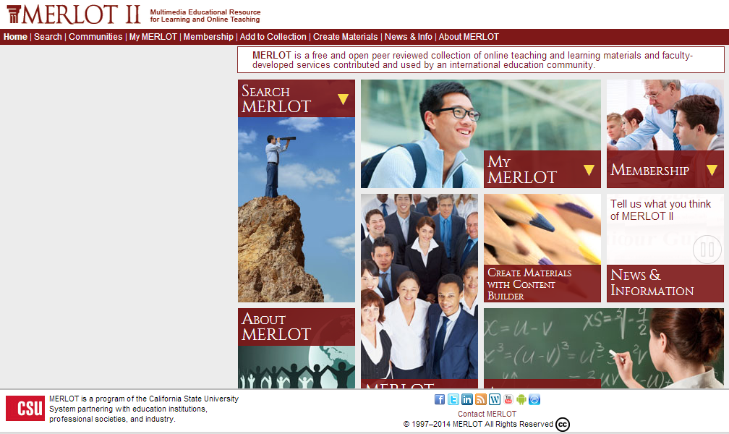
www.MERLOT.org

Slide 12
Using MERLOT
You don’t need to register/login, but if you do, you get the opportunity to:
  Save items you like to your “collections”
  Contribute by rating items
  Contribute in discussions, sharing your ways of using materials, etc.

Slide 13
Contributing to MERLOT
Contribute material (created by you, or others)
You can also volunteer to be a MERLOT peer reviewer of materials

Slide 14

Searching or Browsing…

Slide 15
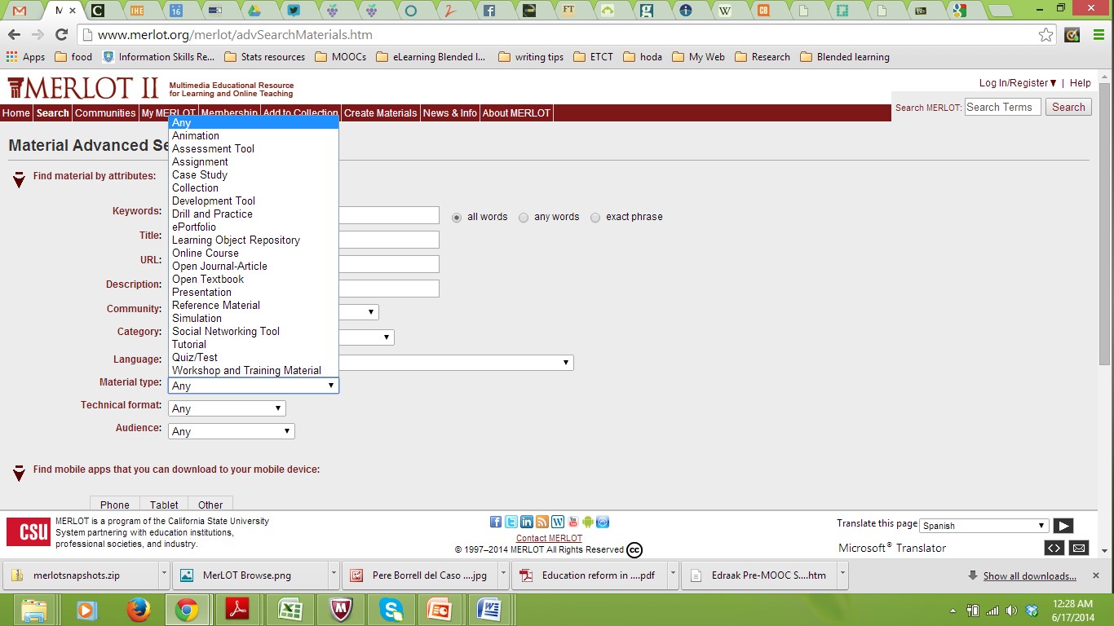
Advanced Search options…

Slide 16
Browsing examples from different disciplines

Slide 17
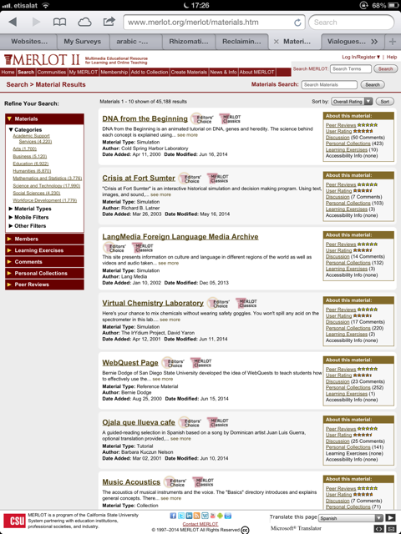

Slide 18
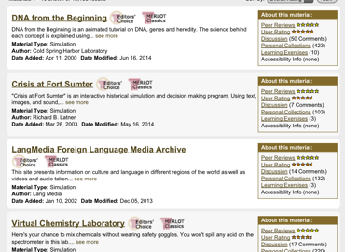

Slide 19
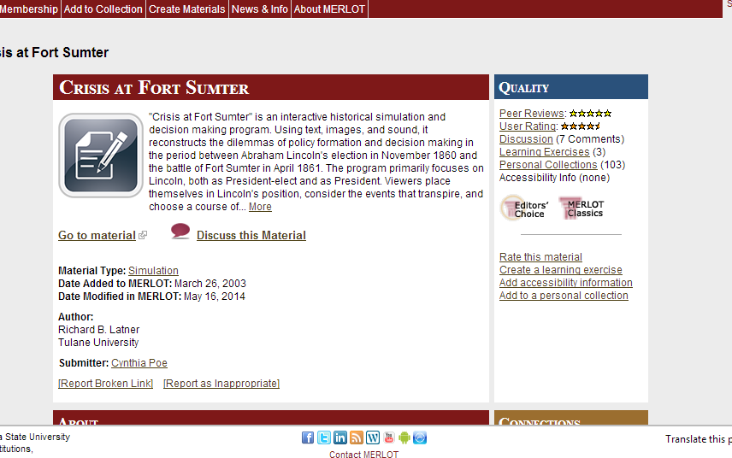
History: Crisis at Fort Sumter

Slide 20
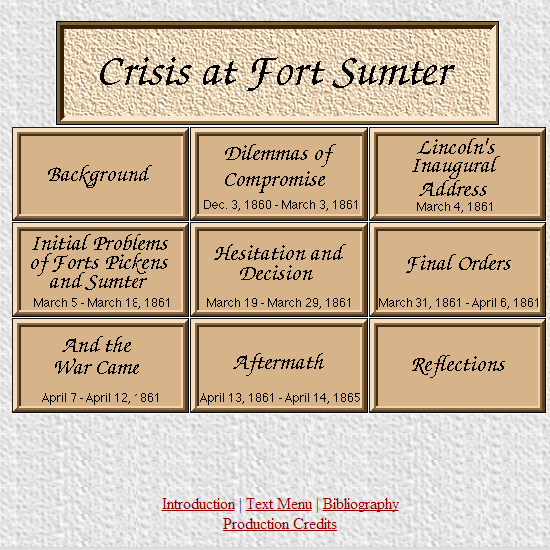

Slide 21
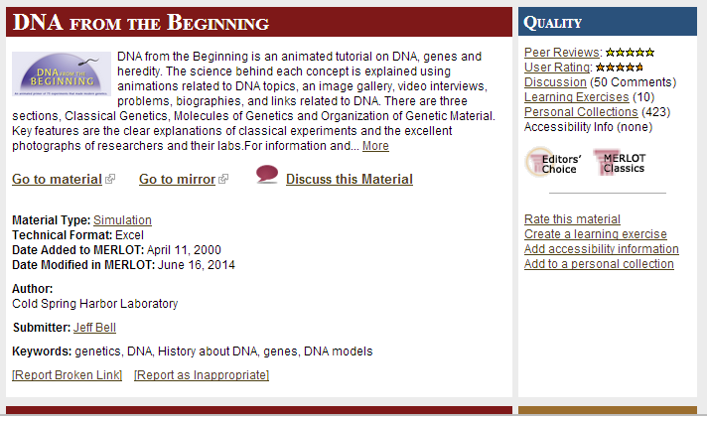
DNA from the Beginning

Slide 22


Slide 23
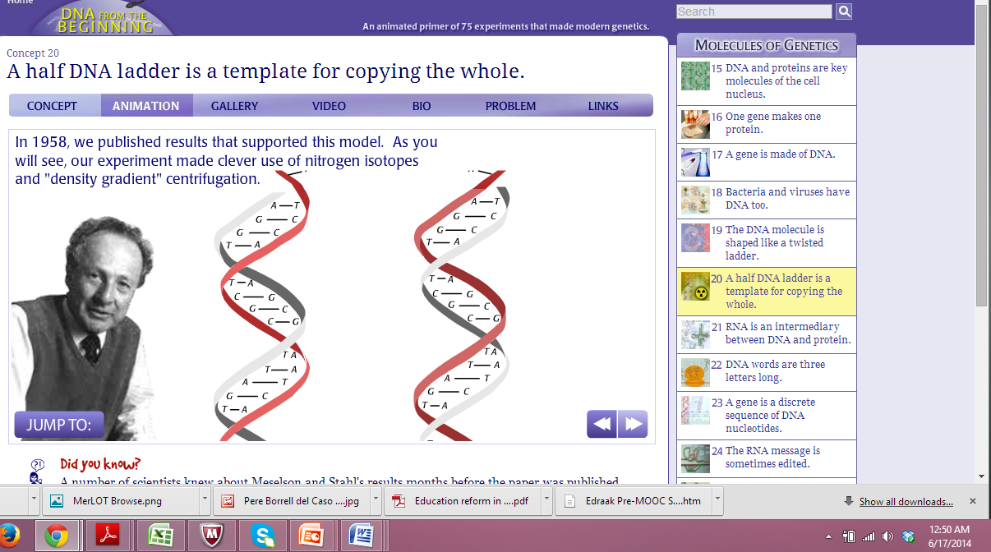

Slide 24
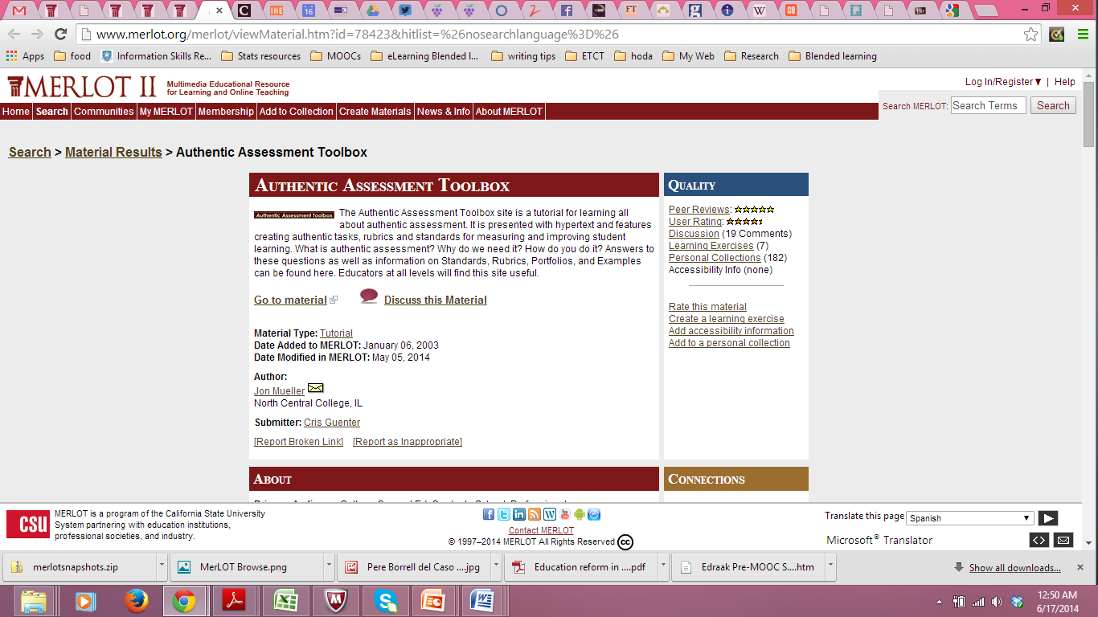

Slide 25
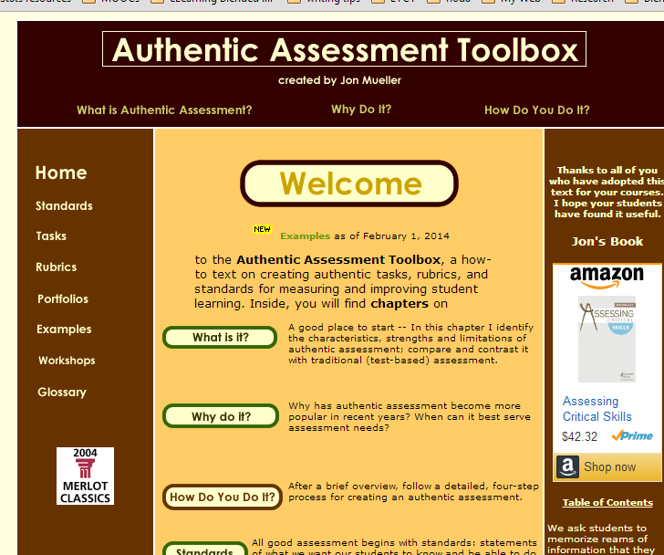

Slide 26
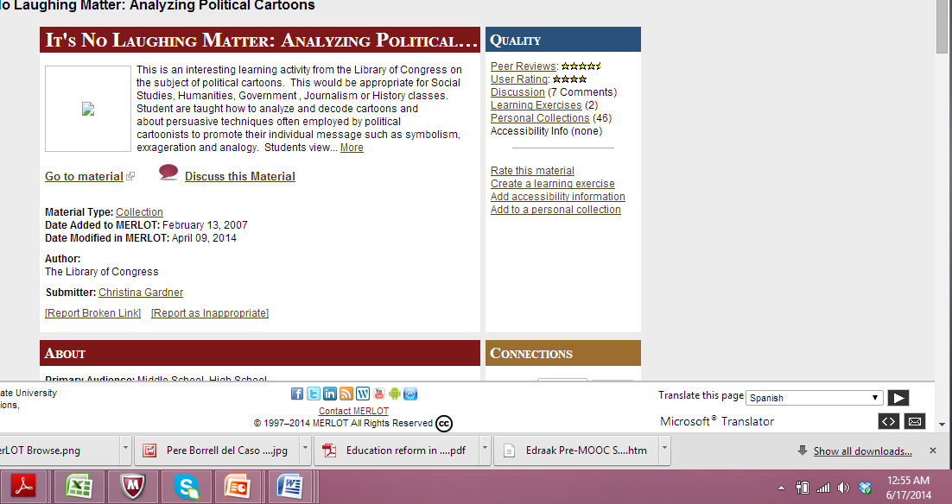
Analyzing Political Cartoons

Slide 27
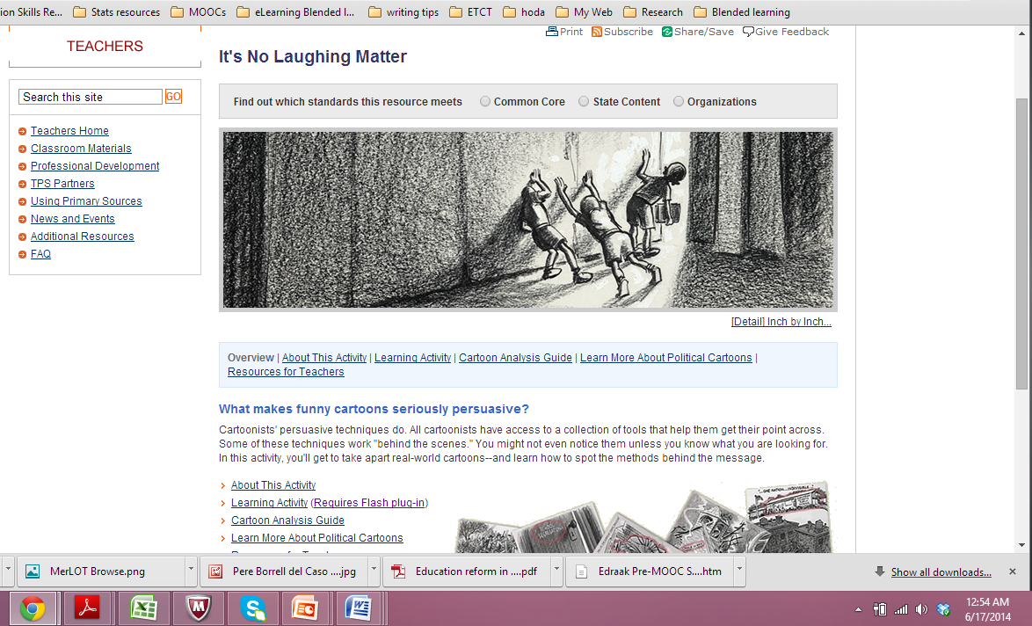

Slide 28
Search Engines for OER
http://www.berknergroup.com/blog/search-engines-for-open-educational-resources

