Slide 1
Openness at the University of Cape Town
Laura Czerniewicz
Director: OpenUCT Initiative
@czernie
laura.czerniewicz@uct.ac.za

Slide 2
Some premises
OERs overlap with Open access and Elearning
OER part of a broader open movement
Innovation usually starts with soft funding (external & internal)
Institutional context and culture critical to how OER and open agenda play out
Open access
OER
Elearning

Slide 3
Institutional cultural types
Policy definition:
Loose
Collegium
Bureaucracy
Control of implementation:
Loose
Control of implementation:
Tight
Enterprise
Corporation
Policy definition:
Tight
McNay, I. (1995). From collegial academy to corporate enterprise: The changing cultures of universities.

Slide 4
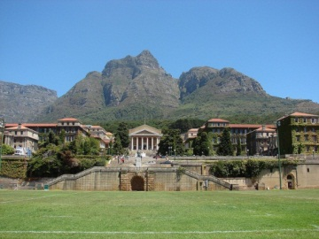
Institutional cultural types
Policy definition:
Loose
Collegium
Bureaucracy
Control of implementation:
Loose
Control of implementation:
Tight
Enterprise
Corporation
Policy definition:
Tight

Slide 5
The collegium type
Characterised by
loose institutional policy definition
informal networks and decision arenas
and innovation at the level of the individual or
department. (McNay 1995)
The organisational response
’laissez faire’, few targeted policies or processes (Rossiter, 2007).
Core value of collegium is freedom
Defines organizational expectations in terms of freedom from external controls (Yee-Tak 2006)

Slide 6
University of Cape Town
Oldest South African university
Top ranked African university
QS World University Rankings
The Times Higher Education World University Rankings
Academic Ranking of World Universities
Medium sized
+/- 25 500 students
982 permanent academics (of 5 442 total staff)

Slide 7
Strategic approaches
Individual agency/ control
Maximum flexibility
Network / community building
Enabling environment
Champions at different levels
Collegium culture:
loose institutional policy definition
informal networks and decision arenas
and innovation at the level of the individual or department. (McNay 1995)

Slide 8
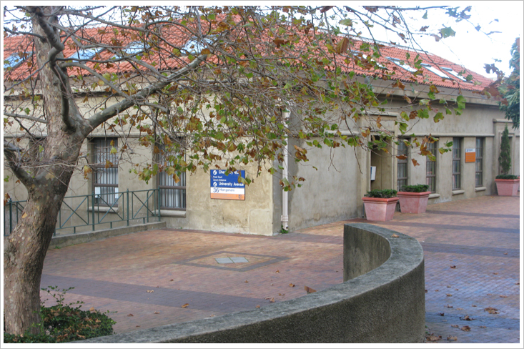
Historically
Opportunities for open agenda in the eLearning space (CHED)(rather than OA)
Contributed to change strategy
No institutional repository

Slide 9
Multiplicity
Multiple strategies
Many small sites of innovation and activity, aiming for agglomeration across the institution, to achieve critical mass
Develop networks and build community
Aim for enabling policies
Aim for agency + assistance
Change at all levels of the university

Slide 10
Open education at UCT
Scholar
Scholar
Scholar
Scholar
Student
Community
2007
Opening Scholarship
2008
2009
2010
2011
2012
2013
2014
2015

Slide 11
Open education at UCT
Scholar
Scholar
Scholar
Scholar
Student
Community
2007
Opening Scholarship
2008
2009
2010
2011
2012
2013
2014
2015

Slide 12
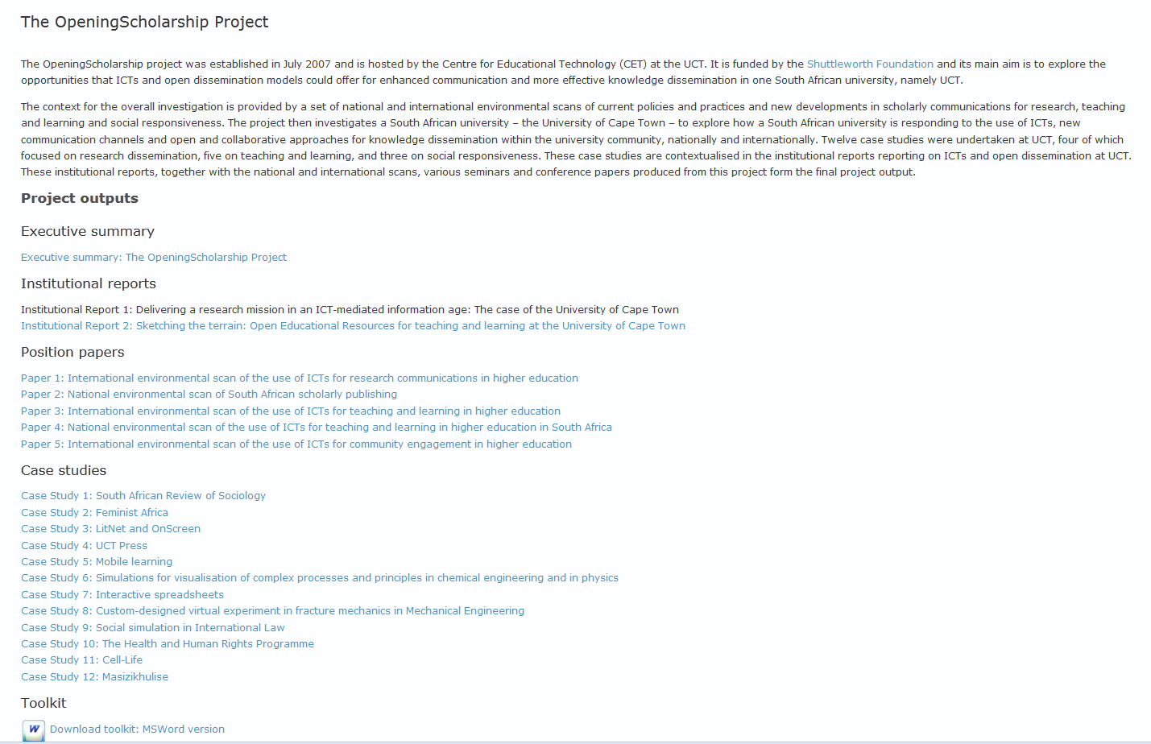
http://www.cet.uct.ac.za/OpeningScholarship

Slide 13
Open education at UCT
Scholar
Scholar
Scholar
Scholar
Student
Community
2007
Opening Scholarship
2008
2009
2010
2011
2012
2013
2014
2015

Slide 16
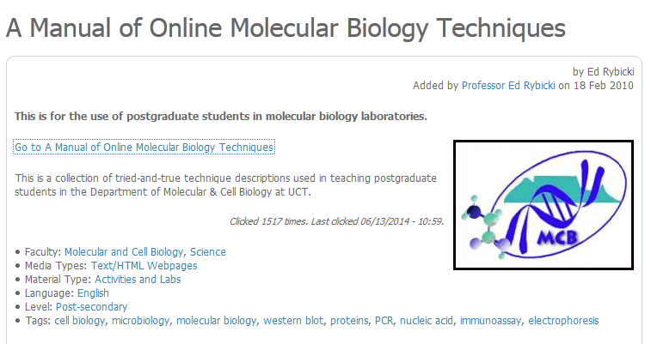
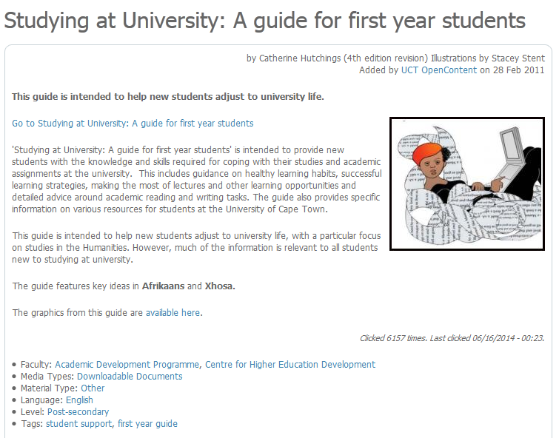
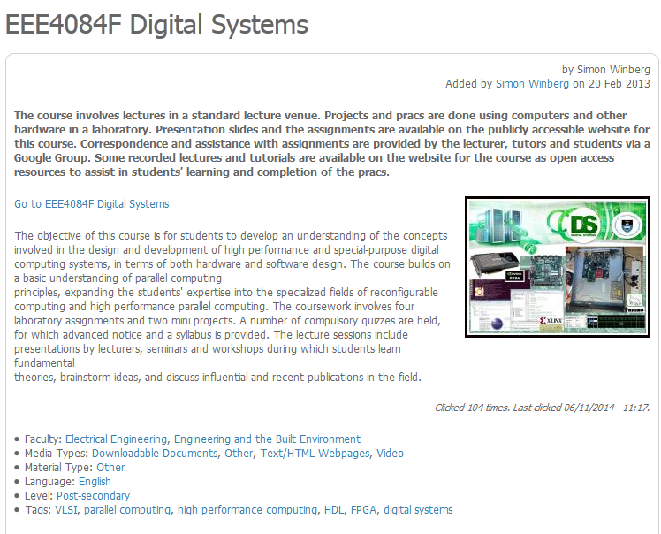
All Kinds of OERs

Slide 17
Open education at UCT
Scholar
Scholar
Scholar
Scholar
Student
Community
2007
Opening Scholarship
2008
2009
2010
2011
2012
2013
2014
2015

Slide 18
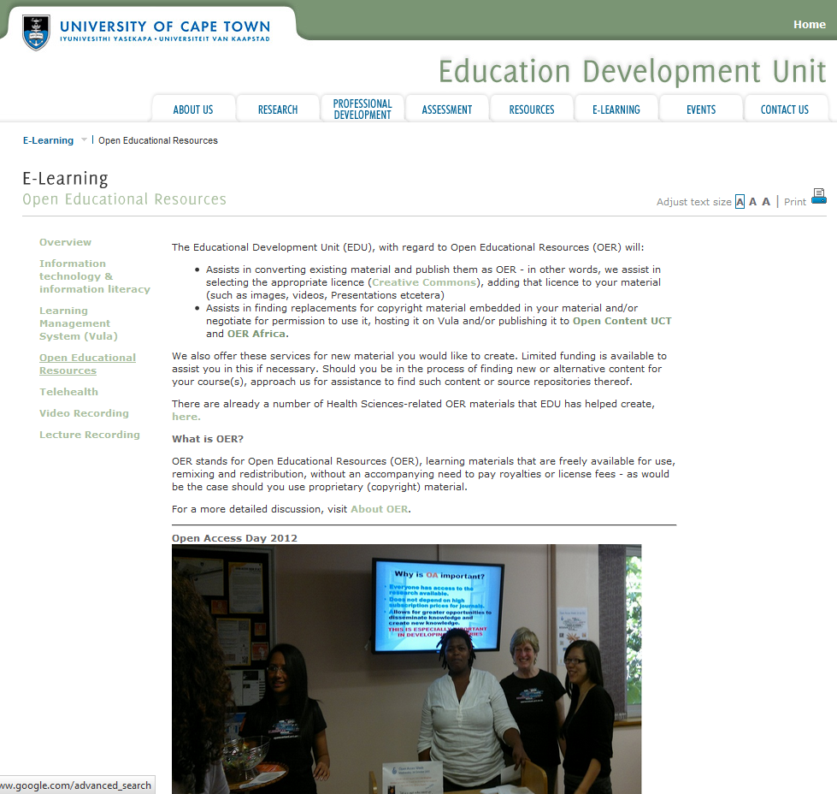
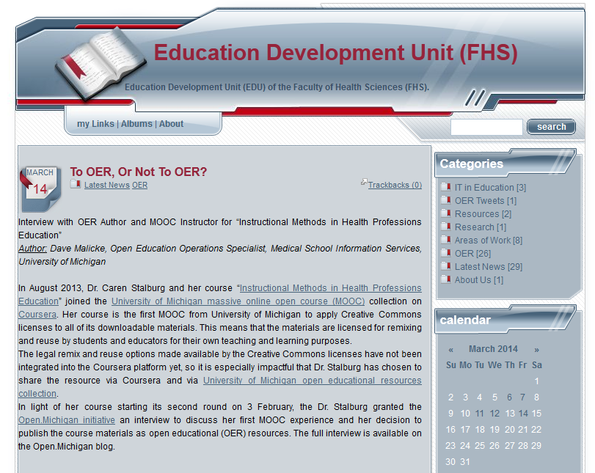
http://www.healthedu.uct.ac.za/about/

Slide 19
Open education at UCT
Scholar
Scholar
Scholar
Scholar
Student
Community
2007
Opening Scholarship
2008
2009
2010
2011
2012
2013
2014
2015

Slide 20
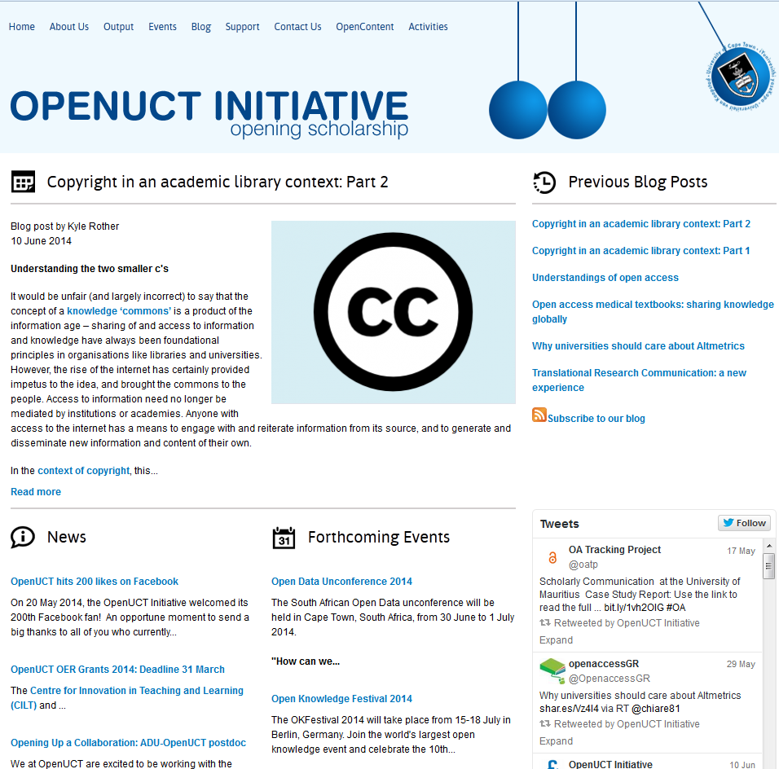
http://openuct.uct.ac.za

Slide 21
UCT Open Education Activities
Small grants for OERs
Student OER Project
Events (40+ events in 2013 alone)
Advocacy
Development and training
Policy engagement
Technical development

Slide 22
Incentives: small grants

Slide 23
IP policy
Work enabled by new UCT IP Policy
Specifically addresses issues relating to the creation of OER resources and the licensing processes to be followed
Expressly states the support for publication of materials under Creative Commons licenses

Slide 24
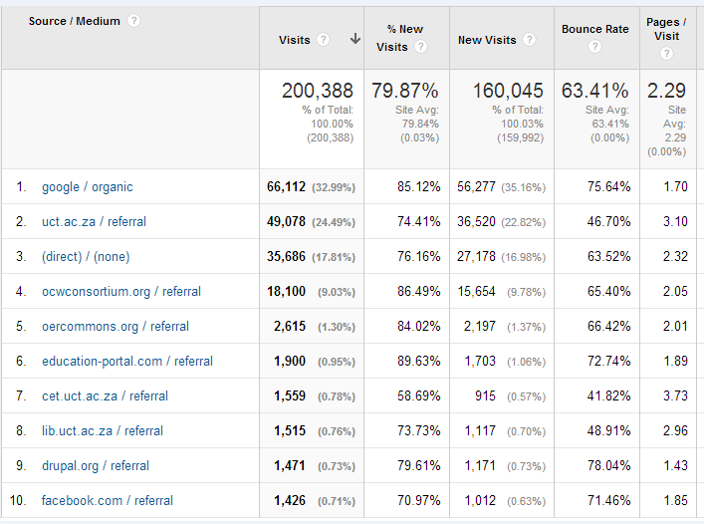
Growth of Open Content

Slide 25
184 countries
UK: 5 980
Germany: 1 632
USA: 21 437
India: 6 010
Philippines: 2 134
Brazil: 1 564
Australia: 1 892
South Africa 91 281

Slide 26
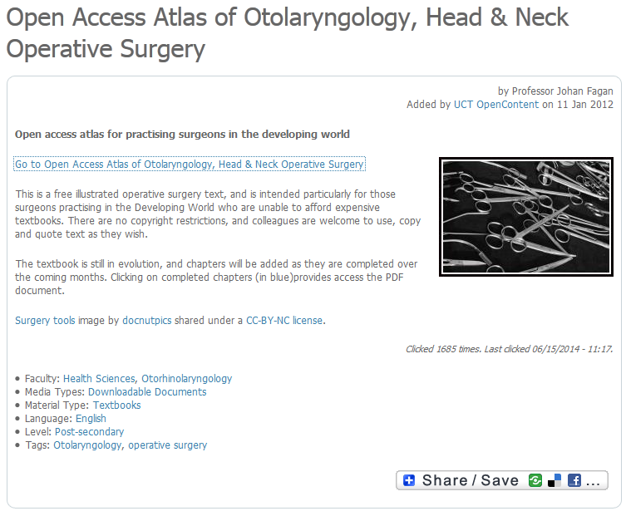
70 chapters written by international experts free of charge
Translations into Portuguese, Spanish & French
Chapters have been downloaded 260,000 times
A rate of >700 chapters per day
A chapter is downloaded every 2.2 minutes

Slide 27
Online Lectures
YouTube channel view count is nearing 200 000
Almost a 1000 videos online

Slide 28
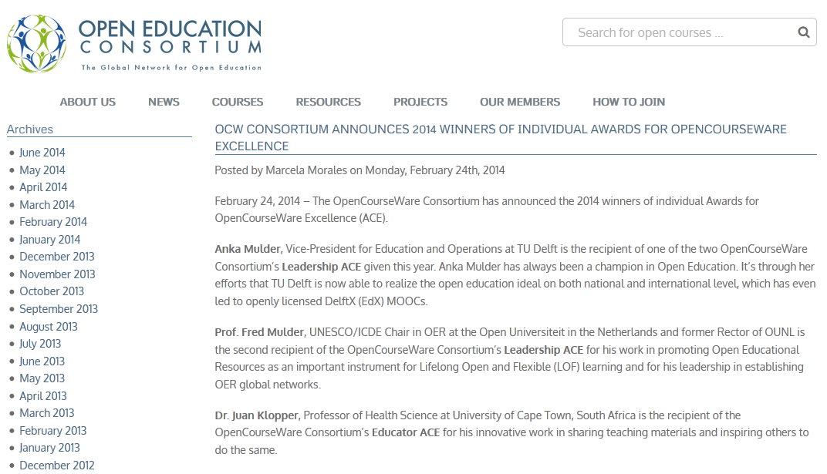

Slide 29
OER to Journal Article
http://blogs.uct.ac.za/blog/oer-uct/2010/12/06/sharing-knowledge-leads-to-opportunities
Matumo Ramafikeng’s OER published in the Journal of Occupational Therapy of Galicia, an open access journal for occupational therapists in the Spanish speaking world

Slide 30
Open education at UCT
Scholar
Scholar
Scholar
Scholar
Student
Community
2007
Opening Scholarship
2008
2009
2010
2011
2012
2013
2014
Main streamed
2015 +

Slide 31
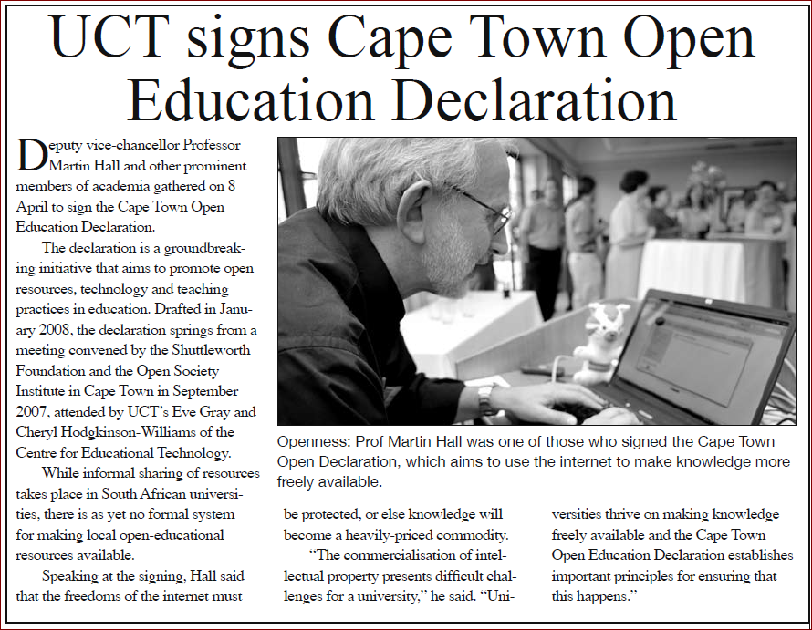
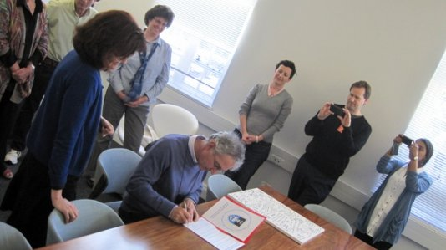
Symbolic support
At senior level
DVC signs Cape Town Declaration (2008)
VC signs Berlin Declaration (2011)

Slide 32
Policy Support (2014)
The widespread availability of open education resources, open content, open courses etc. from the global north is both an opportunity and a concern as there is an equally urgent need for local teaching and learning resources to be made freely available online.
The University encourages Employees and Students to make all forms of works of scholarship available … This includes (but is not limited to) essays, books, conference papers, reports (where permitted by a funder of the research leading to the report), educational resources, presentations, scholarly multi-media material, audio-visual works and digital representations of pictorial and graphical materials.
An Author must deposit an appropriate version of Scholarly Publications into an officially designated Institutional Repository or into an acceptable curatorial system which can be harvested by UCT
A Student shall either through self-archiving or assisted archiving upload the final corrected version of their thesis or dissertation into the officially designated Institutional Repository prior to graduating

Slide 33
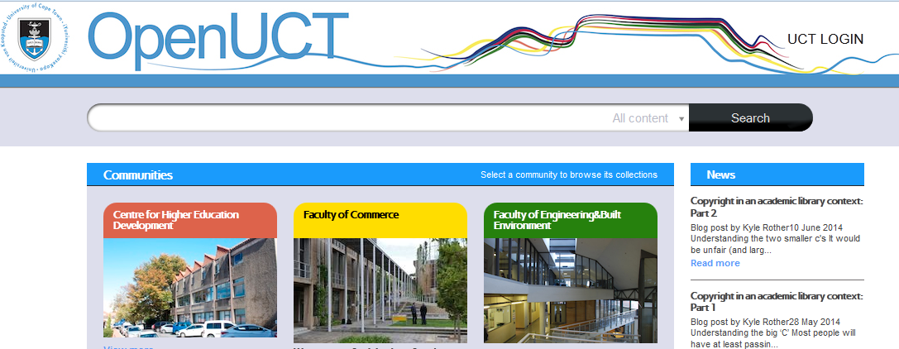
Integrated New Repository

Slide 34
Conclusion
A steady upswell and buy-in
Acceptance of non-linear organic process
Slow approach more likely to be sustainable & effective
Integration of resourcing requirements into existing structures
A research-based approach to inform strategy
Shift from soft funded projects to mainstream

Slide 35
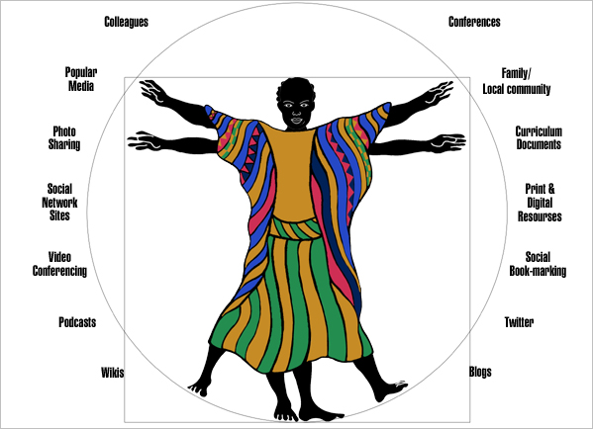
Thank you
Image: Stacey Stent

Slide 36
References
Czerniewicz, L and Brown, C (2009) study of the relationship between institutional policy, organisational culture and e-learning use in four South African universities in Computers & Education 53 (2009) 121–131
McNay, I (1995) From collegial academy to corporate enterprise: The changing cultures of universities. In T. Schuller (Ed.), The Changing University. Buckingham: Society for Research into Higher Education and Open University Press
Rossiter, D (2007) Whither e-learning? Conceptions of change and innovation in higher education. Journal of Organisational Transformation and Social Change. 4 (1), pp.93–107
Yee-Tak , W (2006) Student Expectations in the New Millennium: An Explorative Study of Higher Education in Hong Kong, Dissertation, unpublished dissertation

