Slide 1
Facilitate Open Science Training for European Research
Why Open Science?
Dr. Nancy Pontika
CORE
The Open University
nancy.pontika@open.ac.uk
@nancypontika

Slide 2
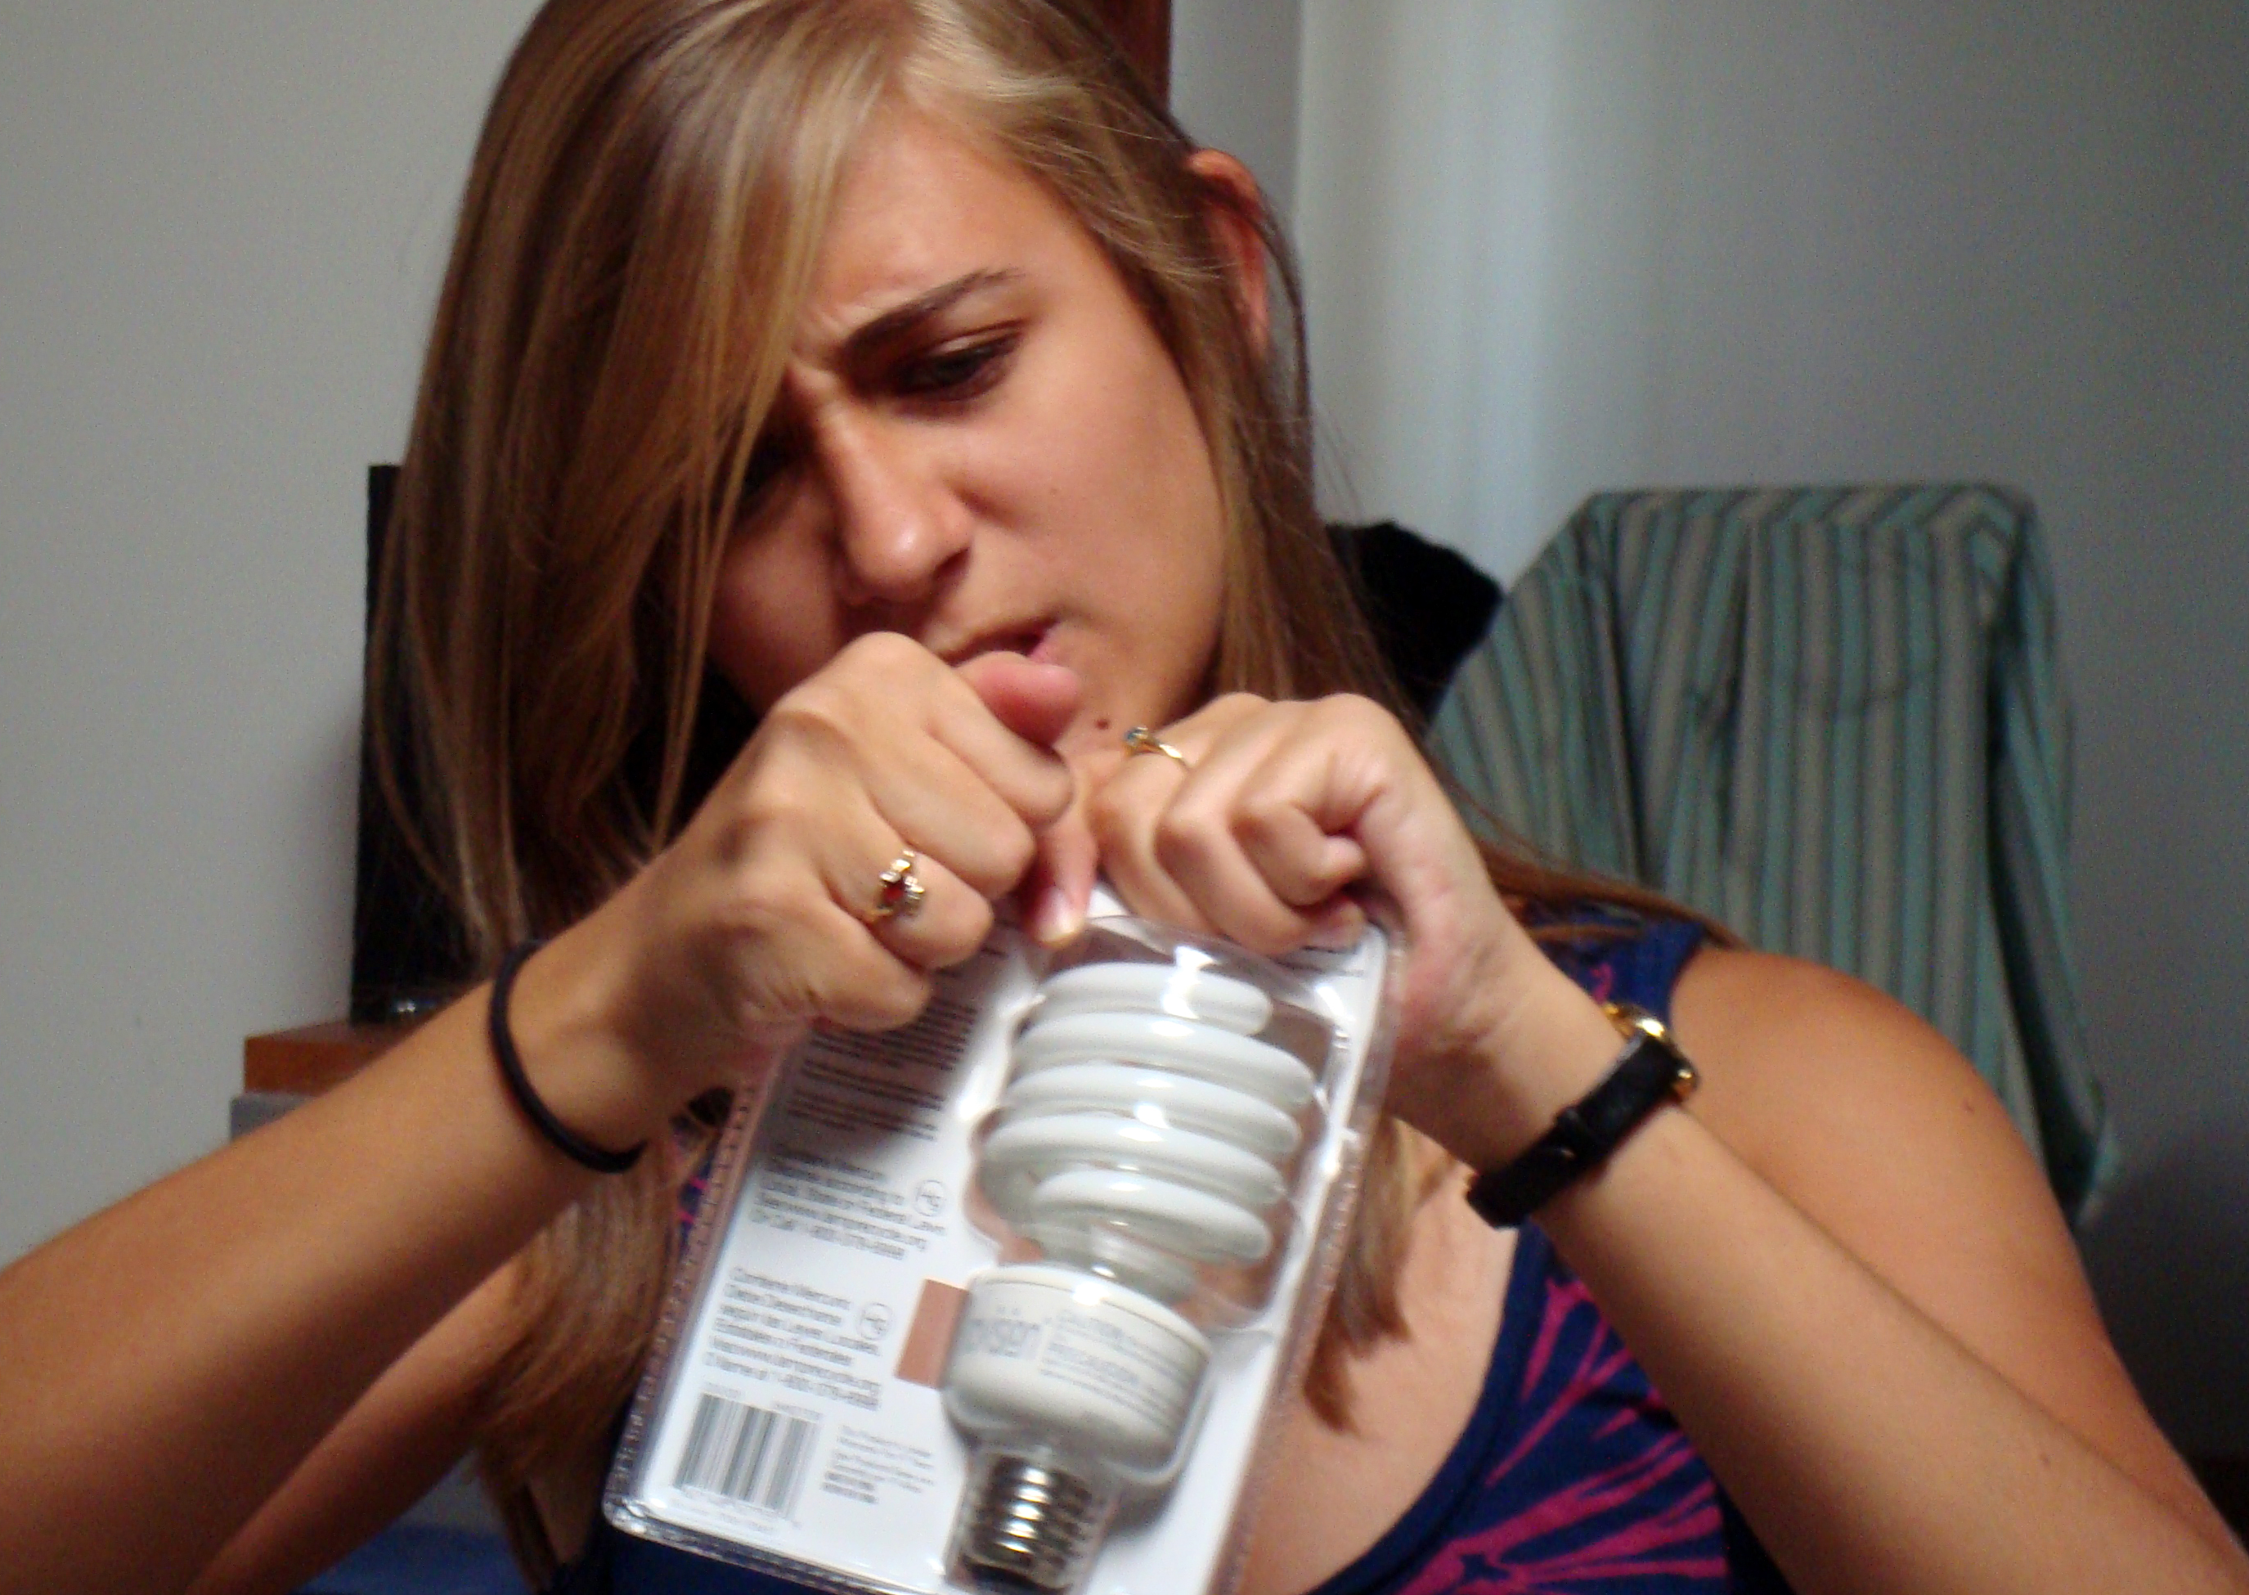
Open Science Implementation – is it a wrap rage?
Image from Wikipedia https://en.wikipedia.org/wiki/Wrap_rage

Slide 3
Why a course on “Open Science”
Open Science as a term is widely used but difficult to apply
  Many components in the OS definition
  Information regarding components not yet available
  Some components not fully understandable or developed yet
  Gaps in best practices, workflows, software, techniques
  Training the trainers necessary to achieve its widespread adoption
  Need to shift research practices and how to better proceed with this transition
  How to assist fields who have taken the first steps towards Open Science and support fields reluctant to experiment

Slide 4
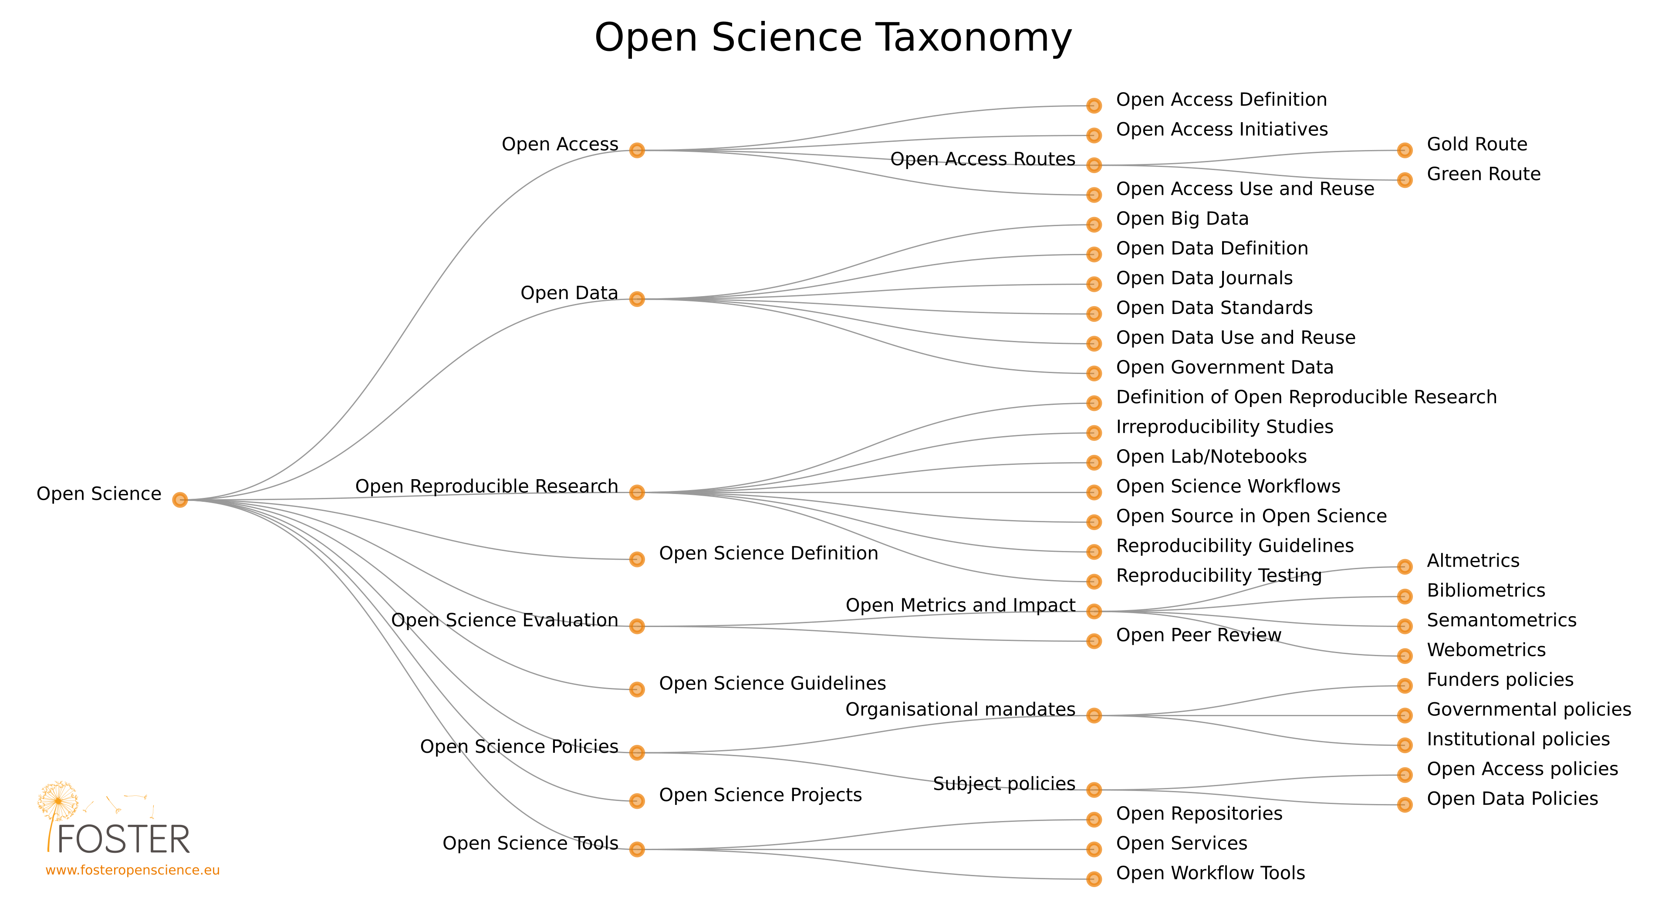
Open Science taxonomy

Slide 5
Purpose of the taxonomy
Features for navigation and browsing
Users subscribe and receive updates
Allows connections between content files
Provides a recommendation system in the platform
Maps the field with a visual layout of the OS components
Shows gaps in the field where attention is required
Ensures that the platform covers OS related topics
Assists with the helpdesk request

Slide 6
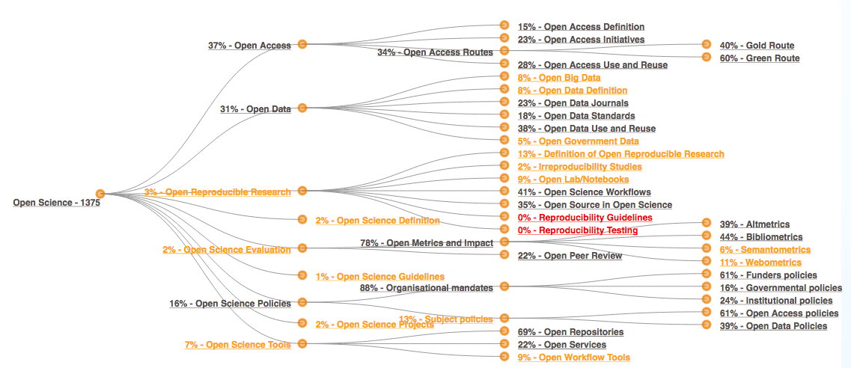
Open Science taxonomy with percentages

Slide 7
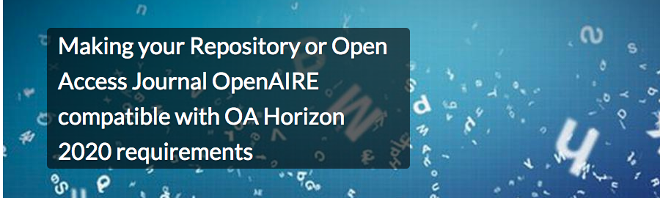
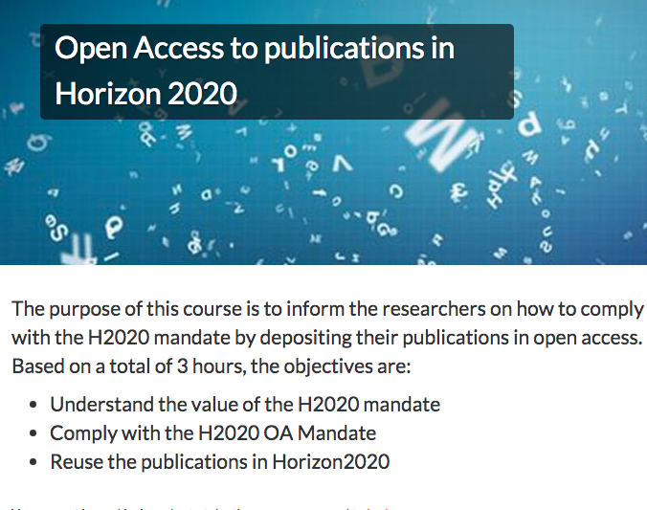
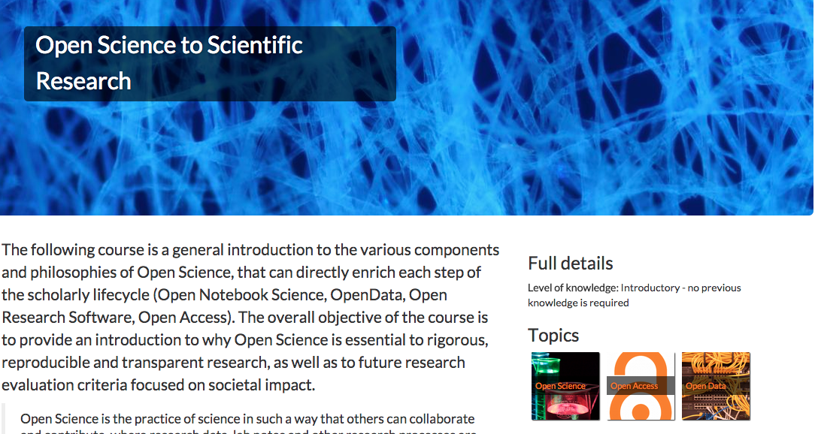
FOSTER portal: Courses

Slide 8
FOSTER portal courses: details
Available on the FOSTER platform https://www.fosteropenscience.eu/
Currently 16 courses available in 3 languages (English, Spanish, Polish)
So far the FOSTER courses were taken by 1700 learners

Slide 9
Why an eLearning platform?
Technology allows online knowledge sharing
Adoption of educational and learning methods
Open Educational Resources (OERs)
Massive Open Online Courses (MOOCs)
Combination of learning activities
Reaching globaly a wide number of learners
Currently Open Science is mainly taught face to face – now an elearning course using material with open licenses and attracting participants from all over the world is being implemented.

Slide 10
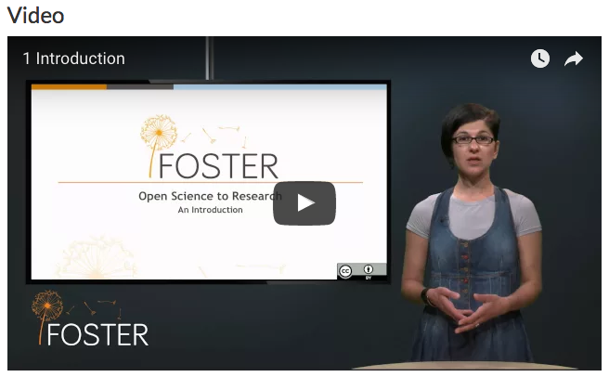
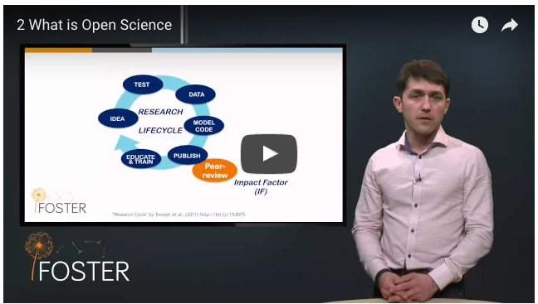
The course: Introduction to Open Science
  Learning outcomes
  Level of previous knowledge
  Targeted audience
  Online material with re-usable/open licenses
  Videos, readings, quizzes, certificate
  Self-paced for the time being
  Forum where learners can post questions
Direct link to the course https://www.fosteropenscience.eu/content/open-science-scientific-research

Slide 11
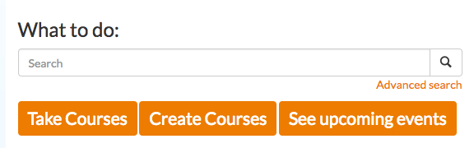
Propose and build you own course
Create an account at the FOSTER portal
  It is a free and easy procedure
Send us an email with a short course proposal
  elearning@fosteropenscience.eu
Team of experts will review your proposal
Interested to know what entails to build a course?
  Course on Courses https://www.fosteropenscience.eu/content/foster-course-course-creation
Translate an existing course in an other language

Slide 12
Thank you!
Website
  www.fosteropenscience.eu
Take Courses
  https://www.fosteropenscience.eu/courses
Create Courses
  https://www.fosteropenscience.eu/coursecreation
Contact email:
  elearning@fosteropenscience.eu
Twitter:
  @fosterscience

