Slide 1


E-course on Research Data Management at UT Library
Tiiu Tarkpea
Data Librarian
University of Tartu Library, Estonia
28.04.2017

Slide 2

Resource

Slide 3
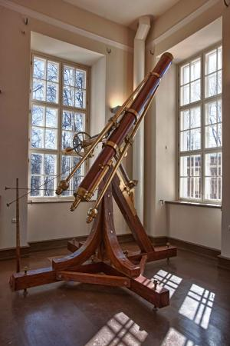
Outline
Course overview
E-course model
RDM module
RDM learning objectives
Assignements
Repositories, problems
Students’ feedback
Conclusions
Next steps
Resource

Slide 4
Course Overview
Introduction to information research
Online course in Moodle, Sisu@UT websites
8-module elective 3-ECTS course (9 weeks)
Since 2008, RDM since 2015
Integrated to all doctoral curricula
59 PhD students in 2015, 110 in 2016, ≈ 60 in 2017
28% Medicina, 29% Socialia, 26% Realia et Naturalia
17% Humaniora
RDM free tutorial

Slide 5
E-course model
Based on personal information needs
(PhD thesis topic)
Individual tutoring and feedback by subject and data librarians
Independent learning in suitable place and time
Open forums as contribution to learning community
Assignments
Reflection

Slide 6

RDM Module
Terminology (Research Data, Open Data…)
Research funding in Estonia
Principles&Recommendations of RC on OS
Legal and ethical issues
Research Data Management
Data repositories
DataCite and DOI

Slide 7
RDM Learning Objectives
Finishing the RDM module students should have realised the importance of raw scientific data and the necessity of data management, are able to find and use open data repositories, know what is the digital object identificator and how to get the DataCite DOIs for their own datasets.

Slide 8
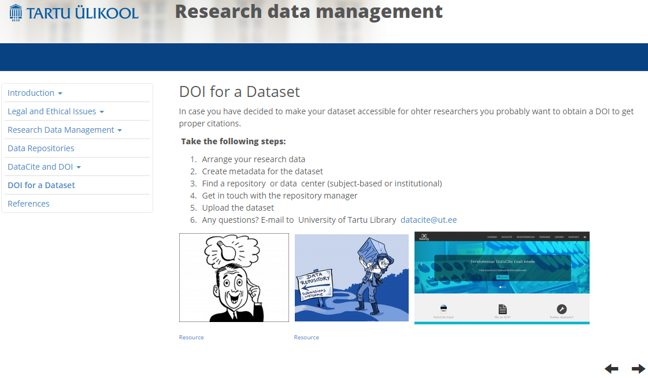

Slide 9
Assignments
Get familiar with registers of repositories and find a data repository and a dataset that is relevant for your research
Study the checklist of DMP. Answer the questions in context of your (forthcoming) research
Use DataCite Metadata Search and find out, how many DataCite DOIs has minted Tartu University as allocator so far (491 074 (26.04.2017))
2017: Use repository registries, DataCite or OpenAire portals and point out the repository from which you found a suitable dataset.
Did you find how to cite the data from the repository?
Comment on your searches and analyze their productivity.

Slide 10



Repositories, problems
„I have never heard about open research data repositories before!“
Search is much more complicated compared to search in article databases
Not enough metadata
Students don’t understand datasets
Reliability of data

Slide 11
Feedback
„Until reading the learning material, I had not thought about some of the most important aspects of data management for my research. I had thought only about the ways in which I would manipulate my data, enhance it and process it once it was gathered.
I had not thought about the ways in which it could be documented to allow it to be preserved, accessible and reusable by other researchers. For these reasons data management appears to be more important than I originally considered.“

Slide 12
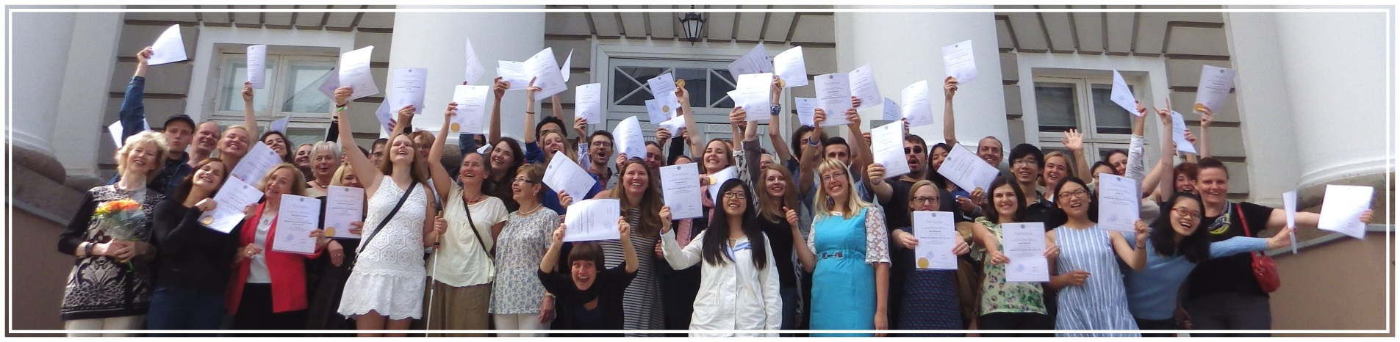
Feedback
Have you ever thought about the importance of data management?
„Absolutely, it is an essential consideration for my research project. This was drummed into me when I was doing my Master’s degree at the University of Manchester„
Resource

Slide 13

Starting to design a RDM course…
RDM glossary is needed
Start from the beneficials
Discipline-based teaching
Research topic defined
Case studies as examples
Step-by-step self-tests
Digital literacy!
Resource
Notes:
A digitally literate person will possess a range of digital skills, knowledge of the basic principles of computing devices, skills in using computer networks, an ability to engage in online communities and social networks while adhering to behavioral protocols, be able to find, capture and evaluate information, an understanding of the societal issues raised by digital technologies (such as big data), and possess critical thinking skills. (Wikipedia)

Slide 14
Next Steps
„Special course on RDM needed!“
Full RDM e-course for PhD students
Apply the course results to research workflow
Data Management Plan (DMPonline)
F2F courses (Doctoral Schools)
2h introductions to everyone interested

Slide 15
Outcomes
Tarkpea, T., Seiler, V. Integrating data literacy into Information literacy e-course for PhD students //European Conference on Information Literacy (4. : 2016 : Praha, Česko)
The Fourth European Conference on Information Literacy : (ECIL)
October 10th-13th, 2016, Prague, Czech Republic : abstracts / editors:
Sonja Špiranec, Serap Kurbanoğlu, Hana Landová, Esther Grassian, Diane
Mizrachi, Loriene Roy, Denis Kos. -- Prague : Association of Libraries of
Czech Universities, 2016. -- 240 pages.
ISBN 978-80-270-0530-7
http://ecil2016.ilconf.org/wp-content/uploads/2016/10/ECIL2016_BoA.pdf

Slide 16
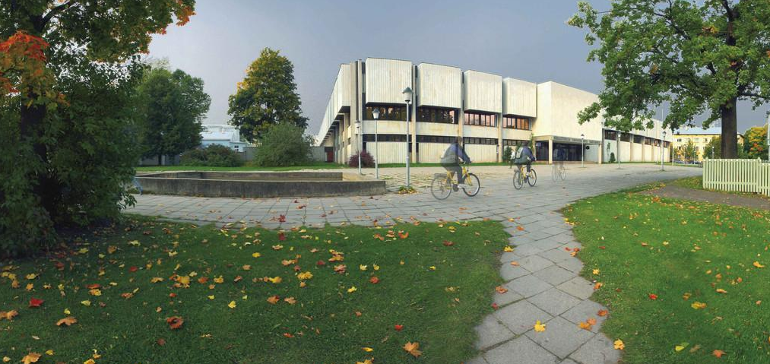
Resource
Thank you!
Tiiu Tarkpea
tiiu.tarkpea@ut.ee

