Slide 1
Webinar Q&A on DSpace
Nason Bimbe, Iryna Kuchma, Evan Njoroge and Felix Kibet Rop
Attribution 4.0 International

Slide 2
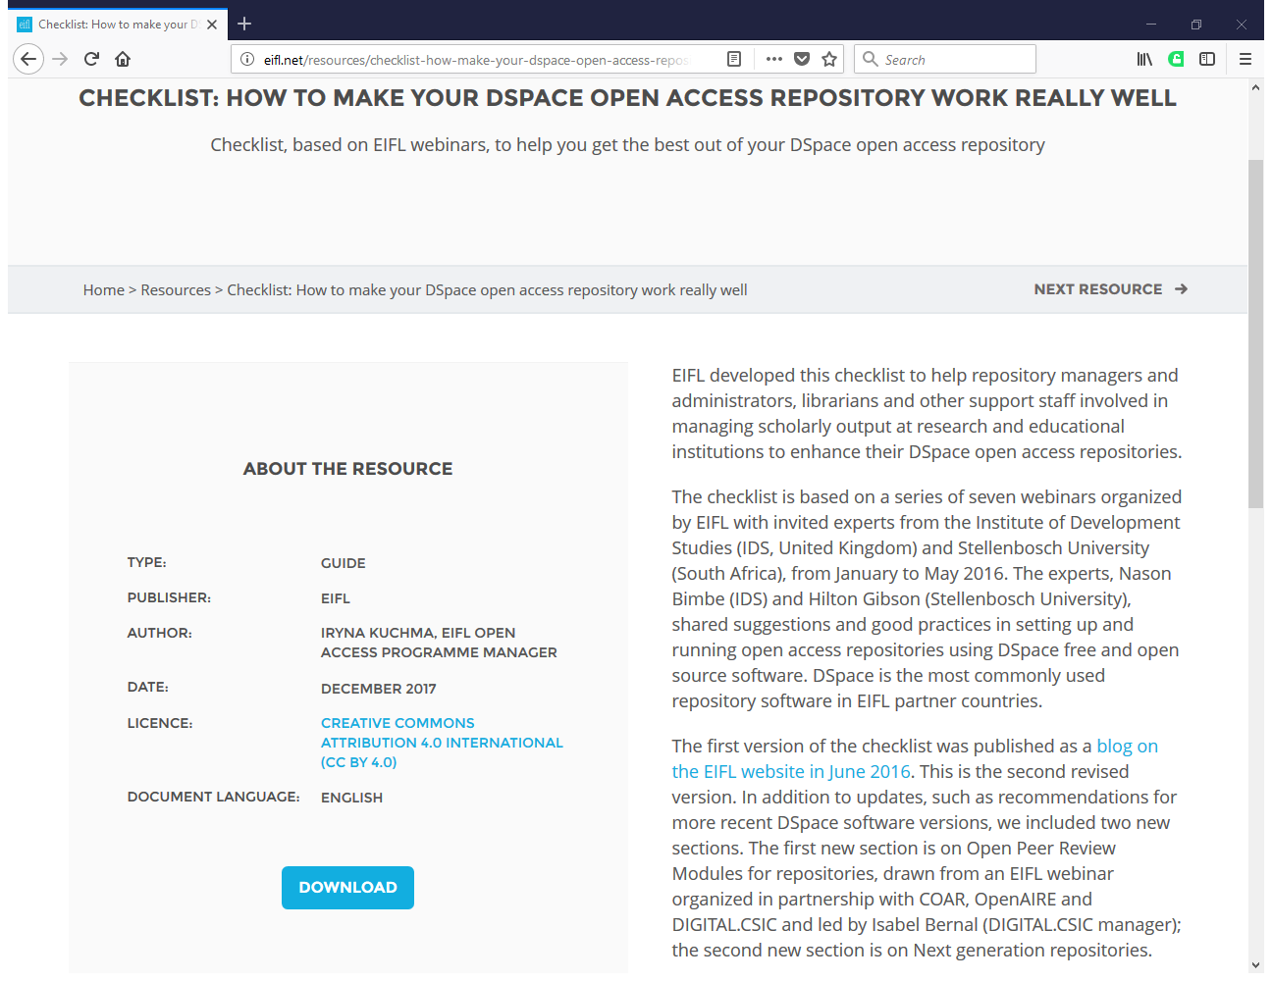
http://eifl.net/resources/checklist-how-make-your-dspace-open-access-repository-work-really-well

Slide 3
New to DSpace?
Take a look at our expert tips for setting up and managing a DSpace repository and
Resources on the following topics
DSpace installation | DSpace system administration
Post-installation tasks | Enabling a responsive user interface
How to upgrade DSpace | Customizing DSpace

Slide 4
Which version of the DSpace software do you use?
Always run your repository with the latest software versions (or no more than one version behind)
The current latest release is DSpace 6.2
If you want to upgrade your DSpace from 5.x to 6.x with XMLUI, Nason Bimbe has prepared useful notes, available at https://zenodo.org/record/1095493#.Wi-W6Ddx3cs

Slide 5
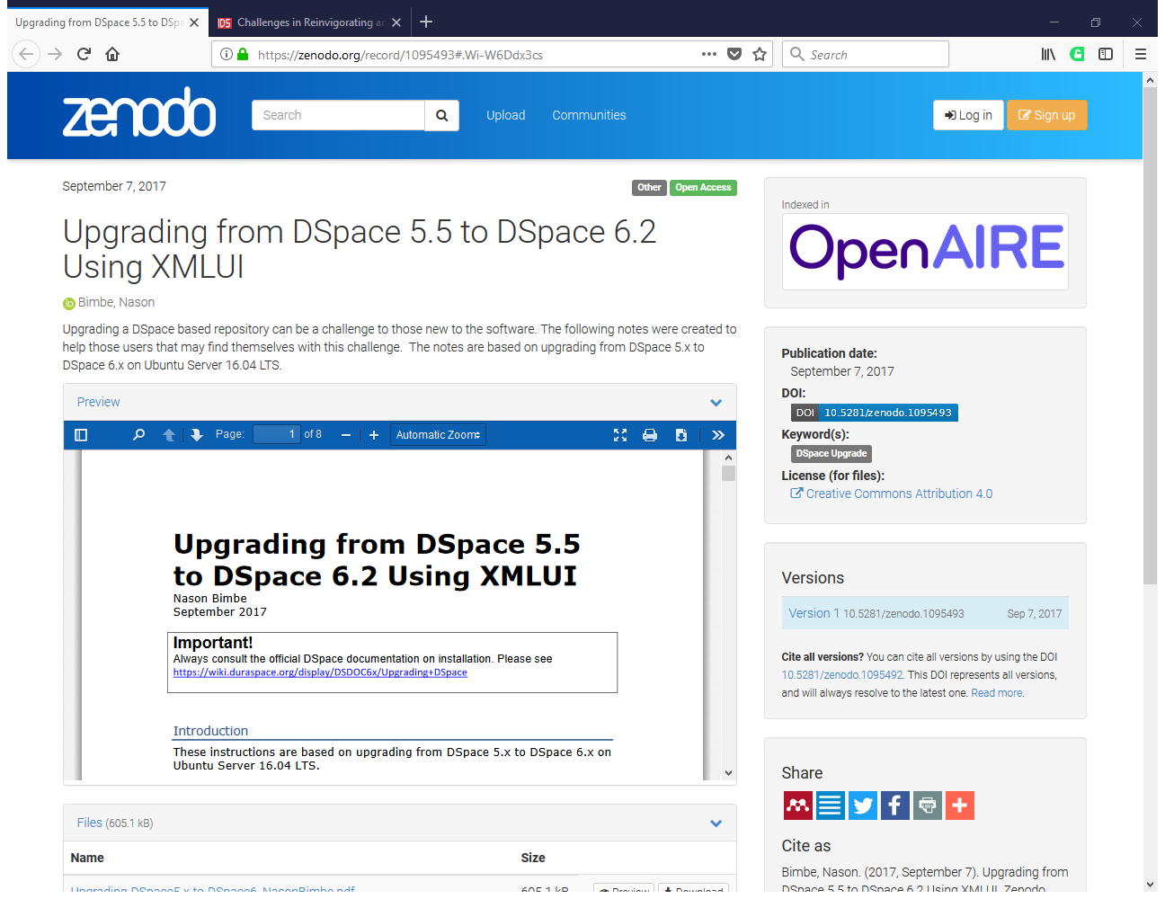

Slide 6
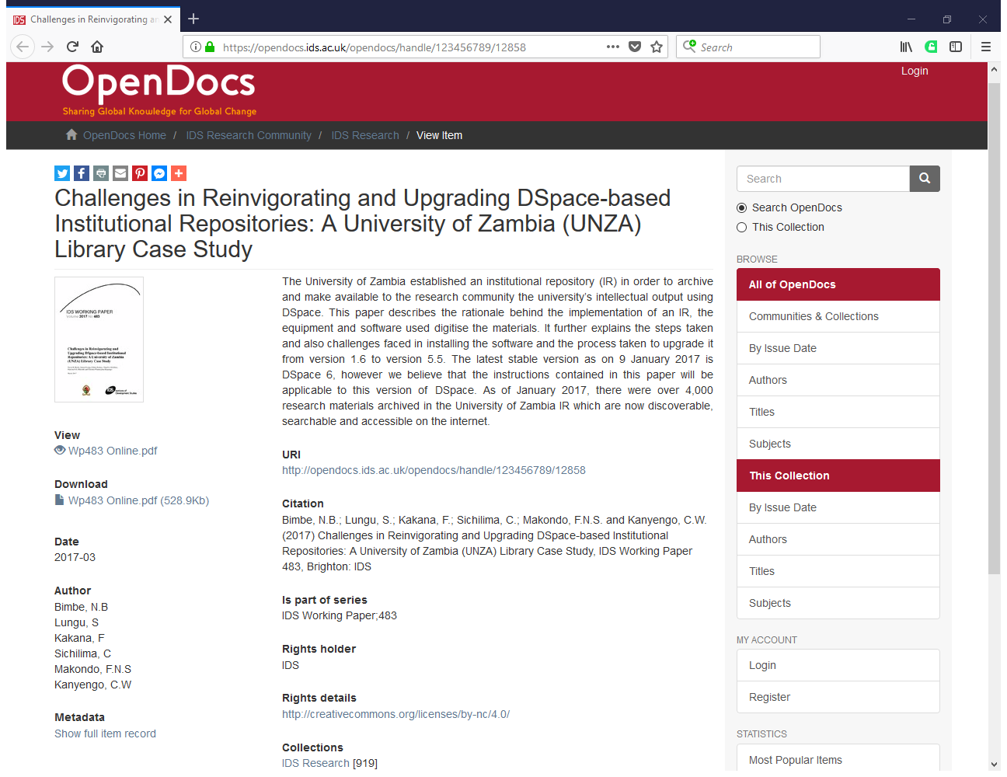
https://opendocs.ids.ac.uk/opendocs/handle/123456789/12858

Slide 7
Q&A
Have you enabled the handle service?
Do you have backup/restore procedures and policies for disaster recovery?
Have you enabled the OAI-PMH server?
How to improve discoverability through search engines
Do you track and analyze statistics and web traffic?
http://eifl.net/resources/checklist-how-make-your-dspace-open-access-repository-work-really-well

Slide 8
Q&A (2)
Does your repository offer a good user experience for smartphones and tablets?
Does your repository have an open access repository policy?
Do you allow your researchers to register to deposit in your repository with their ORCID?
New plugin: Open Peer Review Module for repositories
http://eifl.net/resources/checklist-how-make-your-dspace-open-access-repository-work-really-well

Slide 9
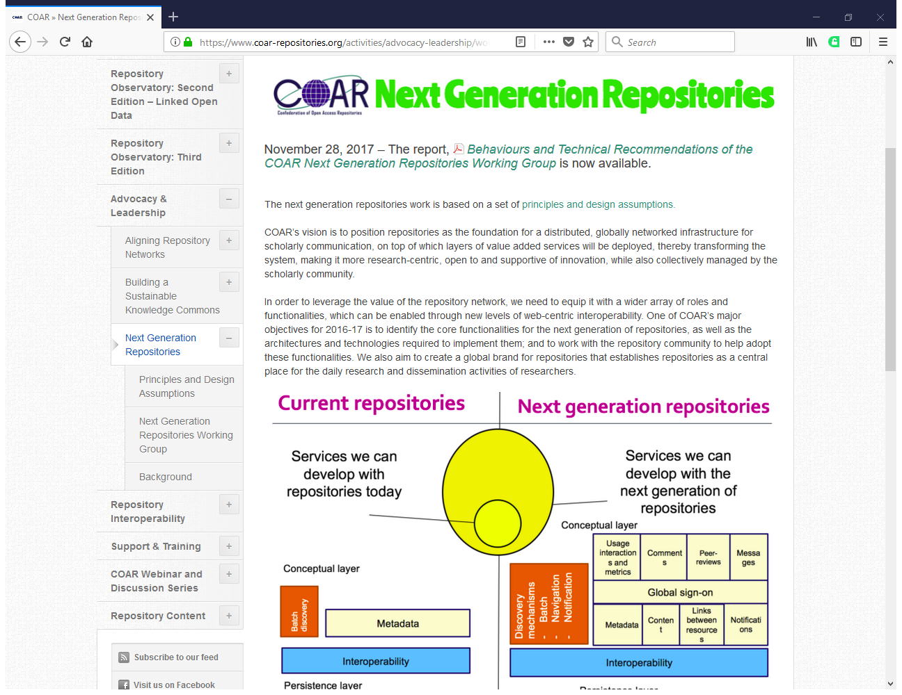
https://www.coar-repositories.org/activities/advocacy-leadership/working-group-next-generation-repositories

Slide 10
Today’s questions
Some Dspace 6.x features fail to run on Tomcat 8.
I also want to find out how I can customize DSpace application starting from novice to advanced customization.
(Gilbert Kunonga)

Slide 11
Today’s questions (2)
Can you start a closed repository and later on make it open access? What are the settings that need to change? Could you give an example or demo of this during the webinar? In general, can you change DSace settings at any point of development?
(Jolanta Kaun)

Slide 12
Thank you! Contacts: Nason Bimbe: nasonbimbe@gmail.com Evan Njoroge: evannjoroge@gmail.com Felix Kibet Rop feropx@gmail.com Iryna Kuchma: iryna.kuchma@eifl.net
www.eifl.net

