Slide 1
An Introduction to Mentoring
Prepared for CARLIGH
By
Buhle Mbambo-Thata,
University Librarian,
National University of Lesotho, Lesotho

Slide 2
acknowldgements
Adapted from “Organisational Life Foundations”

Slide 3
Outline of presentation
What Is Mentoring?
What is a Mentor?
What is A Mentee?
Mentoring & Coaching
Characteristics of a mentor
Mentee and Mentor Roles and Responsibilities
Giving and Receiving Feedback
Dos and Don’ts in a mentoring relationship

Slide 4
What Is Mentoring?

Slide 5
What is A Mentoring ?
A powerful personal development and empowerment tool.
An effective way of helping people to progress in their careers
A partnership between two people normally working in a similar field or sharing similar experiences.

Slide 6
What is Mentoring ?
“ Is to support and encourage people to manage their own learning in order that they may maximise their potential, develop their skills, improve their performance and become the person they want to be”
Eric Parsloe The Oxford School of Mentoring.

Slide 7
What is A Mentoring ?
Helpful relationship based on mutual trust and respect.
“Mentoring inherently involves personal change and growth”
(Center for Women and Information technology i.e. CWIT 2004:5).

Slide 8
What is A Mentoring ?
“A developmental, caring, sharing and helping relationship when one person invests time, know-how and effort in enhancing another’s personal growth, knowledge and skills and responds to critical needs in the life of that person in ways that prepares the individual for greater productivity or achievement in the future” (CWIT 2004: 6).

Slide 9
What is A Mentoring ?
“A process where mentor and mentee work together to discover and develop the mentee’s abilities.”
( University of California San Francisco i.e. UCSF faculty mentoring facilitator toolkit 2007: 2).

Slide 10
What is A Mentoring ?
Process whereby an experienced, highly regarded, empathic person (the mentor) guides another individual (the mentee) in the development and examination of their own ideas, learning and personal and professional development. :

Slide 11
what is a mentor?

Slide 12
What is A Mentor ?
Someone “who has been there-done that” before.
An individual with expertise who can help develop the career of the mentee.
Someone who guides, trains, advises and promotes career development of the mentee.

Slide 13
What is A Mentor ?
A guide who can help the mentee to find the right direction and who can help them to develop solutions to career issues.
Mentors rely on having had similar experiences to gain empathy with the mentee and understanding issues.

Slide 14
What is A Mentor ?
“A mentor is a person looked upon for wise advice and guidance”
”(CWIT 2004: 6).

Slide 15
What Is A Mentee?

Slide 16
What is A Mentee ?
“A mentee or a protégé is a person guided and helped especially in the furtherance of his or her career by another, more influential person”
”(CWIT 2004: 6).

Slide 17
Mentoring &
Coaching
Difference

Slide 18
Mentoring & Coaching Difference
Mentoring | Coaching
Focuses on capability and potential | Focuses on skills and performance.
Concerned with implications beyond the task | Concerned with the task
Works Best “Offline” | Primarily a line manager role
Agenda is set by the learner | Agenda is set by the coach

Slide 19
Mentoring & Coaching Difference
Mentoring | Coaching
Emphasises feedback and reflection by the learner | Emphasises feedback to the learner
Typically a longer relationship often for life | Typically addresses a short term need
Feedback and discussions primarily about the implicit, intuitive issues and behaviours | Feedback and discussion primarily explicit.

Slide 20

G

Slide 21
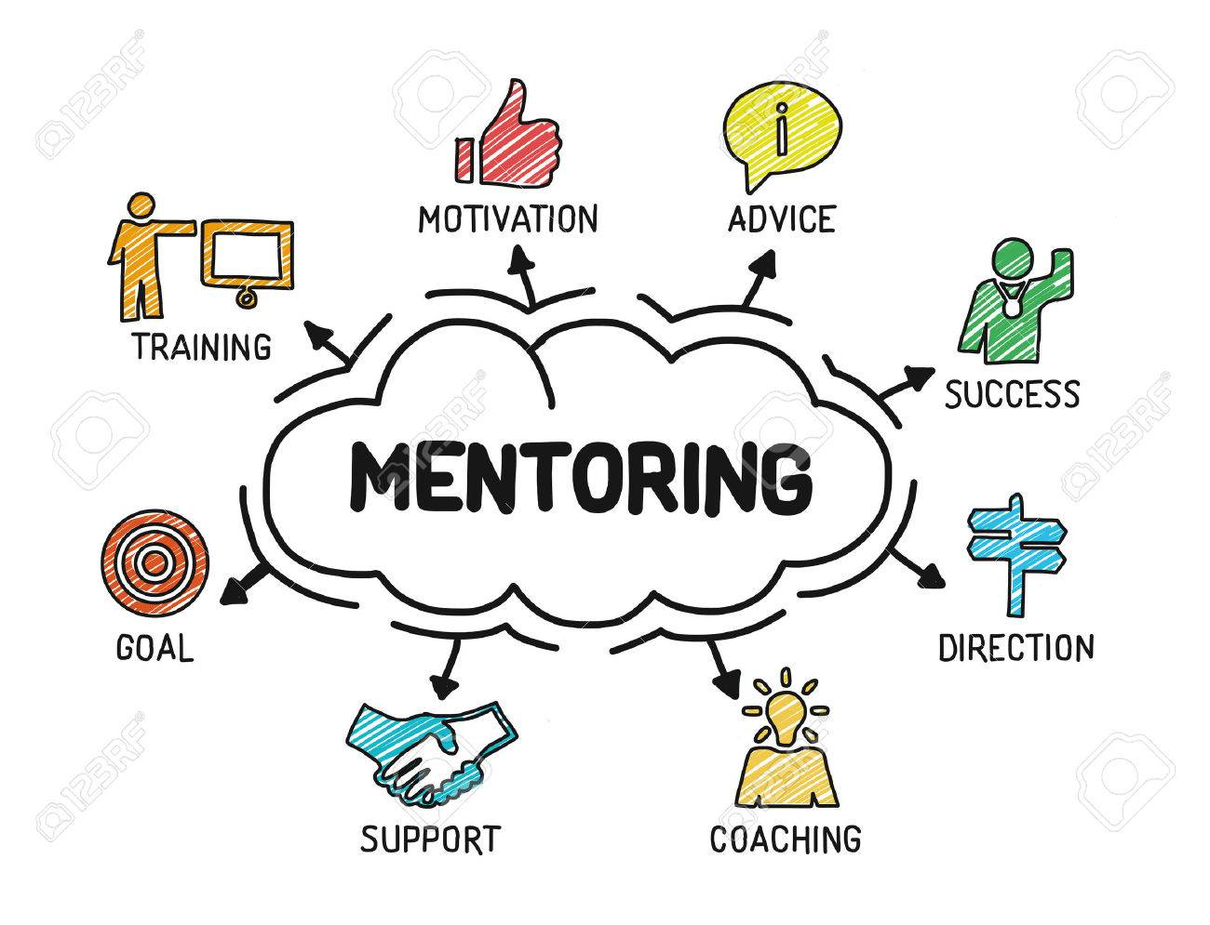
G

Slide 22
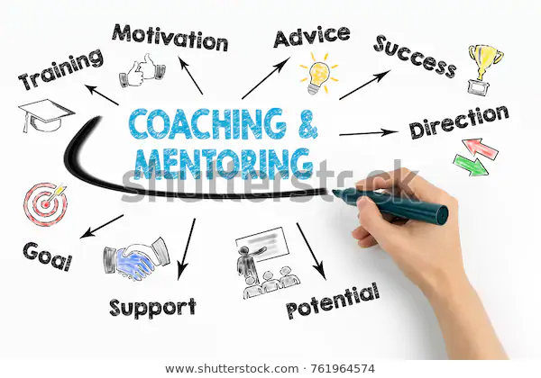
G

Slide 23
Characteristics of a mentor

Slide 24
Characteristics of a Mentor
Inspiring others by doing what they enjoy most.
Role Modeling
Trainer
Companion
Support
Resource

Slide 25
Companion
Enjoys sharing interests and experiences
Spends time talking with and listening to the mentee

Slide 26
Support
Boosts self-esteem
Gives support
Listens to ideas and concerns
Expresses belief in the mentee abilities

Slide 27
Resource
Provides opportunities to try new things
Encourages mentee to approach other people as resources
Suggests new sources of information.

Slide 28
Mentee and Mentor Roles and Responsibilities

Slide 29
Mentee and Mentor Roles and Responsibilities
As a protégé / mentee, one needs to understand that they have entered into a partnership with a mentor in a desired field.
One needs to keep in mind that this relationship needs nurturing from both the mentee and the mentor.

Slide 30
Mentee and Mentor Roles and Responsibilities
The mentee should not expect the mentor to “take care of him or her” or intercede on the mentee’s behalf when challenges occur.
The mentor is the person who will help the mentee learn to handle the mentee’s own challenges.

Slide 31
Mentee and Mentor Roles and Responsibilities
The mentor is not necessarily a personal friend but rather a guide to help the mentee successfully achieve their mentoring goals / aims.
The mentee has to;
Committed
participatory
I

Slide 32
Giving and Receiving Feedback

Slide 33
Giving and Receiving Feedback
Mentees want to receive honest, candid feedback from their mentor.
Equally important is the feedback mentees can offer to mentors.
Engaging in reciprocal and on-going feedback is a vital component of the partnership.
Timely feedback

Slide 34
Effective Feedback From the Mentee
Whether the advice or guidance you offered was beneficial and solved an
issue.
Whether the mentor communication style and/or actions facilitate a positive mentoring experience.
Whether the mentor communication style and/or actions create challenges to a positive mentoring experience.

Slide 35
Effective Feedback To Mentee
Focuses on
Mentee strengths and assets.
Areas for growth, development and enhancement.
Harmful behaviors or attitudes.
Observations on how the mentee may be perceived by others.

Slide 36
Dos and Don’ts in a mentoring relationship

Slide 37
Don’ts of a Mentee
1. Be passive—do not wait for
the mentor to initiate interactions.
2. Be late, disorganized.
3. Stay in the comfort zone.
4. Stay in a mentoring relationship
when it is no longer helpful.

Slide 38
Dos of a Mentee
Take initiative.
Look for opportunities to
learn from your mentor.
3. Be respectful of mentor’s time.
Communicate agenda and goals with
mentor prior to meeting.
Practice self-reflection.
Clarify own values.

Slide 39
Thank you for your attention!
B.mbambo-thata@nul.ls

