Slide 1

Introduction to Bibliometrics:
Supplement: Training exercises and examples
Niamh Brennan,
Programme Manager, Research Informatics
Trinity College Dublin, Ireland
23rd June 2021
nbrennan@tcd.ie

Slide 2
Providing Training in Bibliometics

Slide 3
Working with Information providers
Clarivate Analytics, Elsevier/Scopus, Dimensions etc. provide valuable training, online and face-to-face.
Check out the webinars provided by these and by Altmetric.com
The same rules apply: make sure the institutional context is clear (otherwise your researchers will get mixed messages).
If you organize this training, you will be viewed as the contact and provider of additional information.

Slide 4
Who is your audience?
Librarians (Faculty Liaison Librarians, Other Colleagues)
Students (Postgraduate, undergraduates in final year/who may be publishing)
Early Career Researchers
Established Researchers
External groups/individuals
What are their disciplines?
Multiple disciplines / Interdisciplinary
Arts and humanities
Social Sciences
STEM (Science, Technology, Engineering, Mathematics)
Health Sciences

Slide 5
Make it as relevant and interactive as possible…
Survey the participants beforehand
Check their access to the tools & resources referenced in the training
Give them a ‘prepare’ task (a reflective question, a case study, a tool to access);
Give them practical exercises to do in class and/or to take away
Study the audience’s disciplinary publishing behaviour.
Use relevant examples (fields, publishers etc.)

Slide 6
Your Research Impact Health Check
Example of a Training Resource from Trinity College Dublin
  Create at least one research profile (and keep it up-to-date)
  Get an ORCID id
  Publish – and then make your work (posters, papers etc.) available on Open Access through TARA
  Use Research Professional for funding alerts
  Promote your work via all means
  Find out how research in your field is evaluated
  Know how to use Web of Science, Scopus etc.
  Set up alerts for citations to your work in WoS, Scopus, Google Scholar
  Help organise conferences
  Attend publisher workshops
  Study best practice & developments in the communication of research impact

Slide 7
Track and Maximise your Citations and other Bibliometrics
Publish with the most unique form of your name you can e.g. Mary X. Kelly instead of Mary Kelly.
Add your ORCID number to your profile in Scopus and other tools.
If you have publications listed in these tools, check that there is one, correct form of your author name. If there are errors or more than one name variant for you, use the ‘Contact’ customer services facility to request corrections or name merges.
Check that all of your publications are listed. Note: these tools only index certain journals and very few books/book chapters. Check the master list of journals for the particular tool (available online). If your journal is indexed and your article is not listed, contact customer services for a correction.
Make sure your affiliation is correct. If it is not, contact customer services for a correction.
Set up citation alerts for your own publications. Note who is citing you and from what journal.
Keep an eye on the citation networks in your subject area and monitor where the activity is happening and what journals these citing authors are publishing in. This may be where your audience is. Use this information to inform your publication strategy.
Make sure that your publications are open access. Monitor the relationship between the open access hits and downloads of your work, news and social media mentions, and citations.
Compare your metrics using different tools and understand which resource works best for you (and why).
Ask your Library for help getting started with this.

Slide 8
Examples of Exercises

Slide 9
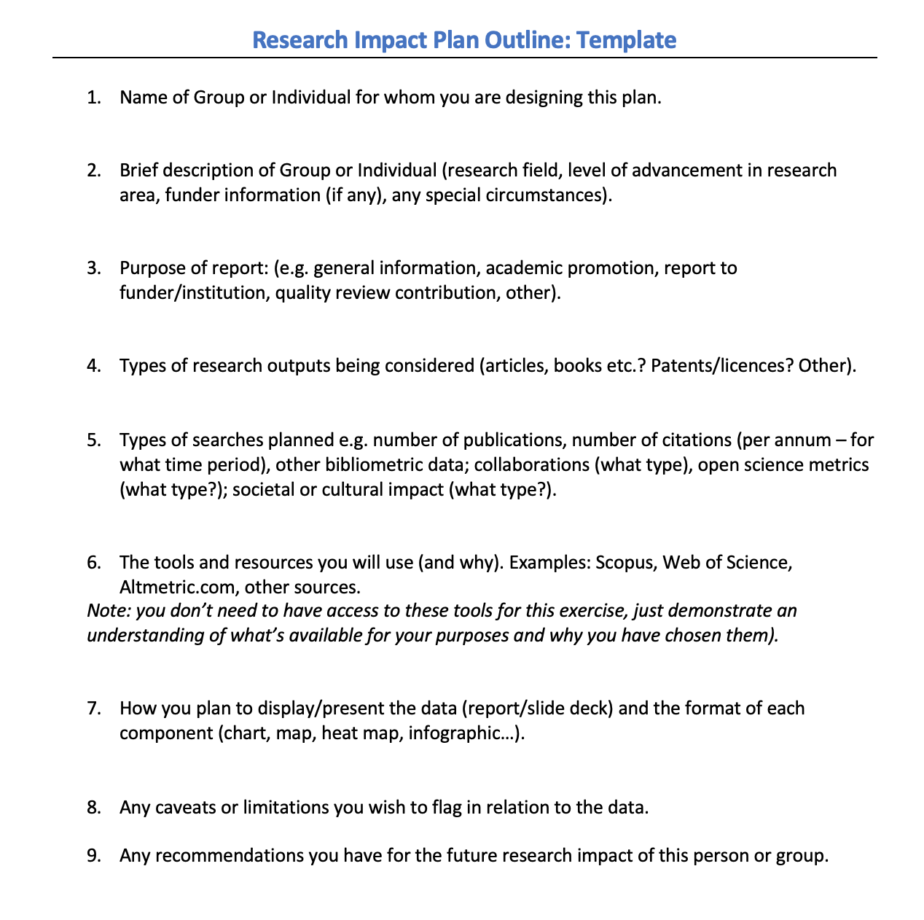

Slide 10

Think of the name of a researcher from your institution for whom you’d like to produce a research report.

Slide 11
Google Scholar Citation Profile – Exercise 1/1.
1. Login to your Google account (or create an account).
2. Go to scholar.google.com, make sure you are logged in and click "My Citations"
3. Follow instructions to create your profile and add or remove publications that are yours or not yours
4. You can track new papers and citations (of yourself and/or others)
5. You can correct your profile, add & remove publications and download the details to BIBTeX and to various reference management software formats.

Slide 12
Working with Google Scholar Citation Profiles 1/2
To get an overview of the Google Scholar profiles from your institution, add your institutional email (e.g. tcd.ie) to the end of this search query:https://scholar.google.com/citations?hl=en&view_op=search_authors&mauthors=
Try this for your institution. Does your chosen researcher have a Google Scholar Citation profile? If so, click on his/her profile – and keep the tab open.
To edit your profile, add co-authors, add/remove publications, enable/disable auto-updating, download to BIBTeX (for upload to ORCID and other services): see excellent article at: http://blog.impactstory.org/impact-challenge-day-3-google-scholar/

Slide 13
Microsoft Academic – Exercise 3.
Microsoft Academic is a NEW service - built from the ground up in partnership with the Bing team to be ‘more scalable, responsive, and compatible with modern web browsers’.
USE it to find publications, citations and collaborations information for individual researchers and institutions.
Go to academic.research.microsoft.com [click Start Now in the query box]
Search foryour chosen researcher in the search box on top; note his/her overall no. of papers & citations.
Use the facets on the left side bar to filter results:
  By year [get no. of papers per year]
  By collaborating institution [get no. of papers per institution - & derive no. of papers per country from it]
  * Do the same for your institution!*

Slide 14
Microsoft Academic
Issues
Can’t download data
Need to drill to next level to see numbers (of collaborative papers etc.)
Can’t edit
Can’t link to ORCID
Missing publications
Pros:
Can optimise pubications in Bing
Can access collaborations on an institutional basis
Can use APIs for data (or use a scraper like Grespr).
Under development – should improve

Slide 15
ResearcherID – Exercise 4
ResearcherID is the profile tool from Thomson Reuters. You can choose what to show publicly. Researcher ID is also important as a basis to provide feedback to Web of Science for grouping author name variants or corrections to affiliations.
1. Go to Researcher ID, sign up and complete your profile.
2. Add some publications if you have a few listed in Web of Science and preview the public version of your profile.
2. If you already have made an ORCID ID you can link Researcher ID to it.
3. Search for your institution in ResearcherID. Does your chosen researcher have a ResearcherID profile? If so, select his/her ‘Collaborations’ and click on ‘Map’.

Slide 16
Publish or Perish – Exercise 5
Publish or Perish is a free citations analysis tool based on Google Scholar data (and alternatively, on Microsoft Academic data). Publish or Perish (PoP) is downloaded to your desktop (Windows or Windows emulator on a Mac). You still need a working Internet connection. Google Scholar limits it to less than 1,000 records.
Open Publish or Perish (from your list of programs).
Select ‘Google Scholar’ and 2011-2015.
Enter your researcher’s name (as precisely as possible). Press return.
Deselect any unwanted results.
Note the citation analytics data provided.
Under ‘Edit’, output the results.

Slide 17
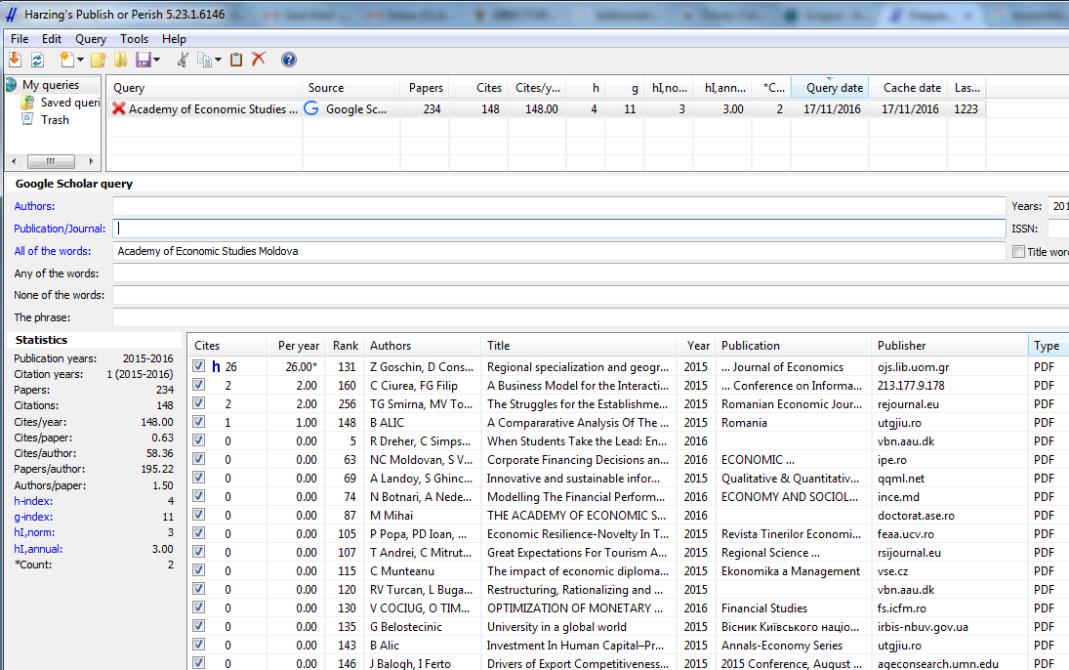
Google Scholar data does not work well for Institutional analysis but can be tried (use the option to search ALL words)

Slide 18
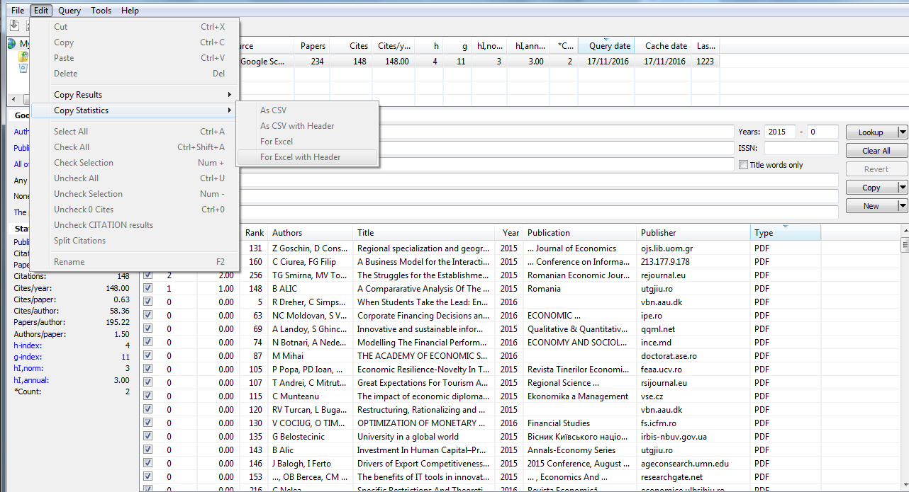
Output from Publish or Perish via the Edit menu.

Slide 19
Collecting data about your Researcher - Exercise 6/1.
Using the researcher’s name from your institution, find and save the following information to a folder on your desktop:
His/her overall number of papers, citations, impact per paper and (if possible) h-index. Time period: 2011-2015. [format: list –Word]
His/her no. of papers per year from 2011-2015 [format: Excel or csv]
His/her no. of citations per year from 2011-2015 [Excel or csv]
His/her disciplinary breakdown (no. of papers per field) 2011-2015. [format: Excel or csv]
His/her list of papers (2011-15) with DOIs (and keywords if possible) [format: Excel or csv]

Slide 20
Hint: If you do not have access to Web of Science, InCites or Scopus, use Google Citation Profile and/or Publish or Perish. You could also try: Microsoft Academic Search or ResearcherID. (both of the latter will require manual extraction of data].

Slide 21
Collecting data about your Researcher – Exercise 6/2.
Using the same researcher’s name from your institution, find and save the following information to a folder on your desktop:
A list of his/her collaborating institutions 2011-2015 [format Excel or csv]
A list of his/her collaborating countries 2011-2015 [format: Excel or csv]
Hint: If you do not have access to Web of Science, InCites or Scopus, use Microsoft Academic Search or ResearcherID. (both of the latter will require manual extraction of data].

Slide 22
Preparing your data – Exercise 7/1.
Using Word, create a simple table showing the overall number of papers, citations, impact and h-index for your researcher. Add any other numeric headline information you may be aware of from other sources.
Using Excel, create bar charts for the annual number of (a) papers and (b) citations of your researcher.
Using the saved list of your researcher’s collaborating institutions, create a table of the top 20 (or less) by number of papers.
Using the saved list of your researcher’s collaborating countries, create a table of the top 20 (or less) by number of papers.

Slide 23
Preparing your data – Exercise 7/2.
Using the saved full list of collaborating countries, clean up any errors in the country names. Make sure the word ‘Country’ appears in the appropriate column header. Save the spreadsheet to the folder on your desktop.
Open ‘OpenHeatMap’* [CHROME BOOKMARKS]
Find and upload your spreadsheet with the country collaborations to OpenHeatMap.
Select from the presentation options – and publish!
Take a screenshot of your map. Paste it into Powerpoint, right-click to ‘save as picture.’
Alternatively, upload the countries information to Tableau Public or just copy and paste the map from Researcher ID.

Slide 24
Options for presenting your Report – Exercise 8
The timeframe, audience and purpose of your report will be relevant. Consider using one or more of the following:
Slide deck
  You will need to copy and paste the data you have prepared into Powerpoint or an open source equivalent.
Word document
– You will need to copy and paste the date you have prepared into MS Word or an open source equivalent.
Infographic – either in pdf/jpg OR online & interactive
– You may use Canva.com or PiktoChart.com [both in CHROME BOOKMARKS] or equivalent. To make the results available you may Download the report and/or share it online.

Slide 25
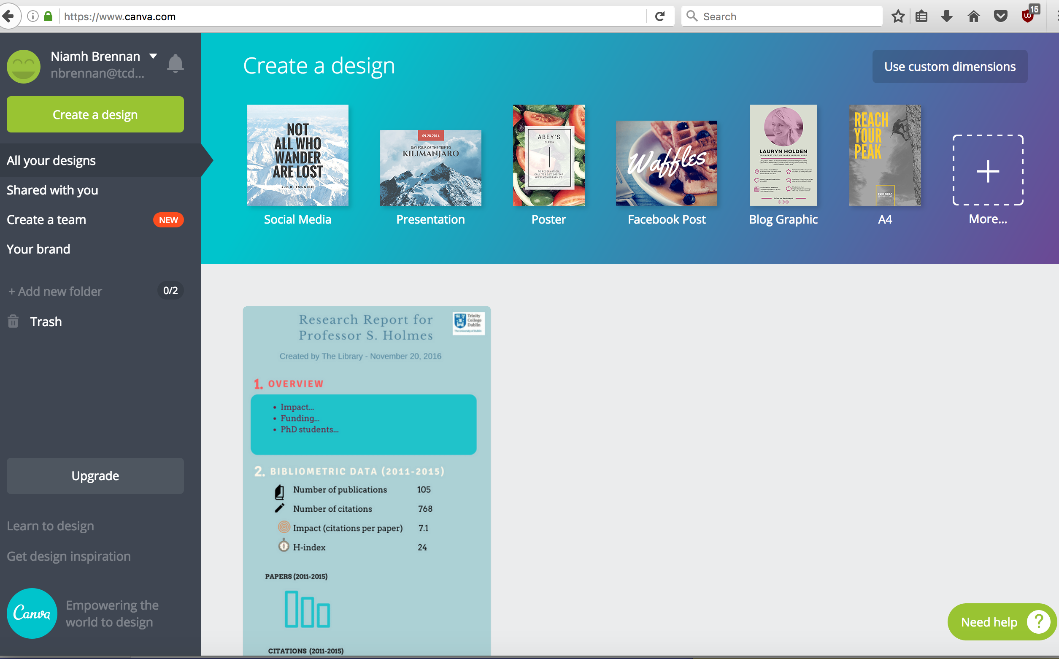
Data presentation using Canva.com

Slide 26
Presenting your report – Exercise 9.
You’ve got all the data you need for now – it’s time to present it!
Put it in a slideshow – open a blank powerpoint presentation and add the data you’ve collected to the slides.
Present your data in an infographic – Register with Canva.com or Piktochart and create your presentation online. When you are finished, make it public! (You can always change it/delete it later).
[introduction to Canva.com]

Slide 27
Review your report – Exercise 10.
Add 3-4 headline statements – awards and honours (if you can find this information),other items of note (patents etc?).
Add additional information if possible and appropriate (Altmetric, benchmarked, societlal impact, professional leadership). See next section!
Don’t forget to add your data sources and note the methodology and any caveats that should be taken into account in relation to the metrics used.

Slide 28
Getting more data – Exercise 11.
Go to Altmetric Explorer & login (details will be provided).
Follow the instructions provided to set up a new ‘Group’. Give it the name of your choice.
Under ‘Edit’, you must paste a list of DOIs of your researcher’s papers. You saved the spreadsheet in Exercise 1. Now copy the DOIs from the spreadsheet and paste into the Edit box on Altmetric Explorer. Click on the number that appears.
Analyse the Overall data for use in headline statements. Copy the Twitter map if appropriate. Note mentions in news items and policy documents in particular.
Add to your report!

Slide 29
Other data sources
Patent databases
Institutional repository statistics (and Google Analytics) – number of OA papers, hits, downloads… from industry, gov, schools, universities (latter from Google Analytics).
Impact case studies (see UK REF Impact Database for inspiration!).
Institutional information – local databases, reports, research information system?

Slide 30
Evaluating individuals, groups and Institutions
All of the metrics used may be applied at the group and institutional levels – but it is not easy to aggregate the data using free tools.
Benchmarked information is extremely desirable but is not currently freely available.
Solutions:
Use institutional data from U-Multirank (some information is also available from other university ranking systems).
Get periodic access to Web of Science/InCites or Scopus/SciVal - & download the essential data.
Establish benchmarking/data-sharing partnerships with similar institutions and exchange validated local information.
Pressurise the existing service providers to improve their services (facilitating downloads, linking to ORCID, improving coverage, etc.) and to make more of this information available to organisations who currently do not have access to it.

