Slide 1

Introduction to Bibliometrics
Niamh Brennan,
Programme Manager, Research Informatics
Trinity College Dublin, Ireland
23rd June 2021
nbrennan@tcd.ie

Slide 2
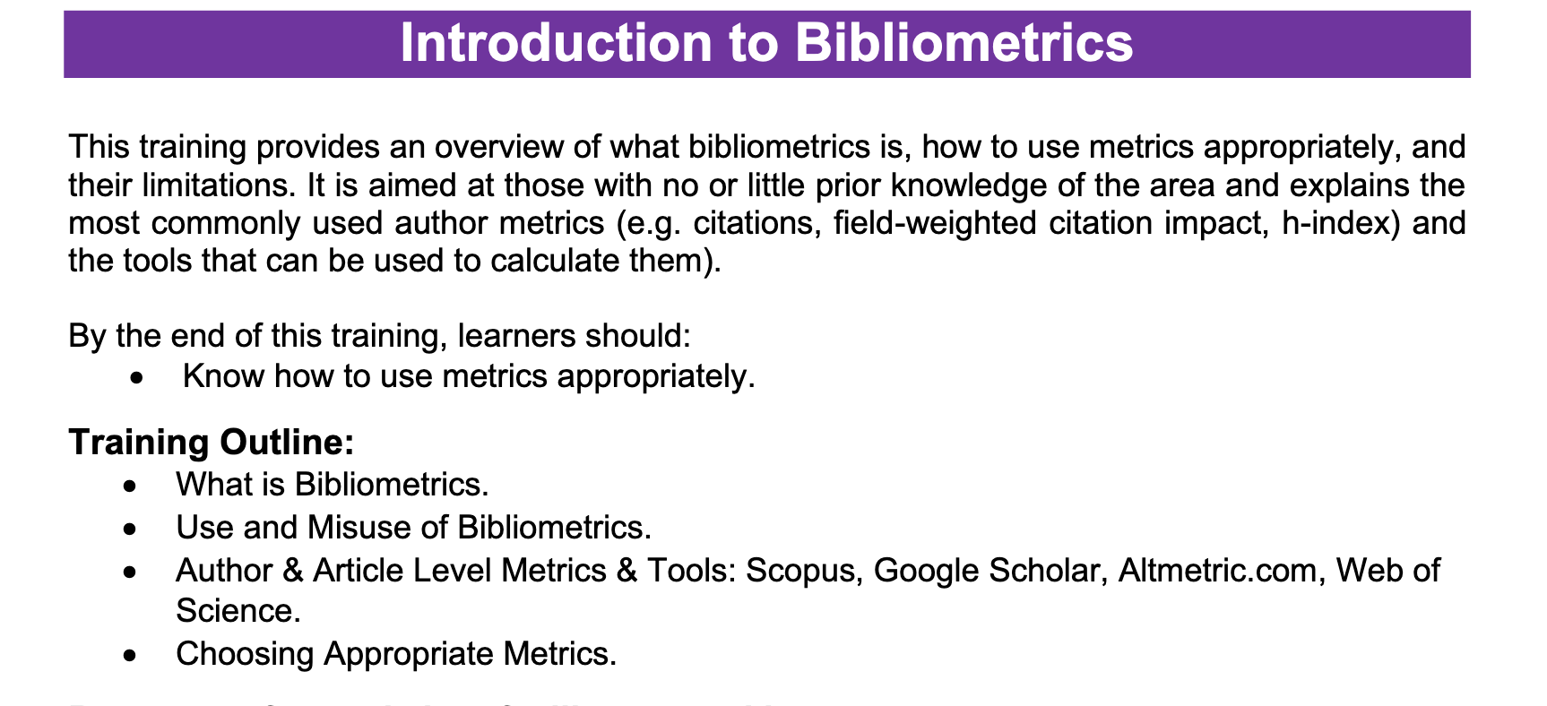
– From The EIFL Digital Research Literacy Training Outline

Slide 3
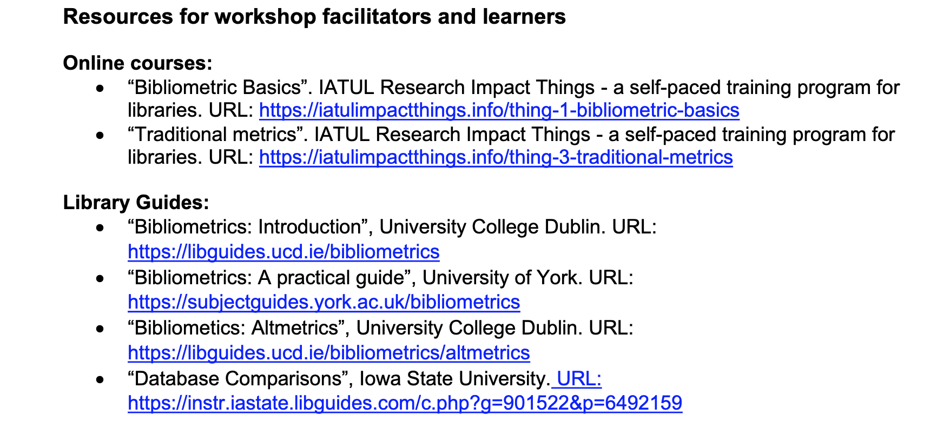

– From The EIFL Digital Research Literacy Training Outline
The Metrics Toolkit: https://metrics-toolkit.org/ [CC-BY]
SPARC Article Level Metrics: A Primer: https://sparcopen.org/wp-content/uploads/2016/01/SPARC-ALM-Primer.pdf

Slide 4
What are bibliometrics?

Slide 5

Eugene Garfield (1925-2017)
Founder of the fields of scientometrics (the quantitative study of science and technology) and bibliometrics.
Garfield introduced the citation as a qualitative measure of academic impact and from it, the concepts of “citation indexing” and “citation linking”
“I had always envisaged a time when scholars would become citation conscious, and to a large extent they have, for information retrieval, evaluation, and measuring impact…I did not imagine that the worldwide scholarly enterprise would grow to its present size, or that bibliometrics would become so widespread.”
– Eugene Garfield, quoted in ‘Baykoucheva, S. Eugene Garfield’s Ideas and Legacy and Their Impact on the Culture of Research. Publications 2019, 7, 43. https://doi.org/10.3390/publications7020043
Eugene Garfield. Science History Institute, CC BY-SA 3.0 https://creativecommons.org/licenses/by-sa/3.0 , via Wikimedia Commons

Slide 6
Bibliometrics
Bibliometrics is defined as ‘the statistical analysis of books, articles, or other publications and their citations’.
They include a wide range of indicators, such as:
Author level indicators e.g. Hirsch-Index (h-Index)
Article / publication level indicators e.g. number of papers, citations etc.
Normalised indicators e.g. Field Normalised Citation Impact
Journal level Indicators e.g. Journal Impact Factor
Collaboration indications e.g. countries of co-authorship collaborators
The sources of bibliometric information are often proprietary databases which have well-known issues of access, incomplete coverage (especially for Arts, Humanities and Social Sciences) and geographical and linguistic biases.

Slide 7
Uses and abuses of bibliometrics

Slide 8
Bibliometrics are often used in Research Evaluation
Strategic Planning
Key performance indicators (institutional, national)
Reporting: quality reviews, departmental reviews, accreditation reviews, government agency reviews, annual reports
Research grant proposals
Academic promotions
Memberships (for example) of academies
Funder/national analyses (for example, research prioritisation).
Recruitment
University Rankings

Slide 9
University Rankings – examples of metrics used
Metric/indicator | University Ranking
Papers per academic staff | THE
Citations per paper | Shanghai ARWU / per staff (QS, QS Subject, THE) – based on Field Weighted Citation Impact FWCI.
H-index | QS Subject Ranking
% of papers with international collaboration | THE
% of papers with industry collaboration | THE
Reputation (Academic/Employer) | THE & QS, QS Subject Ranking

Slide 10
The Abuses of Bibliometrics
“Bibliometrics has a problem. In fact, the field — which tracks scholarly impact in everything from journal papers to citations, data sets and tweets — has a lot of problems. Its indicators need better interpretation, its tools are widely misused, its relevance is often questioned and its analyses lack timeliness.”
“ … careless use.
The h-index, which captures the distribution of a scientist's citations, is innately flawed because it is not responsive to field or career stage …
Impact factors tell us about journals, not individual publications, but research managers use them to pick staff.
Engineers publish conference proceedings, but submit only journal papers for assessment. Mathematicians publish infrequently and cite deep into the past; molecular biologists, quite the opposite. Economists and particle physicists have utterly different norms of authorship assignment.
Few users of bibliometrics appreciate the implications of these nuances, yet many think they can read the numbers, or persuade others to read them their way.”
From: Adams, J. Bibliometrics: The citation game. Nature 510, 470–471 (2014). https://doi.org/10.1038/510470a

Slide 11
The Impetus for Change
2012: DORA: the San Francisco Declaration of Research Assessment
2014: The Leiden Manifesto
2015: The Vienna Principles
2015: The Metric Tide: Report of the Independent Review of the Role of Metrics in Research Assessment and Management (UK)
2017: The Bratislava Declaration of Young Researchers
2019: The Hong Kong Manifesto for Assessing Researchers

Slide 12

DORA: the San Francisco Declaration of Research Assessment
General Recommendation
Do not use journal-based metrics, such as Journal Impact Factors, as a surrogate measure of the quality of individual research articles, to assess an individual scientist’s contributions, or in hiring, promotion, or funding decisions.
Themes:
the need to eliminate the use of journal-based metrics, such as Journal Impact Factors, in funding, appointment, and promotion considerations;
the need to assess research on its own merits rather than on the basis of the journal in which the research is published; and
the need to capitalize on the opportunities provided by online publication (such as relaxing unnecessary limits on the number of words, figures, and references in articles, and exploring new indicators of significance and impact).
https://sfdora.org/

Slide 13
The Leiden Principles
1) Quantitative evaluation should support qualitative, expert assessment.
2) Measure performance against the research missions of the institution, group or researcher.
3) Protect excellence in locally relevant research.
4) Keep data collection and analytical processes open, transparent and simple.
5) Allow those evaluated to verify data and analysis.
7) Base assessment of individual researchers on a qualitative judgement of their portfolio.
8) Avoid misplaced concreteness and false precision.
9) Recognize the systemic effects of assessment and indicators.
10) Scrutinize indicators regularly and update them.

Slide 14

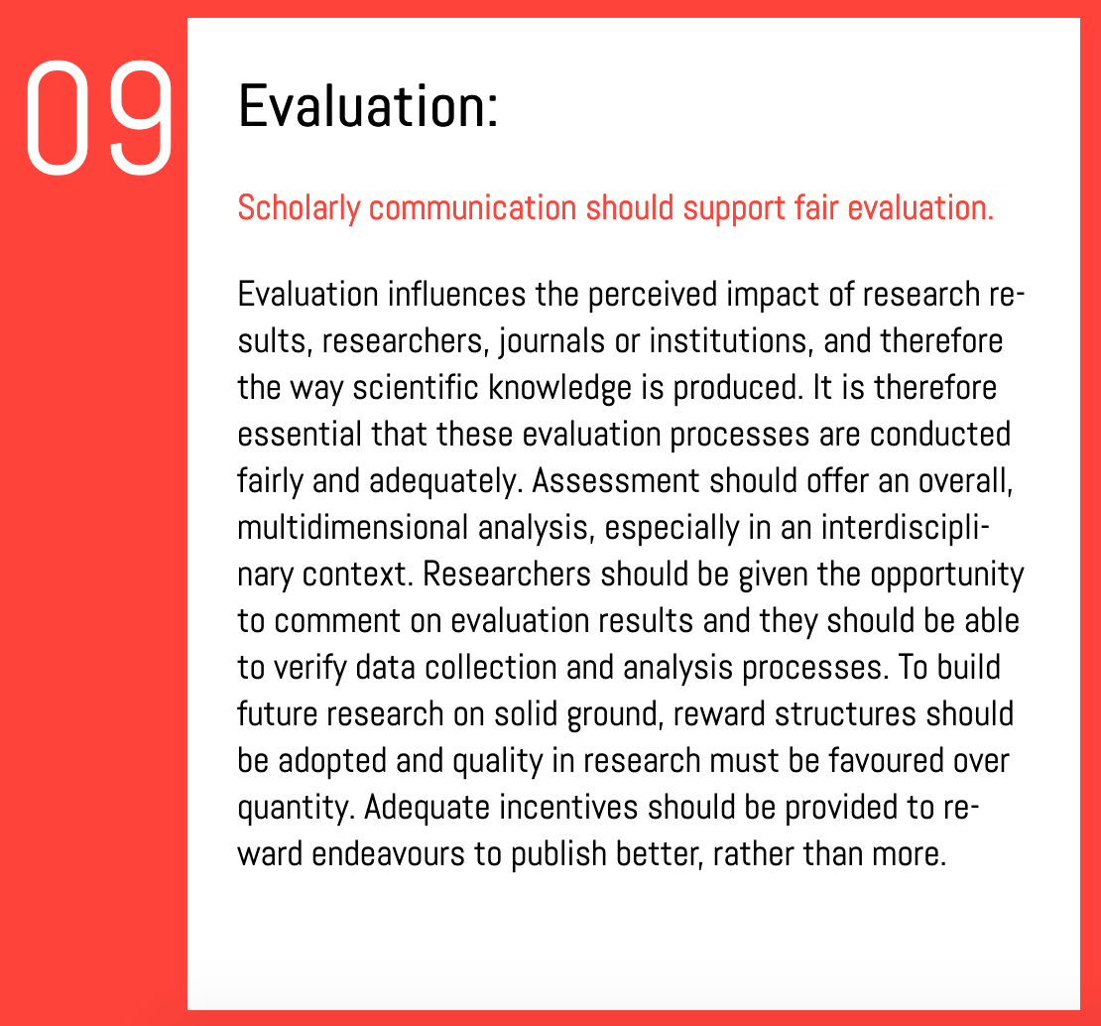
https://viennaprinciples.org/

Slide 15
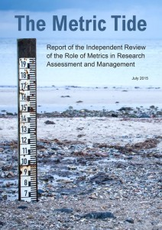
The Metric Tide
Scepticism about the broader use of metrics in research assessment and management.
Peer review, despite its flaws, continues to command widespread support
Carefully selected indicators can complement decision-making, but a ‘variable geometry’ of measures that respect research diversity are required.
Legitimate concern that some indicators can be misused or ‘gamed’ e.g. journal impact factors, university rankings and citation counts
The data infrastructure underpinning the use of metrics and information about research remains fragmented.
No metric can currently provide a like-for-like replacement for UK REF peer review.
It is not currently feasible to assess research outputs or impacts in the UK REF using quantitative indicators alone.
It is not currently feasible to use quantitative indicators in place of narrative case studies. However, there is scope to enhance the use of data in assessing research environments.

Slide 16
Responsible Metrics
Robustness: basing metrics on the best possible data in terms of accuracy and scope
Humility: recognising that quantitative evaluation should support – but not supplant – qualitative, expert assessment
Transparency: keeping data collection and analytical processes open and transparent, so that those being evaluated can test and verify the results
Diversity: accounting for variation by field, and using a range of indicators to reflect and support a plurality of research and researcher career paths across the system
Reflexivity: recognising and anticipating the systemic and potential effects of indicators, and updating them in response.

Slide 17
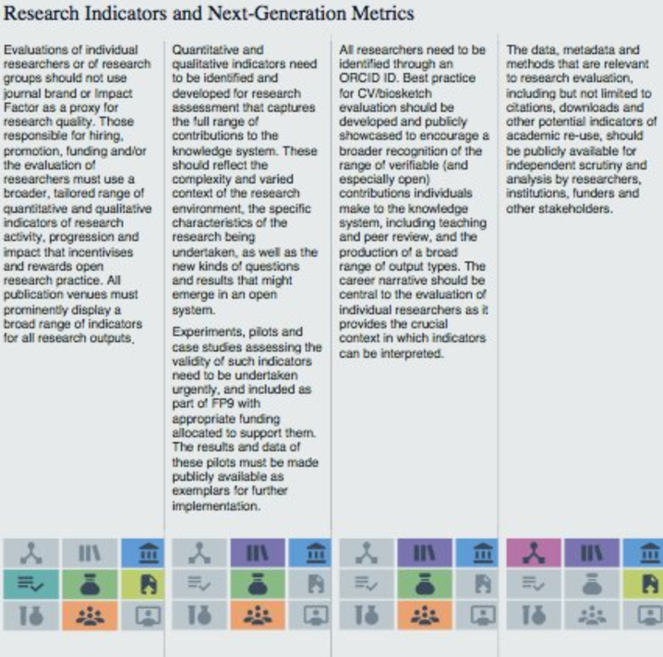
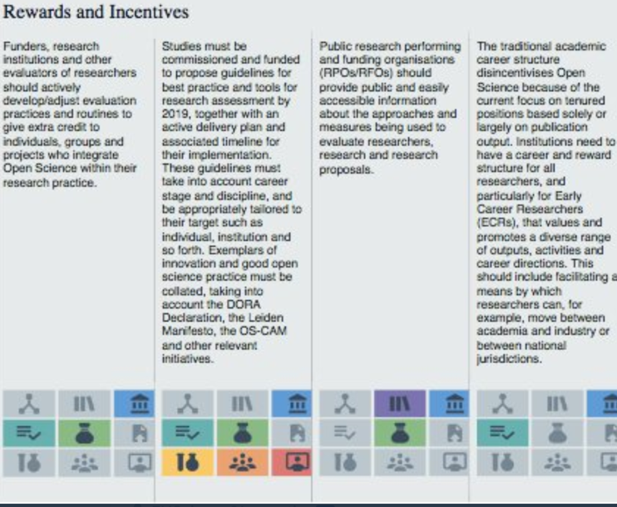
2020: European Commission Open Science Policy Platform Recommendations: ‘Rewards and Incentives’ & ‘Next Generation Metrics’.
2 of the 8 Pillars of Open Science

Slide 18
The basics of bibliometrics

Slide 19
The Rules of Bibliometrics
Never compare bibliometric data across fields or disciplines.
Always use a range of metrics.
Try to balance quantitative data with qualitative data if at all possible (ideally including peer review). This is vital for disciplines that are poorly served by bibliometric information.
Be sure to identify your data sources, parameters and methodology. It’s OK to mix data sources (it’s probably desirable).
Researchers should be aware of the ways in which you are evaluated and the means with which you can improve your results.
Remember to add a caveat to your reports highlighting issues with the coverage of bibliometric tools.

Slide 20
Commonly-Used Metrics
Author level metrics
Article level metrics
A word about the Journal Impact Factor

Slide 21

Getting familiar with bibliometrics.
Examples of commonly used personal metrics:
Number of publications. Usually qualified by peer reviewed / non peer reviewed; sometimes qualified by role (e.g. senior authorship)
Number of citations
Average number of citations per paper
Field Normalised (or Field Weighted) Citation Impact
H index
Collaborations (in terms of co-authorship, often qualified by international / national.
Patent applications: patents / licence awarded
Patent citations
Check out the Metrics Toolkit:
https://www.metrics-toolkit.org//

Slide 22
Author level metrics
Author-level metrics are citation metrics that measure the bibliometric impact of individual authors, researchers, academics, and scholars.
Used: to allocate resources (e.g. funding, academic appointments). However, there remains controversy in the academic community as to how well author-level metrics achieve this goal.
Examples: Number of publications, number of citations, citations per paper, h-index, Field Weighted Citation Impact etc.

Slide 23
Metric | Description | Field weighted | Tool
h-index | The number of articles (h) by an author that have been cited at least (h) number of times. Example: A researcher with an h-index of 16 has published 16 articles that have been cited at least 16 times each. | No | Scopus (Elsevier) Web of Science (Clarivate Analytics) Google Scholar Citations
Field-Weighted Citation Impact (FWCI) | The ratio of citations received relative to the expected world average, normalised for field, year and publication type. A field-weighted citation impact of 1 indicates the expected global average number of citations have received. More than 1 indicates the expected global average has been exceeded, and less than 1 shows the expected global average has not been met. | Yes | SciVal (Elsevier)
Category-Normalized Citation Impact (CNCI) | Calculated by dividing the actual count of citing items by the expected citation rate for documents with the same document type, year of publication and subject area. A CNCI of 1 represents performance at par with world average, values above 1 are considered above average and values below 1 are considered below average. | Yes | InCites (Clarivate Analytics)
Citations per publication | The number of citations received by an entity, divided by the number of publications produced by the entity. Also known as 'Citation impact' in InCites. | No | Scopus & SciVal (Elsevier) Web of Science & InCites (Clarivate Analytics)
Author-Level Eigenfactor | A weighted measure based on an author's citations, excluding self-citations. It adjusts for the number of authors of the paper, the number of outgoing citations from each paper citing an author's paper and for the importance of the citing paper. The score reported in the Social Science Research Networ (SSRN) ranking tables is calculated from SSRN citation data only | Yes | SSRN (Elsevier)

Slide 24
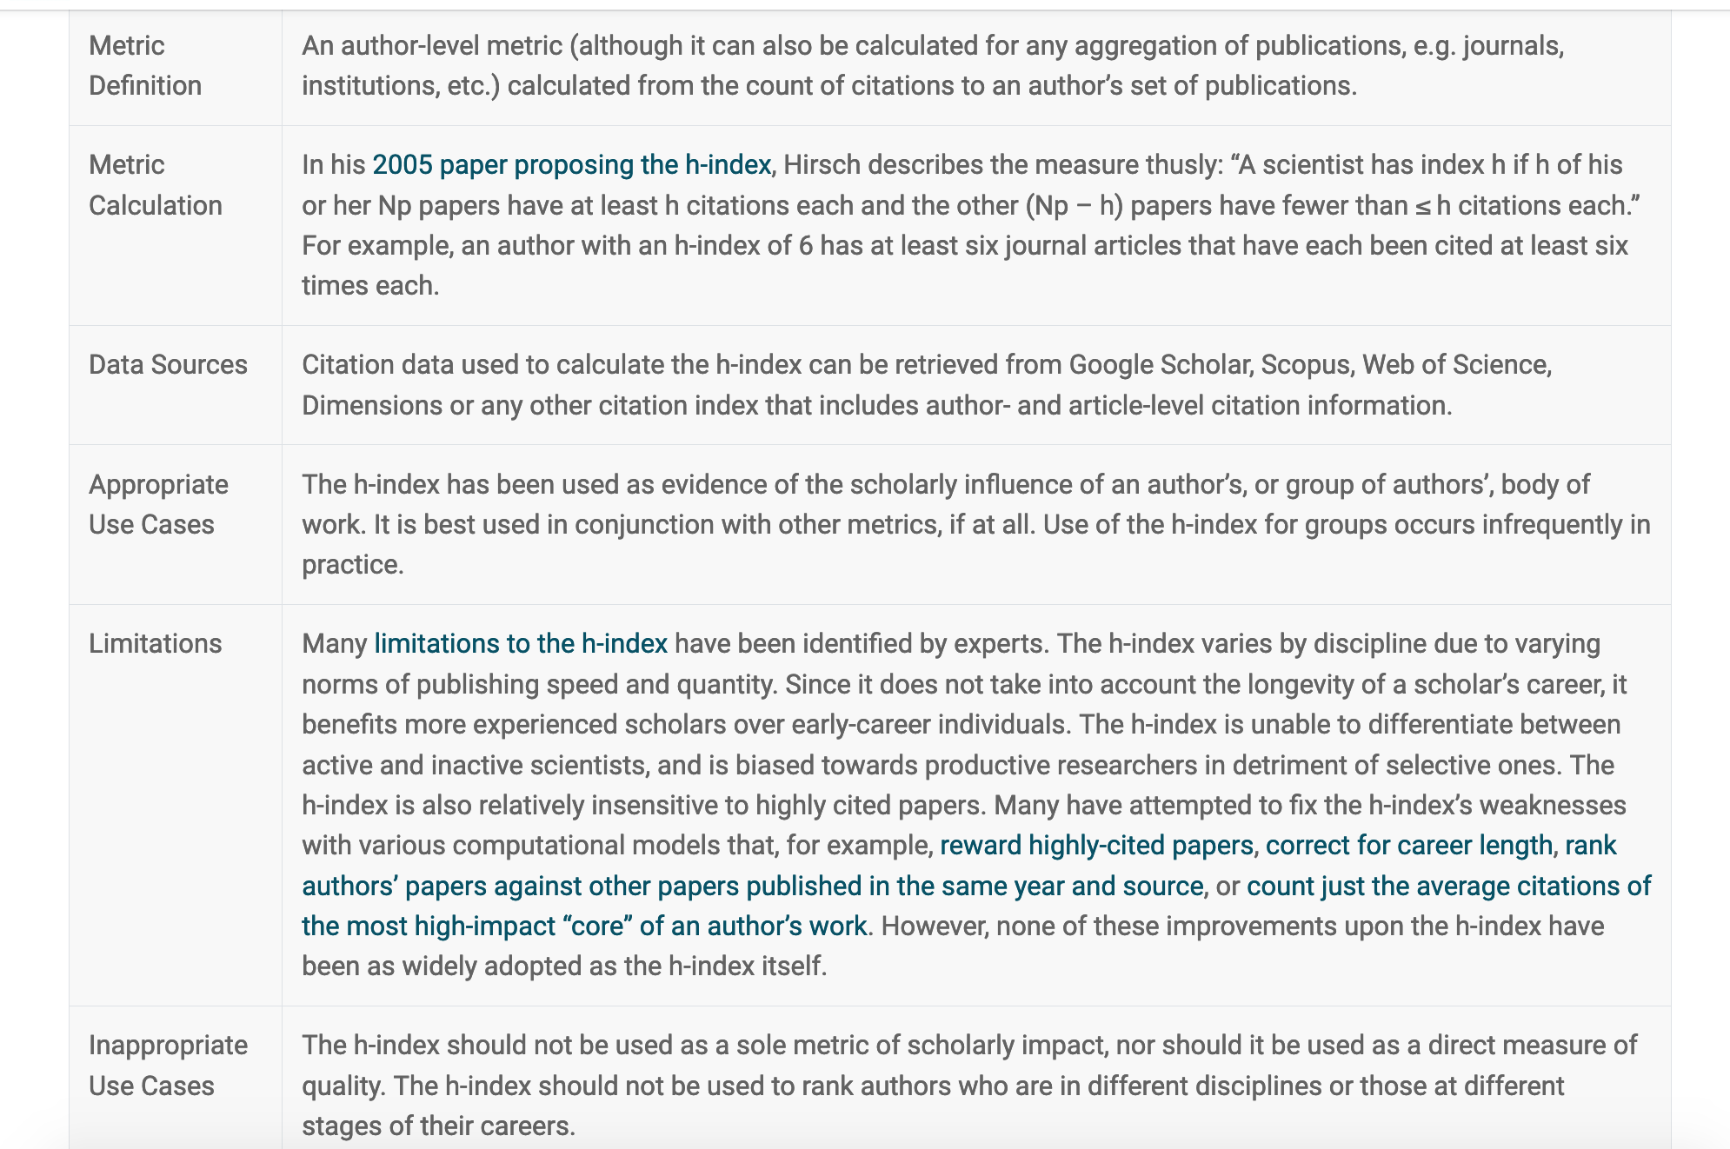
The H-index
[from the Metrics Toolkit]

Slide 25
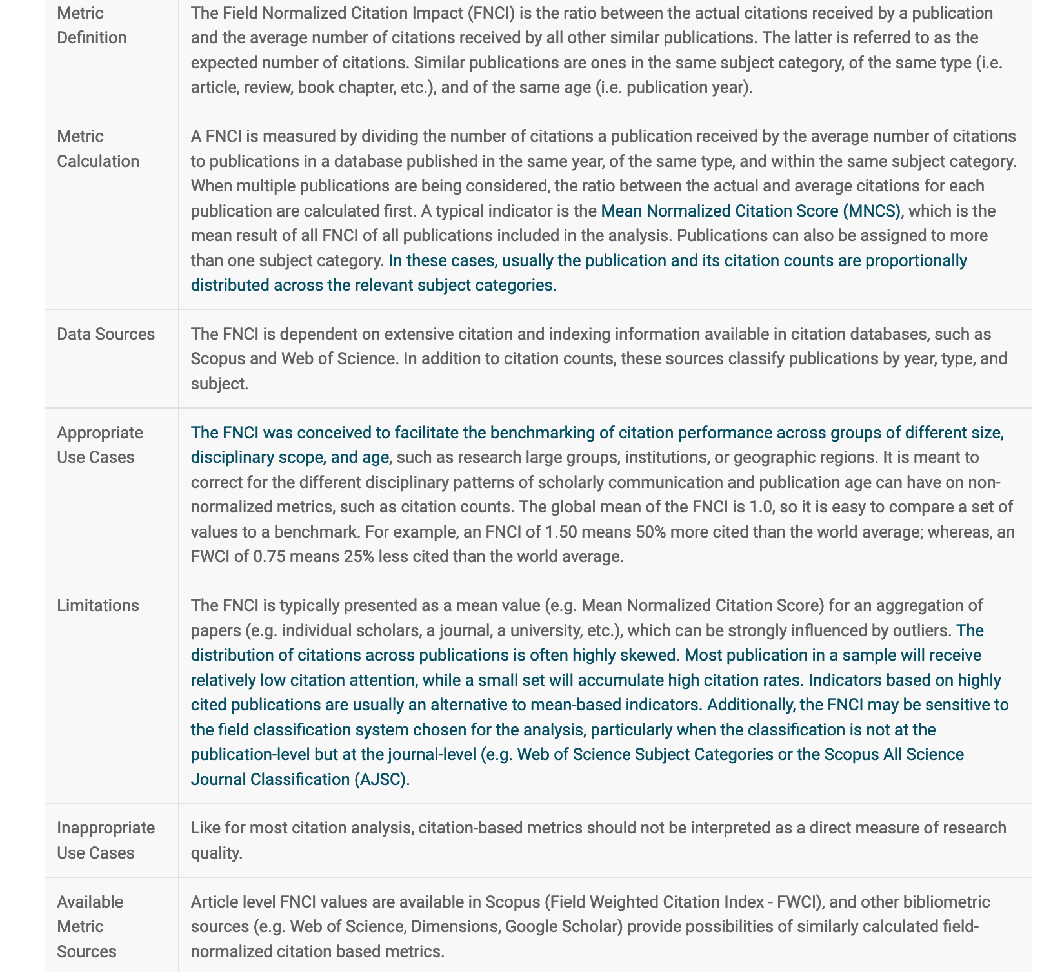
Field-weighted Citation Impact
[from the Metrics Toolkit]

Slide 26

Other Author metrics:
Publons
From Clarivate Analytics
Free
Profiles and data for and about reviewers
Good for early career researchers

Slide 27
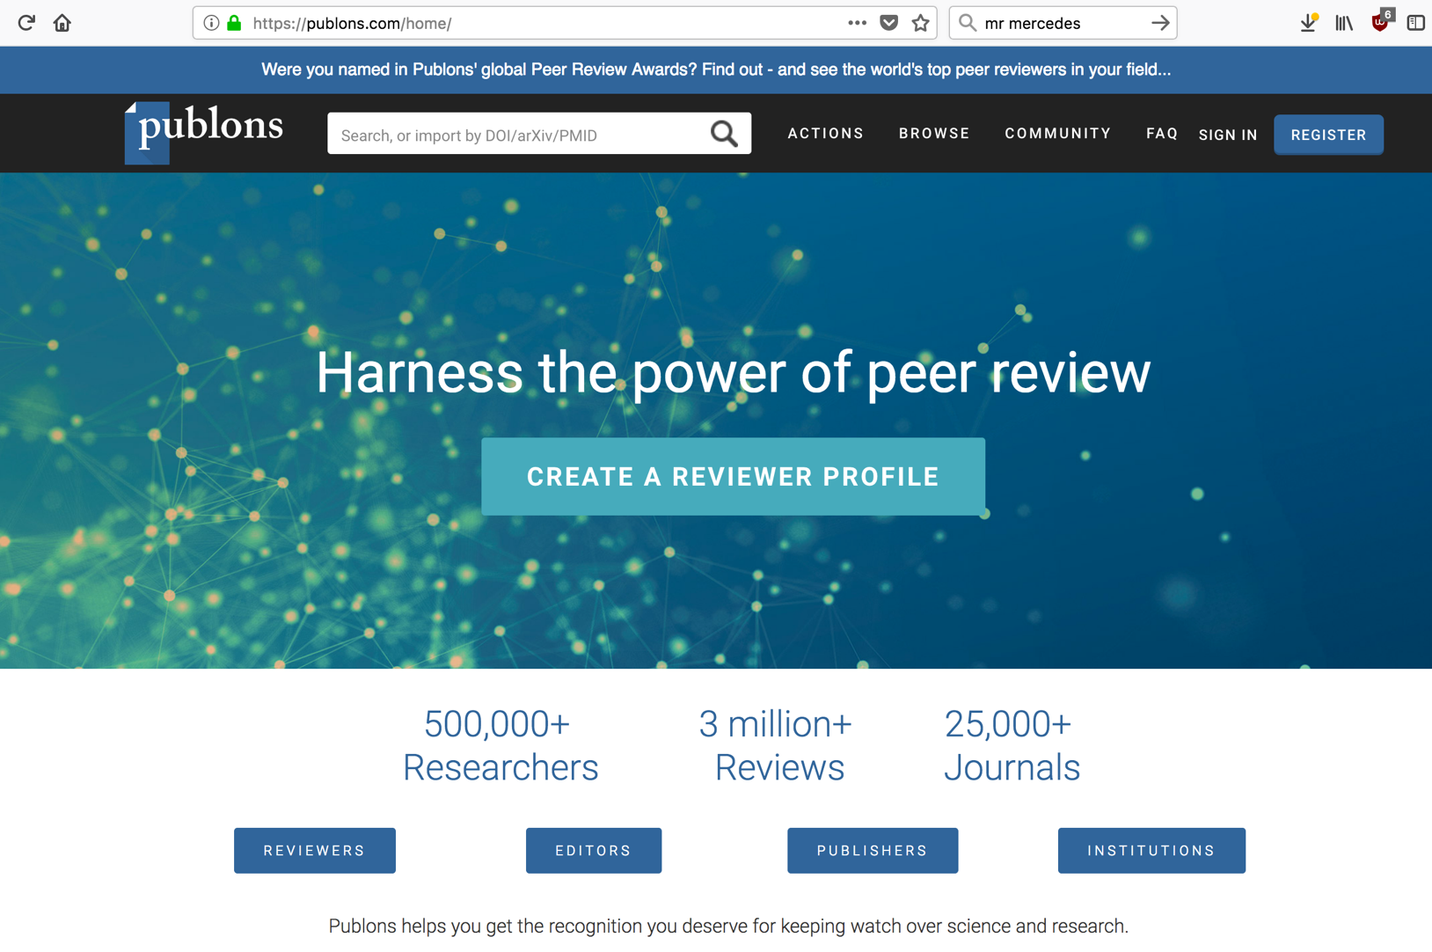
Publons: free information on reviewer activity

Slide 28
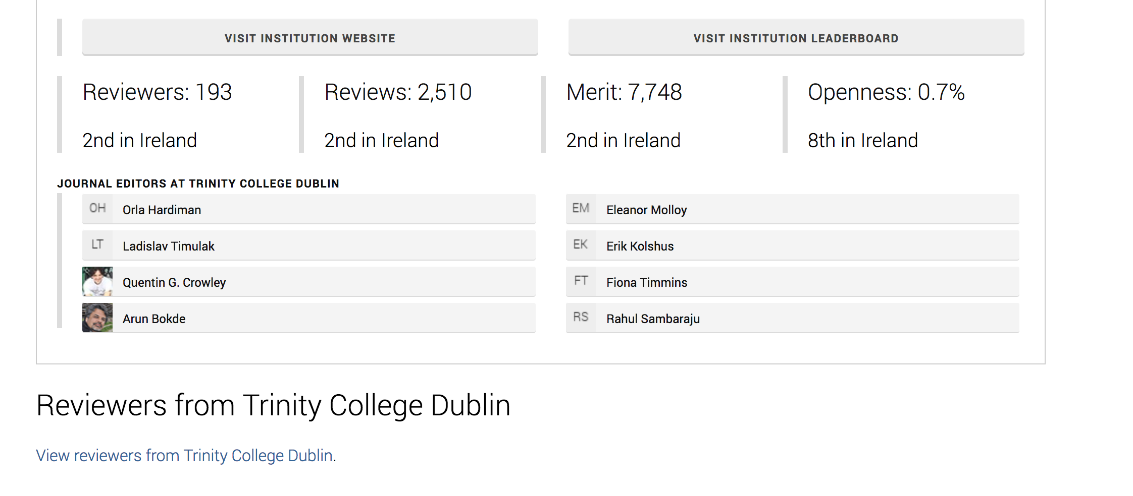

Slide 29
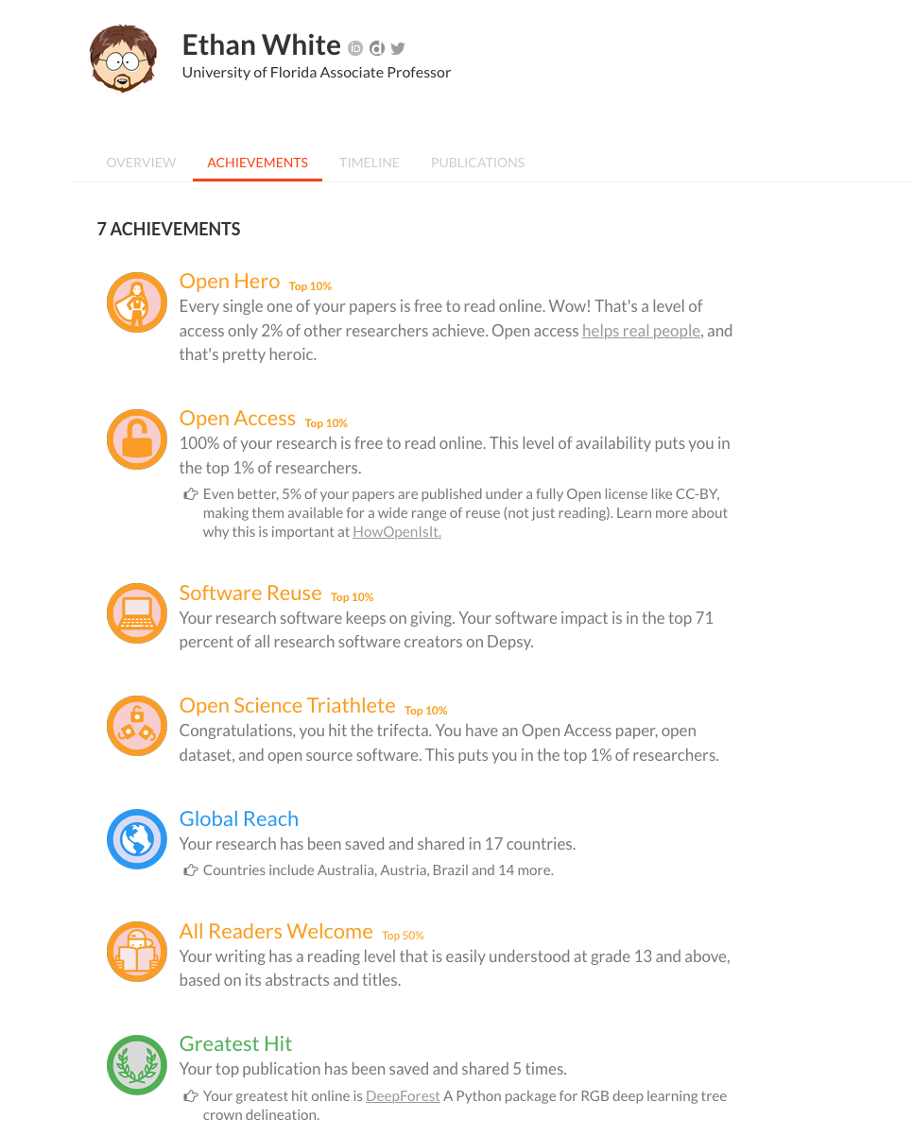

https://profiles.impactstory.org/
Author level Open Science Metrics

Slide 30
Article Level Metrics
Usage. Views on publisher’s site? Number of times accessed / downloaded? Times viewed/downloaded in PubMed Central / supplemental data accessed?
Captures. Times bookmarked on CiteULike /shared within Mendeley etc.?
•Mentions. What is the discussion around an article? How many times has it been blogged about? How many news stories have been written about it? How frequently is it mentioned in Wikipedia? How many comments did it generate on the publisher’s site and elsewhere?
•Social Media. Number of Facebook likes / LinkedIn & other networks shares? Number of tweets generated? These data points can contribute to a sense of an article’s immediacy.
•Citations. What articles are citing this article? This is a traditional metric that complements the above by demonstrating the long-­‐term contribution an article makes to the scientific literature
Adapted from SPARC ‘Article Level Metrics: A Primer’ https://sparcopen.org/wp-content/uploads/2016/01/SPARC-ALM-Primer.pdf

Slide 31
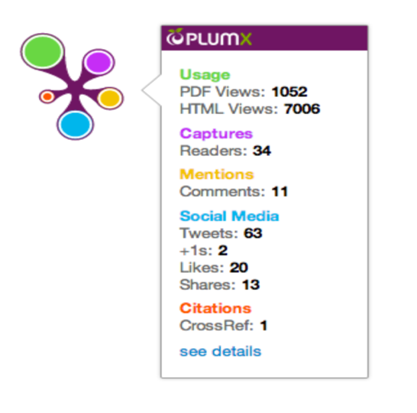
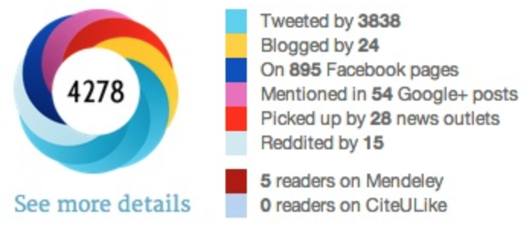
Using Altmetrics
Altmetric.com ‘donut’
‘Plum Print’ widget

Slide 32
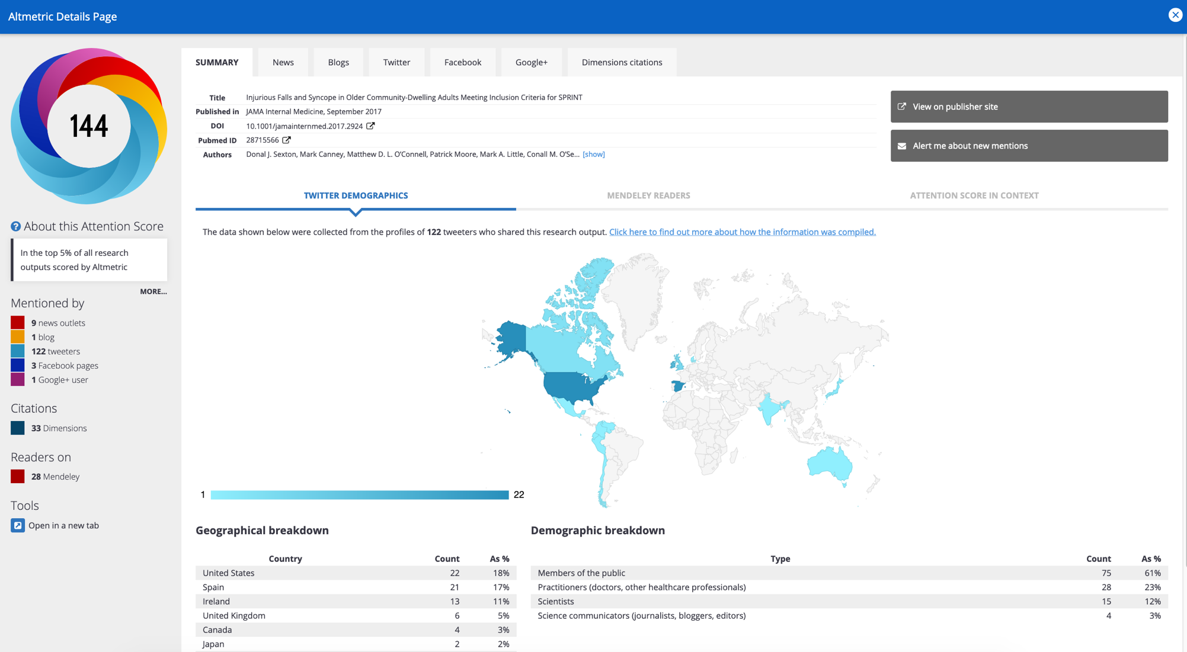
In your workshops, get your learners to analyse a (free*) Altmetric doughnut for a selected publication (examine Twitter mentions, blog mentions etc.)
Ask them to create an Impact Strategy based on their analysis
* Altmetric.com doughnuts are embedded in repository publication records or on publisher webpages or use the free Altmetric.com widget.

Slide 33
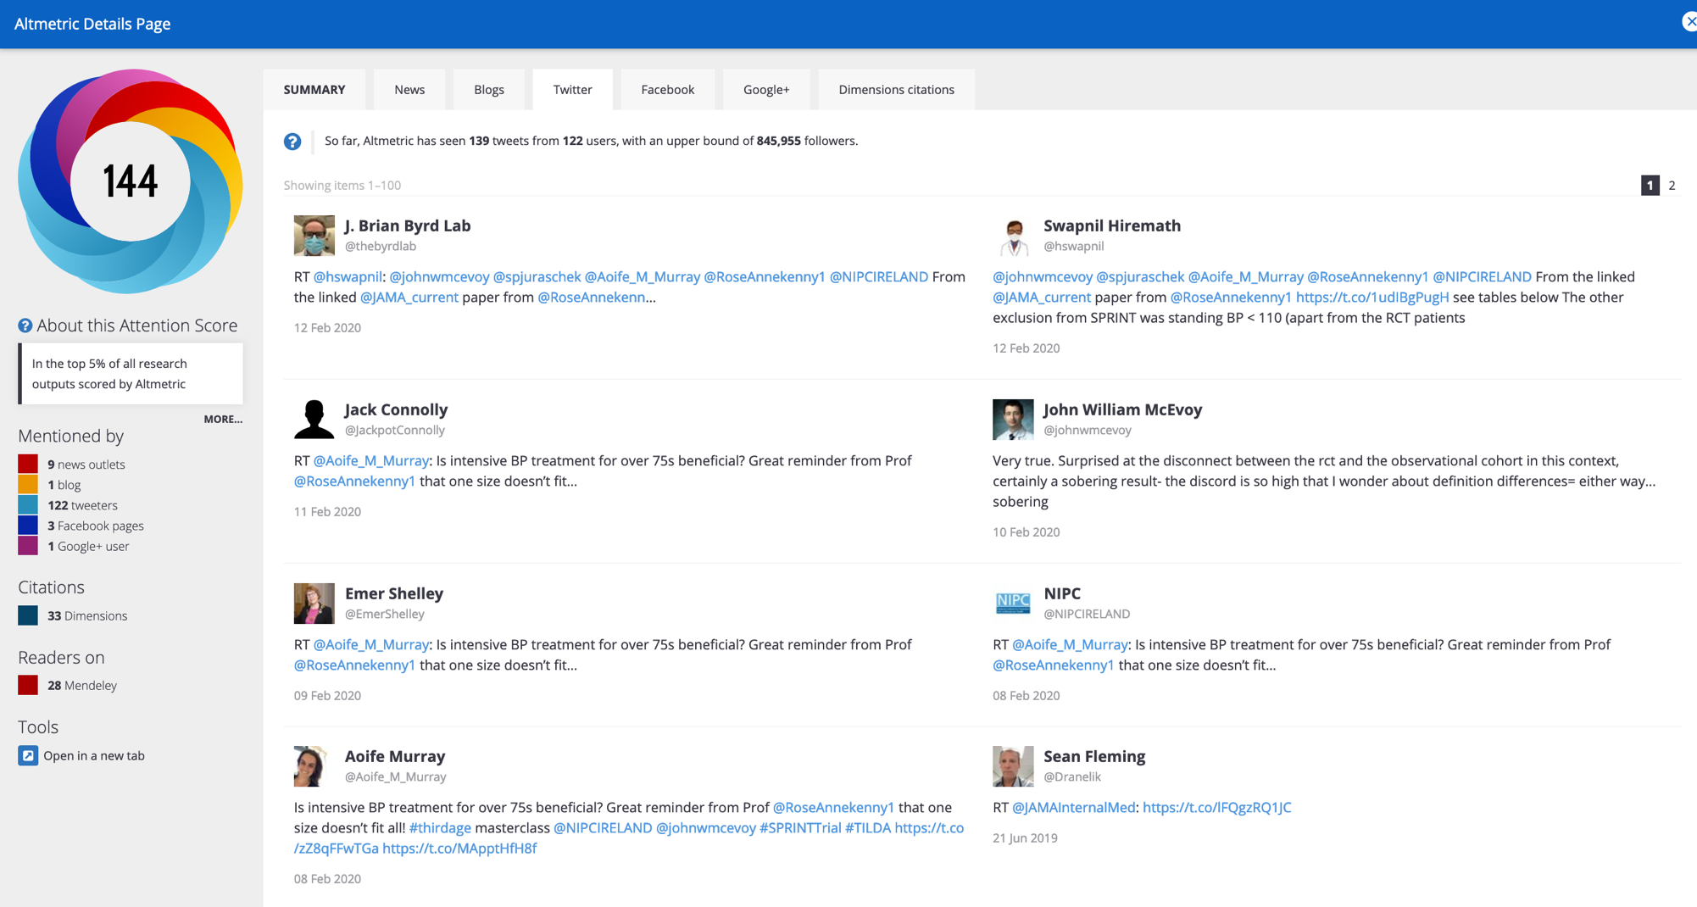
Analysing Twitter mentions on the Altmetric.com doughnut for a publication

Slide 34
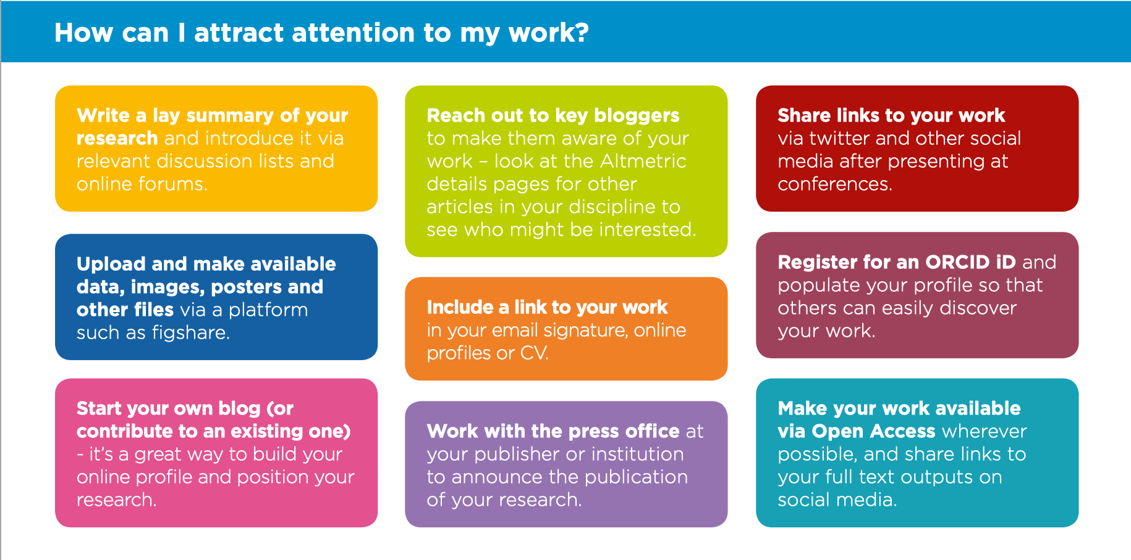

Slide 35
How to make sure your altmetric ‘mentions’ are tracked
Always link to a page that includes your research’s unique identifier e.g. DOI, arXiv ID, PubMed ID) linking to the publisher article page or institutional repository abstract page.
The link needs to be in the main body of the work (not in headers, etc.)
Altmetric.com and equivalent services need to be tracking the source of the work that is referenced, in other words, the publisher or journal or policy paper source needs to be tracked by them. You can check to see if the source of your work is tracked by contacting the altmetric service provider.

Slide 36
Use Digital Object Identifiers…
DOIs are increasingly important in tracking and monitoring research impact e.g. in services such as Altmetric.com
Include the DOI in citations of your work
If you are reviewing books, include the DOI of the book, and encourage other reviewers to do the same.
Include the DOI in tweets and other social media alerts and discussions on your work
If your work has not been assigned a DOI by its publisher, contact the publisher and request one.
Check to see if your institution can assign a DOI to its published works (e-theses, reports, etc.)

Slide 37
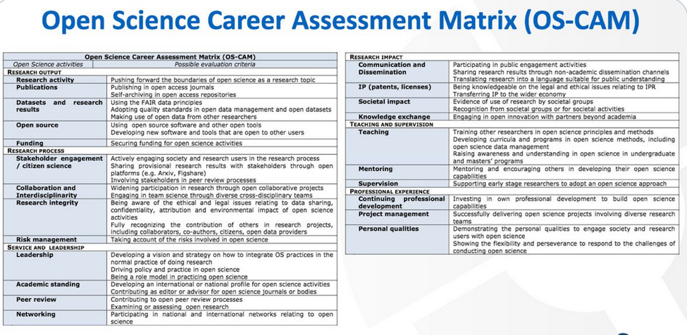
Open Scholarship / Open Science Metrics
Open Scholarship metrics usually track the usage (hits and downloads) of open access publications, datasets and other content from:
Other Universities
Government depts;
NGOs
Industry
Schools
Citizen scientists / the public
The European Commission Open Science Policy Platform has produced the ‘Open Science Career Assessment Matrix which proposes recognizing a key set of Open Science measures and indicators …
… which has led to the
Open Science Rewards & Incentives Registry
initiative

Slide 38
A word on the Journal Impact Factor
As a journal level metric, the JIF should not be used as an indicator for the quality or impact of particular articles or authors. The JIF is not statistically representative of (the citations to) individual articles and cannot summarize the quality of an author’s entire body of work.
As a retrospective measure of past citations to a journal, the JIF is not a good predictor of whether an individual article will be highly cited. Due to the skewed distribution of citations (relatively few articles receive most citations, sometimes described as “the long tail”), the use of the mean rather than the median value of citations per article does not offer a reliable prediction for the average number of citations an article can expect to receive. [From The Metrics Toolkit]

Slide 39
Bibliometric Tools

Slide 40
















A confusing array of tools available for research evaluation and reporting.

Slide 41
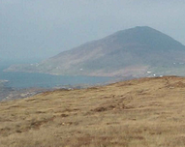
The Research Evaluation Landscape
Research Profiles owned and edited by you
University CRIS /IR profile
ORCID profile
Citation & metrics sources
Scopus / SciVal
Web of Science/InCites
Identifiers
ORCID number
Scopus ID
Researchgate/ Academia.edu (etc.)
Google Scholar profile
Google Scholar
Altmetric.com
Dimensions
DOIs
Researcher ID
Impact Story
PlumX
Kudos
Publish or Perish
ResearcherID profile
Scopus profile
Repositories/Platforms: Archiving, Management & Dissemination Resources
Institutional Repository
Subject Repositories
PubMed Central
Data repositories (commercial & open source)
Publishing platforms
Publishing tools
Impact case studies: resources
Data Management: resources
Microsoft Academic Search
Lens.org

Slide 42
Web of Science
Source: Clarivate Analytics
An abstract and citation database.
A curated database focused on quality; coverage issues especially for particular disciplines.
Use to: perform a basic analysis of researchers’ outputs and to find metrics such as h-index, overall citations and publications. Facility to export lists of publications and citations. [Use the search and filter functionality and then click ‘citation analysis’]
Further analyses are supported (‘analyse’ search results by collaborating countries, institutions etc.)
InCites, a benchmarking and deeper analysis tool is based on Web of Science data and requires another subscription.

Slide 43
Scopus
Source: Elsevier
An abstract and citation database.
A curated database focused on quality; coverage issues especially for particular disciplines.
Use to: perform a basic analysis of researchers’ outputs and to find metrics such as h-index, overall citations and publications. Facility to export lists of publications and citations. [Use the search and filter functionality and select, and then click ‘citation analysis’]
Further analyses are supported (‘analyse’ search results by collaborating countries, institutions etc.)
SciVal, a benchmarking and deeper analysis tool is based on Scopus data and requires another subscription.
Free Scopus author profiles with citations data can be accessed on the web.

Slide 44
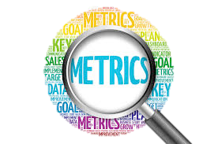
Tools & Resources by:
Accessibility
Coverage
Functionality

Slide 45
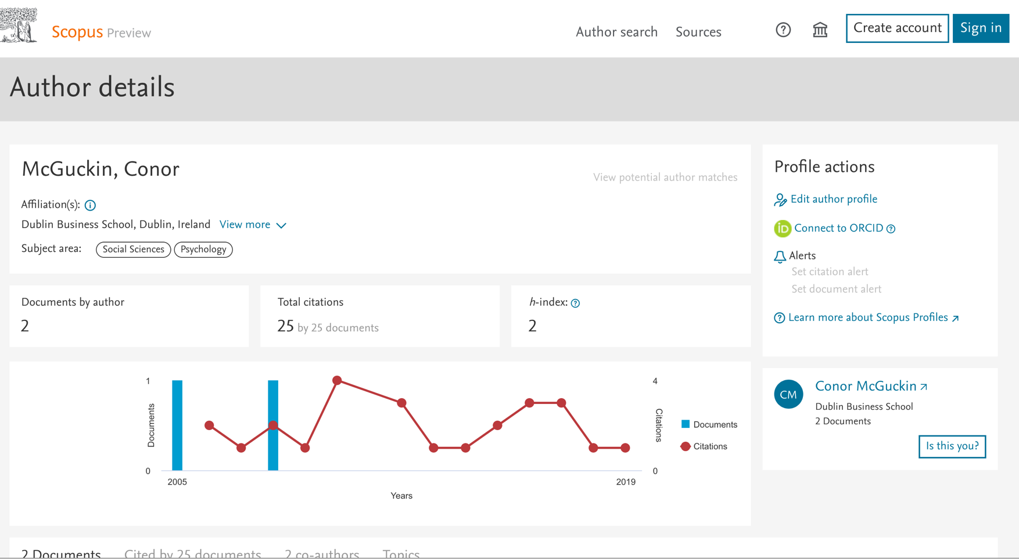
Scopus free author profiles via: http://scopus.com

Slide 46

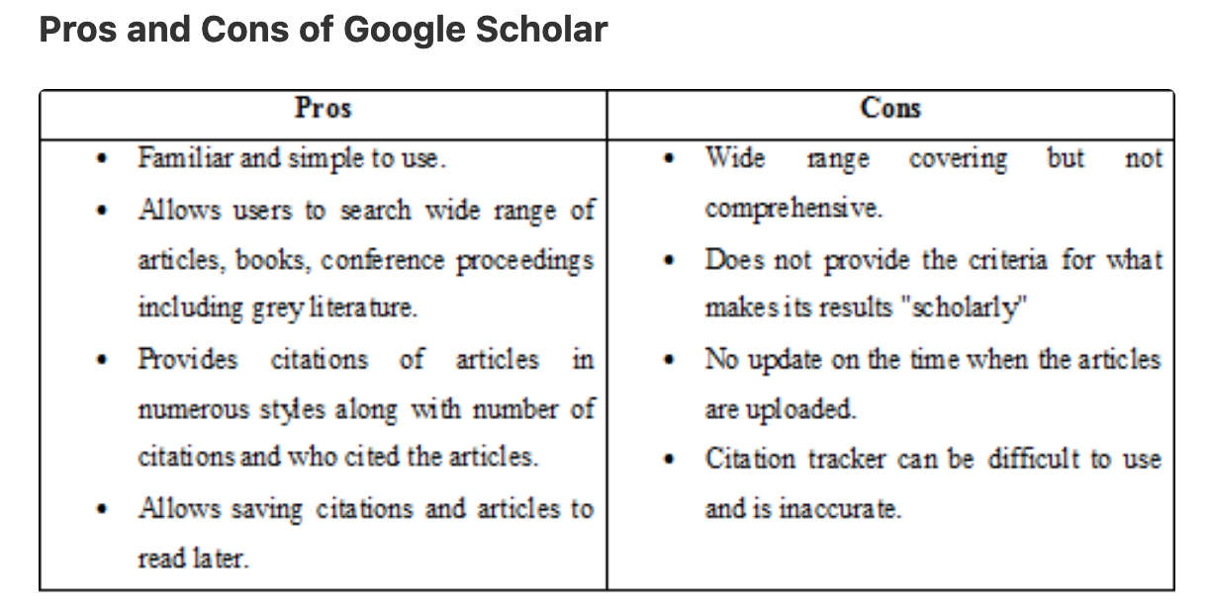
Google Scholar
Also:
It’s a ‘black box’
Errors & duplication not always easy to fix.
No API (can’t import to other systems)
But …
The coverage is excellent (books, book chapter included)
Google Citation profiles provide bibliometric data & can be validated;
Downloadable to RIS & BibTex.
It’s free

Slide 47
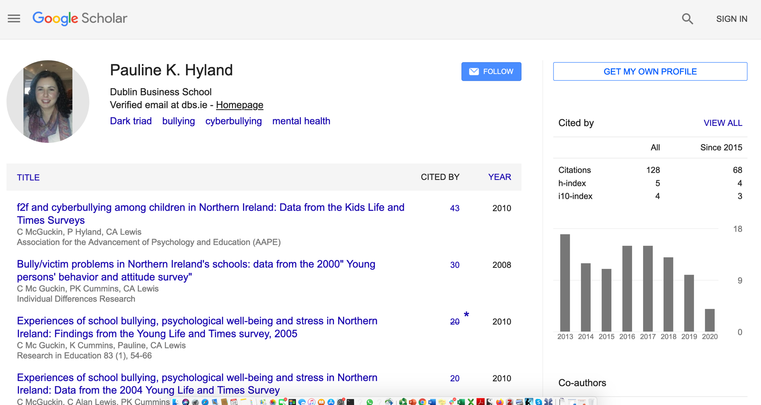

Slide 48

Publish or Perish (analytics based on Google Scholar data)
From Virginia Tech [ http://www.lib.vt.edu/research/metrics/publish-perish.html ]
Publish or perish tool is a software program that retrieves and analyzes academic citations. It uses Google Scholar and Microsoft Academic Search to obtain raw citations, then analyzes these and presents the following metrics:
Total number of papers and total number of citations
Average citations per paper, citations per author, papers per author, and citations per year
Hirsch's h-index and related parameters
Egghe's g-index
The contemporary h-index
Three variations of individual h-indices
The average annual increase in the individual h-index
The age-weighted citation rate
An analysis of the number of authors per papers
Anne-Wil Harzing
Free
Desktop-based
Download limit of 1K records
Good training resources
Useful – especially for arts, humanities & social sciences.
https://harzing.com/resources/publish-or-perish

Slide 49
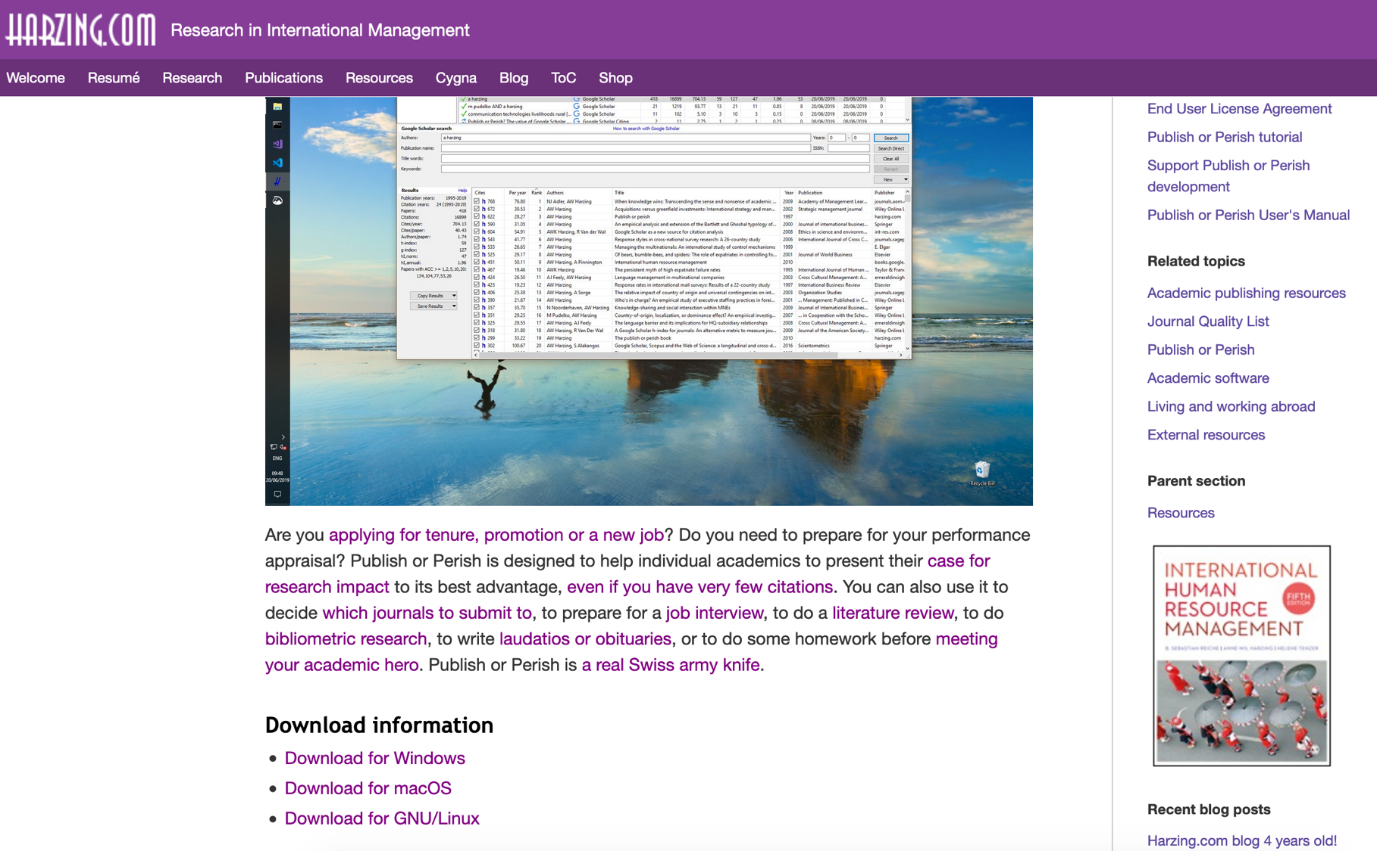

Slide 50
Dimensions
From Digital Science
Very large database
Includes datasets and clinical trials alongside publications information
Includes funding information (financial data in addition with funder names & grant information
Incorporates Altmetrics data.
Incorporates UnPaywall data.
Free version supports basic searches & simple analytics
Limited exports with free version
Powerful AI-based analytics with subscription version
Very credible contender against Web of Science & Scopus
Free API.

Slide 51
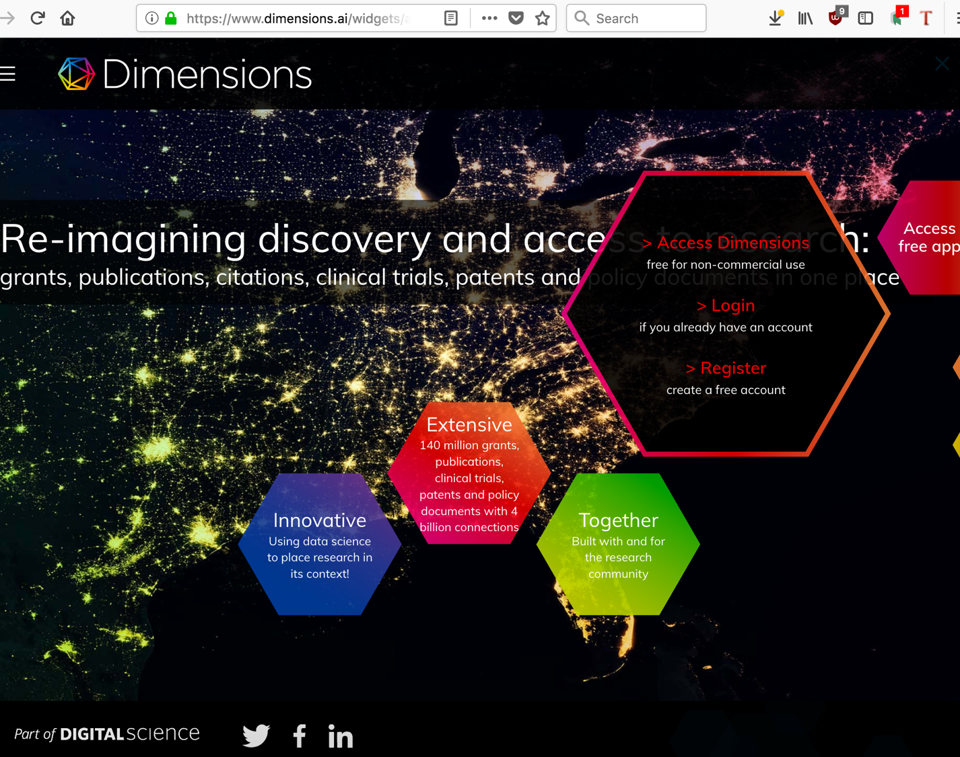
Dimensions 1
Free version:
90+ million publication records,
approximately 9 million records with Altmetric data,
just over 128 million documents (with over 50 million available by full text searching), and
approximately 4 billion connections between items.
Subscription
almost 35 million patents,
Information on $1 trillion USD of funded research projects from 250 global funders 380,000+ clinical trials
Institutional / country analytics
http://www.istl.org/18-winter/electronic2.html

Slide 52
Microsoft Academic
From Microsoft Research
“ … employs advances in machine learning, semantic inference and knowledge discovery to help you explore scholarly information in more powerful ways than ever before.”
Very large database
Semantic search
Researcher profiles (on application)
Bibliometric analyses & visualisations
Institutional data analysis
API
Free

Slide 53
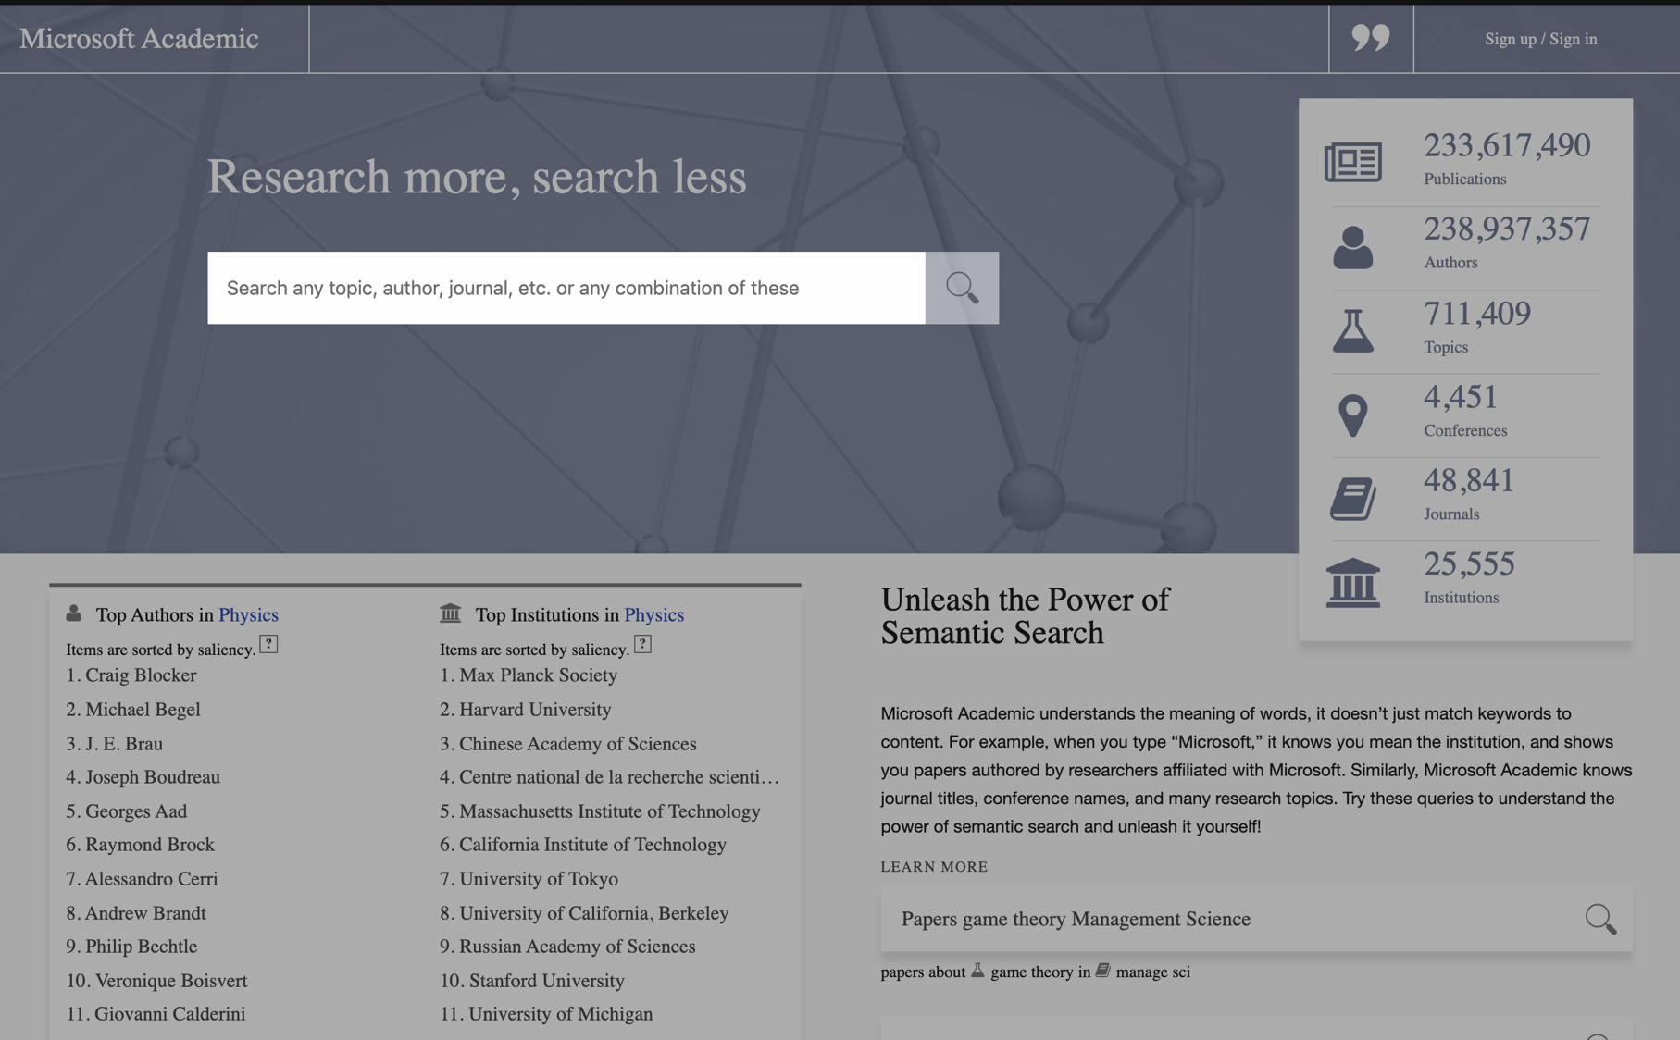

Slide 54
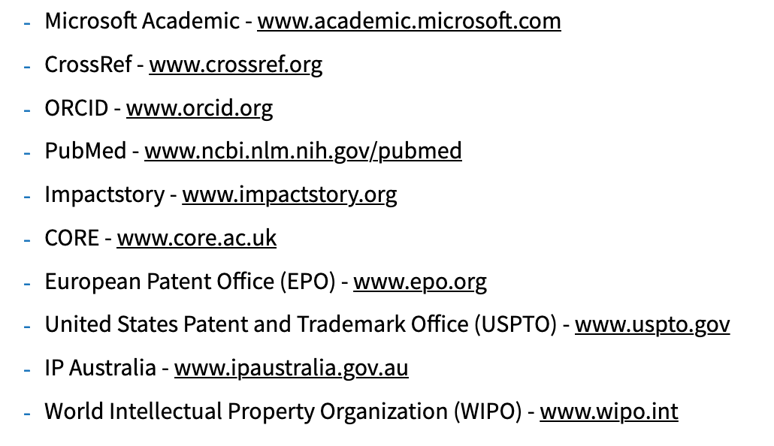
The Lens
The Lens is a joint initiative of Cambia (non-profit NGO) and Queensland University of Technology.
Free; non-profit; based on open source software
Data Partners

Slide 55


Slide 56
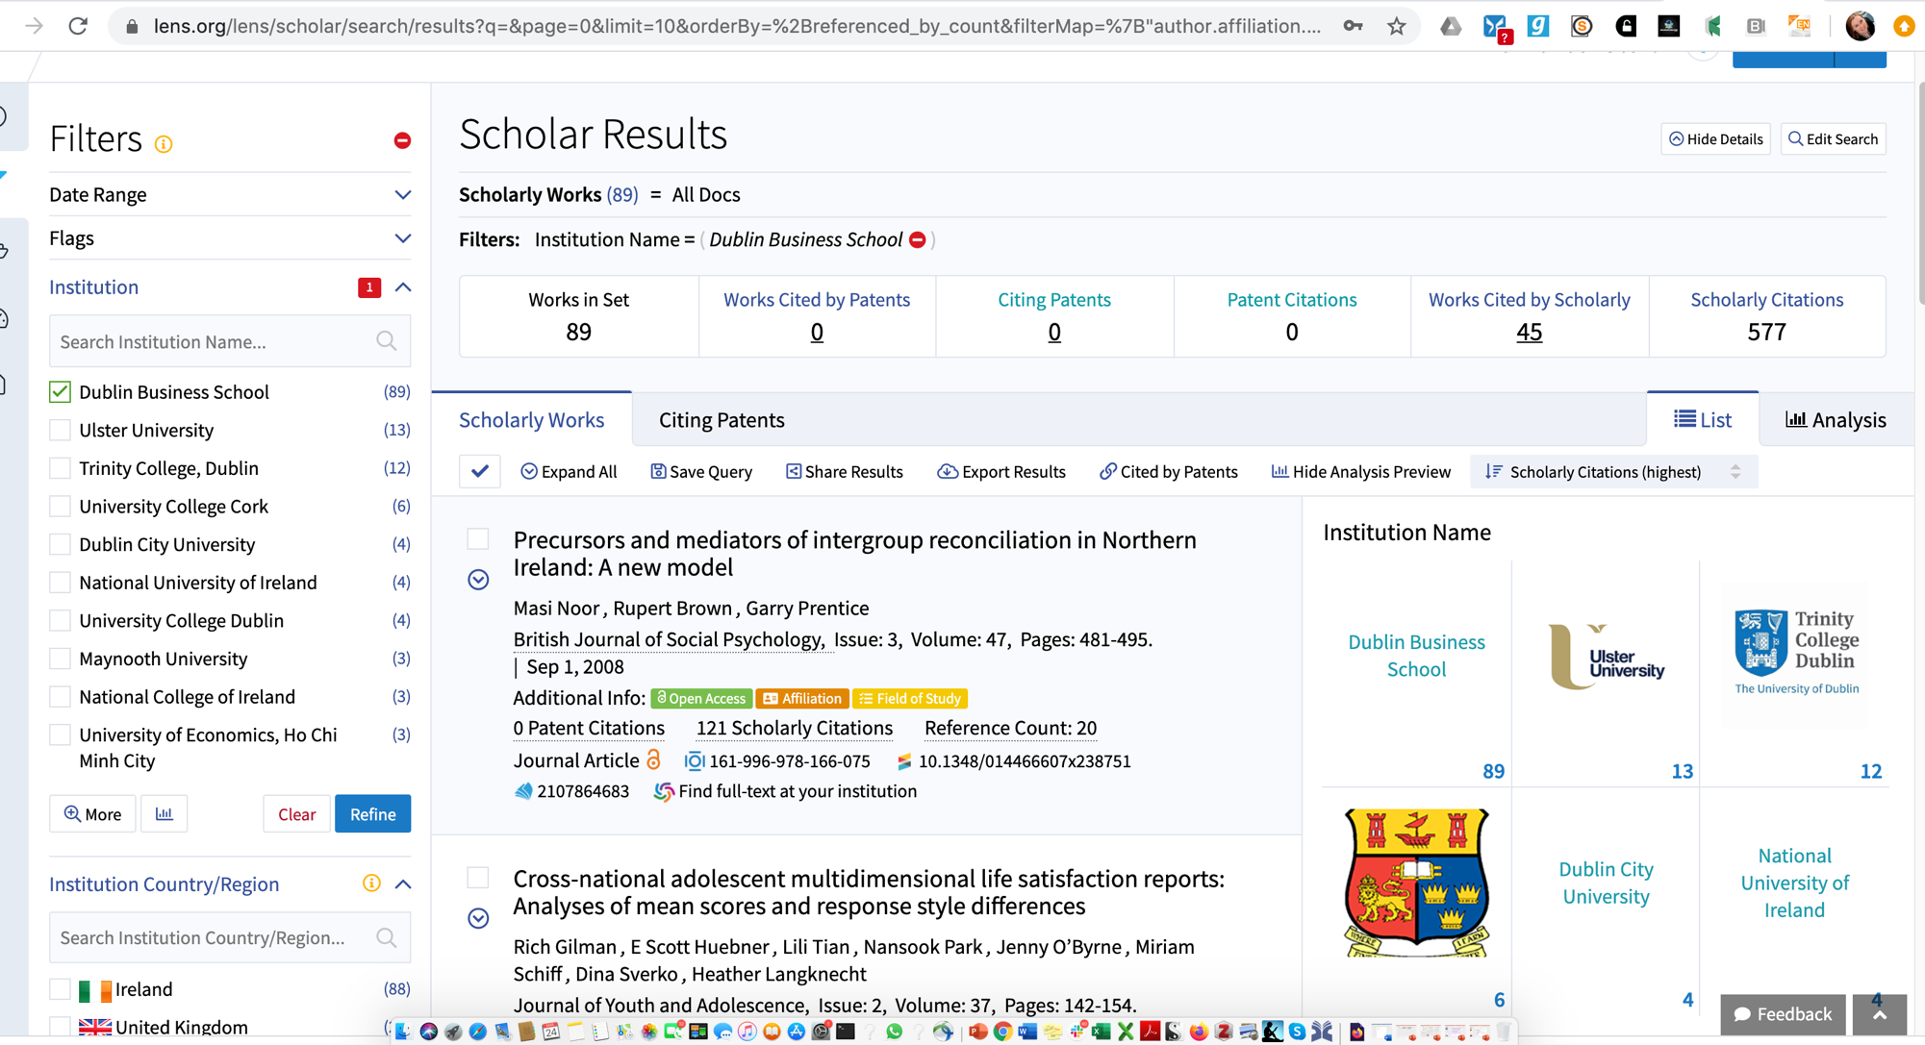

Slide 57
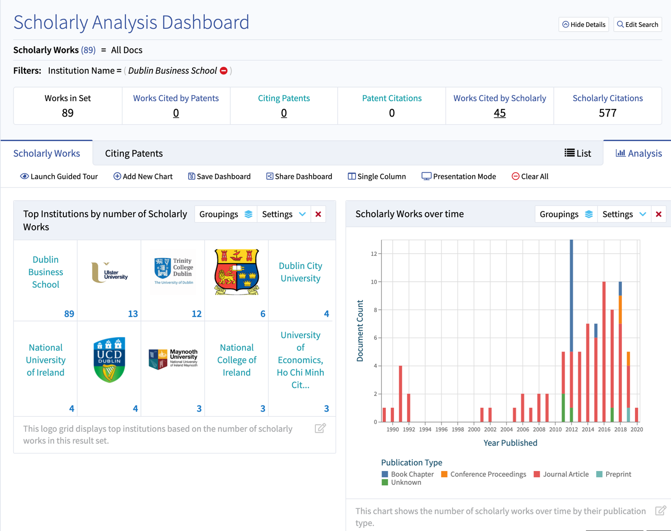

Slide 58
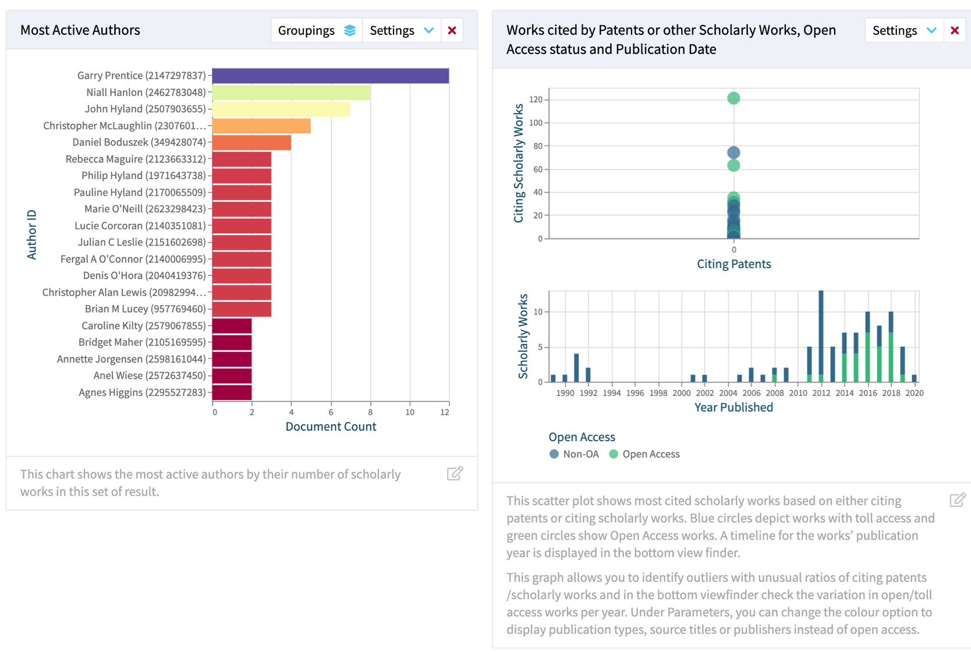

Slide 59
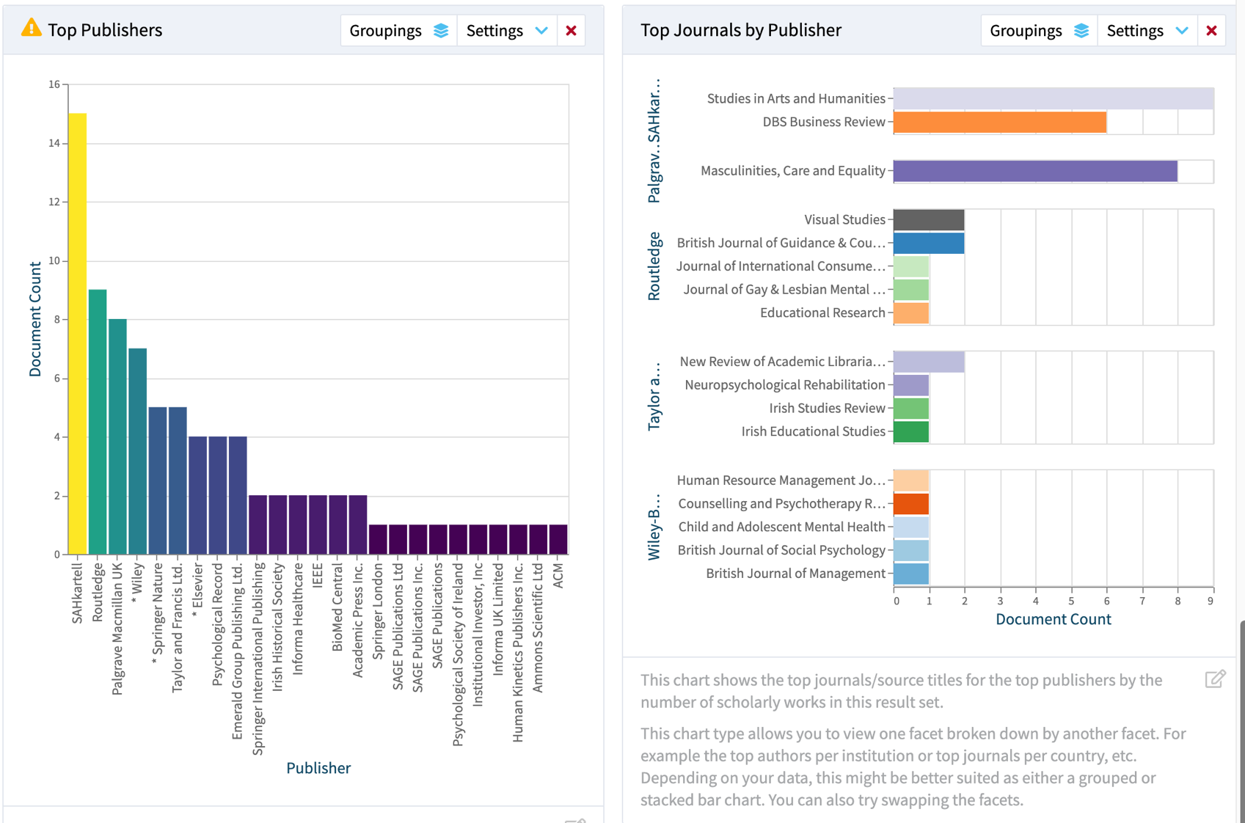

Slide 60
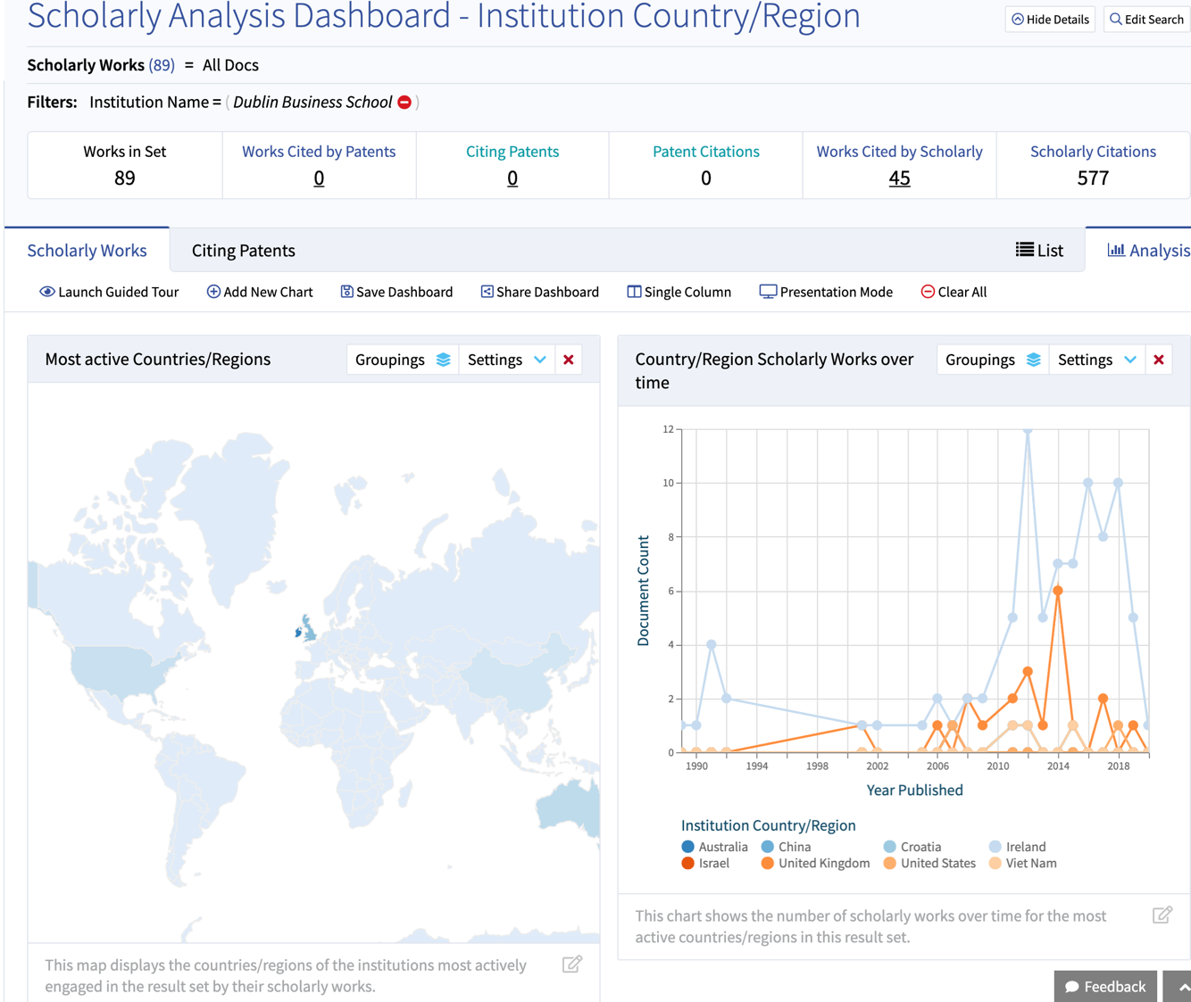

Slide 61
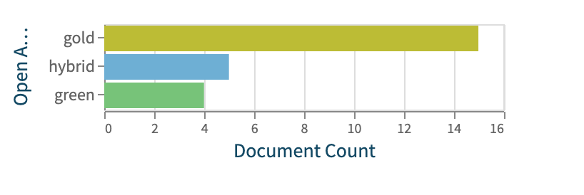
The Lens a.k.a. Lens.org
Very large database
Extensive range of searches &
filters (e.g. Open Access filter).
Coverage of patents & datasets as well as publications
Configurable analytics (with visualisations)
Shareable workspace for saved searches
Alerts
Exports in multiple formats of up to 50K records; REST API
FREE

Slide 62

Bibliometrics Tools: Accessibility
Name | Supplier | Subscription | Free | Open Source
Web of Science | Clarivate Analytics
InCites | Clarivate Analytics
Scopus | Elsevier
SciVal | Elsevier
Dimensions | Digital Science
Google Scholar | Google
Publish or Perish | Anne Harzing
Microsoft Academic Search | Microsoft Research
Lens.org | Cambia/QUT
1Findr | Max Planck Institute

Slide 63
Bibliometrics Tools: Coverage
Name | Records | Journals | Time period
Web of Science (core) | 71 million | 20,300 | 1969–
InCites | – | – | 1980–
Scopus | 60 million | 21,500 | 1996–
SciVal | – | – | 1996–
Dimensions | 140 million | 62,000 (?) | [1665!] More 1960–
Google Scholar | unknown | unknown
Publish or Perish | unknown | unknown
Microsoft Academic Search | 209.5 million | 48,024 | –
Lens.org | 195.6 million | 48,024 [+?] | –
1Findr | 90 million | 80,000

Slide 64
Bibliometrics Tools: Functionality
Name | Metrics | Researcher | Institution | Country | Benchmarking
Web of Science | Simple | (S) | (S) | (S)
InCites | Advanced | (S) | (S) | (S) | (S)
Scopus | Simple | (S) | (S) | (S)
SciVal | Advanced | (S) | (S) |  | (S)
Dimensions | Advanced |  | (S) | (S)
Google Scholar | Simple
Publish or Perish | Advanced
Microsoft Academic Search | Advanced
Lens.org | Advanced
1Findr | Minimal

Slide 65
Bibliometrics Tools: ownership, coverage & where to find them
Name | Owner | Where to find ? | No. of Records | No. of Journals indexed | Time period covered
Web of Science (core) | Clarivate Analytics | Subscription: check with your Library | 71 million | 20,300 | 1969–
InCites | Clarivate Analytics | Subscription: check with your Library | – | – | 1980–
Scopus | Elsevier | Subscription: check with your Library | 60 million | 21,500 | 1996–
SciVal | Elsevier | Subscription: check with your Library | – | – | 1996–
Dimensions | Digital Science | Freemium: free version on the web | 140 million | 62,000 (?) | [1665!] More 1960–
Google Scholar | Google | Free: available on the web | unknown | unknown
Publish or Perish | Professor Ann-Wil Harxing | Free: available to download | unknown | unknown
Microsoft Academic Search | Microsoft | Free: available on the web | 209.5 million | 48,024 | –
Lens.org | Cambia, an independent non-profit social enterprise. | Free: available on the web | 195.6 million | 48,024 [+?] | –

Slide 66
Altmetric Tools
 | Name | Supplier | Where to find it? | Subscription | Free/Free version | Free Plug-in/API | Embedded in:
 | Altmetric.com | Digital Science | Free widgets online; subscribed version via your Library |  |  |  | Dimensions; Repositories: Journal articles/data -bases
 | PlumX | Elsevier | Free widgets online; subscribed version via your Library |  |  |  | SciVal; Journal articles/data -bases
 | Kudos | Kudos | Free version available online; premium version also online |  |  |  | Application Website

Slide 67
Where to find Open Research Metrics & Related Tools
Name | Supplier | Subscription | Free | Open Source | Where:
ImpactStory | ImpactStort |  |  |  | Web-based
Google Analytics | Google |  |  |  | Web-based
Repository stats & plugins | Various |  |  |  | Repositories
OA Publisher statistics | Various |  |  |  | OA journals & publishing platforms
Web of Science /InCites | Clarivate Analytics |  |  |  | Commercial database
Scopus/SciVal | Elsevier |  |  |  | Commercial database
Dimensions | Digital Science |  |  |  | Commercial database
Unpaywall | ImpactStory |  |  |  | Dimensions Web of Science, Browser extension.
Kopernio | Clarivate Analytics |  |  |  | Browser extension

Slide 68
Bibliometrics Tools: application at individual researcher level?
Name | Metrics | Researcher | Institution | Country | Benchmarking
Web of Science | Simple
InCites | Advanced
Scopus | Simple
SciVal | Advanced
Dimensions | Advanced
Google Scholar | Simple
Publish or Perish | Advanced
Microsoft Academic Search | Advanced
Lens.org | Advanced

Slide 69
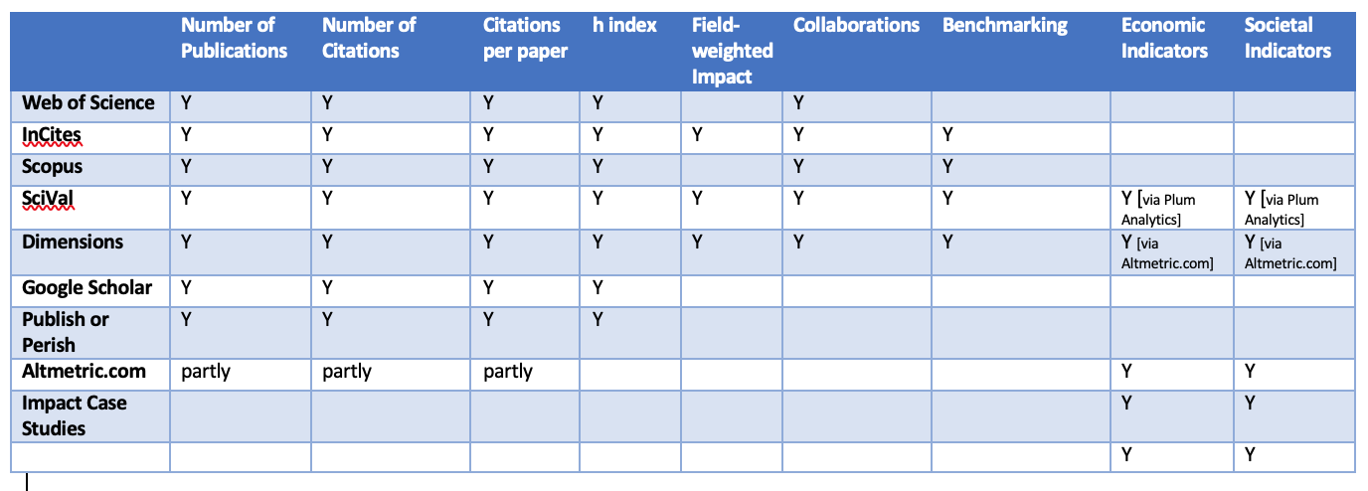
Which tool? Some of the main metrics provided by different tools and resources

Slide 70
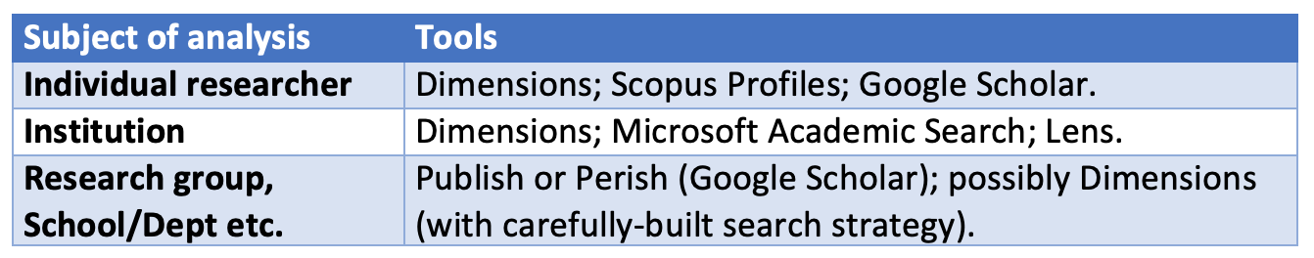
Bibliometric tools: Conclusion
More work is involved if you have no subscription – but there are options now, and they are multiplying.
Open Citations has been transformative (as is CrossRef).
– or ask for a trial from the commercial vendors

Slide 71

Choosing your metrics
Apply the bibliometric rules, DORA and the Leiden Principles.
Use the Metrics Toolkit
Consult: European Commission: Expert Group on Assessment of University-Based Research, Assessing Europe's University Based Research, European Commission DirectorateGeneral for Research, 2010 https://arrow.tudublin.ie/cserrep/17/

Slide 72
ReCap
What are bibliometrics?
Use and misuse of bibliometrics
Author level metrics
Article level metrics
Tools: commercial/subscription, freemium, free.
Choosing appropriate metrics

Slide 73
Thank You

