Slide 1

Make Your Work Count:
Library-based skills & training on research impact
Niamh Brennan,
Programme Manager, Research Informatics
Trinity College Dublin, Ireland
30th June 2021
nbrennan@tcd.ie

Slide 2
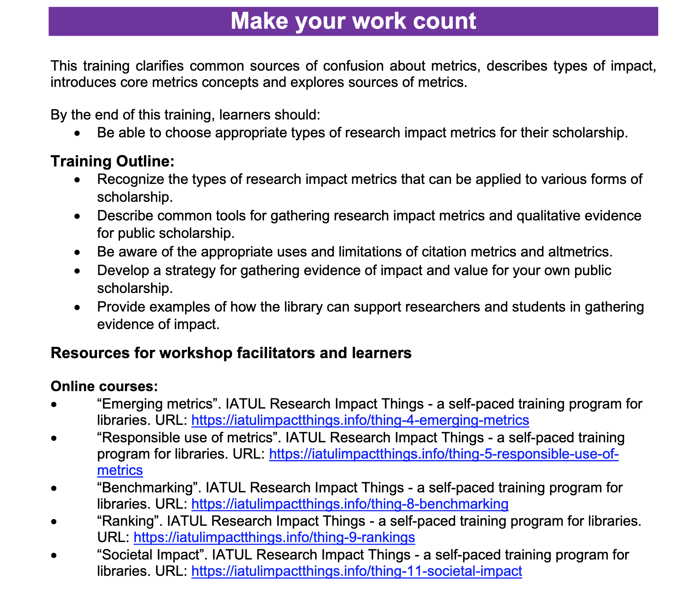
– From The EIFL Digital Research Literacy Training Outline
https://www.eifl.net/system/files/resources/202011/digital_research_literacy_training_outline_revnov2020_0.pdf

Slide 3
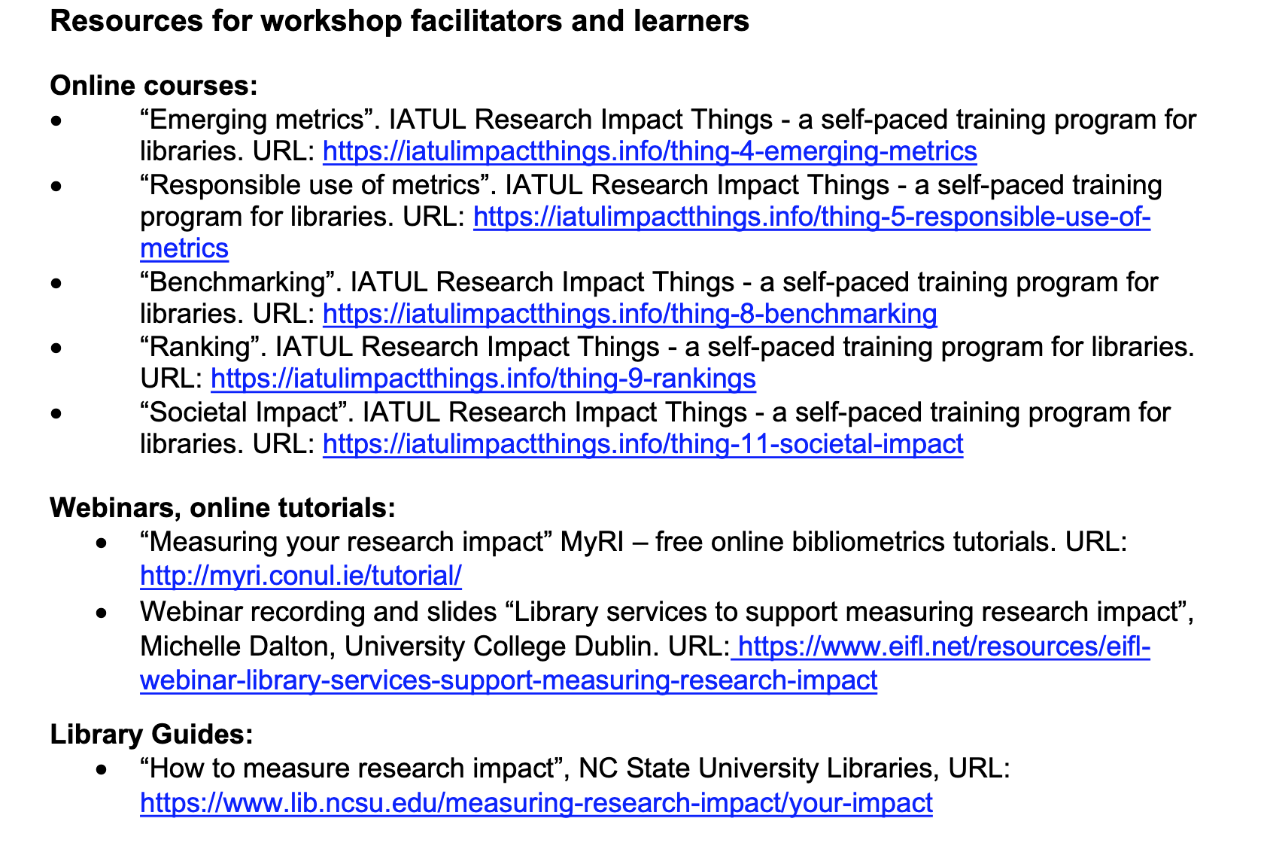
– From The EIFL Digital Research Literacy Training Outline
https://www.eifl.net/system/files/resources/202011/digital_research_literacy_training_outline_revnov2020_0.pdf

Slide 4
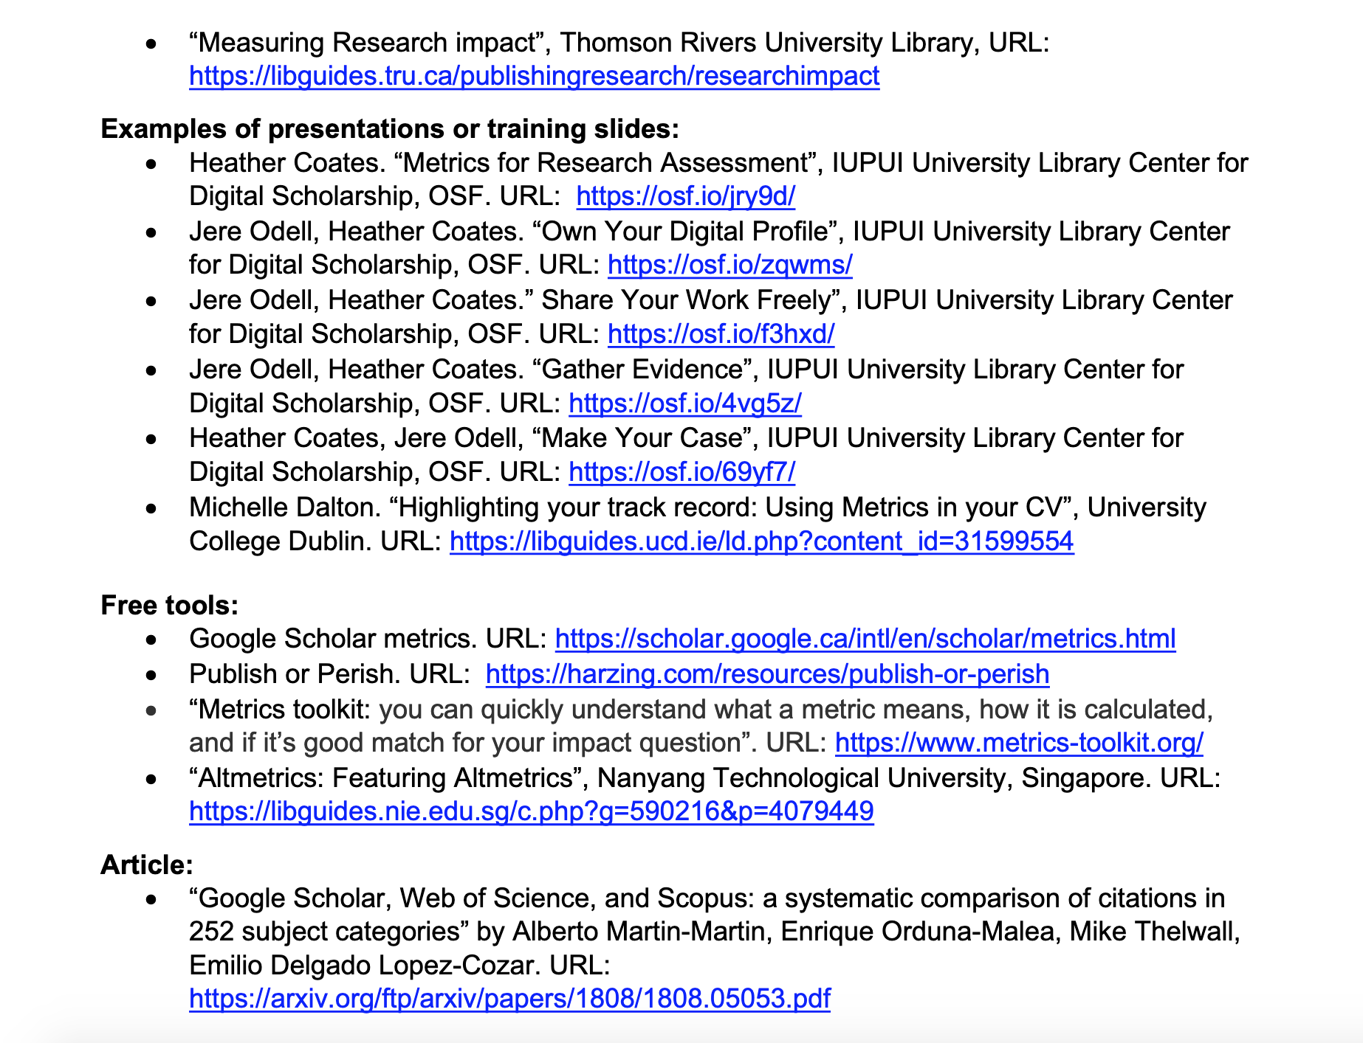
– From The EIFL Digital Research Literacy Training Outline
https://www.eifl.net/system/files/resources/202011/digital_research_literacy_training_outline_revnov2020_0.pdf

Slide 5
TODAY: How to choose the appropriate types of research impact metrics for particular types of scholarship
By recognizing the types of research impact metrics that can be applied to various forms of scholarship
By describing common tools for gathering research impact metrics and qualitative evidence for public scholarship.
Promoting awareness of the appropriate uses and limitations of citation metrics and altmetrics
By developing individual and group strategies for gathering evidence of impact and value for their own public scholarship
By providing examples of how the library can support researchers and students in gathering evidence of impact.

Slide 6
1. The types of research impact metrics that can be applied to various forms of scholarship
How research impact is measured
Research impact: the disciplinary perspective
Basic skills for all.

Slide 7

Tracking Impact:
which indicators?
}
Tracked changes
Case studies
Policy papers
More…
Under investigation in TCD
via focus groups / consultation
[IDR contributes to impact and is an impact in its own right]
Interdisciplinarity Indicators
Niamh Brennan,
Trinity College Dublin, 2019

Slide 8


Slide 9
What is Research Impact?
“impact is the provable benefits of research in the real world.”

Slide 10
What to measure | How | Tool | Where to find it
Research inputs (grant submissions, awards, collaborations) | University / funder pre- and post- award management system; Local and personal records. | University pre- and post- award management system; | Online via University Research Office
Research Outputs (publications and other research works). | Institutional Current Research Information System (CRIS); Bibliometric databases; Specialised databases | Institutional Current Research Information System (CRIS) Web of Science / InCites; Scopus / SciVal; Dimensions Microsoft Academic Search Lens.org PubMed | Online via institution’s webpages Via your Library website Via your Library website Via your Library website + (freemium web version); Free on web; Free on web
Esteem indicators (awards, honours, fellowships, etc) | Institutional Current Research Information System (CRIS); Manually collected. | Institutional Current Research Information System (CRIS) | Online via institution’s webpages
Citations, h-index and related bibliometric data | Bibliometric databases | Web of Science / InCites; Scopus / SciVal; Dimensions Google Scholar Citations / Publish or Perish (Harzing) Microsoft Academic Search Lens.org PubMed | Via your Library website Via your Library website Via your Library website + freemium web version; Free on the web; Free on the web; Free on the web; Free on the web; Free on the web;
Altmetric data (news and other media mentions, social media mentions, policy paper references, patent citations, Wikipedia references etc. | Altmetric databases; Manually collected; | Altmetric.com Plum X | Via your Library website + free per paper view on web Via your Library website + free per paper view on web;
Open Research metrics | Institutional Repository Specialist repository Impact story | Institutional Repository Specialist repository Impact story | Free on the web Free on the web Free on the web
Research data metrics | Data repository Impact Story Data citation databases | Zenodo etc. (see re3data.org); Impact story; Data Citation Index (Web of Science) | Free on the web Free on the web Via your Library website.
Citizen Science/ Engagement | Institutional Current Research Information System (CRIS); Reports & case studies; Manually collected. | Institutional Current Research Information System (CRIS); | Online via institution’s webpages Department/Institution/Funder
Societal/economic/cultural impact | Case studies (UK REF-style) Reports Manually collected. | Case study template | Department/Institution/Funder Department/Institution/Funder Department/Institution/Funder
Overall research quality | Field-specific peer review panel | Peer review panel/s (usually established by department/institution/funder) | Department/Institution/Funder

Slide 11
Research evaluation by discipline
There is no ‘one size fits all’ when it comes to research evaluation. Disciplinary differences in research methods and behaviours and in research ‘inputs’ and ‘outputs’ need to be taken into account if any type of meaningful research evaluation is to take place. And when it comes to the area of interdisciplinary research, an understanding of the cultures of other disciplines is vital to successful collaboration.
Arts & Humanities
Social Sciences
Health Sciences
Engineering & Technology
Sciences

Slide 12
What to measure | How | Tool | Where to find it
Research inputs (grant submissions, awards, collaborations) | University / funder pre- and post- award management system; Local and personal records. | University pre- and post- award management system; | Online via University Research Office
Research Outputs (publications and other research works). | Institutional Current Research Information System (CRIS); Bibliometric databases; Specialised databases | Institutional Current Research Information System (CRIS) Web of Science / InCites; Scopus / SciVal; Dimensions Microsoft Academic Search Lens.org PubMed | Online via institution’s webpages Via your Library website Via your Library website Via your Library website + (freemium web version); Free on web; Free on web
Esteem indicators (awards, honours, fellowships, etc) | Institutional Current Research Information System (CRIS); Manually collected. | Institutional Current Research Information System (CRIS) | Online via institution’s webpages
Citations, h-index and related bibliometric data | Bibliometric databases | Web of Science / InCites; Scopus / SciVal; Dimensions Google Scholar Citations / Publish or Perish (Harzing) Microsoft Academic Search Lens.org PubMed | Via your Library website Via your Library website Via your Library website + freemium web version; Free on the web; Free on the web; Free on the web; Free on the web; Free on the web;
Altmetric data (news and other media mentions, social media mentions, policy paper references, patent citations, Wikipedia references etc. | Altmetric databases; Manually collected; | Altmetric.com Plum X | Via your Library website + free per paper view on web Via your Library website + free per paper view on web;
Open Research metrics | Institutional Repository Specialist repository Impact story | Institutional Repository Specialist repository Impact story | Free on the web Free on the web Free on the web
Research data metrics | Data repository Impact Story Data citation databases | Zenodo etc. (see re3data.org); Impact story; Data Citation Index (Web of Science) | Free on the web Free on the web Via your Library website.
Citizen Science/ Engagement | Institutional Current Research Information System (CRIS); Reports & case studies; Manually collected. | Institutional Current Research Information System (CRIS); | Online via institution’s webpages Department/Institution/Funder
Societal/economic/cultural impact | Case studies (UK REF-style) Reports Manually collected. | Case study template | Department/Institution/Funder Department/Institution/Funder Department/Institution/Funder
Overall research quality | Field-specific peer review panel | Peer review panel/s (usually established by department/institution/funder) | Department/Institution/Funder
Arts & Humanities
Institutional CRIS are particularly important in Arts and Humanities due to the issues with coverage of the bibliometric and other external databases. CRIS can include non-traditional academic outputs such as multimedia. However, the profiles need to be kept up to date.
Bibliometric data is problematic in Arts & Humanities due to coverage issues and different disciplinary publishing and citation practices; use with caution.
Google Scholar and Publish or Perish may be better for Arts & Humanities than other databases.
Altmetrics are particularly important in Arts & Humanities due to weaknesses of bibliometric indicators.
Open Research metrics including data impact information is particularly important in Arts & Humanities in demonstrating impact.
Citizen Science / Engagement and Societal/Economic/Cultural Case studies are particularly important in Arts & Humanities due to weaknesses of bibliometric indicators.
Peer review is particularly important in Arts & Humanities due to weaknesses of bibliometric indicators.

Slide 13
What to measure | How | Tool | Where to find it
Research inputs (grant submissions, awards, collaborations) | University / funder pre- and post- award management system; Local and personal records. | University pre- and post- award management system; | Online via University Research Office
Research Outputs (publications and other research works). | Institutional Current Research Information System (CRIS); Bibliometric databases; Specialised databases | Institutional Current Research Information System (CRIS) Web of Science / InCites; Scopus / SciVal; Dimensions Microsoft Academic Search Lens.org PubMed | Online via institution’s webpages Via your Library website Via your Library website Via your Library website + (freemium web version); Free on web; Free on web
Esteem indicators (awards, honours, fellowships, etc) | Institutional Current Research Information System (CRIS); Manually collected. | Institutional Current Research Information System (CRIS) | Online via institution’s webpages
Citations, h-index and related bibliometric data | Bibliometric databases | Web of Science / InCites; Scopus / SciVal; Dimensions Google Scholar Citations / Publish or Perish (Harzing) Microsoft Academic Search Lens.org PubMed | Via your Library website Via your Library website Via your Library website + freemium web version; Free on the web; Free on the web; Free on the web; Free on the web; Free on the web;
Altmetric data (news and other media mentions, social media mentions, policy paper references, patent citations, Wikipedia references etc. | Altmetric databases; Manually collected; | Altmetric.com Plum X | Via your Library website + free per paper view on web Via your Library website + free per paper view on web;
Open Research metrics | Institutional Repository Specialist repository Impact story | Institutional Repository Specialist repository Impact story | Free on the web Free on the web Free on the web
Research data metrics | Data repository Impact Story Data citation databases | Zenodo etc. (see re3data.org); Impact story; Data Citation Index (Web of Science) | Free on the web Free on the web Via your Library website.
Citizen Science/ Engagement | Institutional Current Research Information System (CRIS); Reports & case studies; Manually collected. | Institutional Current Research Information System (CRIS); | Online via institution’s webpages Department/Institution/Funder
Societal/economic/cultural impact | Case studies (UK REF-style) Reports Manually collected. | Case study template | Department/Institution/Funder Department/Institution/Funder Department/Institution/Funder
Overall research quality | Field-specific peer review panel | Peer review panel/s (usually established by department/institution/funder) | Department/Institution/Funder
Social Sciences
Institutional CRIS are particularly important in Social Sciences due to the coverage issues of the bibliometric and other external databases. They include non-traditional academic outputs such as multimedia. However, the profiles need to be kept up to date.
Bibliometric data is problematic in Social Sciences due to coverage issues and different disciplinary publishing and citation practices; use with caution.
Google Scholar and Publish or Perish may be better for Social Sciences than other databases.
Altmetrics are particularly important in Social Sciences due to weaknesses of bibliometric indicators and importance of societal impact.
Open Research metrics including data impact information are particularly important in Social Sciences in demonstrating impact.
Citizen Science / Engagement and Societal/Economic/Cultural Case studies are particularly important in Social Sciences due to weaknesses of bibliometric indicators and importance of demonstrating societal impact. Policy paper references are very valuable.
Peer review is particularly important in Social Sciences due to weaknesses of bibliometric indicators.

Slide 14
What to measure | How | Tool | Where to find it
Research inputs (grant submissions, awards, collaborations) | University / funder pre- and post- award management system; Local and personal records. | University pre- and post- award management system; | Online via University Research Office
Research Outputs (publications and other research works). | Institutional Current Research Information System (CRIS); Bibliometric databases; Specialised databases | Institutional Current Research Information System (CRIS) Web of Science / InCites; Scopus / SciVal; Dimensions Microsoft Academic Search Lens.org PubMed | Online via institution’s webpages Via your Library website Via your Library website Via your Library website + (freemium web version); Free on web; Free on web
Esteem indicators (awards, honours, fellowships, etc) | Institutional Current Research Information System (CRIS); Manually collected. | Institutional Current Research Information System (CRIS) | Online via institution’s webpages
Citations, h-index and related bibliometric data | Bibliometric databases | Web of Science / InCites; Scopus / SciVal; Dimensions Google Scholar Citations / Publish or Perish (Harzing) Microsoft Academic Search Lens.org PubMed | Via your Library website Via your Library website Via your Library website + freemium web version; Free on the web; Free on the web; Free on the web; Free on the web; Free on the web;
Altmetric data (news and other media mentions, social media mentions, policy paper references, patent citations, Wikipedia references etc. | Altmetric databases; Manually collected; | Altmetric.com Plum X | Via your Library website + free per paper view on web Via your Library website + free per paper view on web;
Open Research metrics | Institutional Repository Specialist repository Impact story | Institutional Repository Specialist repository Impact story | Free on the web Free on the web Free on the web
Research data metrics | Data repository Impact Story Data citation databases | Zenodo etc. (see re3data.org); Impact story; Data Citation Index (Web of Science) | Free on the web Free on the web Via your Library website.
Citizen Science/ Engagement | Institutional Current Research Information System (CRIS); Reports & case studies; Manually collected. | Institutional Current Research Information System (CRIS); | Online via institution’s webpages Department/Institution/Funder
Societal/economic/cultural impact | Case studies (UK REF-style) Reports Manually collected. | Case study template | Department/Institution/Funder Department/Institution/Funder Department/Institution/Funder
Overall research quality | Field-specific peer review panel | Peer review panel/s (usually established by department/institution/funder) | Department/Institution/Funder
Health Sciences
Institutional CRIS are particularly important in Health Sciences due to the collection of data beyond traditional publication information. National/international leadership roles can be captured, as well as information on Public and Patient Engagement. However, the profiles need to be kept up to date.
Bibliometric data can work well in Health Sciences but should always be used with care;
Altmetrics are important in Health Sciences, balancing bibliometric indicators and highlighting societal impact.
Open Research metrics including data impact information are important in Health Sciences in demonstrating societal impact.
Citizen Science / Engagement and Societal/Economic/Cultural Case studies are particularly important in Health Sciences due to the importance of demonstrating societal impact. Policy paper references are very valuable.
Peer review is always important in Health Sciences.

Slide 15
What to measure | How | Tool | Where to find it
Research inputs (grant submissions, awards, collaborations) | University / funder pre- and post- award management system; Local and personal records. | University pre- and post- award management system; | Online via University Research Office
Research Outputs (publications and other research works). | Institutional Current Research Information System (CRIS); Bibliometric databases; Specialised databases | Institutional Current Research Information System (CRIS) Web of Science / InCites; Scopus / SciVal; Dimensions Microsoft Academic Search Lens.org PubMed | Online via institution’s webpages Via your Library website Via your Library website Via your Library website + (freemium web version); Free on web; Free on web
Esteem indicators (awards, honours, fellowships, etc) | Institutional Current Research Information System (CRIS); Manually collected. | Institutional Current Research Information System (CRIS) | Online via institution’s webpages
Citations, h-index and related bibliometric data | Bibliometric databases | Web of Science / InCites; Scopus / SciVal; Dimensions Google Scholar Citations / Publish or Perish (Harzing) Microsoft Academic Search Lens.org PubMed | Via your Library website Via your Library website Via your Library website + freemium web version; Free on the web; Free on the web; Free on the web; Free on the web; Free on the web;
Altmetric data (news and other media mentions, social media mentions, policy paper references, patent citations, Wikipedia references etc. | Altmetric databases; Manually collected; | Altmetric.com Plum X | Via your Library website + free per paper view on web Via your Library website + free per paper view on web;
Open Research metrics | Institutional Repository Specialist repository Impact story | Institutional Repository Specialist repository Impact story | Free on the web Free on the web Free on the web
Research data metrics | Data repository Impact Story Data citation databases | Zenodo etc. (see re3data.org); Impact story; Data Citation Index (Web of Science) | Free on the web Free on the web Via your Library website.
Citizen Science/ Engagement | Institutional Current Research Information System (CRIS); Reports & case studies; Manually collected. | Institutional Current Research Information System (CRIS); | Online via institution’s webpages Department/Institution/Funder
Societal/economic/cultural impact | Case studies (UK REF-style) Reports Manually collected. | Case study template | Department/Institution/Funder Department/Institution/Funder Department/Institution/Funder
Overall research quality | Field-specific peer review panel | Peer review panel/s (usually established by department/institution/funder) | Department/Institution/Funder
Engineering & Technology
Engineering & Technology
Institutional CRIS are particularly important in Engineering & Technology due to issues of coverage of conference papers and reports as well as collection of data beyond traditional publication information. However, the profiles need to be kept up to date.
Bibliometric data can be problematic in Engineering & Technology due to issues of coverage of conference papers and reports; use them with caution.
Google Scholar and Publish or Perish may be better for Engineering & Technology citations reporting than other citation databases.
Altmetrics are important in Engineering & Technology , balancing bibliometric indicators and highlighting societal impact.
Open Research metrics including data impact information are important in Engineering & Technology in demonstrating societal impact.
Citizen Science / Engagement and Societal/Economic/Cultural Case studies are particularly important in Engineering & Technology due to the importance of demonstrating societal impact. Policy paper references are very valuable.
Peer review is always important in Engineering & Technology

Slide 16
What to measure | How | Tool | Where to find it
Research inputs (grant submissions, awards, collaborations) | University / funder pre- and post- award management system; Local and personal records. | University pre- and post- award management system; | Online via University Research Office
Research Outputs (publications and other research works). | Institutional Current Research Information System (CRIS); Bibliometric databases; Specialised databases | Institutional Current Research Information System (CRIS) Web of Science / InCites; Scopus / SciVal; Dimensions Microsoft Academic Search Lens.org PubMed | Online via institution’s webpages Via your Library website Via your Library website Via your Library website + (freemium web version); Free on web; Free on web
Esteem indicators (awards, honours, fellowships, etc) | Institutional Current Research Information System (CRIS); Manually collected. | Institutional Current Research Information System (CRIS) | Online via institution’s webpages
Citations, h-index and related bibliometric data | Bibliometric databases | Web of Science / InCites; Scopus / SciVal; Dimensions Google Scholar Citations / Publish or Perish (Harzing) Microsoft Academic Search Lens.org PubMed | Via your Library website Via your Library website Via your Library website + freemium web version; Free on the web; Free on the web; Free on the web; Free on the web; Free on the web;
Altmetric data (news and other media mentions, social media mentions, policy paper references, patent citations, Wikipedia references etc. | Altmetric databases; Manually collected; | Altmetric.com Plum X | Via your Library website + free per paper view on web Via your Library website + free per paper view on web;
Open Research metrics | Institutional Repository Specialist repository Impact story | Institutional Repository Specialist repository Impact story | Free on the web Free on the web Free on the web
Research data metrics | Data repository Impact Story Data citation databases | Zenodo etc. (see re3data.org); Impact story; Data Citation Index (Web of Science) | Free on the web Free on the web Via your Library website.
Citizen Science/ Engagement | Institutional Current Research Information System (CRIS); Reports & case studies; Manually collected. | Institutional Current Research Information System (CRIS); | Online via institution’s webpages Department/Institution/Funder
Societal/economic/cultural impact | Case studies (UK REF-style) Reports Manually collected. | Case study template | Department/Institution/Funder Department/Institution/Funder Department/Institution/Funder
Overall research quality | Field-specific peer review panel | Peer review panel/s (usually established by department/institution/funder) | Department/Institution/Funder
Sciences
Institutional CRIS are particularly important in Sciences due to the collection of data beyond traditional publication information. National/international leadership roles can be also captured. However, the profiles need to be kept up to date.
Bibliometric data can generally work well in Sciences research evaluation but should always be used with care; there are differences in bibliometrics within Science fields.
Altmetrics are important in Sciences, balancing bibliometric indicators and highlighting societal impact.
Open Research metrics including data impact information are important in Sciences in demonstrating societal impact.
Citizen Science / Engagement and Societal/Economic/Cultural Case studies are particularly important in Sciences due to the importance of demonstrating societal impact.
Peer review is always important in Sciences.

Slide 17
Basic Level Research Impact Skills for All
ORCID and other profiles
DOIs and other standards
Predatory journal recognition and avoidance
How to access tools such as Web of Science, Scopus, Dimensions, Lens.org etc.
How to check personal details in tools such as Web of Science, Scopus, Dimensions, Lens.org etc. How to establish citation alerts. How to correct errors.
Checking that your intended publication sources are indexed in Scopus etc.
Making your work (publications & data) open access.

Slide 18
2. Common tools for gathering research impact metrics and qualitative evidence for public scholarship.
Tools: availability, coverage, location
Case study template
Manual collection (surveys, questionaires).

Slide 19


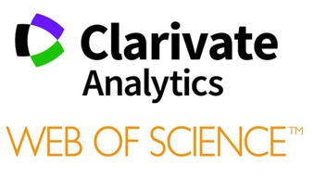













A confusing array of tools available for research evaluation and reporting.

Slide 20
The tools
Institutional CRIS (Research information system – if available); other sources of institutional information.
Your institutional repository
Subscribed resources (if available):
  Web of Science, InCites, Essential Science Indicators
  Scopus and SciVal
Google Scholar, Google Citations, Publish or Perish, ResearcherID, Lens.Org, Microsoft Academic Search… etc.
Altmetric tools (Altmetric.com; PlumX)
ORCID
Data visualisation tools (Tableau Public, Canva.com, Piktochart)
Research Impact Case Study templates

Slide 21

Bibliometrics Tools: Functionality (‘S’=Subscription required)
Name | Metrics | Researcher | Institution | Country | Benchmarking
Web of Science | Simple | (S) | (S) | (S)
InCites | Advanced | (S) | (S) | (S) | (S)
Scopus | Simple | (S) | (S) | (S)
SciVal | Advanced | (S) | (S) |  | (S)
Dimensions | Advanced |  | (S) | (S)
Google Scholar | Simple
Publish or Perish | Advanced
Microsoft Academic Search | Advanced
Lens.org | Advanced
1Findr | Minimal

Slide 22
Altmetric Tools
 | Name | Supplier | Where to find it? | Subscription | Free/Free version | Free Plug-in/API | Embedded in:
 | Altmetric.com | Digital Science | Free widgets online; subscribed version via your Library |  |  |  | Dimensions; Repositories: Journal articles/data -bases
 | PlumX | Elsevier | Free widgets online; subscribed version via your Library |  |  |  | SciVal; Journal articles/data -bases
 | Kudos | Kudos | Free version available online; premium version also online |  |  |  | Application Website

Slide 23
Where to find Open Science Metrics & Related Tools
Name | Supplier | Subscription | Free | Open Source | Where:
ImpactStory | ImpactStort |  |  |  | Web-based
Google Analytics | Google |  |  |  | Web-based
Repository stats & plugins | Various |  |  |  | Repositories
OA Publisher statistics | Various |  |  |  | OA journals & publishing platforms
Web of Science /InCites | Clarivate Analytics |  |  |  | Commercial database
Scopus/SciVal | Elsevier |  |  |  | Commercial database
Dimensions | Digital Science |  |  |  | Commercial database
Unpaywall | ImpactStory |  |  |  | Dimensions Web of Science, Browser extension.
Kopernio | Clarivate Analytics |  |  |  | Browser extension

Slide 24
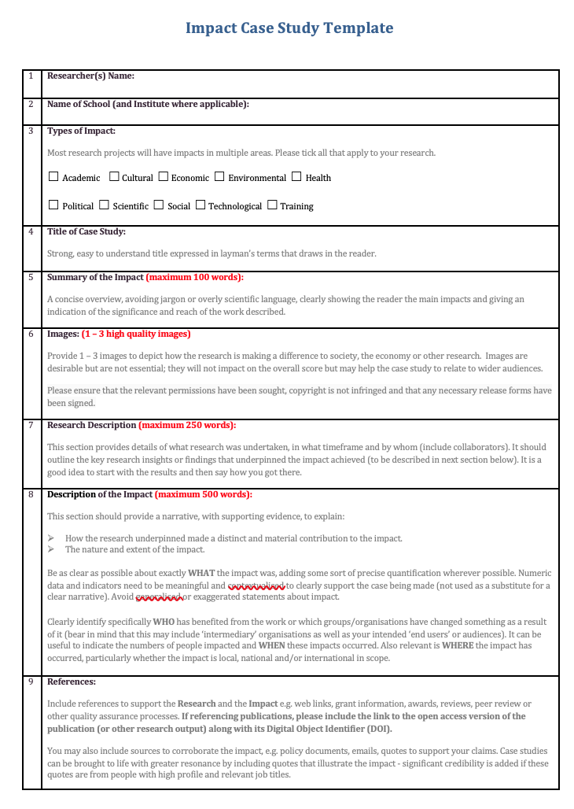
Planning & creating societal impact
Impact Case Study Templates
A tool for capturing the societal, economic and cultural impact of a research project.
Example shown is from Trinity College Dublin
Suggestions on how to use this type of tool appear later in this presentation.
A Word version of this template is available as part of EIFL’s ‘Make Your Work Count’ Resources for Practitioners and Workshop Facilitators.
Niamh Brennan,
Trinity College Dublin, 2019

Slide 25
3. Promoting awareness of the appropriate uses and limitations of citation metrics and altmetrics
Use a basket of metrics!
Use the Metrics Toolkit
Promote DORA & the Leiden Manifesto

Slide 26

Choosing your metrics
Apply the bibliometric rules, DORA and the Leiden Principles.
Use the Metrics Toolkit
Consult: European Commission: Expert Group on Assessment of University-Based Research, Assessing Europe's University Based Research, European Commission DirectorateGeneral for Research, 2010 https://arrow.tudublin.ie/cserrep/17/

Slide 27
Appropriate Use: The rules
Never compare bibliometric data across fields or disciplines.
Always use a range of metrics.
Try to balance quantitative data with qualitative data if at all possible (ideally including peer review). This is vital for disciplines that are poorly served by bibliometric information.
Be sure to identify your data sources, parameters and methodology. It’s OK to mix data sources (it’s probably desirable).
Strive to make your researchers aware of the ways in which they are being evaluated and provide them with the means to improve their results.
Share expertise and information with colleagues (and make the world a better place!).

Slide 28
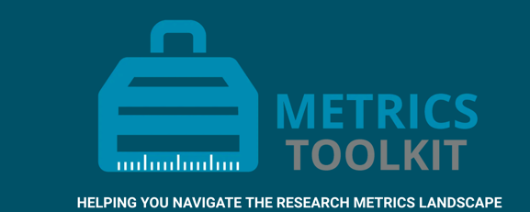
Check out the Metrics Toolkit:
https://www.metrics-toolkit.org//

Slide 29
4. Individual and group strategies for gathering evidence of impact and value for their own public scholarship
1. Developing a Research Impact Strategy (using all appropriate metrics)
2. Using a Research Impact Case Study template

Slide 30
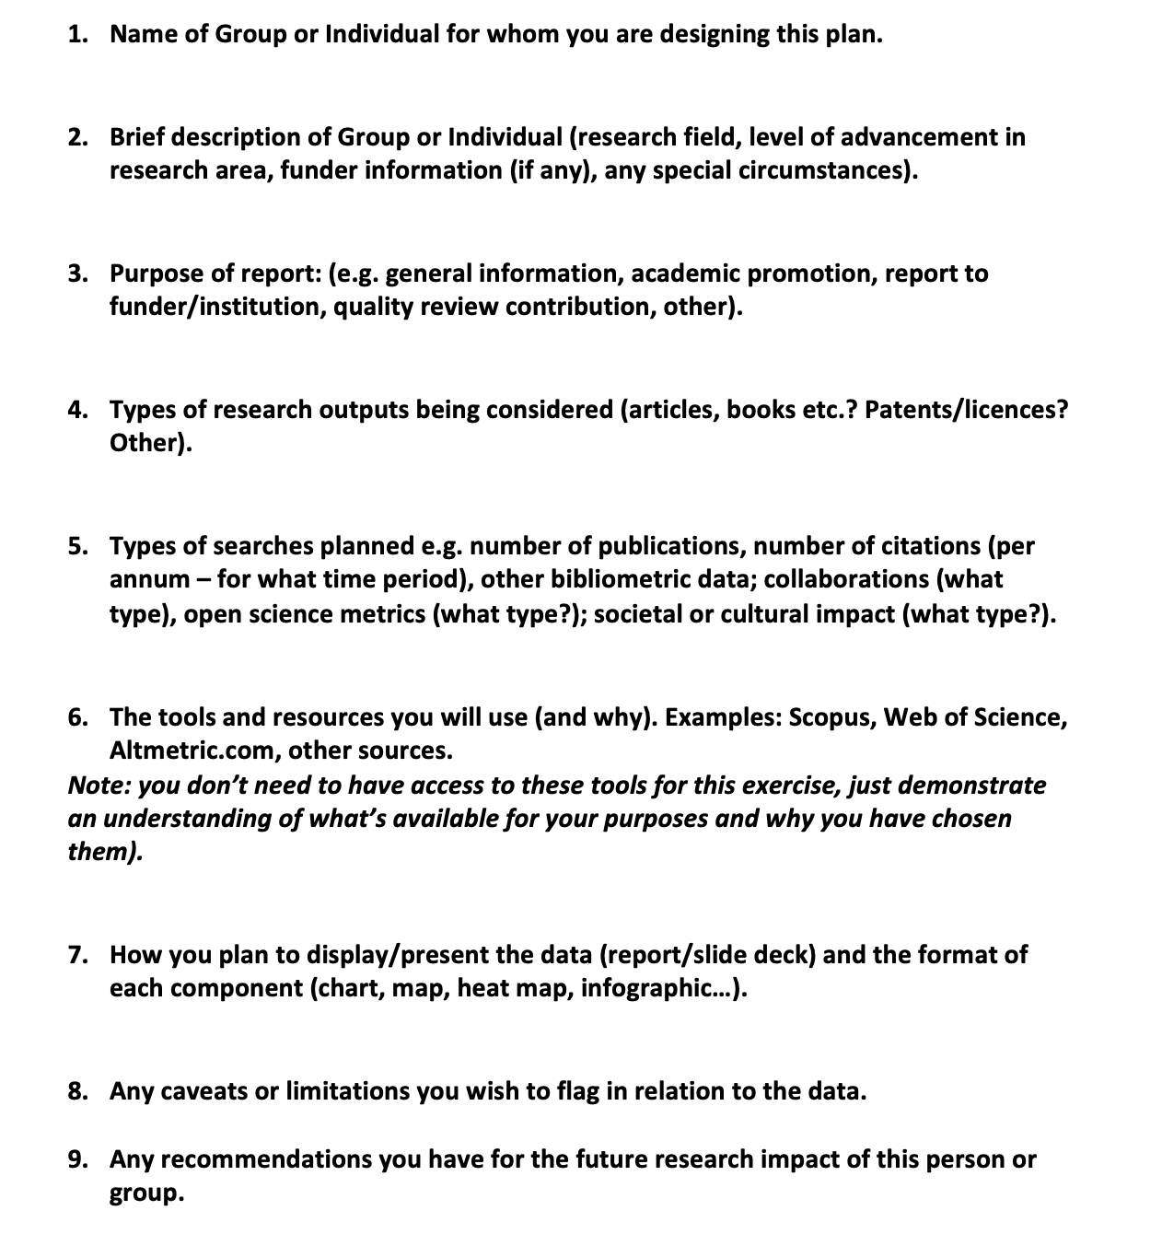
Research Impact Report Planning Template
A template for outlining the purpose, means and methodology for a research impact report. Can be applied to individuals, groups or institutions.
A Word version of this template is available as part of EIFL’s ‘Make Your Work Count’ Resources for Practitioners and Workshop Facilitators.
Niamh Brennan, 2019

Slide 31
Planning & creating societal impact
Use this type of template with research students and researchers at any stage of their project, but ideally at the outset, and then at later stages.
Work with faculty to capture the societal impact of group and individual research via this template. Work with faculty to publish selected case studies online and/or in a brochure.
In a multi-disciplinary workshop environment, ask participants to complete the template and then present their societal impact to the group. Participants from other disciplines should be encouraged to comment and make suggestions.
A Word version of this template is available as part of EIFL’s ‘Make Your Work Count’ Resources for Practitioners and Workshop Facilitators.
Niamh Brennan,
Trinity College Dublin, 2019

Slide 32
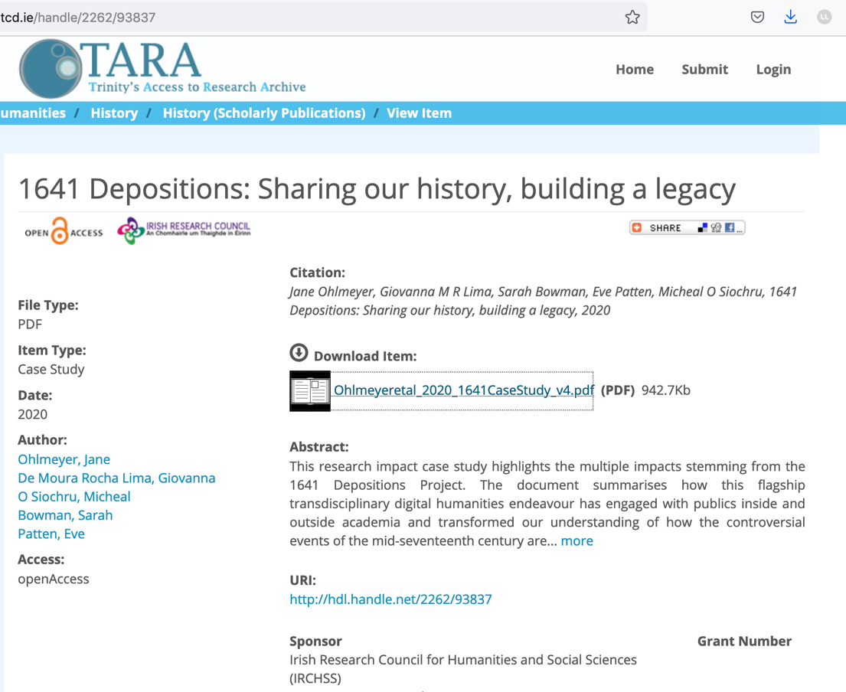
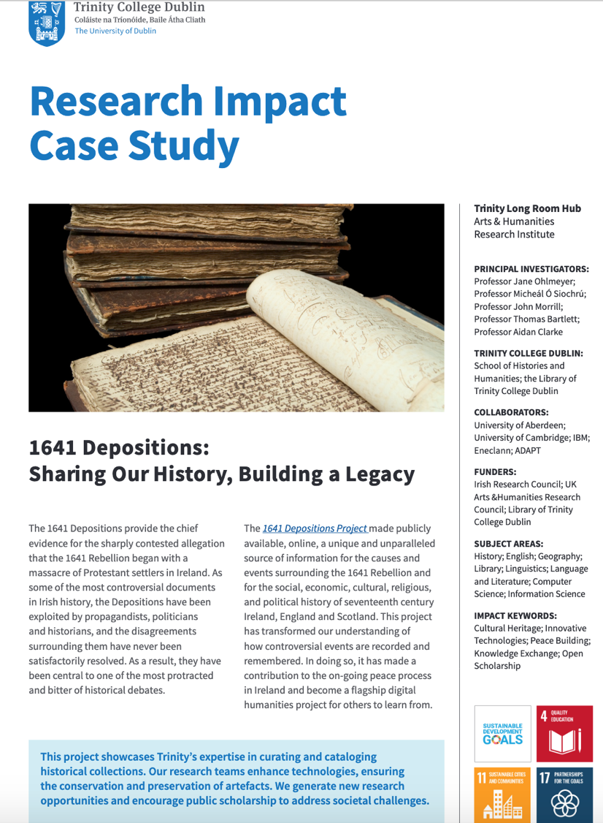
http://www.tara.tcd.ie/bitstream/handle/2262/93837/Ohlmeyeretal_2020_1641CaseStudy_v4.pdf

Slide 33
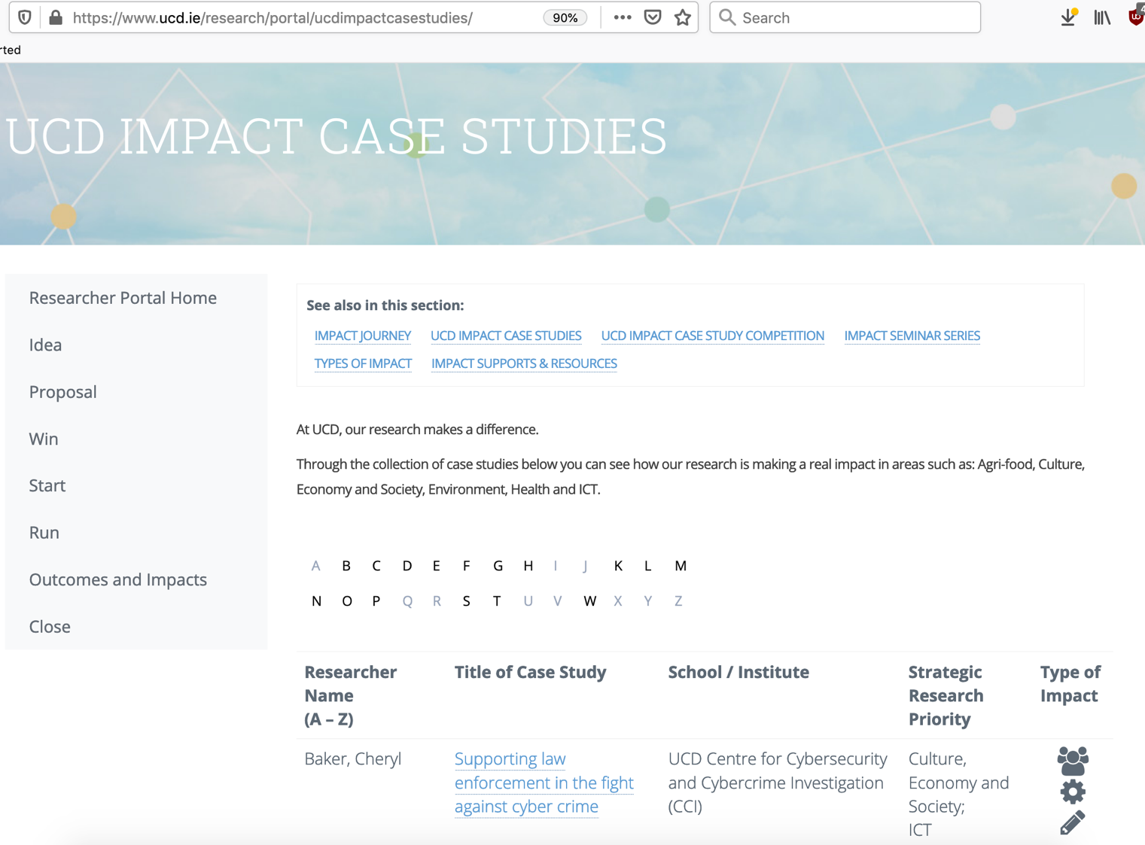

https://researchrepository.ucd.ie/bitstream/10197/7292/1/Furthering_Impact_May_2014.pdf

Slide 34
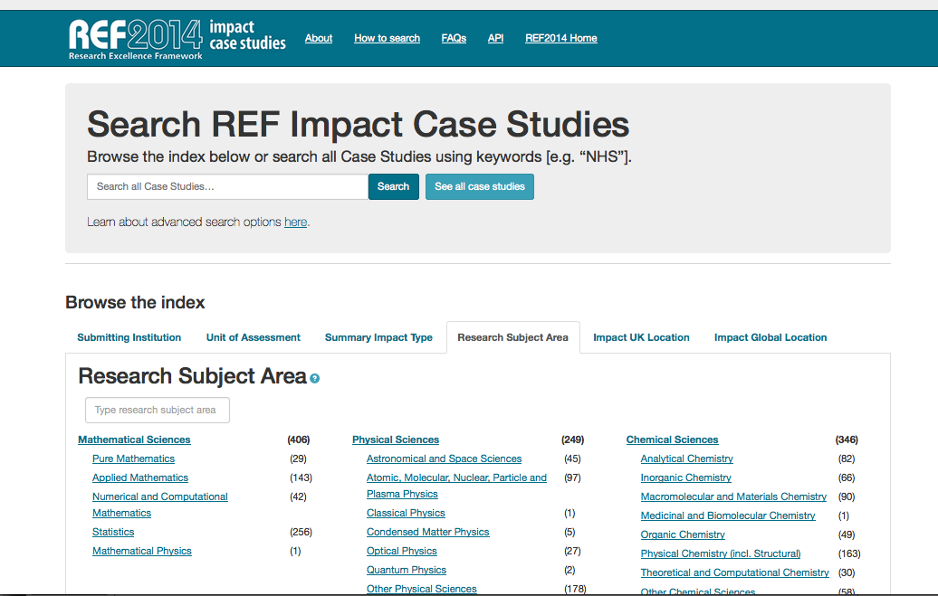
Free Fulltext Research Impact Case Studies from the UK REF Impact Portal:
https://impact.ref.ac.uk/casestudies/

Slide 35
For the purposes of the UK Research Excellence Framework (REF), impact is:
underpinned by excellent research
a change in something beyond academia, and can include policy change, an increase in effectiveness, improved wellbeing, or reduced costs
demonstrated with evidence
achievable through partnership, collaboration and engagement.

Slide 36
5. Examples of how the library can support researchers and students in gathering evidence of impact.
  Training
  Your research impact health check
  Harnessing the H-index
  EIFL Big Six safari
  The x-day impact challenge
  Certified training
  With Schools/departments: research forum workshop
  Competition: submit your impact case study
  Publications, LibGuides etc.

Slide 37
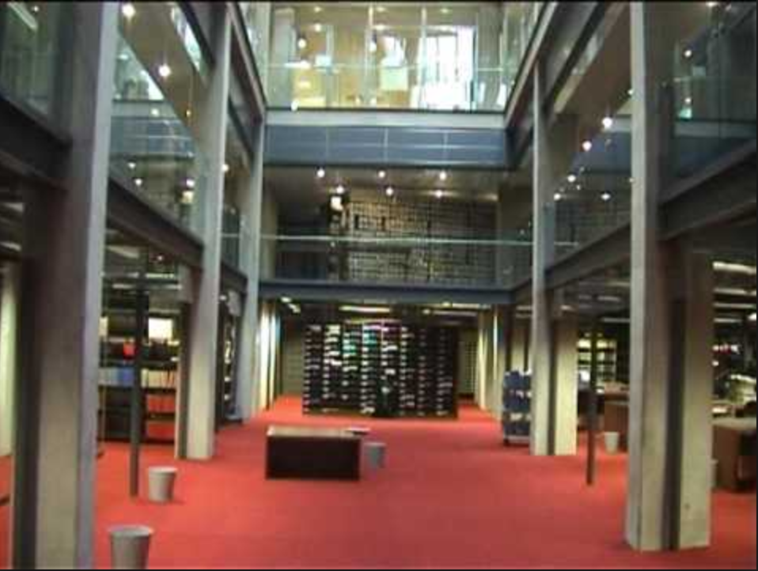
Research evaluation: the role of the Library

Slide 38
“It is clear that as the nature of research within our institutions changes, so must the role of the library in supporting research.
The increasingly competitive research environment demands greater collaboration (across disciplines, institutional, and national boundaries) and generates greater quantities of data than ever before.
In addition, funders are placing increased emphasis on the demonstration of the impact of research outputs and engendering wide dissemination of research
findings...”
- ARL, New Roles for New Times:Transforming Liaison Roles in Research Libraries, August 2013.
http://www.arl.org/storage/documents/publications/NRNT-Liaison-Roles-final.pdf

Slide 39
“...As research activities evolve, research support must evolve with it. There has been much debate within libraries as to what form this evolution will take—but little consensus in terms of the part to be played by the library in general or the role of library staff members in particular.”
- ARL, New Roles for New Times:Transforming Liaison Roles in Research Libraries, August 2013.
http://www.arl.org/storage/documents/publications/NRNT-Liaison-Roles-final.pdf

Slide 40

Task Force on Librarians’ Competencies in Support of E-Research and Scholarly Communication
1. Scholarly publishing services
Providing publishing services via local or hosted digital publishing platforms for journals, books, conference proceedings, working papers and other works of original scholarship from faculty and students. Working with digital repository and other professionals to provide for storage, description, access and preservation of this content.
2. Copyright and Open Access advocacy and outreach
Providing consultation and education to faculty and students on copyright and open access policies, services and resources. Marketing and promoting open access license and publishing alternatives to commercial publishing equivalents.
3. Scholarly resource assessment
Providing expertise, consultation and outreach to the campus community around scholarly resource assessment and metrics, from traditional bibliometrics to emerging altmetrics.

Slide 41

Increase in jobs with ‘scholarly communication’ in the title
Differences in title, emphasis and content between Europe and North America. E.g. North America is more sharply focused on copyright whereas European ones have a broader remit.

Slide 42

‘The Value of Libraries for Research & Researchers’
– RLUK/RIN 2011
http://www.rin.ac.uk/system/files/attachments/value_of_libraries_for_screen_1.pdf

Slide 43
For Researchers
Provides and promotes access to essential research materials
Procures data sources such as bibliometric tools and resources.
Offers a physical space to work in
Provides induction and training programmes to develop research skills
Assists with research tasks
Provides specialists with subject expertise to assist with research queries
Provides information and advice (online and face to face) on topics such as publishing, open access, copyright, citations etc.
Provides a named point of contact for research staff and PhD students
Assists with research grant proposals
Helps with research evaluations of their work, validation, checking and presentation of their data
Offers specific expertise eg bibliometrics
Assists with submitting articles to the open access repository
Digitises important research collections

Slide 44
For Research Managers
VP Research, Research Office, Heads of Schools etc.
Supplies respected knowledge and a valued contribution to debates and current issues
Supports research evaluation via data checking and validation and collection of publications
Offers a centralised focus for new initiatives that require information expertise
Provides information to support inernal management exercises eg profiling researcher activity
Manages open access repository/researcher archive
Advises researchers on topics eg open access, data management) and achieve compliance with policies
Supports research information management eg as part of the work flow
Faciltates data sharing between the open access repository and the research information system.
Assists with research grant proposals
Advises on the procurement of new systems
Offers specific expertise eg bibliometrics
Assists with publishing research outputs

Slide 45
Library characteristics
Intermediate outcomes
End benefits
Increased potential impact
Information & organisational skills
Good knowledge of external environment
Good subject expertise
Close relationships with researchers
Increased visibility of research
More research income
Proactive information specialists
Strong service culture
Wider institutional role
Improved institutional understanding of assets
Higher quality research
Outward-facing library
Manifestation of scholarship
Strong research materials
Recruitment & retention of high quality researchers
Researcher-focused services
Publicly available research catalogue
Better research management
Improved research practices
More efficient research
Flexible physical space
Improved coordination of research activities
Better informed researchers
Manages institutional repository
More satisfied researchers
Opportunities for browsing
Information & organisational skills
Good reputation of institution for research
Greater research output
Neutral position at centre of university
New research interests or direction
Legacy perception of Library as home of knowledge
Better research environment
More motivated researchers

Slide 46
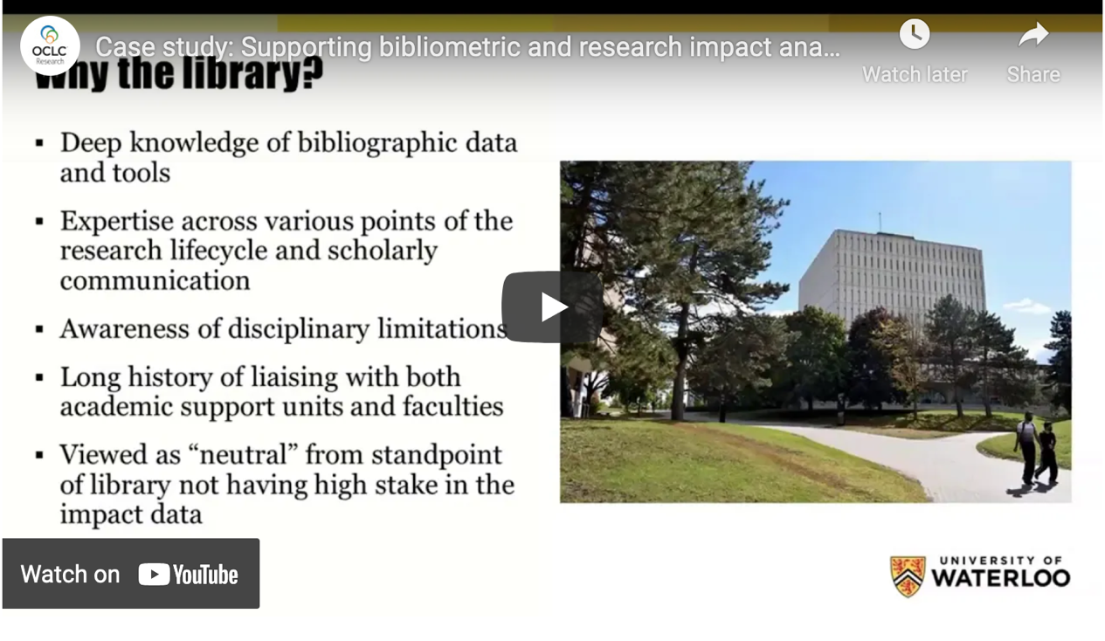
Emerging Roles for Libraries in Bibliometric and Research Impact Analysis: Lessons Learned from the University of Waterloo
February 3, 2021 - by Rebecca Bryant
OCLC Research webinar series
Link to webpage:
https://hangingtogether.org/?p=8830
Watch on You Tube:
https://youtu.be/tE6NTCVIgBU

Slide 47

Gordon, Shannon, and Alison Hitchens. Library Impact Practice Brief: Supporting Bibliometric Data Needs at Academic Institutions. Washington, DC: Association of Research Libraries, October 28, 2020. https://doi.org/10.29242/brief.waterloo2020.

Slide 48
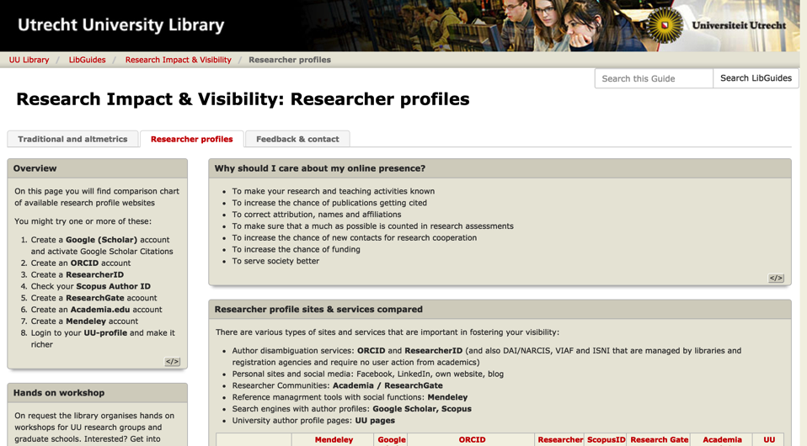
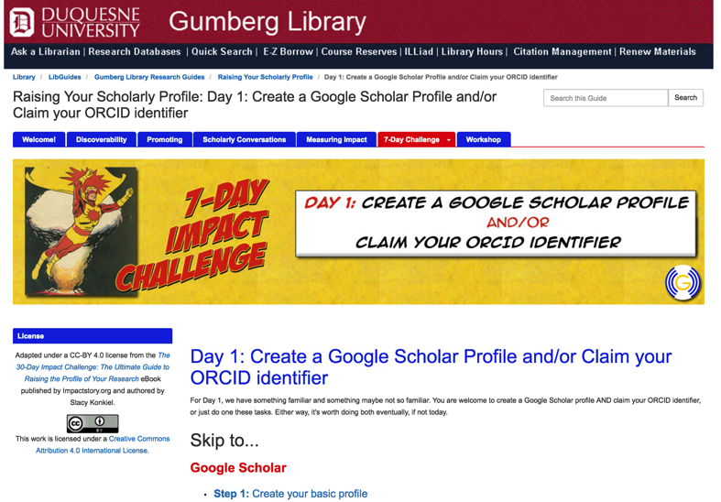
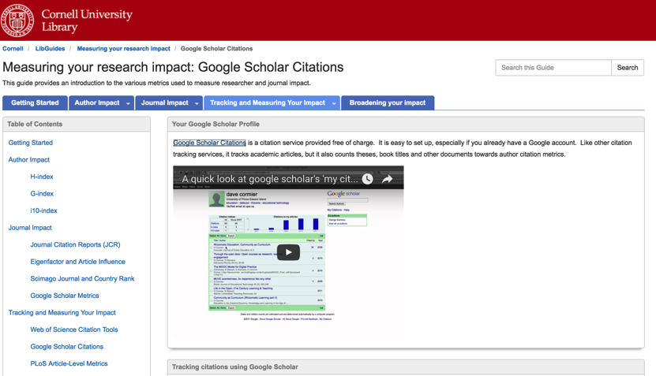
Library webpages provide excellent information in this area…

Slide 49
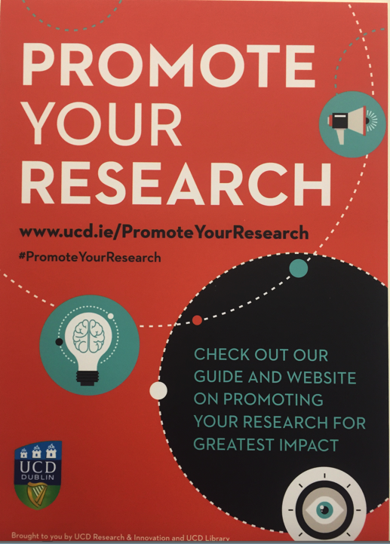
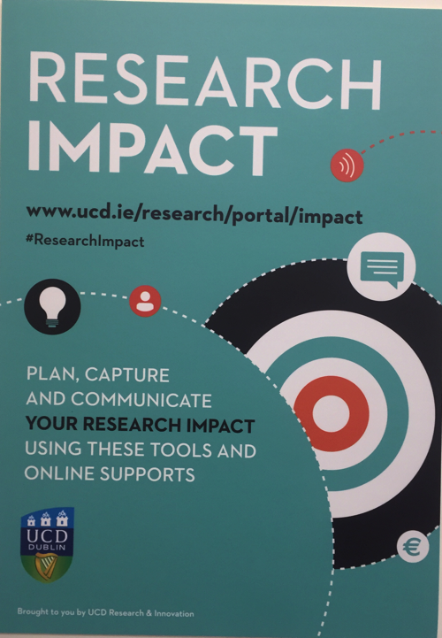

Slide 50
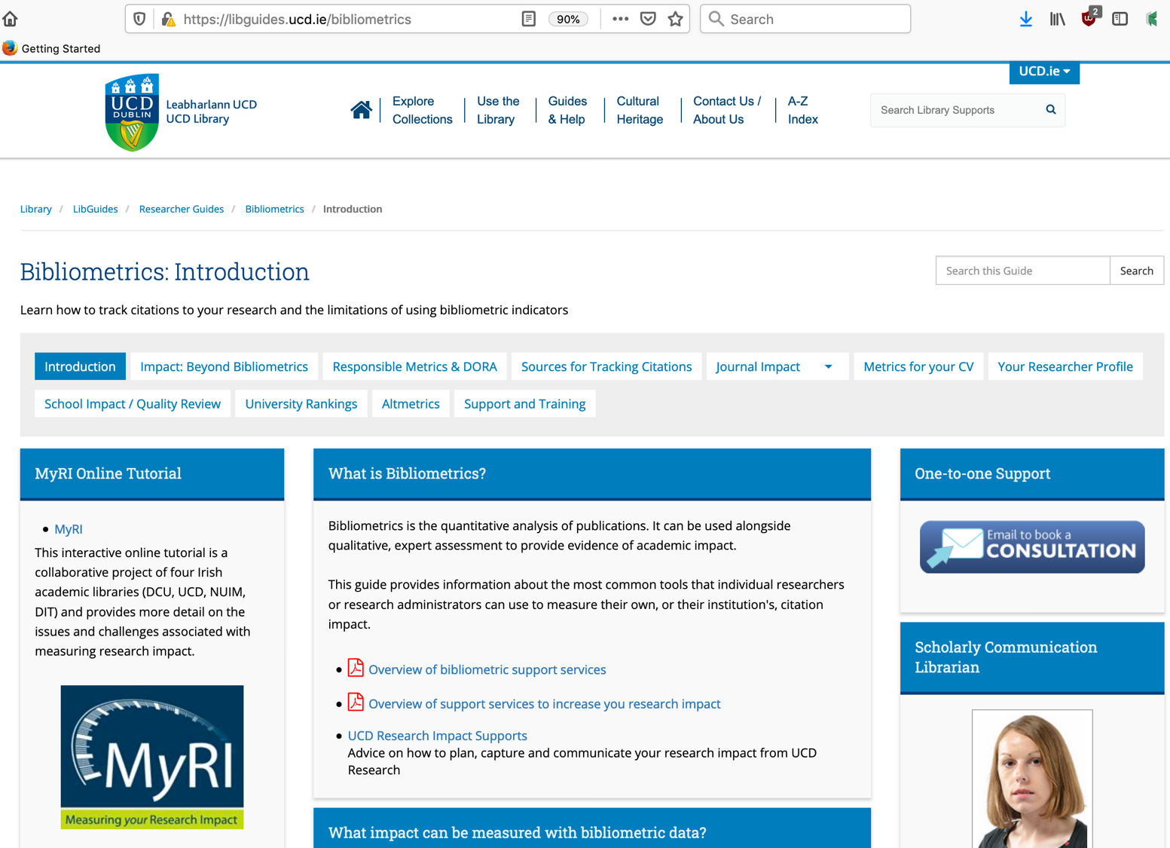
https://libguides.ucd.ie/bibliometrics

Slide 51
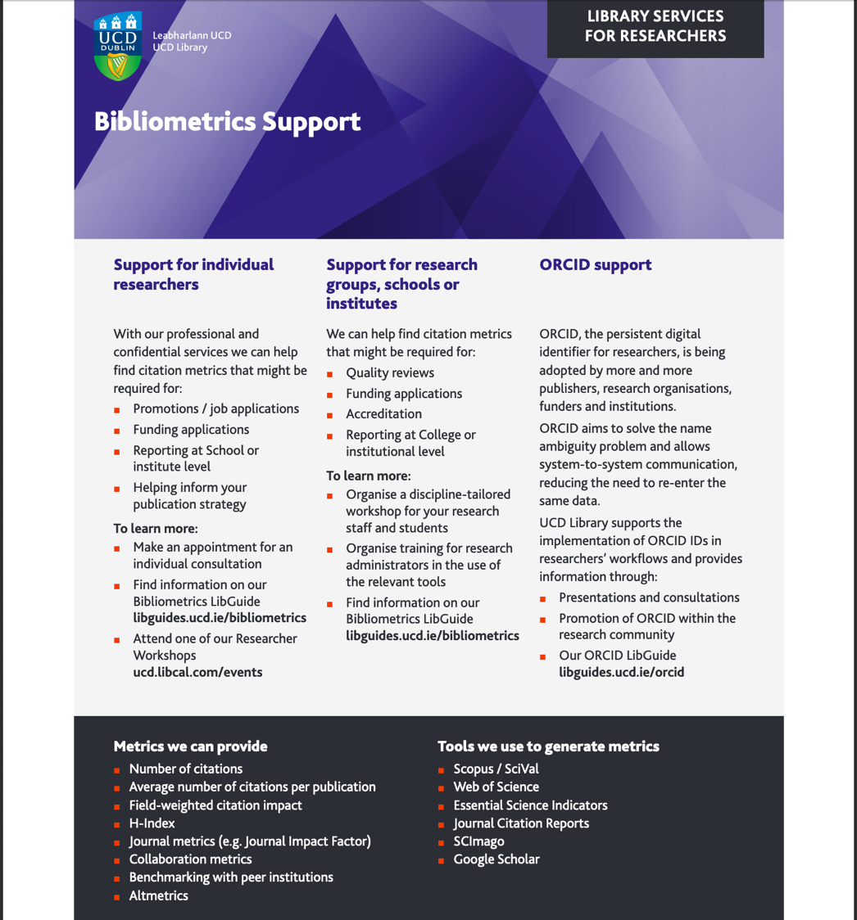
https://libguides.ucd.ie/ld.php?content_id=31885722

Slide 52

http://myri.conul.ie/

Slide 53
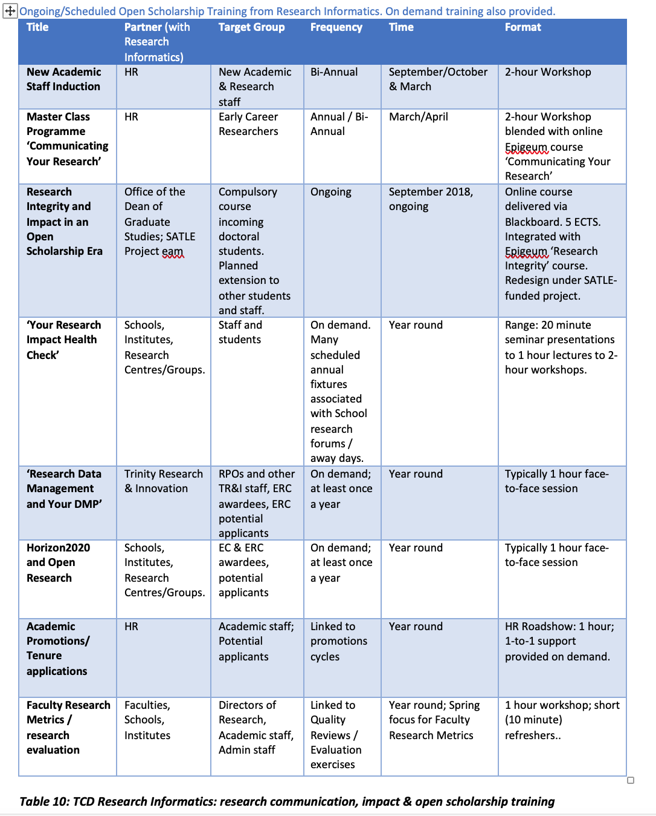
Example of Research Impact Training Schedule:
‘Your Research Impact’
‘Publishing and Promoting Your Research’, etc.
Source: Trinity College Dublin
New academic staff induction
Incoming doctoral student training
Early Career Researcher Master Classes
Library User Support Programme
Open Access week webinar
30 day (or 7 day) research impact challenge
Faculty Research Forum presentation
Joint workshop with research institute
Joint event with publisher/s.
Presentation to postgraduate student research day
More …

Slide 54
Make it as relevant and interactive as possible…
Survey the participants beforehand
Check their access to the tools & resources referenced in the training
Give them a ‘prepare’ task (a reflective question, a case study, a tool to access);
Give them practical exercises to do in class and/or to take away
Study the audience’s disciplinary publishing behaviour.
Use relevant examples (fields, publishers etc.)

Slide 55
Pitching your Research Impact Skills training …
Use an attractive theme
Position it within a broader training / impact model or framework
Examples …

Slide 56
Your Research Impact Health Check
Example of a Training Resource from Trinity College Dublin
  Create at least one research profile (and keep it up-to-date)
  Get an ORCID id
  Publish – and then make your work (posters, papers etc.) available on Open Access through TARA
  Use Research Professional for funding alerts
  Promote your work via all means
  Find out how research in your field is evaluated
  Know how to use Web of Science, Scopus etc.
  Set up alerts for citations to your work in WoS, Scopus, Google Scholar
  Help organise conferences
  Attend publisher workshops
  Study best practice & developments in the communication of research impact

Slide 57






The EIFL Big Six
The EIFL ‘Big Six’: Effective Publishing Strategy is embedded in several of these thematic areas
1.ORCID number
2.Research profile
3.Metrics
4.Open Access
5.Data Management
6.Impact statement

Slide 58
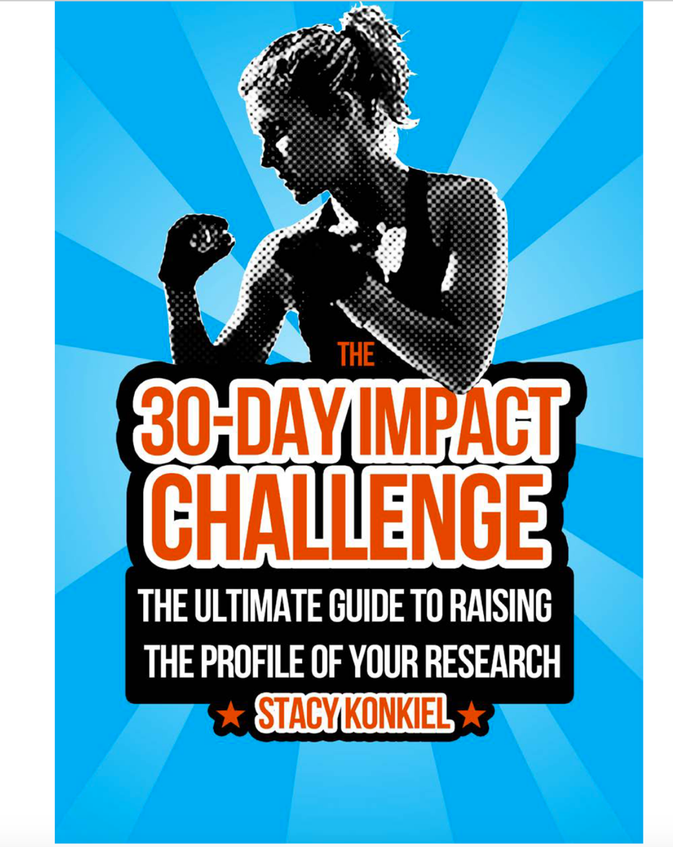
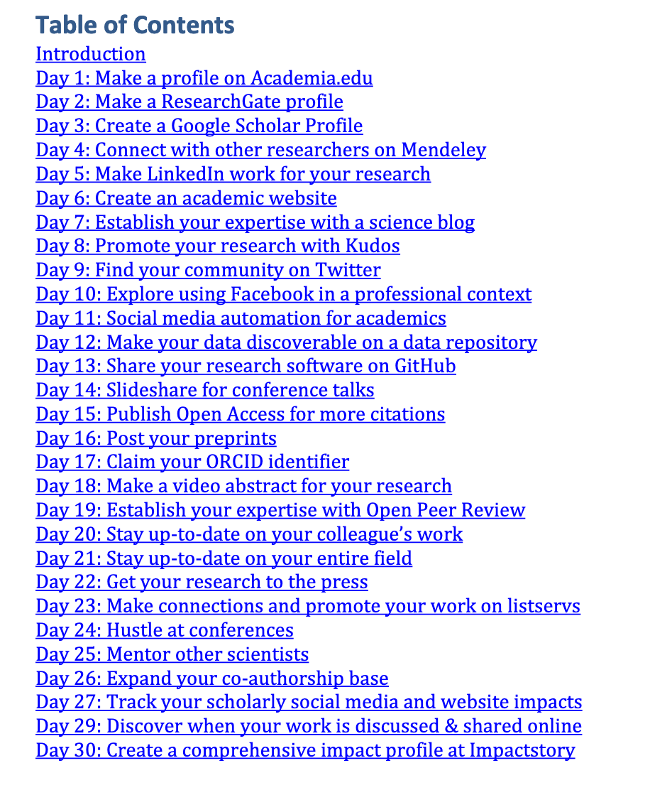
The Impact Challenge: Effective Publishing Strategy-relevant topics are embedded in parts of this list – but you could use this idea and add your own topics …
http://blog.impactstory.org/wp-content/uploads/2015/01/impact_challenge_ebook_links.pdf

Slide 59
Add these topics to the 30 Day or 7 day Impact Challenge:
Check your Scopus/Web of Science/Google Scholar profile; correct it if necessary
Set up citation alerts to your publications; Analyse where your citations come from. Analyse the journals covering your topic: where are the citations coming from? Consider publishing in new venues.
Check the altmetrics score on your publications (or publications of your colleagues/senior researchers). Where are the social media hits coming from? Who are the relevant bloggers / tweeters (twebs?). Follow/reach out to them.
Develop a social media impact plan (targeted tweets about forthcoming publications – with DOIs AND OA links)
Set up a profile on Kudos / Impact Story / Publons … more
Identify relevant conferences & plan papers
Identify publishers of interest: check their websites, submission policies, read an entire issue, check peer review process
All of these activities can be workshopped!

Slide 60
How to choose the appropriate types of research impact metrics for particular types of scholarship
ReCap
Recognizing the types of research impact metrics that can be applied to various forms of scholarship
Describing common tools for gathering research impact metrics and qualitative evidence for public scholarship.
Promoting awareness of the appropriate uses and limitations of citation metrics and altmetrics
Developing individual and group strategies for gathering evidence of impact and value for their own public scholarship
How the library can support researchers and students in gathering evidence of impact.

Slide 61
Thank You

