Slide 1
EIFL eLibrary Myanmar Project:
Benefits and Impact on Myanmar’s Higher Education Libraries
Rima Kupryte, EIFL Director
Myat Sann Nyein, EIFL eLibrary Myanmar project local coordinator
CONSAL XVII, 2 - 5 May, 2018, Naypyitaw, Myanmar

Slide 2

A project of EIFL (Electronic Information for Libraries).
EIFL’s vision: A world in which everyone has the knowledge they need to reach their full potential.

Slide 3
Launched in December 2013
Main aim – to help improve higher education in Myanmar by increasing availability and usage of e-resources in teaching and learning.
Started small – 2 universities: University of Mandalay & University of Yangon.
Rapid expansion – reaching 13 universities with 200,000 students by 2018.

Slide 4
List of partner universities
Joined in 2013
University of Mandalay
University of Yangon (including Universities’ Central Library)
Joined in 2014
Dagon University
Yadanabon University
Yangon University of Economics
Joined in 2015
East Yangon University
West Yangon University
Joined in 2018
Mandalay Technological University
University of Computer Studies, Mandalay
University of Computer Studies, Yangon
Yangon Technological University
Mawlamyine University
Sittwe University

Slide 5
Challenges
Human capacity
Role of librarians ignored for five decades.
Librarians, faculty, students – very poor digital skills.
No experience using e-resources.
Rote learning.
Cooperation among libraries rare.
Infrastructure
University & library infrastructure decayed.
Few universities had internet.
Low bandwidth – 2 Mbps / second.
Difficulties getting static IP addresses.
No online presence e.g. websites.

Slide 6
What did we do?
Negotiated discounted & free access to high-quality academic e-resources.
Built capacity to use e-resources.
Raised awareness about availability and benefits of e-resources.
Encouraged faculty to embed e-resources in curriculum.
Increased skills of librarians in IT & information literacy.
Encouraged librarians to build close links with faculty.
Developed a library consortium to sustain & grow the project.
Created institutional open access repositories to make local research globally visible.

Slide 7
Results: Excellent terms of use
All e-resources available on unlimited, simultaneous user basis.
Access 24/7 to faculty and students anywhere on campus.
Remote off-campus access to EBSCO database via username and password.
Walk-in users from other universities allowed to use licensed e-resources in libraries of partner universities.
55 high quality e-resources.
Free access to 27 of these.
25,000 full-text scholarly journals.
265,000 academic e-books.

Slide 8
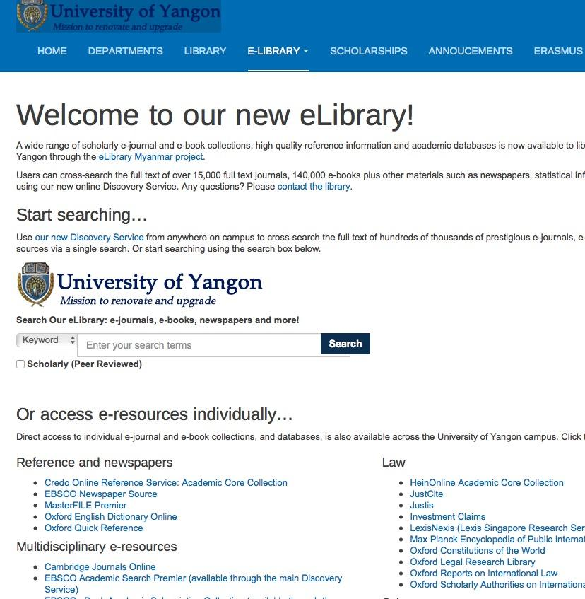
EBSCO search box plus customized interface with institutional branding

Slide 9
Results: Increased skills & capacity of librarians
ALL librarians at seven partner universities have basic computer and internet skills.
Each library has a team of ‘advanced librarians’ who have capacity to train others in the use of e-resources and information literacy.
Libraries provide regular ICT, information literacy and e-resources training for faculty and students.
Library leaders are confident in raising issues with university management.
Libraries are reviewing their organizational charts and job descriptions.
Notes:
Hired local project coordinators

Slide 10
Result: Good collaboration with faculty
From 2014 – 2017 over 200,000 full-text downloads of journal articles and book chapters.
Faculty conduct classes in the library.
Faculty set research assignments that require use of the library and e-resources.
Librarians are invited to classes to introduce e-resources that are relevant to particular subjects.

Slide 11
Result: Upgrades in infrastructure
Universities, libraries have wi-fi.
New high-speed fiber optic cables.
Universities have static IP addresses.
All universities have websites.
Investment in library furniture, computer labs, training rooms, workstations, air conditioning.
Notes:
Photo is of new computer lab at Dagon University

Slide 12
Result: New and improved library services
Increased opening hours (some over weekends & holidays).
Library induction for new students.
Basic IT & e-resources training for faculty & students.
Libraries providing technology advice, software upgrades.
Training in bibliographic referencing & citations.
Supporting research by responding to requests for articles/e-book chapters.
Student volunteer programmes – students helping peers with IT and staffing IT help desks.
Notes:
Librarians confidence has grown, lost their reserve, more outgoing and proactive. Status of librarians and libraries has improved

Slide 13
Result: Increased visibility of local research
May 2017 - University of Mandalay & University of Yangon launched open access repositories
Yangon University of Economics, Yadanabon University and Yezin Agricultural University to launch repositories in 2018
By April 2018:
  University of Yangon repository had received 21,586 views from 2,366 unique users in 85 countries.
  University of Mandalay repository had received 13,139 views from 1,386 unique users in 86 countries.
Notes:
There had been 21,586 views by 2,366 unique users from 85 countries since the repository was set at University of Yangon.
There had been 13,139 views by 1,386 unique users from 86 countries at University of Mandalay

Slide 14
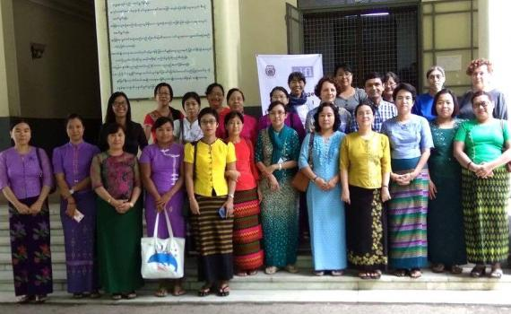
Result: Myanmar Academic Libraries Consortium
Open for other libraries to join. Through MALC, other libraries can gain access to e-resources.

Slide 15
Conclusion: Dramatic change in libraries
Libraries are no longer ignored and neglected.
Libraries are well stocked with high-quality international e-resources.
Libraries are equipped with IT.
Libraries are offering new services.
Capacity and mindsets of librarians have changed.
Librarians are taking the lead in helping faculty and students to use valuable e-resources and integrate them into curriculum and teaching.
Notes:
Academic libraries are no longer ignored and neglected. Well-stocked with high-quality international e-resources, equipped with IT, and offering new services and training, the libraries are at the centre of learning, research and teaching at their institutions.
The capacity and mindsets of librarians have changed. They are initiating change, improving infrastructure and conditions in their libraries, and leading the way in helping faculty and students to access and use valuable resources, and to integrate them into curricula and teaching.
The project has been a catalyst for change, leading to the government and university investment in technological infrastructure (new fiber internet lines; eLibrary training rooms with computers, laptops etc).

Slide 16
Thank you!
To our three Local Project Coordinators, Aung Kyaw Soe, Myat Sann Nyein and Tin Win Yee.
To the library directors and librarians from our partner universities.
To the university rectors and pro-rectors at our partner universities.
To the Ministry of Education.
To our donors - Open Society Foundations Higher Education Support Programme .
Notes:
three Local Project Coordinators, Aung Kyaw Soe, Myat Sann Nyein and Tin Win Yee;

Slide 17
Thank you!
rima.kupryte@eifl.net
myatsann.nyein@gmail.com
www.eifl.net

