Slide 1
How to get published

Slide 2
Agenda
The publishing process:
Conducting publishable research
Writing your paper
Choosing the right journal
Adhering to their guidelines
Preparing your paper
Managing peer-review
Handling revisions and rejections
Where to find help
Getting started

Slide 3
What are journals looking for?

Slide 4
Conducting publishable research
Make sure…
… Your question is researchable and interesting
Spend time refining the question and seek guidance from a supervisor
… Your research has not been done before
Conduct a thorough literature review before and during methodology design stage
… Your methodology is appropriate
Choose the most appropriate data collection and analysis techniques
... Your data is good-quality, relevant and representative
Pay attention to sampling your population and maximising the validity of your data
… Your write-up answers your research question
Write critically and analytically, not descriptively

Slide 5
Conducting publishable research
But how?
Speak to your supervisor
They are there to help you, particularly regarding your research design and methodology
Communicate with other researchers
Fellow researchers may have first-hand experiences they can share
Take advantage of your library’s services:
Your library will probably provide training sessions and workshops about designing your research project, academic writing, preparing manuscripts, understanding Open Access
Your library will also offer databases and digital and print resources to help with your research project, for example books, journals and databases such as SAGE Journals

Slide 6
Preparation and submission

Slide 7
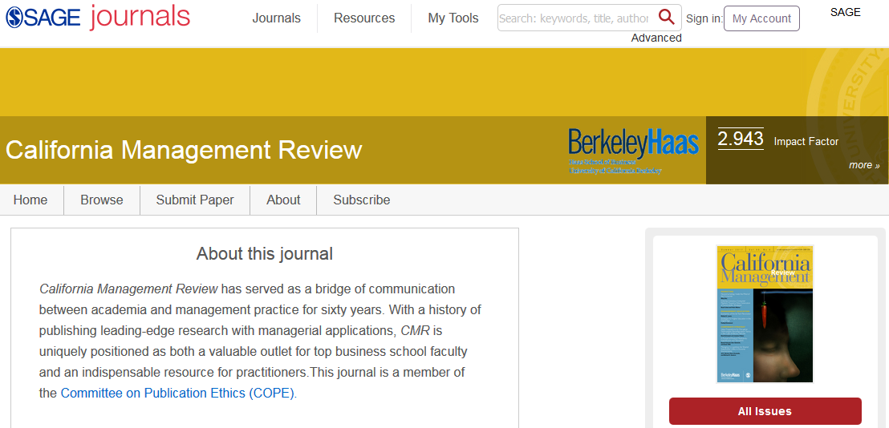
Choosing the right journal
TIP: Read 3 or 4 recently published articles from your chosen journal to get a feel for what submissions have been successful.
Choosing the right journal is key to acceptance. Consider:
Which journals do you read and cite regularly?
Which journals focus most closely on your field of research?
What is the publisher’s reputation?
Who is the editor?
Who is on the editorial board?
How international is the journal’s scope?
Do you know anyone who has published in the journal?
Funded or self-funded?
Notes:
Funded or self-funded? If you are funded, there may be certain guidelines you have to follow as a condition of receiving the research funding, which may restrict some of your choices in choosing a journal.
TIP: Read 3 or 4 recently published articles from your chosen journal to get a feel for what submissions have been successful.

Slide 8
Choosing the right journal
Once you have created your shortlist of potential journals…
What are their aims, scope and subject area?
Are they are a member of COPE?
What is their impact factor?
How well-ranked are they?
What is their open-access policy?
How long would the process take?
Review previous issues of each suitable journal…
Do they publish your kind of work?
Do you like their style?
Do you think they would accept your work?
What are their individual submission guidelines? Can you meet them?
Notes:
Impact factor – cumulative score of usage – over time/citations. The IF is statistics from 2 year prior to the year we’re currently in (for example, the 2018 report which we’re currently using and quoting, contains data from 2017), in 2020 – the 2019 report will contain data from 2018 etc.
Other indexes to be aware of: the Social Sciences & Humanities Index (SSCI), and the Arts & Humanities Citation Index (A&HCI).

Slide 9
What is Open Access Publishing?
A paper published via an open access (OA) route means that research literature is free-to-view by anyone in the world via the internet, and to reuse with a attribution under a Creative Commons licence, or equivalent.
Three types of OA, all of which are available at SAGE:
Pure ‘Gold’ OA Publishing - Articles are peer reviewed, selected and formally published and then made available with no subscription pay-walls.
(~200 pure gold journals at SAGE).
Mega journals – such as SAGE Open?
Hybrid journals - This is the practice of making articles published in traditional subscription journals freely available (~98% of journals at SAGE)
‘Green’ Open Access Archiving - This relates to the practice of archiving a version of the article somewhere other than the publisher’s website where the final version of the article is hosted.
Notes:
NOTE: This is usually enough information on Open Access,gh just to get people aware of different publishing routes. If it comes up, the average price for an article processing charge (APC) is around $3000.
Info on green OA and how authors can share/re-use their work: https://uk.sagepub.com/sites/default/files/author_archiving_policies_and_re-use.pdf

Slide 10
SAGE/EIFL offer when publishing in a fully open access SAGE journal
1. APC waivers For authors from: Botswana, Cambodia, Congo, Ethiopia, Fiji, Georgia, Ghana, Ivory Coast, Kenya, Kosovo, Kyrgyzstan, Laos, Lesotho, Malawi, Maldives, Moldova, Nepal, Senegal, Serbia, Sudan, Tanzania, Uganda, Ukraine, Uzbekistan, Zambia, Zimbabwe. Conditions: The waiver applies only when ALL authors collaborating on an article are from one of the eligible countries. 2. APC discount - 20% For corresponding authors from: Azerbaijan, Belarus, Estonia*, Kosovo, Latvia*, Lithuania*, Macedonia, Moldova, Palestine*, Serbia*, Slovenia*, Ukraine Conditions: -The discount is available to corresponding authors from institutions that have a current subscription* to one of the SAGE journals packages offered via EIFL. -This discount cannot be combined with any other, such as Society discounts, promotional discounts or prepaid order discounts. If the author is entitled to or claims multiple discounts, the highest single discount will be applied. *countries with institutions that have active subscriptions More information: https://eifl.net/apcs/sage-apcs-open-access-journals
Notes:
NOTE: This is usually enough information on Open Access,gh just to get people aware of different publishing routes. If it comes up, the average price for an article processing charge (APC) is around $3000.
Info on green OA and how authors can share/re-use their work: https://uk.sagepub.com/sites/default/files/author_archiving_policies_and_re-use.pdf

Slide 11
Adhering to submission guidelines
Different journals have different submission rules - even journals published by the same publisher!
Each journal makes its submission guidelines publicly available.
These are usually found on the journal website:
Most submissions are done through a website such as ScholarOne or ManuscriptCentral.

Slide 12
Writing your paper
When writing:
Data and findings
Figures and visualizations (tables, graphs etc)
Methods, results, discussions
Conclusion
Introduction
Abstract and title
When finished:
Title
Abstract
Keywords
Main text
Introduction
Methods
Results
Discussion
Conclusions
Acknowledgement
References
Supporting materials

Slide 13
Preparing your title and abstract
The better your title and abstract, the more your work will be:
Discovered
Read
Cited
Consider what your audience would be searching for (keywords). Choose these words carefully and test them with your own internet searches: are you finding what you would expect?
Include your keywords in:
The title
In your abstract (3 to 4 different keywords)
Throughout your paper
… all without losing the natural flow of language!

Slide 14
Submit your paper
Check the submission guidelines one more time
Check your formatting and additional submissions
Have it proof-read
Submit to one journal at a time
And now wait….
… but for how long??
Notes:
There are more articles than ever before being submitted, so editors are very busy people. If the subject is particular niche, then it can take time to find suitable peer-reviewers etc.

Slide 15
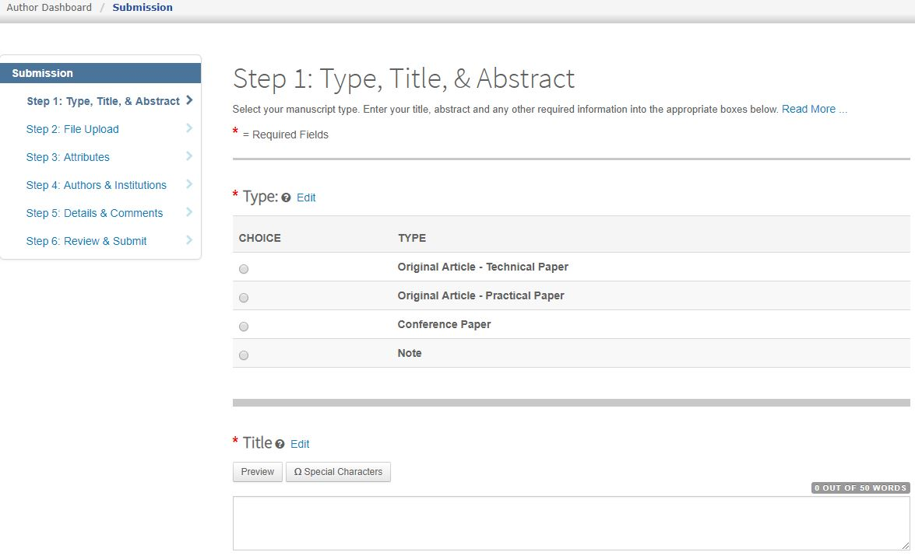
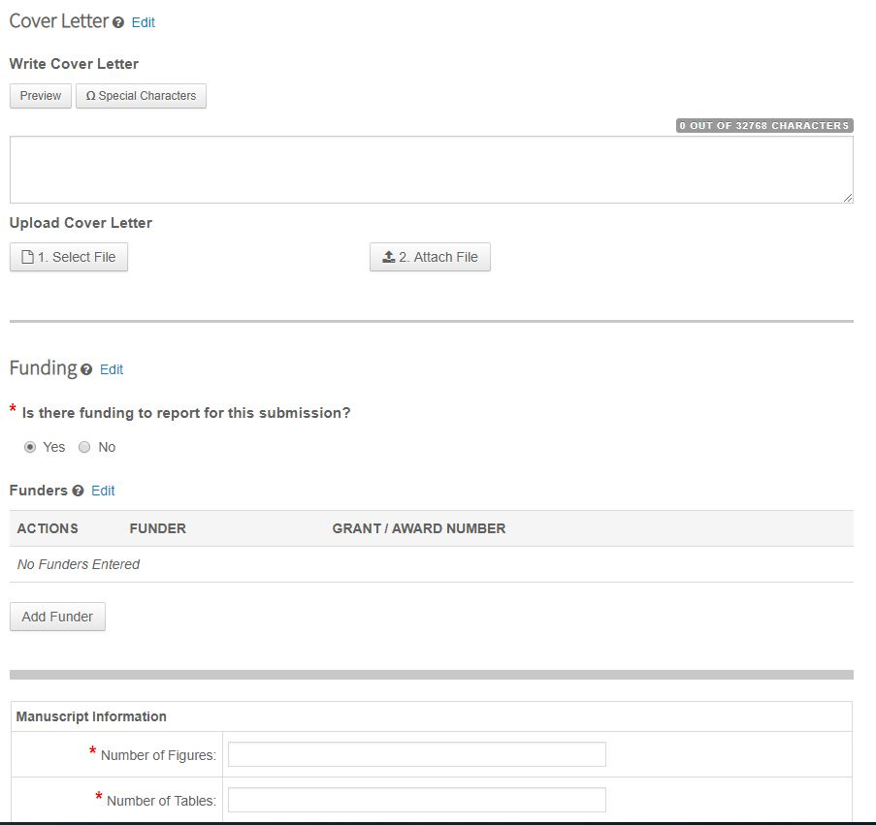
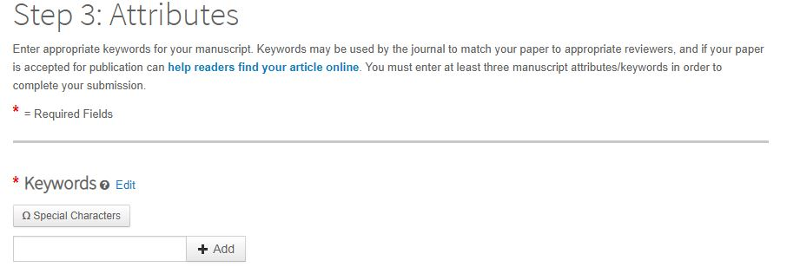
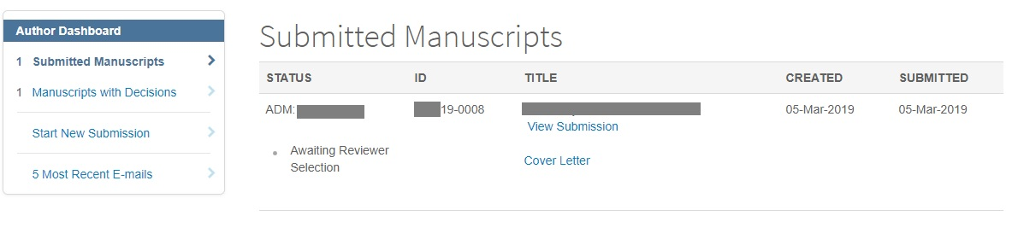
SAGE Track (Manuscript Central)
Notes:
SAGE Track is the system we use to manage submissions (using the Manuscript Central tech and software).
The first 3 animations on this slide is some screenshots from this system showing various stages of the submission process, and you can see the typical submission steps for a journal on SAGE Track on the left hand panel of the first screenshot.
The last screenshot is taken as if I was the author – I can see the status of my submission (could also say things like ‘Awaiting processing’, ‘Awaiting Reviewer Scores’, ‘Awaiting Decision’ etc). You can also see any previously submitted papers under ‘Manuscripts with Decisions’.
80-90% of submissions are handled through SAGE Track (the rest would tend to submitted to the journal editor via email). However, in some Arts & Humanities subject areas this may be as a little as 50-60% through SAGE Track.

Slide 16
The peer review procss

Slide 17
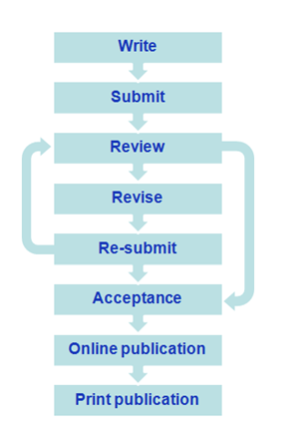
The publication process

Slide 18
Managing peer review
The peer review process
Paper is sent out to two or three referees by an Associate Editor.
Referees write a report and make recommendations to the journal Editor.
Initial decision
Desk reject: immediate rejection, no changes
Or
Peer review
Peer review decision
Reject
Accept with major revisions
Accept with minor revisions
Accept and publish

Slide 19
Handling revisions
Read the reports and Editor’s letter carefully
Follow the timeframes requested
Clearly demonstrate what you have changed
Address each referee point in a covering note
If you can’t meet all criticisms, explain why
Be positive and polite
This process can take 2 to 3 iterations – so be patient.

Slide 20
Acceptance and rejection

Slide 21
What to do if it goes right!?
Celebrate!
Promote your paper!
Example paper
University website
Twitter
Conferences
Facebook
LinkedIn
Blog
Researcher profiles (kudos, orcid)

Slide 22
Why do papers get rejected?
Referees are not convinced of the contribution to the knowledge base
Methods are not robust enough for the journal
e.g. too few observations on quantitative papers
e.g. transparency of qualitative methods
Specific sections are weak
Conclusion
Discussion
Bad grammar and written style

Slide 23
If your paper is rejected…
Stay calm
Read the referees’ report and the Editor’s letter
Try and re-work the paper according to their recommendations
Consider submitting to an alternative journal
You will need to reformat the paper to fit the new journal’s requirements
Start again and write another paper!
Doesn’t mean it’s a bad paper, just the wrong journal!
Consider services such as SAGE Path?
Notes:
Doesn’t mean it’s a bad paper, just the wrong journal! Remember: that spending time choosing the right journal before you submit can save you a lot of time further through the process.
SAGE Path is a service we offer for some journals, which can help to recommend other journals to publish in if your paper is rejected: https://uk.sagepub.com/en-gb/eur/sage-publishing-article-transfer-hub

Slide 24
Roles and responsibilities

Slide 25
Responsibilities of the author
Professional ethics as a researcher searching the truth (no fraud or distortion)
Accurate and professional account of research and relevance to others (clear concise communication)
A commitment to the public good and public values (despite intense competitive pressure in research)
Respect to peers and to the public served (issues such as privacy)

Slide 26
Copyright and publishing ethics
Obtain permission for all copyrighted material
Authorship / Acknowledgement
Funding statement
Conflict of interest
Research ethics
COPE: Committee of Publication Ethics (95% of SAGE Journals are COPE members) http://publicationethics.org/
Notes:
95% of SAGE Journals are COPE members.
Also maybe worth being aware of the different stages that the manuscript goes through – you can often do quite a lot with the original submission of the article before it goes through peer-review (see slide of Green OA).

Slide 27
Responsibilities of the publisher
Sustainability of journals
Quality of journals
Quality of editor and editorial boards
Relevance of the journal as a field develops (managing the aims and scope)
Dissemination of content
Uphold ethical values of the publication

Slide 28
Author rights in the digital age
Copyright situation can be much more complex
Funders may require authors to make their papers available in repositories
Responsibilities sometimes at odds with publisher requirements
It may be up to you to ensure the paper is posted in the right place
Publisher policies vary
Stay informed and if unsure, ask!

Slide 29
Next steps

Slide 30
Key summary
Methodology quality is a key publishing criteria
Make sure you have something worthwhile to say
Find the right journal to say it in
Read articles from your chosen journal to get a sense for what they publish
Ask a friend, colleague or peer to proofread your work before submission
Find specific submission guidelines and follow them completely
Submit to only one journal at a time
Take any feedback constructively – not personally

Slide 31
Where can you find help and support?
Your colleagues, faculty, the library!
Think. Check. Submit
A campaign designed to help researchers follow best-practice during the submission process
Sense About Science
Offers free resources to help scientists ensure their work is academically rigorous and reaches the widest possible audience
SAGE is dedicated to helping researchers be the best they can be
SAGE’s Journal Author Gateway provides plenty of tips on improving your chances of publication
SAGE Research Methods helps researchers refine and improve their research skills
Notes:
Here are some links that might be useful for you/authors:
https://uk.sagepub.com/en-gb/eur/how-to-get-published
https://journals.sagepub.com/pb-assets/PDF/Author%20Gateway%20PDF/N8J1907%20-%20How%20to%20get%20published%20Author%20Gateway_FINAL.pdf (This is a very good flyer!)
https://uk.sagepub.com/en-gb/eur/journal-author-faqs

Slide 32
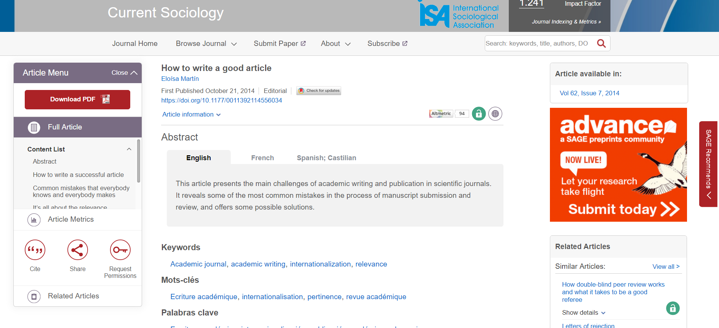
Advice from the former editor of Current Sociology!
Martín, E. (2014). How to write a good article. Current Sociology, 62(7), 949 -955. https://doi.org/10.1177/0011392114556034

Slide 33
Thank you for listening!
Chloe.Turner@sagepub.co.uk
Romy.Beard@eifl.net

