Slide 1


How to send a Manuscript to Enago
- For EIFL Authors

Slide 2

Go to https://www.enago.com/assoc/eifl/

Slide 3
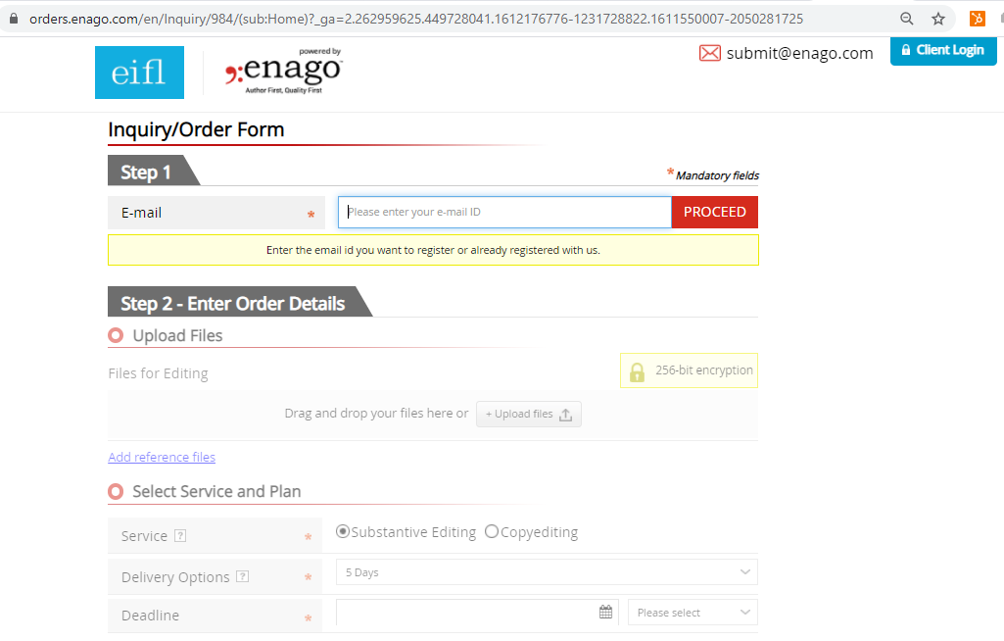
This is the quotation page
Enter your email id
Upload files for editing from your system + any reference file
Choose standard option 5days. 2days option is only for the urgent situations, it comes with the premium of 30% higher cost than standard.
Choose any level of service according to your requirement. We highly recommend Substantive Editing

Slide 4
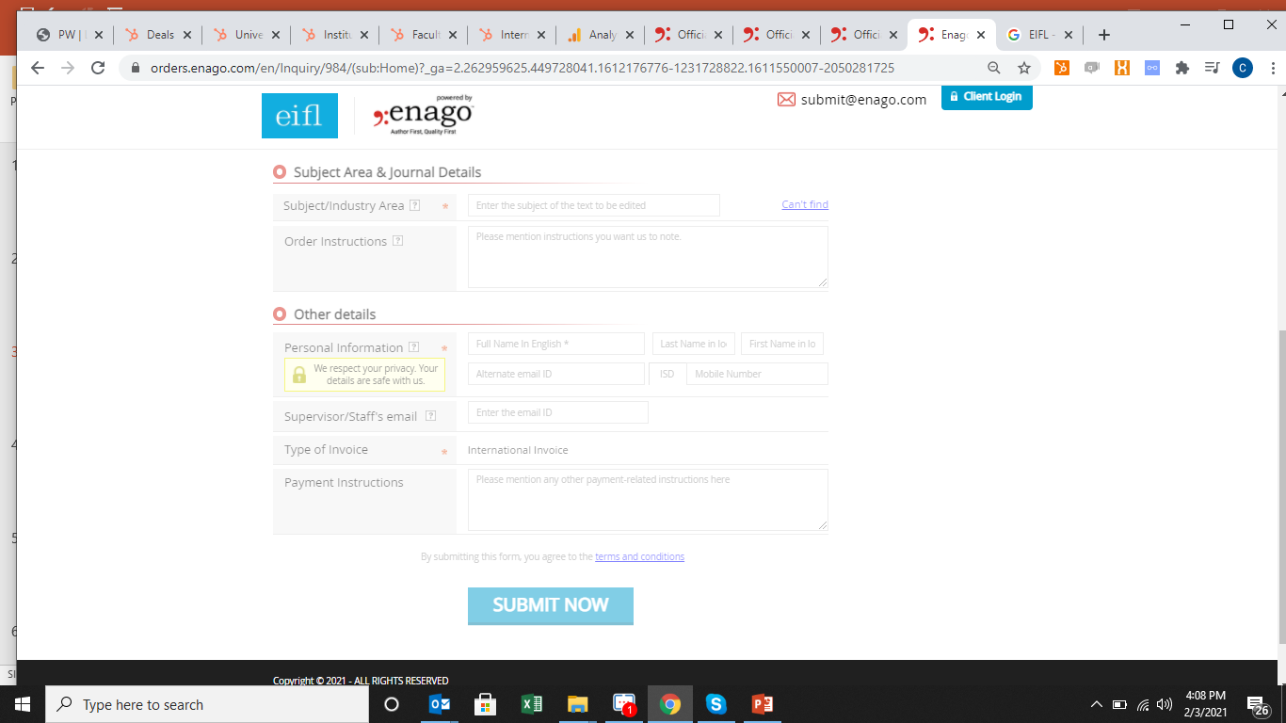
You may select the Subject area and specialization of the manuscript in this section
If you wish to leave any specific instructions pertaining your manuscript, please mention here.
You may enter your personal details in this section.
Click on submit, you receive a reply from team ENAGO in next 60min.
Once the upload is complete, THANK YOU page will appear. If not please contact, submit@enago.com

Slide 5
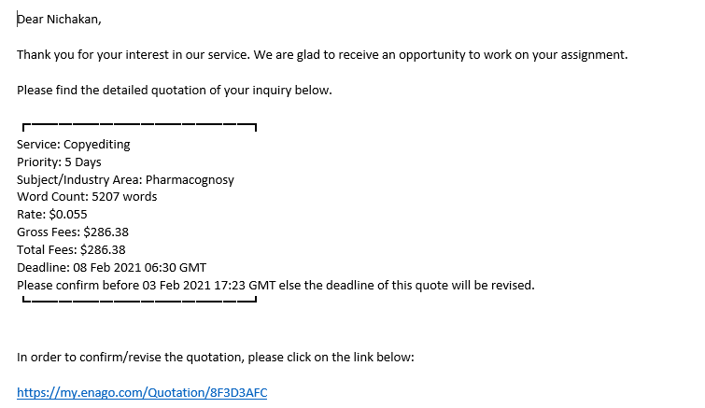
Quotation Email
After filling the form, you will receive the quotation email from email ID : “submit@enago.com” along with details of word count, cost and delivery dates
You may click on the link to confirm or revise the quotation
Once confirmed, you can make the payment within the system.

Slide 6
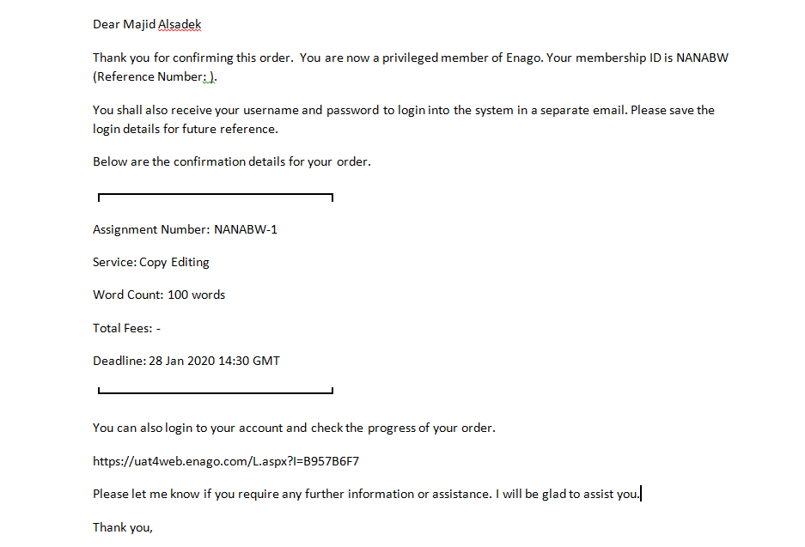
Confirmation Email
On receiving the payment confirmation email from email ID : “submit@enago.com” and the editing starts at our end. Below is an example of the confirmation email.

Slide 7
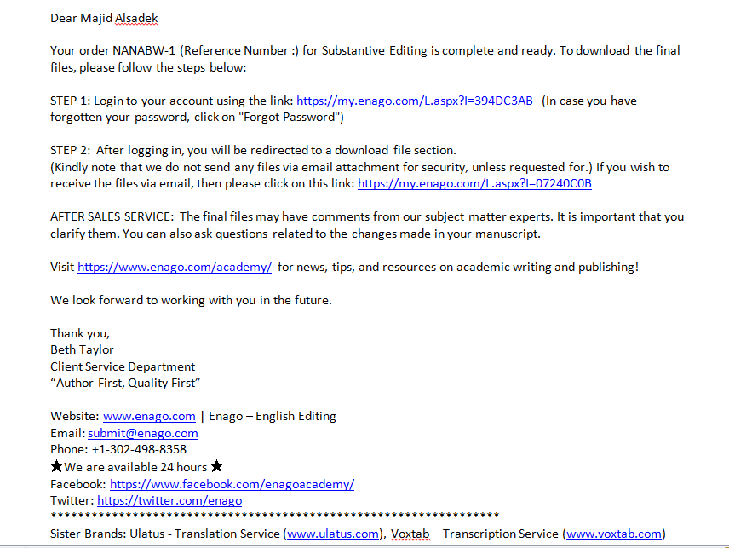
Delivery email
Enago will send you an email notification with a direct link to download the file. This email will be sent to all the email ids filled out in the inquiry form. A sample of email notification is given below:

Slide 8


