Slide 1

Improve your chances of publication

Slide 2









About Enago
Corporate Memberships
  Assisting research authors meet publication success
  Strong reach amongst individual researchers (B2C) & Universities (B2B)
Leaders in Japan, Korea and amongst top 3 players globally.
  Provides Language editing & Publication Support Services
  A preferred partner for leading publishers, societies and universities worldwide

Slide 3
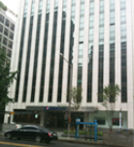

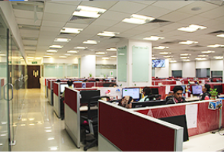
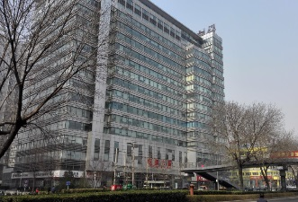
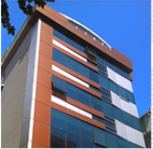

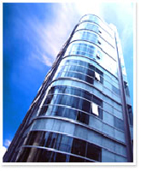
Enago Offices
Korea
China
USA
Turkey
India
Japan
Brazil
Taiwan

Slide 4





Clients and Partners

Slide 5
Enago – Author Services
Scientific Editing & Formatting
Author
Education Services

Slide 6


Copy Editing Service
1
Quality-conscious ESL authors
2 Editors edit the manuscript covering all aspects of editing
2
The Enago Promise
3
Reasonably priced
Ingredients of Editing
After Sales Support
Available only with Enago
Language and Grammar Check
Language Check
Grammar Check
Punctuation check
Style and Consistency
Writing style check
References check
Figures and Tables
Technical Accuracy
Editor Q&A for 365 days
“Two-Editor” System
Native speaking Editor
Specialized Subject Area Matching
Free Add-On
Word Count Reduction
Journal Formatting
Certificate of Editing
Academy Resources
Manuscript Rate card (MRC)
Editorial Workflow
Subject and Language Expert
Proofreader and Language Review
Senior Editor Review
Quick Check l Audit

Slide 7
Substantive Editing Service
1
Top-tier premium service
2 Editors edit the manuscript covering all aspects of editing
2
The Enago Promise
3
Highest skilled editors
Ingredients of Editing
After Sales Support
Available only with Enago
Language and Grammar Check
Language Check
Grammar Check
Punctuation check
Style and Consistency
Writing style check
References check
Figures and Tables
Technical Accuracy
Structural Review
Logical Flow
Presentation
Content Enhancement
Edit Unlimited for 365 days
Editor Q&A for 365 days
“Two-Editor” System
Native speaking Editor
Specialized Subject Area Matching
Free Add-On
Word Count Reduction
Journal Formatting
Certificate of Editing
Academy Resources
Manuscript Rate card (MRC)
Editorial Workflow
Subject and Language Expert
Proofreader and Language Review
Senior Editor Review
Quick Check l Audit
Covered only in Substantive Editing

Slide 8
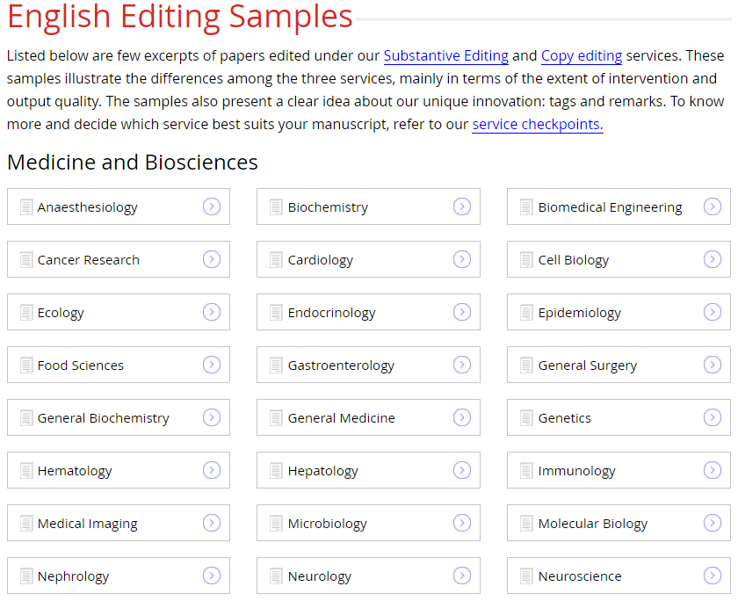

Slide 9
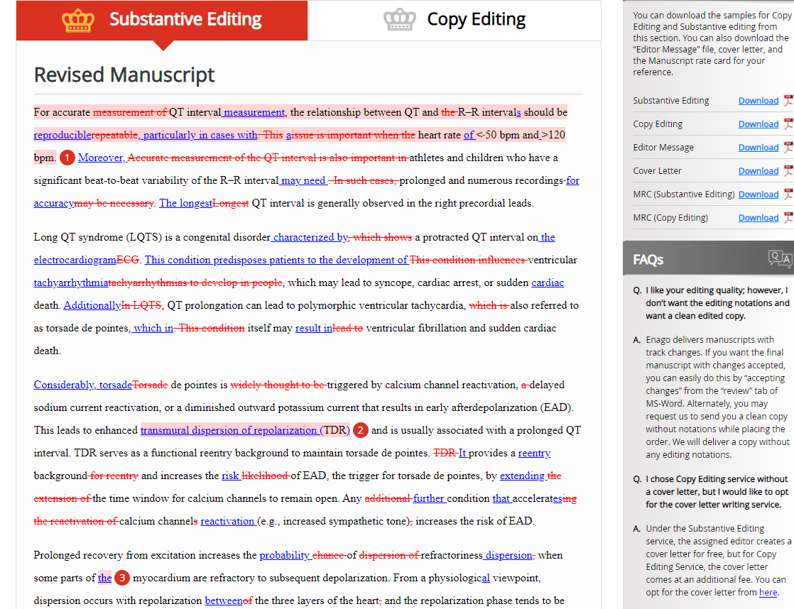

Slide 10
Editing Samples
Please follow this URL Link:
https://www.enago.com/editing-samples.htm

Slide 11
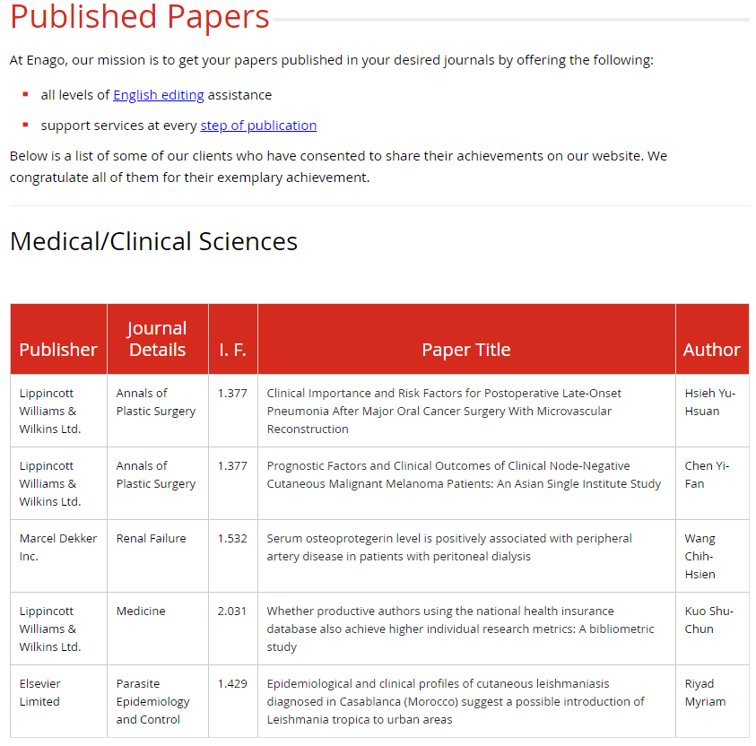

Slide 12
Success Stories in form of Accepted Manuscripts
Please follow this URL Link:
https://www.enago.com/accepted-papers.php

Slide 13

Enago Quality Philosophy
High
Quality
99.4%
Quality Satisfaction Ratio
99.4% of our clients are very happy with our service This is based on the client complains we receive on the quality of our service.
Reasonable Price
77%-85%
Repeat Client Ratio
Depending on different regions
Reasonable Time

Slide 14
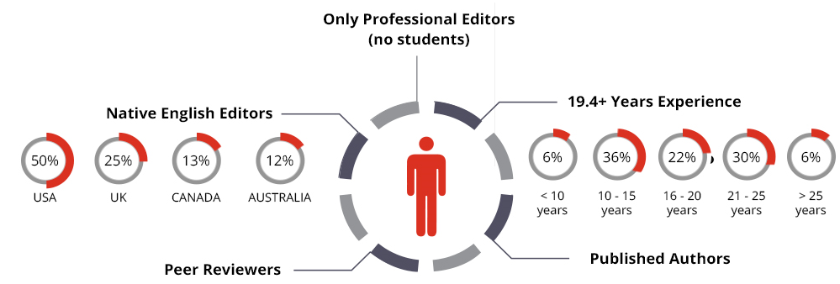






Our Editors

Slide 15


How is Enago Different?
Specialized Subject
Area Matching
The Enago
Promise
”Two Editor “
System
Edit
Unlimited
Notes:
"Two-Editor" System
Two expert editors perform quality edits on a manuscript.
1st edit -- subject and native expert.
2nd edit-- polishes and refines the manuscript
Ensures that even the smallest of grammatical mistakes are corrected and manuscript is formatted according to the target journal style guide.
Specialized Subject Area Matching:
Manuscript given to a subject matter expert.
Focus on optimizing subject and language.
Subject expert editor has incomparable technical competency in their specific field of study
The Enago Promise:
No Rejection by a journal because of language and format.
Re-edits of rejected paper with no additional cost

Slide 16
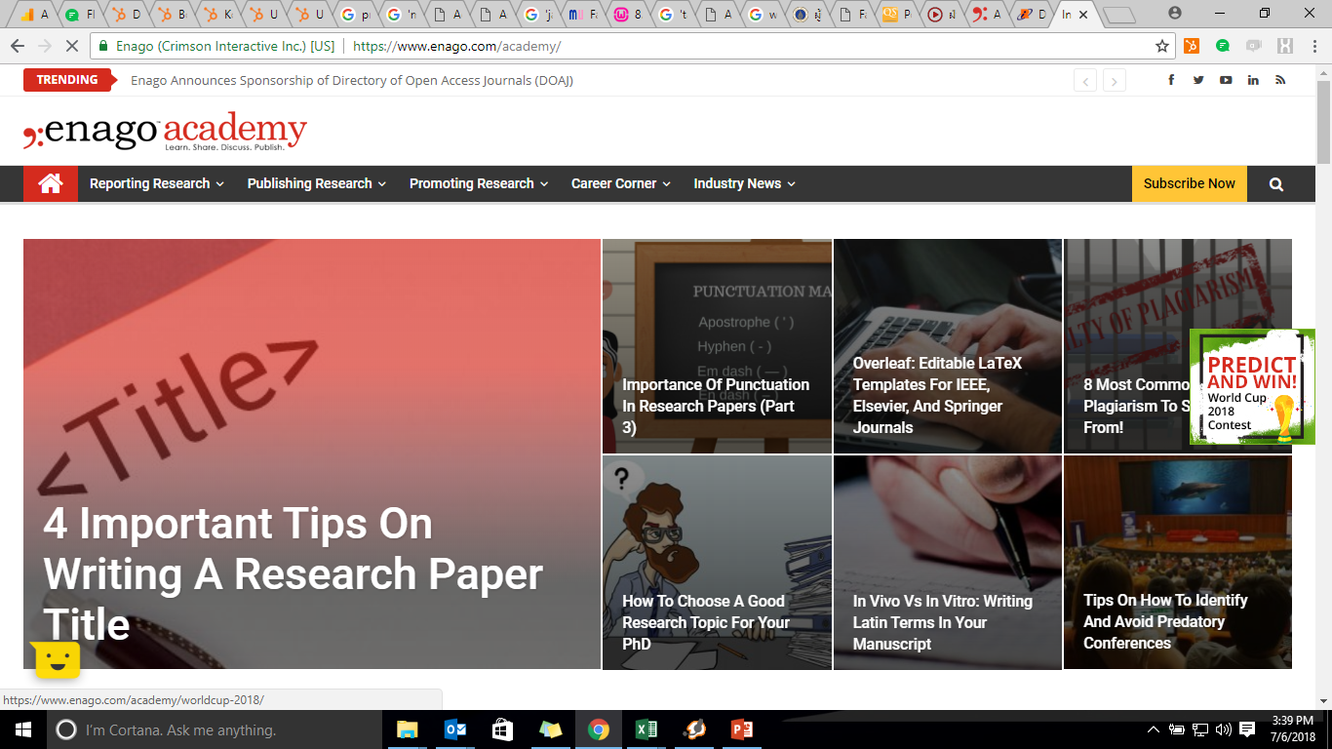
Enago Academy–Knowledge Platform
Guide Researchers/Authors at each stage of the publication cycle
Provide E-books on publication updates , checklists on how to avoid common manuscript errors, and rapidly advance your academic career
Provide online resources for researchers, publishers, authors, editors, and students
Conduct author workshops on academic publishing in ESL countries.

Slide 17
Online Management System:
Live EIFL Landing Page Link:
https://www.enago.com/assoc/eifl/

Slide 18


