Slide 1

EIFL Webinar on Journal Statistics
Ina Smith
Planning Manager, Academy of Science of South Africa (ASSAf)
DOAJ Senior Ambassador for Africa
26 November 2025, Zoom, Pretoria, South Africa

Slide 2
What is “bibliometrics”?
Bibliometrics is the use of counts and statistics - mainly of publications and their citations - to measure and compare patterns of research output and influence (e.g. how often articles are published, cited or co-authored).

Slide 3
Stats help transform raw data into meaningful insights that provide evidence for decision-making, accountability, and strategic growth.

Slide 4

When an editor reports to a journal’s editorial board, the goal is to provide a clear overview of the journal’s performance, health, and direction.
Reports usually combine quantitative data (statistics) with qualitative insights (editorial issues, challenges, and opportunities).

Slide 5
What can be measured?
Journal level stats (macro)
Volume, growth Articles per year, special issues, backlog size
Selectivity, quality Acceptance rate, desk-reject rate, reviewer decline rate, editorial turnaround Impact, visibility Journal-wide citations
Usage Downloads, views, user sessions, geographic distribution
Compliance, integrity % articles with DOIs/ORCIDs/RORs, OA licensing coverage, policy completeness (COPE, authorship, data)
Diversity & reach Authors’ country, reviewer/editor diversity, institutional spread
Financials APC revenue/waivers, production cost per article (if relevant), on-time issue release rate
Article level stats (micro) E.g. performance evaluation
Usage Views, downloads
Engagement Altmetric/PlumX events (news, policy, social), Mendeley readers
Impact Citations
Findability Google Search impressions/clicks (GSC), backlinks/referrers
Timeliness From submission to acceptance to publication durations for that item
Integrity Corrections/retractions, similarity report flags, data/code availability
Open science OA license, ORCID/ROR completeness, data/code links

Slide 6

Reporting to Editorial Board
During Editorial Board meetings or Annual General Meeting of Society/journal owner
On request of funder/call for funding proposals/journal owner
For yourself as Editor, Journal Users, Indexes, etc
Annually, quarterly, mid-year, ad-hoc
Optional dashboard monitoring for the Editorial Office e.g. Superset https://superset.apache.org/

Slide 7
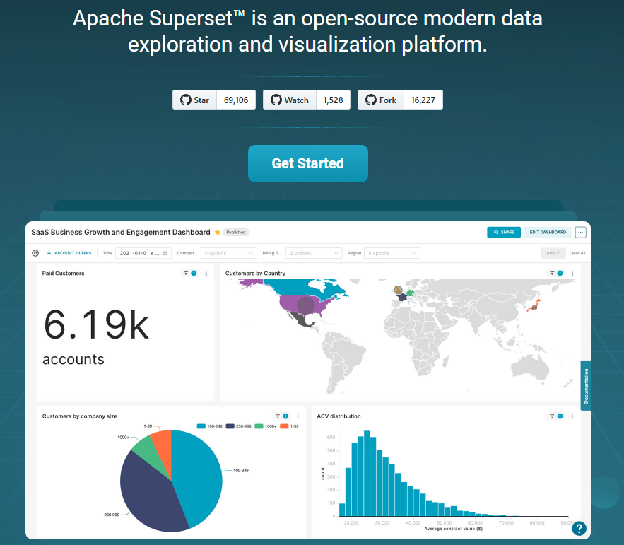

Slide 8
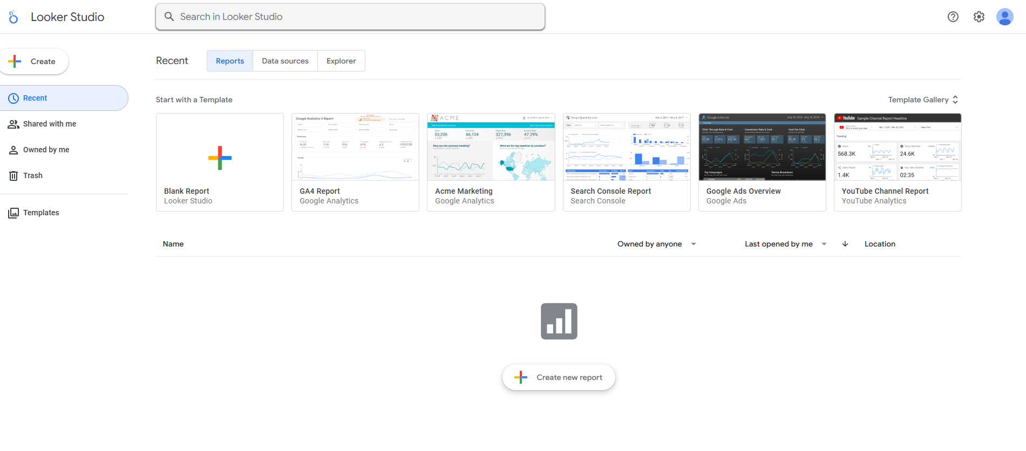

https://lookerstudio.google.com/

Slide 9
Transparency in reporting – make available on journal website for journal users, indexes OJS Dashboard >> Workflow >> Publisher Library
Central to accountability, governance, integrity, trust in journal
Not a requirement
Do not sidestep the system (OJS) if you want accurate metrics
For accurate metrics, metadata is key!

Slide 10


Open infrastructure (in scholarly publishing)
The shared, community-governed “plumbing” that makes research communication work - and that anyone can use, improve, and trust without needing a single vendor’s permission.
In an open infrastructure ecosystem, data hygiene is not just housekeeping - it’s the foundation for visibility, trust, equity, and sustainability of scholarly journals

Slide 11
Best practices when reporting
Visualise data where possible (graphs, charts)
Make datasets available for access (cloud eg GDrive or OJS Library)
Provide context and explain what it means for journals’ health and reputation
Formulate recommendations to improve journal (data-driven decision making), inform strategic planning
Keep report focussed, only relevant info without unnecessary detail
Keep report engaging and forward-looking
No report will/need to look the same (but keep it consistent for your own journal)
Branding, Executive Summary, Table of Contents, Abbreviations, References, Appendixes with details

Slide 12

Statistic sources
Recommended
PKP OJS (views & downloads) /stats/counterR5/counterR5 >> Title Master Report (TR)
openAlex (citations) https://openalex.org/ >> Search journal title
Crossref (metadata health) https://www.crossref.org/members/prep/6689 >> Search journal title
Peer-review (all activity) management/settings/website#plugins >> Review Report
iThenticate (screening counts)
Altmetrics (attention)
Google Analytics (site) & Google Search Console (search) (discovery)
Dimensions (article list, authors, DOI, year, citation counts, OA indicator, journal metrics (total citations, h-index))
Optional

Slide 13
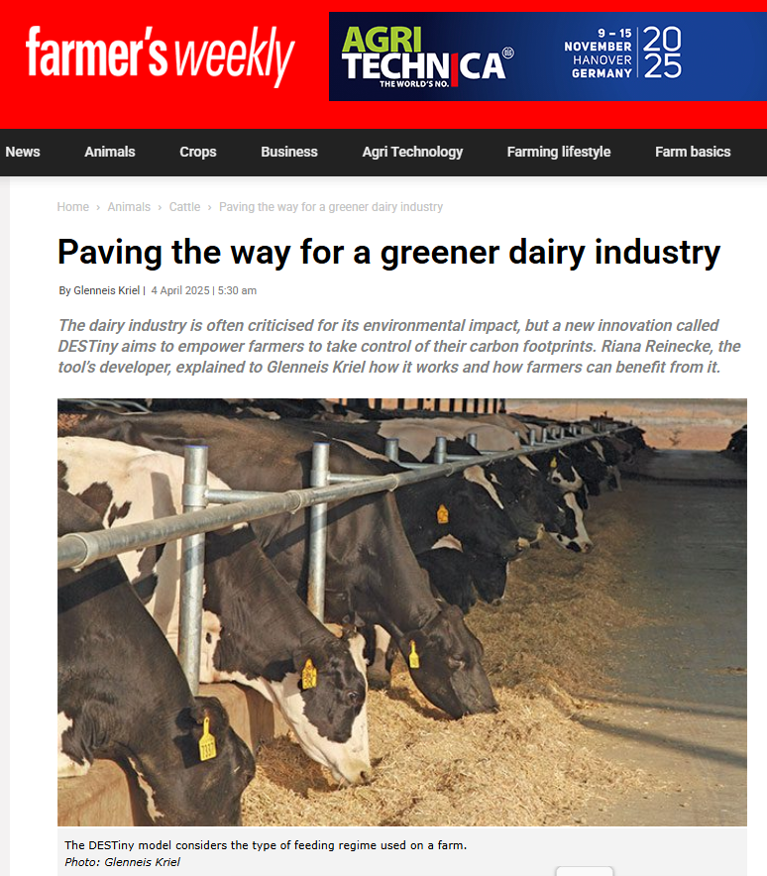
Media mentions
Setup Google Alerts
Paving the way for a greener dairy industry/ By Glenneis Kriel (4 April 2025) https://www.farmersweekly.co.za/animals/cattle/paving-the-way-for-a-greener-dairy-industry/ “Reinecke’s notion of the importance of cattle in the ecosystem is supported by the paper ‘The broad-based eco-economic impact of beef and dairy production: a global review’, published in the South African Journal of Animal Science in 2023.”

Slide 14





Why there isn’t one central, standard system
Different owners Stats sit in many places (Scopus, Web of Science, Crossref, OpenAlex, PubMed, Google Analytics), each with its own rules
Different coverage Each database includes different journals, regions, and outputs. None covers everything
Different meanings A “view,” “download,” or “citation” is measured differently in each system
Many versions One article can have a DOI, PubMed ID, arXiv ID, and copies in repositories (handles), making it hard to combine
No single steward Laws, licenses, and lack of global governance stop anyone from merging it all into one system

Slide 15

Prior Excel knowledge
Know Excel basics (sort data, charts/graphs, etc)
Conversion from json, csv, tsv to xlsx (Excel) json - (JavaScript Object Notation) open standard file format and data interchange format that uses human-readable text to store and transmit data objects consisting of name–value pairs and arrays (or other serializable values). It is a commonly used data format with diverse uses in electronic data interchange, including that of web applications with servers. csv – (Comma-separated values) text data format that uses commas to separate delimiter-separated values, and newlines to separate records. CSV data stores tabular data (numbers and text) in plain text, where each line typically represents one data record. Each record consists of the same number of fields, and these are separated by commas. tsv – (Tab-separated values) text data format for storing tabular data where records are separated by newline and values within a record are separated by tabs. The TSV format is a delimiter-separated values (DSV) and is similar to comma-separated values (CSV).

Slide 16
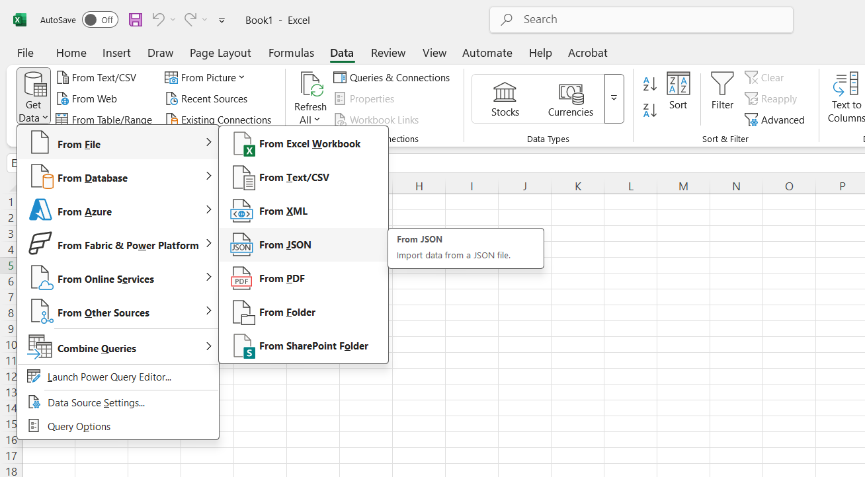

Slide 17
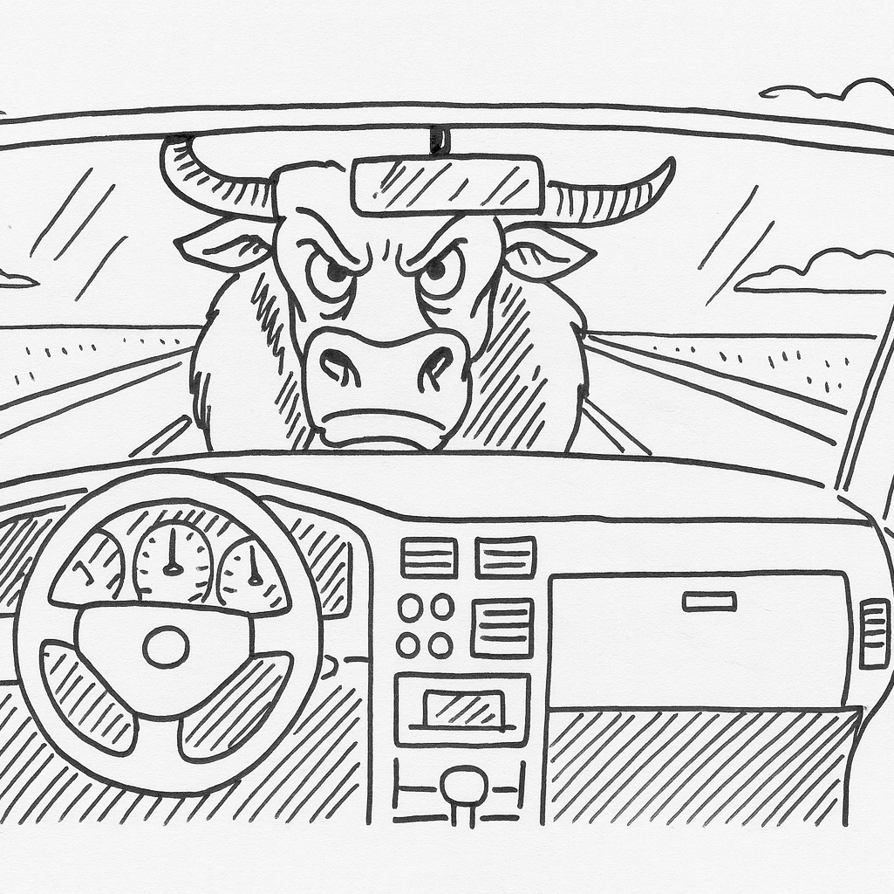
Dashboard
A single, visual page that brings together key indicators, charts, and tables so you can monitor performance at a glance and drill into details if needed.
In scholarly publishing, a dashboard might show article output, citations, usage (COUNTER), and submission timelines - updated from defined data sources - so editors can track trends and make decisions quickly.

Slide 18
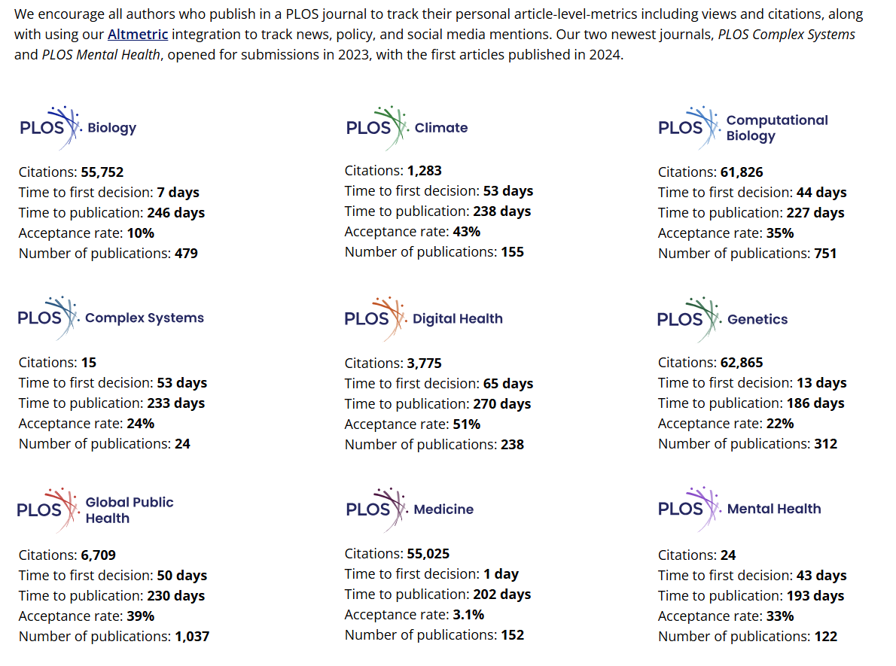
PLOS – “Research metrics” PLOS aggregates journal-level stats (citations from Dimensions, decision times, acceptance rates) and promotes article-level metrics with Altmetric integration across its titles. The Dashboard combines external citation data + internal workflow stats + attention data on one page. https://plos.org/metrics/

Slide 19
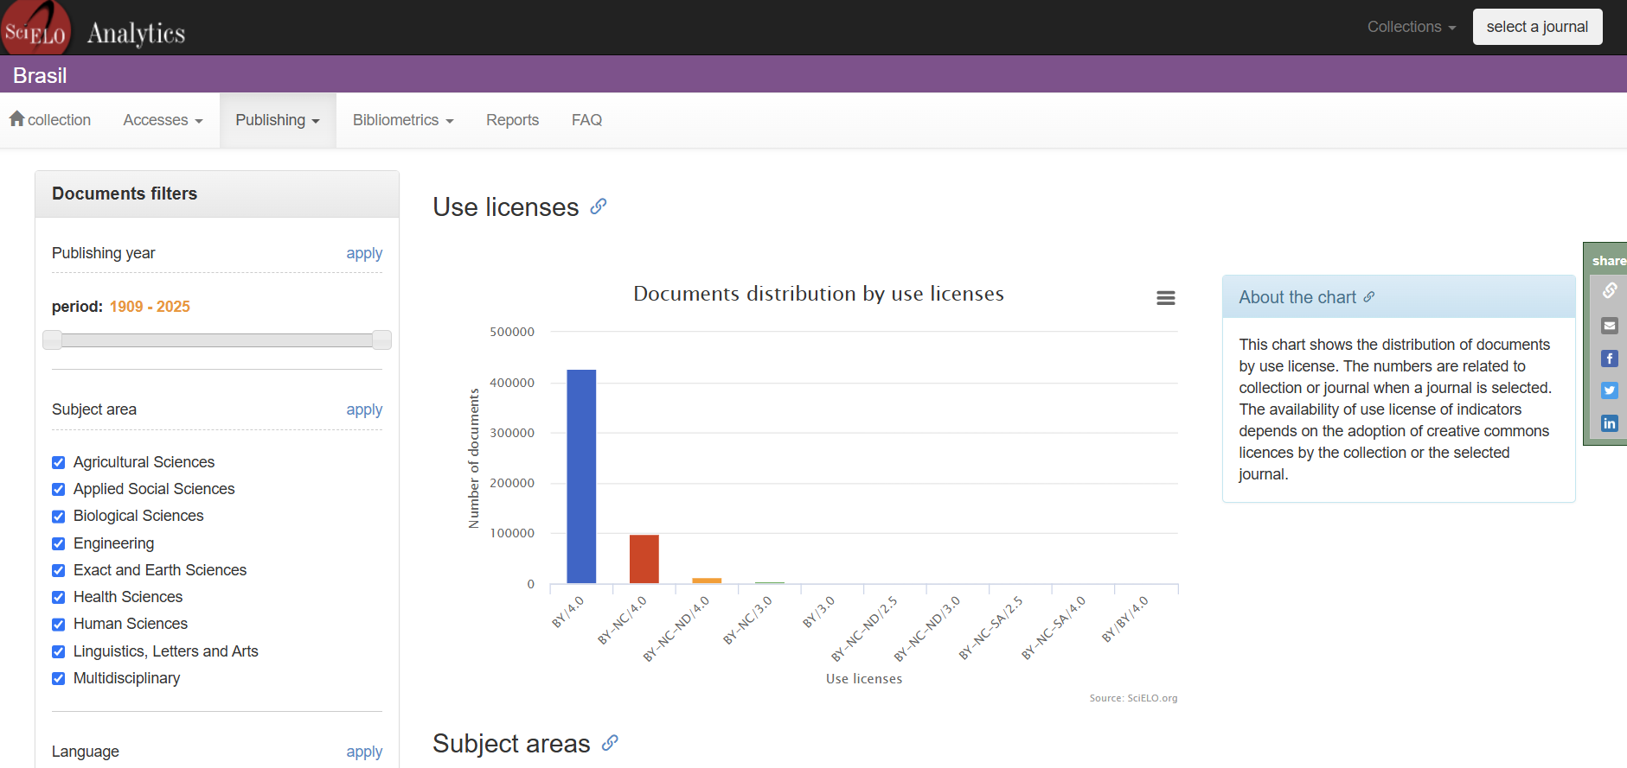
An interactive public dashboard for journals in the SciELO network with bibliometrics, access/usage, languages, affiliation countries, etc. You can select a collection (incl. South Africa) or a specific journal - useful as a pattern for multi-indicator, filterable views.
https://analytics.scielo.org/w/publication/article

Slide 20
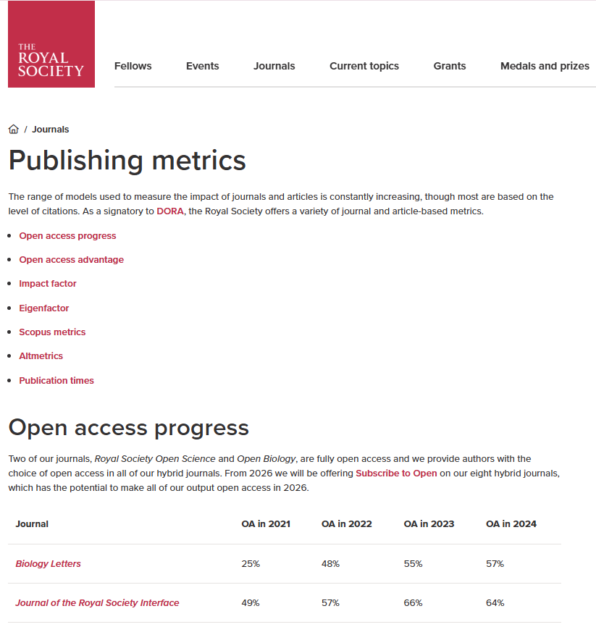
Royal Society Publishing Metrics publish a comparative dashboard showing, per journal, citations, downloads/usage, and Altmetric scores - explicitly contrasting open-access vs subscription articles. This is a clear, public example of mixing citation + usage + altmetrics in one view.
https://royalsociety.org/journals/publishing-metrics/

Slide 21
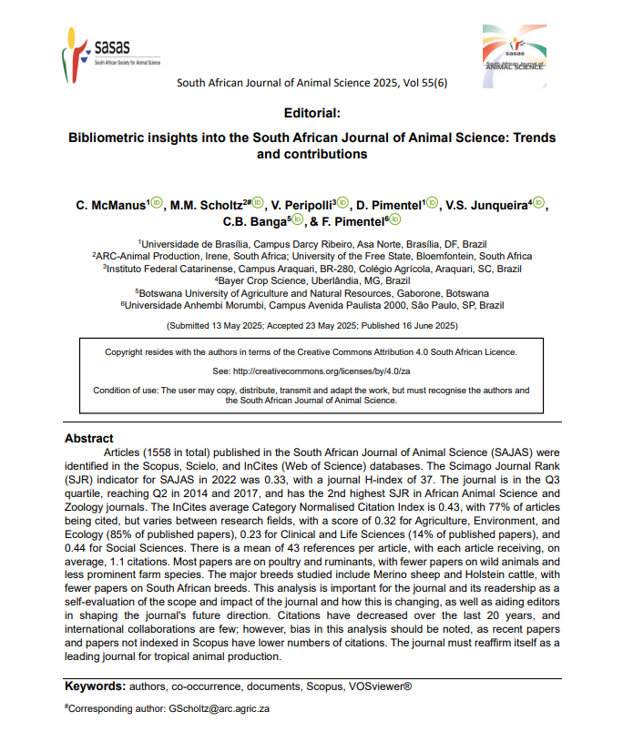
https://doi.org/10.17159/sajas.v55i6.01
Reporting - Editorial

Slide 22
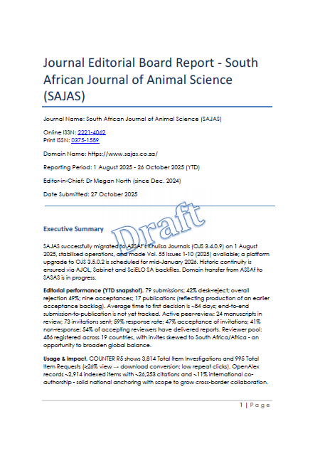
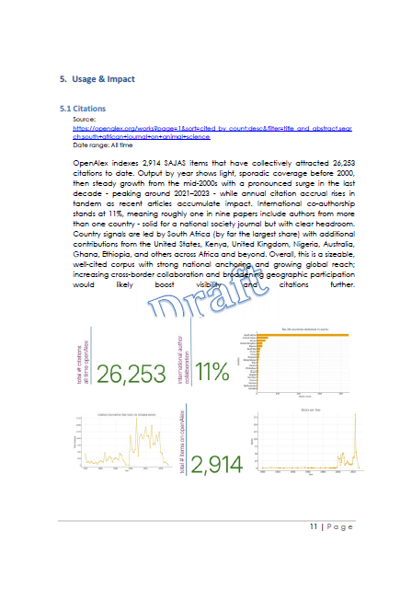
Reporting - Report

Slide 23
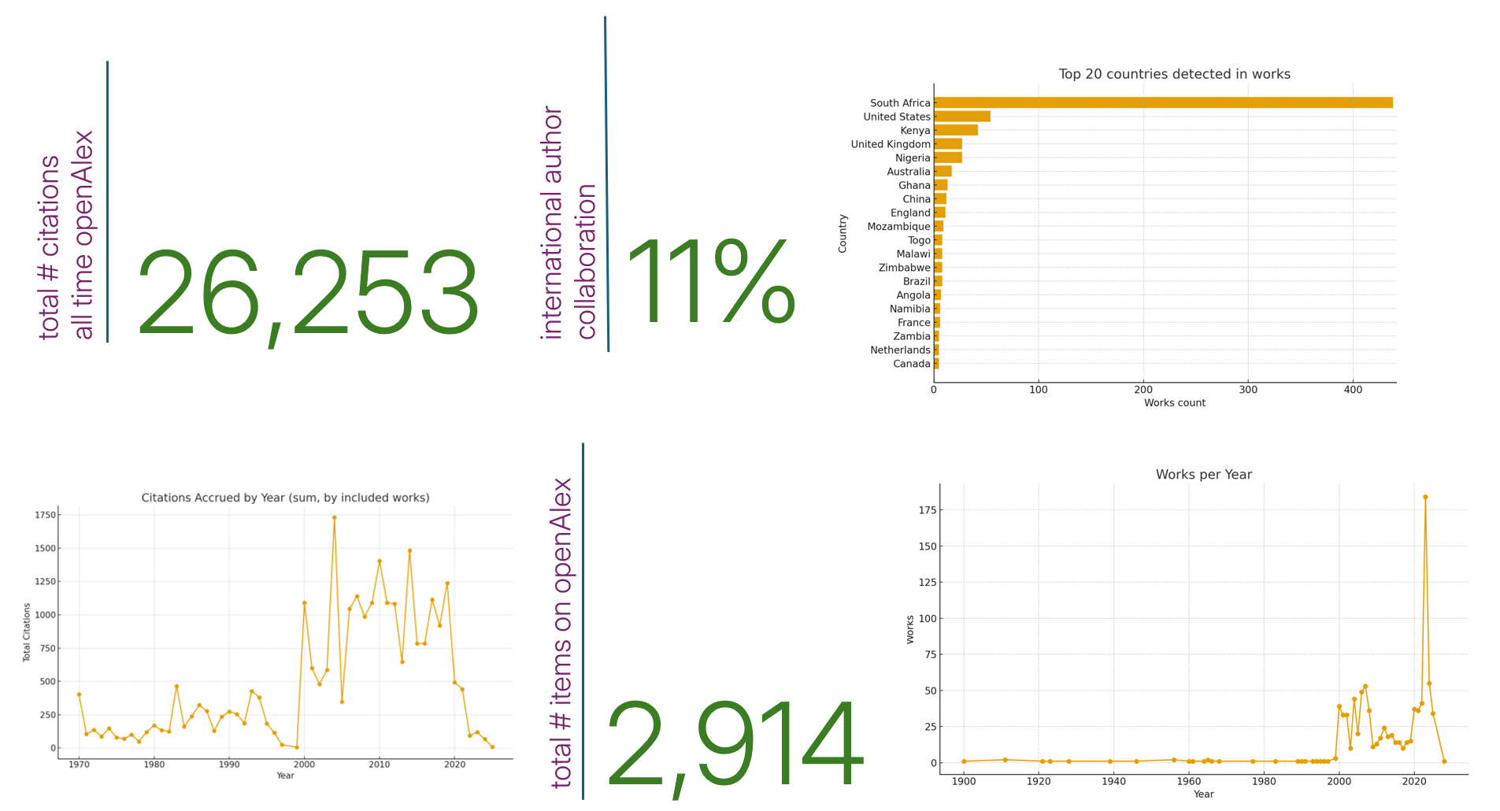

Slide 24
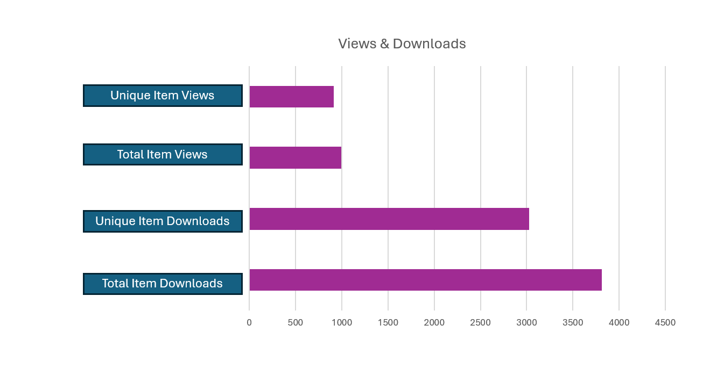

Slide 25

PKP OJS
1
views & downloads /stats/counterR5/counterR5 >> Title Master Report (TR)

Slide 26

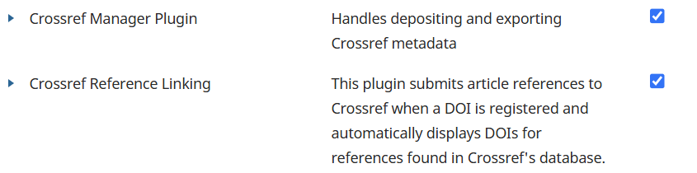
PKP OJS Plugins for statistics

Slide 27
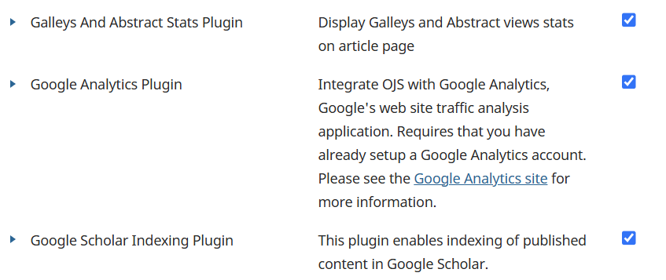

Slide 28
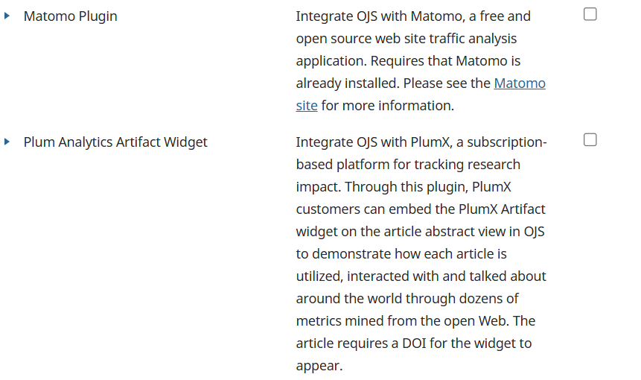

Slide 29
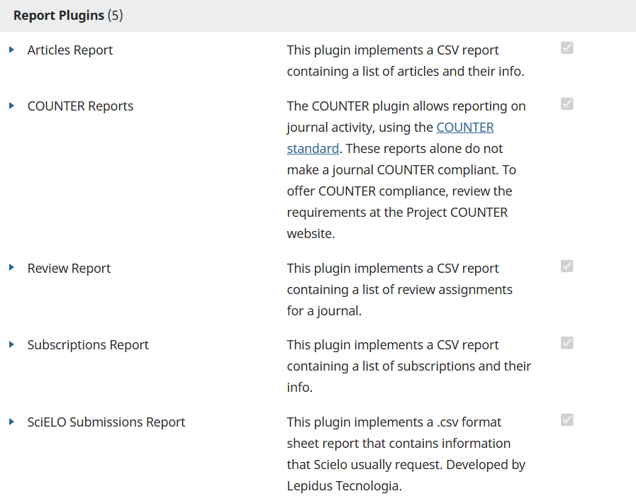

Slide 30
Bugs reported re OJS statistics
Article-level stats display 0 views/downloads
Log-processing - files stuck and not moving to archive
Usage data from before the upgrade (3.3) does not always reappear in reports after moving to 3.4
But NONE in the tools shared as part of this presentation

Slide 31

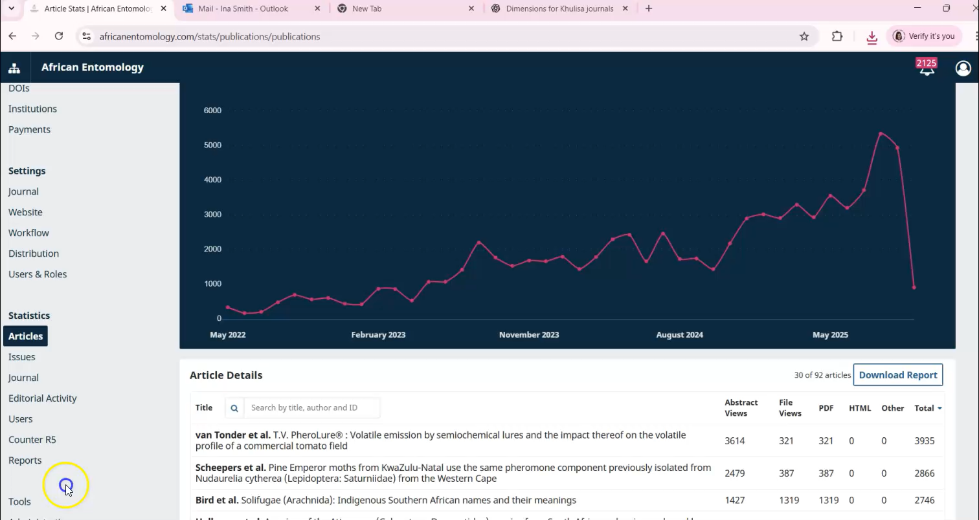
OJS Views & Downloads Report

Slide 32
COUNTER Reports
COUNTER stands for Counting Online Usage of Networked Electronic Resources It’s an international standard that tells publishers, libraries, and platforms how to measure and report usage statistics (views, downloads, investigations, etc.) in a consistent, trustworthy way
Without COUNTER, every platform could count “views” or “downloads” differently, making it impossible to compare numbers across publishers or systems

Slide 33
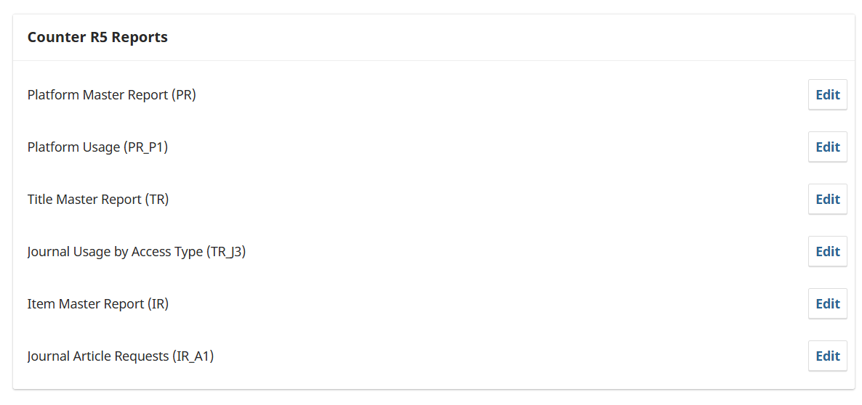
COUNTER 5 Reports in OJS

Slide 34
Platform Master Report (PR)
What it is: A full report on usage activity at the platform level (your whole OJS installation, not just one journal).
What you get: Total investigations (any interaction, e.g. views or downloads) and requests (full-text views/downloads) across the whole platform.
Use case: High-level overview of your entire publishing platform’s reach.

Slide 35
Platform Usage (PR_P1)
What it is: A standard view of the Platform Master Report.
What you get: Summarized monthly usage figures (total requests and investigations) for the entire platform.
Use case: Quick snapshot of overall traffic for your OJS instance.

Slide 36
OJS Views & Downloads
Title Master Report (TR)
What it is: A full report at the journal (title) level.
What you get: Detailed statistics about each journal title (all metrics, all possible breakdowns: usage type, access type, etc.).
Use case: Drill down into how each journal is being used. File will be downloaded in .tsv – convert to xlsx https://dataconverter.io/convert/tsv-to-xlsx

Slide 37
Journal Usage by Access Type (TR_J3)
What it is: A filtered view of the Title Master Report.
What you get: Journal usage broken down by access type (e.g., controlled vs. open access).
Use case: Helps you see whether usage is different between open-access and subscription-style content.

Slide 38
Item Master Report (IR)
What it is: A full report at the item level (individual articles, chapters, etc.).
What you get: Every possible usage measure for items (investigations, requests, by month, by access type).
Use case: Very detailed article-level tracking (but can get very large).

Slide 39
Journal Article Requests (IR_A1)
What it is: A standard view of the Item Master Report, focusing only on journal articles.
What you get: Monthly counts of total item requests (i.e., full-text downloads/views) per article.
Use case: Most useful report for editors/authors, as it shows how often articles are being accessed.

Slide 40
PR / PR_P1 → platform-level (all journals together)
TR / TR_J3 → journal-level (individual journals)
IR / IR_A1 → article-level (individual items)

Slide 41
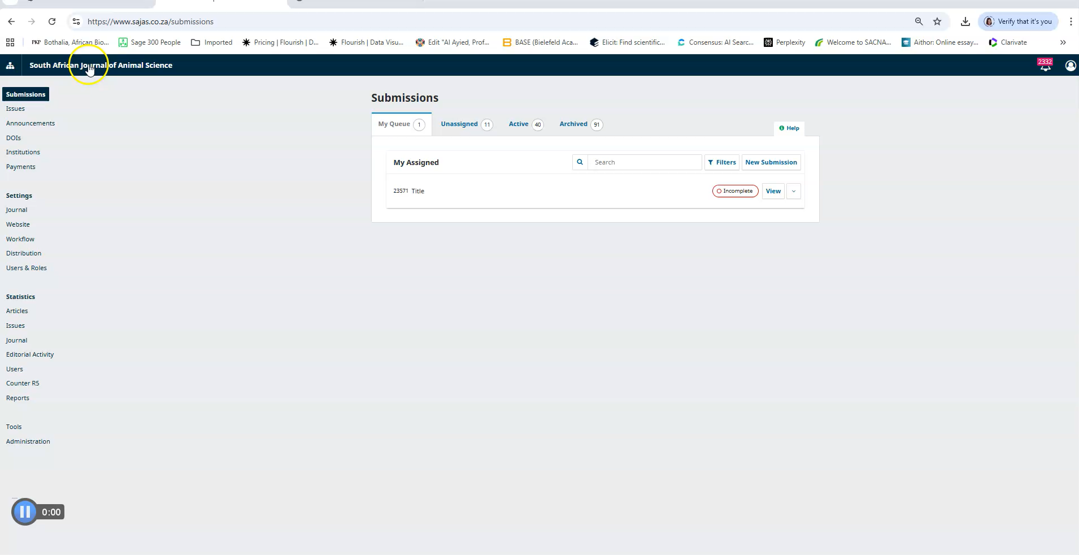

Slide 42

openAlex
2
citations https://openalex.org/ >> Search journal title

Slide 43
What is an API call/request?
API stands for Application Programming Interface
Application → A software program (like OJS, Crossref, OpenAlex, or a mobile app)
Programming → Code and instructions that tell the software what to do
Interface → The “bridge” that allows two different systems to talk to each other
An API is the set of rules and tools that let applications exchange information or services
For example:
OJS can use the Crossref API to register DOIs automatically.
OpenAlex provides an API so you can query their database for journal or article metadata.
In everyday words: an API is like a menu in a restaurant - it tells you what’s available and how to order it. The kitchen (software) does the work, and you get the result (the response)

Slide 44
What is an API call/request?
An API call is a message sent to an API endpoint (a URL)
It asks for data or tells the system to do something
The system processes the request and sends back a response (often in JSON or XML)
For example, if you make an API call to openAlex:
https://api.openalex.org/works?filter=primary_location.source.issn:1996-7489&type:journal-article&per-page=200&select=id,doi,title,publication_year,cited_by_count,referenced_works
That call tells openAlex’s API: “Give me all journal articles with this ISSN.” The API responds with metadata about those articles

Slide 45
Stats from openAlex
Free, open database of scholarly works used by researchers, libraries, and platforms worldwide. Inclusion makes a journal’s articles more discoverable
Many open science tools, repositories, and analytics systems use OpenAlex data. Indexing helps connect a journal’s content with citation networks, researcher profiles, and institutional dashboards
OpenAlex provides citation counts, usage of DOIs, and linkages to other works, which help journals and authors understand reach and influence
Unlike proprietary databases, OpenAlex is openly accessible, lowering barriers for journals (especially from the Global South) to be visible in global scholarly communication

Slide 46
Being indexed in OpenAlex increases a journal’s global visibility, connects its articles to the wider research ecosystem, and ensures that its impact can be openly tracked and recognised.

Slide 47
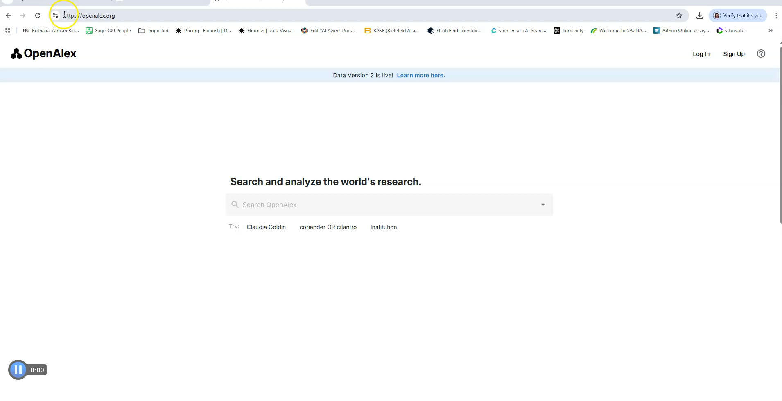

Slide 48
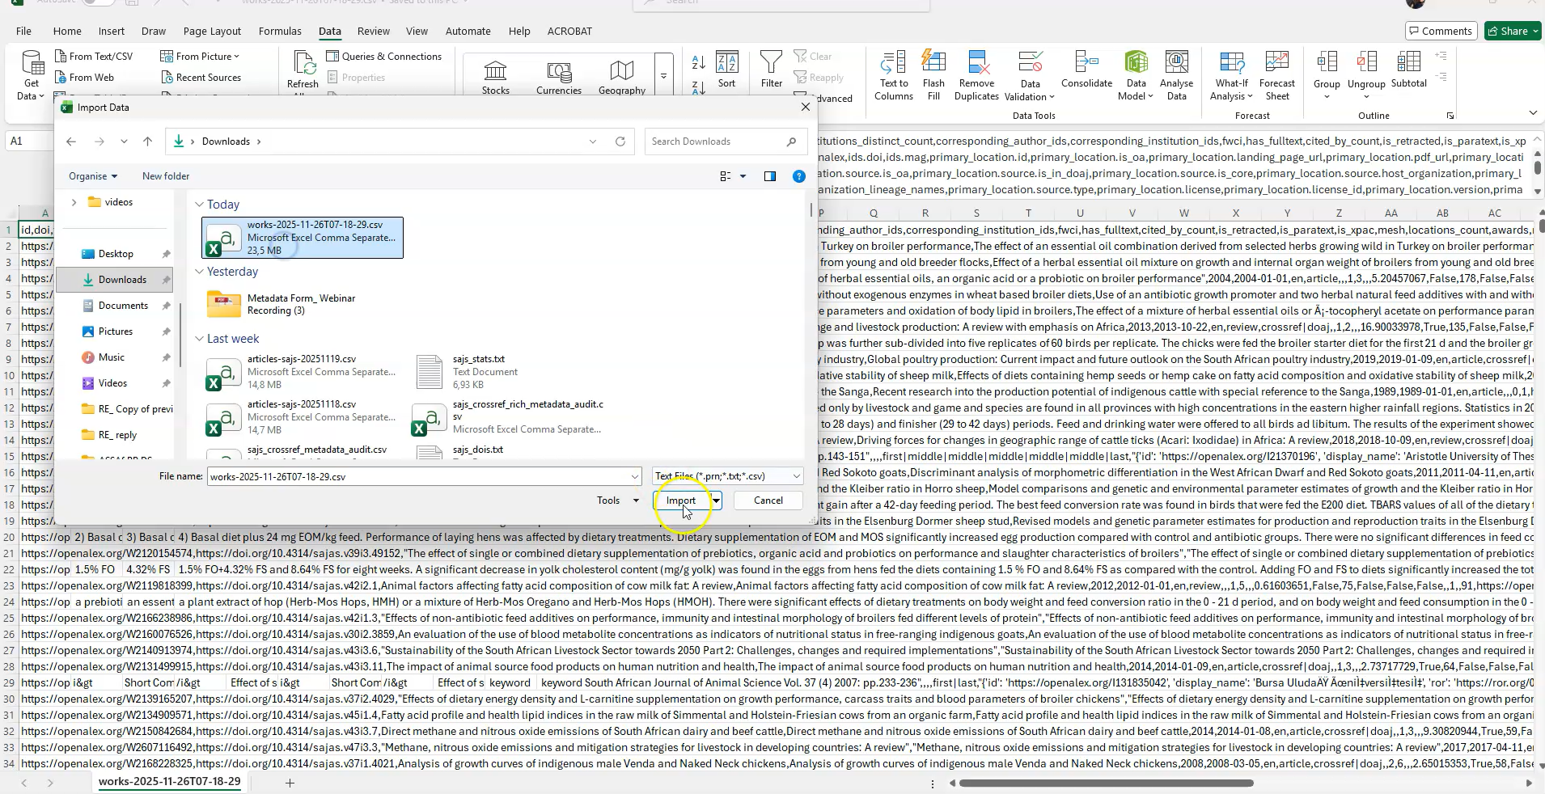

Slide 49

Crossref
3
metadata health https://www.crossref.org/members/prep/6689 >> Search journal title

Slide 50
Stats from Crossref
Global, non-profit organisation that provides Digital Object Identifiers (DOIs) and metadata services for scholarly content
Assigns persistent DOIs so journal articles, books, datasets, and other research outputs can always be found
Maintains metadata network that links publications, authors, funders, institutions, and citations
Underpins global research infrastructure, ensuring discoverability, interoperability, and trust in scholarly communication

Slide 51
Reports from Crossref
Participation Reports - Each Crossref member (i.e. publisher) has a Participation Report you can look up https://www.crossref.org/members/prep/
The report shows, for example, what percentage of records include things like funding metadata, license URLs, abstracts, reference lists, ORCID IDs, Crossmark, etc.
Conflict Reports - show where duplicate DOIs or conflicting metadata have been submitted
DOI error reports, schemas, etc. - Crossref offers various diagnostic and validation reports.
APIs / metadata search - you can query individual DOIs or journal records via the Crossref REST API or Metadata Search to see what metadata is actually present

Slide 52
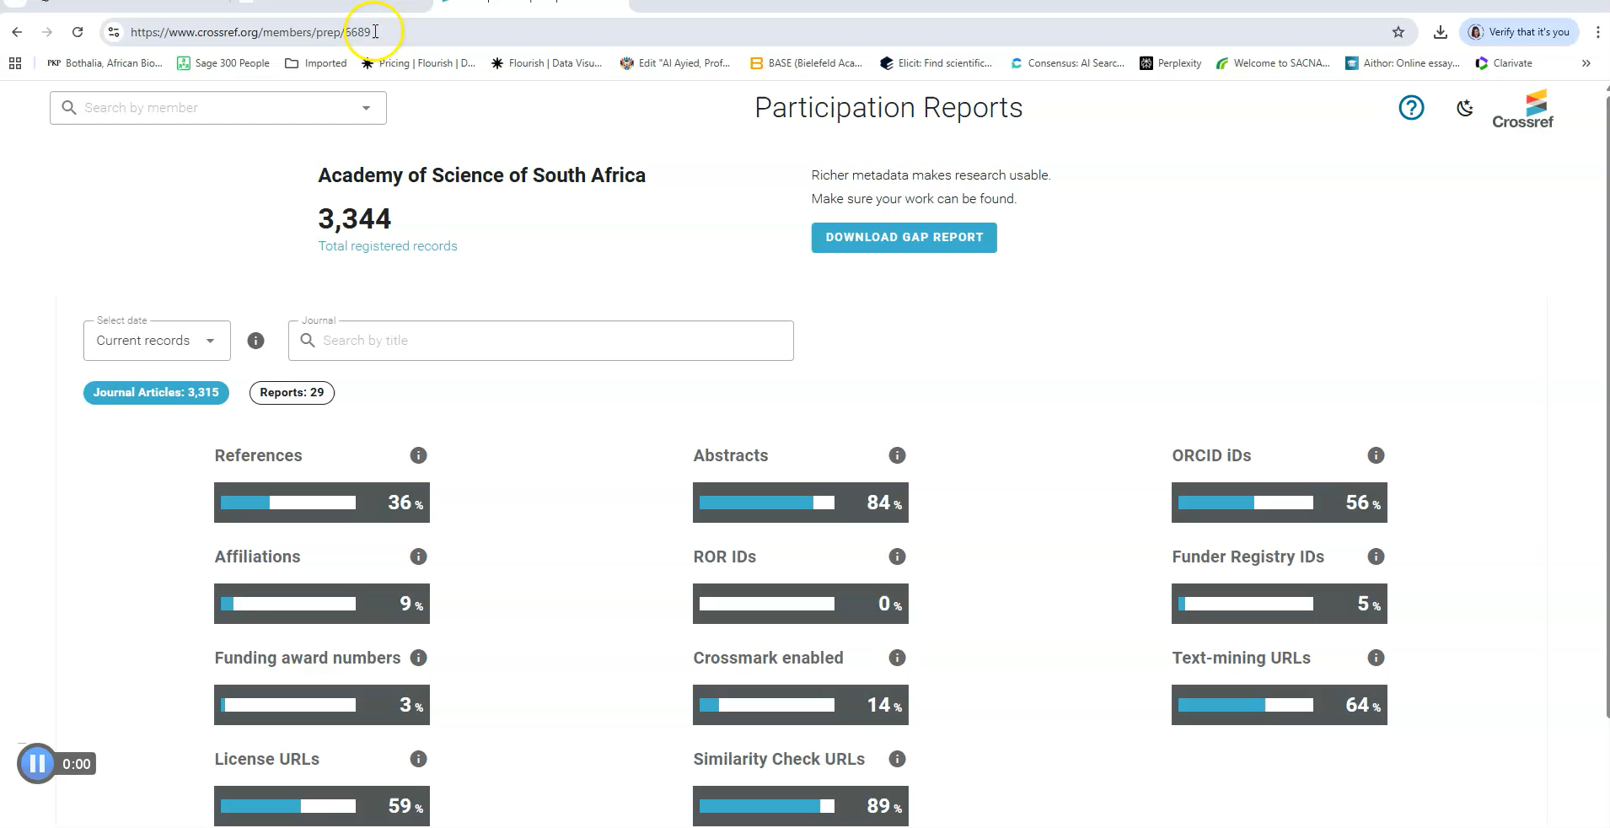

Slide 53
A Crossref Participation Report shows what percentage of that member’s metadata records include 11 key metadata elements. These key elements add context and richness, and help to open up content to easier discovery and wider and more varied use. As a member, you can use Participation Reports to see for yourself where the gaps in your organisation’s metadata are, and perhaps compare your performance to others.
References
Abstracts
ORCID iDs
Affiliations
ROR IDs
Funder Registry IDs
Funding award numbers
Crossmark enabled
Text mining URLs
License URLs
Similarity Check URLs
https://www.crossref.org/documentation/reports/participation-reports/

Slide 54
Canonical metadata
Refers to the official, authoritative version of metadata for a research object (like a journal article, book chapter, dataset, or preprint). It is the version that systems and indexes (e.g. Crossref, OpenAlex, DOAJ) recognise as the “single source of truth”
When a journal deposits an article’s metadata with Crossref, that becomes the canonical metadata tied to its DOI
Other systems (Google Scholar, OpenAlex, ORCID, repositories) then pull or sync from this canonical record to ensure consistency
👉 In short: canonical metadata is the trusted, standardised record that defines how a research output is described, cited, and connected across scholarly infrastructure

Slide 55
Crossref is the backbone (spine) that makes research outputs easy to find, link, and cite

Slide 56
Peer-review (OJS)
4
all activity management/settings/website#plugins >> Review Report

Slide 57
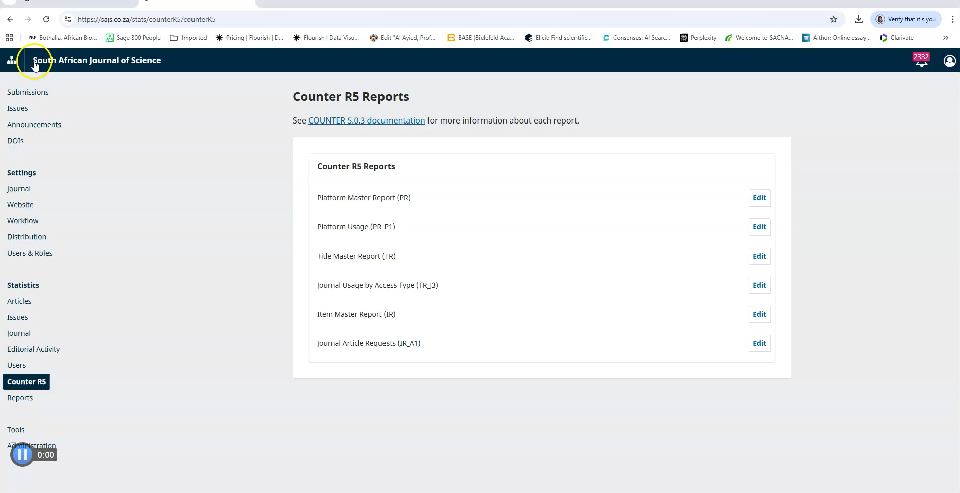

Slide 58

iThenticate
5
plagiarism screening counts

Slide 59
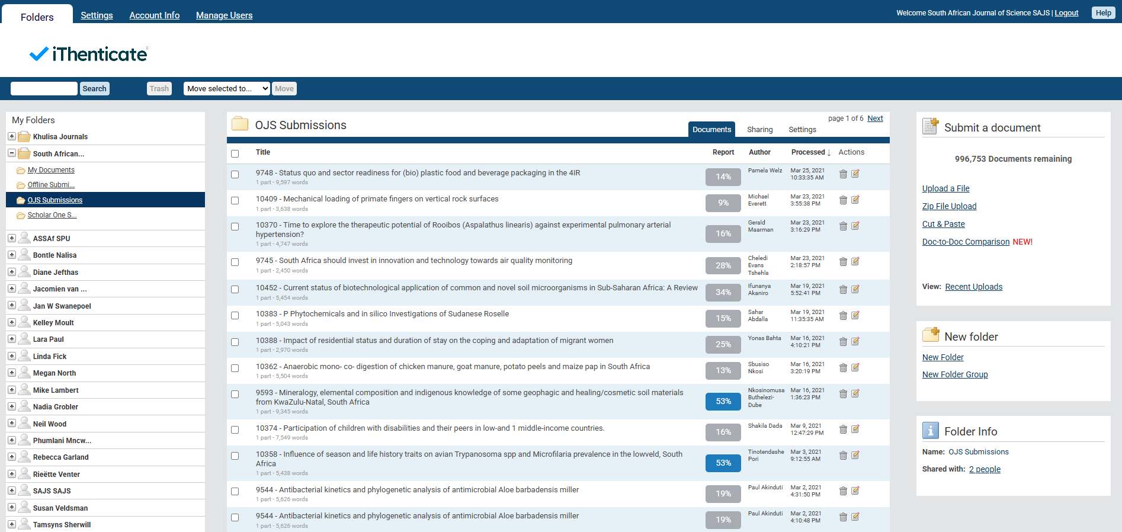

Key Performance Indicators (KPIs)
% of submissions screened
Average similarity %
% above threshold
Desk-rejections due to plagiarism
Revisions requested due to similarity
Turnaround time for screening
Trends in similarity over 12 months
Similarity by article type
Similarity by country/region
iThenticate 2.0 (also for AI detection) https://www.youtube.com/@iThenticateVideos

Slide 60
Altmetrics
6
attention

Slide 61
Tools to measure Altmetrics
Altmetric.com (Altmetric Attention Score / “the donut”)
Data for free, article-by-article, using: bookmarklet, API (limited), DOI lookups
PlumX Metrics (Elsevier / Scopus)
Social media, Mendeley readers, citations, patents, clinical guidelines
Free via Scopus abstract pages if your institution has access
PlumX widgets can also be added to OJS if publisher has a licence
Crossref Event Data (free)
Tweets, Wikimedia mentions, Reddit, News, Blogs, StackExchange, Crossref-to-Crossref links
Query API e.g. https://api.eventdata.crossref.org/v1/events?mailto=you@example.org&obj-id=https://doi.org/10.17159/sajs.2024/18378
openAlex (free)
Mentions, Wikipedia links, Social media activity (via Crossref Event Data), Citations

Slide 62


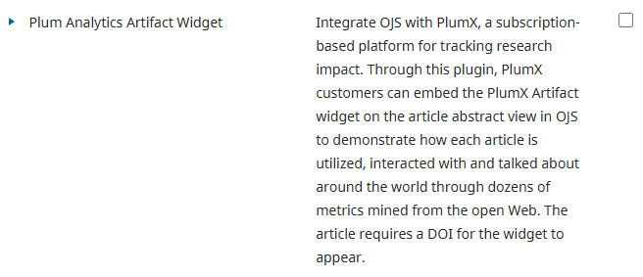
Install Altmetric bookmarklet to browser: https://www.altmetric.com/solutions/free-tools/bookmarklet/

Slide 63

Google Analytics
7
site discovery

Slide 64
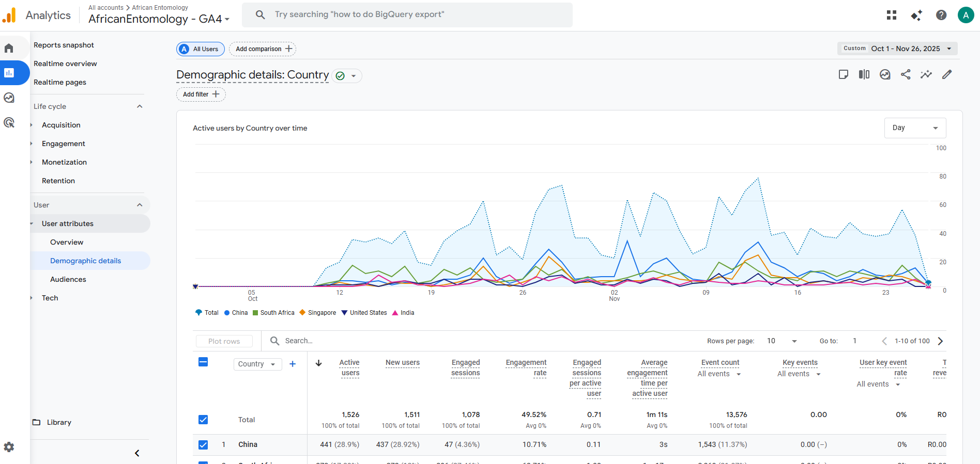

Slide 65

Google Search Console
8
search discovery

Slide 66
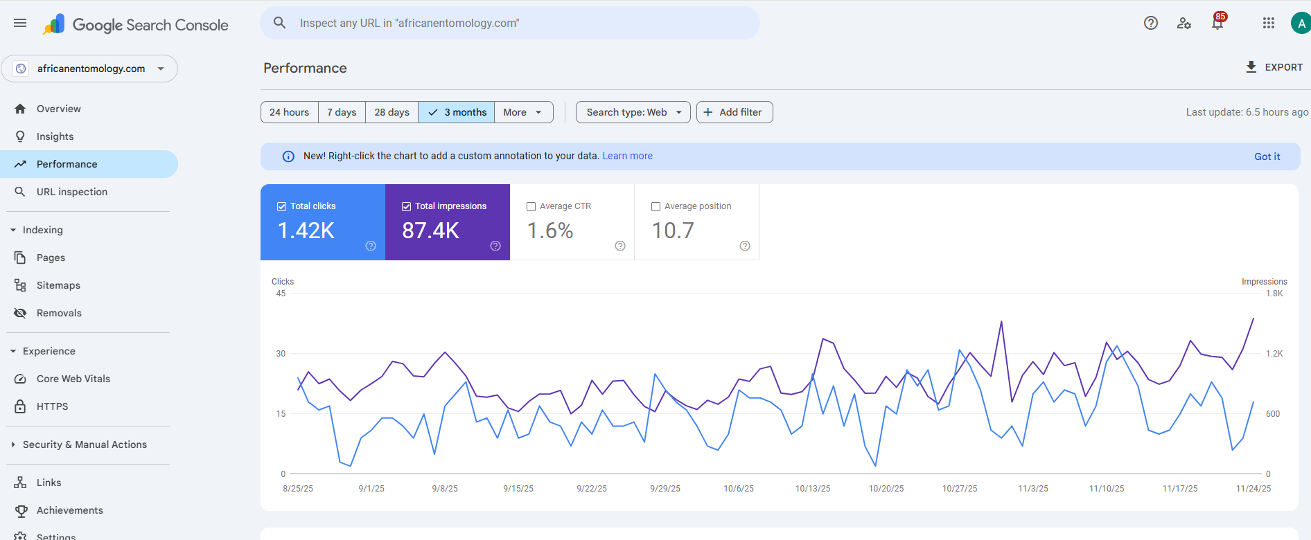

Slide 67
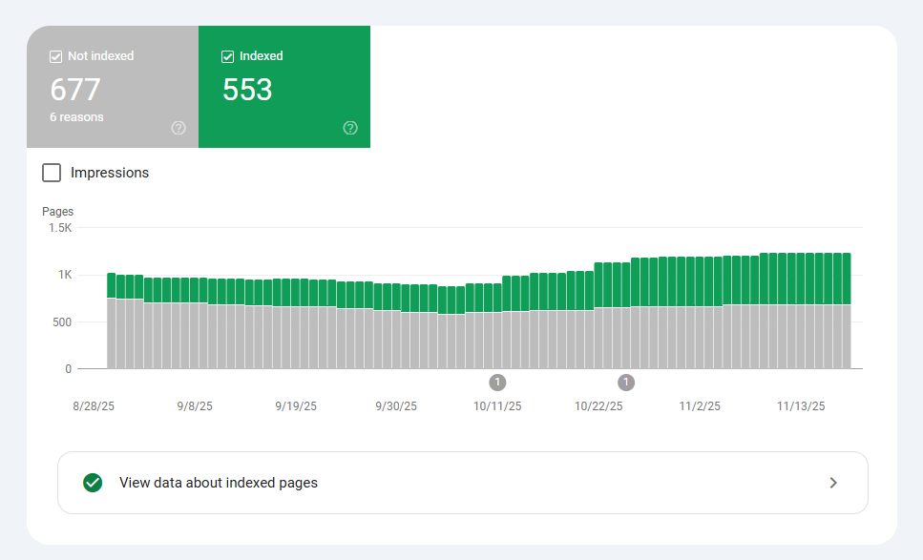
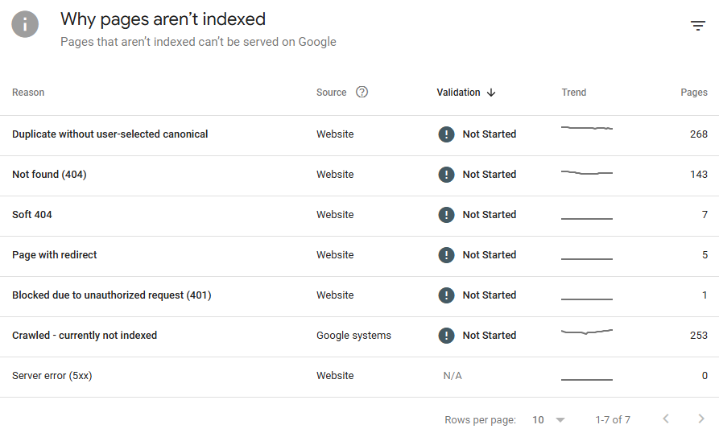

Slide 68

Dimensions
9
article list, authors, DOI, year, citation counts, OA indicator, journal metrics (total citations, h-index), SDGs

Slide 69
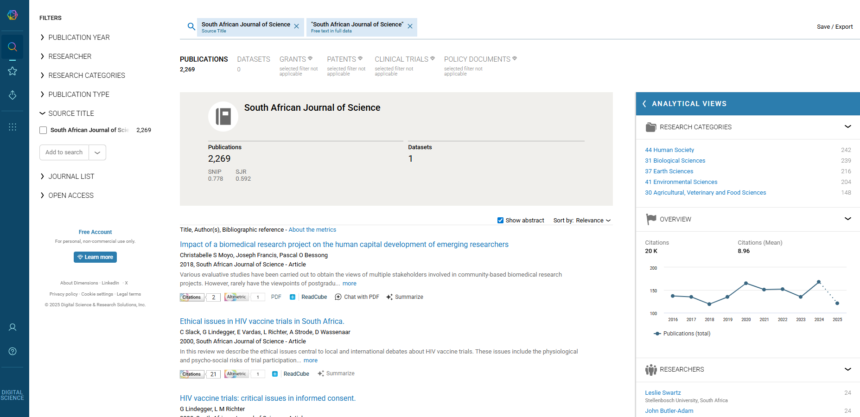
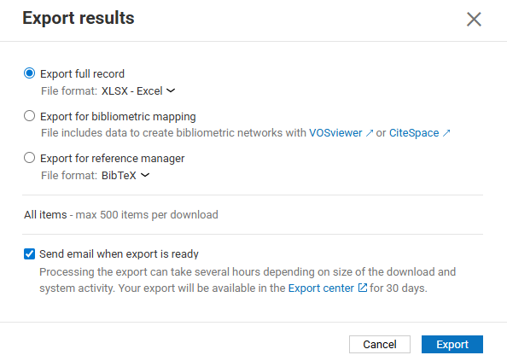

https://app.dimensions.ai/discover/publication

Slide 70
Data hygiene
Set of practices used to keep data clean, accurate, consistent, and usable

Slide 71
Why data hygiene matters for scholarly journals in an open infrastructure environment

Slide 72
Clean, consistent metadata underpins the reputation of the journal. Inaccurate DOIs, wrong author names, or missing licensing info reduce trust in the journal’s outputs. In an open environment, where data are harvested and reused by many systems (DOAJ, Crossref, Scopus, OpenAlex, Google Scholar, etc.), errors spread quickly and undermine credibility.

Slide 73
Open infrastructures rely on interoperability. If journal data are clean and standardised, services can harvest them without friction. For example:
Correct ORCID iDs ensure researchers’ work links to their profiles
Consistent journal titles/ISSNs mean articles are correctly indexed
Proper licensing signals that content is open, boosting inclusion in repositories and indexes
Without good hygiene, the same article might appear fragmented across systems or be missed entirely

Slide 74
Reliable usage and citation metrics depend on clean data. Duplicate or inconsistent records distort statistics, which in turn affects:
Institutional reporting (e.g., DHET accreditation)
Global visibility (impact measures, Altmetrics)
Policy decisions (open science compliance tracking) Poor data hygiene = misleading performance signals

Slide 75
Open infrastructure thrives on automation and harvesting (e.g. Crossref APIs, OAI-PMH feeds, COUNTER reports). If journals maintain clean data, they avoid costly reprocessing and manual corrections later. This makes operations more sustainable for small editorial teams with limited resources.

Slide 76
For journals in the Global South, strong data hygiene ensures they are visible in the same way as well-resourced Northern journals. Clean metadata helps level the playing field by allowing inclusion in global infrastructures without bias introduced by poor data quality.

Slide 77
Thank you
ina@assaf.org.za ina@doaj.org

