Slide 1
Creative Commons Licenses How to license a repository and which article version to submit
Attribution 4.0 International

Slide 2
Copyright and Creative Commons Licenses

Slide 4
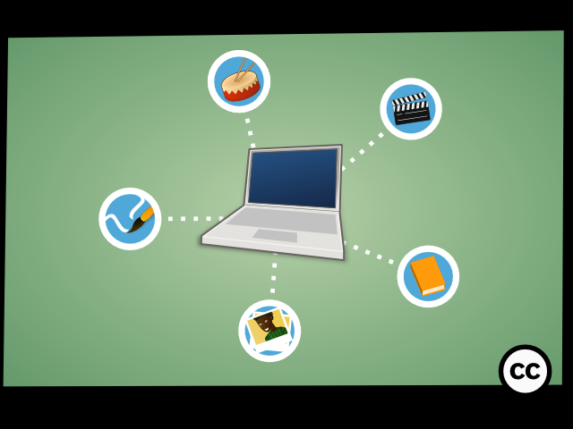

Slide 5
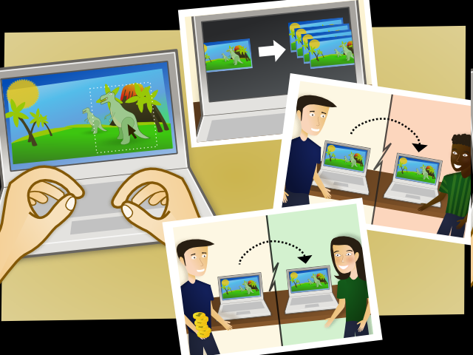

Slide 6
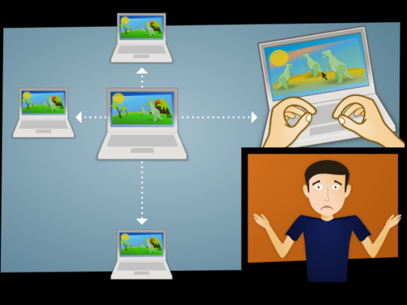

Slide 7
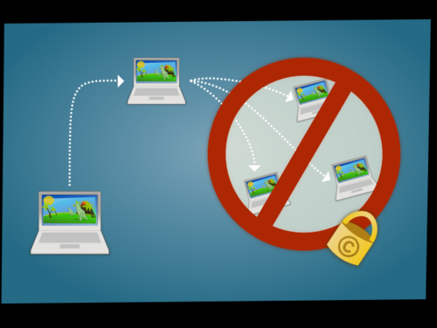

Slide 8
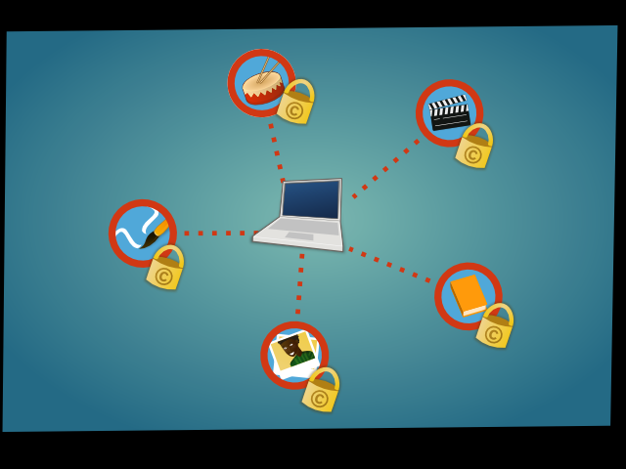

Slide 9
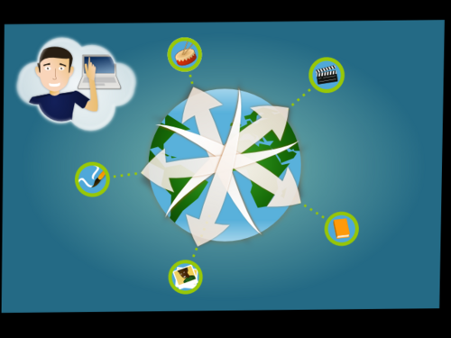

Slide 10
Everything you wanted to know about Creative Commons Licenses
(But were afraid to ask)
“Everything You Wanted to Know about Creative Commons Licenses (But Were Afraid to Ask)” by Lillian Rigling is licensed under a Creative Commons Attribution 4.0 International License.

Slide 11
Notes:
How many folks recognize this symbol?
This is the copyright symbol. It indicates that a work has the protection of copyright law

Slide 12
All Rights Reserved
Notes:
Sometimes it comes with this tagline “All rights reserved.” That means that the author is holding onto all of the protections of their copyright. But what if they want to share a litte? How can they

Slide 13
Notes:
Has anyone seen this symbol?
This is the Creative Commons symbol. It’s an indicator that the creator of the work has chosen to grant a license to you to use the work in some ways. These licenses still work within the boundaries of copyright, but provide an easy way to share work with others.

Slide 14
Some Rights Reserved
Notes:
In other words, if copyright is “all rights reserved,” creative commons is “some rights reserved”

Slide 15
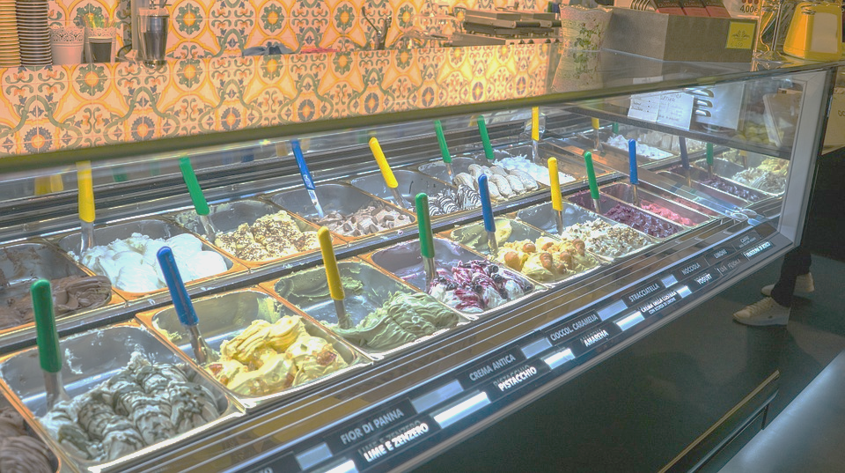
The many flavours of Creative Commons
Notes:
Creative Commons licenses come in many different flavours. They allow the creator to choose a license that suits their needs, allowing the creator to retain the rights they want, while still licensing the rights they want.

Slide 16
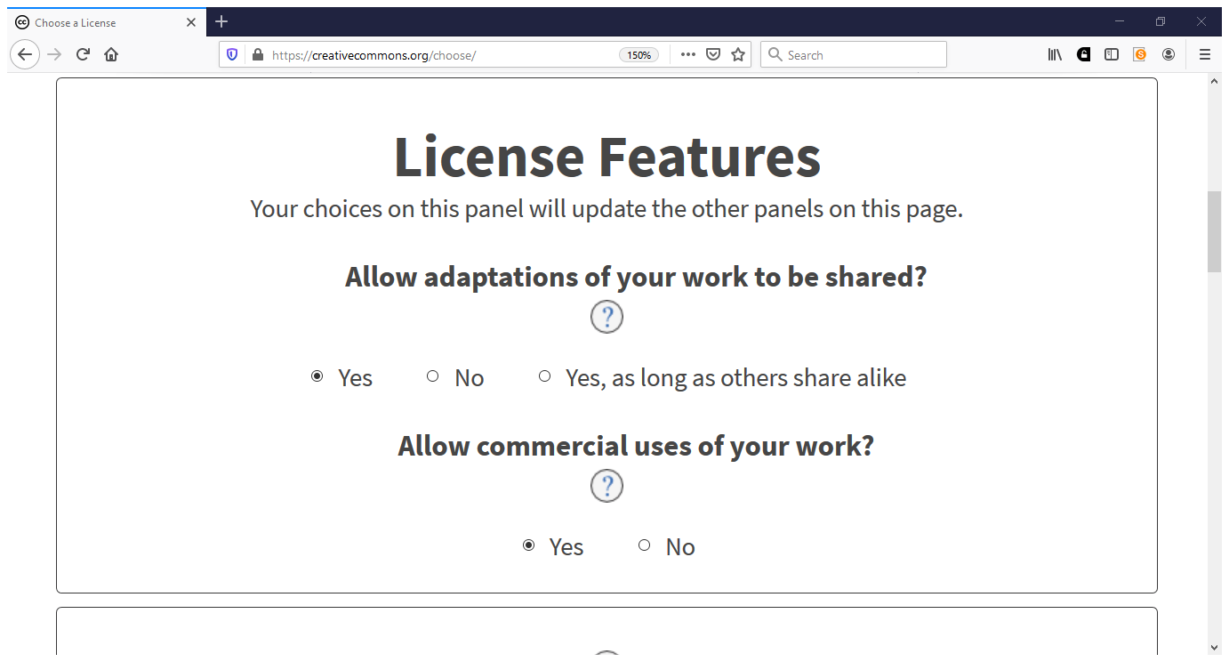
https://creativecommons.org/choose

Slide 17
Notes:
Since, unlike ice cream, you can’t taste the different flavours of CC licenses, Creative Commons has four handy symbols that you need to know in order to identify what kind of license a work has. Each symbol indicates the a different condition for re-use.

Slide 18
BY: Attribution
Notes:
First, the little person or “BY” “By” indicates attribution. That is, if you want to use this work, you need to credit the original author. This symbol is saying “You can use this in any way you want, but you have to say it’s ‘by’ me!” All CC licenses have the “By” condition.

Slide 19
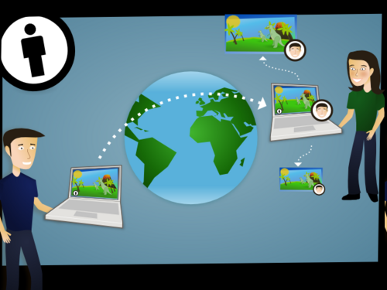

Slide 20
https://creativecommons.org/choose

Slide 21
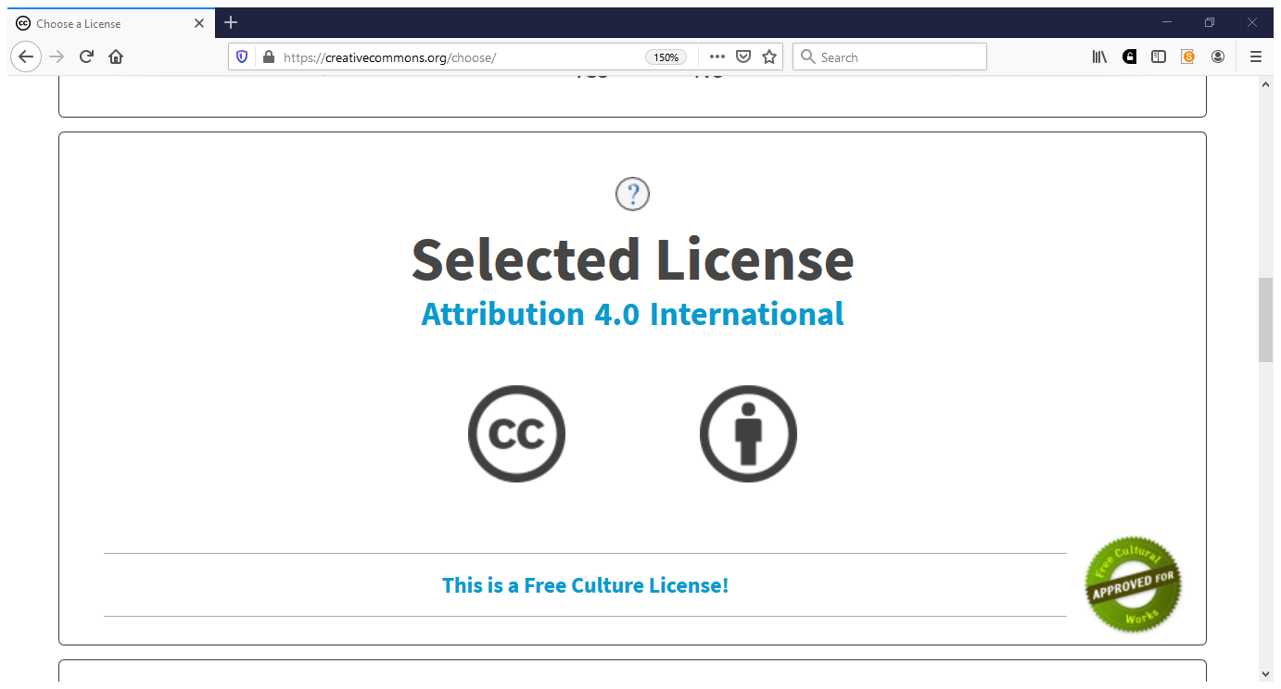

Slide 22
NC: Non-Commercial
Notes:
This is NC or Non-commercial. This symbol indicates that the work can only be used for a non-commercial purpose. That means that only the creator can make money using the work.
Keep in mind that this restriction is about the use, not the user. For example, a big for-profit corporation can use a Creative Commons Licensed work with the non-commercial condition in training materials for their employees, but not to sell their products.

Slide 23
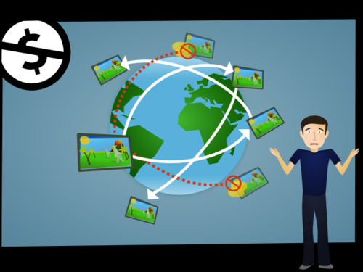

Slide 24
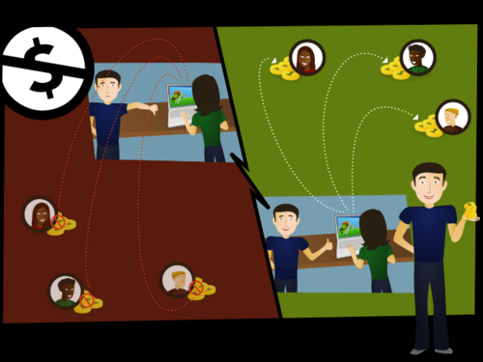

Slide 25
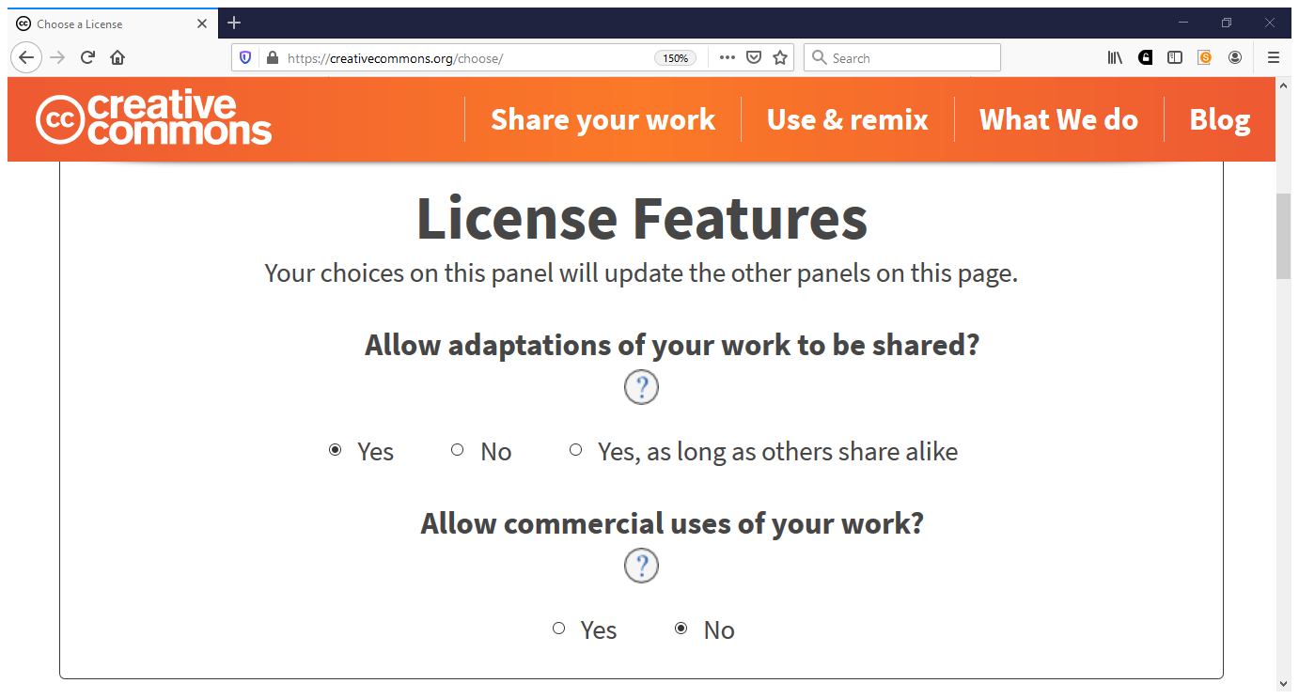

Slide 26
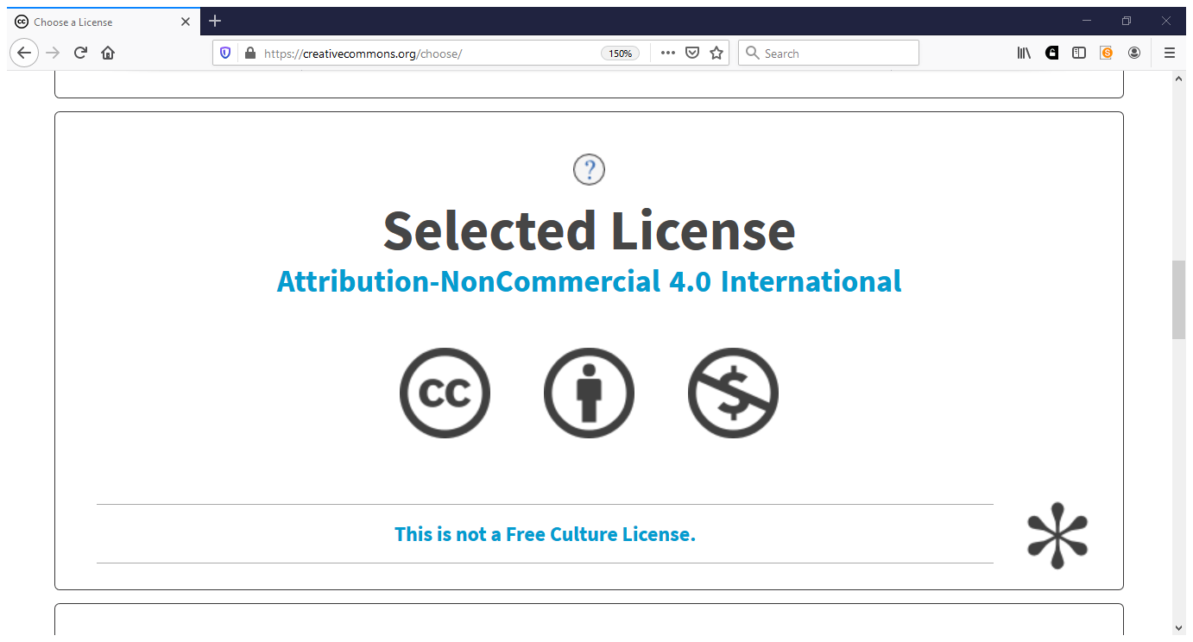

Slide 27
ND: No-Derivatives
Notes:
This equals symbol means “no derivatives.” It’s saying “if you share your version, your version must equal mine.” A user can make small changes and re-share, for example, creating a physical copy of a digital copy, or fixing a typo. A user can also take a work licensed with the No-Derivatives condition and use it as a piece of a collection of works, as long as the licensed work itself is unaltered.

Slide 28
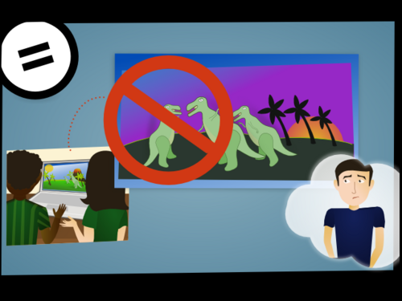

Slide 29
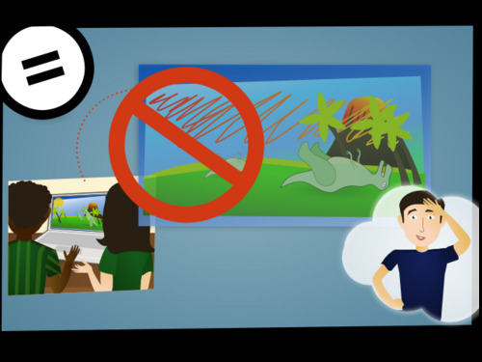

Slide 31
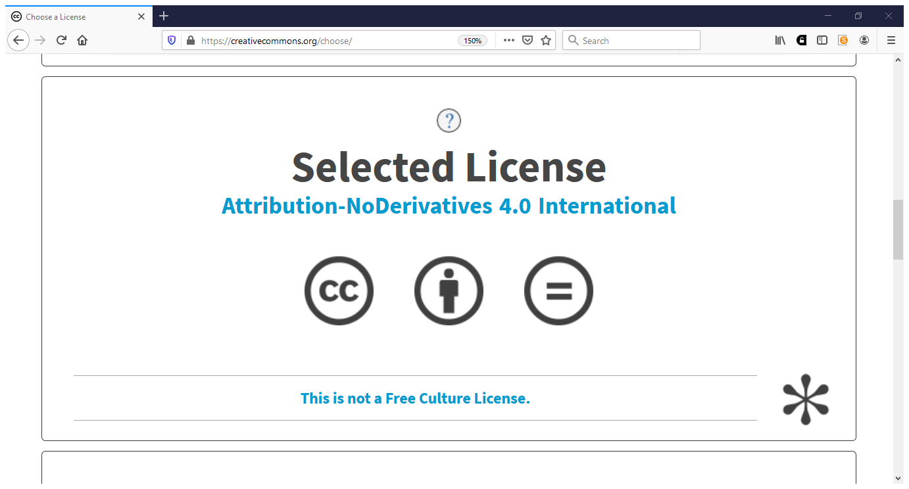

Slide 32
SA: ShareAlike
Notes:
The last possible condition is the ShareAlike condition. This is the condition that says, “If you want to share something you built using my work with others, you have to share it with the same license or a compatible license.” This shows that the user wants the work to stay openly licensed in some way.

Slide 33
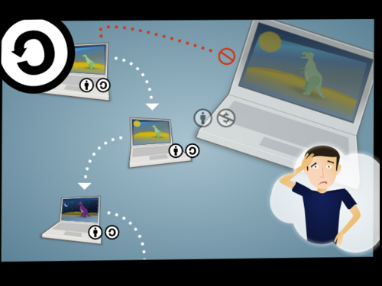

Slide 34
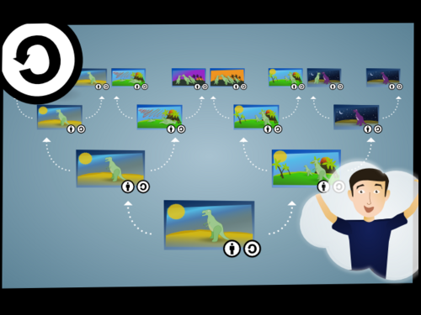

Slide 35
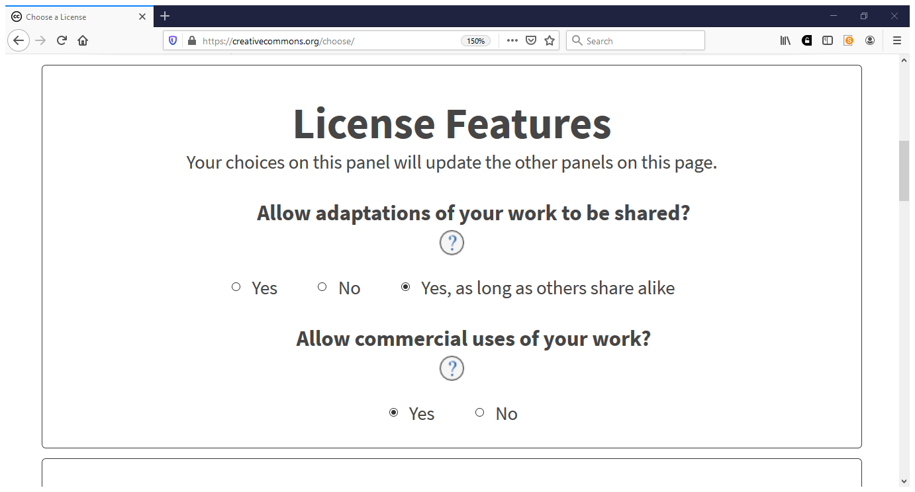

Slide 37
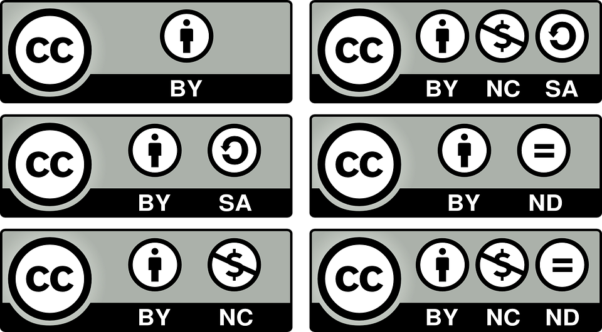
Notes:
There are six different ways to combine these four symbols to make creative commons licenses. You can see they all have the creative commons symbol in the left corner, followed by a series of other symbols, each representing the conditions we just talked about.

Slide 38
Attribution
Notes:
This is a CC-By License, it has just one condition: Attribution

Slide 39
Attribution
ShareAlike
Notes:
This is CC-BY-SA. It has two conditions: Attribution - You must Credit me - and ShareAlike - If you share, you must use the same or a compatible license.

Slide 40
Attribution
NonCommercial
Notes:
This is CC-BY-NC, which again has the attribution condition, as well as the non-commercial condition - use this, but only for non-commercial purposes

Slide 41
Attribution
No Derivatives
Notes:
And this is our last license with only two conditions: CC-BY-ND. This license still requires attribution, but it says that if you share, your version must equal the original.

Slide 42
Attribution + NonCommercial
ShareAlike
No Derivatives
Notes:
There are two licenses that have three conditions: CC-BY-NC-SA and CC-BY- NC-ND. They both have the attribution condition “You must credit me” and the noncommercial condition “You can use this, but only for noncommercial purposes.” CC-BY-NC-SA also has the share-alike condition, “you must share any adaptations of this work with the same or a compatible license” whereas the bottom license, CC-BY-NC-ND has the no derivatives condition “your work must equal mine.”
You’ll note here that there are no licenses with all four conditions because ShareAlike and No Derivatives are incompatible. No derivatives means no one can share adaptations of the work, whereas the sharealike condition only applies when a user is sharing an adaptation of a work/

Slide 43
To Recap…
Four symbols
Four possible conditions
Six Creative Commons Licenses

Slide 44
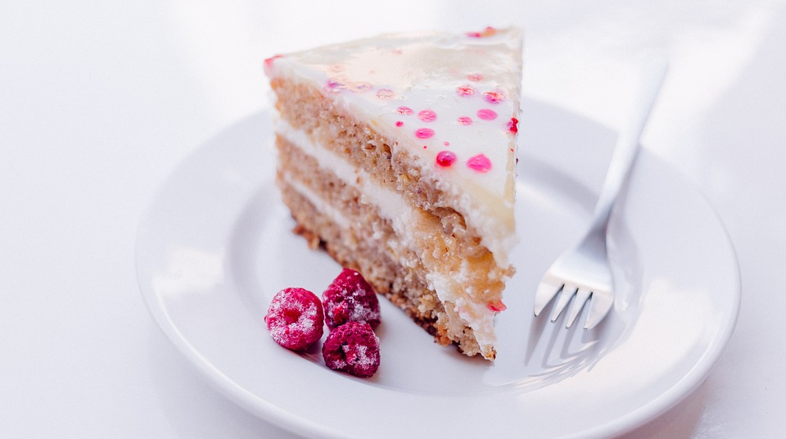
How do CC Licenses work?
Notes:
So now that we know how to figure out what kind of a license you’re looking at, it’s important to know how these licenses work.
Creative commons licenses are all kind of like a layer cake, and those symbols are the frosting. Inside, there are three different layers of Creative Commons cake that make this license enforcible and trustworthy

Slide 45
Layer 1: Human-Readable (Common Deeds)
Notes:
The first layer is the human-readable layer. This is a plain language summary of each of all of the terms of the license. These are not legally enforceable, but they make it easy for folks to get a sound summary of the terms of the license

Slide 46
Layer 2: Legal Code
Notes:
The second layer is just for lawyers. This is where the legally-enforceable terms and conditions are. This legal code is sound and designed to work within copyright law internationally. This is where the meat of the license is, and this is what makes it trustworthy.

Slide 47
Layer 3: Machine-Readable
Notes:
The final layer is a machine-readable layer. Since CC licenses are often shared using the web, this provides metadata that describes the conditions of the license so that users can search for openly-licensed works.

Slide 48
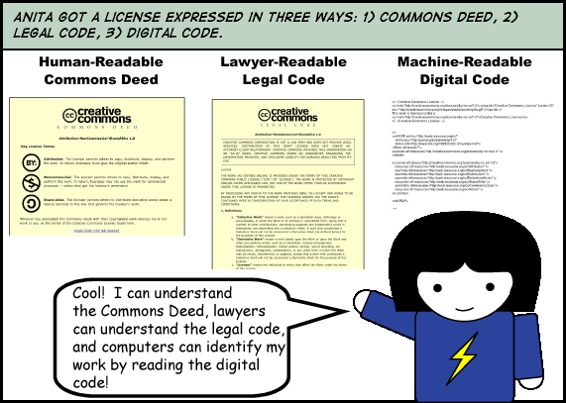

Slide 49
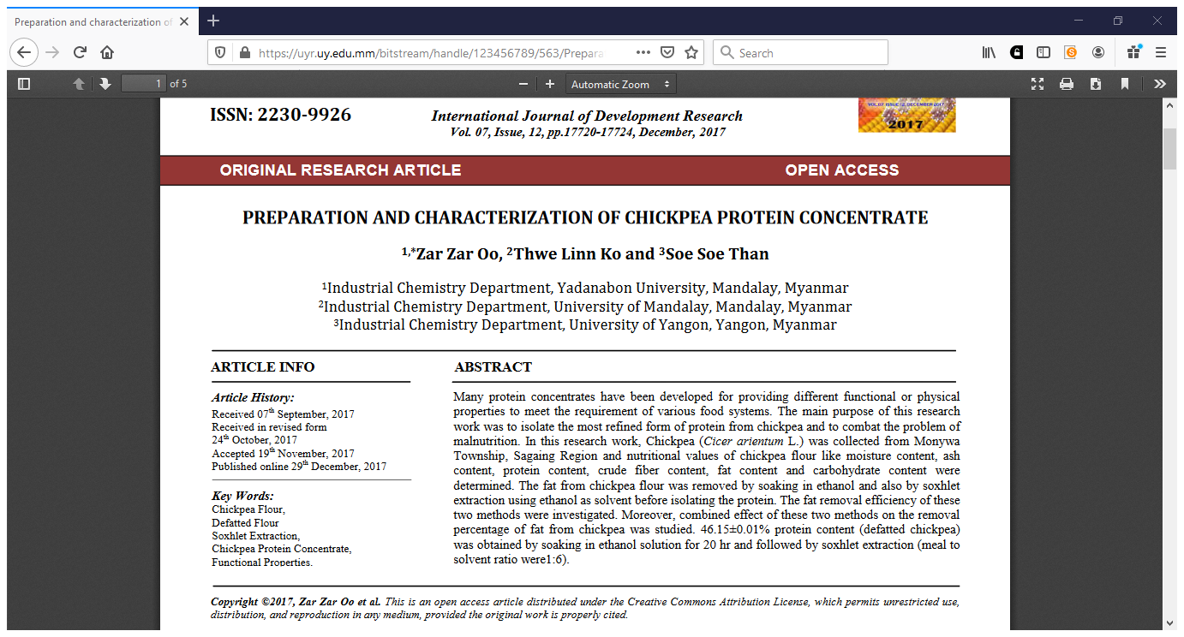

Slide 50
Copyright ©2017,Zar Zar Oo et al. This is an open access article distributed under the Creative Commons Attribution License, which permits unrestricted use, distribution, and reproduction in any medium, provided the original work is properly cited

Slide 51
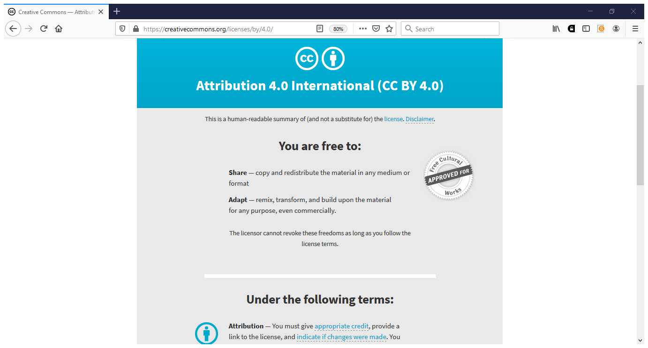

Slide 52
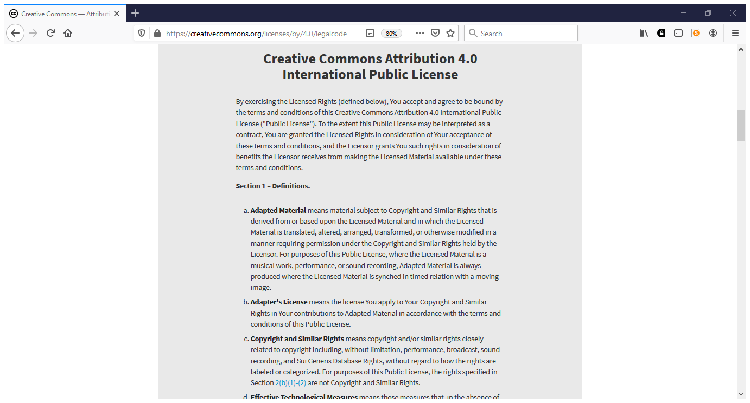

Slide 53
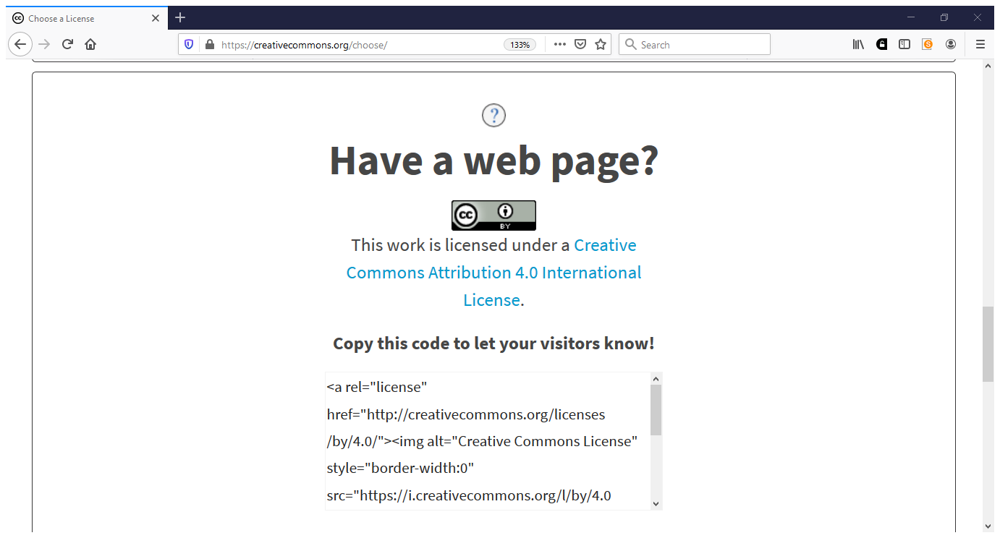

Slide 54
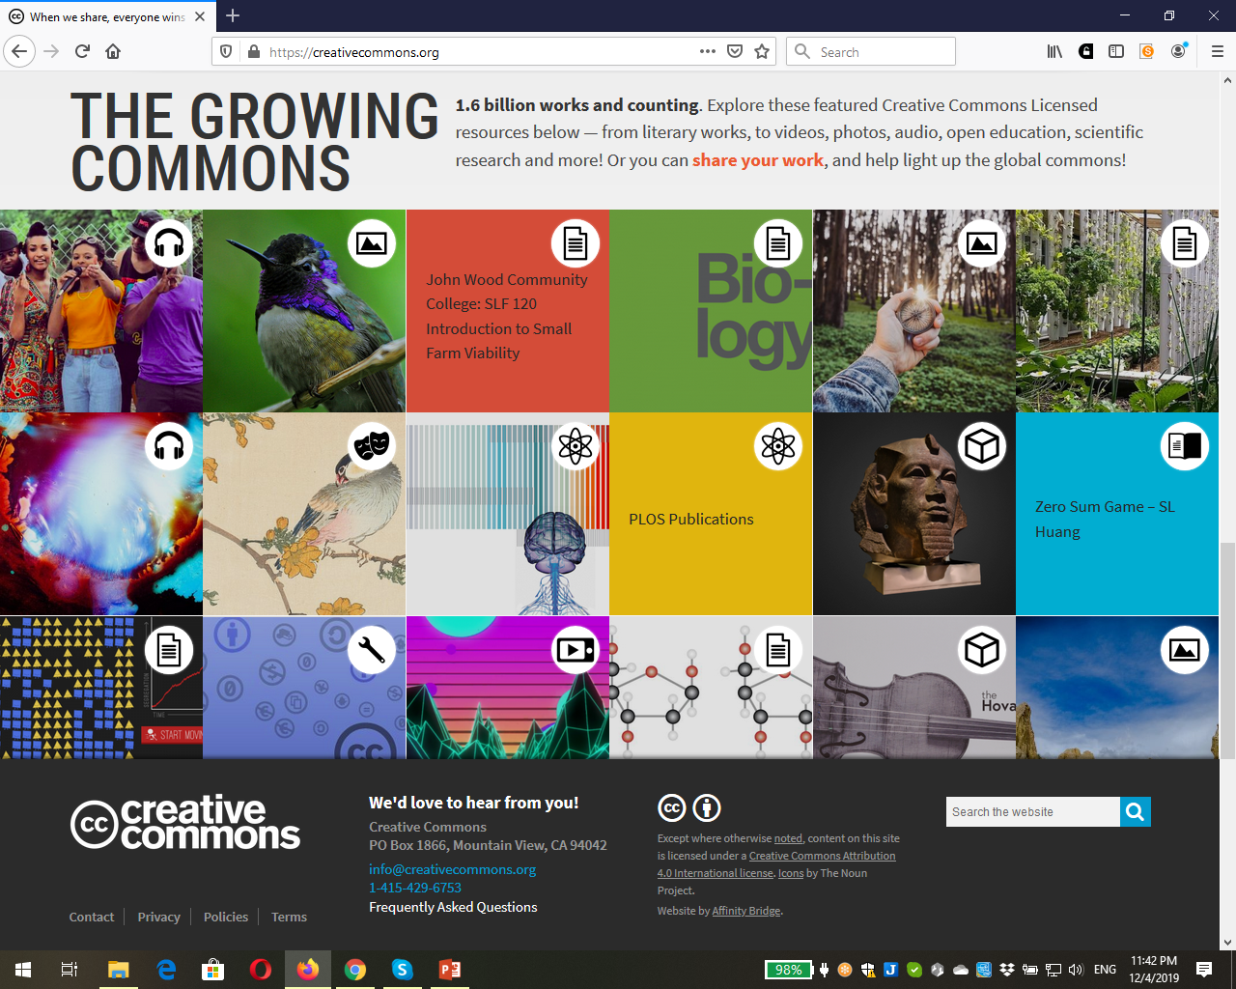

Slide 55
How to license repositories

Slide 56
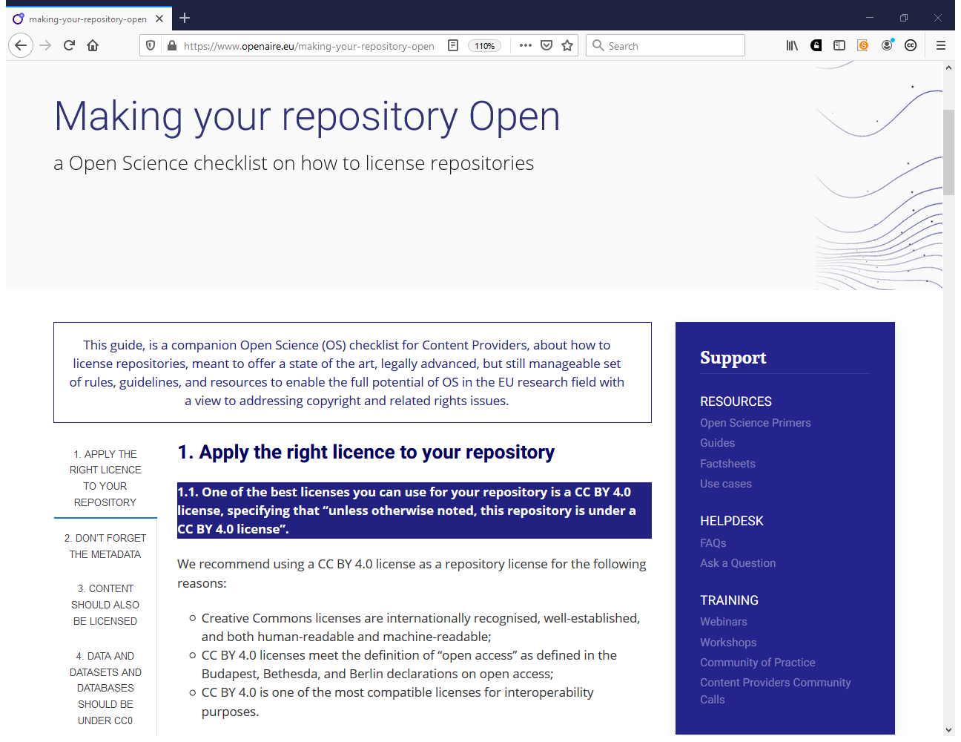
https://www.openaire.eu/making-your-repository-open

Slide 57
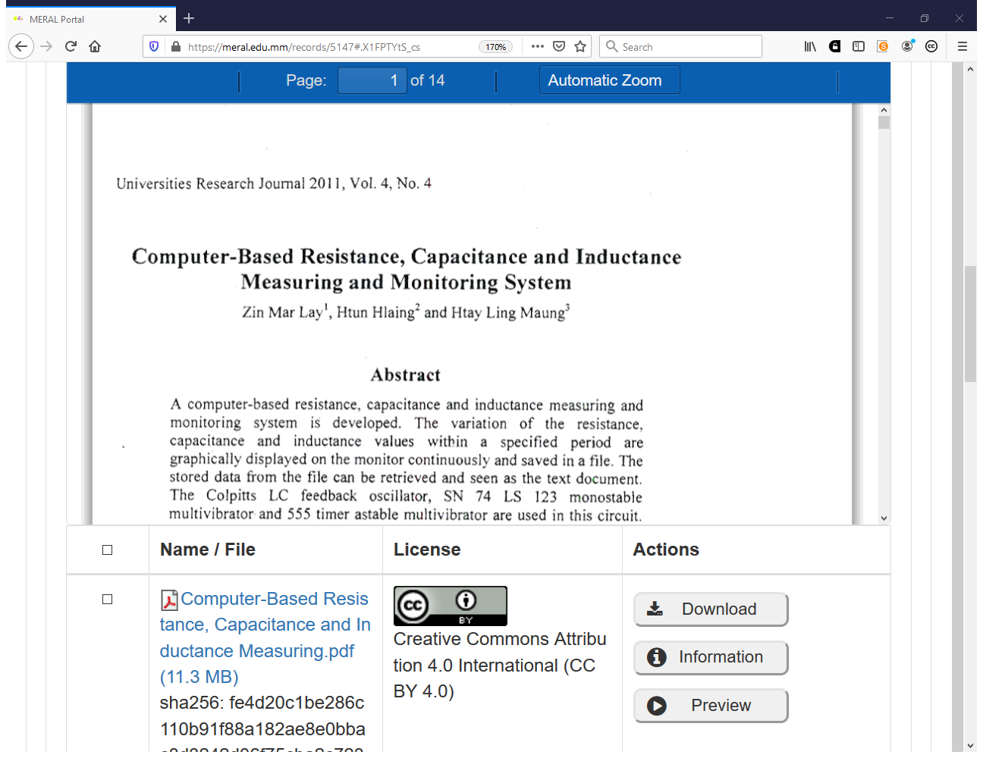

Slide 58
Access and Reuse
Access: Files may be deposited under closed, open, embargoed or restricted access. Files deposited under closed access are protected against unauthorized access at all levels. Access to metadata and data files is provided over standard protocols such as HTTP and OAI-PMH.
Content use and re-use: Use and re-use is subject to the license under which the objects were deposited. Creative Commons Attribution (CC-BY International 4.0) licence is a preferred licence.
Embargo status: Users may deposit content under an embargo status and provide and end date for the embargo. [MERAL] will restrict access until the end of the embargo period; at which time, the content will become publicly available automatically.
Metadata use and reuse: Metadata is licensed under Creative Commons Attribution (CC-BY International 4.0) licence, except for email addresses. All metadata is exported via OAI-PMH and can be harvested. https://meral.edu.mm/about

Slide 59
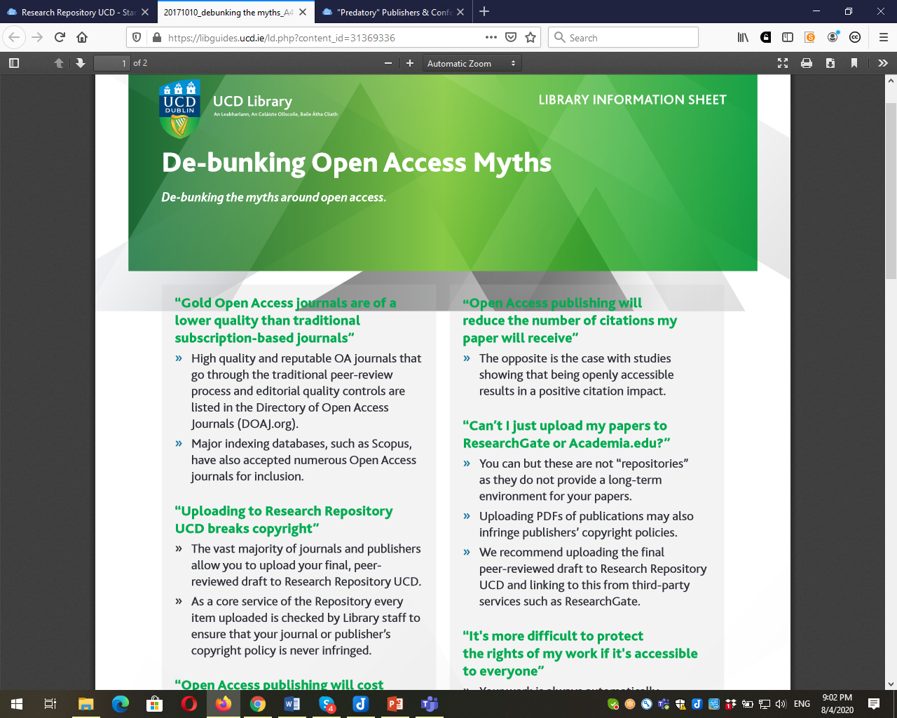
https://libguides.ucd.ie/ld.php?content_id=31369336

Slide 60
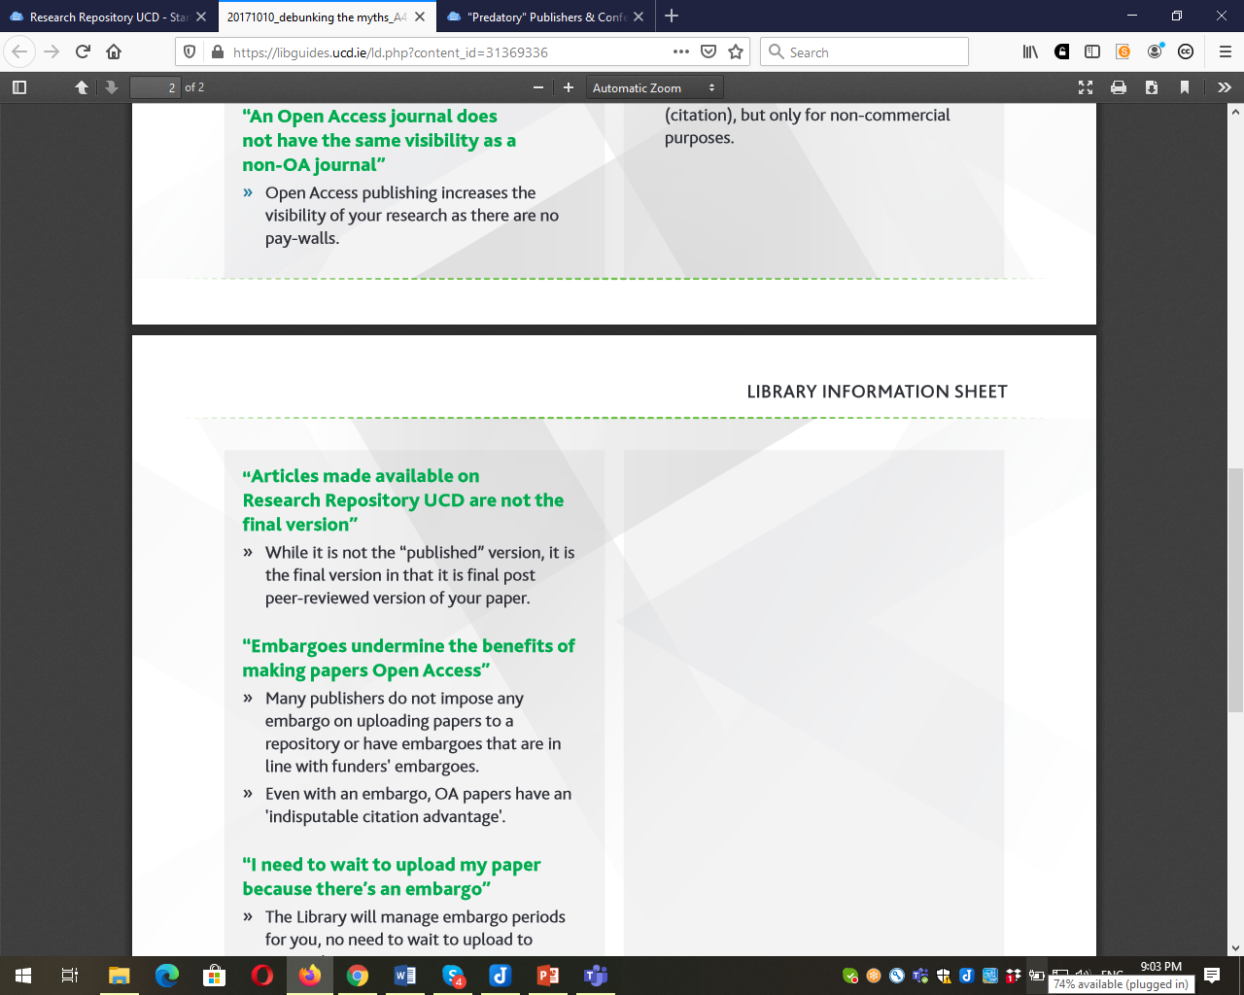

Slide 61
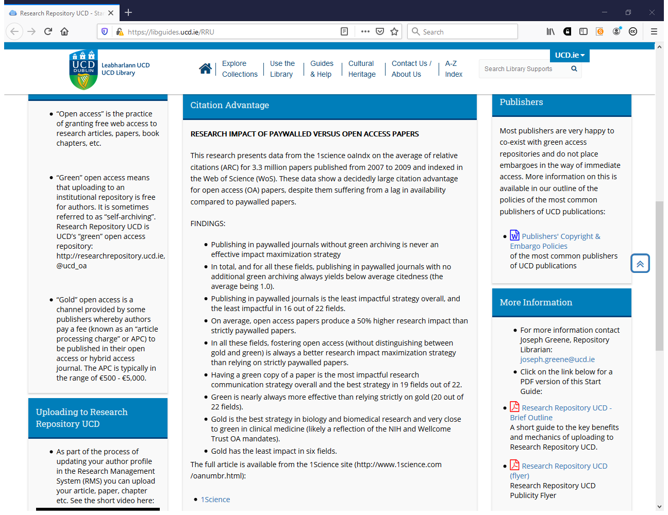

Slide 62
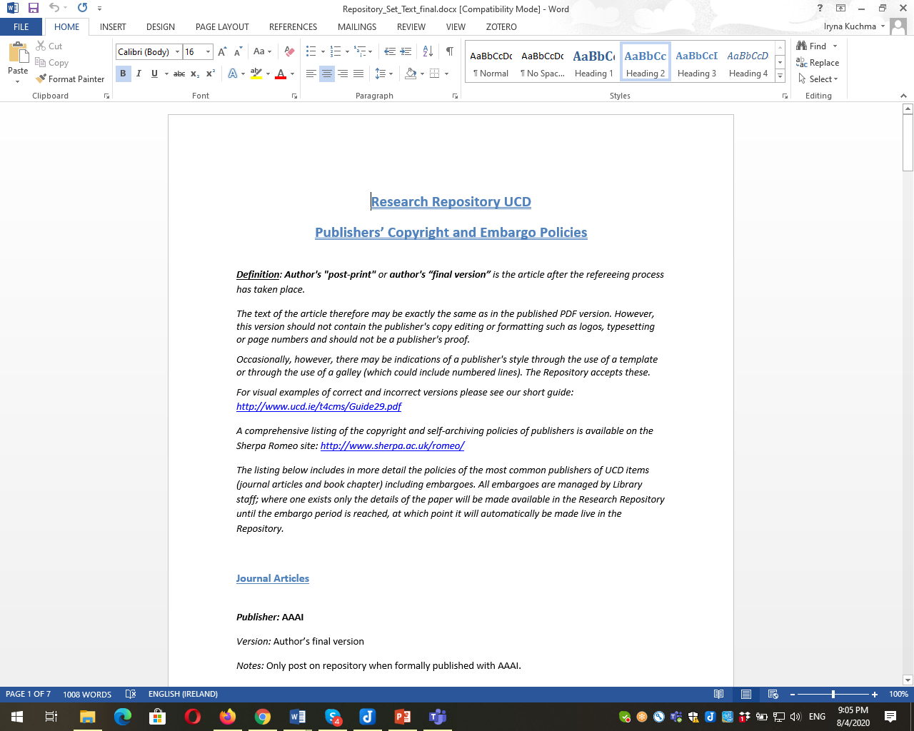

Slide 63
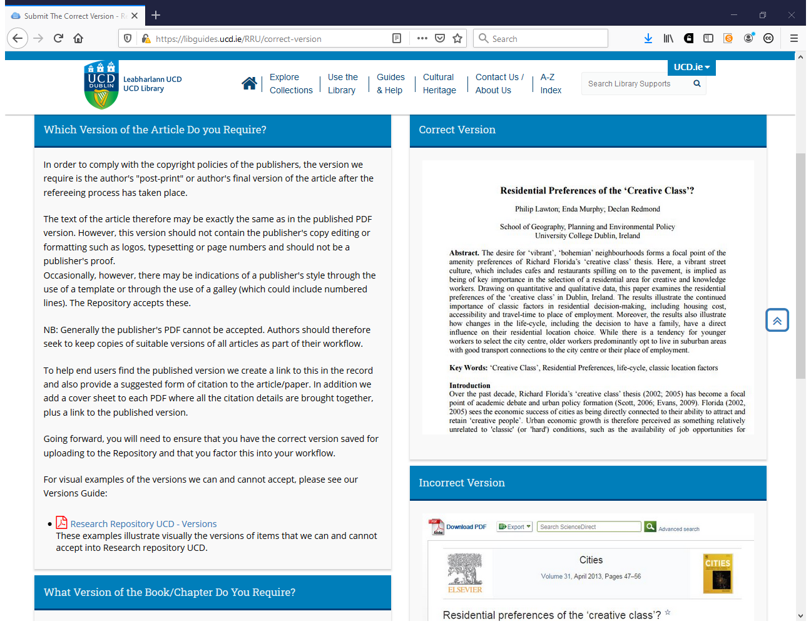
https://libguides.ucd.ie/RRU/correct-version

Slide 64
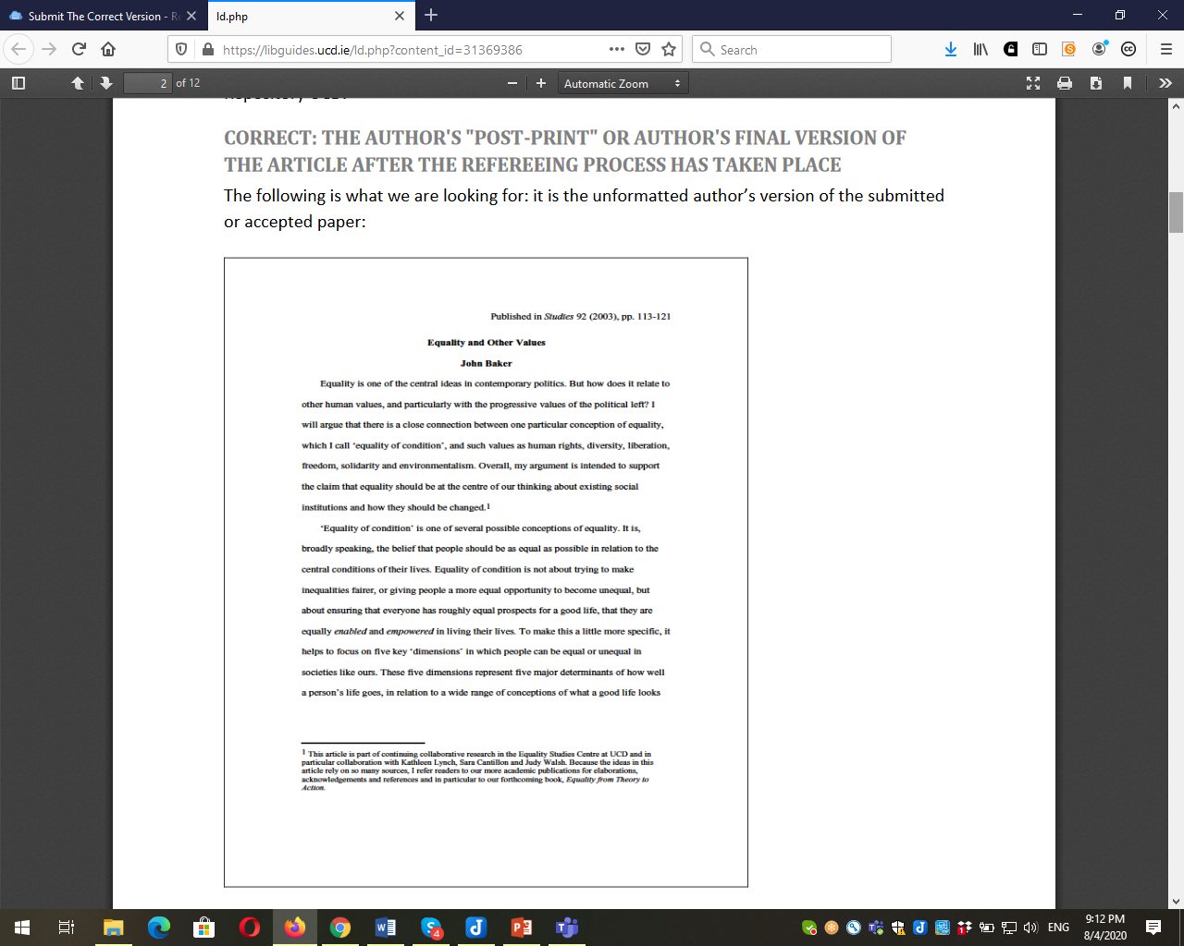

Slide 65
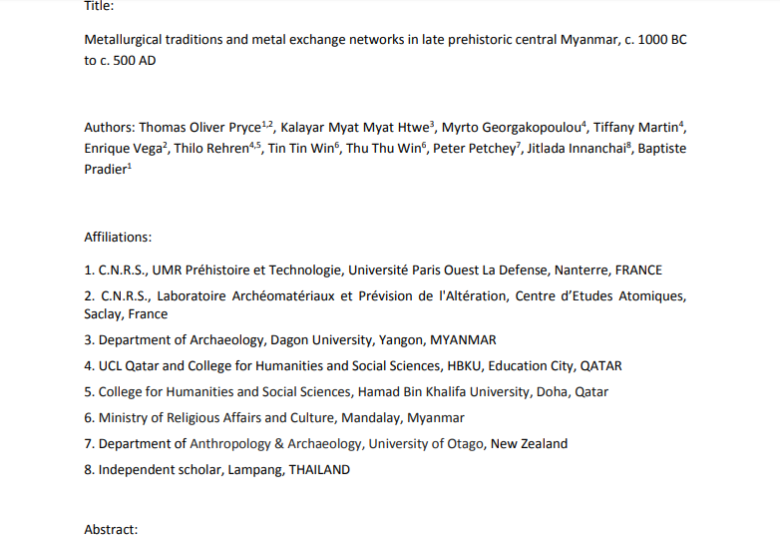

Slide 66
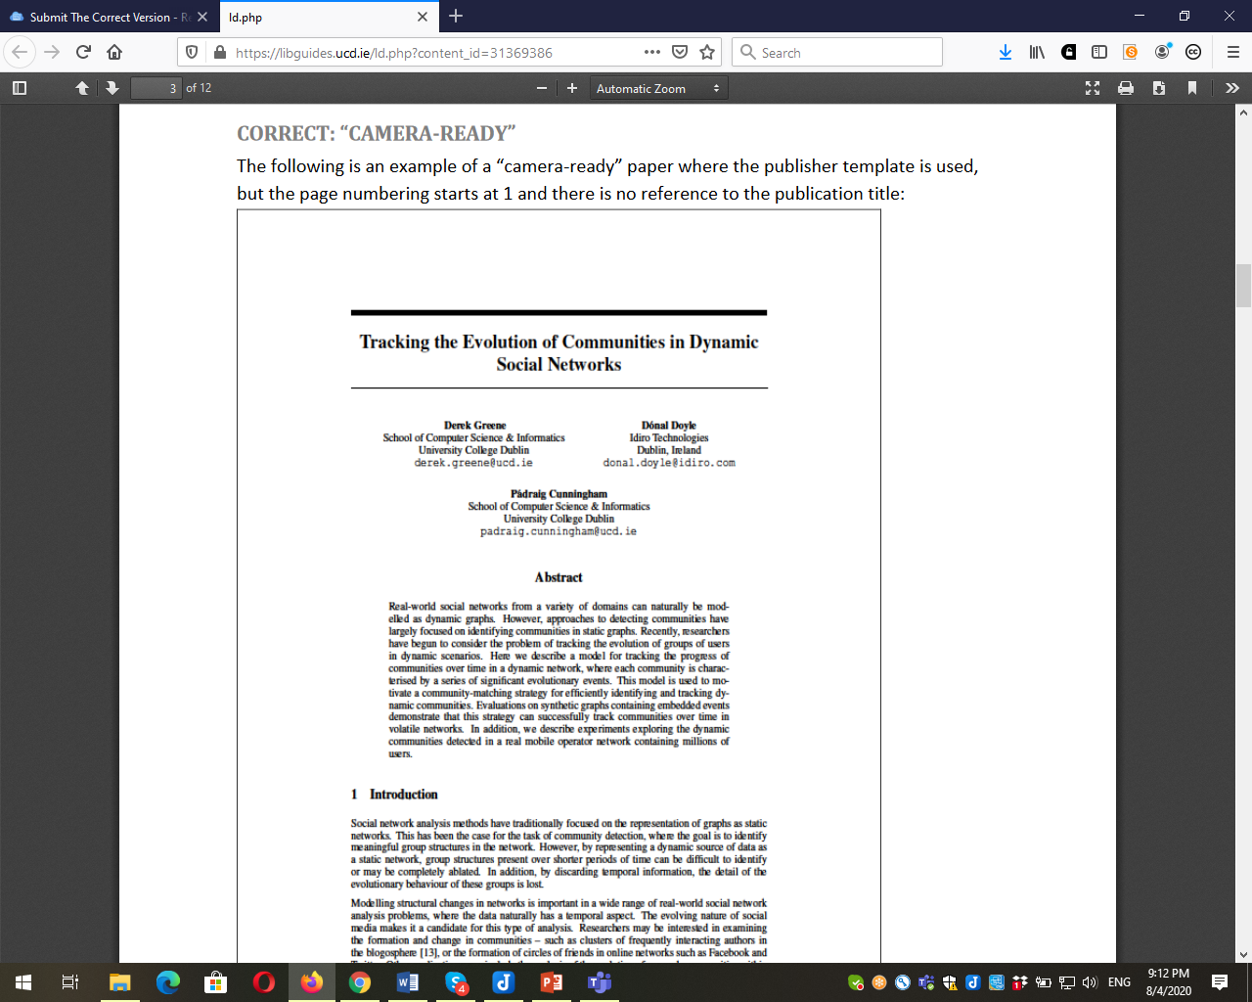

Slide 67
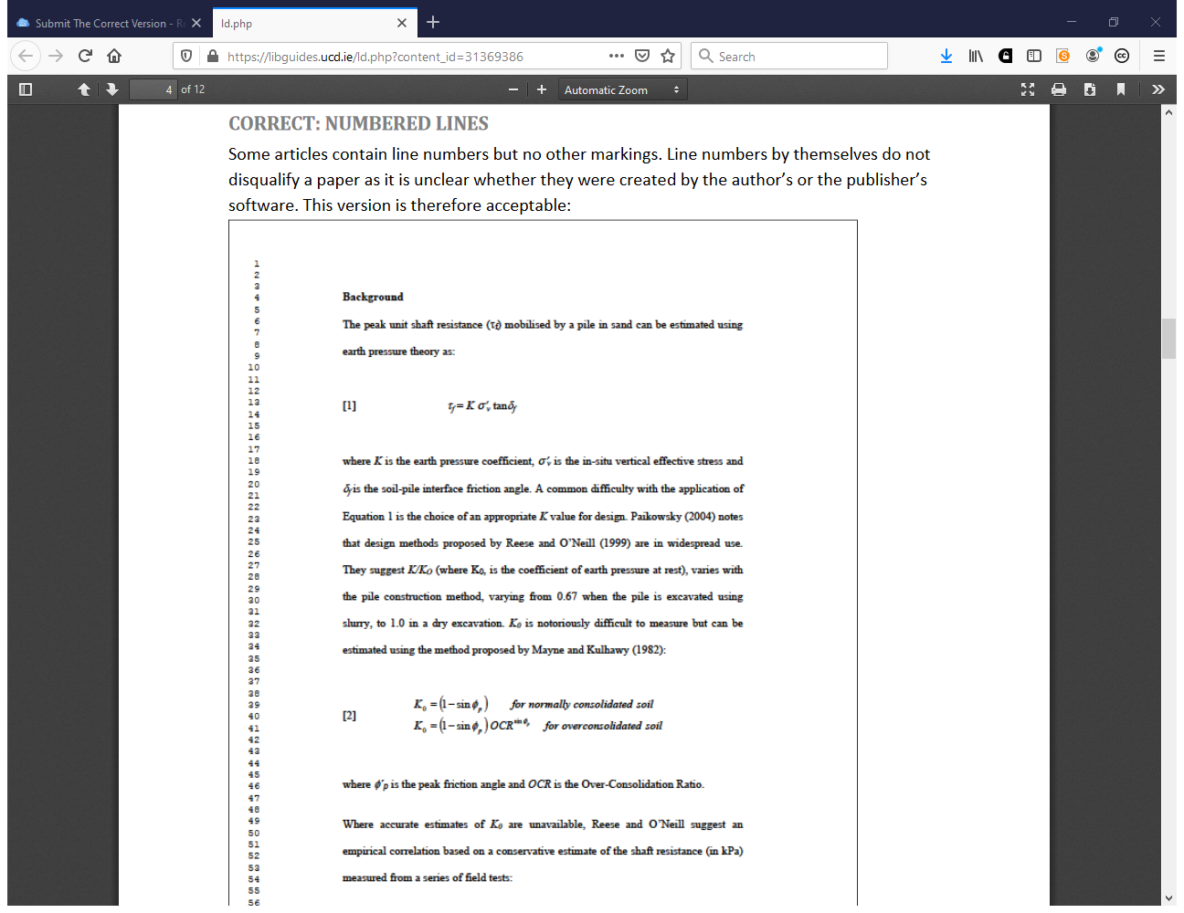

Slide 68
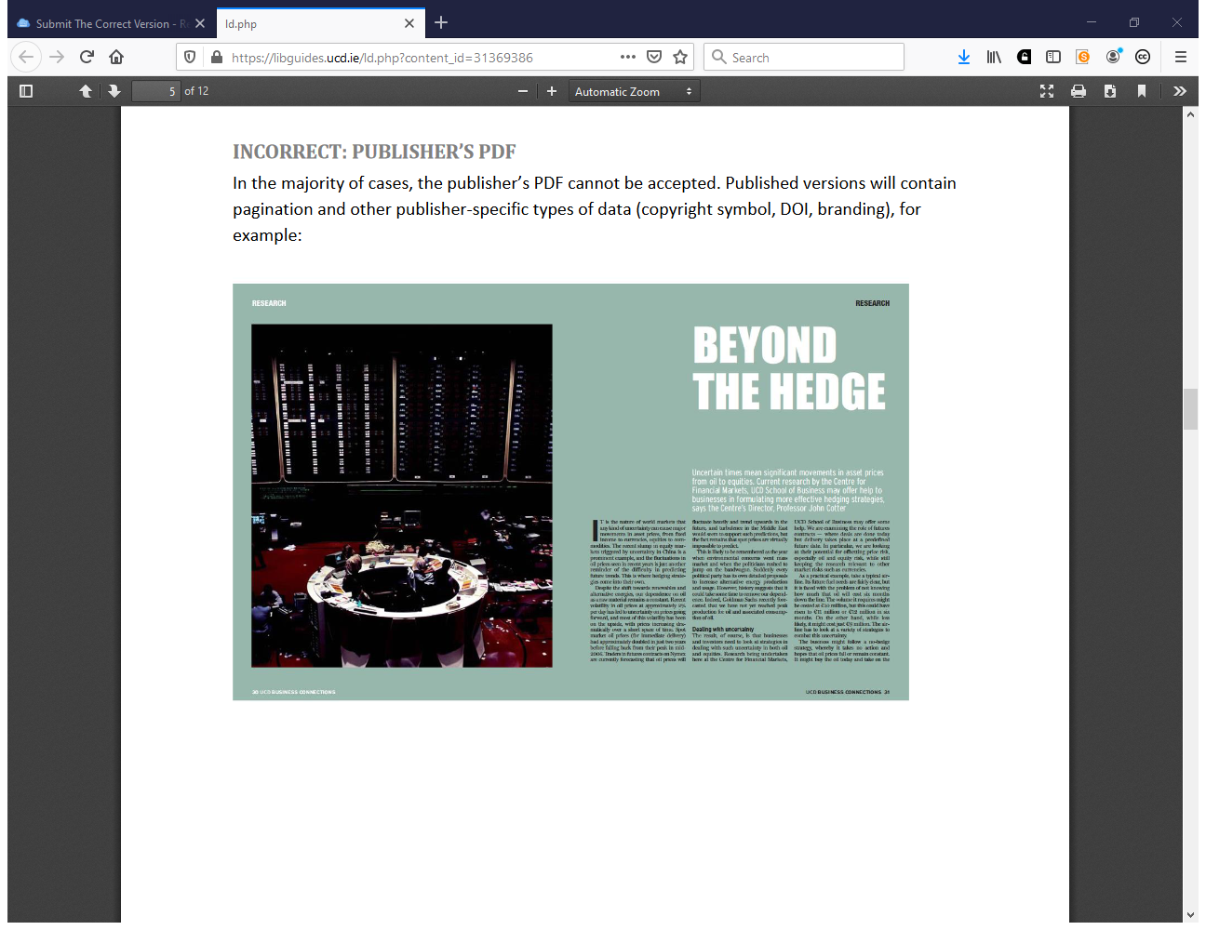

Slide 69
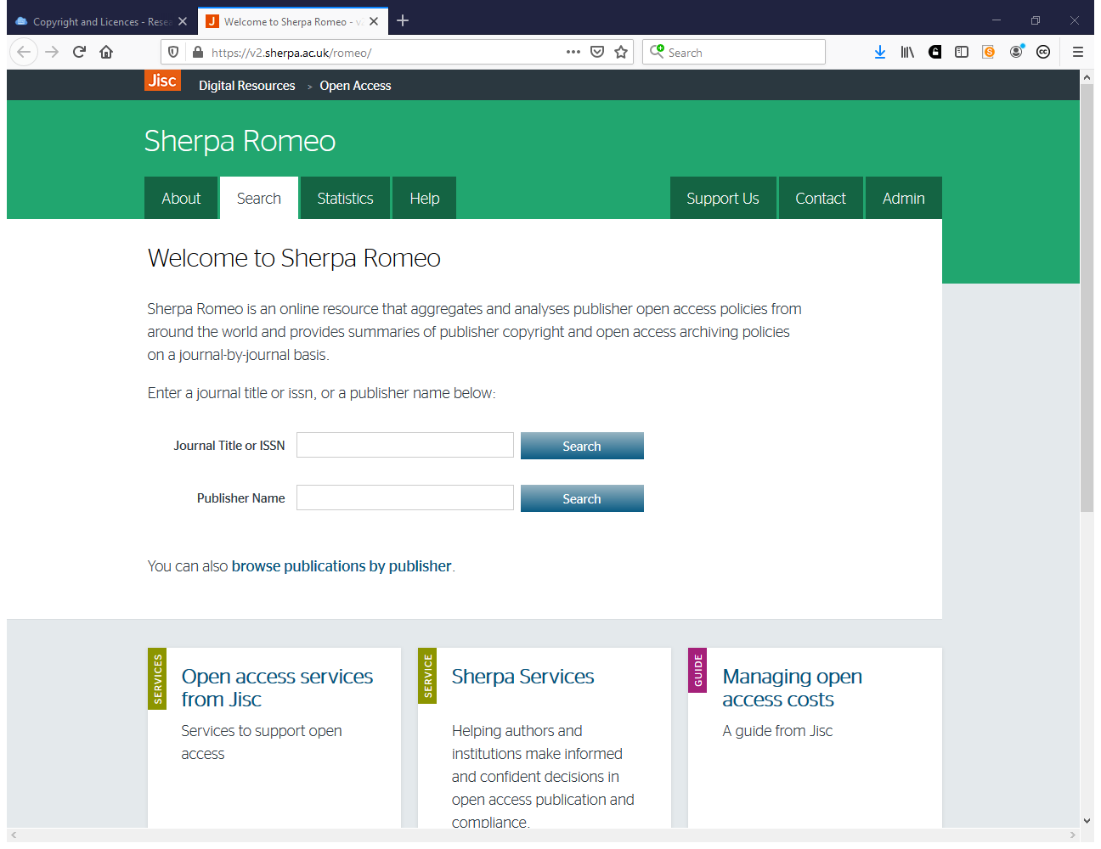
https://v2.sherpa.ac.uk/romeo/

Slide 70
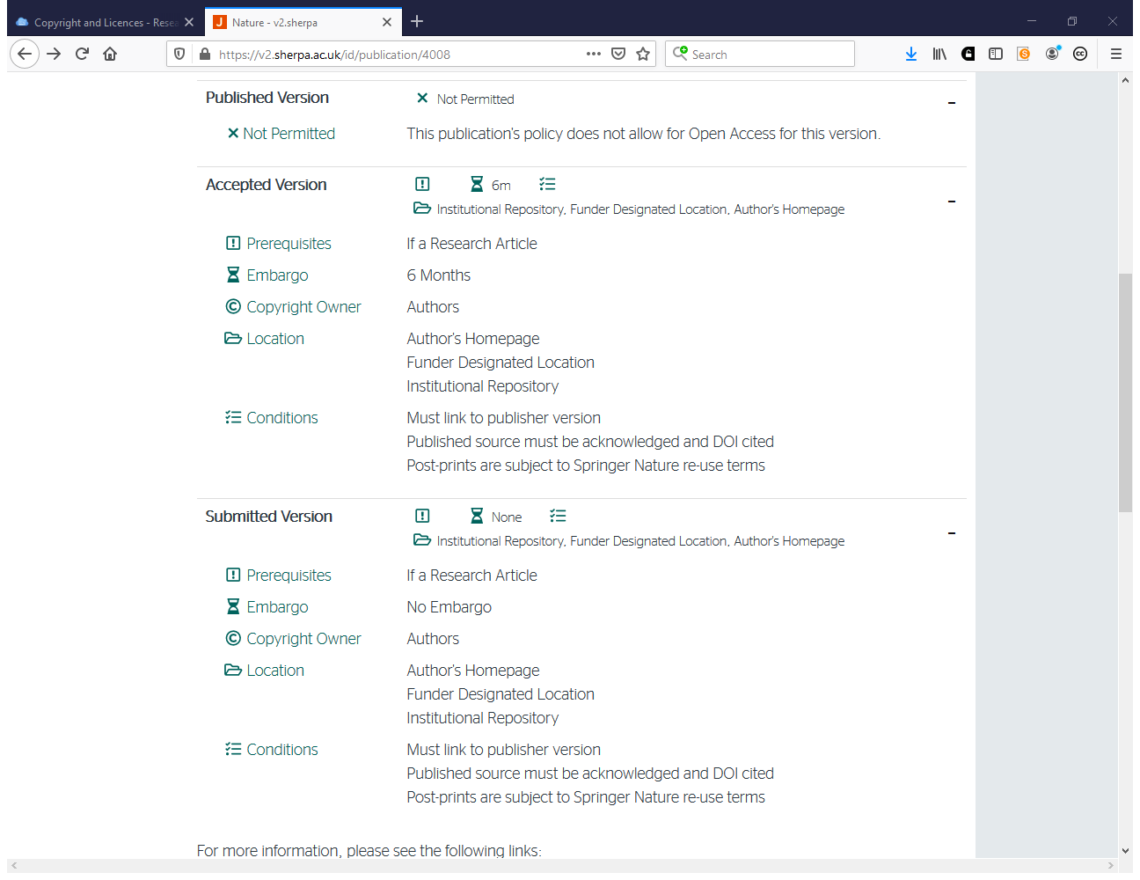

Slide 71
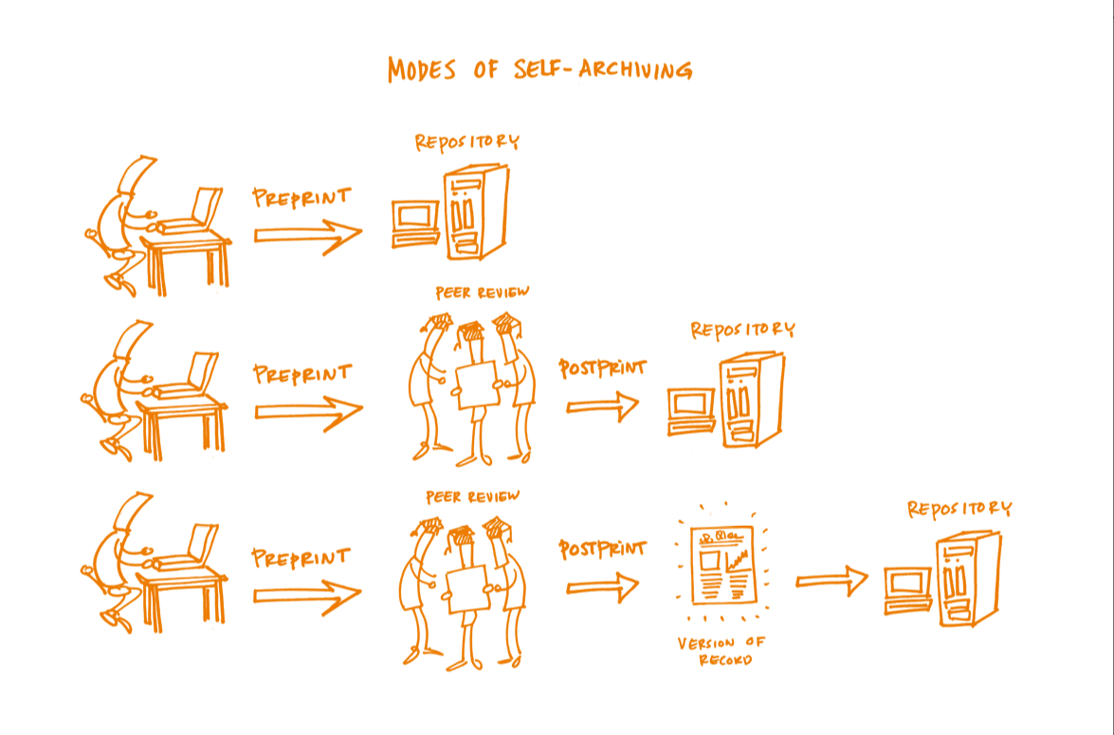

Slide 72
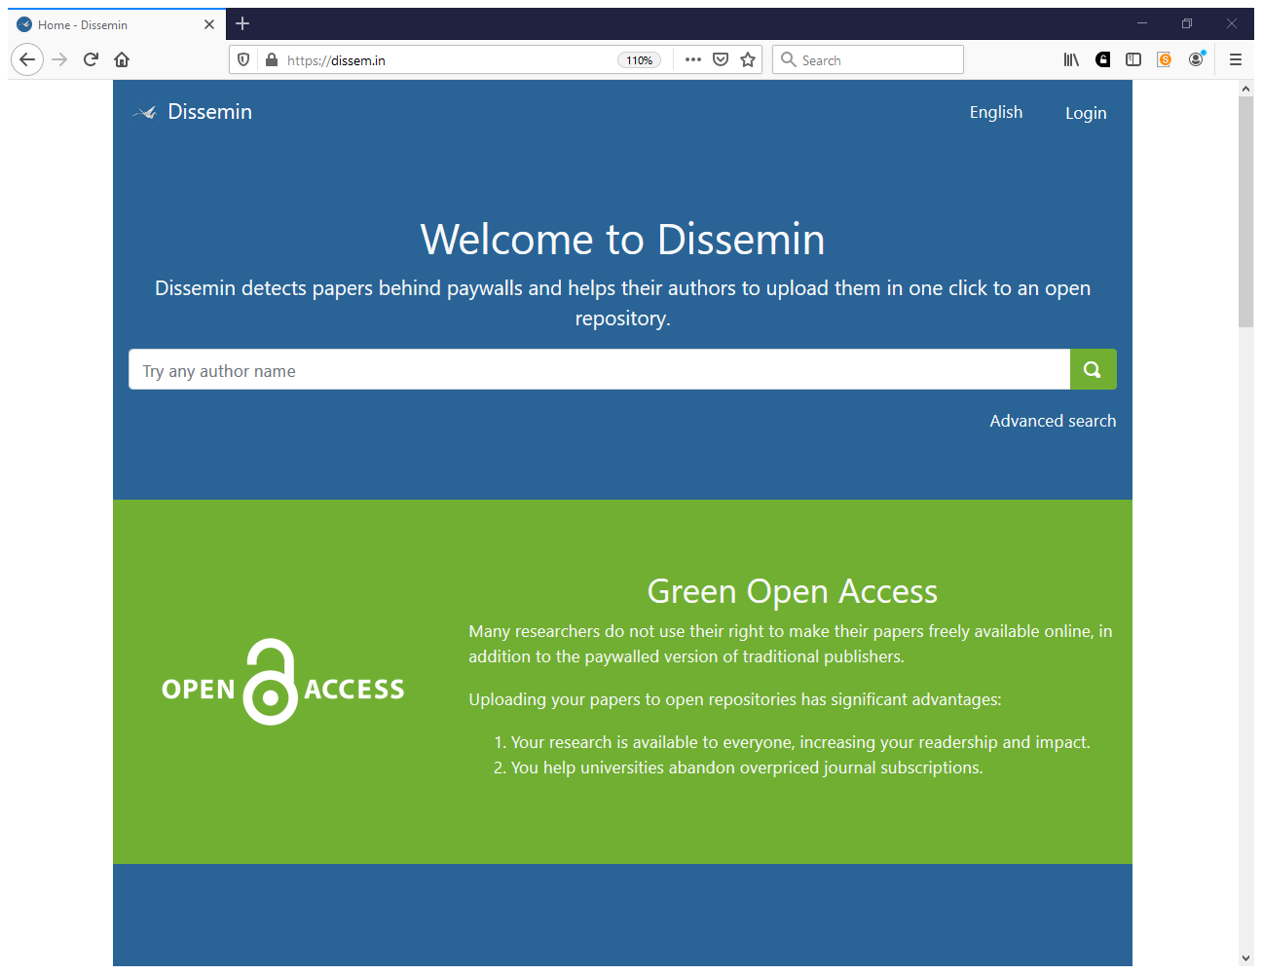
https://dissem.in

Slide 73
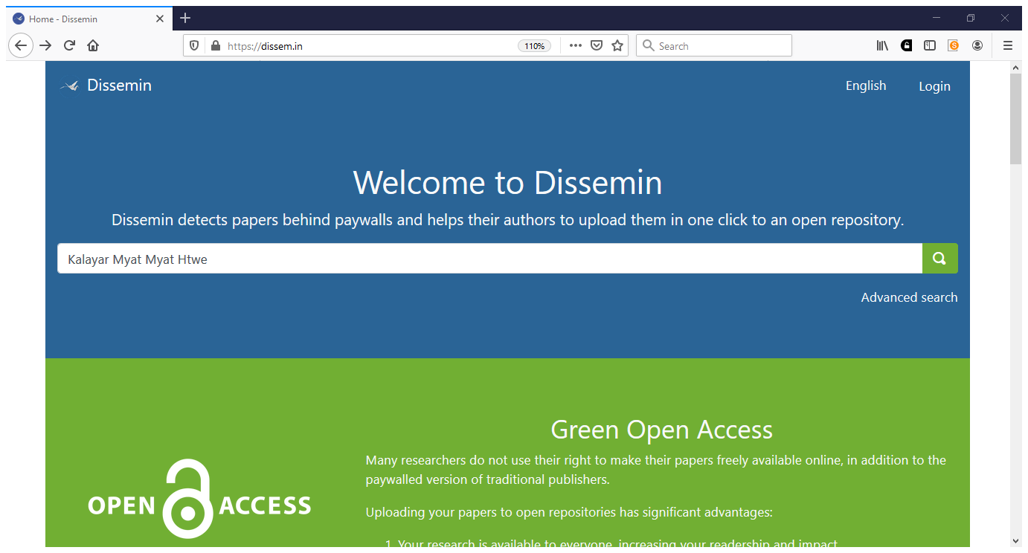

Slide 74
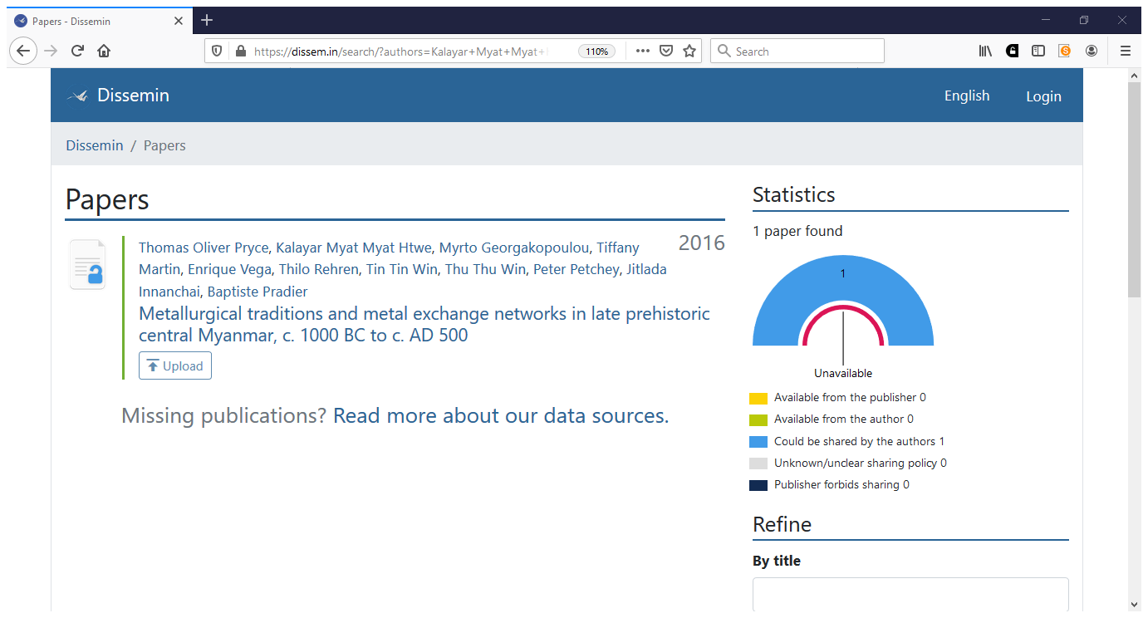

Slide 75
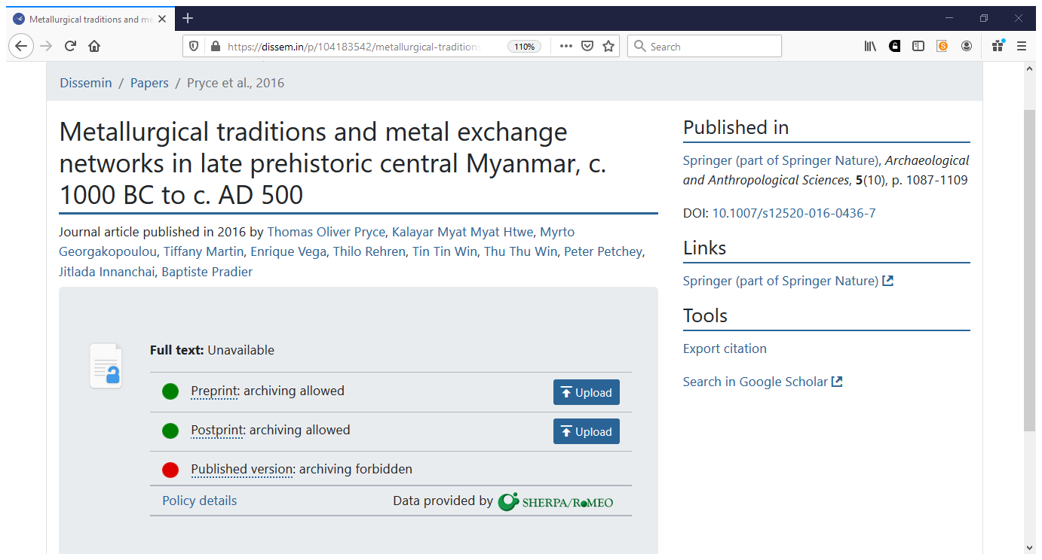

Slide 76
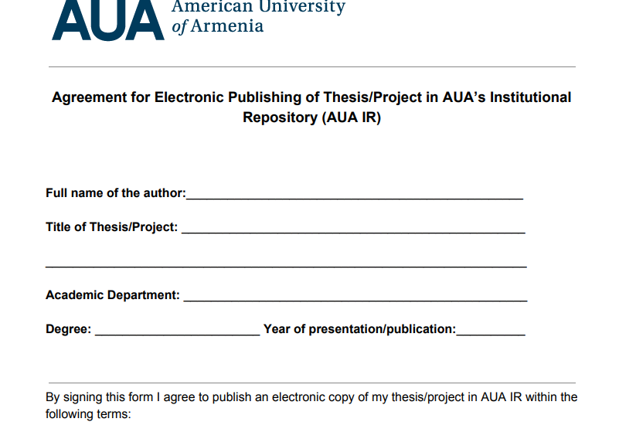
https://library.aua.am/files/2019/09/Agreement-for-Electronic-Publishing-Form.pdf

Slide 77
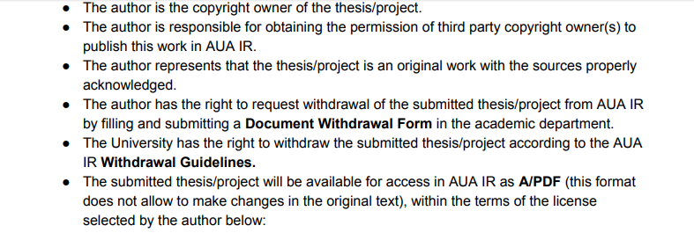
https://library.aua.am/files/2019/09/Agreement-for-Electronic-Publishing-Form.pdf

Slide 78
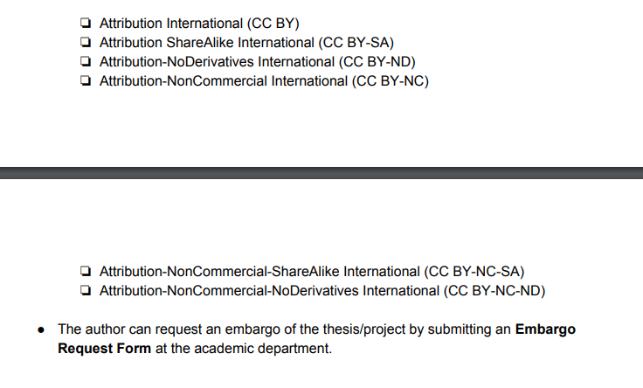
https://library.aua.am/files/2019/09/Agreement-for-Electronic-Publishing-Form.pdf

Slide 79
Which repository metadata fields for Creative Commons licences?
dc.rights where you mention the license, for example: Creative Commons Attribution 4.0 International
dc.rights.uri where you type a link to this license, for example https://creativecommons.org/licenses/by/4.0/

Slide 82
Thank you! Questions?
Contacts: iryna.kuchma@eifl.net
www.eifl.net
Attribution 4.0 International

