Slide 1
Managing and sharing research data
EIFL Digital Research Literacy Training Programme
Obrad Vučkovac
University of Belgrade, Vinča Institute of Nuclear Sciences
Belgrade, Republic of Serbia
19 May 2021

Slide 2
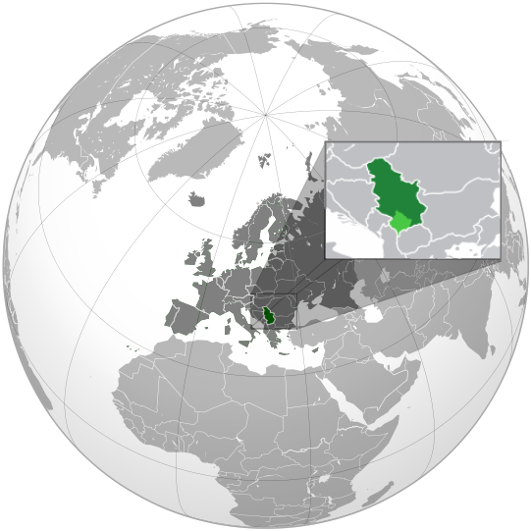
Open Science in Serbia
Open Science projects in Serbia: BE-OPEN, OpenAIRE, NI4OS
Open Science Platform - national open science policy
Science Fund of the Republic of Serbia required DMPs in two calls.
Милан Јелисавчић, CC BY-SA 3.0, via Wikimedia Commons

Slide 4
Serbia.RDM team
Diverse team: Researcher and university professor, librarians, IT specialist
Workshops:
November 2019: PSSOH conference (Application of Free Software and Open Hardware)
2020: workshops at the University of Novi Sad, Institute of technical sciences SASA, Institute for biological sciences “Dr Siniša Stanković” (online)

Slide 5
Workshop concept
Researcher’s experience 1: experiences and benefits of opening data.
What is Research Data Management? General introduction on RDM and FAIR data principles.
Importance of metadata; Best practices for supplemental data in articles.
Researcher’s experience 2: debunk the myth on open data, incentives to open datasets, anonymisation process
Photo by Med Badr Chemmaoui on Unsplash

Slide 6
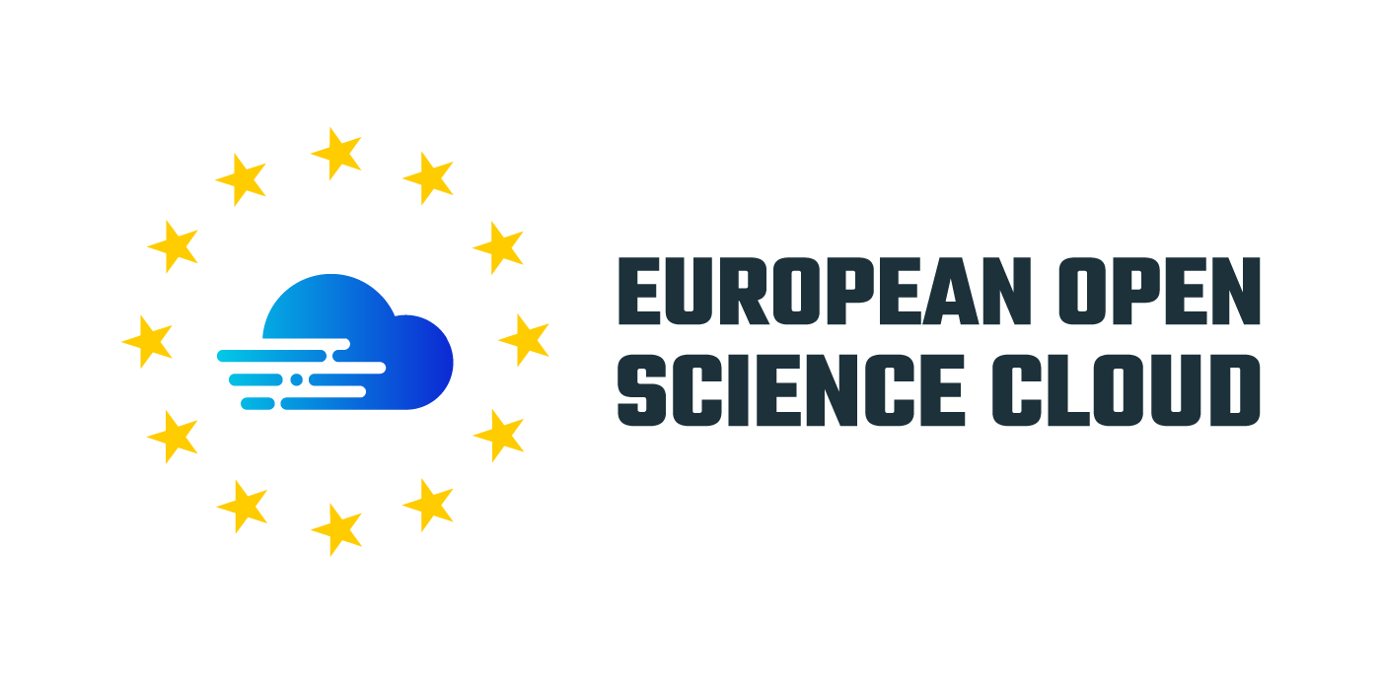
EOSC Secretariate co-creation activity: Boosting EOSC readiness: Creating a scalable model for capacity building in RDM (July 2020 - March 2021)
Aim: to build capacities for bridging the infrastructure gap in the uptake of EOSC practices between the EU and non-EU Western Balkans countries.
Results:
website: RDM.Serbia - https://rdm.open.ac.rs/
data repository: Dataverse SERDAR - http://dataverse.rcub.bg.ac.rs/
machine actionable DMP - localization of Argos
open research data policy: amandments to the national policy
dissemination & training: for researchers, librarians and decision makers

Slide 7
Key takeaways
Researcher’s experience - have someone who has experience with data management. Don’t matter if it’s bad experience like data loss, or low quality metadata.
Be someone they can rely on - learn a lot on RDM, offer your services. Build a trust, change the culture.
One bite at a time - start with general picture on RDM and proceed to more detailed parts, like which metadata standard or controlled vocabulary to use, how to choose repository for long-term preservation, or which licence to use.
Data management and FAIR principles ≠ open data - “as open as possible, as closed as necessary”

Slide 8
Key takeaways
Infrastructure and support - promote general purpose repositories (Zenodo), or institutional repository (if it’s standardised and well maintained). Introduce data stewards.
Incentives - institutional reward for FAIR data and/or publishing in open access; open data champions.
Websites, guidelines
Start small … but start!
Prepare yourself - there will be a lots of questions, be prepared. You can’t answer them all, but you can provide your contact and willingness to help.

Slide 9
Thank you for your attention!
Questions?
Obrad Vučkovac
obrad.vuckovac@gmail.com

