Slide 1
Multilingualism in OJS
Issues and lessons learned
Karl Magnus Nilsen
Septentrio Academic Publishing
University Library
UiT The Arctic University of Norway
CC BY 4.0, unless indicated otherwise
Dr. Marcus Gossler, Latin dictionary, CC BY-SA 3.0

Slide 2
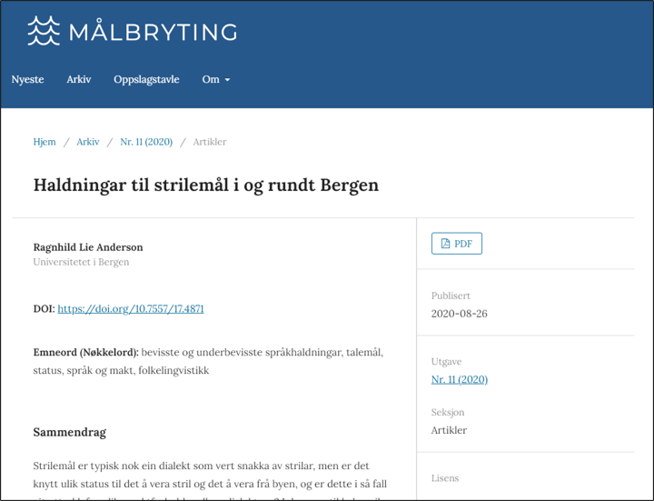
About Septentrio Academic Publishing
Free service for OA journals at UiT
Established 2003
29 journals
100 % diamond OA
Open Journal Systems
Staff: ca 2 Full Time Equivalents
https://septentrio.uit.no/ ​

Slide 3
Multilingualism
More or less focus on multilingualism in computer systems
Sometimes depending on where the system is developed
«Everybody speaks English, right?»
Stronger emphasis on multilingualism in non-English speaking countries

Slide 4
Why multilingualism is important
Increases accessibility
Improves user experience
Keeps languages alive

Slide 5
Calls for multilingualism in scholarly publishing
Helsinki Initiative on Multilingualism in Scholarly Communication
Addresses various stakeholders to support multilingualism, esp. national languages
The Diamond Open Access Standard
A concrete set of requirements/recommendations on multilingual support on publishing platforms – DOAS, p. 34

Slide 6
Some numbers
7164 languages in use today (as of Jan 23 2025)
20 largest languages used by 3.6 billion people
54% of the world’s languages are used by 10000 people or less
(Source: Ethnologue)
Most of the 54 % are considered endangered
Need to be used and visible to keep them alive

Slide 7
Multilingualism in OJS
A system of Canadian origin
«Always» a focus on multilingual features
UI translated into a number of languages
Language settings in three categories
User Interface
Forms
Submission

Slide 8
Two cases from Septentrio’s practice
Definition of smaller languages in OJS locale registry
Translation of email templates from English to Norwegian

Slide 9
Case 1: Smaller languages and ISO codes

Slide 10
Challenge for smaller languages in OJS
Language features often rely on standardized ISO-codes
ISO-639-1 (two letters, e.g. it)
ISO-639-2 and ISO-639-3 (three letters, e.g. ita)
OJS relies on both ISO-639-1 and ISO-639-2/3
A language without ISO-639-1 code will not be installed
A challenge for smaller languages without ISO-639-1

Slide 11
Challenge for smaller languages in OJS
Smaller languages in Septentrio’s journals: Southern Sami, Lule Sami, Inari Sami, Kven Finnish, Meänkieli (Tornedalen Finnish)
Case of Inari Sami
A few hundred speakers – seriously endangered
Very little literature at all
Authors were very keen on having the article language marked correctly

Slide 12
How we solved it (in OJS 3.3)
All available languages are defined in registry/locales.xml
One line pr language, example: <locale key="it_IT" complete="true" name="Italiano" iso639-2b="ita" iso639-3="ita“
The key attribute is the ISO-639-1 code for the language, with a region suffix
There are some unassigned ISO-639-1 codes – what if we use one of those for Inari Sami?

Slide 13
How we solved it (in OJS 3.3)
We tried it – and it worked
What we did:
Add a line in registry/locales.xml, with an unused ISO-639-1 code as key:
<locale key="sy_NO" complete="false" name="Anarâškielâ" iso639-2b="smn" iso639-3="smn" />

Slide 14
How we solved it (in OJS 3.3)
Add a folder in locale/, with the same name as the key:
locale/sy_NO
This folder contains all the translations for the language, but may be empty if the language is used only for submissions and metadata.
The language can now be found in the list of available languages and can be installed like any other language

Slide 16
Results
We have done this for all the five languages mentioned earlier
Southern Sami - https://doi.org/10.7557/12.6408
Lule Sami - https://doi.org/10.7557/sda.7035
Inari Sami - https://doi.org/10.7557/12.6384
Kven Finnish - https://septentrio.uit.no/index.php/arina/article/view/5249
Meänkieli - https://septentrio.uit.no/index.php/arina/article/view/5229
We hope it has helped the visibility of those languages

Slide 17
Issues
CrossRef XML Export Plugin
The XML deposit to CrossRef fails on the invalid language code
Workaround:
Use plugin to export XML
Remove the failing language code
Deposit manually without language code using CrossRef admin tool
CrossRef and OJS should come up with a solution that isn’t discriminating smaller languages

Slide 18
Case 2: Translation of email templates

Slide 19
Translation
Translation in OJS is done through a tool called Weblate (https://translate.pkp.sfu.ca/)
Web based tool
Anybody may contribute to the translation of any language
Mechanisms for cooperation
When a new OJS version is released, it uses the translations currently in Weblate

Slide 20
Importance of context
Simplest strategy is to just go ahead and translate word by word
But what if you don’t know the context of the string?

Slide 21
Email template REVIEW_REMIND
In the Review stage, an editor can Send Reminder:
To remind a reviewer to respond to a review invitation
To remind a reviewer to deliver a review
OJS links both contexts to email template REVIEW_REMIND
Reviewer 1
Reviewer 2

Slide 22
Email template REVIEW_REMIND
The English template text fits both contexts:
Just a gentle reminder of our request for your review of the submission, "{$submissionTitle}," for {$contextName}. We were hoping to have this review by {$reviewDueDate}, and would be pleased to receive it as soon as you are able to prepare it.”

Slide 23
Norwegian translation of REVIEW_REMIND
The Norwegian translators only thought about the 2nd context
Annoyed potential reviewers who had not yet accepted a review invitation
The Norwegian translation in Weblate was corrected to fit both contexts
Denne e-posten sendes for å minne deg på at du har tatt på deg å vurdere innleveringen «{$submissionTitle}» for {$contextName}. Jeg minner om at fristen var satt til {$reviewDueDate}, og ser fram til å motta vurderingen din så snart den er klar.

Slide 24
Thank you for listening
Comments or questions: karl.magnus.nilsen@uit.no

