Slide 1
Open Access and Books
Emerging New Models and the Global South
Professor Martin Paul Eve
Birkbeck, University of London
Dr Frances Pinter
Executive Chair, CEU Press
Notes:
Iryna introduces us
FP to say something about EIFL connection and why we thin there will be new opportunities for Global South

Slide 2
Navigating the Session
Vision of the Future for monographs
Recent Policy Developments
New Business models
COPIM and other infrastructure initiatives
Opening the Future and CEU Press
Driving future projects
Notes:
Go over the list

Slide 3
Vision of the Future
No publishing or access barriers
Majority of monographs published as OA
Frictionless discoverability; good infrastructure
Reductions in:
Publishing and access costs
Administration costs for libraries
Transaction costs for everyone
Notes:
Emphasise why this is good for the Global South

Slide 4
Books and going OA:
Challenges
Policies
Mandates
Funding
Access
Infrastructures
Business Models
Notes:
I’m going to talk about some aspects of these
Martin will talk about a specific model – Subscribe to open, that we think has promise for a more equitable world
But first..policies

Slide 5
Recent Policy Developments
Mandates
Who mandates? Who funds? E.g. UKRI
Books (vs Journals)
Green/gold, Licensing & Embargoes
Libraries
New models from publishers
Notes:
Mandates from reseach funder – public and private
Mandates are not free money

Slide 6
Plan S – a Change Driver
17 National Funders
5 Charitable and International Funders
EU and European Research Council
Developments at UKRI and REF
Notes:
Coalition S driving change through Plan S
Implementation is hard because all parts of the system need changing
And this all applies only to funded research – estimated at less than 20% of HSS output of UK publishers
UKRI -UKRI developments
Research funders set aside some money for OA, but often not enough
Conditions – different to journals
Green and gold – both allowed, but most authors don’t like green for books
Licensing – CC BY NC ND
Embargoes – up to 12 months
Plan S – driving the change

Slide 7
Who pays for OA monographs now?
Research Funders (BPC)
Institutions/departments (BPC)
Libraries collectively (BPC and Non-BPC)
(largely through Scholarly Communications offices)
Notes:
Need to redirect OA fupport from Schol Comms to acquisitions/collection budgets – because oA has the potential to be both cheaper and better

Slide 8
Key policy for books – from UKRI
Green and Gold – either is fine (but authors less happy about books going green)
Licensing – Prefers CC BY, but accepts NC and ND
Embargoes – up to 12 months

Slide 9
New business models from publishers
University Presses (and other mission driven publishers)
scholar led - Open Book Publishers - non BPC,
Huddersfield UP – BPC
small/medium (CEU Press and Liverpool with OtF)
large – non-BPC (MIT, Michigan)
large – BPC (UCP, CUP)
Commercial presses
Springer/Nature – BPC, following journals

Slide 10
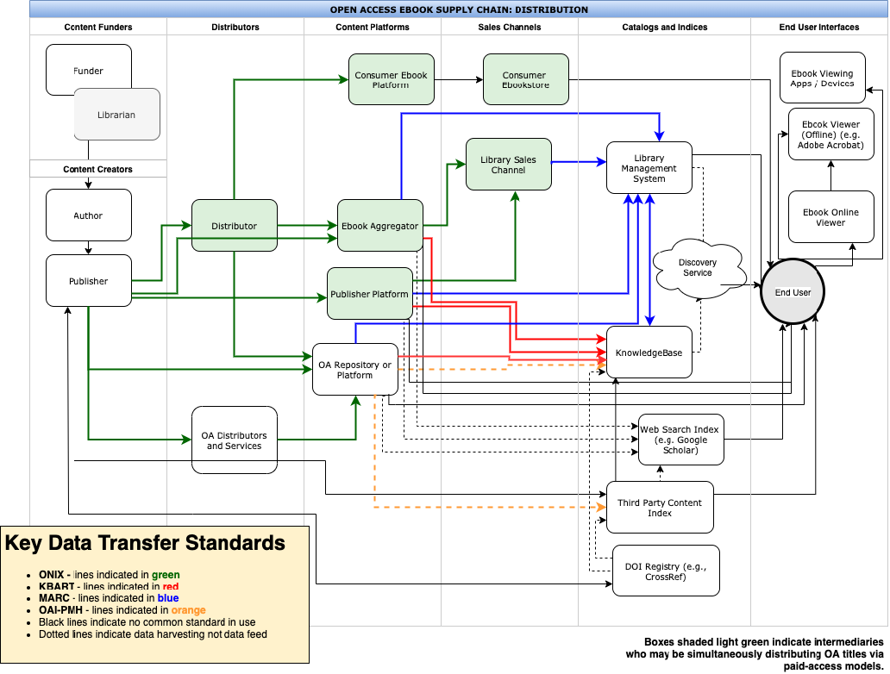
Libraries want OA books but….
Notes:
Difficulties in identifying, delivering and accessing OA through libraries
Library suppliers often do not indicate that there is an OA edition. This will change at EBSCO in months, others will have to follow
Metadata gets garbled en route to libraries – infrastructure projects working on fixing this
So now on to Martin

Slide 11
£3.6m
COPIM is funded by the Research England Development Fund (REDFund) as a major development project in the Higher Education sector with significant public benefits, and by Arcadia, a charitable fund of Lisbet Rausing and Peter Baldwin.
International partnership
Libraries, Universities, OA book publishers, Researchers, Infrastructure providers.
Notes:
Explain here that COPIM is working with a number of presses, and that this model has been adopted by CEUP and LUP, but here the case study will be CEUP

Slide 12
SCALING infrastructure development at COPIM
Open Book Collective
THOTH - Platform for Metadata & dissemination of OA books
Opening the Future - an S2O model, piloting with CEU Press & Liverpool University Press
And collaborating with initiatives around the world

Slide 14
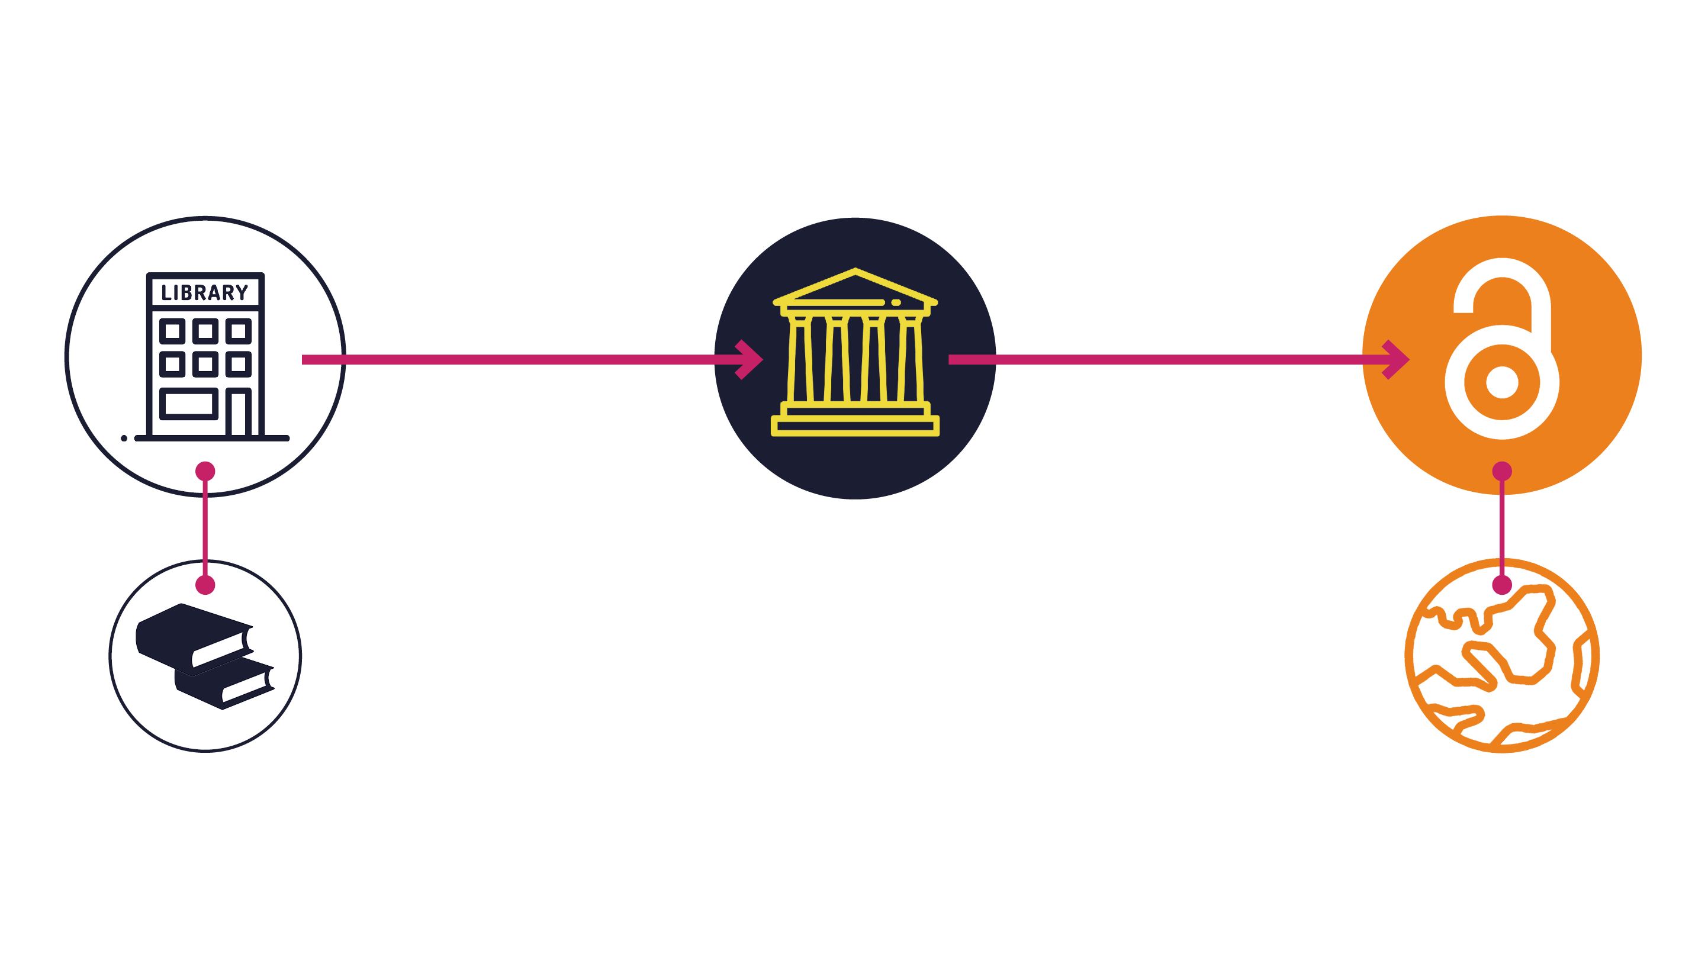
Opening the Future in a nutshell

Slide 15
Central European University Press
nearly
30
years old
A small press with a
big mission
500
backlist titles
Notes:
Small press with a big mission.
Part of the OSF/Soros family

Slide 16
279
7
they were downloaded
350,000
of the top 10 downloads were over
titles were made open on Project MUSE during
times, from
10
129
March to June 2020
countries
years old
Notes:
An example of what happens when OA books are open
Now back to Martin

Slide 17
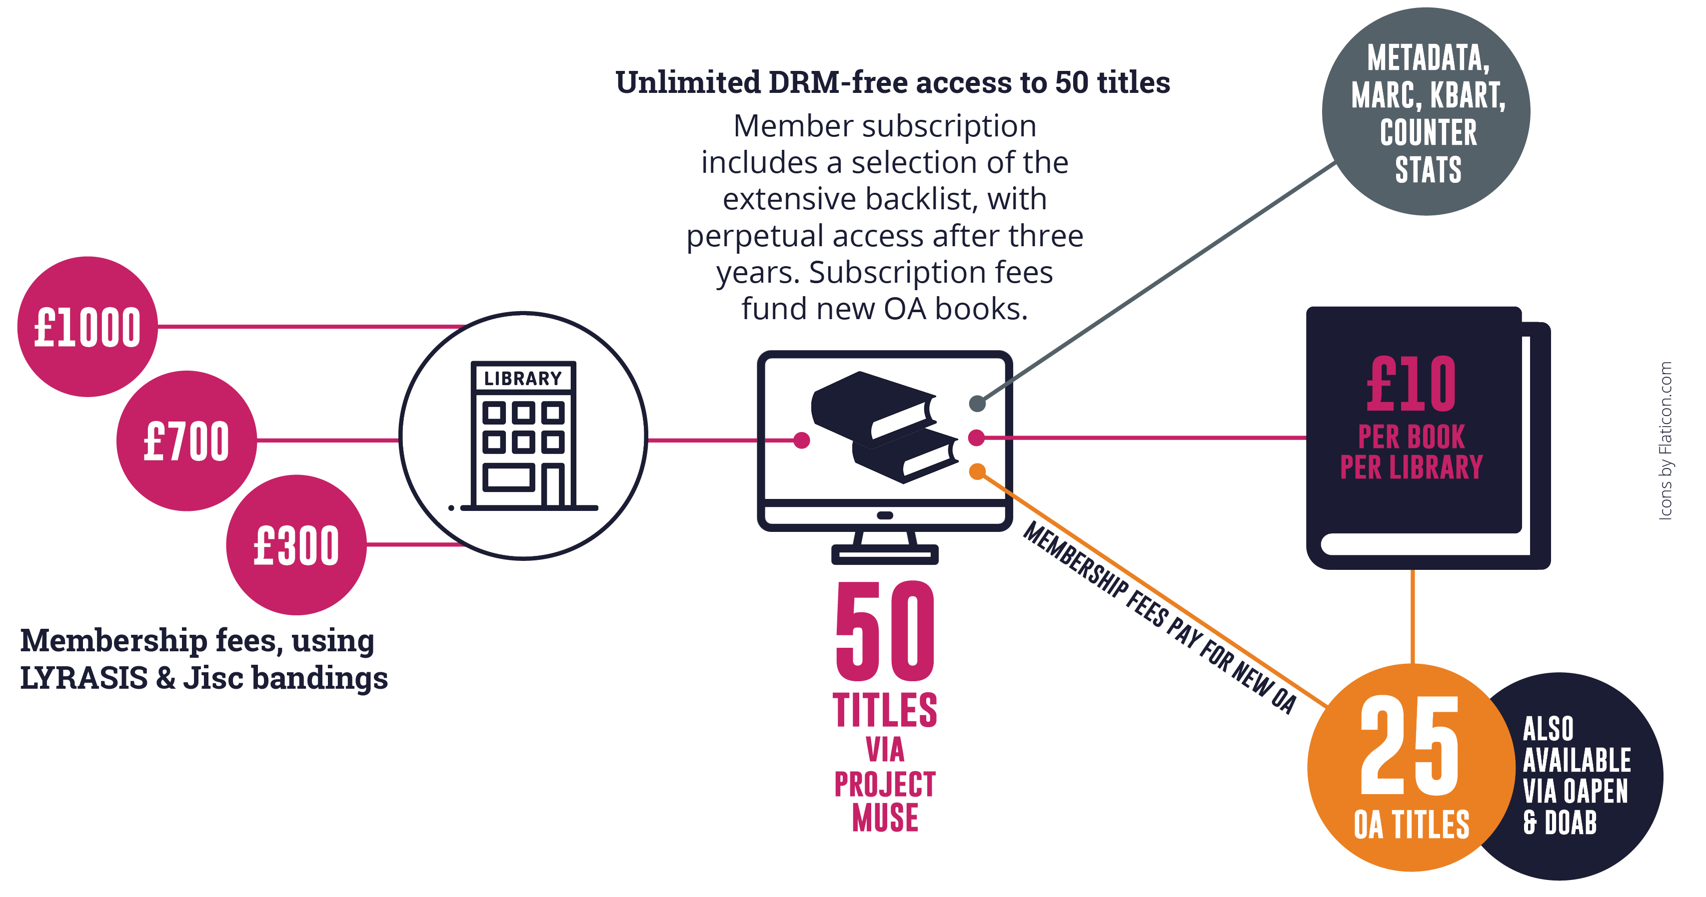
Note: £10 per book is for indication only and is calculated on the basis of every library receiving 50 books as a subscription and gaining access to 25 new open access books per year. Cost modelling is based on an average membership of £700 per year (our medium-size band pricing) and assumes 250 library members. Appraising the cost per book/per library is only possible once we’ve had time to accrue members. This is a pilot project.

Slide 18
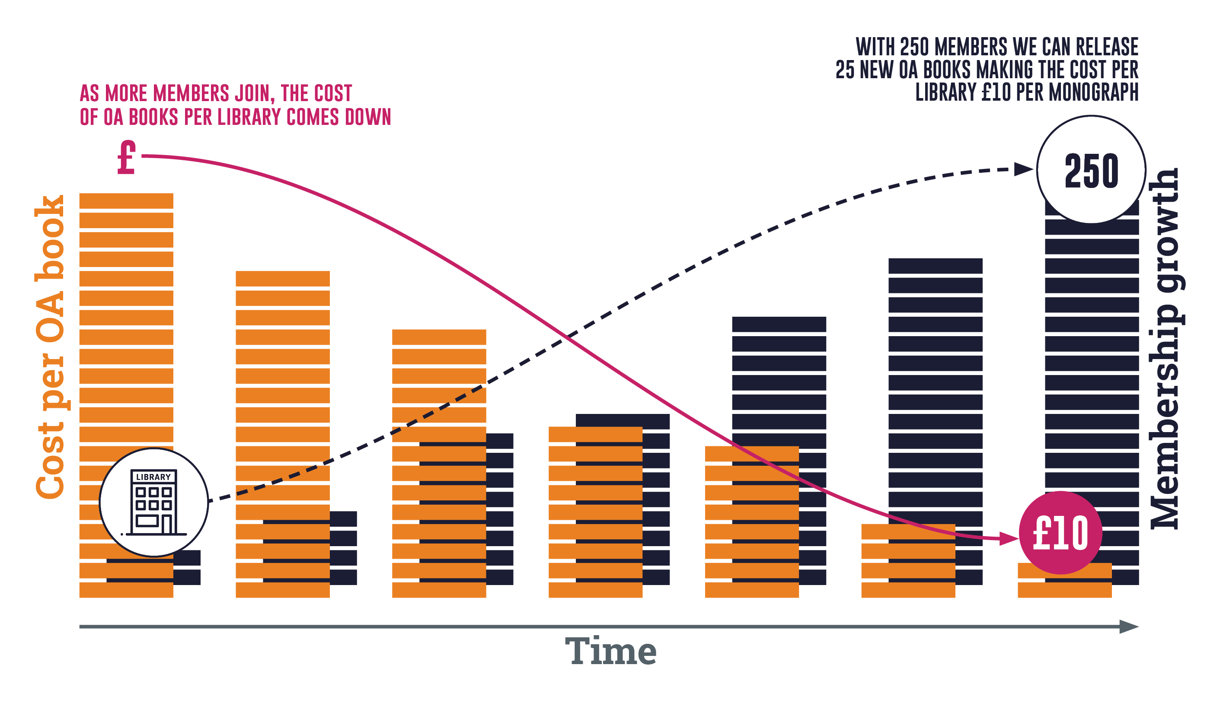
Note: the OA modelling here is based on an average membership of £700 per year (our medium-size band pricing). Appraising the cost per book/per library is only possible once we’ve had time to accrue members. This is a pilot project. Icons by Flaticon.com

Slide 19
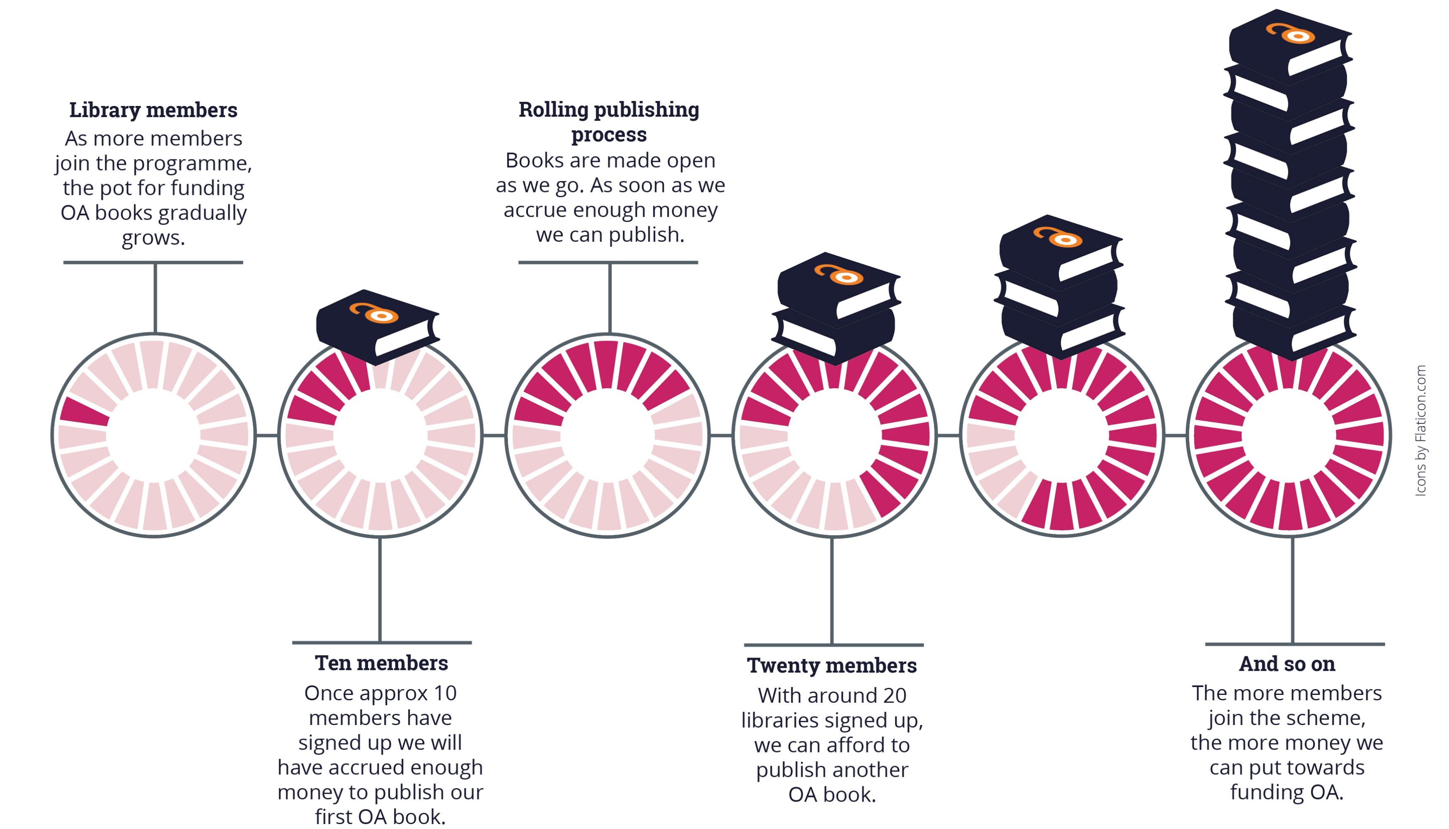
Note: the OA modelling here is based on an average membership of £700 per year (our medium-size band pricing). Appraising the cost per book/per library is only possible once we’ve had time to accrue members. This is a pilot project.

Slide 21
Why publishers should use this model
Relatively low risk
COPIM toolkit
Avoids BPCs
Laying the groundwork

Slide 22
What Librarians are saying about this model
More equitable access to publishing for unfunded authors
S2O works better with existing library workflows and spending patterns
More equitable spreading of costs
Better for long term planning for publishers and libraries
Better for humanities and social sciences where BPC funding is not widely available
Aligns better with UNSDG

Slide 23
New Opening the Future projects: Thoughts for your regions
Collections from groups of publishers
Geographic collections
Thematic collections
Notes:
Explain thinking behind multi-publisher approach

Slide 24
Get engaged
We need both BPC and Non-BPC models to work
Access to publishing for Global South is important for the world
Endorse non-BPC Opening the Future model
What happens if STEM is open and HSS stays mainly closed?
OA for all needed for global challenges
Notes:
1.Support both BPC and non-BPC where you can
3. And other non-BPC models
4. STEM – journals vs HSS - books

Slide 25
For more information
martin.eve@bbk.ac.uk
frances@pinter.org.uk
https://openingthefuture.net
for FAQs, downloadable brochure, lists of available titles & ISBNs

