Slide 1
Identifying and assessing Open Access journals and publishers
Attribution 4.0 International

Slide 2
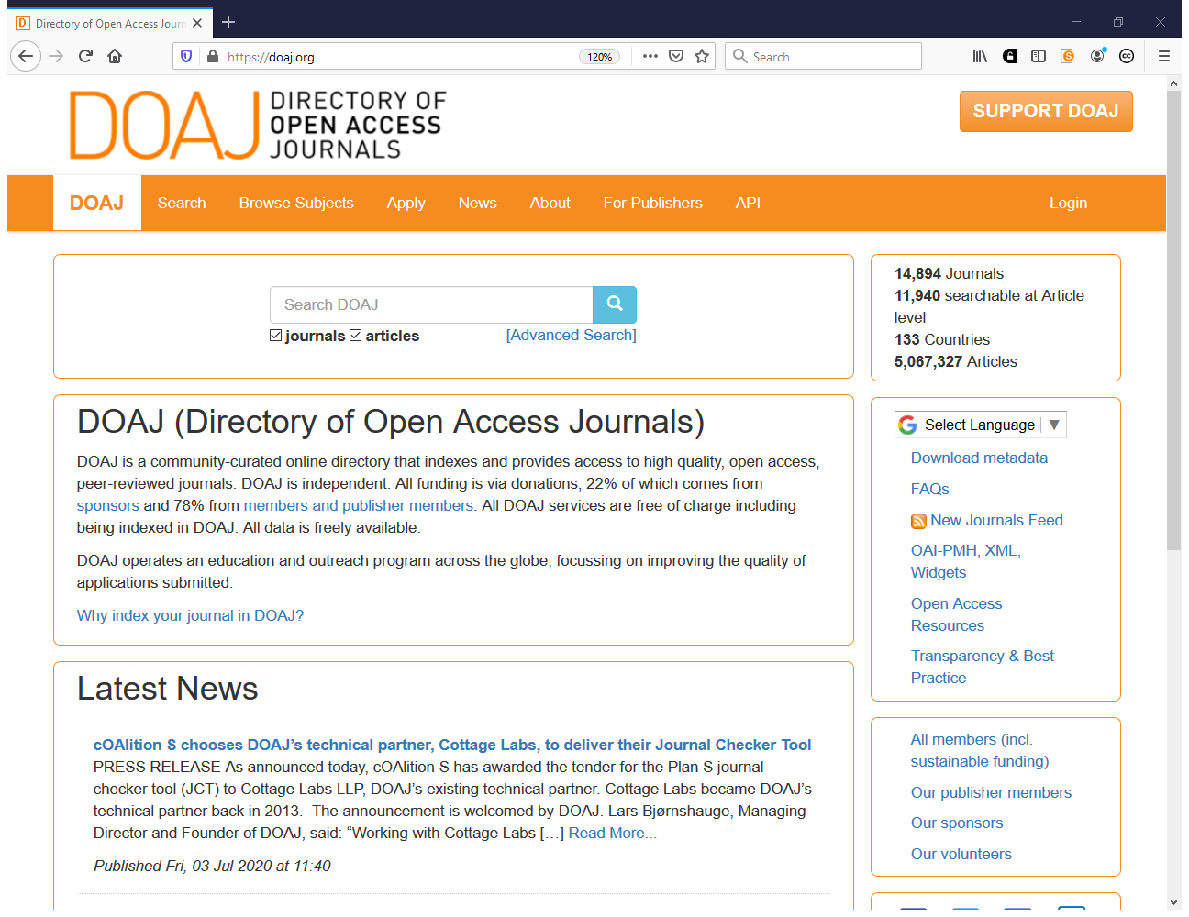
https://doaj.org

Slide 3
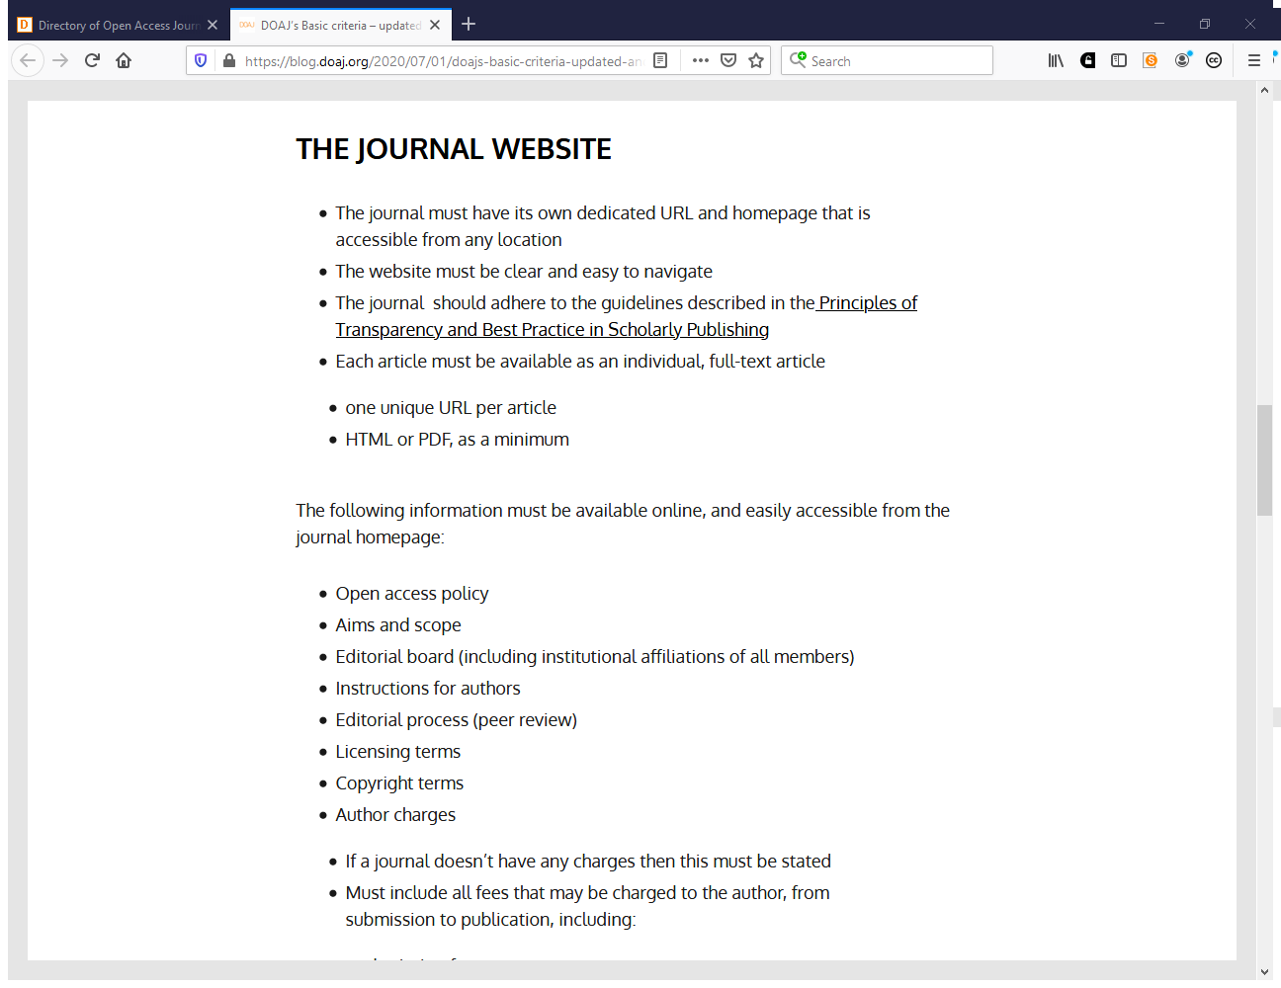

Slide 4
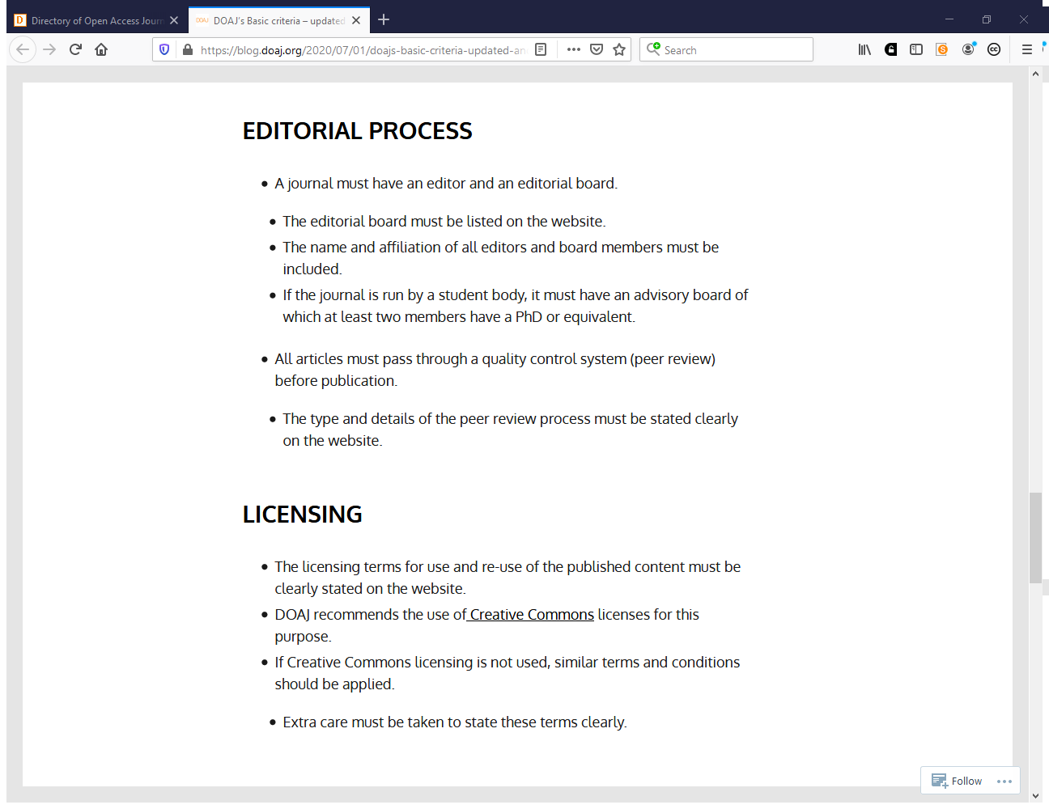

Slide 5
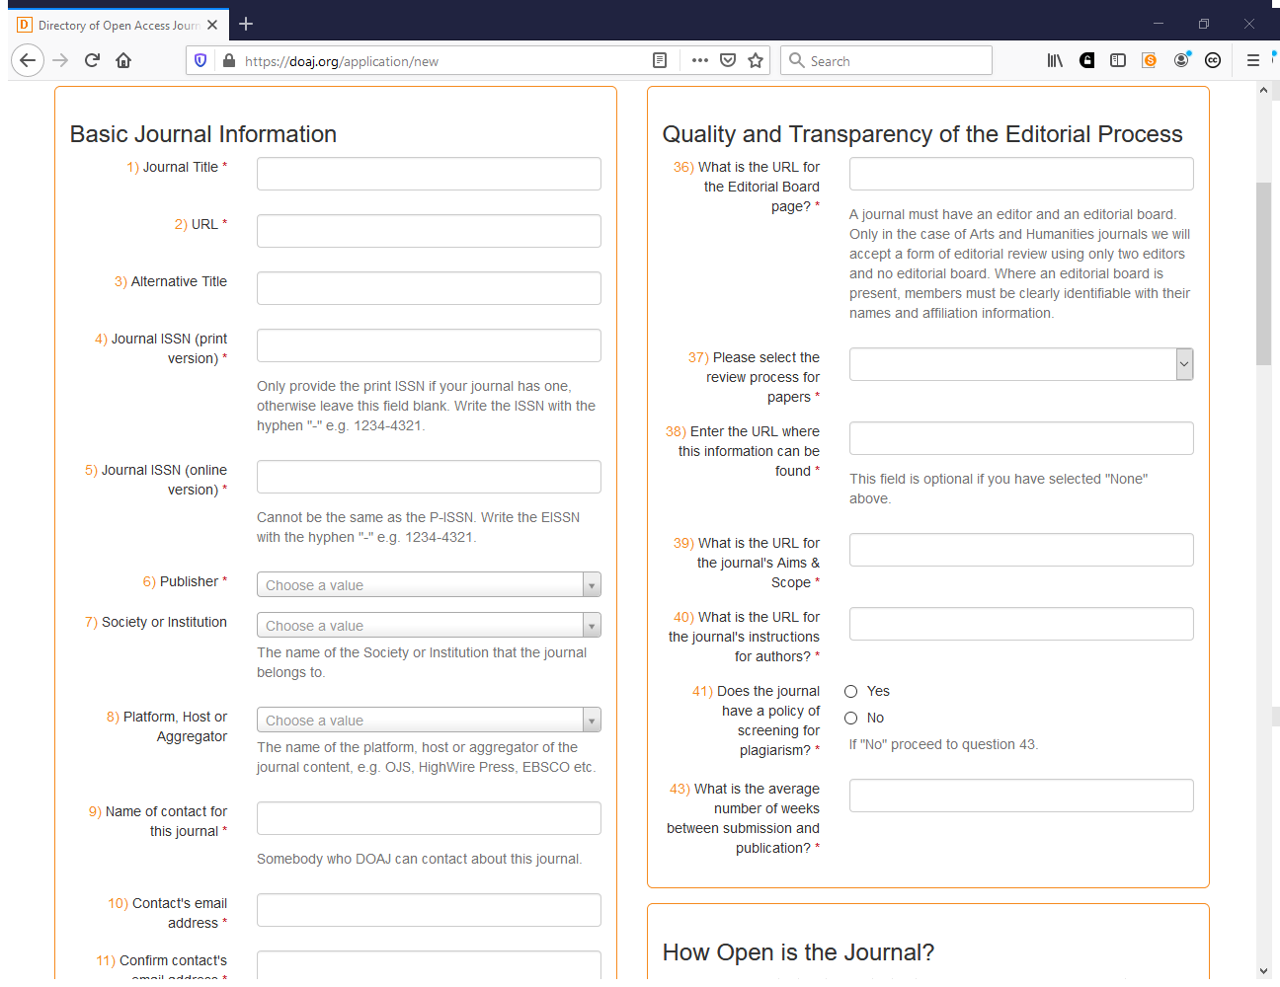

Slide 6
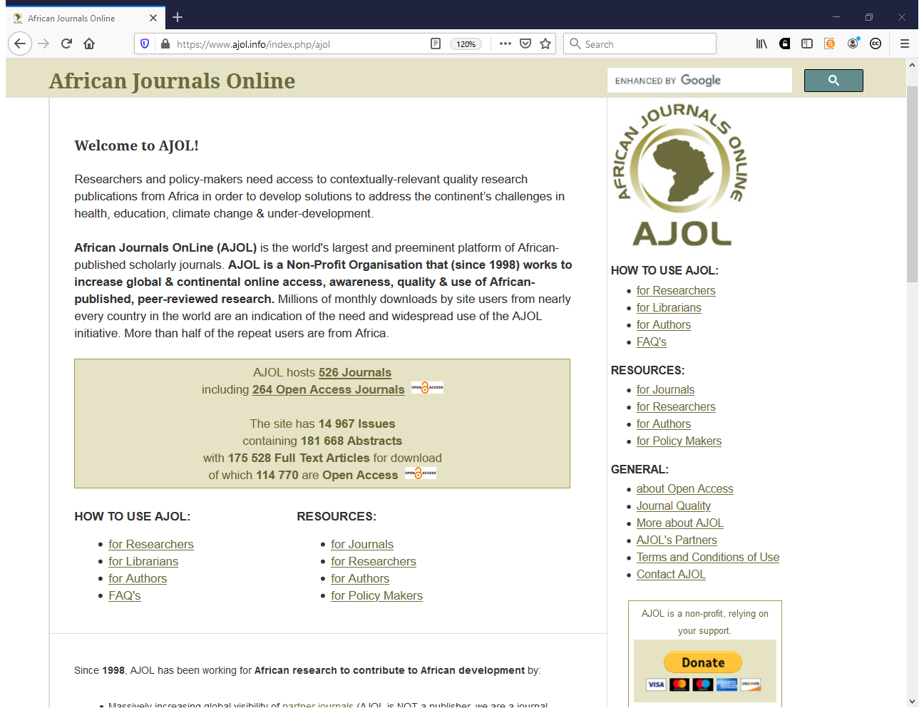
https://www.ajol.info

Slide 7
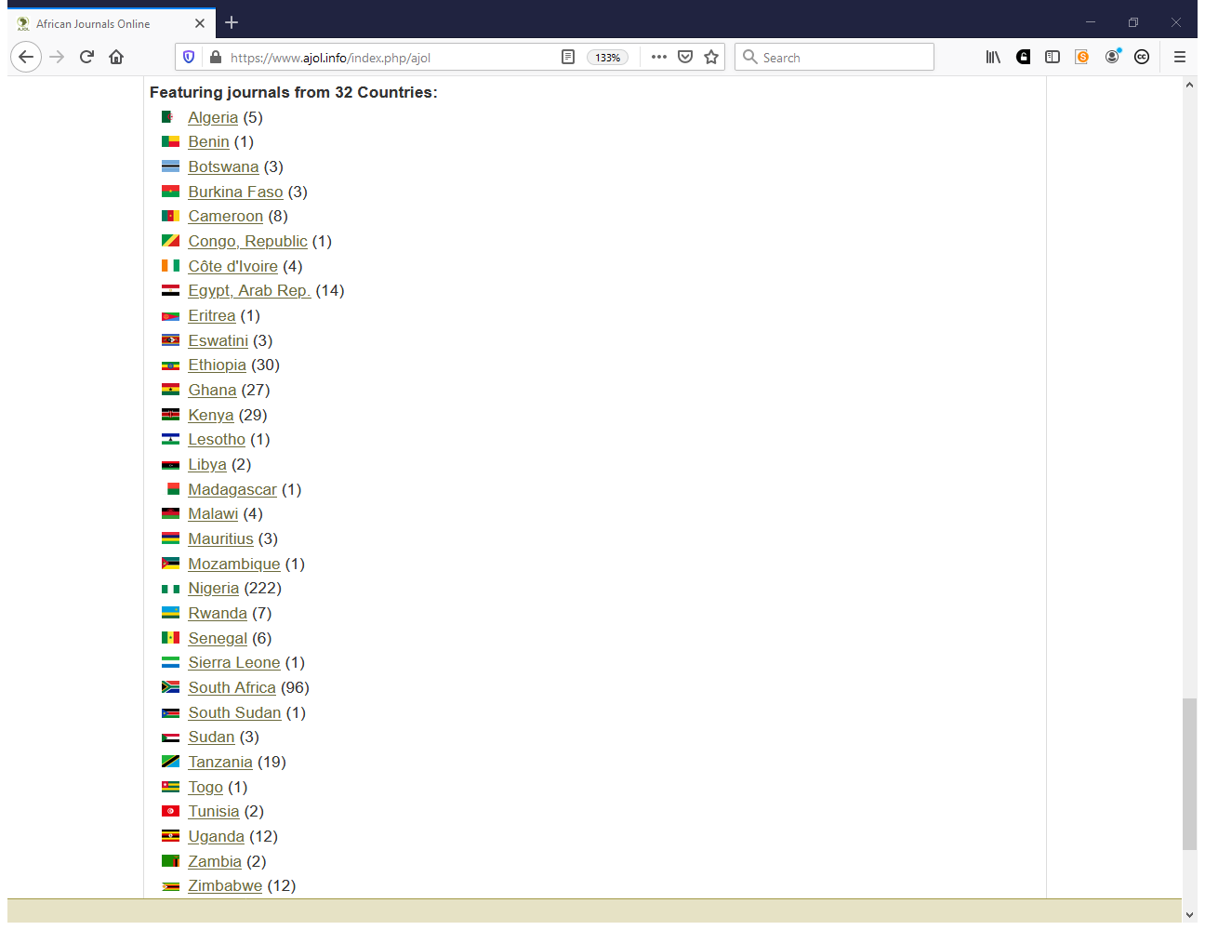

Slide 8
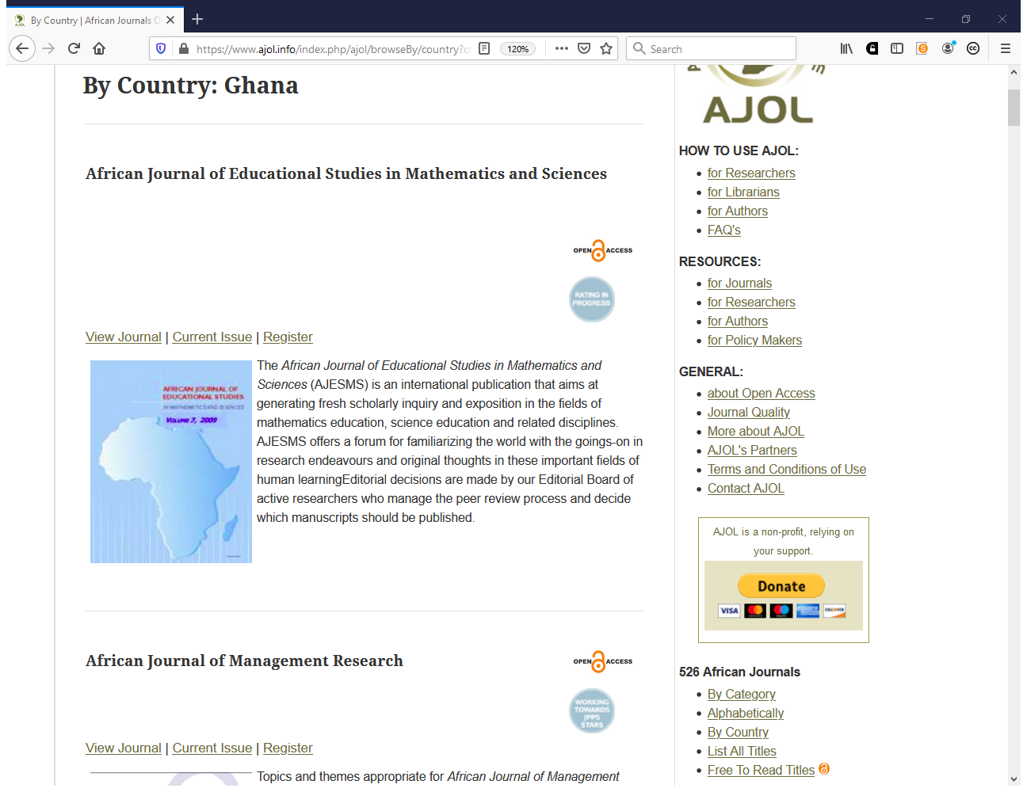

Slide 9
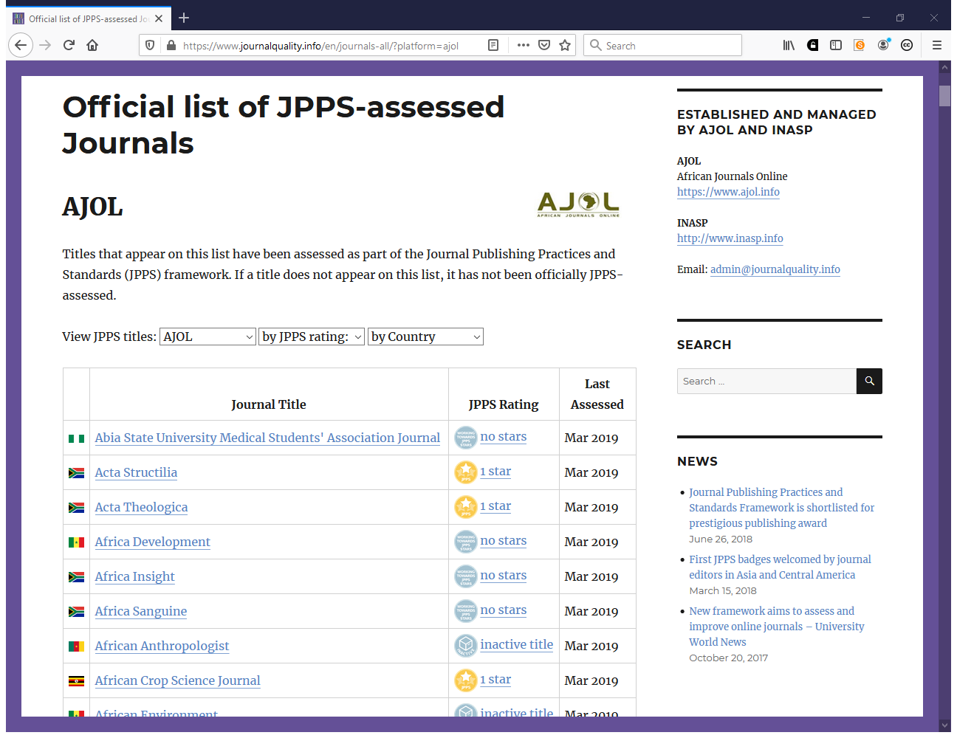
https://www.journalquality.info

Slide 10
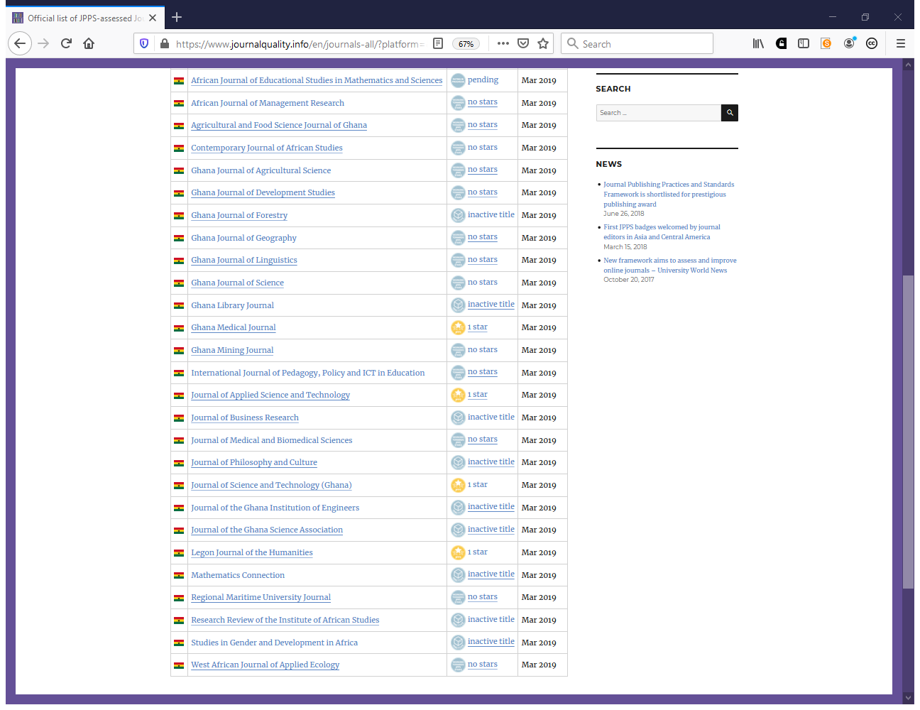

Slide 11
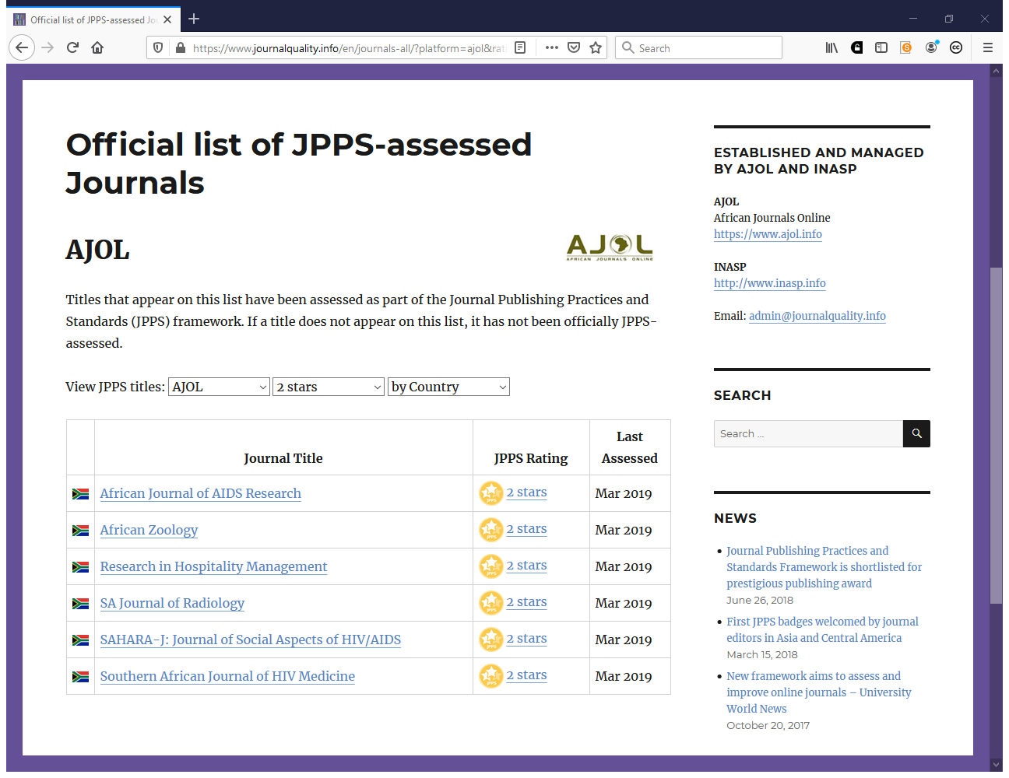

Slide 12
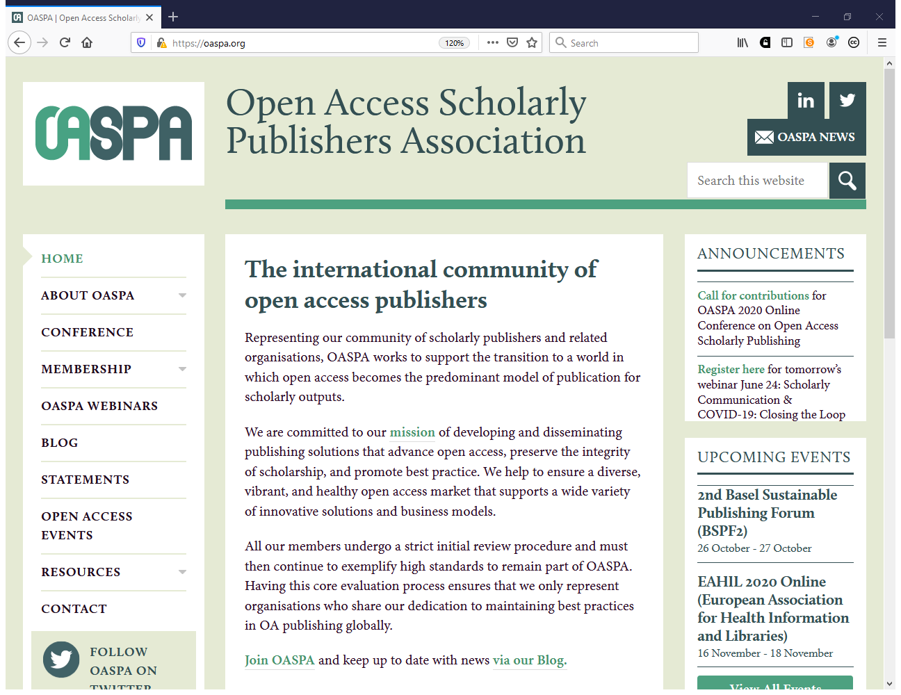

Slide 13
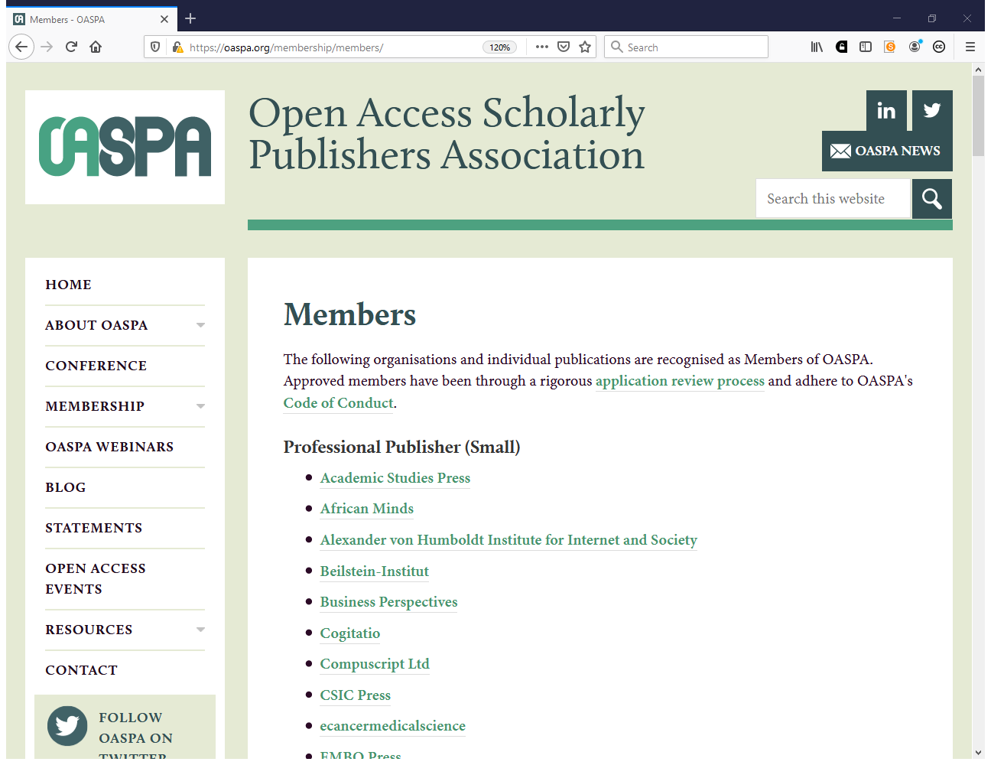
https://oaspa.org/membership/members

Slide 14
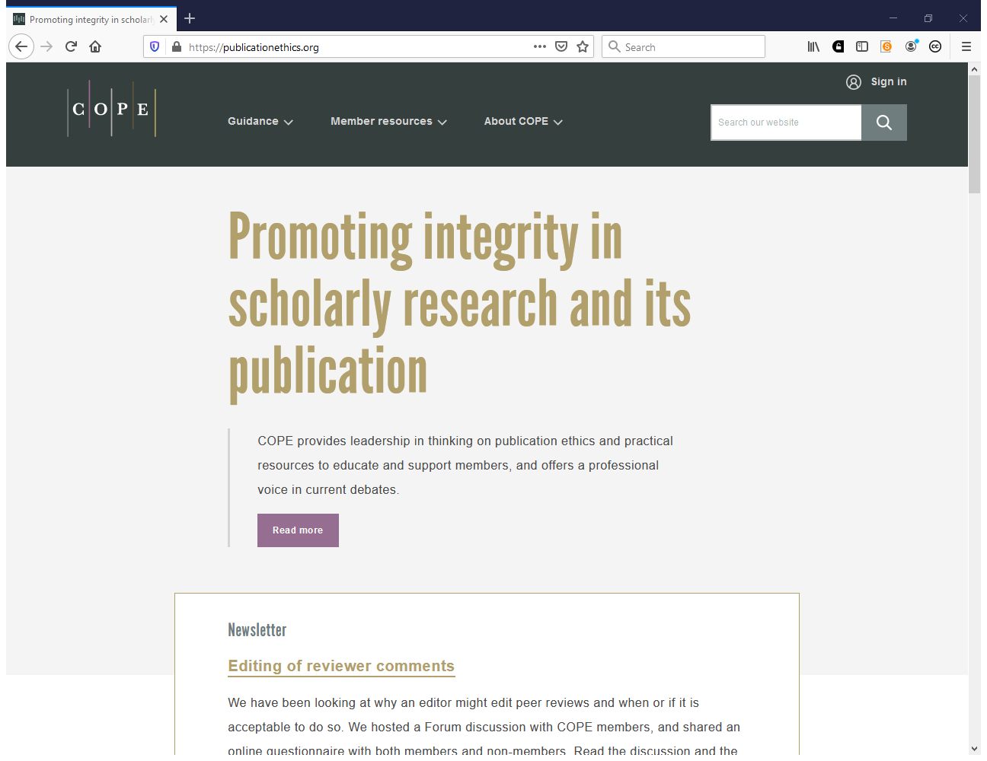

Slide 15
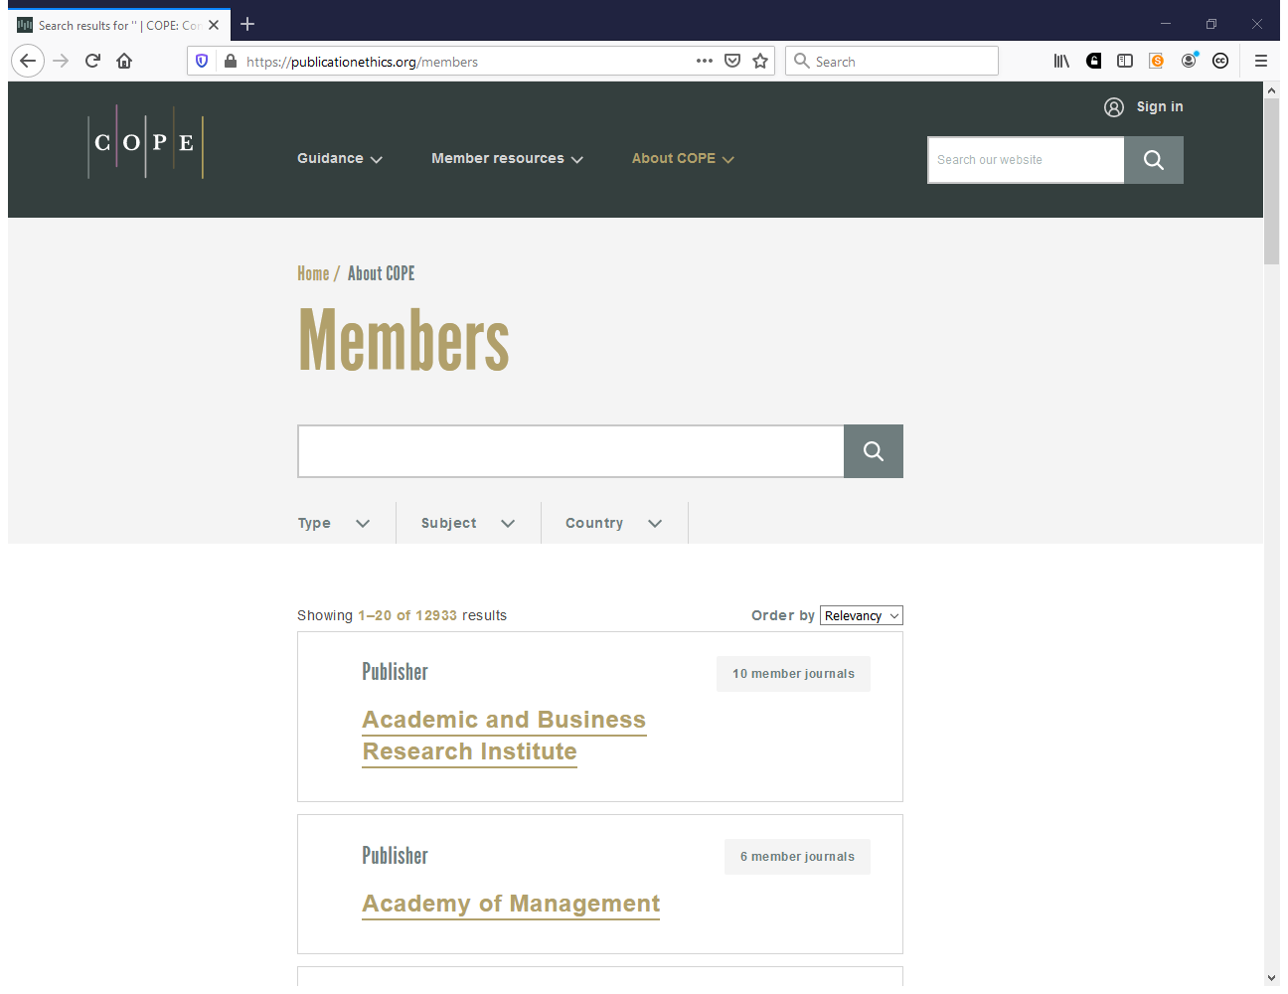
https://publicationethics.org/members

Slide 16
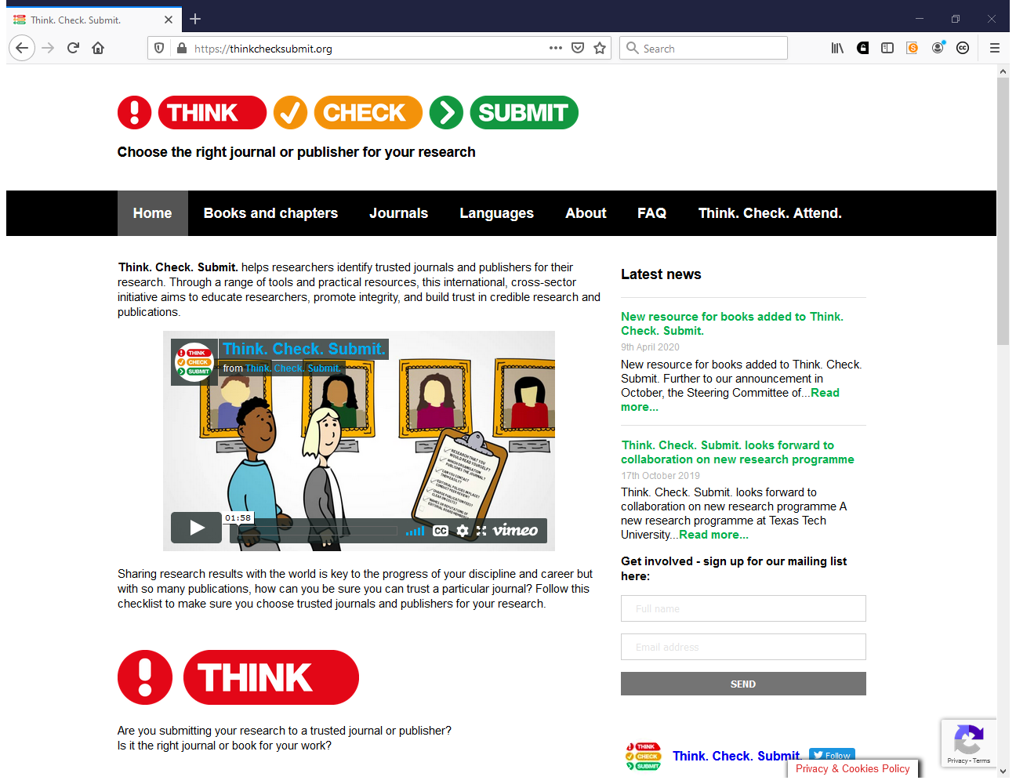
https://thinkchecksubmit.org

Slide 17
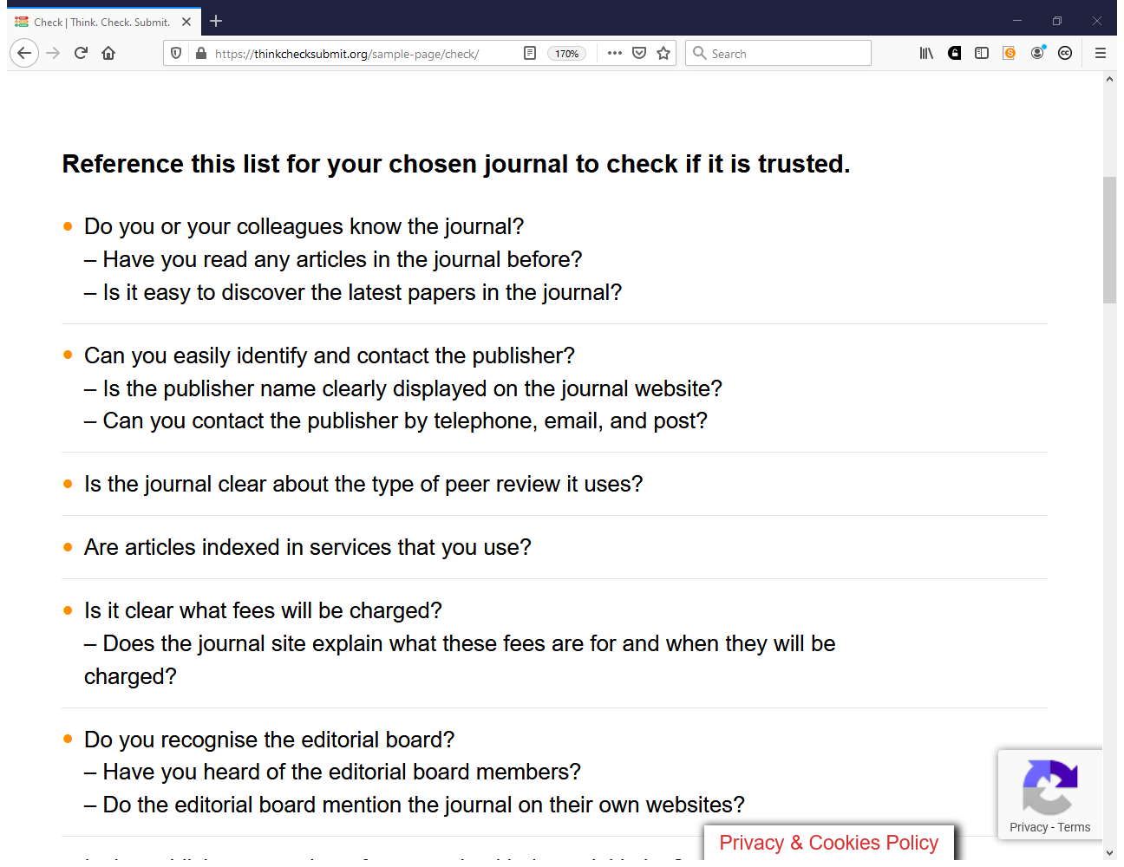

Slide 18
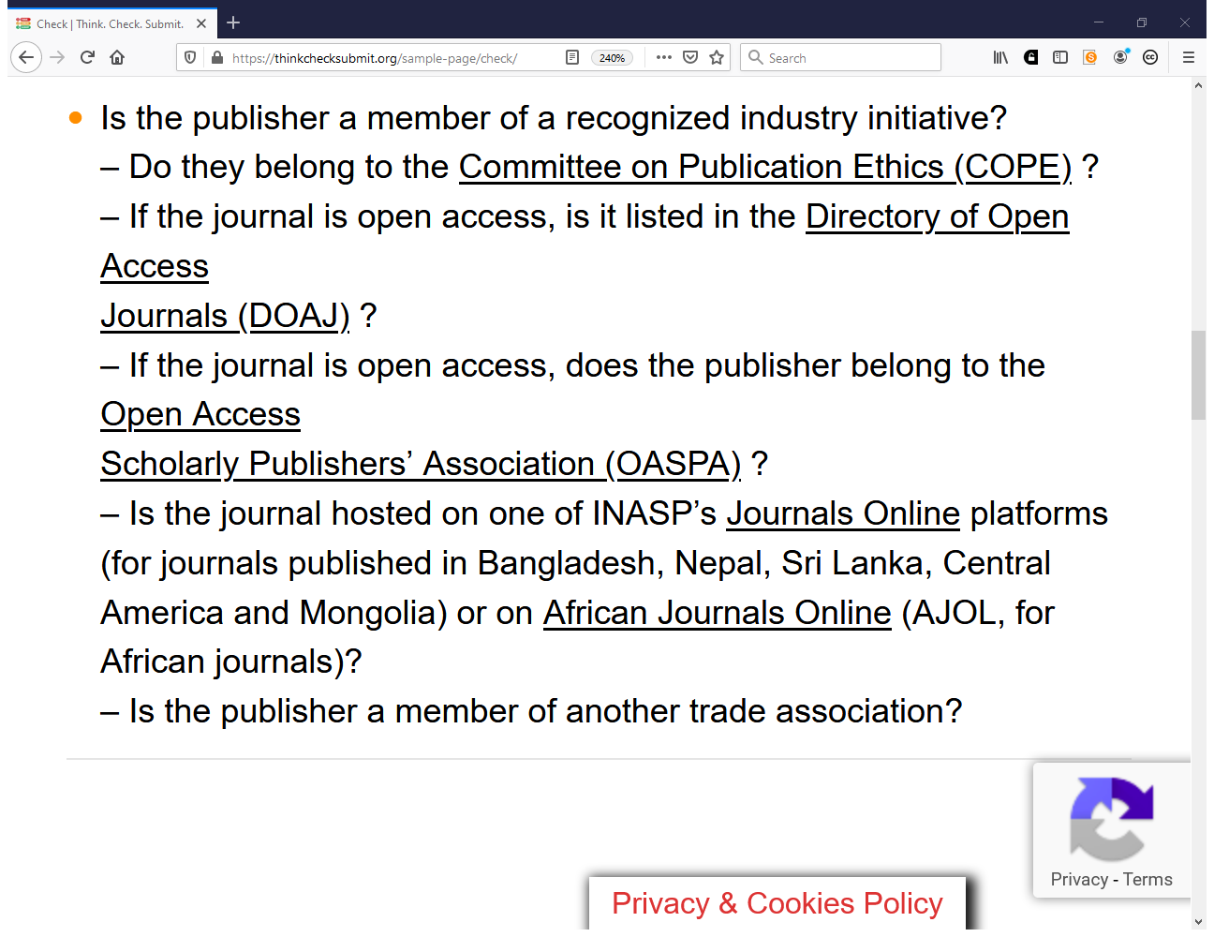

Slide 19
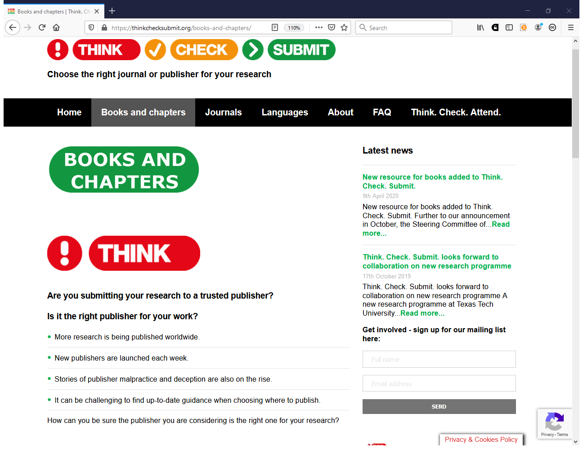

Slide 20
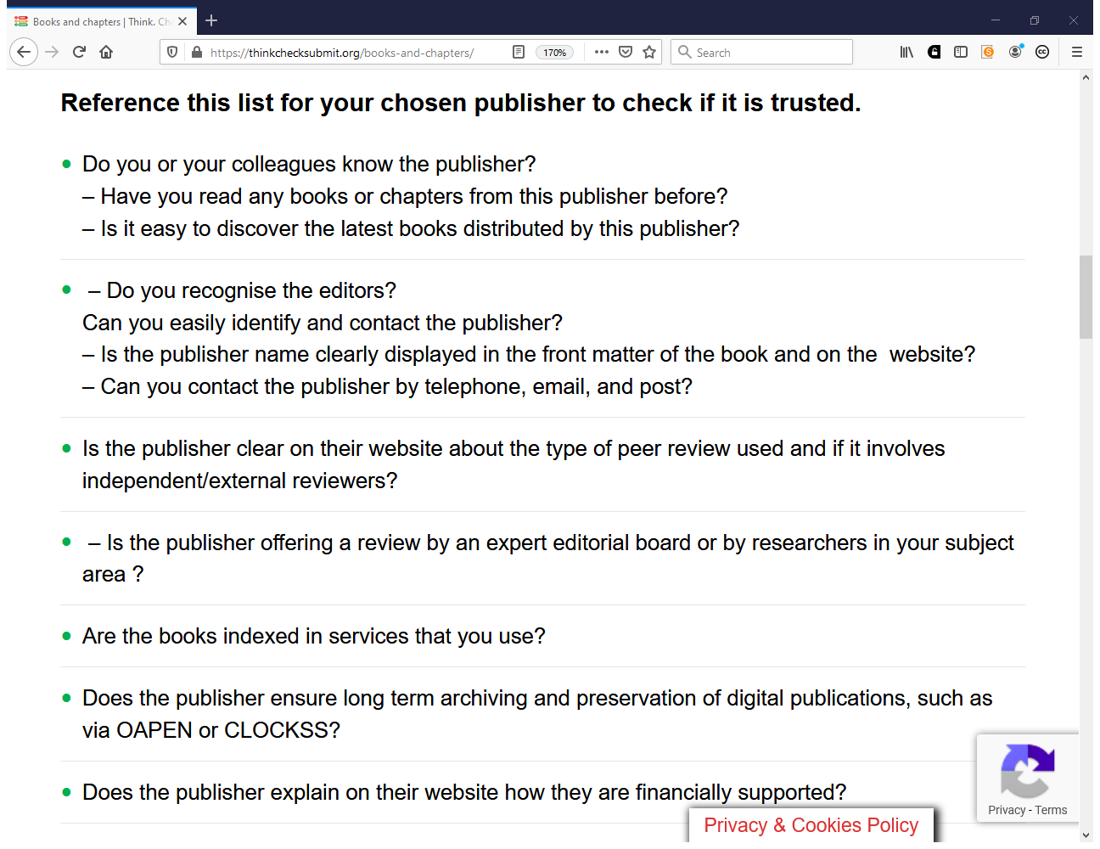

Slide 21
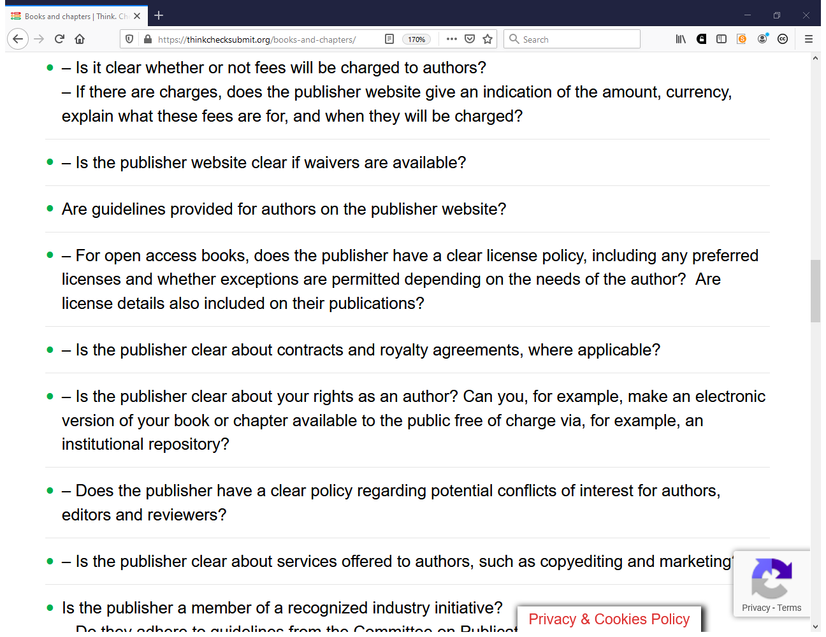

Slide 22
For research assessment, evaluation, promotion
What if none of the above works?
Keep evidences of peer review, editorial control and other quality related communications with a journal/publisher and be ready to share it with the review committees.
Any other suggestions?

Slide 23

DOAJ DEFINITION
Predatory publishers are publishers, who are not living up to reasonable standards in terms of content, services, transparency and business behavior.
Notes:
Two kinds: many would actually like to do a decent job, but lack the knowledge – many are just exploiting and cheating

Slide 24
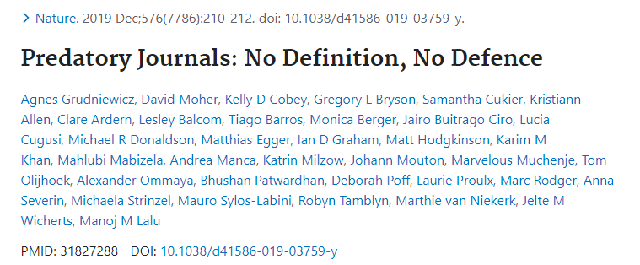
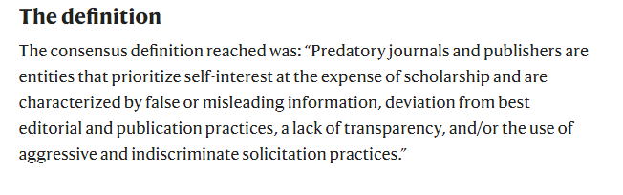

Slide 25
Differences between predatory / questionable and low-quality journals

Slide 26
DOAJ DEFINITION
Low Quality Publishers are publishers, who publish low quality articles due to inadequate peer review and or editors / peer reviewers from one institute only
Notes:
Two kinds: many would actually like to do a decent job, but lack the knowledge – many are just exploiting and cheating

Slide 27
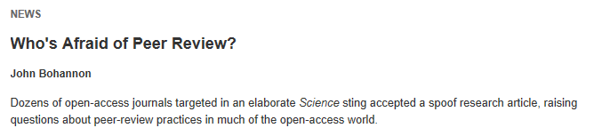
* http://walt.lishost.org/2015/11/ppppredatory-article-counts-an-investigation-part-1/
**Shen and Björk. BMC Medicine201513:230
Predatory Publishing: the Media Picture
BIG PROBLEM UNIQUELY LINKED TO OPEN ACCESS JOURNALS
OPEN ACCESS IS LOW QUALITY (everything accepted)
REPUTED SCIENTISTS ALSO PUBLISHED THERE
DANGER FOR THE REPUTATION OF SCIENCE
BIG MEDIA ATTENTION WITH BIASED SURVEYS
THE STING

Slide 28
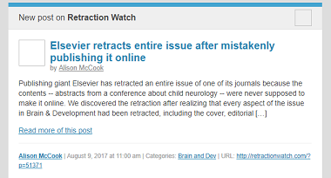
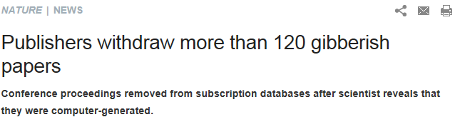
* http://walt.lishost.org/2015/11/ppppredatory-article-counts-an-investigation-part-1/
**Shen and Björk. BMC Medicine201513:230
Predatory Publishing: the Real Picture
NOT ONLY IN OPEN ACCESS JOURNALS
Not AS HIGH AS OFTEN REPORTED
according to a study* by Walt Crawford the number questionable publishers in 2014 was about 3275 publishing about 121,000 articles and not 420,000 (Shen and Björk ** reported 8000 journals and 420,000 articles-- Still cited massively!)

Slide 29
*** Walt Crawford
http://citesandinsights.info/civ17i1.pdf
PREDATORY PUBLISHING IN PERSPECTIVE
Proportion of low quality journals is comparable between open access and subscription publishing
but it looks worse mainly because Open Access journals are more visible
FACTS
Not all subscription journals are in Scopus or WoS: only 25-35,000 of 100,000 (data Ulrich’s Web)
Not all open access journals are in DOAJ : only 14,000 of 35,000 ***
CONCLUSION Percentage of Good Quality Journals in Open Access and Subscription Journals is comparable

Slide 30
WHAT TO DO?
Listing predatory journals
- not inclusive
- difficult to get off
Listing good quality journals
- inclusive
- difficult to get on
http://blogs.lse.ac.uk/impactofsocialsciences/2017/02/21/blacklists­are­technically­infeasible­practically­unreliable­and­unethical­period/

Slide 31
Thank you!
Questions?
Contact: iryna.kuchma@eifl.net
www.eifl.net

