Slide 1
Plan S: Taking stock of the current situation and new developments
OpenAIRE Policy and Legal Task Force
Webinar, 27 May 2020
Johan Rooryck | Open Access Champion, cOAlition S

Slide 2



Summary
cOAlition S
Why Plan S ?
Plan S: strong principles
Implementation guidance and challenges
Working with key stakeholders
Other activities
Questions and discussion

Slide 3

cOAlition S: 24 funders
National European funders:
Austria: FWF
Finland: AKA
France: ANR
Ireland: SFI
Italy: INFN
Luxembourg: FNR
Netherlands: NWO
Norway: RCN
Poland: NCN
Slovenia: ARRS
Sweden: FORMAS, FORTE, VINNOVA
UK: UKRI
European funders:
European Commission
European Research Council
Charitable foundations:
The Wellcome Trust
The Bill & Melinda Gates Foundation
Aligning Science Across Parkinson’s
Global dimension
World Health Organisation + TDR
Jordan: HCST
Zambia : NSTC
South Africa : SAMRC
African Academy of Sciences
São Paulo Statement : AmeliCA,
SciELo, African Open Science
Platform, OA2020, cOAlition S
Coordinated action with OA2020
Coordinated action with COAR

Slide 4


Why Plan S ?
Funders
Research funding organizations in cOAlition S want:
  To accelerate science by making research results immediately available to the largest possible audience worldwide.
  Greater transparency in research communication
  A cost-effective transition from the (unsustainable) subscription model to an Open Access model.
  Use their funding to drive academic publishing
  towards full and immediate Open Access

Slide 5
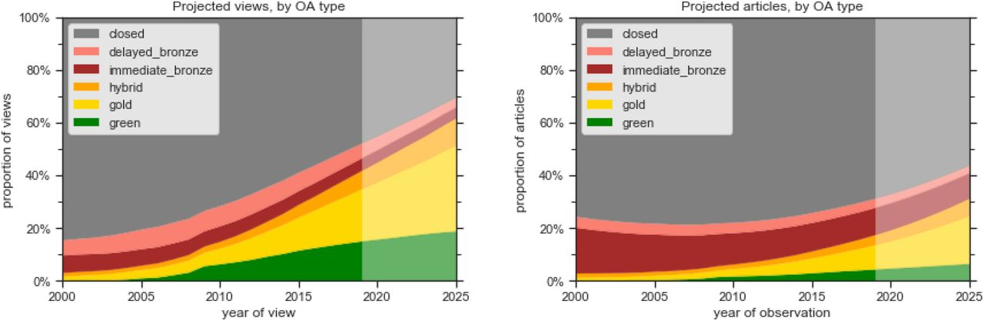
Why Plan S ?
Research visibility
In 2019:
31% of all journal articles are available as “OA”
52% of article views are to “OA” articles
Given existing trends, we estimate that by 2025:
44% of all journal articles will be available as “OA”
70% of article views will be to “OA” articles
Heather Piwowar, Jason Priem, & Richard Orr (2019) The Future of OA: A large-scale analysis projecting Open Access publication and readership. doi: https://doi.org/10.1101/795310

Slide 6
Plan S : strong principles
Research results are a public good and should be
immediately available so as to accelerate science
No more paywalled publications
Open Access must be immediate:
no embargo periods
Publication under a CC-BY license by
default, no copyright transfer (Principle 1)
No ‘hybrid’ model of publication, except as a
transitional arrangement with a defined endpoint

Slide 7
Plan S : strong principles
Pricing, contracts and publication fees should
be transparent and reasonable (Principle 5)
Funders commit to support such publication fees,
individual researchers do not pay (Principle 4)
Multiple routes to OA compliance (Principle 5)
A commitment to assess research outputs based
on their intrinsic merit and NOT their venue of
publication or quantitative metrics
following DORA (Principle 10).

Slide 8

Implementation guidance: key changes
Timeline extended by one year:
  Publications from calls published as
  of 1 January 2021 must be in Open Access.
  Transformative arrangements will be
  supported until the end of 2024
Greater clarity on compliance routes:
  cOAlition S supports a diversity of business models
  Plan S is NOT just about Gold OA:
  Immediate Green is fully compliant!

Slide 9
Implementation guidance:
Routes to compliance
Gold & Diamond route
Open Access
journals/ platforms
Authors publish in Open Access journal…
… cOAlition S funders financially support publication fees for author.
Green route
Subscription
journals
Authors can publish in a subscription journal…
…*IF* they make the Version of Record or Author Accepted Manuscript instantly available in a repository
cOAlition S funders do *NOT* financially support publication fees in ‘hybrid’ subscription journals
Transformative route
Hybrid/ subscription journals
Authors publish in a journal with a Transformative Arrangement.
cOAlition S funders *CAN* financially support Open Access under Transformative Arrangements

Slide 10
Implementation guidance:
Transformative arrangements (1)
Plan S supports three strategies:
  Transformative agreements (TAs)
    TAs are contracts between library consortia
    and publishers that convert current subscription
    costs into Open Access publishing costs.
    OA2020 promotes TAs to accelerate
    the transition to Open Access
    OA2020 aims for cost-neutral TAs.
    (i.e. subscription cost to Publish & Read)

Slide 11
Implementation guidance:
Transformative arrangements (1): ESAC
cOAlition S encourages publishers, institutions,
and library consortia to enter into TAs that
adhere to Plan S principles and ESAC guidelines.
Temporary and transitional [Plan S – end 2024]
Authors retain copyright [Plan S – non-negotiable]
Agreements must be transparent.
Experience shows that national (library) consortia
teaming up with national funders are best equipped
to negotiate successful TAs.

Slide 12
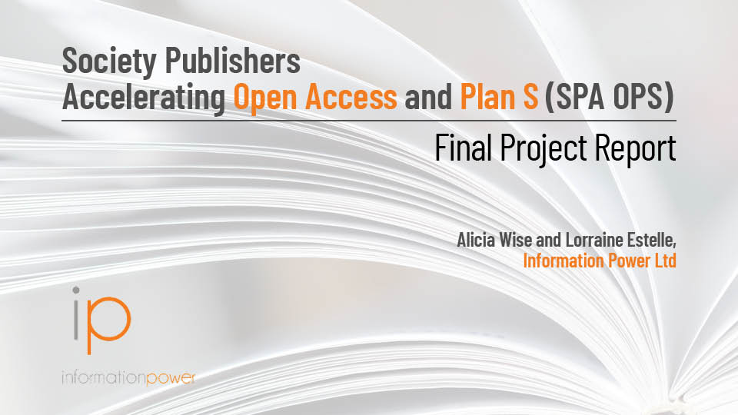
Implementation guidance:
Transformative arrangements (2)
2. Transformative model agreements
Report, Model Agreement, and
implementation toolkit published
on 12 September 2019
https://wellcome.figshare.com/
Societies can use this Transformative Model Agreement
as early as 2020
Libraries continue to pay their old subscription in exchange for immediate Open Access of all journal content. No APCs.
The Microbiology Society is negotiating a TMA for its 6 journals with the help of JISC.
https://zenodo.org/record/3406178#.XhH0-i2ZNiN

Slide 13
Implementation guidance:
Transformative arrangements (3)
Transformative journals
A framework for journal transitions where:
    The share of Open Access content is gradually increased with at least 5% in absolute terms and at least 15% in relative terms, year-on-year
    Subscription costs decrease as income from Open Access fees increases (no double payments)
    The journal commits to transition to full
    Open Access and no later than when 75% of research content is published Open Access

Slide 14

Implementation:
Developing a Journal Checker Tool
  Making it easy: a Journal Checker Tool, available on 1 January 2021, that allows researchers to identify journals that enable compliance with Plan S.
  A supplier has now been selected, work has started.
  The initial focus will be on identifying publishing venues that:
    offer a route to compliance, as set out
    in the Implementation of Plan S
    offer a CC-BY option to all researchers
    working under a Plan S policy
    allow the author to retain copyright

Slide 15

Working with key stakeholders: researchers
  Working with researcher groups to ensure we understand their concerns and find ways of mitigating them
  Ambassador network established – to engage with research community and share concerns with cOAlition S leadership team

Slide 16




Working with key stakeholders: early career researchers (ECR)
  cOAlition S has established a Task Force to measure the impact of Plan S on ECRs, including representatives from
  4 ECR organizations:
  Global Young Academy (GYA), Young Academy Europe (YAE), Marie Curie Alumni Association (MCAA), and EuroDoc.

Slide 17

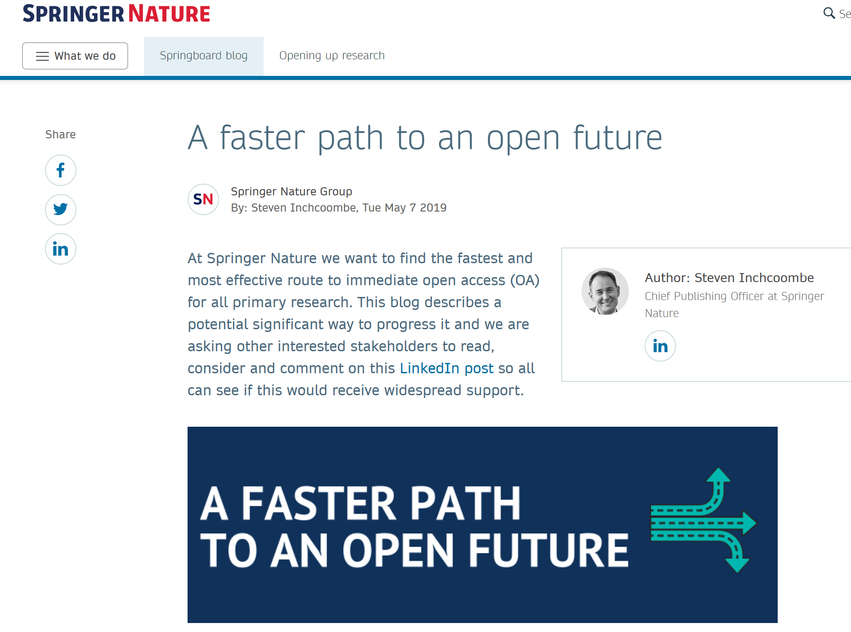
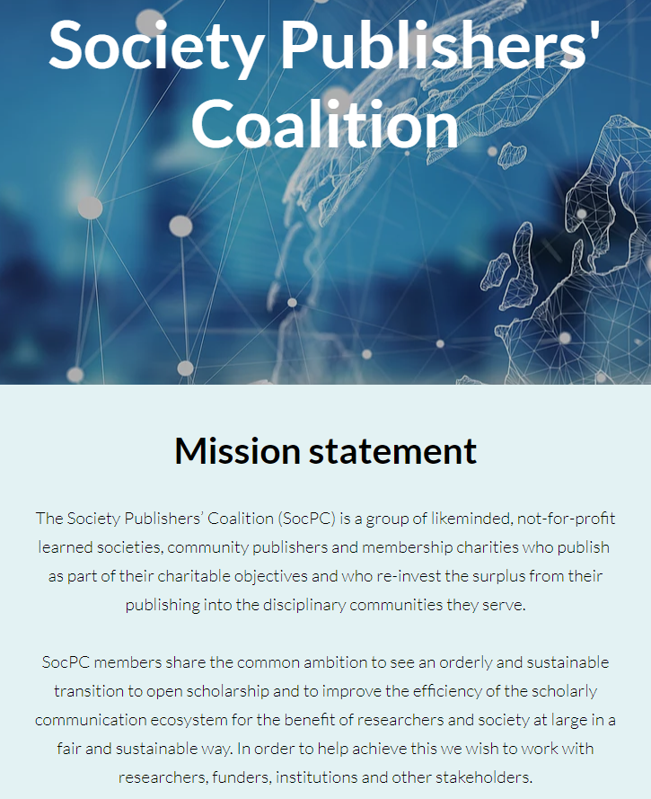
Working with key stakeholders: publishers
  In active discussions with publishers – such as the Society Publishers’ Coalition, Springer Nature and others – to explore the “transformative journal” model

Slide 18
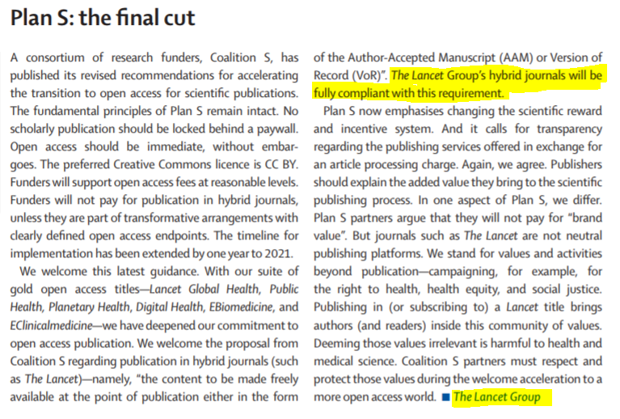
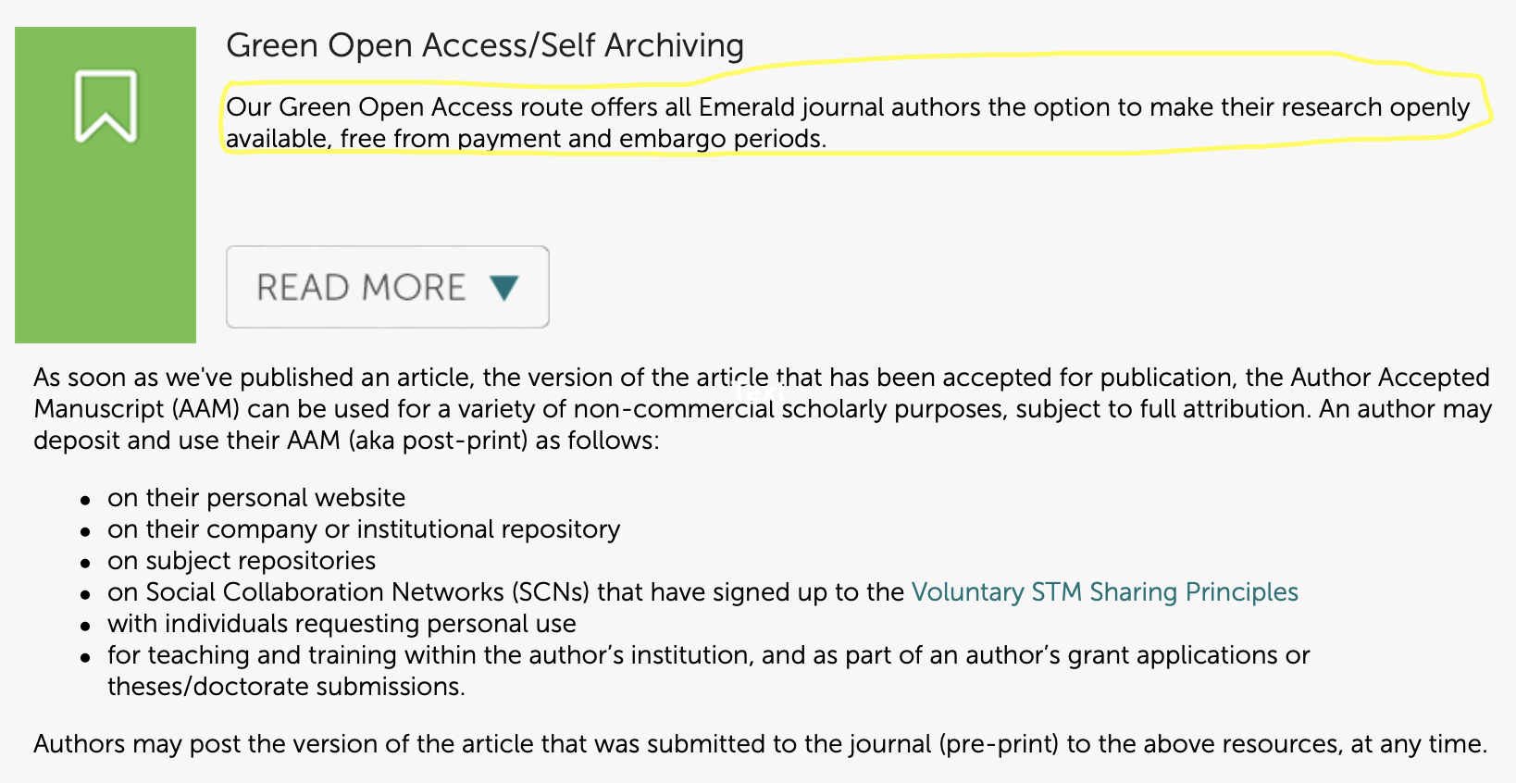
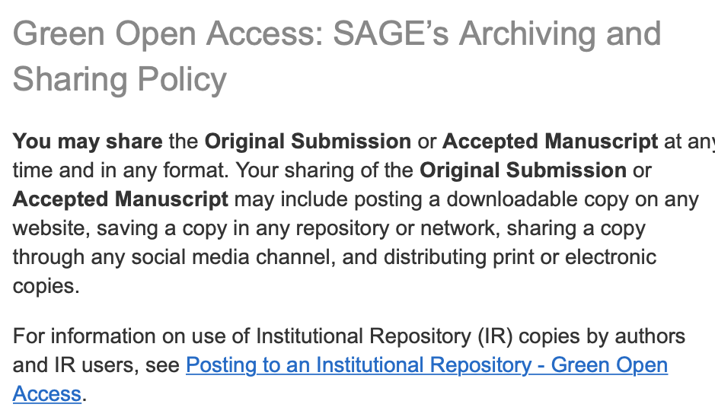
Working with key stakeholders: publishers
  …other journals and publishers support “Green Open Access” (at least as an interim model)

Slide 19

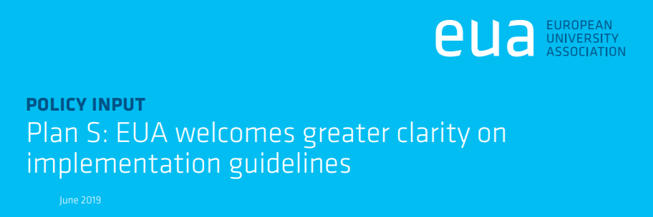
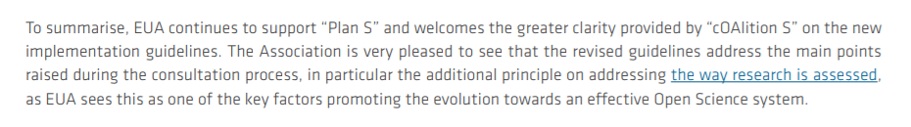
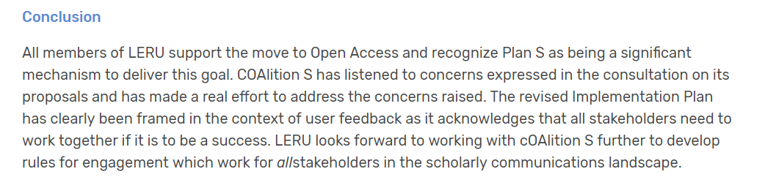

Working with key stakeholders: universities

Slide 20

Other activities
Transparent pricing
Plan S Guidance specifies: “cOAlition S, in partnership with publisher representatives and other stakeholders, will define the various services (e.g., triaging, peer review, editorial work, copy editing) publishers will be asked to price.”
cOAlition S aims to help make the nature and prices of OA publishing services more transparent, to build confidence amongst stakeholders that prices are fair and reasonable.
cOAlition S has recently announced
their price transparency requirements.
From July 2022, only publishers adhering to the Plan S price transparency frameworks will be eligible to receive publication funds from cOAlition S members.

Slide 21
Other activities
Transparent pricing
The two approved price breakdown frameworks are:
  The Breakdown of Publication Services and Fees developed by the Fair Open Access Alliance (FOAA), already implemented by Frontiers, MIT Press, Copernicus and MDPI.
  The Plan S Price and Transparency Framework developed by Information Power, which has been piloted by Annual Reviews, Brill, The Company of Biologists, EMBO Press, European Respiratory Society, F1000 Research, Hindawi, IOP Publishing, PLOS, and Springer Nature.

Slide 22
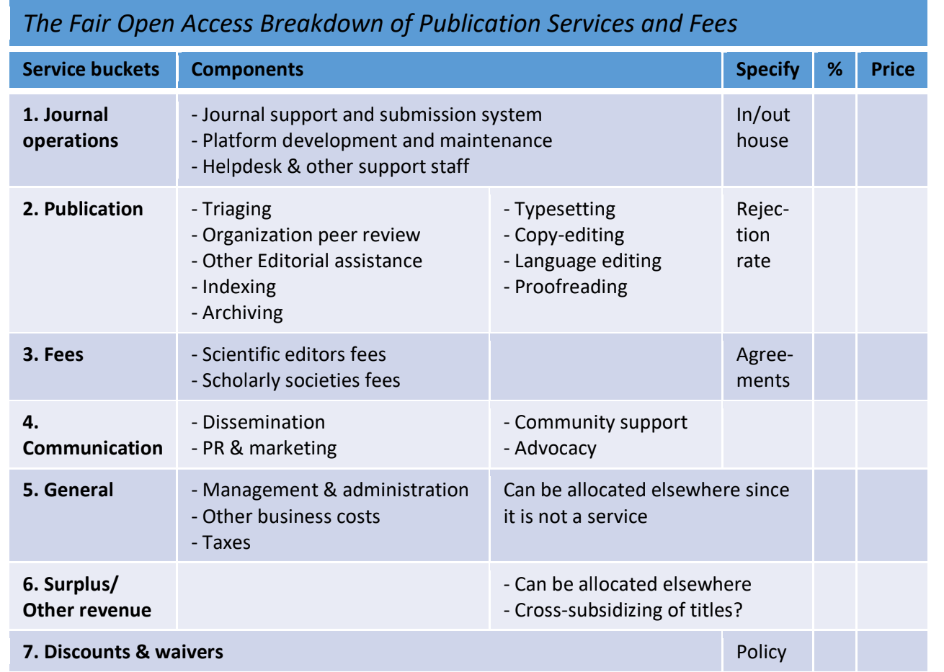
Other activities
Transparent pricing – FOAA

Slide 23

Other activities
Non-APC funding models
Principle 5: "The Funders support the diversity of business models for Open Access journals and platforms."
‘Diamond’ initiatives rarely rely on per-unit payments.
Tender for study on ‘Diamond’ journals and platforms:
How can Plan S funders support ‘Diamond’ publishing?
Analysis of global landscape and funding models, potential collaboration, challenges, and recommendations for funding mechanisms.
Tender closed on 24 April, 11 proposals received,
outcome selection expected beginning June 2020.

Slide 24

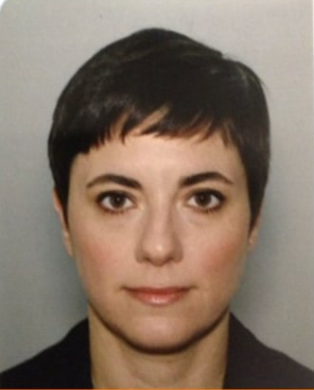



Other activities – cOAlition S office
A cOAlition S office has now been established at the European Science Foundation (ESF) in Strasbourg with €2m contributed by a subset of cOAlition S funders.
Nora Papp-Le Roy (Programme Manager)
Robert Kiley (Coordinator)
Johan Rooryck (Open Access Champion)

Slide 25


Working together to deliver OA
Plan S is part of a wider open science movement, looking to accelerate the transition to providing research results in Open Access
To fully deliver on its ambition – to make full and immediate OA a reality – we need a global coalition of funders, but also institutions, researchers, and publishers

Slide 26


Questions and discussion

