Slide 1
EIFL DIGITAL RESEARCH LITERACY TRAINING PROGRAMME OUTLINE
‘Preprints’
Ana Đorđević
Faculty of Chemistry Library, University of Belgrade, Serbia
09 June 2021

Slide 2
The Content
01
Introduction to preprints
02
For and against preprints
03
Preprints’ platform to share early findings
04
Training for researchers – practical exercises

Slide 3
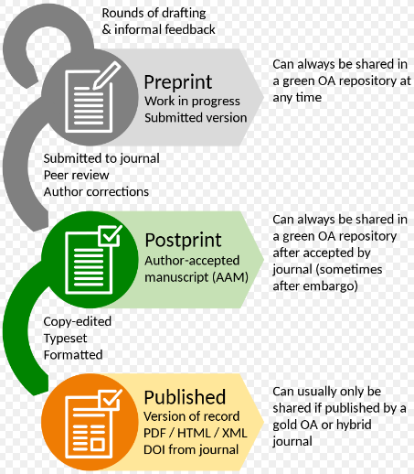
Thomas Shafee - Own work; adapted from diagram by Ginny Barbour (CC BY 4.0)

Slide 4
Characteristics of preprints
preprints are preliminary scientific reports that are made publicly available online for anyone to read, comment , and discuss before they have been peer reviewed,
preprints enable rapid release and discussion of data,
working in progress with constant feedback,
preprints are often not indexed in mainstream bibliographic services...

Slide 5
Benefits
Credit
Feedback
Visibility
List of funder policies: https://asapbio.org/funder-policies

Slide 6
Social Science, Natural Science & Humanities...
*Rapidly adopted*
immediate availability to their peers and the public,
avoiding lengthy peer-review processes prior to release,
readers can leave comments…

Slide 7
Issues with preprints
Pressure to publish quickly,
Many preprints are never revised,
Preliminary results could be reported by the media or posted and discussed on social media with little regard,
Retrospective “tagging” won’t have much effect.

Slide 8
Suggested solutions...
References should clearly disclose that the source is a preprint (DOI, preprint link…),
Preprints should not be used as references in any medical publication,
Watermarking the article,
Highlighting that the findings have not been formally peer reviewed,
Pre-publication checks by server hosts,
Preprints marked and linked via DOI to the subsequently fully published article.

Slide 9

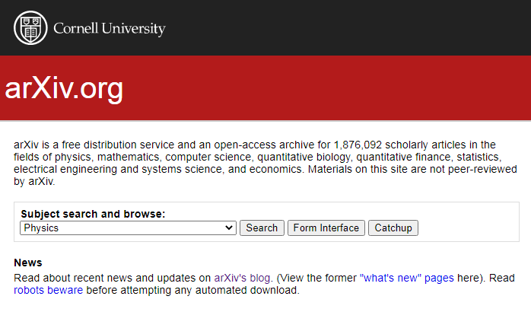

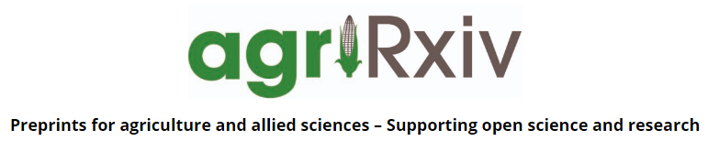


Directory of preprint server policies
and practices:
https://asapbio.org/preprint-servers

Slide 10
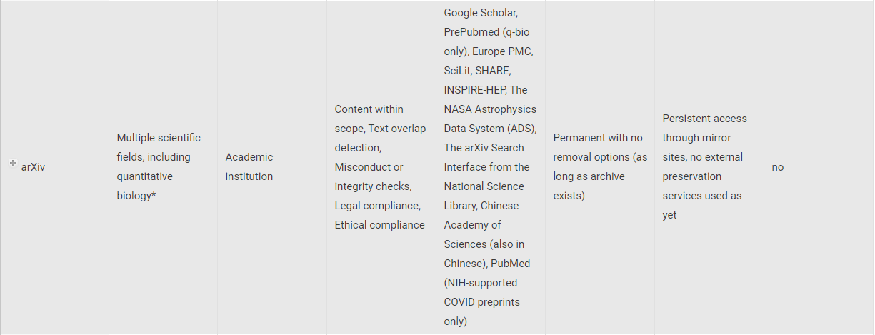

Slide 11
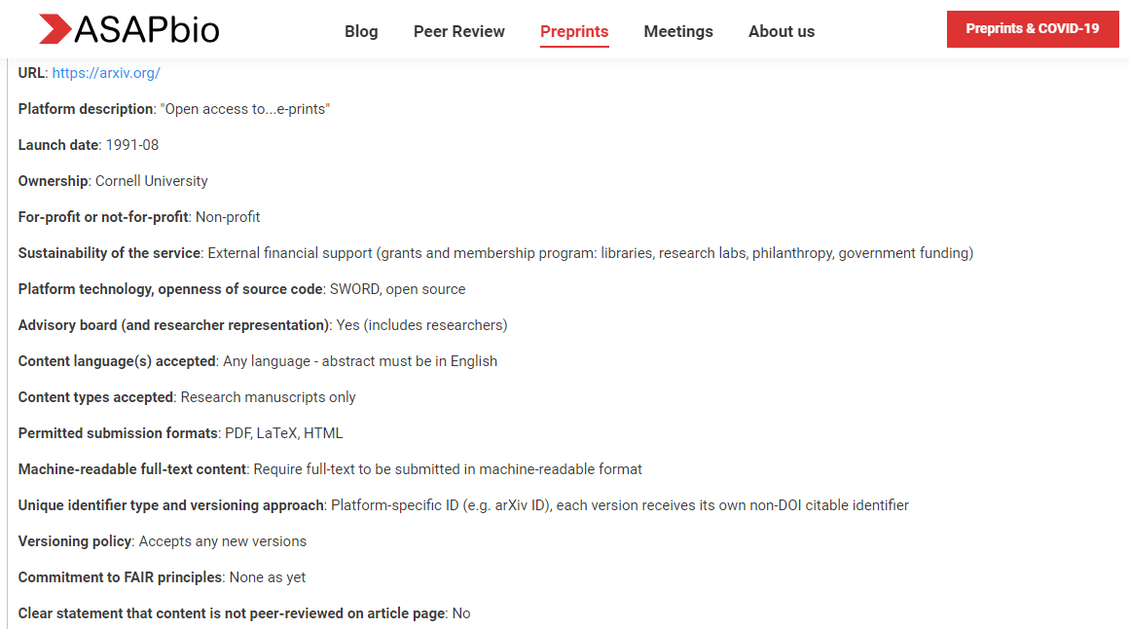

Slide 12
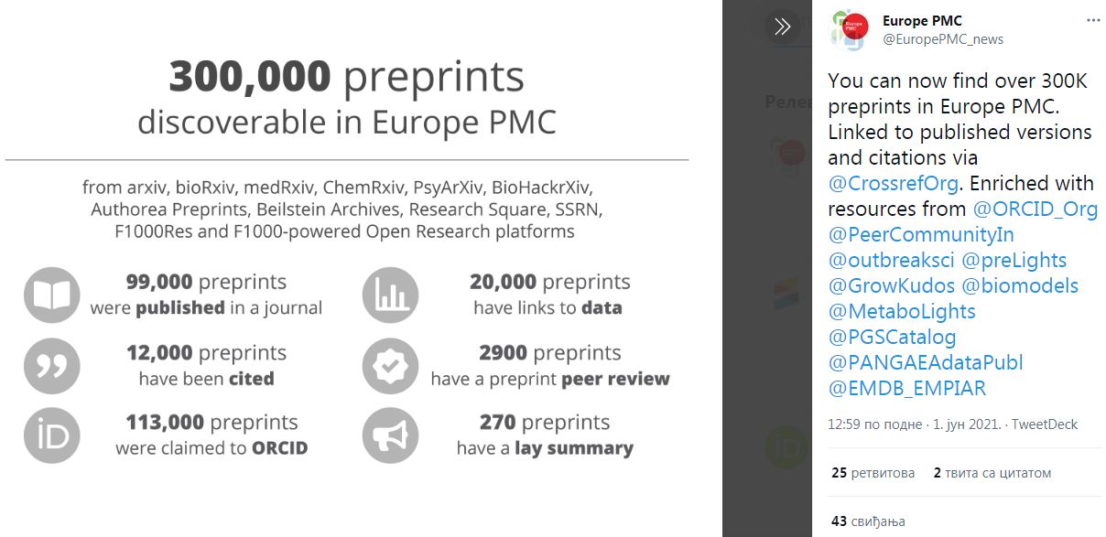

Slide 13
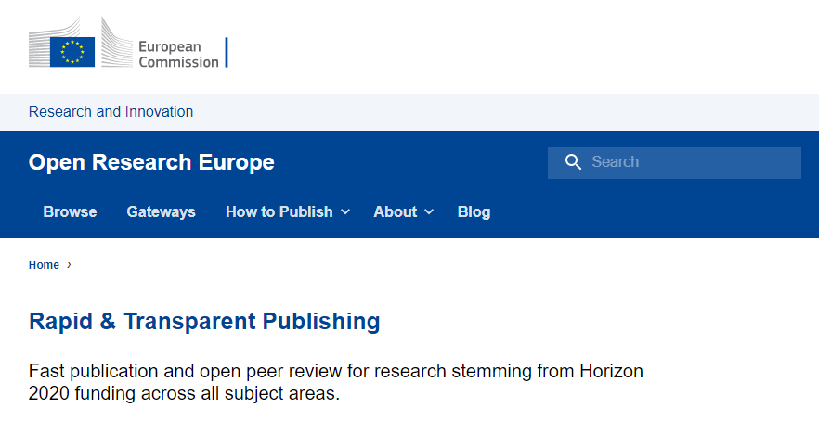
Open Research Europe
https://open-research-europe.ec.europa.eu/

Slide 14
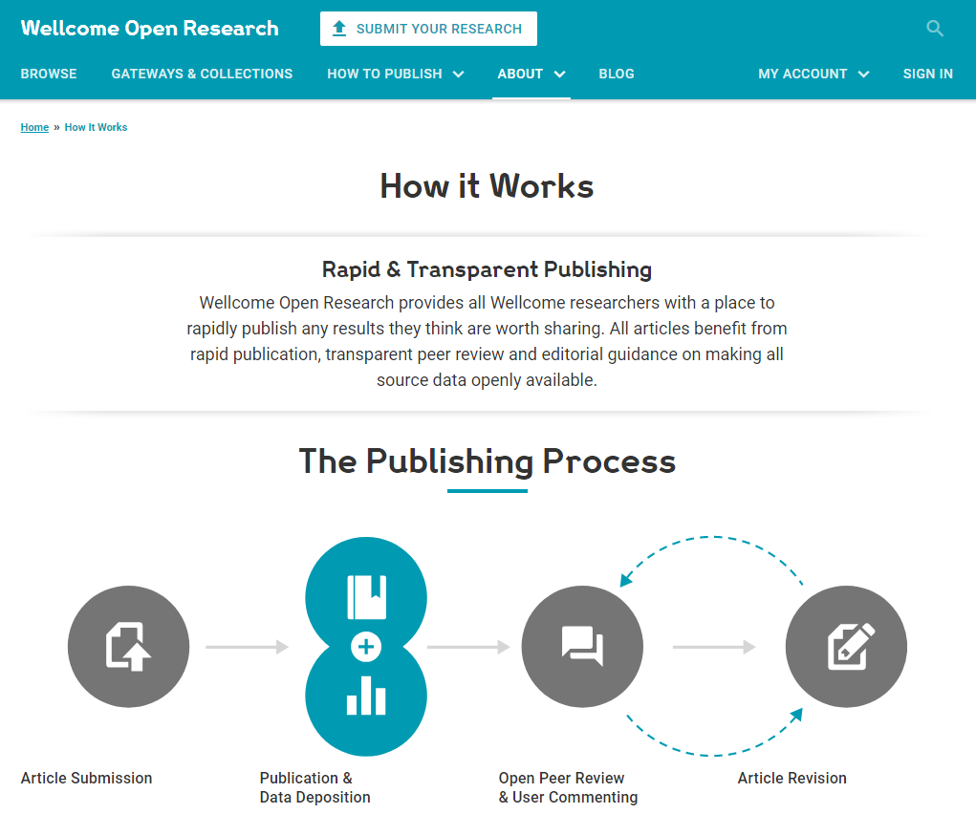
Welcome Open Research
https://wellcomeopenresearch.org/

Slide 15
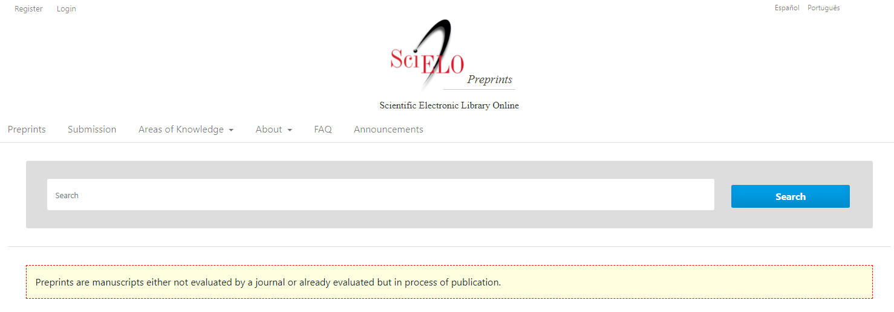
SciELO Preprints
https://preprints.scielo.org/

Slide 16
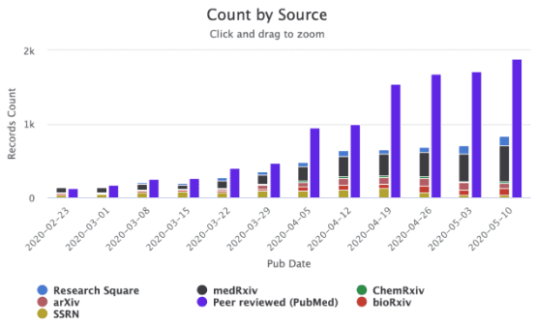
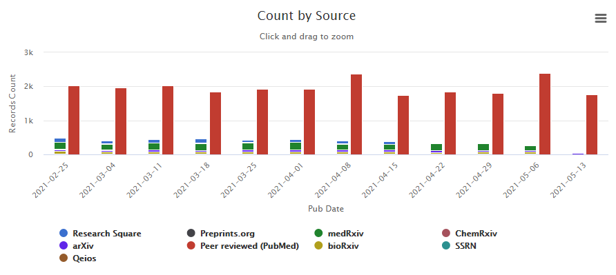
Preprints & COVID-19
COVID-19 preprints per week from https://icite.od.nih.gov/covid19/search/

Slide 17
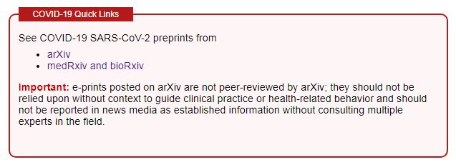
Preprints & COVID-19
4,075 results
15,742 articles (12,161 + 3,581)

Slide 18
Training focus
· Breaking fears,
· Explain why traditional journals do not meet the needs of modern scientific communication,
· Explain Open Research Europe and new trends at the international level.

Slide 19
Approaches
· Education should include lively discussion,
· Not everyone should be expected to accept immediately,
· It is useful to invite a researcher who has published preprints to share their experience.

Slide 20
Formats
Format | Methods | Technical requirements | Topics
Lecture + demo for researchers (90 min) | Verbal presentation Preprints features: demonstration Registration and depositing: demonstration Participants are free to ask any questions they may have during the presentation | Computer + video beam Online | Full range
In person (~45 min) | Introduction to preprints Preprint servers and searching literature Participant is free to ask any questions | Live – in library Online | Depends on researchers’ or librarians’ prior knowledge

Slide 21
Practical
Researchers should be reminded that they have to take into account journal policies.
In Serbia
· Local physicists, mathematicians and engineers have been using arXiv for a long time and they know benefits of preprints,
· This practice is sporadically present among local psychologists:
https://osf.io/3fjqk/, https://psyarxiv.com/discover?q=serbia,
· Chemists are quite conservative, they publish in traditional journals and with major commercials publishers,
· Researchers who work more intensively with colleagues from abroad are more likely to publish a preprint,
· A major problem is the research evaluation system which relies on the Impact Factor,
· The most suitable target group for education are researchers who are involved in EU projects.

Slide 22
Tricky issues: Traditional model of publishing vs. Preprints
Traditional way | Preprints
Small number of reviewers, The review process is not transparent (a paper might have been accepted despite a negative review, but the readers don’t have access to this information), Is slow, Paywalls (one can’t have an opinion on a paper they can’t read), Too many papers are published, some of which are never read | Open access to a large number of researchers around the world, Commenting, discussing and providing feedback (which may not be relevant, but it’s at least transparent), Even more preprints are published, some of which are never read,
The common opinion is that the published results are certainly good (while publishers are still reluctant when it comes to publishing replication studies which demonstrate that some results are not so good) | The common opinion is that preprints are not verified and that anyone can write them
The part of the evaluation system which relies on the impact factor, | Preprints are not recognized in many countries and officially accepted in the research evaluation system,
Publishers constantly encourage publishing through the traditional model (personal gain). | Publishers often do not allow the publication of a preprint in their journals, which may discourage authors from setting up a preprint first and then publishing the paper.

Slide 23
References
AMWA-EMWA-ISMPP Joint Position Statement on Medical Publications, Preprints, and Peer Review. null 2021, 1–6. https://doi.org/10.1080/03007995.2021.1900365.
Abdill RJ, Blekhman R. Tracking the popularity and outcomes of all bioRxiv preprints. Elife. 2019;8:e45133.
Fraser N, Momeni F, Mayr P, et al. The relationship between bioRxiv preprints, citations and altmetrics. Quant Sci Stud. 2020;1(2):618–638.
Maslove DM. Medical preprints-a debate worth having. J Am Med Assoc. 2018;319(5):443–444.
Penfold NC, Polka JK. Technical and social issues influencing the adoption of preprints in the life sciences. Shafee T, ed. PLoS Genet. 2020;16(4):e1008565.
medRxiv. Submission Guide. medRxiv. 2021. [cited 04 May 2021]. Available from: https://www.medrxiv.org/submit-a-manuscript.
Mudrak, B. What Are Preprints, and How Do They Benefit Authors? Available from: https://www.aje.com/arc/benefits-of-preprints-for-researchers/.
Serghiou S, Ioannidis JPA. Altmetric Scores, Citations, and Publication of Studies Posted as Preprints. JAMA. 2018;319(4):402–404. https://doi.org/10.1001/jama.2017.21168.
Polka, JK, & Penfold, NC. Biomedical preprints per month, by source and as a fraction of total literature (Version 3.0) [Data set]. Zenodo. 2020. http://doi.org/10.5281/zenodo.3819276

Slide 24

Questions?
anadj@chem.bg.ac.rs
@ana_carpediem
Ana Đorđević

