Slide 1


The TU Darmstadt Case
CJEU, C-117/13
Dr. Nils Rauer, MJI
Webinar, 8 June 2016

Slide 2


The Exception of Article 5 (3) lit. n) of the Directive 2001/29

Slide 3
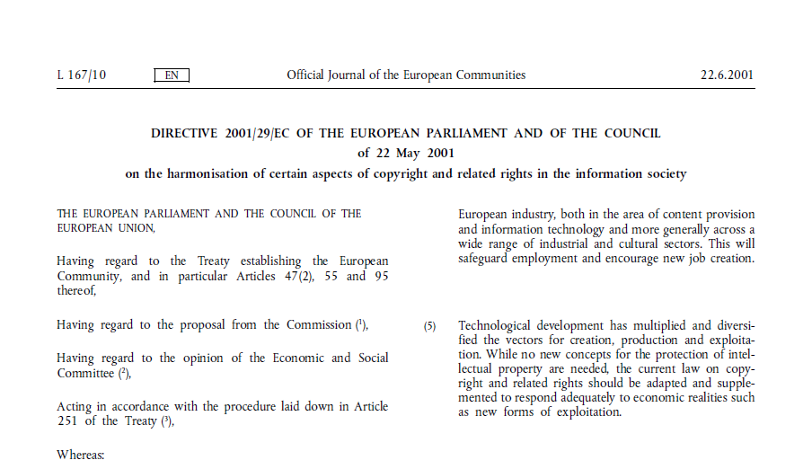
The Directive

Slide 4
The Directive
Article 5 (3) lit. n) – Exceptions & Limitations
Member States may provide for exceptions or limitations to the rights provided for in Articles 2 and 3 in the following cases:
(n) use by communication or making available, for the purpose of research or private study, to individual members of the public by dedicated terminals on the premises of establishments referred to in paragraph 2(c) of works and other subject-matter not subject to purchase or licensing terms which are contained in their collections;

Slide 5
The German Copyright Act
Section 52b – Communication of works at terminals in public libraries, museums and archives
So far as there are no contractual provisions to the contrary, it shall be permissible to make published works available from the stocks of publicly accessible libraries, museums or archives, which neither directly nor indirectly serve economic or commercial purposes, exclusively on the premises of the relevant institution at terminals dedicated to the purpose of research and for private study. In principle, reproduction of a work in excess of the number stocked by the institution shall not be made simultaneously available at such terminals. Equitable remuneration shall be paid in consideration of their being made available. The claim may only be asserted by a collecting society.

Slide 6

The Case

Slide 7





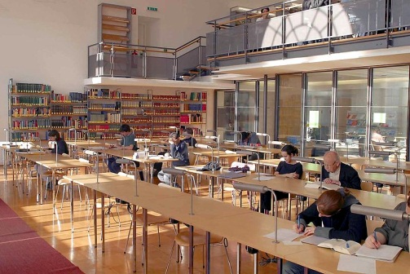
The Case

Slide 8

The Case
Course of Action
Digitising of the library's physical book collection
Reject of publisher's offer to license the ebook version
Installation of the dedicated terminals
  Search function
  Read function
  Print function (paper)
  Save function (USB stick)inrichtung der elektronischen Leseplätze
Guidelines for users as to the scope of permissible use
Warning letter issued by the publisher

Slide 9
The Case
Course of Proceedings
Landgericht Frankfurt, Az.: 2-06 O 172/09
Oberlandesgericht Frankfurt, Az.: 11 U 40/09
    Judgment handed down on 24 November 2009
Landgericht Frankfurt, Az.: 2-06 O 378/10
Bundesgerichtshof, Az.: I ZR 69/11
Europäischer Gerichtshof, Rs.: C-117/13
Bundesgerichtshof, Az.: I ZR 69/11
  Judgment handed down on 16 April 2015
Bundesverfassungsgericht, Az.:AR 7081/15
March 2009
May 2009
August 2010
March 2011
Sept 2012
Sept 2014
May 2015

Slide 10

The Case
Four Aspects of Dispute
May a library rely on the exception of § 52b UrhG if the publisher is offering a digital version of the book? – priority of contracts
Is there a right to digitise even though § 52b UrhG does not say anything about digitising? – narrow interpretation of exceptions
May the library offer the user the option to print the displayed pages? – combination of exceptions
May the library offer the user the option to save the displayed pages on a data carrier? combination of exceptions

Slide 11
The Case
Four Aspects of Dispute
3:1
4:0
1:3
2:2
…plus alternating reasons given by the courts!

Slide 12

A closer look at the arguments

Slide 13
Priority of Contractual Provisions
General Principle vs. Ratio of the Provision
Recitals of the directive indeed give priority to contractual provisions
Article 5 (3) lit. n): "not subject to purchase or licensing terms"
Offers and opportunities are not yet
license agreements
Reasonableness test does not
work in practice – libraries require
legal certainty
1:0 for us

Slide 14
Right to Digitise
Interpretation of Exceptions
Digitising is an act of reproduction
Article 5 (3) lit. n): "communication or making available"
Principle of narrow interpretation of exceptions to copyright (?)
Rather, interpreting statutory rules in line with their sense & purpose

Slide 15
Right to Digitise
Interpretation of Exceptions
CJEU
"Such a right of communication of works enjoyed by establishments such as publicly accessible libraries covered by Article 5(3)(n) of Directive 2001/29, within the limits of the conditions provided for by that provision, would risk being rendered largely meaningless, or indeed ineffective, if those establishments did not have an ancillary right to digitise the works in question."

Slide 16
Right to Digitise
Interpretation of Exceptions
Still, right to digitise is not mentioned in Article 5 (3) lit. n)
But, in Article 5 (2) lit. c) we find a right for libraries to carry out "specific acts of reproduction"

Slide 17
Right to Digitise
Interpretation of Exceptions
CJEU
"Furthermore, the scope of that ancillary right of digitisation must be determined by interpreting Article 5(2)(c) of Directive 2001/29 in the
light of Article 5(5) of that directive, under which that limitation is applicable only in certain special cases which do not prejudice the normal exploitation of the work…"
2:0 for us

Slide 18
Printing & Storing Option
Points of Discussion
Another act of reproduction, this time at the terminal.
German legislator: "a use equivalent to analogue use of the physical book"
German law: "reading terminals"
Article 5 (3) lit. n) as a limitation to the right of making available
Article 5 (5) – (1) how to define adequate means of studying a text in today's world? (2) what is reasonable in light of the publisher's core business nowadays also including e-books

Slide 19
Printing & Storing Option
Privileged Institution / Person
CJEU
"Such acts of reproduction […] also cannot be permitted under an ancillary right stemming from the combined provisions of Articles 5(2)(c) and 5(3)(n) of Directive 2001/29 […]. Moreover, since those acts are carried out not by the establishments referred to in Article 5(3)(n) of Directive 2001/29, but rather by the users of the dedicated terminals installed within those establishments, they cannot be authorised under that provision."

Slide 20
Printing & Storing Option
Privileged Institution / Person
CJEU
"By contrast, such acts of reproduction on analogue or digital media may, if appropriate, be authorised under the national legislation transposing the exceptions or limitations provided for in Article 5(2)
(a) or (b) of Directive 2001/29 since, in each individual case, the conditions laid down by those provisions, in particular as regards the
fair compensation which the rightholder must receive, are met."

Slide 21
Printing & Storing Option
Scope of Permissible Use
CJEU
"Furthermore, such acts of reproduction must observe the
conditions set out in Article 5(5) of Directive 2001/29.
Consequently, the extent of the texts reproduced
may not, in particular, unreasonably prejudice
the legitimate interests of the rightholder."
3:0 and 4:0 for us

Slide 22
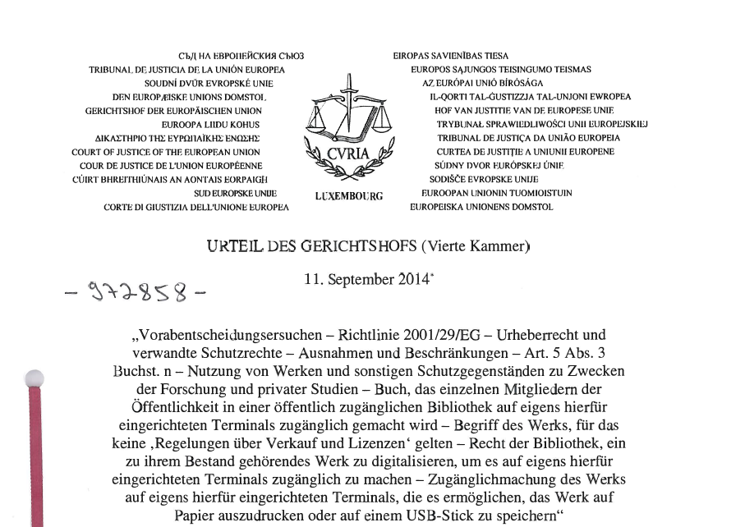
The Judgments

Slide 23
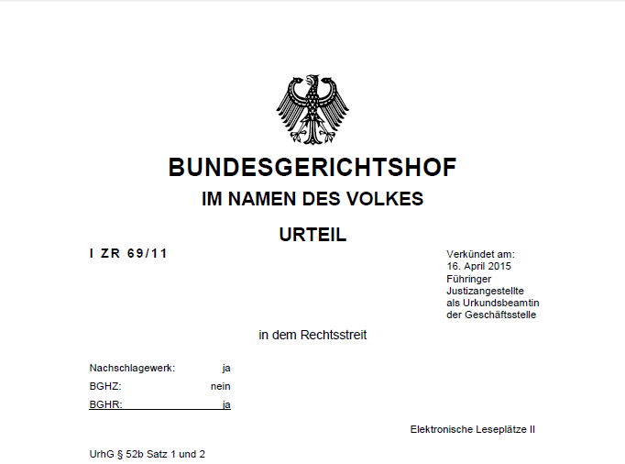
The Judgments

Slide 24

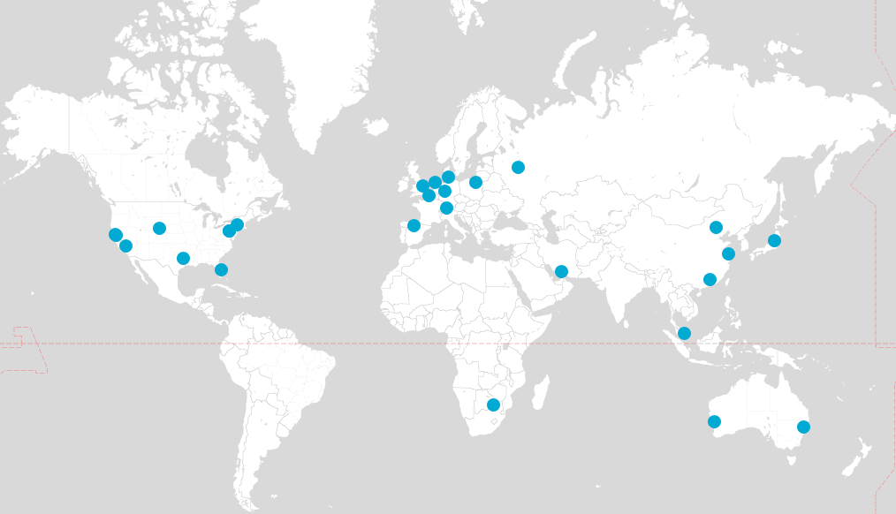

Thank you very much!
Copyright is our business – globally
  Dr. Nils Rauer, MJI (Gießen)
  Partner, Frankfurt
  T +49 69 962 36 371
  nils.rauer@hoganlovells.com
    ” Recommended lawyer for data protection.“
    Legal500, 2015
    ” Frequently recommended lawyer for trademark and competition law.“
    JUVE Handbook, 2014/2015 & 2015/2016
    ” Good IP lawyer“, Competitor
    JUVE Handbook, 2014/2015
    ” knowledgable, tough opponent“, Competitor
    JUVE Handbook, 2015/2016

Slide 25
Referent
Dr. Nils Rauer ist Partner im Frankfurter Büro von Hogan Lovells und leitet dort den Bereich Intellectual Property, Media & Technology (IPMT). Er hat sich auf den Bereich des gewerblichen Rechtsschutzes spezialisiert. Seine Beratungsschwerpunkte liegen hier insbesondere im Urheber- und Wettbewerbsrecht. Er ist Head unseres Global Copyright Teams. Darüber hinaus verfügt er über eine langjährige Expertise im Datenschutzrecht, insbesondere mit Blick auf den internationalen Datenverkehr.
Nils Rauer berät zur Verwertung von Urheberrechten im Internet, digitalen Medien, kollektiver Rechtewahrnehmung und dem Aufbau eines digitalen Binnenmarkts innerhalb der EU. Zu seinen Mandanten zählen Rechteinhaber sowie Internet Provider, Bibliotheken und Verwertungsgesellschaften.
Im Bereich des Wettbewerbsrechts hat sich Nils Rauer auf die Ausgestaltung von Werbekampagnen spezialisiert. Seine Mandanten kommen hier aus der Automobil- und Kosmetikbranche sowie dem Finanz- und Bankensektor.
Nils Rauer verfügt über eine langjährige Erfahrung als Prozessanwalt. Insbesondere im einstweiligen Rechtsschutz verfügt er über eine ausgewiesene Expertise. Unlängst hat Nils Rauer die TU Darmstadt in einem Musterprozess erfolgreich vor dem EuGH in Luxemburg vertreten.
Nils Rauer ist Mitglied des Fachausschusses Urheber- und Verlagsrecht der Deutschen Vereinigung für gewerblichen Rechtschutz und Urheberrecht (GRUR) sowie der Deutschen Gesellschaft für Recht und Informatik (DGRI). Er ist Lehrbeauftragter an der Johannes Gutenberg-Universität Mainz und Referent der Akademie des Deutschen Buchhandels.
  Dr. Nils Rauer, MJI (Gießen)
  Partner, Frankfurt
  T +49 69 962 36 371
  nils.rauer@hoganlovells.com
    „Empfohlener Anwalt für Datenschutzrecht.“
    Legal500, 2015
    „Häufig empfohlener Anwalt für Marken- und Wettbewerbsrecht.“
    JUVE Handbuch, 2014/2015 u. 2015/2016
    „Guter IP-Rechtler“, Wettbewerber
    JUVE Handbuch, 2014/2015
    „kenntnisreich, harter Gegner“, Wettbewerber
    JUVE Handbuch, 2015/2016
Notes:
Bei bloßer Speicherung in den USA auch Anonymisierung und Verschlüsselung möglich

