Slide 1



Reflecting copyright policies changes through time in OJS
25th November
OJS: Best Practices and Use Cases

Slide 2
What?
What is a Copyright policy in a journal?
Where should the copyright policy be? And how can I write it?
  Journal website
  Article metadata
  Article PDF
Does the current copyright policy of the journal applies to all the published issues?
Why is important to know the previous copyright policy?
What if a journal does not have a stated copyright policy?
How can I know the previous copyright policy of the journal?
How can I correct copyright policy/information?
How can I correct copyright metadata?
  Manually
  Semiautomatic
The Scientific Journals of University of Barcelona
Where?
+ How?
Why?
+What if?
How?
Who?

Slide 3
What is a Copyright policy in a journal?
A description of who owns the rights
of the works published in the journal,
and what can people do with these works,
and other details if necessary.

Slide 4
What is a Copyright policy in a journal?
A description of who owns the rights
of the works published in the journal,
and what can people do with these works,
and other details if necessary.
A.K.A
© copyright holders
articles, reviews, etc.
to copy
to share
to rewrite
to make profit
embargo period
self-archiving policy
previous copyright policies
copyright policies for the images
open access policy

Slide 5
What is a Copyright policy in a journal?
A description of who owns the rights
of the works published in the journal,
and what can people do with these works,
and other details if necessary.
A.K.A
© copyright holders
articles, reviews, etc.
to copy
to share
to rewrite
to make profit
Authors or journal/institution
embargo period
self-archiving policy
previous copyright policies
copyright policies for the images
open access policy
Creative Commons
or other licences

Slide 6
Where should the copyright policy be?
In the journal website
In the article metadata
In the article PDF/other formats
Full explanation
Key elements
Copyright holder
License
Publication year
Also in policy repositories (Open Policy Finder) and other directories (DOAJ)

Slide 7

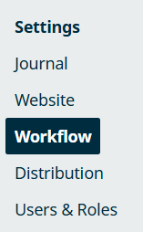
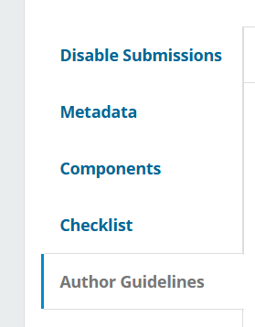
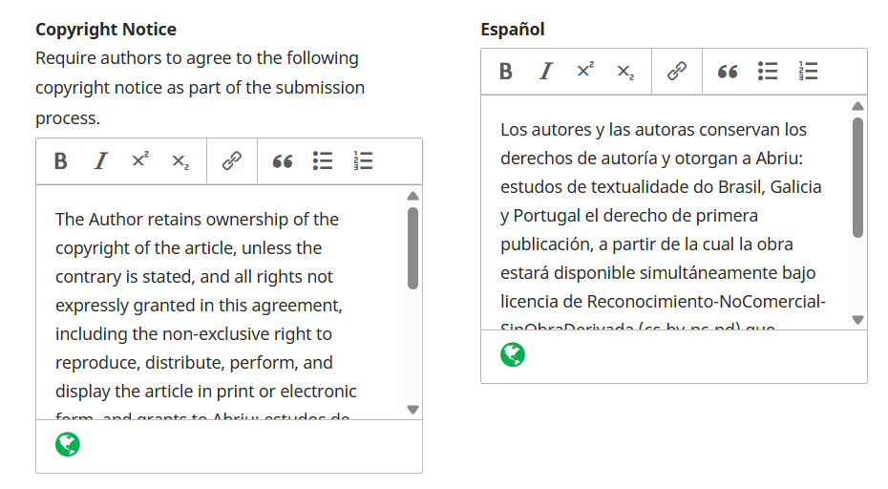
Where should the copyright policy be? – Journal OJS website
(OJS version 3.3.0.21)
2
1
4
3

Slide 8
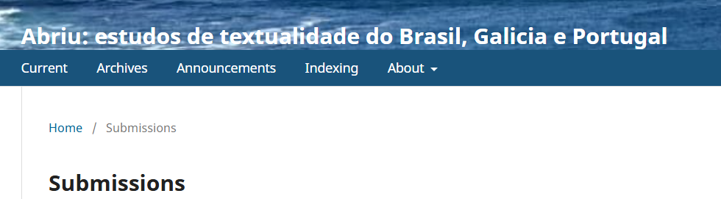
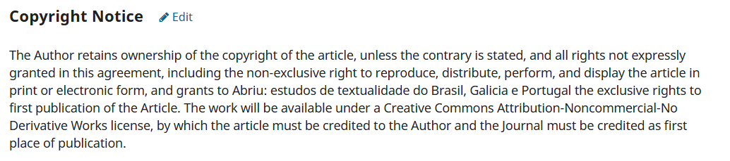
Where should the copyright policy be? – Journal OJS website
Public website information, in “Submissions” menu
Copyright information that authors must read and accept before sending a submission
Copyright information displayed in the article website

Slide 9
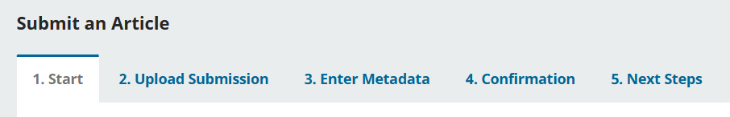
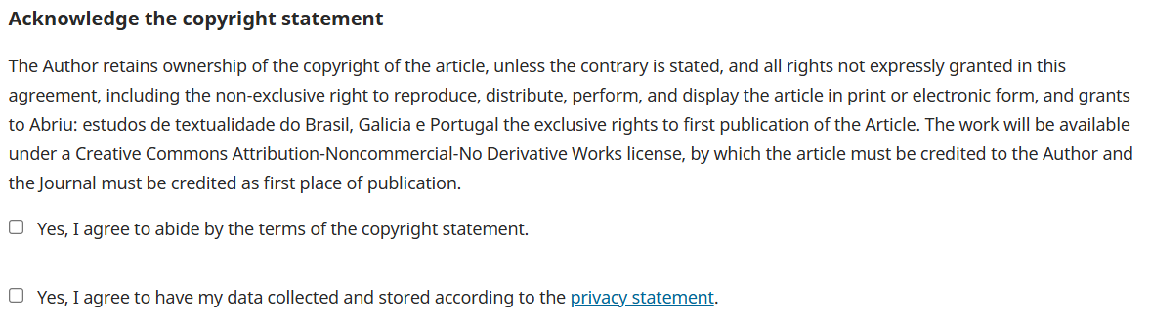
Where should the copyright policy be? – Journal OJS website
Public website information, in “Submissions” menu
Copyright information that authors must read and accept before sending a submission

Slide 10
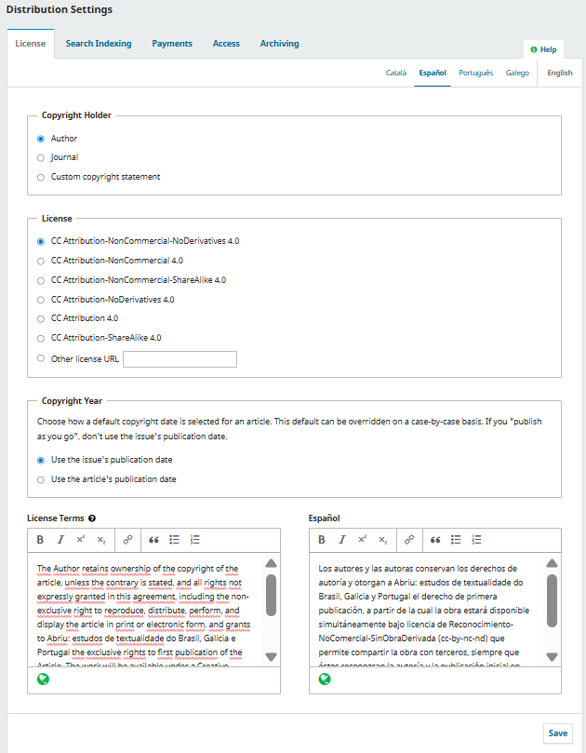
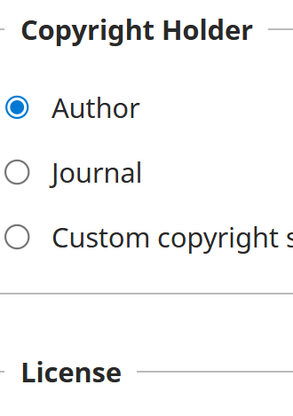
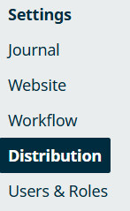
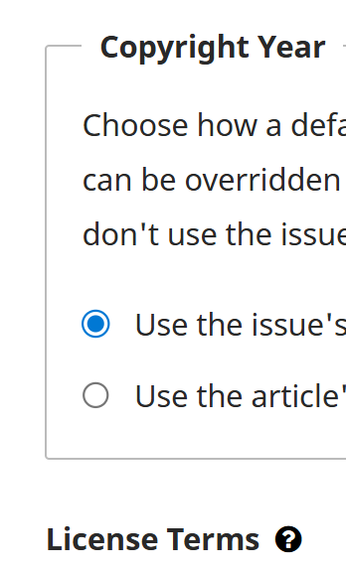
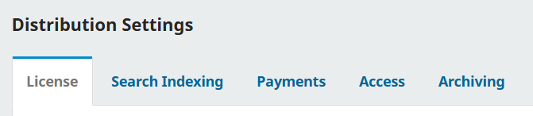
(OJS version 3.3.0.21)
Where should the copyright policy be? – Article metadata
1
2

Slide 11
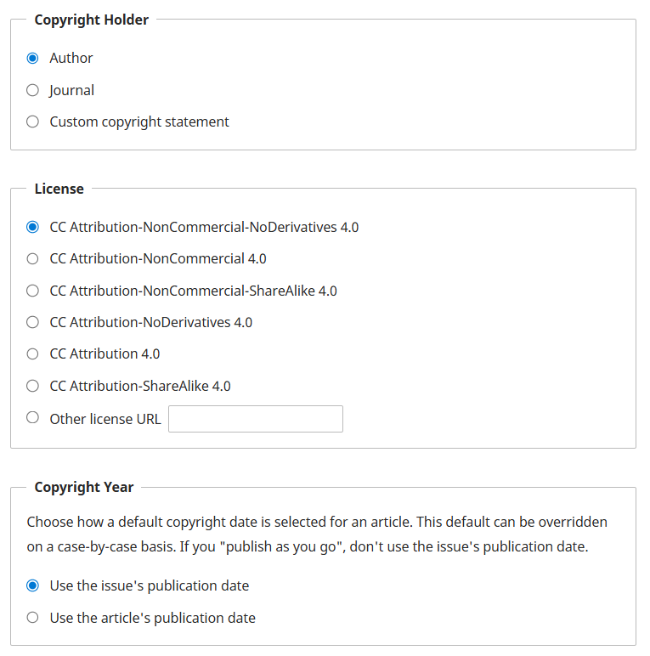
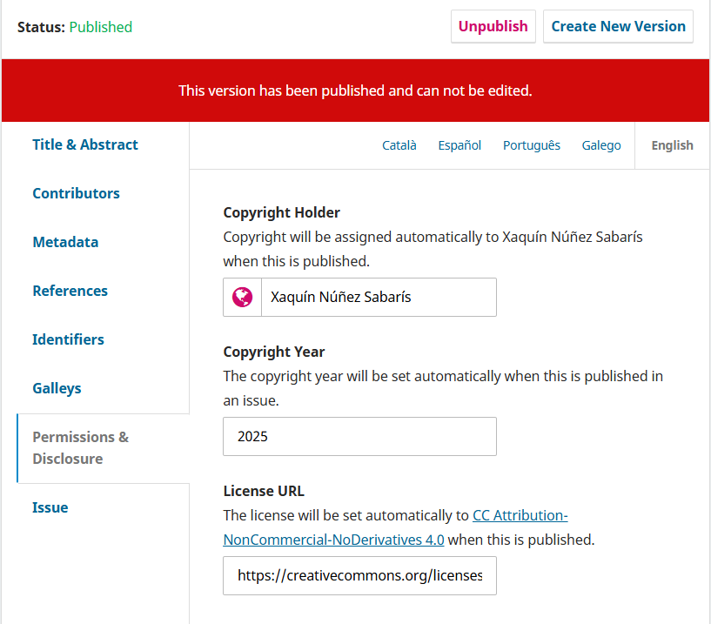
Where should the copyright policy be? – Article metadata
Distribution Settings
Submission/Publication/Permissions & Disclousure

Slide 12
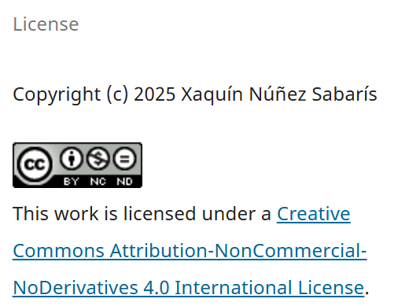
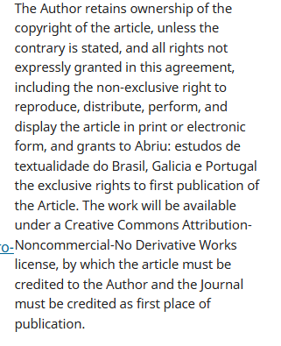
Where should the copyright policy be? – Article metadata
Distribution Settings
Submission/Publication/
Permissions & Disclousure
Copyright information displayed in the article website

Slide 13
Where should the copyright policy be? – Article metadata
Distribution Settings
Submission/Publication/
Permissions & Disclousure
Copyright information displayed in the article website
Metadata to be exported/harvested
Crossref
Native XML

Slide 14
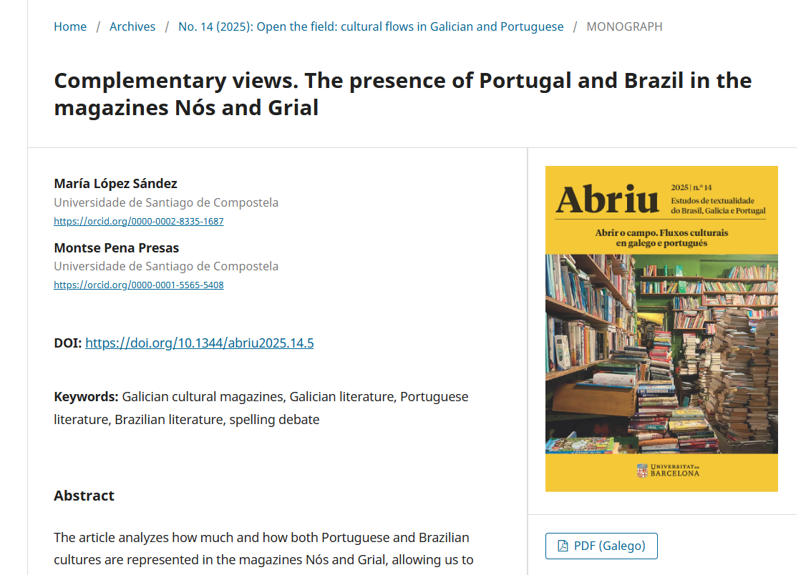
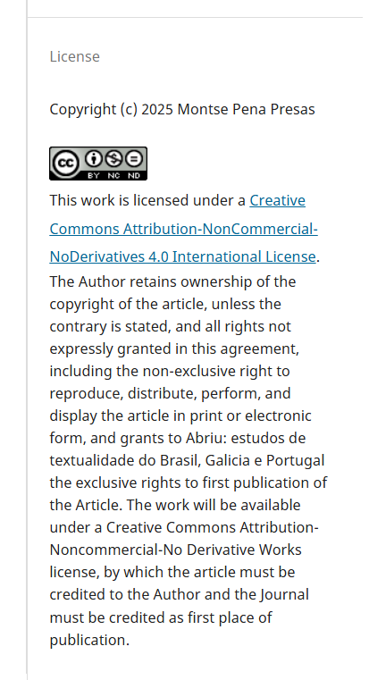
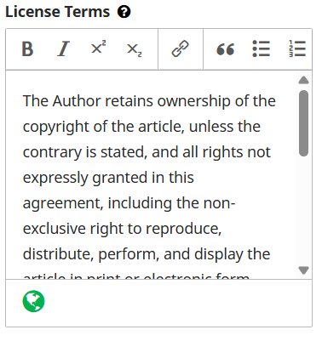
Where should the copyright policy be? – Article metadata

Slide 15
Where should the copyright policy be? – Article metadata
It does not keep attached to the article metadata, it is just displayed on the article website.
If you modify the text, it will automatically show in both current and older articles.

Slide 16

Differences between the Copyright Notice and the Licence Terms
Workflow Settings
Displayed in the submissions website
Also authors must read and accept it before sending a submission
Distribution Settings
Displayed in the article website
If your copyright policy is not very long, you may copy the same text in both fields to keep it simple.

Slide 17
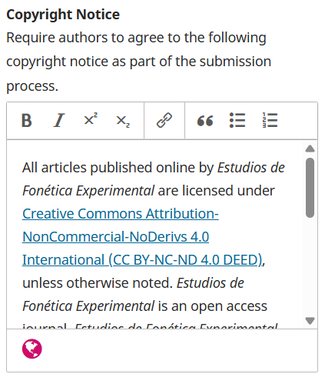
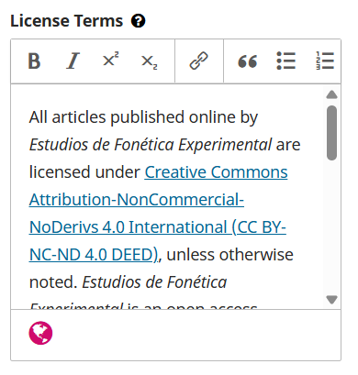

Differences between the Copyright Notice and the Licence Terms
It is advisable to mention that the full copyright statement can be found in the website
Journals with very detailed copyright description that looks too long to be included in the article website, or do not want to repeat some information of the article metadata such the licences.
Also journals that want to show other important elements from other policies in the article website, e.g. self-repository policy.

Slide 18
Where should the copyright policy be? – Article PDF
Usually, in the first page, also in the last page, or in all the pages.
It is preferable that all the copyright key elements (copyright holder, license, year of publication) are close to each other, al least once in the article.
Style freedom, they can be logos, links, shorter or larger information.
In advanced copyediting, it could also be included in the PDF metadata.

Slide 19

Where should the copyright policy be? – Article PDF
Copyright holder + year
© Name surname, year.
John Smith and Jane Smith, 2024
© Authors, 2023
© Journal or institution, year.
© Universtat de Barcelona, 2023
© Journal of EIFL webinars, 2025

Slide 20
Where should the copyright policy be? – Article PDF
Copyright holder + year
© Name surname, year.
John Smith and Jane Smith, 2024
© Authors, 2023
© Journal or institution, year.
© Universitat de Barcelona, 2023
© Journal of EIFL webinars, 2025
Copyright symbol,
it is OK to use for works with Creative Commons
Creative Commons logo,
few journals use it
To save time in copyediting
We prefer mentioning the institution
instead of the journal for rights management

Slide 21
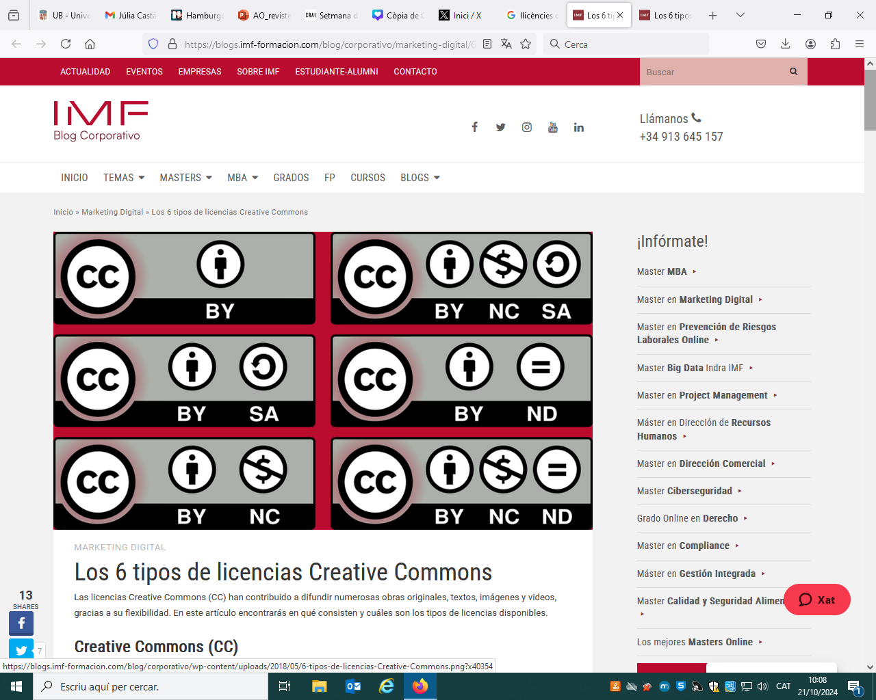
Where should the copyright policy be? – Article PDF
License
CC-BY-NC
Llicència Creative Commons Atribució, CC-BY 4.0.
Creative Commons CC BY-NC-ND 4.0 DEED
Attribution-NonCommercial-NoDerivs 4.0 International
https://creativecommons.org/share-your-work/cclicenses/

Slide 22

Where should the copyright policy be? – Article PDF
Creative Commons CC BY-NC-ND 4.0 DEED
Attribution-NonCommercial-NoDerivs 4.0 International
License
CC-BY-NC
The current CC version is 4.0
Creative Commons License Attribution, CC-BY 4.0.
Short is OK
Provide the specific link of the license,
the canonical link in english
Logos,
or logos + links
or logos + links+ text
https://creativecommons.org/licenses/by/4.0/
or the link in your language
https://creativecommons.org/licenses/by/4.0/deed.es
https://creativecommons.org/share-your-work/cclicenses/
The 6+1 Creative Commons license can be found here

Slide 23

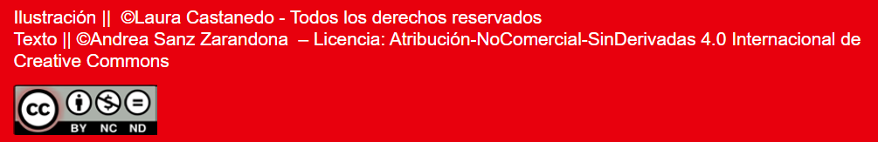

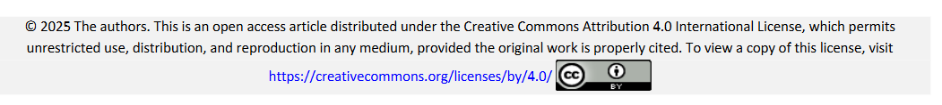
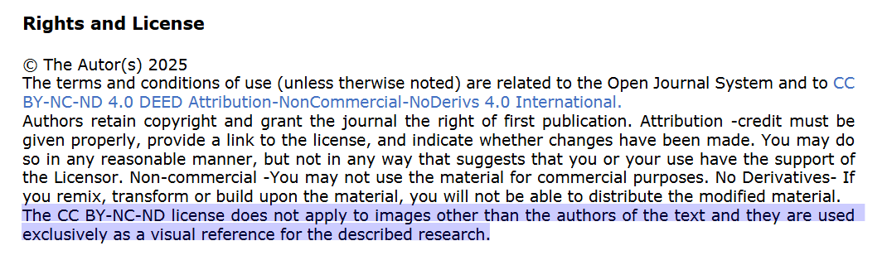
Where should the copyright policy be? – Article PDF
Examples

Slide 24
Does the current copyright policy of the journal applies to all the published issues?
Maybe yes, if the journal was born with this copyright policy.
Or maybe not, if the journal does not have a clear copyright policy since the first issue, or if the journal have changed it through time.
It is not correct nor legal to apply a new copyright policy to older issues retrospectively.

Slide 25
Why is important to know the previous copyright policy?
To reflect the truth and avoid giving misleading information.
Because authors, librarians and all the people have to know what can they do with they older articles, for example to deposit them in their institutional repositories.
Because journals have to know which issues can be indexed in commercial databases with the full text copied.
Because some repositories such as DOAJ requires a very clear copyright policy.
In older journals that are already in OJS, to correct copyright metadata errors.
In new journals that are born/are about to be migrated to OJS, to avoid correcting errors in the future.

Slide 26
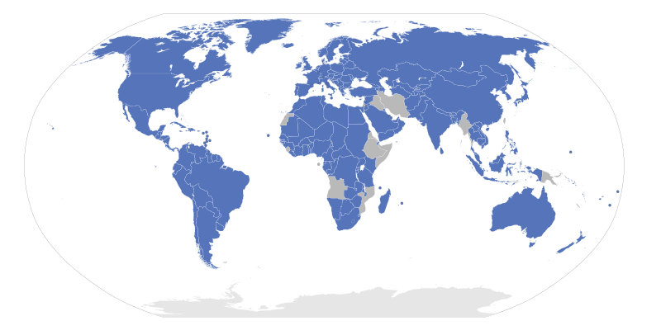
What if a journal does not have a stated copyright policy?
Then the national copyright law of the journal country will apply,
and it is highly probably that is based on the Berne Convention.
In Spain, and many other countries,
the default copyright is
that authors are the copyright holders
and the works have all rights reserved.
Countries that signed the Berne Convention

Slide 27
How can I know the previous copyright policy of the journal?
Revising the older journal issues
  The PDFs of some articles of each issue
  The paratexts of the issues (cover, initial or final information), if any
  Paper journal version
Revising the previous information in the journal website
Revising internal documentation

Slide 28

How can I know the previous copyright policy of the journal?
Revising the older journal issues
Revising the previous information in the journal website in Internet Archive – WayBack Machine https://web.archive.org/
Revising internal documentation

Slide 29
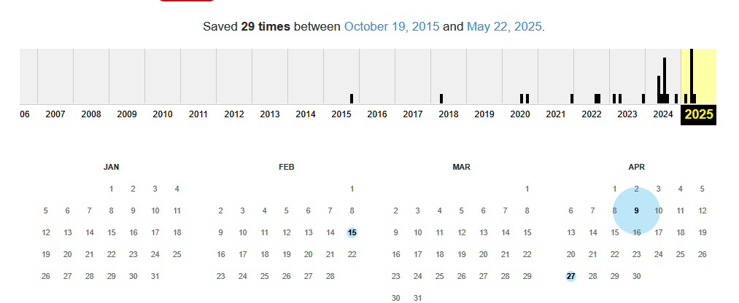

Slide 30
How can I correct copyright policy/information?
Modifying the Copyright Notice (in Worfklow/Submission/Author Guidelines) for the text that appear in the Submission public website, that is also the same text that authors must read and accept it before sending a submission.
Modifying the License Terms (in Distribution/License) for the text that appears in each article website.
It is very common error that the Copyright Notice and the License Terms does not align, or they do not show enough information.
The information on the website is easier to change than the metadata.

Slide 31
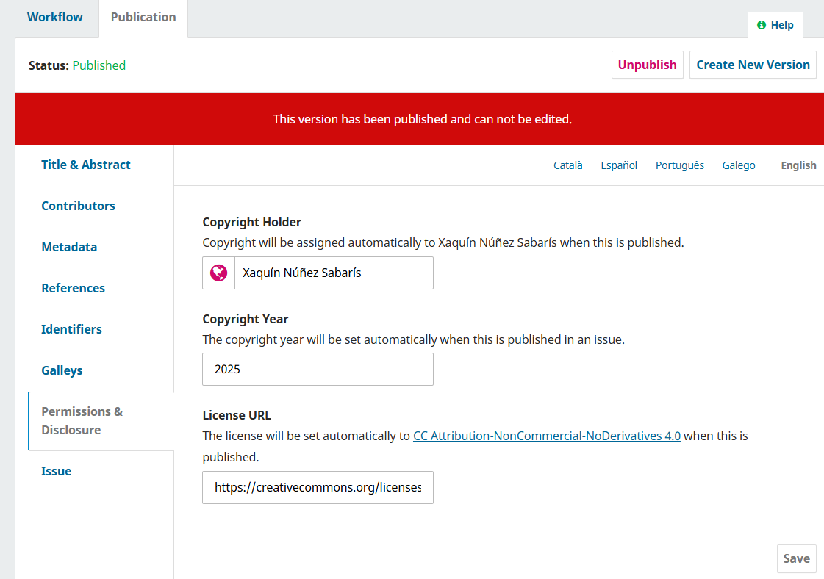
How can I correct copyright metadata? - manually
If there are few mistakes and/or you do not have an IT team or IT knowledge about OJS, you can correct it manually.
You have to go article by article,
in the publication tab of the article submission,
unpublish it,
click in the Permissions & Disclousure tab,
modify the copyright metadata,
click save and
publish it again in “Schedule for Publication”

Slide 32
How can I correct copyright metadata? - manually
It could help you if you temporally modify the copyright metadata settings in Distribution/License, so they can match the copyright policy for older articles. Do not forget to change it back when you have finished to edit old articles.
Sometimes it helps to refresh the navigator.
You might need to erase the copyright holder content in all the language fields, to be able to apply the new metadata settings.

Slide 33
How can I correct copyright metadata? - manually
If you changed the language options over time, and deleted a language in the language setup, you could have “ghost fields”, language fields that exist but you can not see or access. All the fields are in blank but the system detects that they are not completely empty, so the new copyright holder setup can not be applied.
You can resolve it modifying temporally the language setup (Website/Setup/Languages), adding languages in the column “Forms”, until you find which one was missing.
After deleting the information in the ghost field, you can save the new metadata, and put the language setup back of how it was.

Slide 34
How can I correct copyright metadata? – semi-automatic
This is a good option when you have a lot of metadata to correct and if you have an IT team or IT knowledge about OJS.
Search and extract data from OJS database.
Our IT team uses MySQL Workbench https://www.mysql.com/products/workbench/
2. Export these data to a format that editors/librarians can manage.
Our IT team exported to CSV and then they converted into and xlsx file (Excel).
3. Editors/Librarians assign new copyright metadata in the file.
4. The IT team convert the file to CSV again, and use a PHP script to read and rewrite the new data in the OJS database.

Slide 35
MySQL instruction for extract the copyright metadata file
select s.submission_id,s.current_publication_id publication_id,
i.volume,coalesce(i.number,'') number,i.year,
pst.titol,
coalesce(aa.autors,'') autors,
coalesce(psy.copyrightyear,'') copyrightyear_actual,
coalesce(psh.copyrightholder,'') copyrightholder_actual,
coalesce(psl.licenseurl,'') licenseurl_actual
from submissions s
left join publication_settings psi on s.current_publication_id=psi.publication_id
left join issues i on psi.setting_value=i.issue_id
left join (select publication_id,replace(group_concat(distinct setting_value separator '|'),'"','""') titol from publication_settings where setting_name='title' and setting_value>'' group by publication_id) pst on s.current_publication_id=pst.publication_id
left join (select publication_id,group_concat(distinct setting_value separator '|') copyrightholder from publication_settings where setting_name='copyrightholder' and setting_value>'' group by publication_id) psh on s.current_publication_id=psh.publication_id
left join (select publication_id,group_concat(distinct setting_value separator '|') copyrightyear from publication_settings where setting_name='copyrightyear' and setting_value>'' group by publication_id) psy on s.current_publication_id=psy.publication_id
left join (select publication_id,group_concat(distinct setting_value separator '|') licenseurl from publication_settings where setting_name='licenseurl' and setting_value>'' group by publication_id) psl on s.current_publication_id=psl.publication_id
left join (select publication_id,group_concat(distinct a separator ', ') autors from
(select a.publication_id,a.author_id,s.locale,group_concat(s.setting_value order by s.setting_name desc separator ' ') a
from authors a left join author_settings s on a.author_id=s.author_id
where s.setting_name in ('givenname','familyname') and s.setting_value>''
group by a.author_id,s.locale) aa
group by publication_id) aa on s.current_publication_id=aa.publication_id
where s.context_id=89
and psi.setting_name='issueid'
order by i.issue_id,s.submission_id;
the context_id=89 is the identification of the journal títol means title in catalan autors mean authors in catalan

Slide 36
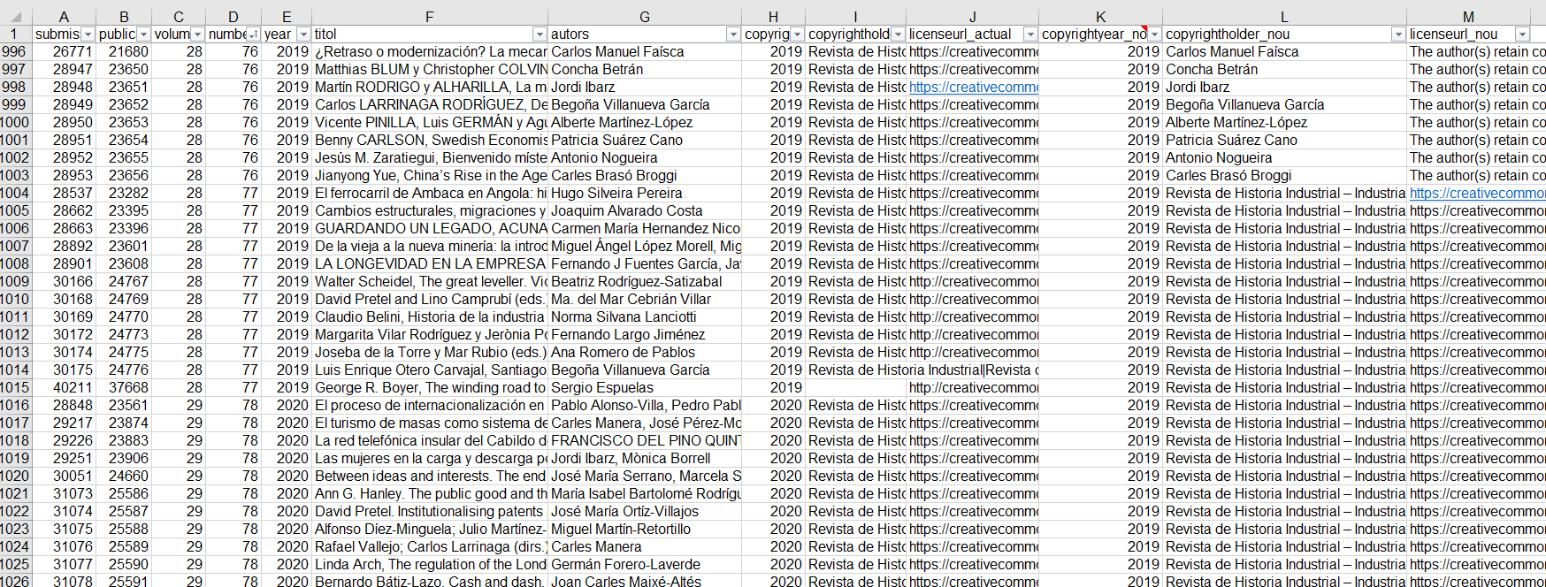
Example xlsx file
Current copyright metadata
New copyright metadata

Slide 37
PHP script to read and rewrite the new data in the OJS database
$cc = [
'copyrightYear'=>'copyrightyear_nou',
'licenseUrl'=>'licenseurl_nou',
'copyrightHolder'=>'copyrightholder_nou'
];
$insert = "insert into publication_settings(publication_id,setting_name,setting_value) values(?,?,?)";
$insertHolder = "insert into publication_settings(publication_id,locale,setting_name,setting_value) values(?,?,?,?)";
$update = "update publication_settings set setting_value=? where publication_id=? and setting_name=?";
$selectsettings = "select if(setting_name='licenseURL','licenseUrl',setting_name) setting_name,
if(setting_value>'',setting_value,'') setting_value
from publication_settings
where publication_id=? and setting_name in ('copyrightHolder','copyrightYear','licenseURL')";
$selectlocales = "select distinct locale from publication_settings where publication_id=? and setting_name='title'";
//we alway put copyrightHolder in these three locales, regardeless of the title
$locales = ['ca_ES','en_US','es_ES'];
$h = fopen('matter.csv','r');
//first line of titles
//submission_id,publication_id,number,year,titol,autors,copyrightyear_actual,copyrightholder_actual,licenseurl_actual,copyrightyear_nou,copyrightholder_nou,licenseurl_nou
$kk = fgetcsv($h,null,';');
while ($l = fgetcsv($h,null,';')) {
$l = array_combine($kk,$l);
extract($l); // publication_id,copyrightYear,copyrightHolder,licenseURL
//current data in database
$a = sql($selectsettings,[$publication_id]);
$a = array_column($a,'setting_value','setting_name');
echo '<hr>';
pre($a); // el que hi ha a la bd
pre($l); // el que hi volem posar
foreach ($cc as $c=>$cn) {
if (isset($a[$c])) {
$vv = [$l[$cn],$publication_id,$c];
echo $update;
pre($vv);
if (!$test) echo sql($update,$vv),"<br>\n";
} else {
if ($c == 'copyrightHolder') {
foreach ($locales as $locale) {
$vv = [$publication_id,$locale,$c,$l[$cn]];
echo $insertHolder;
pre($vv);
if (!$test) echo sql($insertHolder,$vv),"<br>\n";
}
} else {
$vv = [$publication_id,$c,$l[$cn]];
echo $insert;
pre($vv);
if (!$test) echo sql($insert,$vv),"<br>\n";
}
}
}

Slide 38


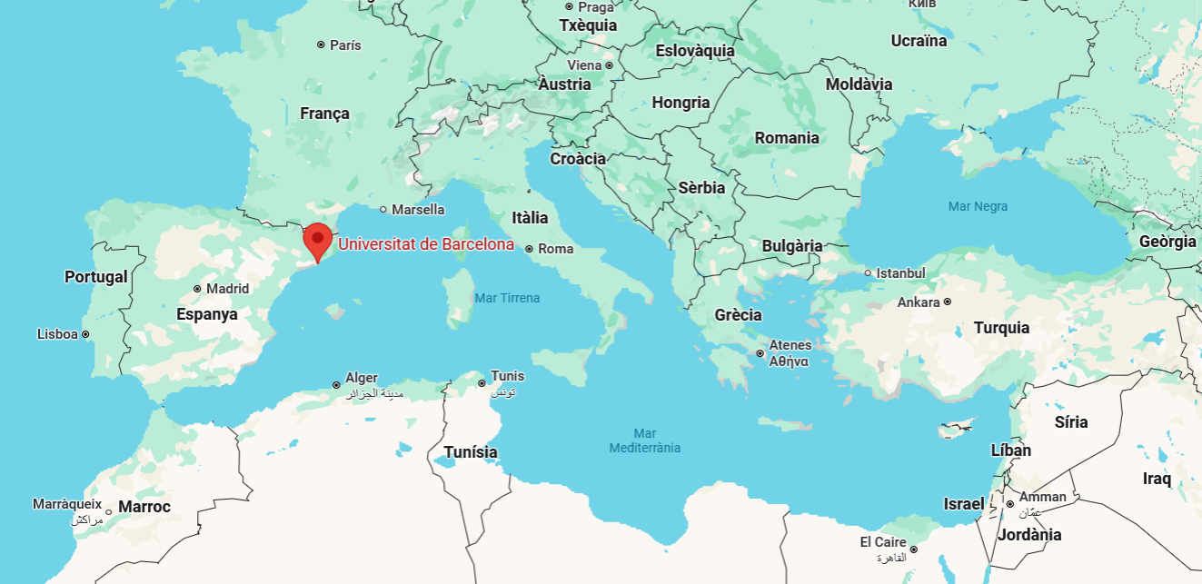


https://revistes.ub.edu
Journals
67
2
28
2

Slide 39
67
Differences
Similarities
Journals choose their copyright policy
  Different Creative Commons licences
  Different copyright holders (authors/journal)
New and old journals
  Newer journals, born digital
    Usually, copyright policy since birth
  Older journals, born in paper or other websites
    Usually, unclear copyright in the first years, and copyright policy implemented later
Others
(edited/coedited, hosted in RCUB/not hosted, subjects, indexation, organisation, author guidelines, periodicity, layout and appearance, etc.)
https://hdl.handle.net/2445/186099
UB regulation about journals
  Creative Commons licence
  A clear copyright policy
    in website, articles and PDF
  Other minimum quality standards
  (peer review, editorial board composition, metadata, author instructions, linguistic requirements, etc.)
Texts models for Copyright and Open Access policies in Catalan, Spanish and English
https://hdl.handle.net/2445/219267

Slide 40

Thank you!
Moltes gràcies!
revistesub@ub.edu
© CRAI Universitat de Barcelona, 2025

