Slide 1
RESEARCH DATA MANAGEMENT SERVICES IN ACADEMIC LIBRARIES
Iryna Kuchma, Open Access Programme Manager
Attribution 4.0 International

Slide 2
Key issues involved in managing research data and the overall benefits in following best practice in this area

Slide 3
How to manage and share research data, including data protection and ethics, open licensing, FAIR data

Slide 4
Takeaways
Understand which data researchers can make open and which need to be protected
Understand the FAIR data principles
Be able to select which data to keep and find an appropriate repository for them
Understand funder requirements

Slide 5
Takeaways (2)
Understand what personal data are and how researchers can protect them, what to consider when developing consent forms, how to store data securely and how to anonymize data
Understand how to re-use data and know how to select the appropriate license for research data
Understand research data management for basic quality assurance, replicability and reusability
Learn tips on how to get maximum impact from research data

Slide 6
Image courtesy of http://aukeherrema.nl CC-BY

Slide 7
Researchers training outline
Why data management is important. Discuss the efficiencies and the drivers (micro / macro)
Data organization, documentation and metadata
Data storage and back-up
Legal and ethical requirements
FAIR data principles, data sharing and re-use
Long-term preservation
Data management responsibilities

Slide 9
Definition of Open Data
Open Data are online, free of cost, accessible data that can be used, reused and distributed provided that the data source is attributed.
Notes:
FOSTER taxonomy definition of Open Data

Slide 10
Tip – use 5 Star Open Data Model to explain FAIR
make your stuff available on the Web (whatever format) under an open license
make it available as structured data (e.g., Excel instead of image scan of a table)
make it available in a non-proprietary open format (e.g., CSV instead of Excel)
use URIs to denote things, so that people can point at your stuff
link your data to other data to provide context
Tim Berners-Lee’s proposal for five star open data - http://5stardata.info
Notes:
Tim Berners Lee’s 5 star open data model may provide a more user friendly way for researchers to think about being FAIR.
The 5 star data website offers a quick and user friendly overview of how to implement each level of open data with an example of a table from a pdf paper.

Slide 11
Why should you be open?
Image by wonderwebby CC-BY-NC-SA www.flickr.com/photos/wonderwebby/2723279491
Notes:
I will focus on reasons why researchers should be open – specifically the benefits and rewards

Slide 12
It’s part of good research practice
Notes:
I like the quote from Ewan Birney that it was never acceptable to publish papers without making data available. If you can evidence and validate your findings, how do others know that they’re right?

Slide 13
Cut down on academic fraud
www.nature.com/news/2011/111101/full/479015a.html
Notes:
Sharing data also cuts down on academic fraud. You’ve probably come across the case of Diederik Stapel – a former professor of social psychology at Tilberg University in the Netherlands. He had literally been making up data to support his hypotheses and various headlines had been picked up by the media e.g. meat eaters are more selfish than vegetarians. Some students questioned the results and the whole story unravelled, showing this had been going on for years. What’s troubling is that this had gone unnoticed. The data weren’t made available and checked, so such a history of fraud could develop.

Slide 14
Validation of results
“It was a mistake in a spreadsheet that could have been easily overlooked: a few rows left out of an equation to average the values in a column.
The spreadsheet was used to draw the conclusion of an influential 2010 economics paper: that public debt of more than 90% of GDP slows down growth. This conclusion was later cited by the International Monetary Fund and the UK Treasury to justify programmes of austerity that have arguably led to riots, poverty and lost jobs.”
www.guardian.co.uk/politics/2013/apr/18/uncovered-error-george-osborne-austerity
Notes:
The validation of results is key. This article references an inadvertent error in a economics paper by Reinhadt and Rogoff. Missing some rows out of an average gave drastically different results – what was published suggested that countries with 90% debt ratios see their economies shrink by 0.1%. Instead, it should have found that they grow by 2.2% – less than those with lower debt ratios, but not a spiralling collapse. This mistake wasn’t picked up on initially as the data hadn’t been shared. The mistake fed into government policy - the findings of this paper were used as justification for austerity measures in the UK and various other countries in the EU.

Slide 15
More scientific breakthroughs
“It was unbelievable. Its not science the way most of us have practiced in our careers. But we all realised that we would never get biomarkers unless all of us parked our egos and intellectual property noses outside the door and agreed that all of our data would be public immediately.”
Dr John Trojanowski, University of Pennsylvania
www.nytimes.com/2010/08/13/health/research/13alzheimer.html?pagewanted=all&_r=0
Notes:
Certain research communities have also seen the benefit of sharing data as it speeds up the process of discovery. This article shows how researchers in the field of Alzheimer’s research have agreed as a community to share data immediately to make scientific breakthroughs.

Slide 16
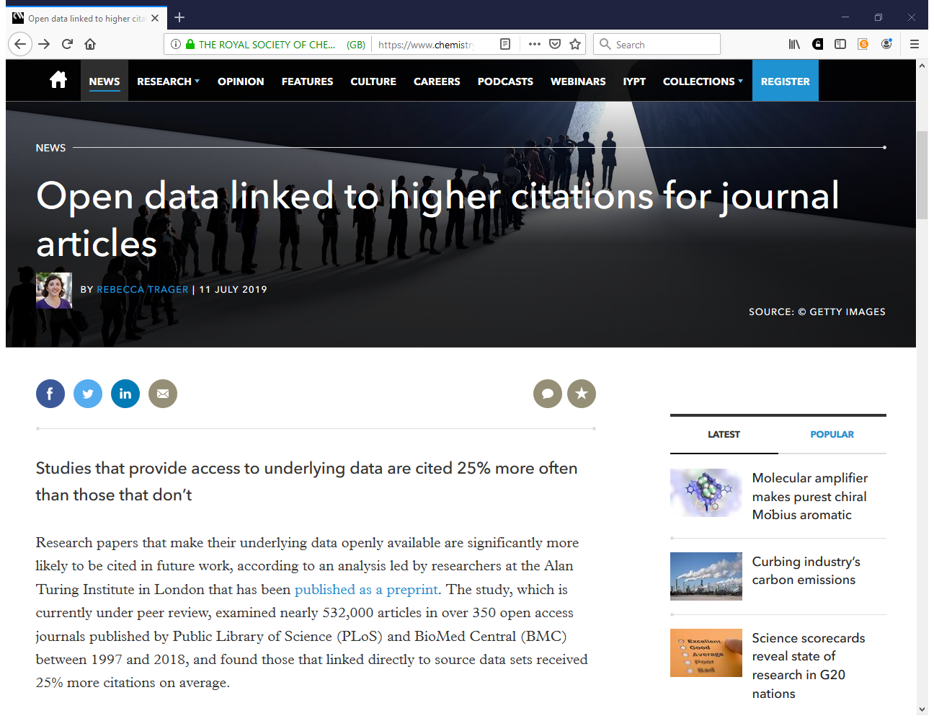
https://www.chemistryworld.com/news/open-data-linked-to-higher-citations-for-journal-articles/3010723.article

Slide 17
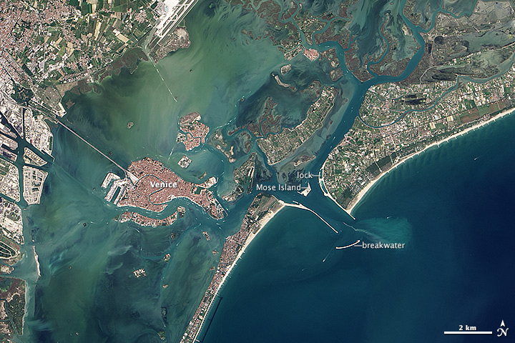
Increased use and economic benefit
The case of NASA Landsat satellite imagery of the Earth’s surface:
Up to 2008
Since 2009
Sold through the US Geological Survey for US$600 per scene
Sales of 19,000 scenes per year
Annual revenue of $11.4 million
Freely available over the internet
Google Earth now uses the images
Transmission of 2,100,000
scenes per year.
Estimated to have created value for the environmental management industry of $935 million, with direct benefit of more than $100 million per year to the US economy
Has stimulated the development of applications from a large number of companies worldwide
http://earthobservatory.nasa.gov/IOTD/view.php?id=83394&src=ve
Notes:
There’s also an economic benefit, as seen by the case of the NASA landsat satellite images. These were sold until 2008 for $600 a scene. Now they’re freely available and used by Google Earth. Previously they sold 19,000 images a year, whereas now they transmit 2.1 million. The revenue has gone up incredibly too from $11.4 million to an estimated value of $935 million with direct benefit of more than $100 million. The release has also stimulated the development of applications from companies worldwide.
This case study comes from the Royal Society Report on Science as an Open Enterprise.

Slide 18
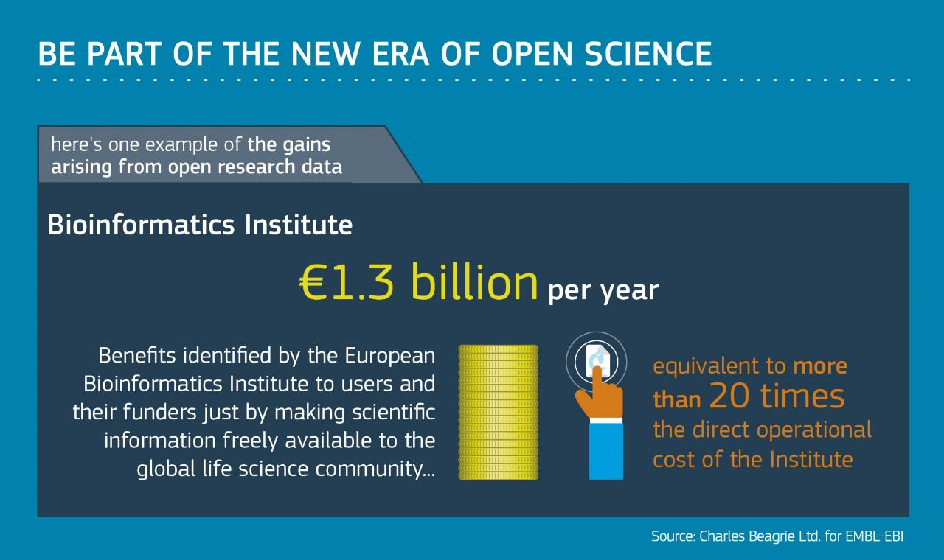

Slide 20
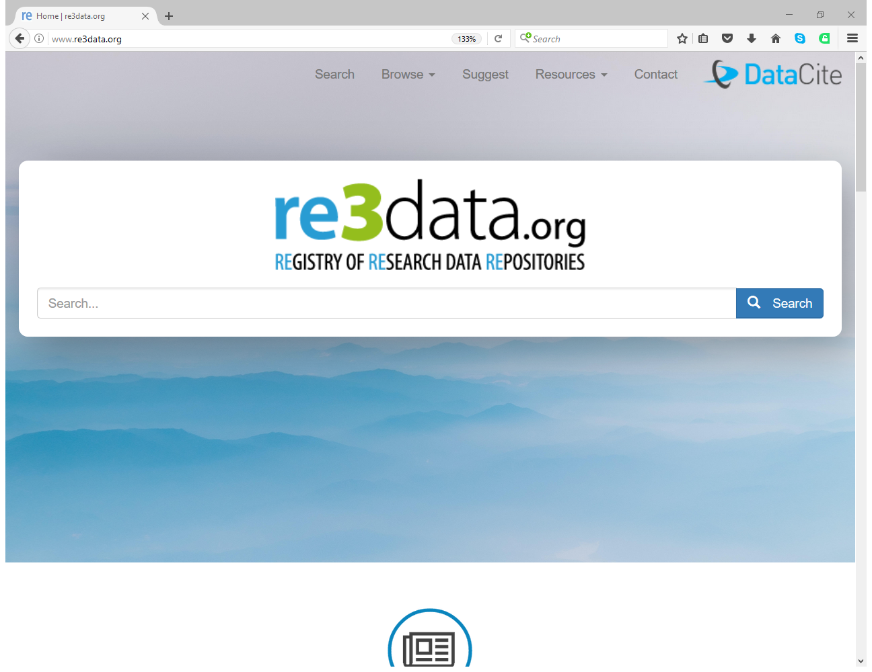

Slide 21
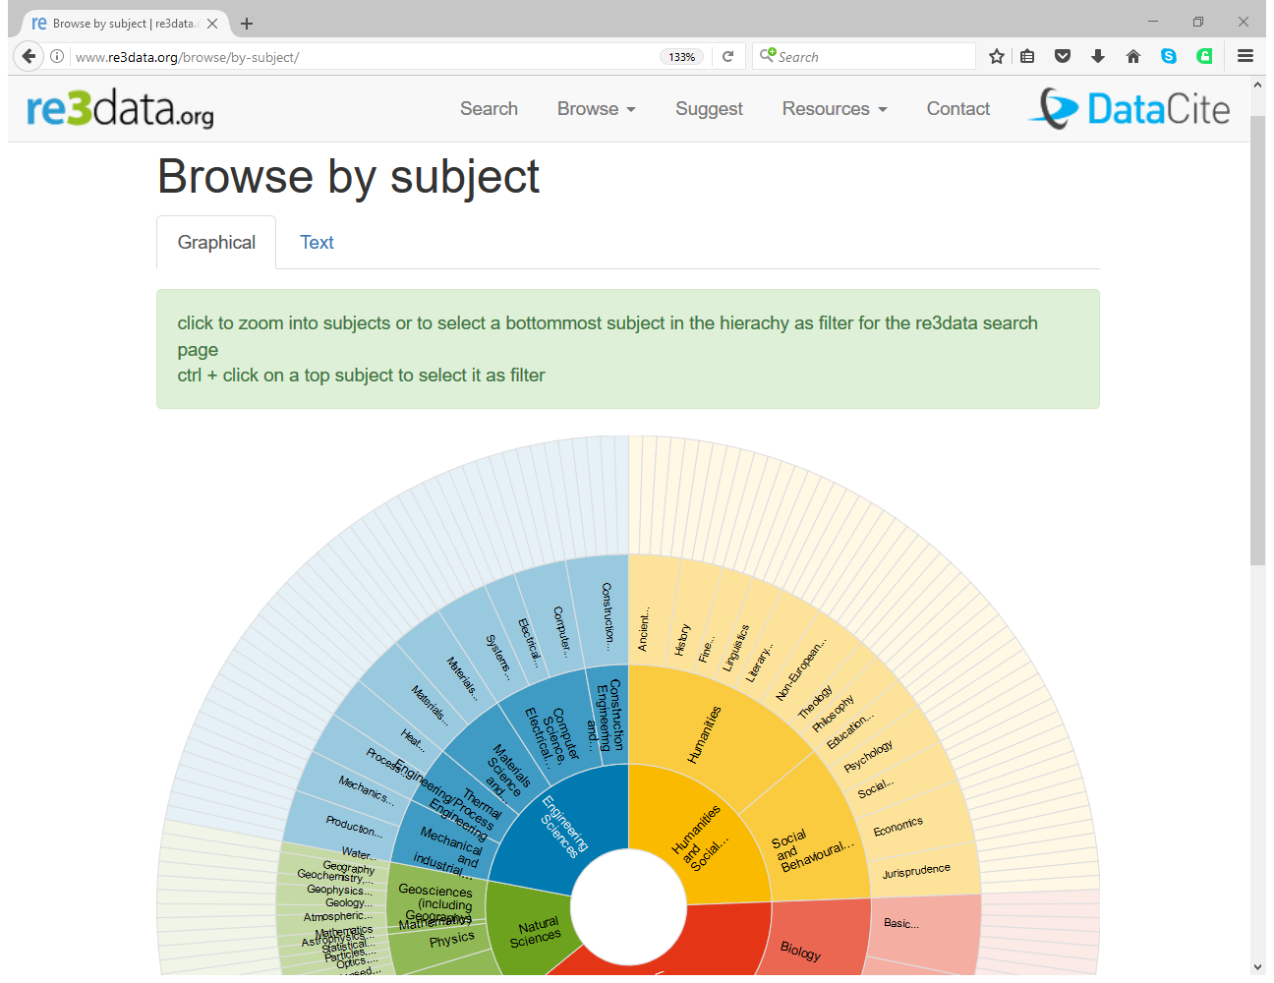

Slide 22
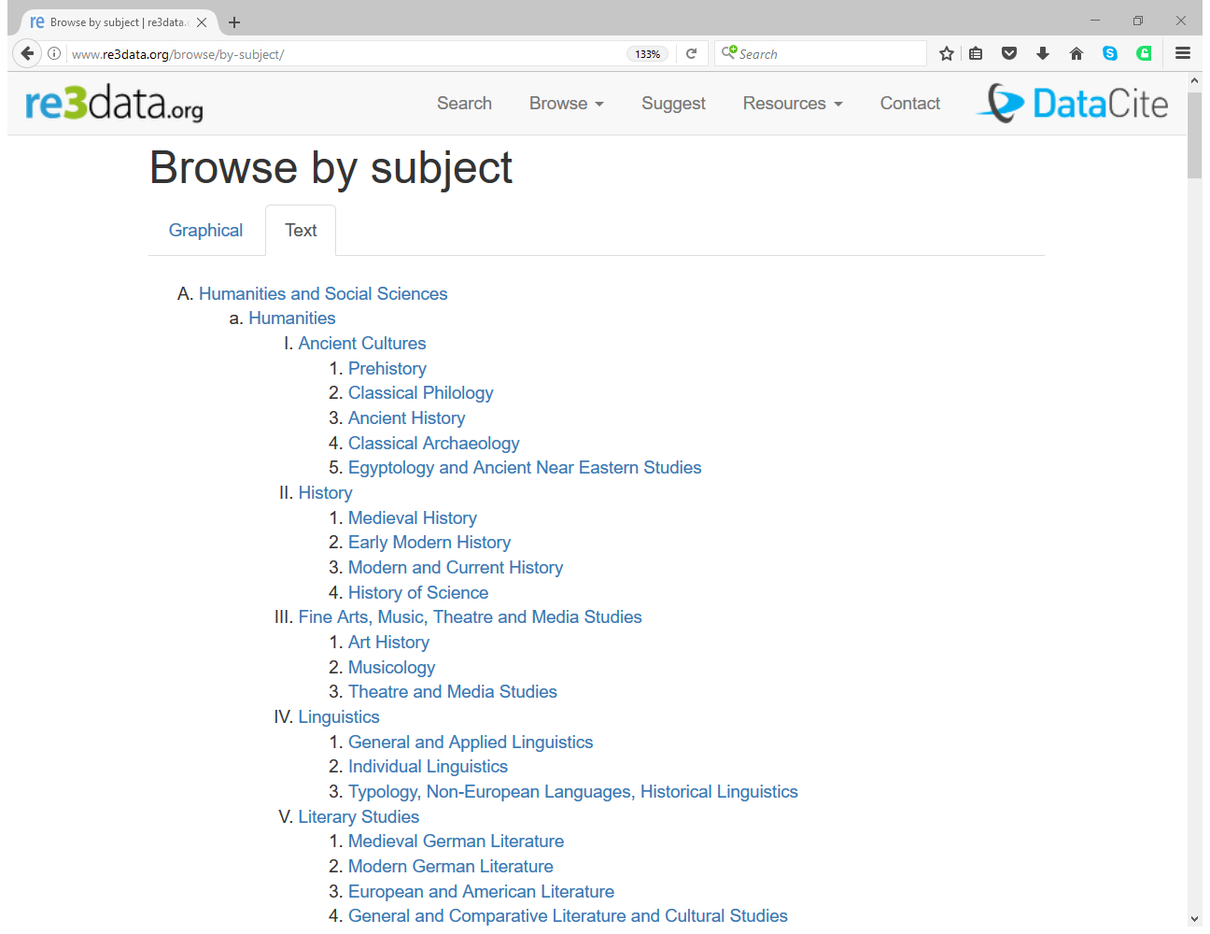

Slide 23
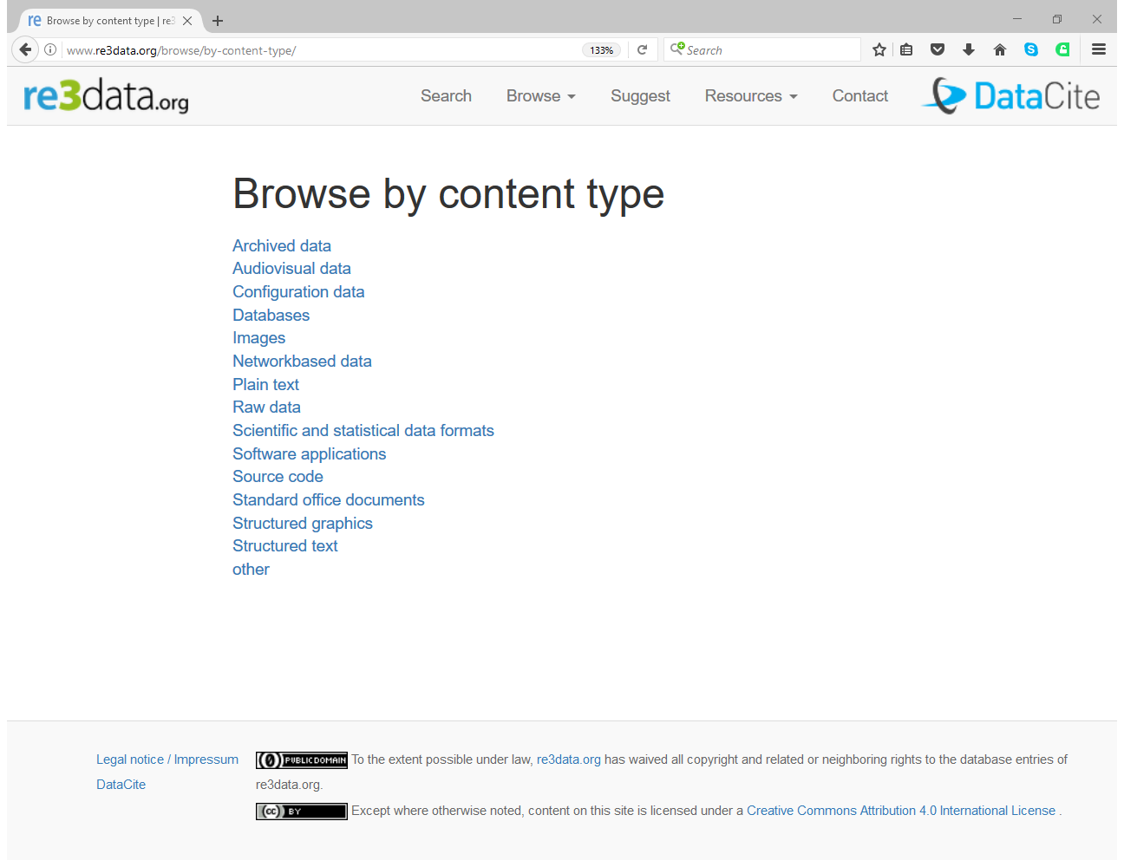

Slide 24
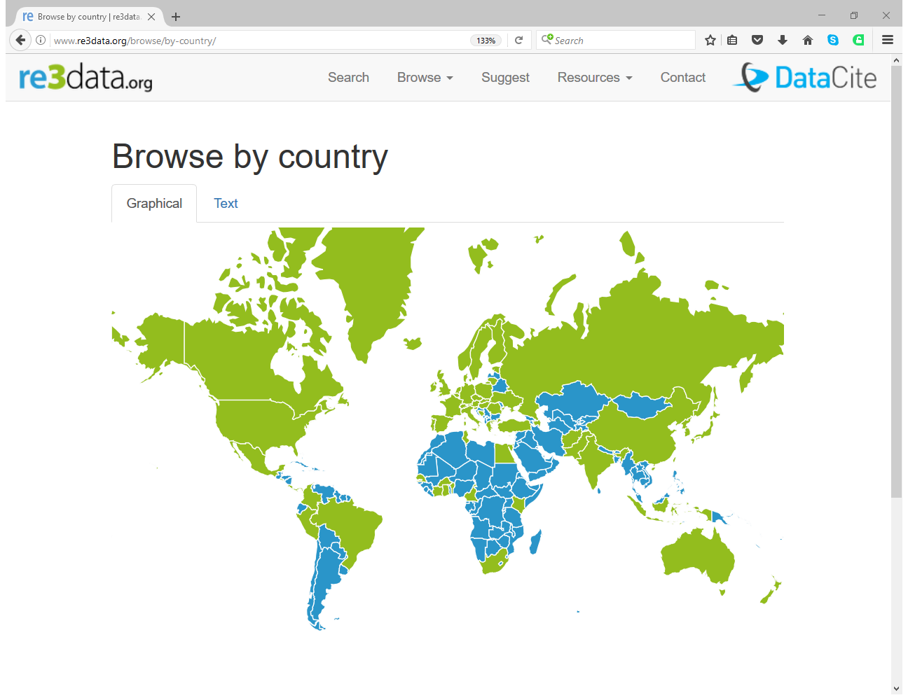

Slide 25
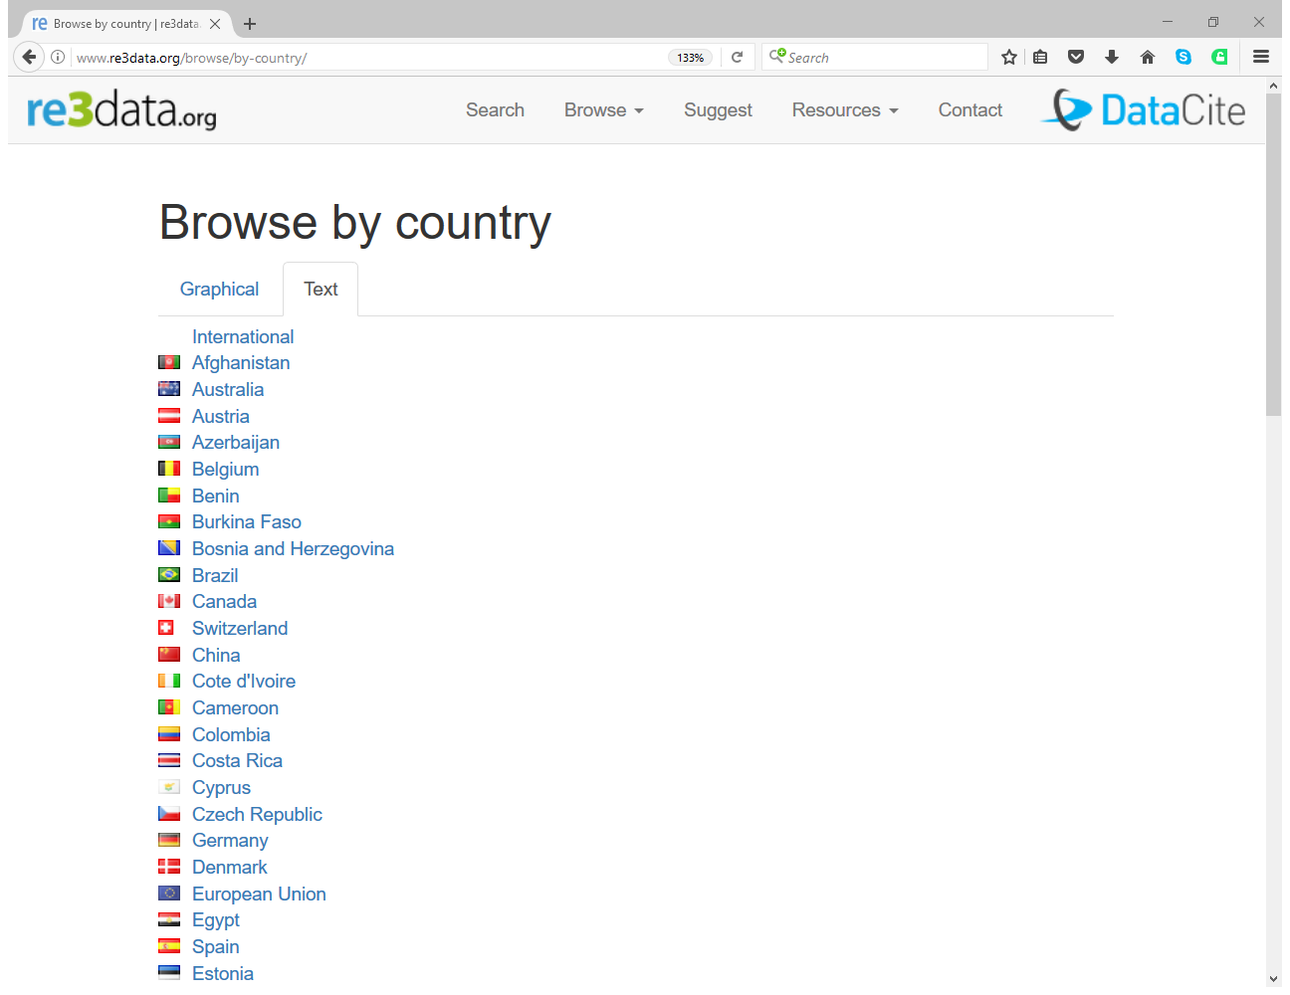

Slide 26
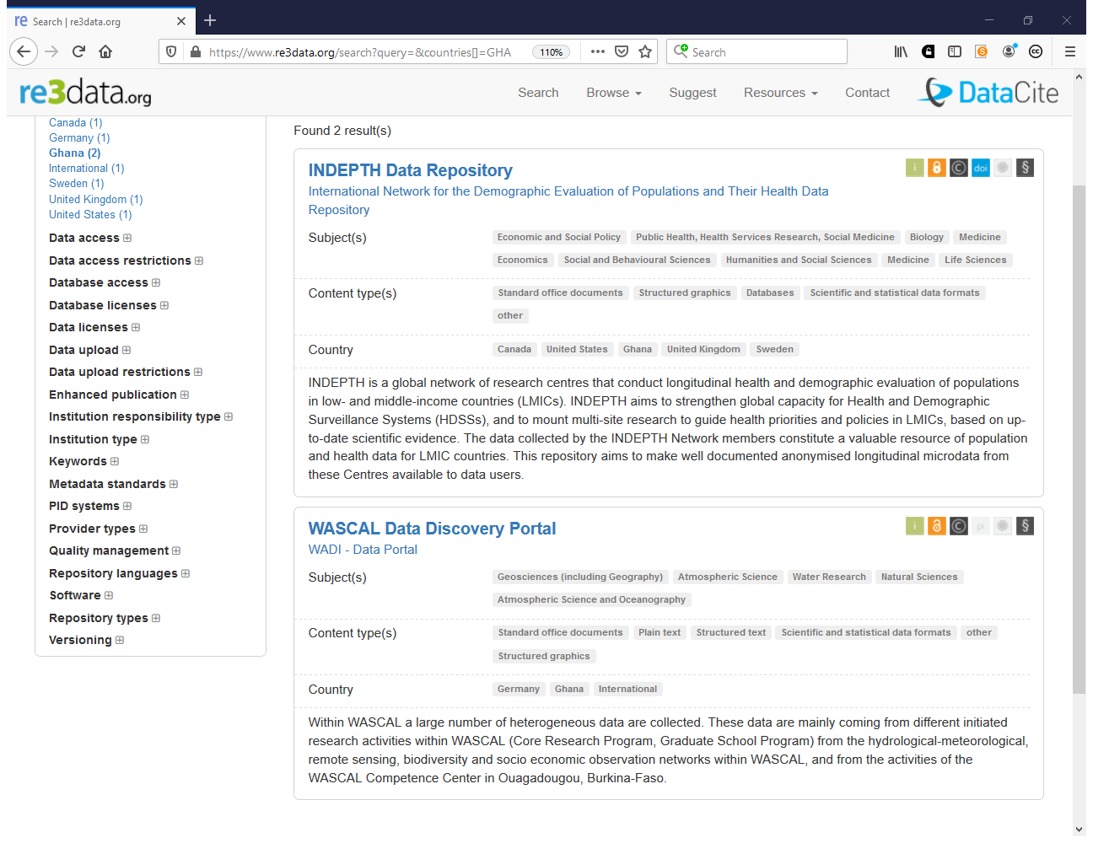

Slide 27
Open Data doesn’t just happen - data management planning helps!
What data will be created (format, types, volume...)
Standards and methodologies to be used, documentation
How ethics and Intellectual Property will be addressed
Plans for storage and back-up
Plans for data sharing and access
Strategy for long-term preservation
Create
Document
Use
Share
Preserve
Store
Notes:
Not true! Decisions made early on can make sharing your data very difficult (i.e., consent, cleaning, etc.). Data management planning at the start of your project can help.
What is a Data Management Plan (dmp)? Essentially, most funders just want evidence at the grant stage that data has been considered – how much will be generated? Usually just a 1-2 page summary covering the expected data to be produced through research along with an idea of what might be shared and how and when it will be shared.
It is important to stress that funders aren’t expecting something carved in stone at this stage. Projects often change quite radically from what is submitted at the proposal stage and this is ok. Researchers just need to be able to provide evidence that they have thought about the data they might be generating and how it will be managed and shared.
DMPs are often submitted as part of grant applications, but are useful whenever you’re creating data. Some HEIs are introducing policies that require DMPs for all research undertaken by staff – whether externally funded or not.

Slide 28
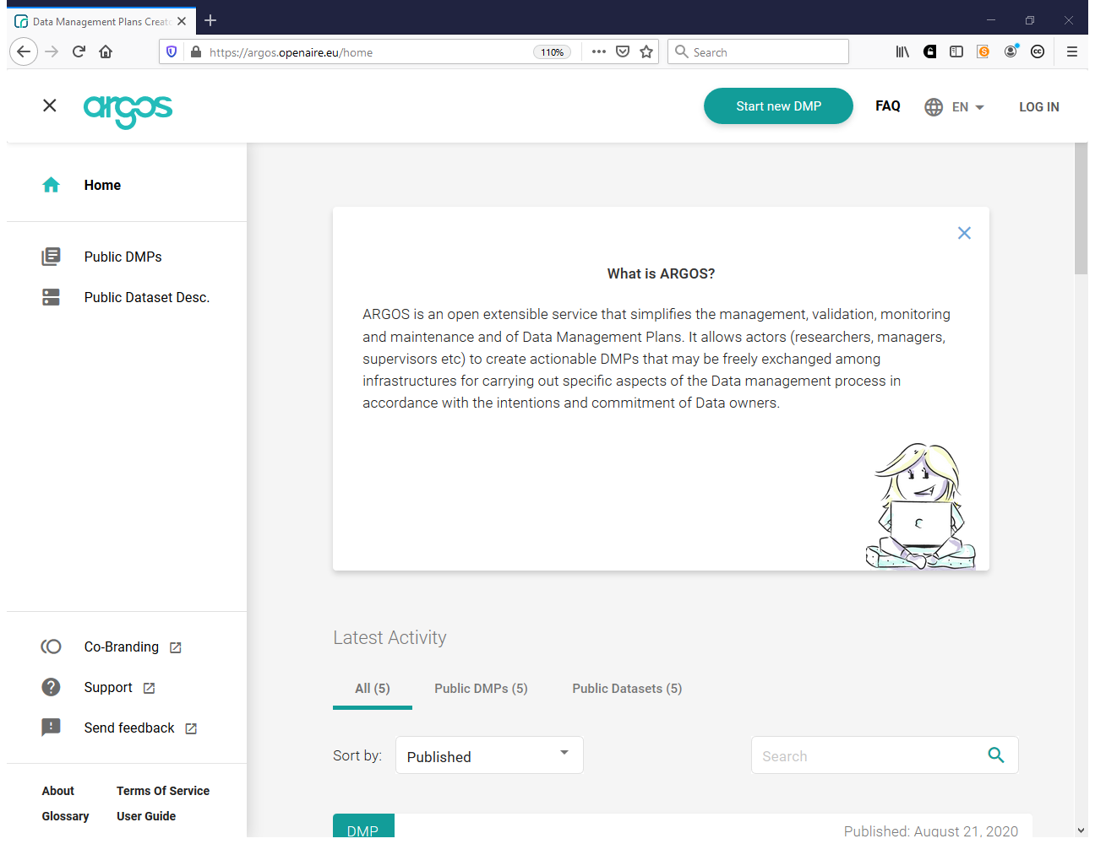
https://argos.openaire.eu

Slide 29
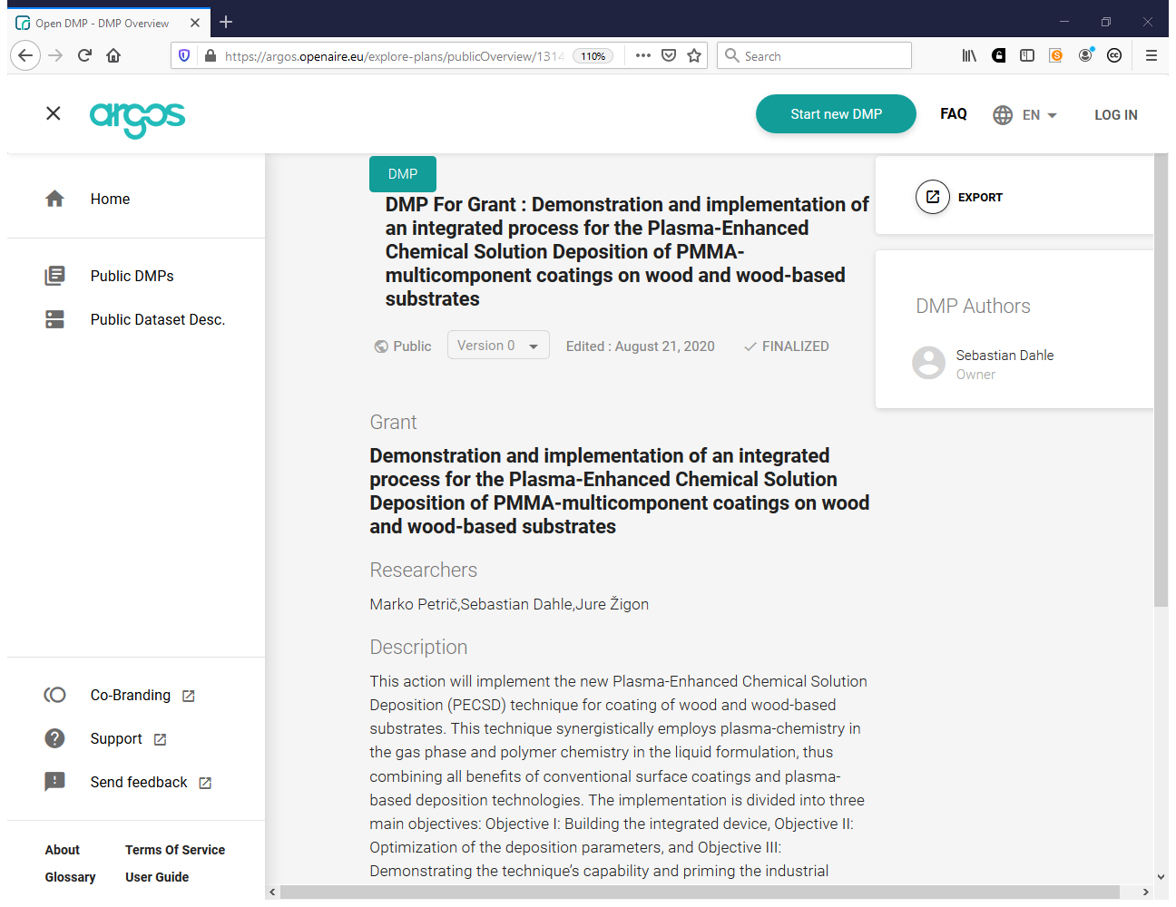

Slide 30
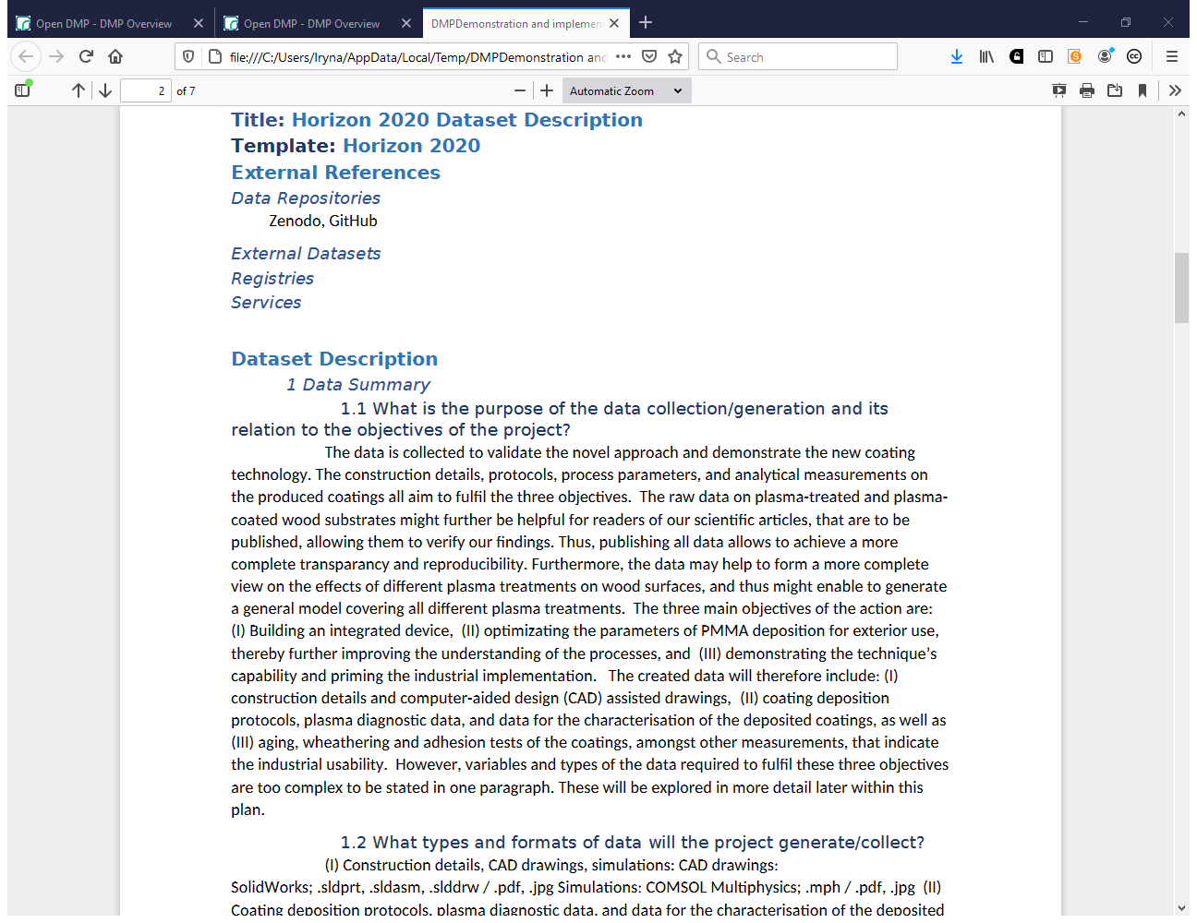

Slide 31
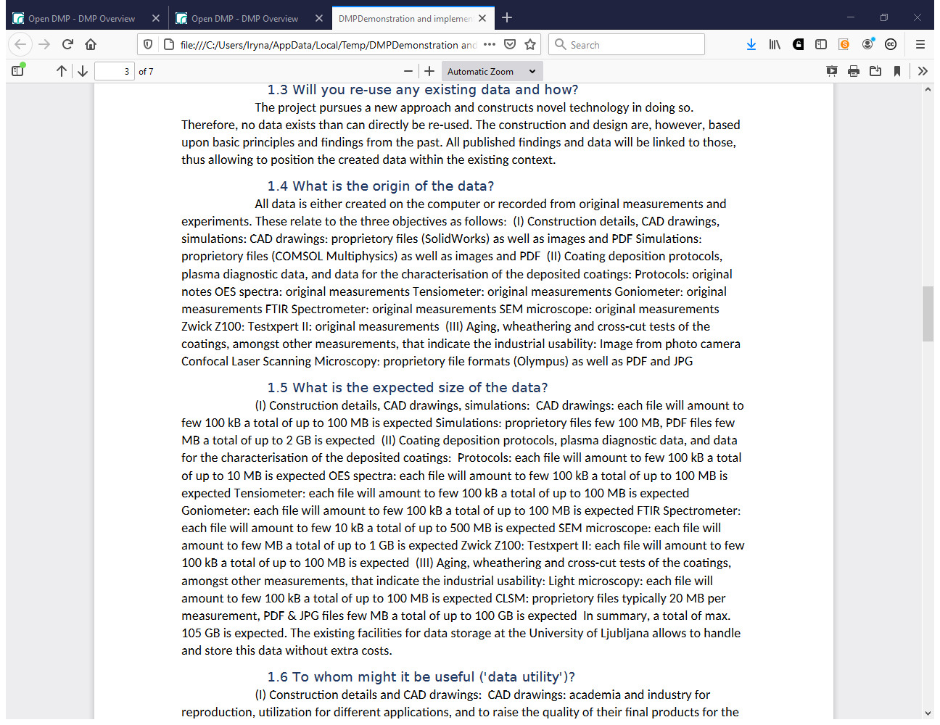

Slide 32
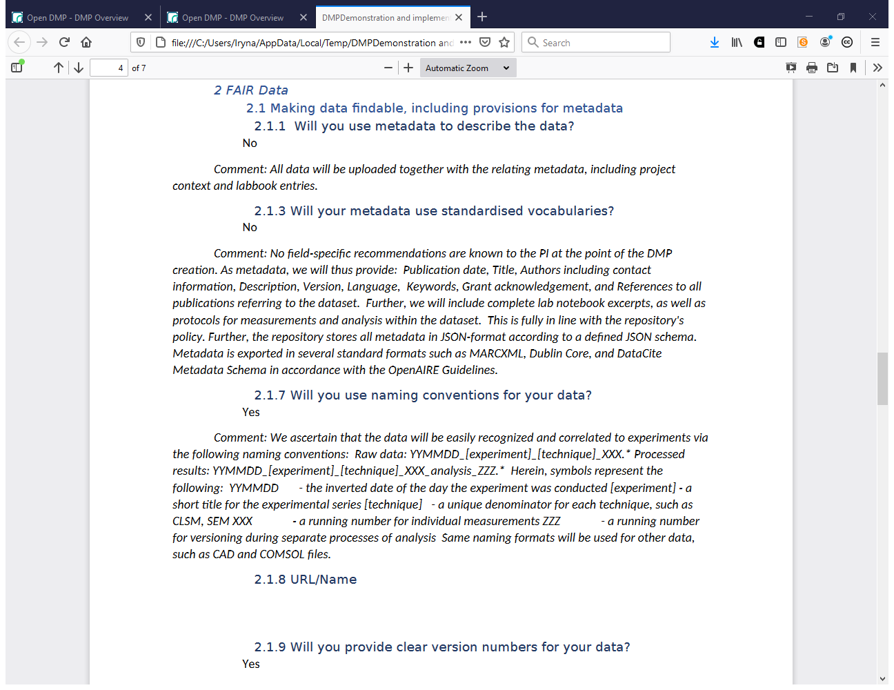

Slide 33
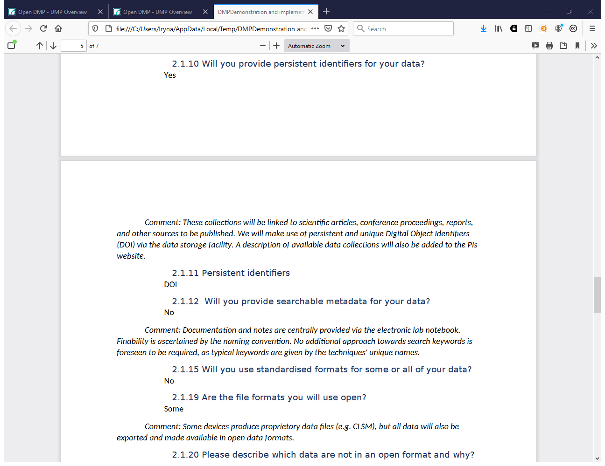

Slide 34
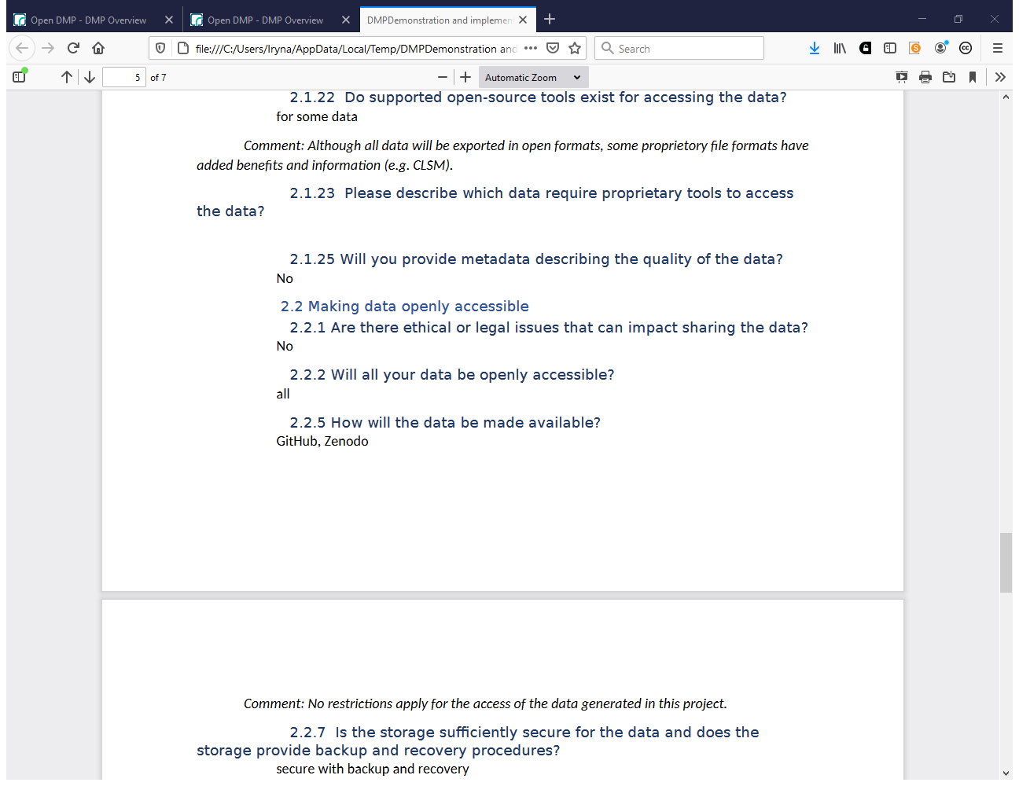

Slide 35
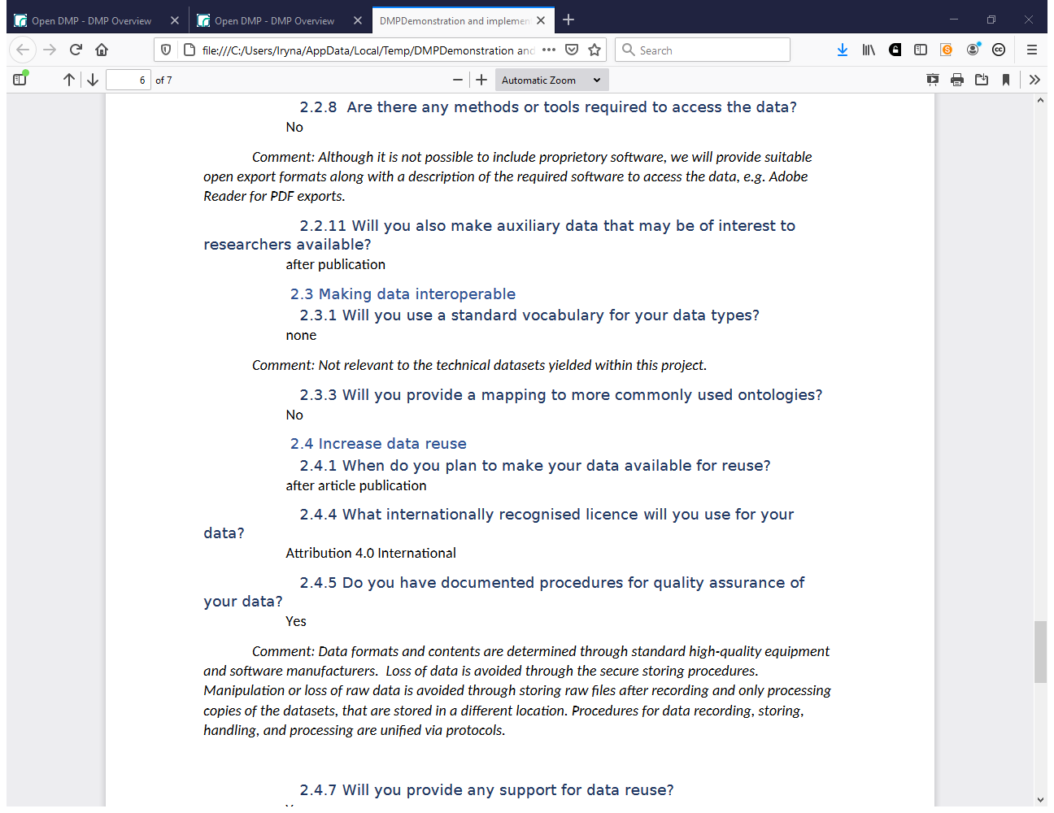

Slide 36
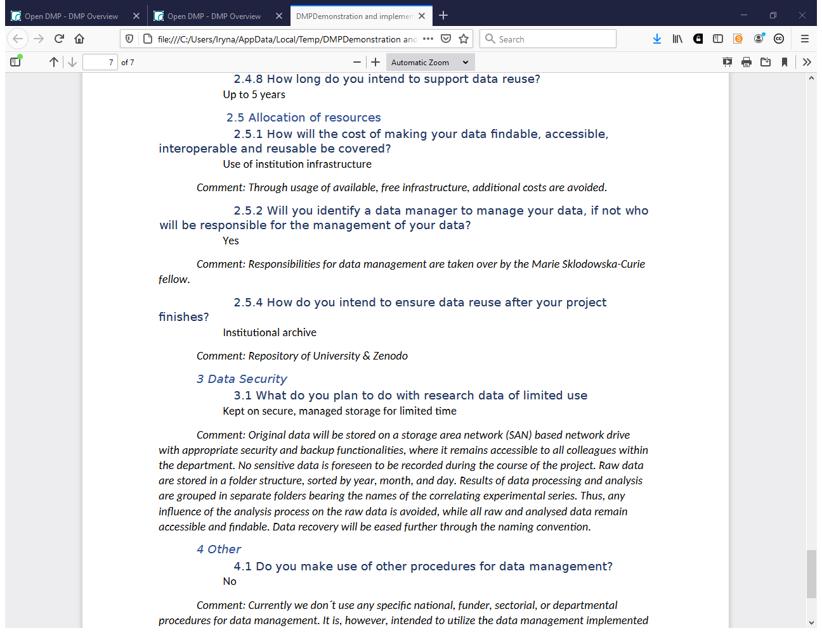

Slide 37
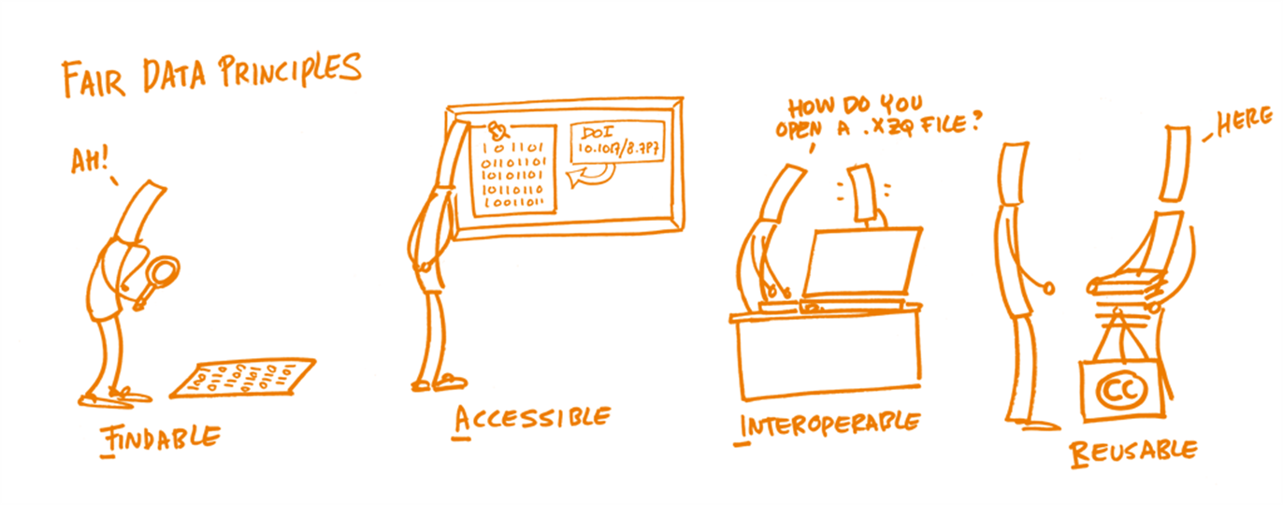

Slide 38
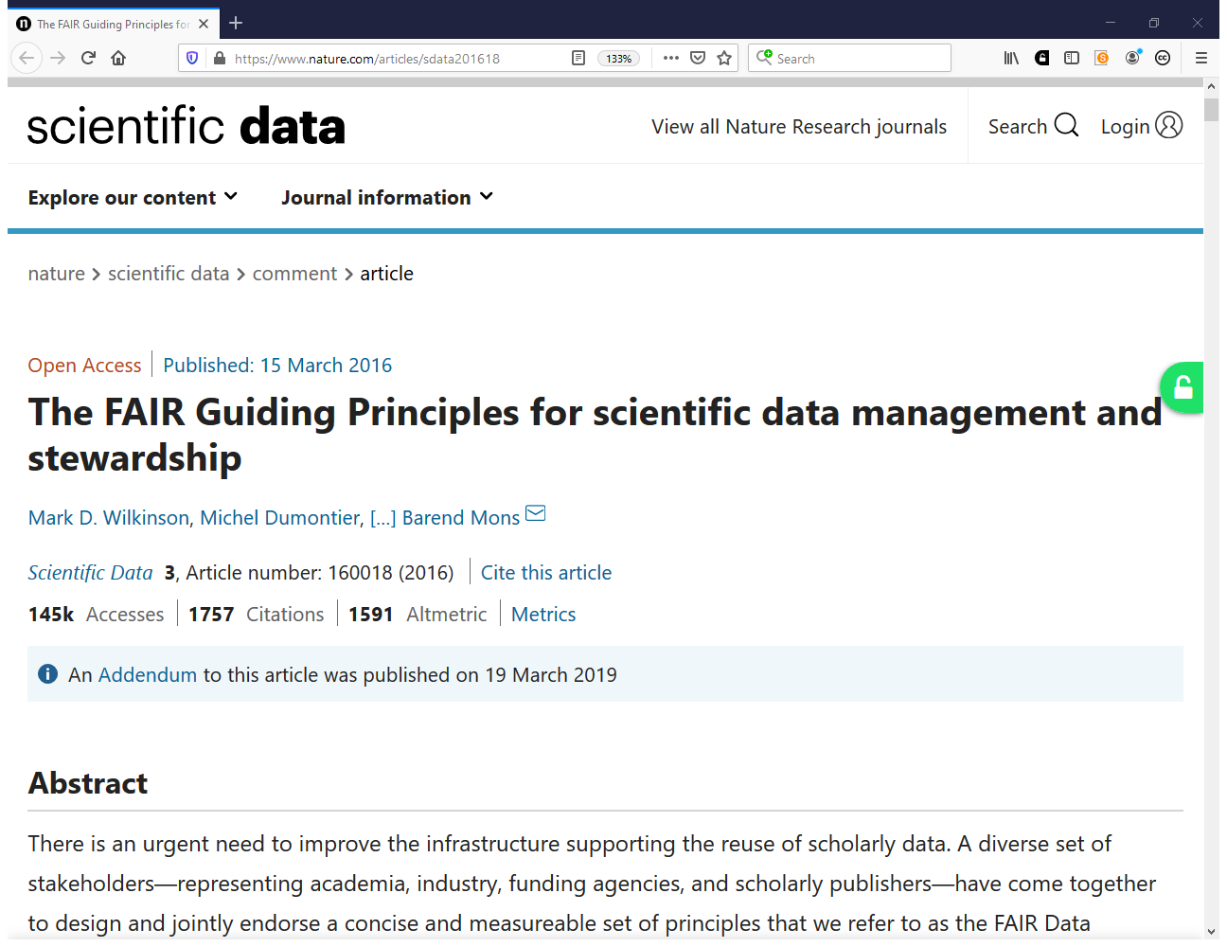
https://www.nature.com/articles/sdata201618

Slide 39
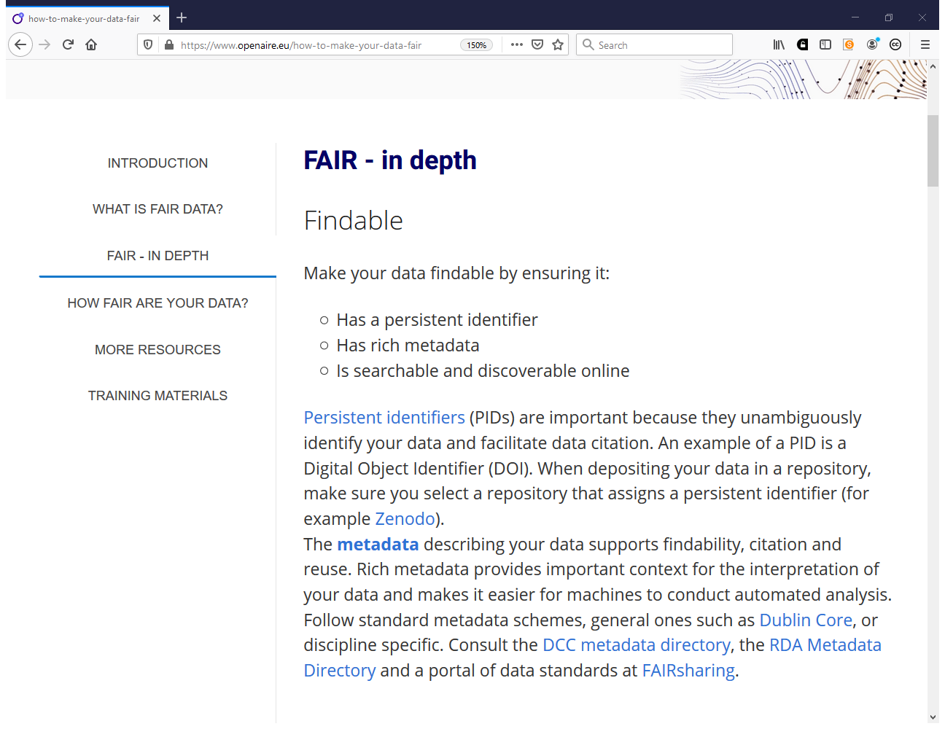
https://www.openaire.eu/how-to-make-your-data-fair

Slide 40
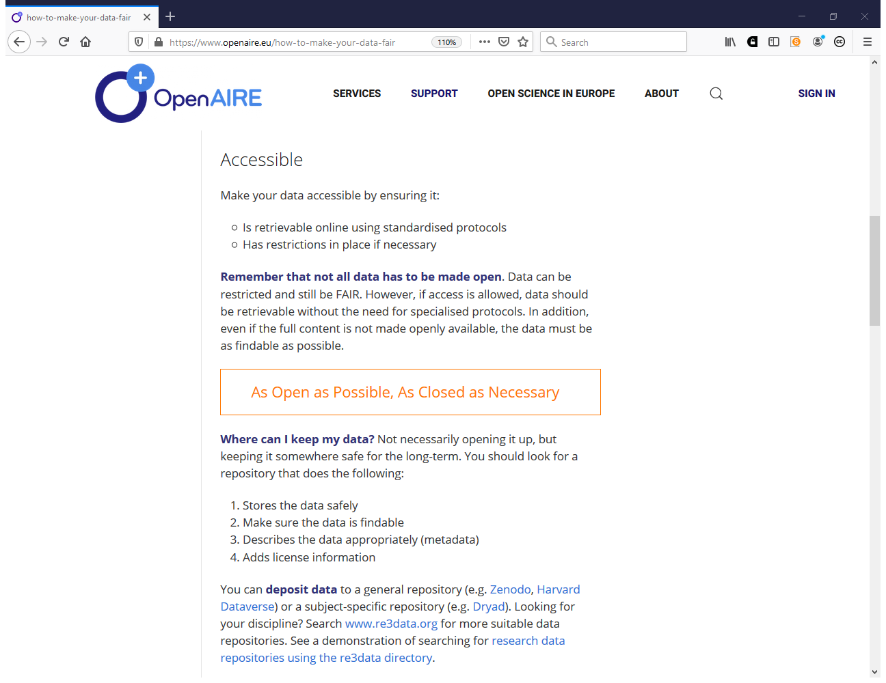
https://www.openaire.eu/how-to-make-your-data-fair

Slide 41
https://www.openaire.eu/how-to-make-your-data-fair

Slide 42
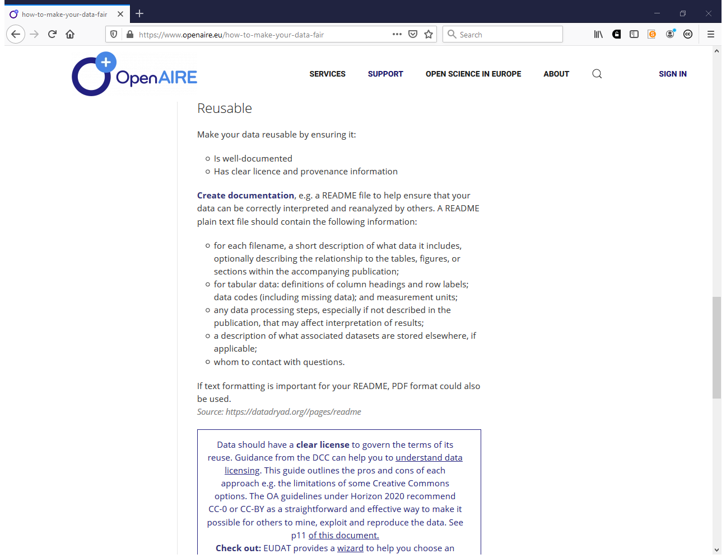
https://www.openaire.eu/how-to-make-your-data-fair

Slide 43
Misconception If I share my data early, I’ll be scooped!

Slide 44
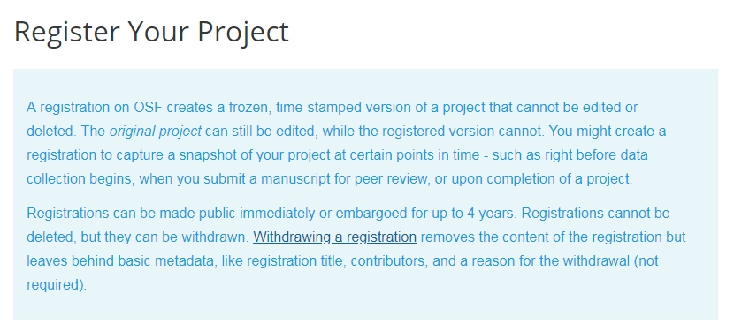
Pre-registration timestamps your work
Notes:
Fears about being scooped are common. You can allay those fears by encouraging researchers to pre-register their project so that they have time stamped evidence that they originated the idea.

Slide 45
Tips – share preprints too
Early feedback on methods and initial findings
Time to correct and mistakes before publishing
Recognition for your ideas by peers

Slide 46
Misconception #2: I have to keep and share everything.
Notes:
In terms of preservation, it is important to remember that not ALL data has to be retained. Selecting what data needs to be kept is something that only the researcher can do. Essentially, he/she will need to retain any data that underpins published findings to allow for validation of results. Additional data that is not required for validation purposes but is deemed to have longer-term value might also be worth keeping.

Slide 47
Deciding which data need to be kept after the project ends
Five steps to follow
Could this data be re-used
Must it be kept as evidence or for legal reasons
Should it be kept for its potential value
Consider costs – do benefits outweigh cost?
Evaluate criteria to decide what to keep
5 steps to decide what data to keep
www.dcc.ac.uk/resources/how-guides/five-steps-decide-what-data-keep
Notes:
Most funders expect enough data to be kept to enable validation of published findings at a minimum. But other data may also have value.
Not always the data – sometimes the code or algorithm more valuable and data can be easily recaptured.

Slide 48
What should be preserved and shared?
The data needed to validate results in scientific publications (minimally!).
The associated metadata: the dataset’s creator, title, year of publication, repository, identifier etc.
Follow a metadata standard in your line of work, or a generic standard, e.g. Dublin Core or DataCite, and be FAIR.
The repository will assign a persistent ID to the dataset: important for discovering and citing the data.
Notes:
Re Software etc: you might also think of virtual machines with the corresponding setup information.
In many cases copyright will prevent the archiving of software and tools. The alternative is a sensible description of configuration settings etc.

Slide 49
What should be preserved and shared? (2)
Documentation: code books, lab journals, informed consent forms – domain-dependent, and important for understanding the data and combining them with other data sources.
Software, hardware, tools, syntax queries, machine configurations – domain-dependent, and important for using the data. (Alternative: information about the software etc.)
Basically, everything that is needed to replicate a study should be available. Plus everything that is potentially useful for others.
Notes:
Re Software etc: you might also think of virtual machines with the corresponding setup information.
In many cases copyright will prevent the archiving of software and tools. The alternative is a sensible description of configuration settings etc.

Slide 50
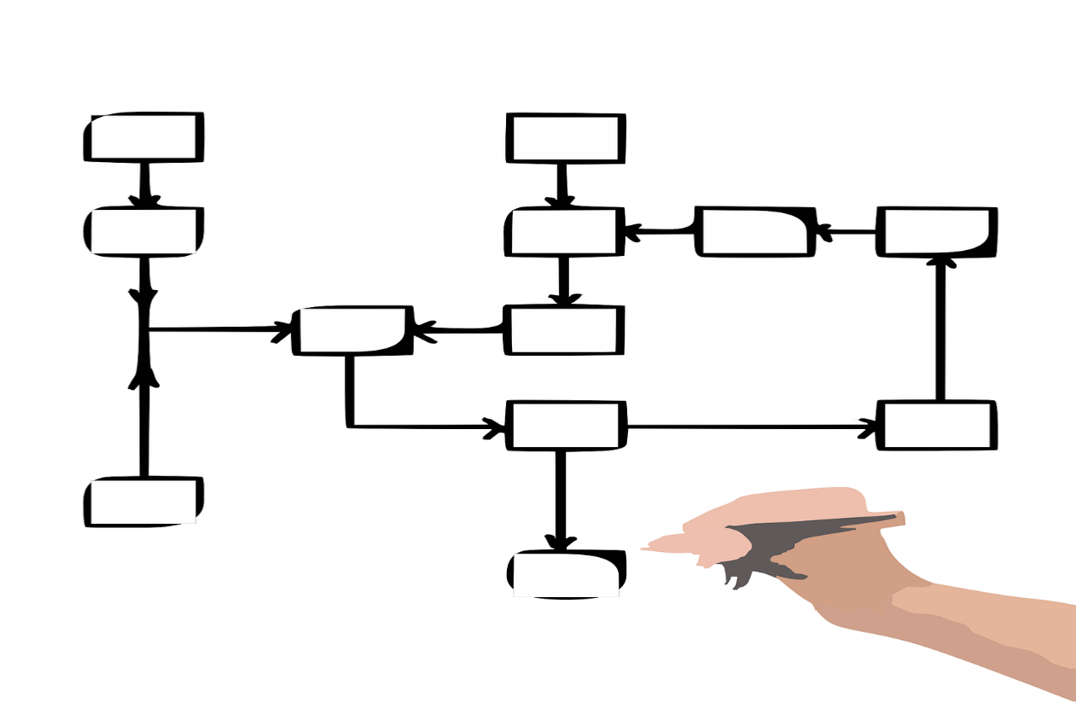
Tip – link data to other outputs for context (reuse)
Open Data
Open Code
Open Workflows
To support validation and facilitate reuse
Software created to analyse and/or visualise the data
What steps were taken and in what order?

Slide 51
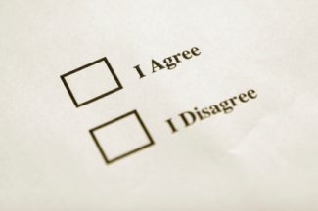
Consider who else has a say about sharing data
Collaborators
Research participants
Commercial partners
Data repository
Publishers
Institutions, funders
Notes:
While the researchers themselves will have a key role to play in sharing data, it is important to note that they are not the only stakeholders involved in the process.
Repository – how will data be made visible? Especially if physical data?
Support staff – e.g., Library staff to help describe data to make it easier to find and understand.
Research participants – informed consent is required. Anonymisation can be very costly.
Commercial – identify what can and can’t be shared and make this explicit. Develop consortium agreements that make each partners rights explicit.
Secondary user – when sharing data, researchers can ask reusers to tick that they accept terms and conditions regarding fair use
51

Slide 52
How to make data open?
Choose your dataset(s)
What can you open? You may need to revisit this step if you encounter problems later.
Apply an open license
Determine what IP exists. Apply a suitable licence e.g. CC-BY
Make the data available
Provide the data in a suitable format. Use repositories.
Make it discoverable
Post on the web, register in catalogues…
https://okfn.org
Notes:
The final aspect to discuss is open data. The Open Knowledge Foundation suggests four simple steps. First off you need to decide what to share. Not all data can be made openly available due to commercial restrictions or sensitivities. Once you’ve decided what to share, determine what IP exists and apply a suitable licence. You should then make the data available in a suitable format so others can bulk download it. Remember that for it to be useful you want to share appropriate metadata and documentation too. Using repositories is useful to make sure your data are properly managed and preserved for the long-term. The final step is to make your data discoverable. Put it online, tell others about it and add details to various registries so it gets found.

Slide 53
Research data lifecycle
RE-USING DATA: follow-up research, new research, undertake research reviews, scrutinising findings, teaching & learning
CREATING DATA: designing research, DMPs, planning consent, locate existing data, data collection and management, capturing and creating metadata
CREATING DATA
PROCESSING DATA
ANALYSING DATA
PRESERVING DATA
GIVING ACCESS TO DATA
RE-USING DATA
PROCESSING DATA: entering, transcribing, checking, validating and cleaning data, anonymising data, describing data, manage and store data
ACCESS TO DATA: distributing data, sharing data, controlling access, establishing copyright, promoting data
ANALYSING DATA: interpreting, & deriving data, producing outputs, authoring publications, preparing for sharing
PRESERVING DATA: data storage, back-up & archiving, migrating to best format & medium, creating metadata and documentation
Ref: UK Data Archive: http://www.data-archive.ac.uk/create-manage/life-cycle
Notes:
This research data lifecycle is taken from the UK Data Archive. It shows you the different processes and activities you’ll go through. As I’m sure you all know, data has a life beyond the project end.
Depending on your line of work, you may enter the cycle at ‘half past ten’, by re-using existing data, or at 12 o’clock:
Creating data: This is when you’ll design the research, write Data Management Plans, negotiate consent agreements, find any existing data you want to reuse, collect/capture your data and create any associated metadata
Processing data: When processing your data, you’ll be entering, transcribing, checking, validating and cleaning it, you may also need to anonymise your data, you should describe it and make sure it’s properly managed and stored.
Analysing data: when you analyse your data you’ll be interpreting it and creating derived data and outputs, you’ll probably also author publications and prepare the data for deposit and sharing.
Preserving data: data repositories play a key role in preserving data: they will make sure it’s properly stored and archived, they will migrate the formats and storage medium and create associated metadata and documentation to explain any changes made
Access to data: it may be that you share your data via a repository or handle access requests yourself. Either way, you need to establish copyright, decide who can have access and promote the data.
Re-using data: data can be re-used in follow-up studies, new research, research reviews, to evidence findings or for teaching and learning. Try to keep an open mind about the different ways in which your data could be re-used and make it as open as possible.

Slide 54
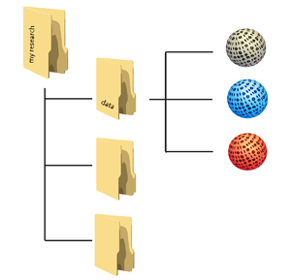
Planning trick 1: think backwards
What data organisation would a re-user like?
CREATING DATA
PROCESSING DATA
ANALYSING DATA
PRESERVING DATA
GIVING ACCESS TO DATA
RE-USING DATA
Notes:
Let’s adopt the perspective of a future data user – maybe yourself: what should your data organisation – folders with data, metadata and documentation – look like at the moment that you start sharing - outside your team - and archiving?
When you are part of a large project which has been going on for some years already, this may be obvious, but for many researchers it isn’t clear from the start.
To answer that broad question, you want to come up, at an early stage, with answers regarding:
Types and formats of data;
New and/or existing;
Expected size;
Metadata;
Documentation;
Software.

Slide 55
Data organisation
http://datasupport.researchdata.nl/en/start-de-cursus/iii-onderzoeksfase/organising-data

Slide 56
Image courtesy of http://aukeherrema.nl CC-BY

Slide 57
Image courtesy of http://aukeherrema.nl CC-BY

Slide 58
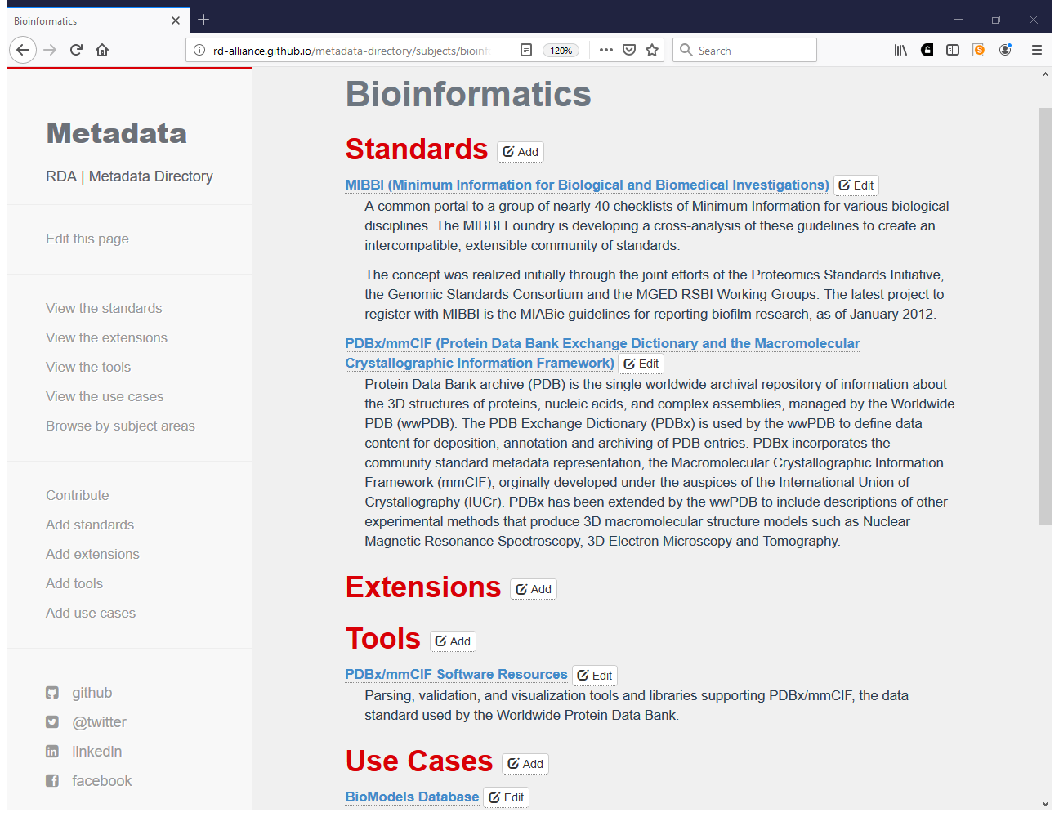
http://rd-alliance.github.io/metadata-directory/subjects/bioinformatics.html

Slide 59
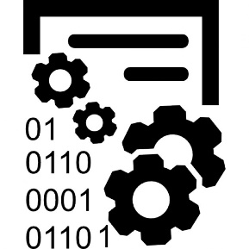
Storing data: what is meant?
Storing and backing up files while research is active
Likely to be on a networked filestore or hard drive
Easy to change or delete
Archiving or preserving data in the long-term
Likely to be deposited in a digital repository
safeguarded and preserved
Notes:
When data are stored on ‘active data storage’ they’re subject to change. Anyone with permission could edit or delete files. They may still be there in 10 years time, but this is not guaranteed.
An archive is different as the data and associated metadata is packaged up together and protected.
Backup is not the same as preservation. If you want your data to be accessible in the future, you should deposit in a trustworthy digital repository which commits to preserving it.

Slide 60
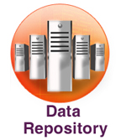
Sharing data: what is meant?
With collaborators while research is active
Data are mutable
(Open) data sharing
Data are stable, searchable, citable, clearly licensed
Notes:
These are not the same thing! When the EC asks about your approach to sharing data they’re interested in the latter.

Slide 61
Archiving, repositories, ehm?
Select a data repository that will preserve your data, metadata and possibly tools in the long term.
It is advisable to contact the repository of your choice when writing the first version of your DMP.
Repositories may offer guidelines for sustainable data formats and metadata standards, as well as support for dealing with sensitive data and licensing.

Slide 62
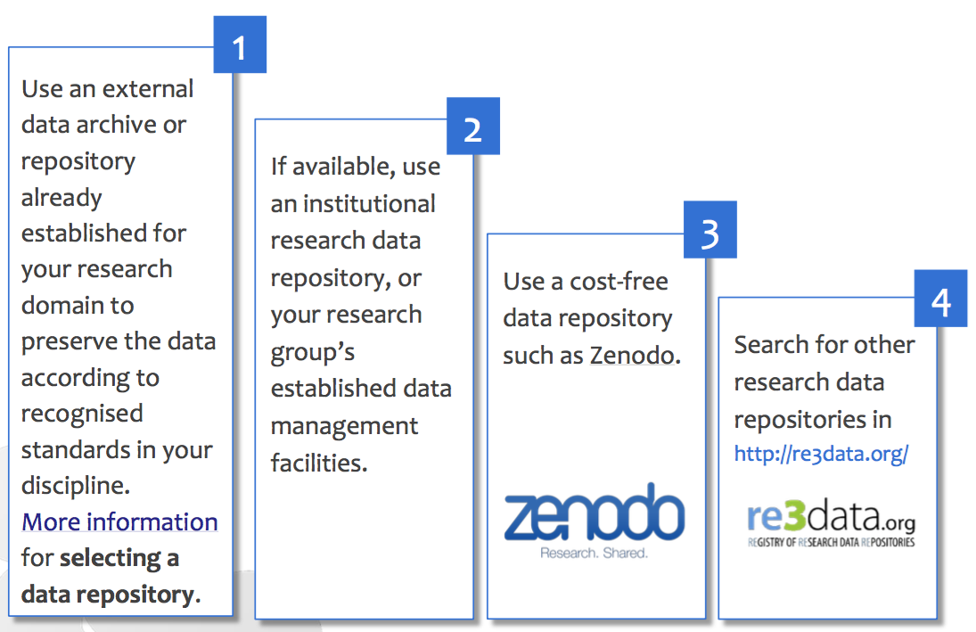
Where to find a repository?
Zenodo: http://www.zenodo.org
Re3data.org: http://www.re3data.org

Slide 63
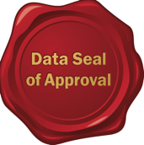
How to select a repository?
Main criteria for choosing a data repository:
Certification as a ‘Trustworthy Digital Repository’, with an explicit ambition to keep the data available in the long term.
Three common certification standards for TDRs:
Data Seal of Approval: http://datasealofapproval.org/en
nestor seal: http://www.langzeitarchivierung.de/Subsites/nestor/EN/nestor-Siegel/siegel_node.html
ISO 16363: http://www.iso16363.org

Slide 64
How to select a repository? (2)
Matches your particular data needs: e.g. formats accepted; mixture of Open and Restricted Access.
Provides guidance on how to cite the data that has been deposited.
Gives your submitted dataset a persistent and globally unique identifier: for sustainable citations – both for data and publications – and to link back to particular researchers and grants.

Slide 65
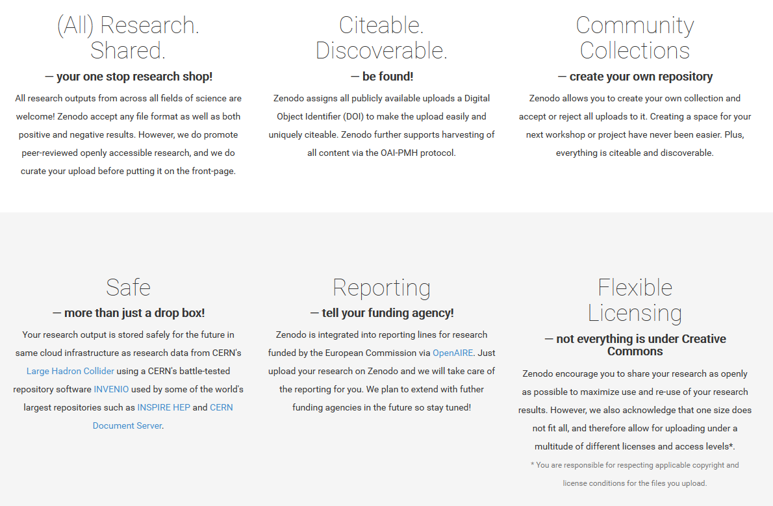
www.zenodo.org

Slide 66
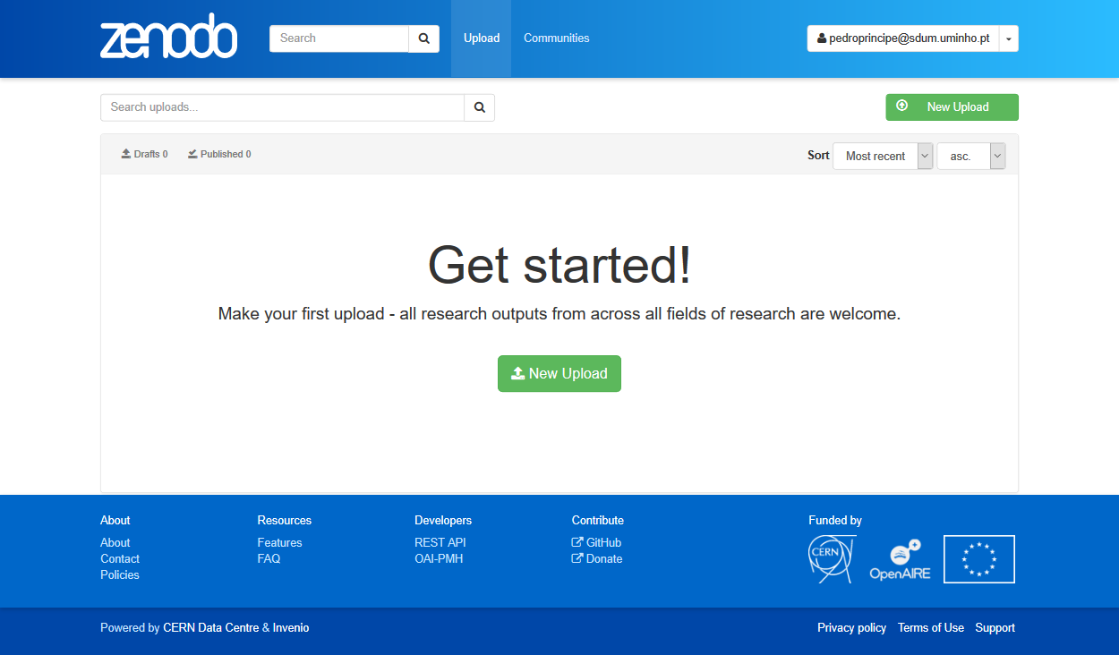

Slide 67
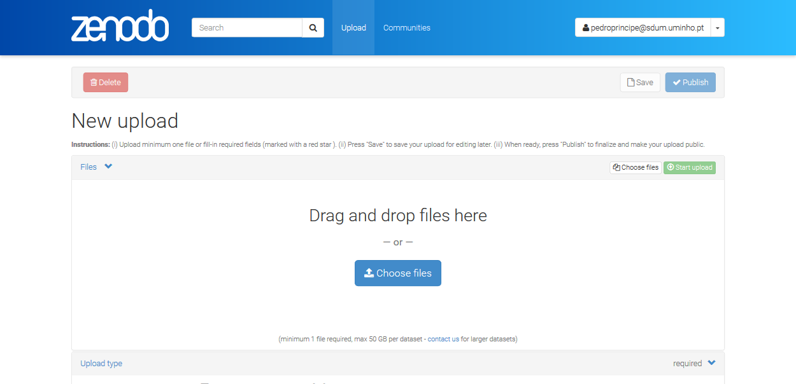

Slide 68
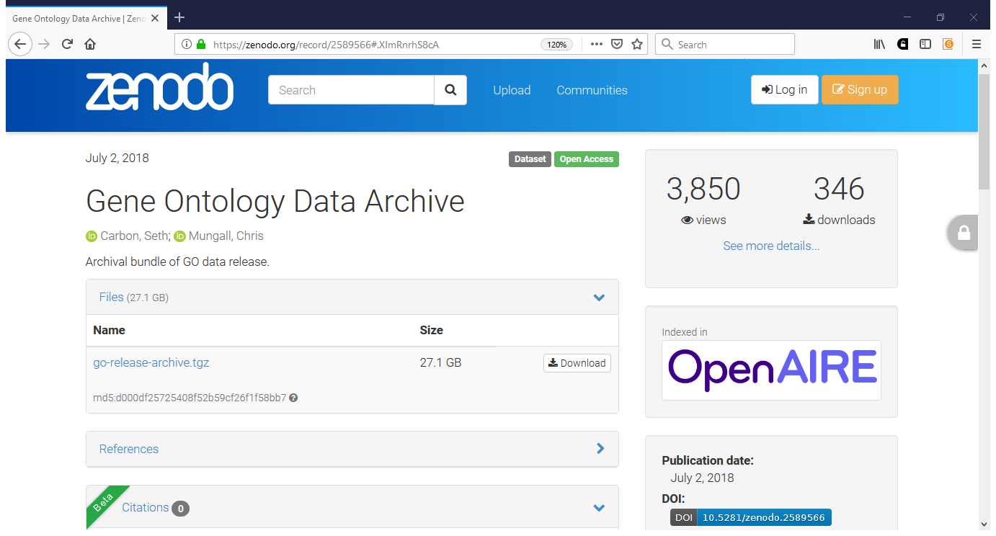

Slide 69
Licensing research data
This DCC guide outlines the pros and cons of each approach and gives practical advice on how to implement your licence
CREATIVE COMMONS LIMITATIONS
NC Non-Commercial
What counts as commercial?
ND No Derivatives
Severely restricts use
These clauses are not open licenses
Horizon 2020 Open Access guidelines point to:
or
www.dcc.ac.uk/resources/how-guides/license-research-data
Notes:
Guidance from the DCC can also help researchers to understand data licensing. This guide outlines the pros and cons of each approach e.g. the limitations of some CC options
The OA guidelines under Horizon 2020 point to CC-0 or CC-BY as a straightforward and effective way to make it possible for others to mine, exploit and reproduce the data. See p11 at: http://ec.europa.eu/research/participants/data/ref/h2020/grants_manual/hi/oa_pilot/h2020-hi-oa-pilot-guide_en.pdf
69

Slide 70
EUDAT licensing tool
Answer questions to determine which licence(s) are appropriate to use
http://ufal.github.io/public-license-selector

Slide 71
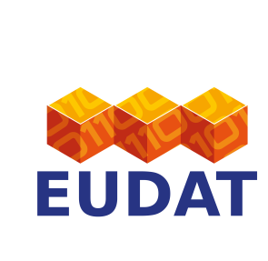
Why manage data?
Non pecuniae investigationis curatore
sed vitae facimus programmas datorum procurationis
(Not for the research funder, but for life we make data management plans)
Make your research easier
Stop yourself drowning in irrelevant stuff
Save data for later
Avoid accusations of fraud or bad science
Write a data paper
Share your data for re-use
Get credit for it
Notes:
You may know the old saying “We do not learn for school, but for life”. For planning and carrying out data management we’d like to encourage a similar attitude in researchers and other stakeholders.
There are lots of reasons to manage research data. You may be required to explain how you will manage your data by your funder or university. Ultimately though, it’s to make your research easier. If data are properly documented and organised, you can stop yourself drowning in irrelevant stuff and find the data when you need it – for example to validate findings. By managing your data you can also more easily share it with others to get more credit and impact.
Well-managed data opens up opportunities for re-use, integration and new science. And RDM is just part of a researcher’s life…

Slide 72
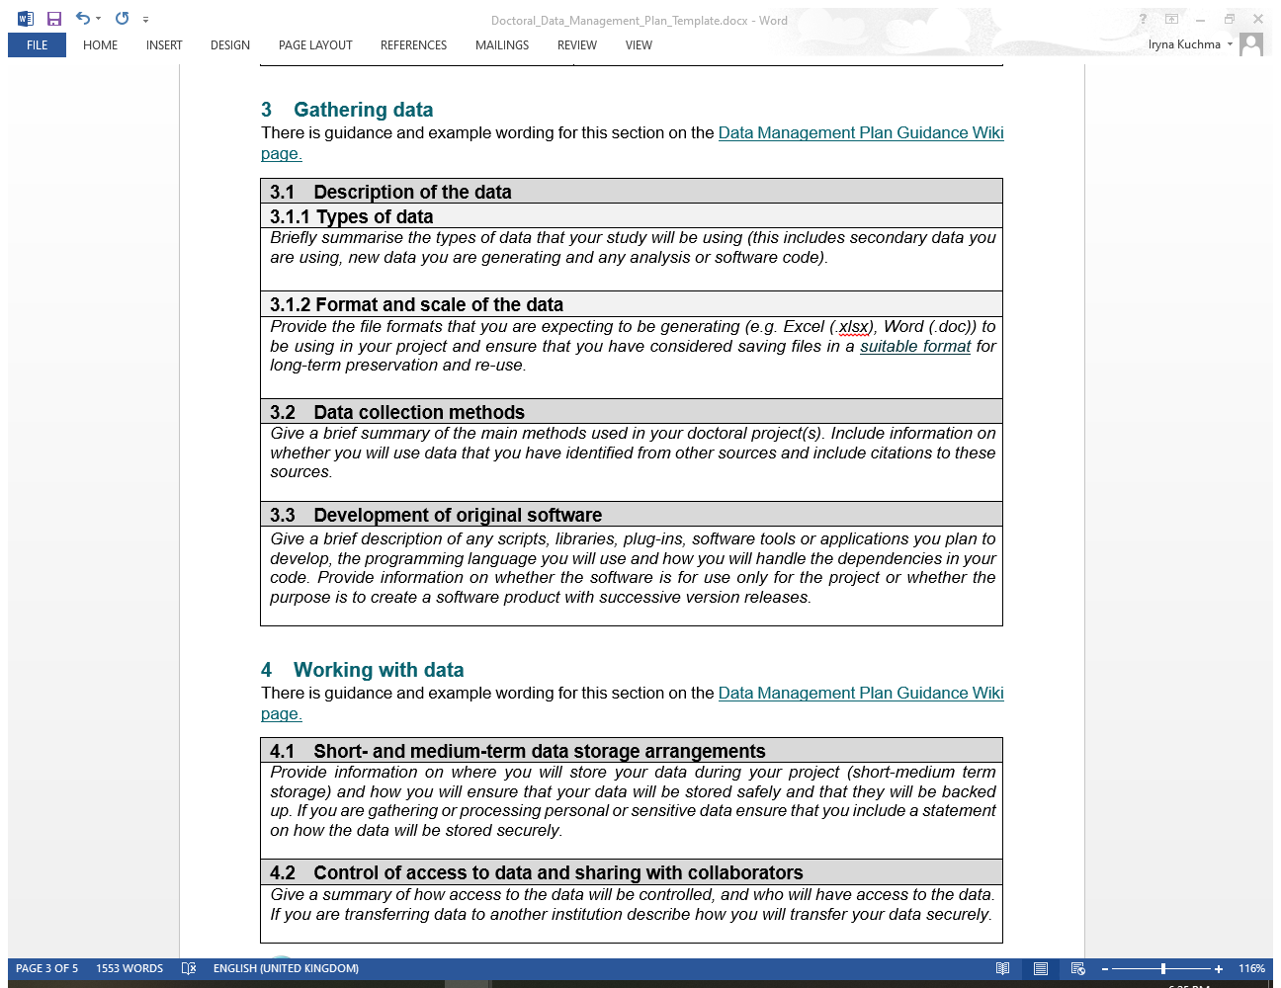

Slide 74
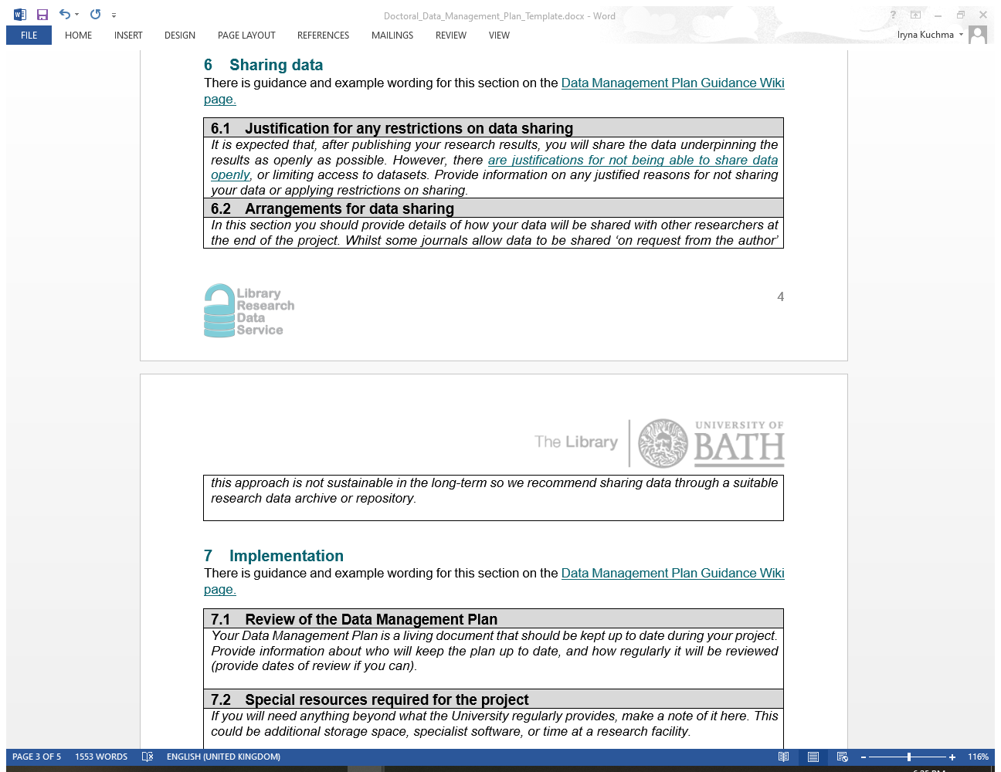

Slide 75
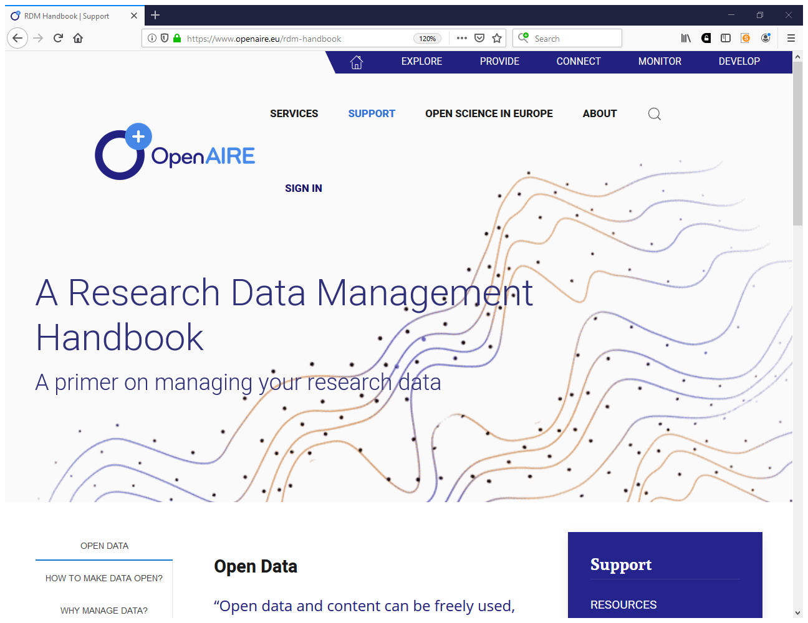
https://www.openaire.eu/rdm-handbook

Slide 76
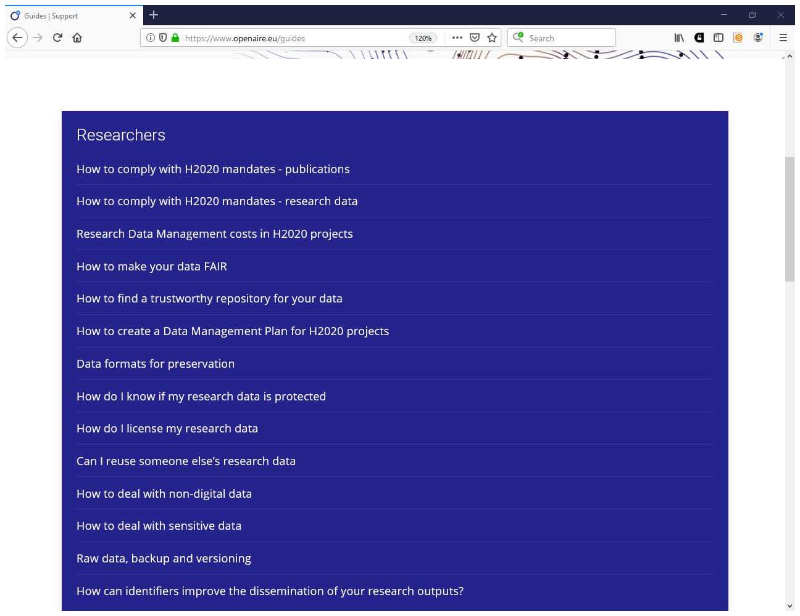
https://www.openaire.eu/guides

Slide 77
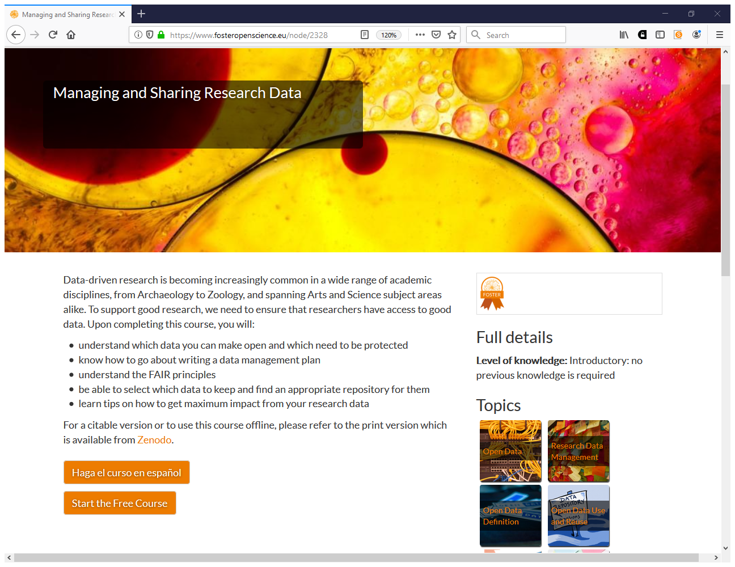
https://www.fosteropenscience.eu/node/2328

Slide 78
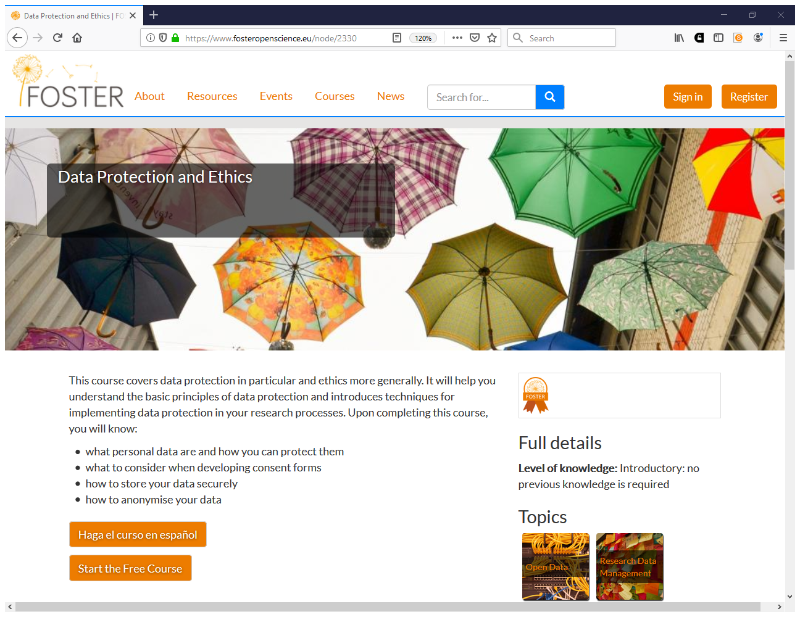
https://www.fosteropenscience.eu/node/2330

Slide 79
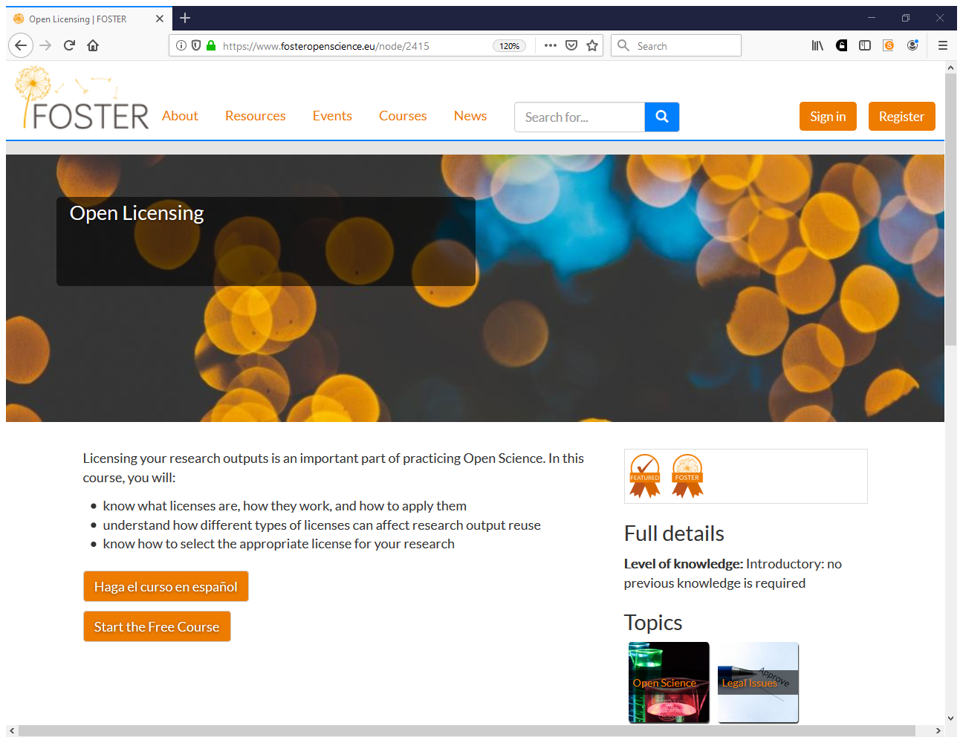
https://www.fosteropenscience.eu/node/2415

Slide 80
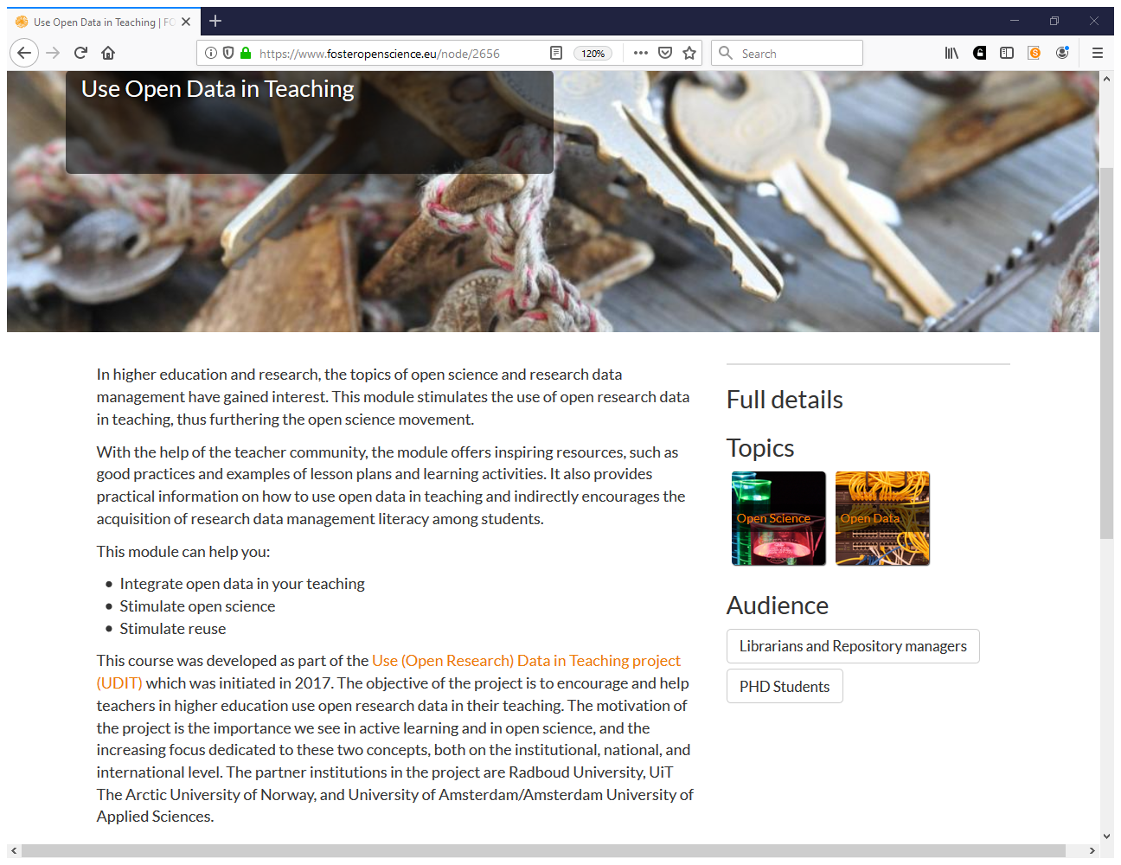
https://www.fosteropenscience.eu/node/2656

Slide 81
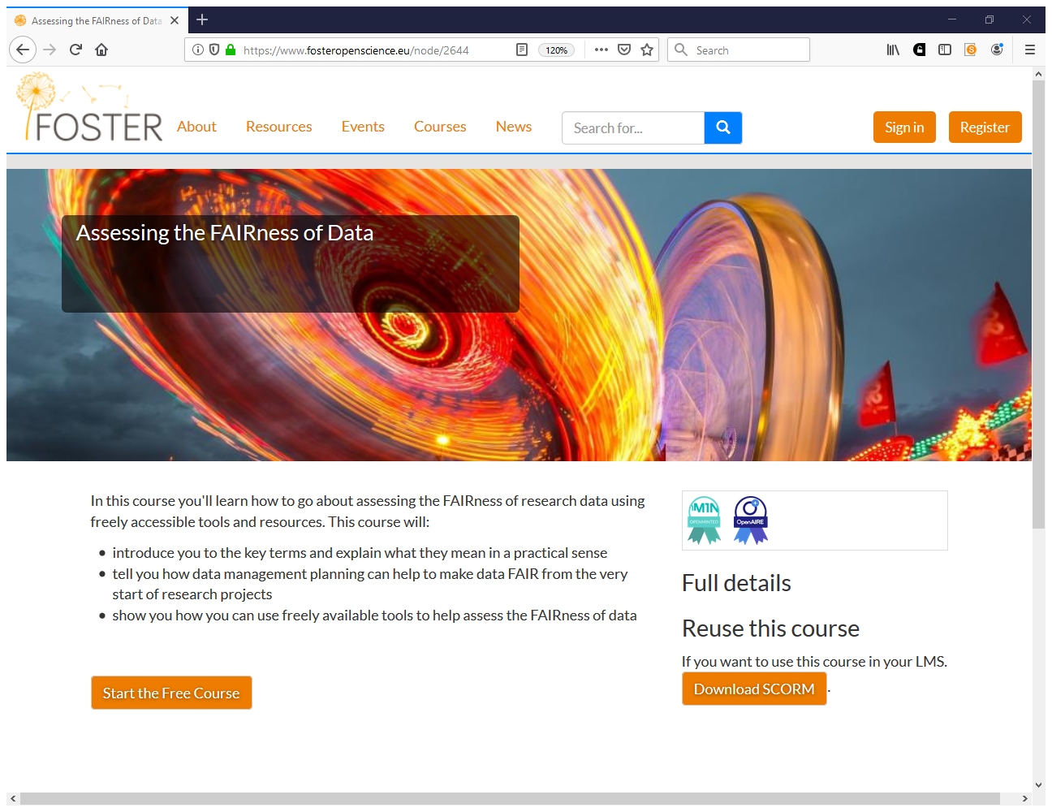
https://www.fosteropenscience.eu/node/2644

Slide 82
With thanks to
Joy Davidson, University of Glasgow
Bianca Kramer & Jeroen Bosman, Utrecht University Library
Marjan Grootveld, DANS
Sarah Jones, DCC
Acknowledgements:
Jonathan Rans, DCC
Thanks to DANS and DCC for reuse of slide
Notes:
Thanks

Slide 83
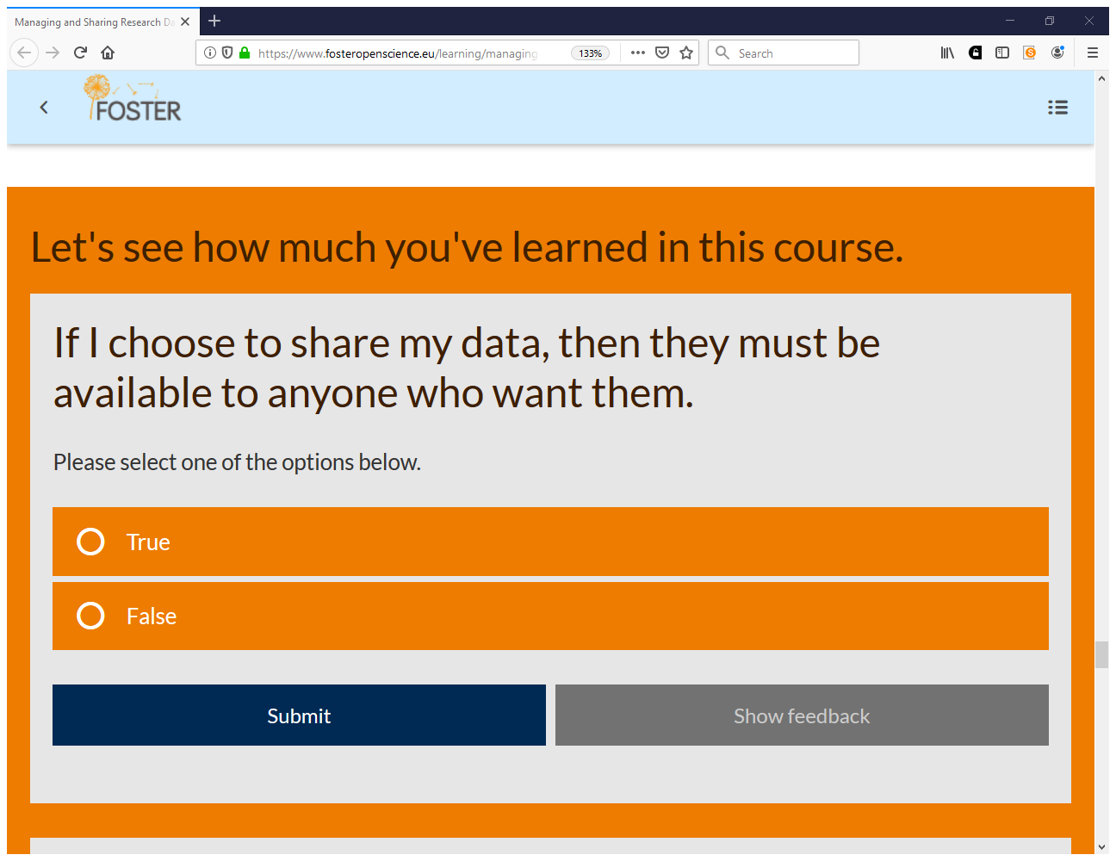

Slide 84
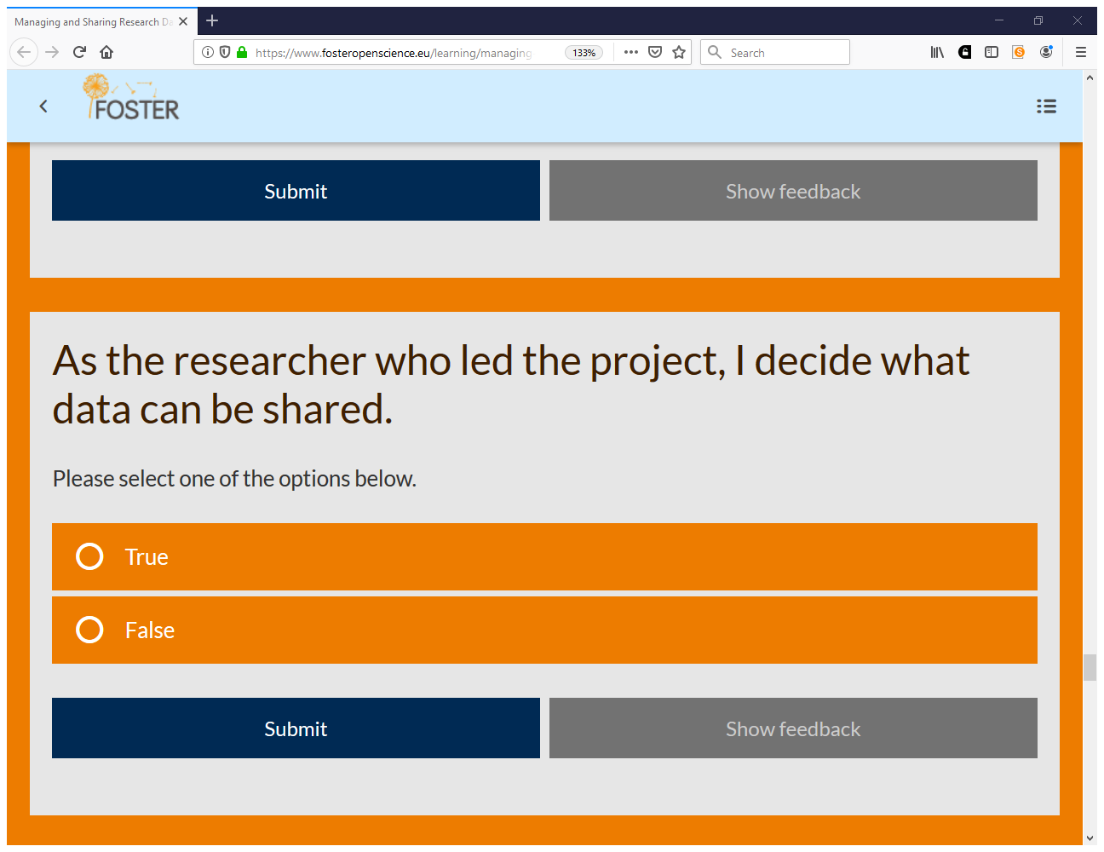

Slide 85
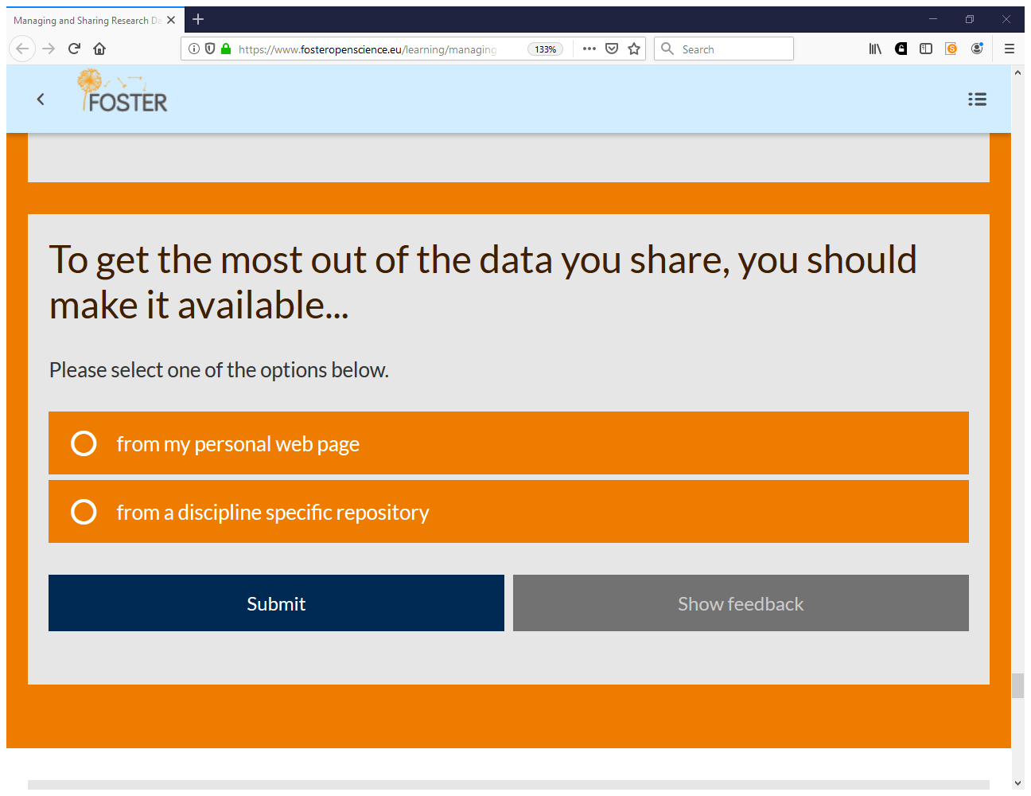

Slide 92
https://covid-19.openaire.eu

Slide 93
https://zenodo.org/communities/covid-19

Slide 94
RDA COVID-19 Working Group. (2020, June 30). http://doi.org/10.15497/rda00052
April 1st through June 30th, 2020
Weekly update webinar and writing sprint
Over 600 data professional experts
4 Research domains and 4 cross cutting areas

Slide 95
http://openaccessweek.org

Slide 96
Thank you! Questions? iryna.kuchma@eifl.net
www.eifl.net

