Slide 1

Repository best practices
Controlled vocabularies
5 February 2025

Slide 2
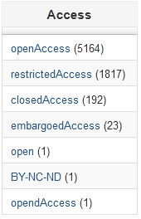
For machines they are not the same!
<dc:rights>openAccess</dc:rights>
<dc:rights>OpenAccess</dc:rights>
<dc:rights>open Access</dc:rights>
<dc:rights>Open Access</dc:rights>
<dc:rights>openaccess</dc:rights>
<dc:rights>open-access</dc:rights>
<dc:rights>access ouvert</dc:rights>
<dc:rights>OA</dc:rights>
<dc:rights>acceso abierto</dc:rights>

Slide 3
COAR controlled vocabularies for repositories
Home: https://vocabularies.coar-repositories.org/
Resource types: https://vocabularies.coar-repositories.org/resource_types/ ( December 2024)
Access rights: https://vocabularies.coar-repositories.org/access_rights/ (September 2022)
Version types: https://vocabularies.coar-repositories.org/version_types/ (September 2022)
Implementation Guidelines: https://coar-repositories.org/wp-content/uploads/2024/04/Implementation-guide-for-COAR-Controlled-Vocabularies.pdf and some more information at https://coar-repositories.org/what-we-do/coar-controlled-vocabularies
Developed by volunteers

Slide 4
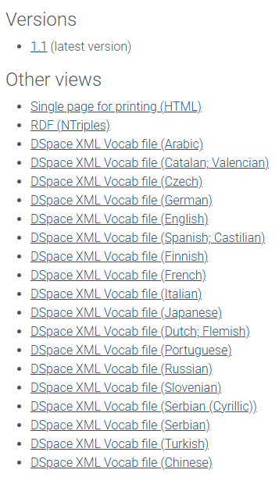
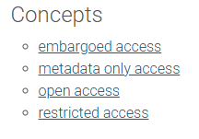
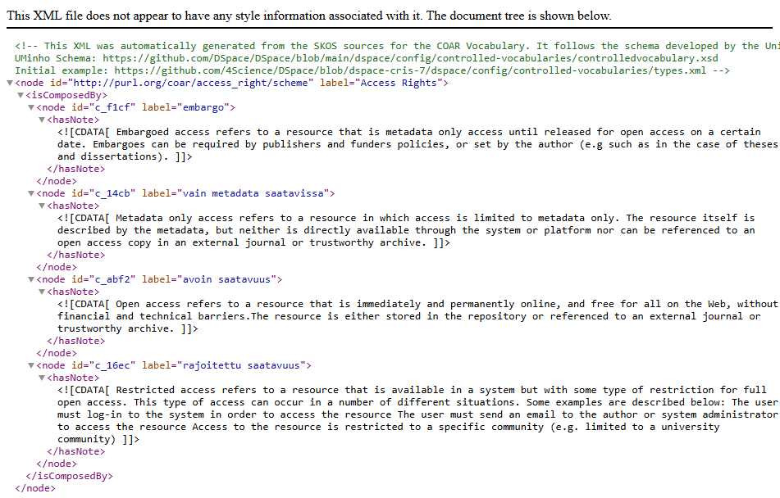

Slide 5
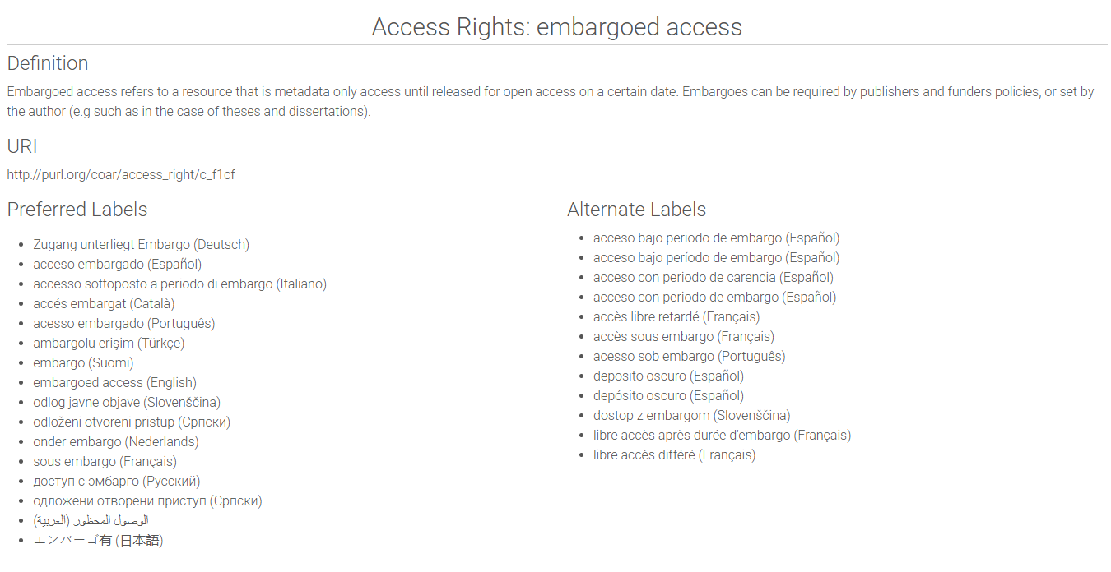

Slide 6
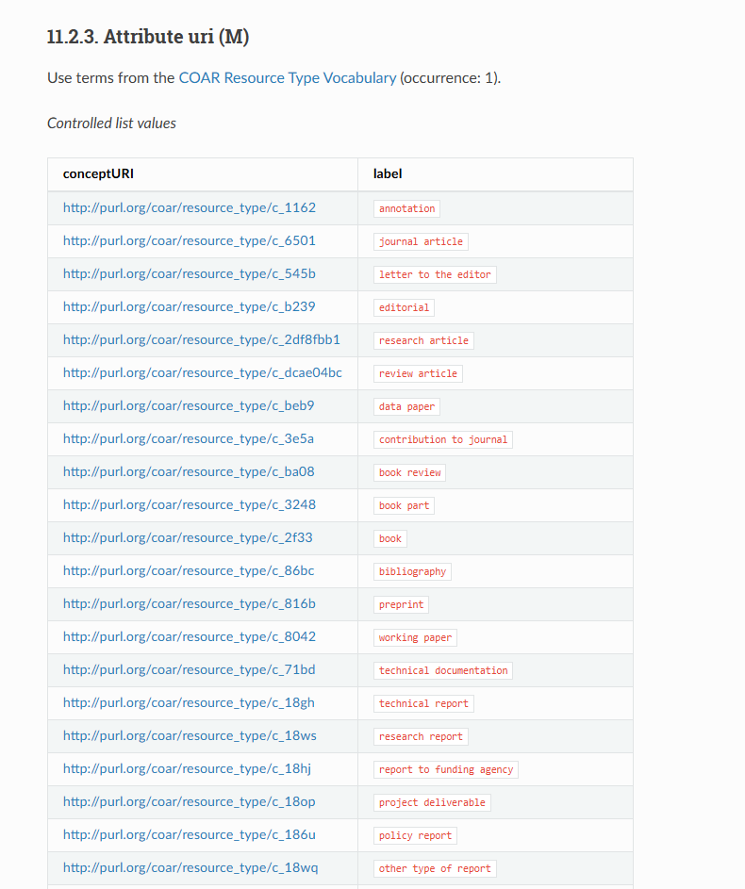
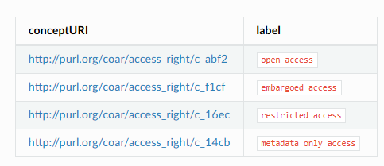
OpenAIRE Guidelines for Literature, institutional, and thematic Repositories
https://openaire-guidelines-for-literature-repository-managers.readthedocs.io/en/v4.0.0/field_publicationtype.html

Slide 7
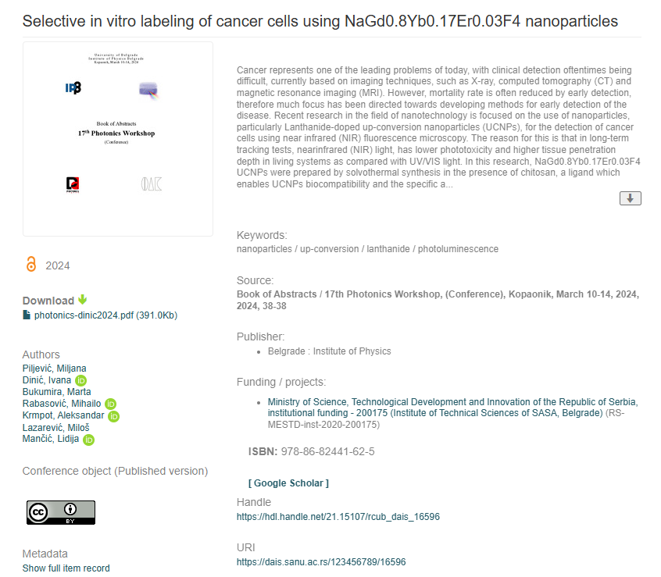

In practice
Example: https://hdl.handle.net/21.15107/rcub_dais_16596
Icon is used to indicate OA
In detailed metadata view

Slide 8
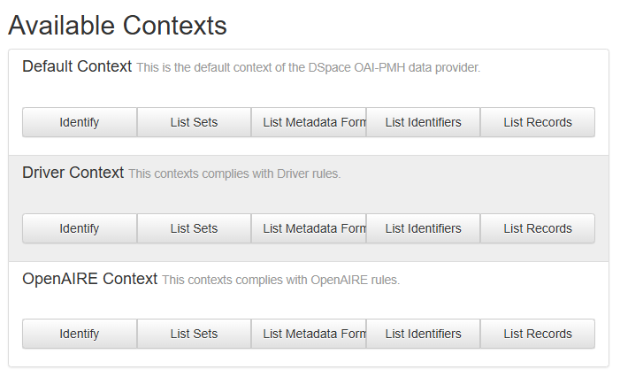
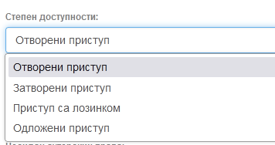
OAI-PMH
Submission form
Controlled term exposed via OAI-PMH
<dc:rights>info:eu-repo/semantics/openAccess</dc:rights>
https://dais.sanu.ac.rs/oai
Human-readable options at metadata input

Slide 9
Thank you!
Questions?
Your thoughts?
iryna.kuchma@eifl.net
milica.sevkusic@eifl.net

