Slide 1
EIFL DIGITAL RESEARCH LITERACY TRAINING PROGRAMME OUTLINE
‘Social media for research’
Ana Đorđević
Faculty of Chemistry Library, University of Belgrade, Serbia
16 June 2021

Slide 2
Agenda
01
Introduction to social media
02
Benefits of using social media
for research
03
Social media platforms
04
Training for researchers – practical exercises

Slide 3
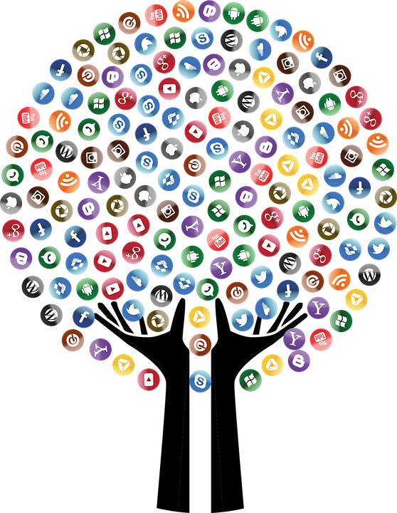
Social media
Total number of active social media users: 4.2 billion
Accessing via mobile phones:
4.15 billion

Slide 4
Social media
are now essential information and interaction channels
- is a free way to network with academic community
are seen as a good source of new information and contacts
are suitable for promoting awareness of research services and results

Slide 5
Websites and Social Media
Sharing content
Building reputation
Helping connect with audience
Reaching out to new audience
Encouraging interaction with colleagues
Finding funders online
Establishing credibility and social proof
Providing key data for institution where you work
The main difference is that social media cannot be relied on completely but provides faster, more personal methods of communication.

Slide 6
Social media
Twitter, 2006
LinkedIn, 2002
Facebook, 2004
Instagram, 2010
YouTube, 2005
Vimeo, 2004
ResearchGate, 2008
Academia.edu, 2008
Mendeley, 2007
Google Scholar, 2004
Altmetric, 2011
ORCID, 2010
Zenodo, 2013
…
>>> wide used
social networks
>>> social networks
for researchers
>>> platforms for
research

Slide 7
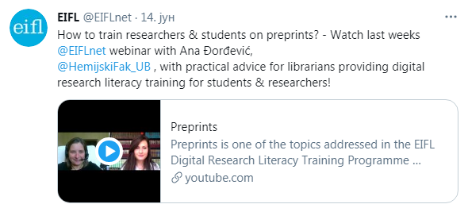
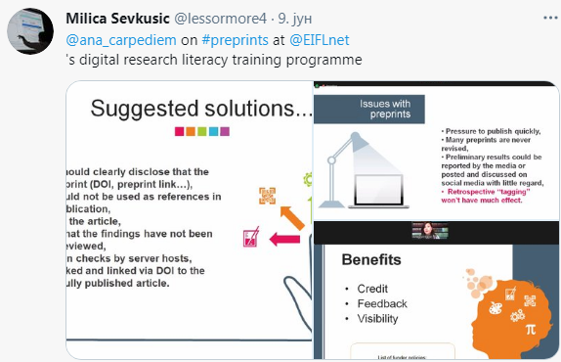
Twitter
active users: 353 million
character-limit: 280
Tagging: locations
@ for mentions
# for sharing or
marking a content

Slide 8
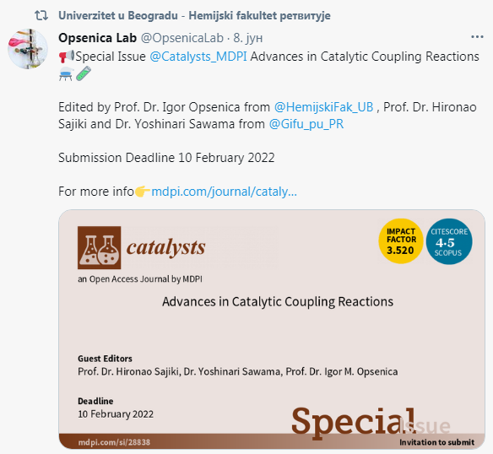
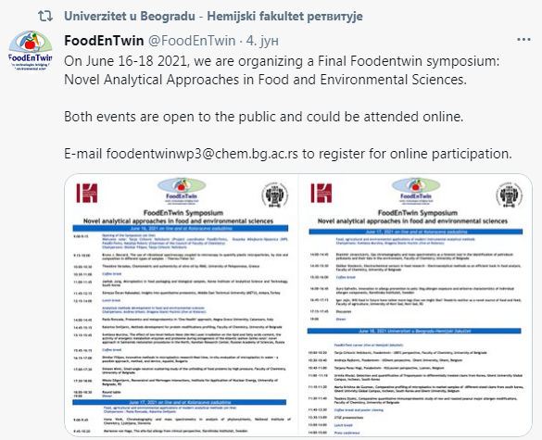
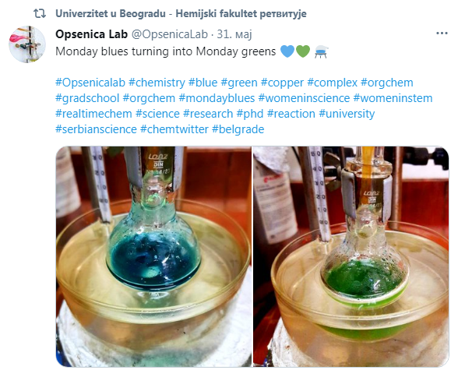
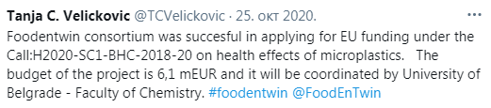
Good practice…

Slide 9
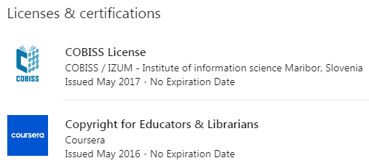
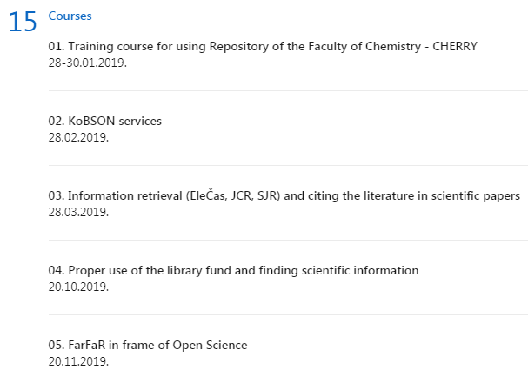
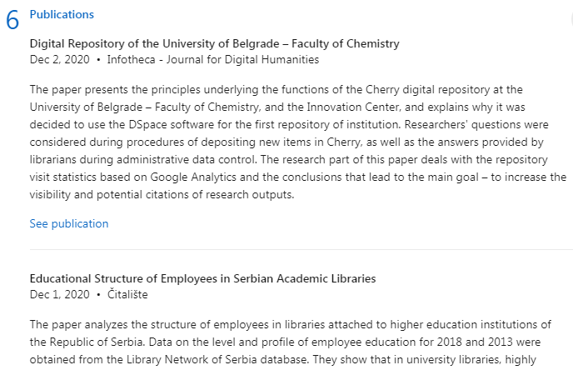
LinkedIn
Text
Image
Video

Slide 10
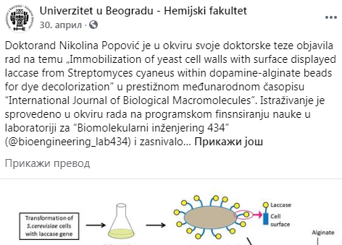
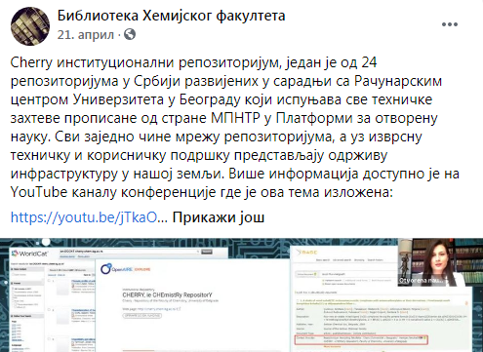
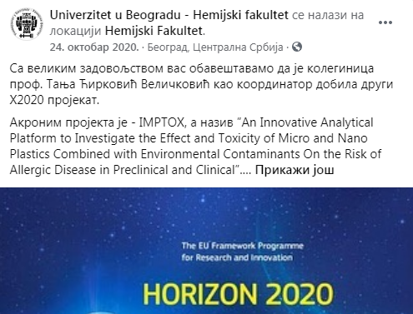
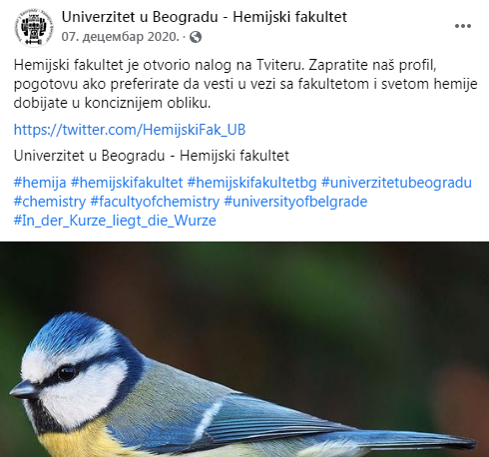
Facebook
Text
Image
Video
Links

Slide 11
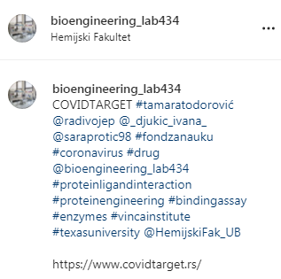
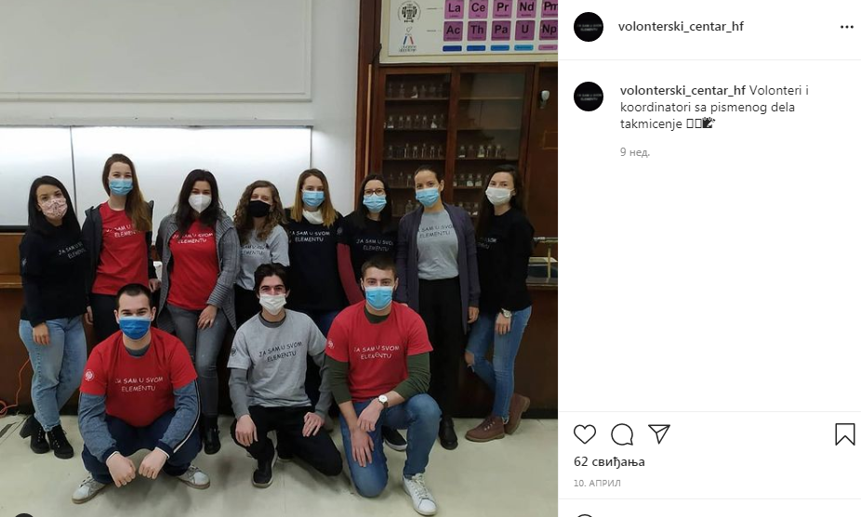
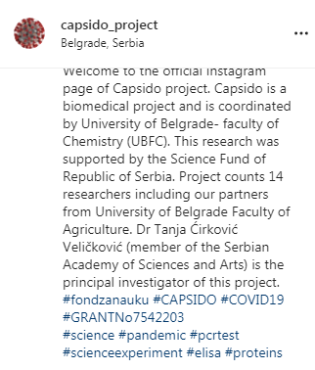
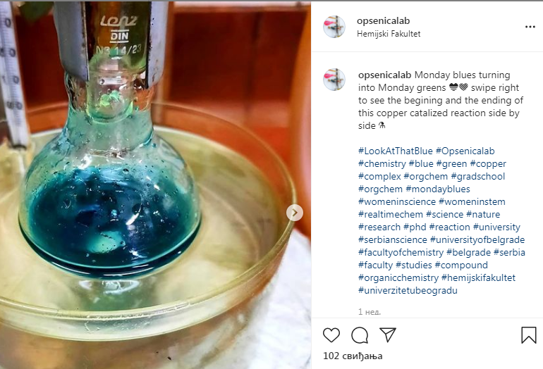
~ 2 billion users
Instagram

Slide 12
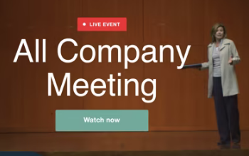
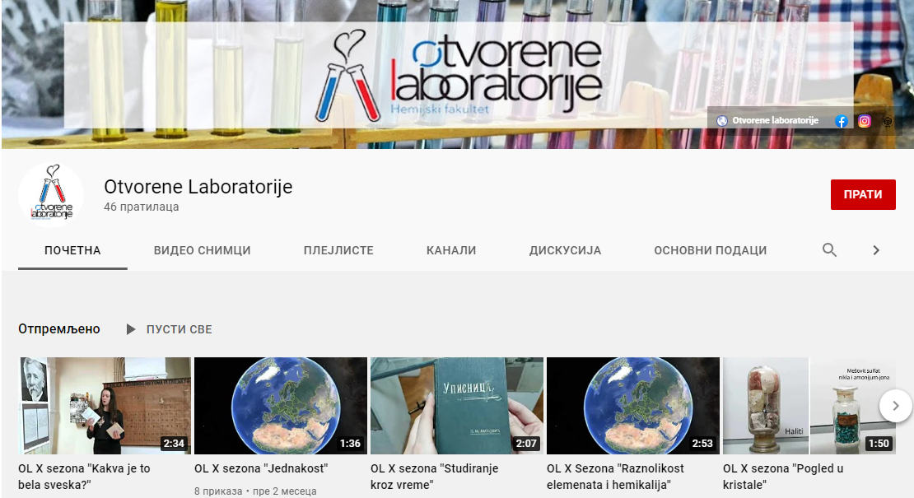
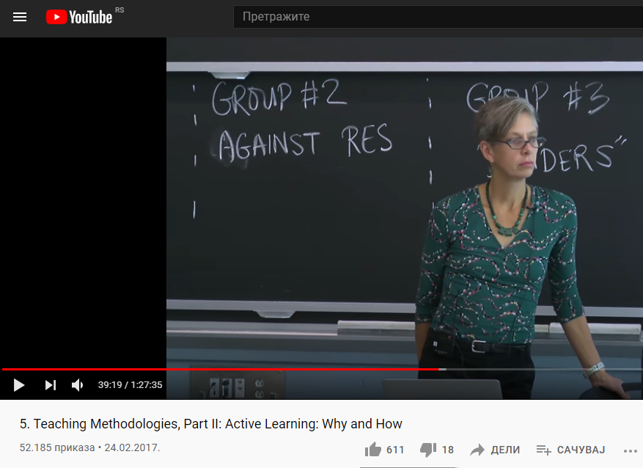
Youtube and Vimeo

Slide 13
Useful tips for researchers
linked to peer reviewed PDF
be up to date with new information
take care of the copyright and credibility of the information you share
take care of spelling and grammar

Slide 14
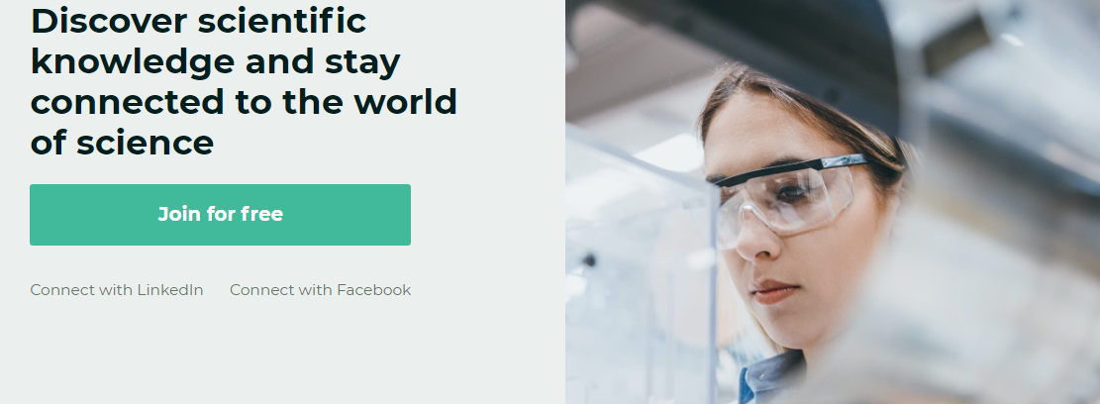
ResearchGate
Access over 135 million publication pages
Community of 20 million scientists

Slide 15
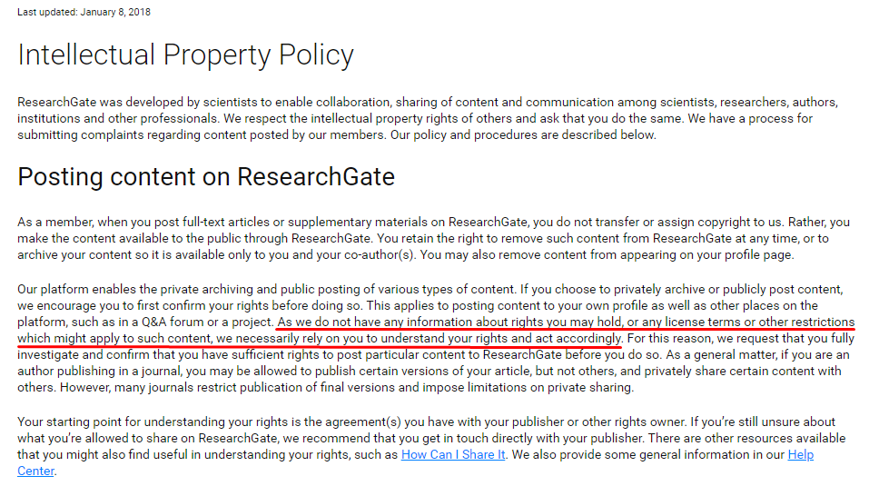

Slide 16
What are you allowed to post on social media for researchers?
A large number of authors regularly post all their articles on social network despite of copyright agreement with publishers…

Slide 17
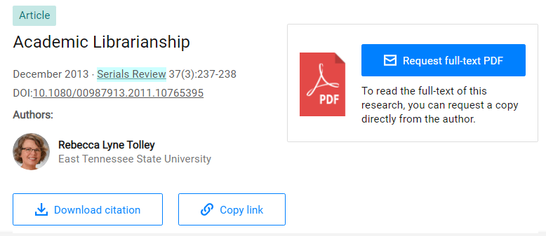
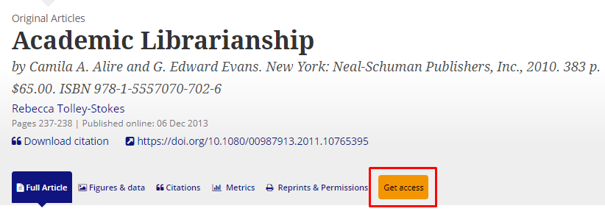
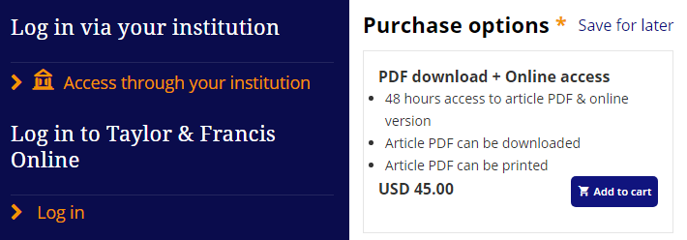

Slide 18
Important role of Sherpa Romeo
“Sherpa Romeo is an online resource that aggregates and analyses publisher open access policies from around the world and provides summaries of publisher copyright and open access archiving policies on a journal-by-journal basis.”

Slide 19
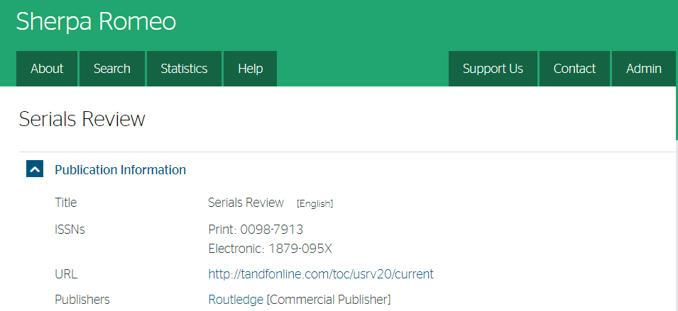
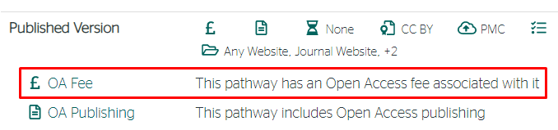
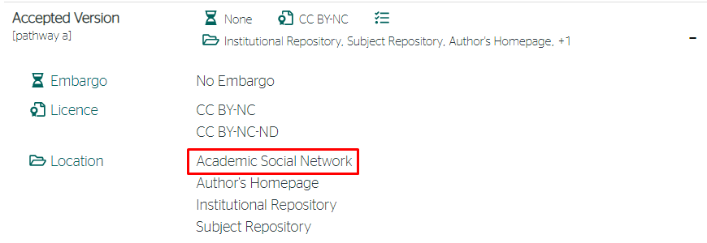
Checking the journal policies…

Slide 20
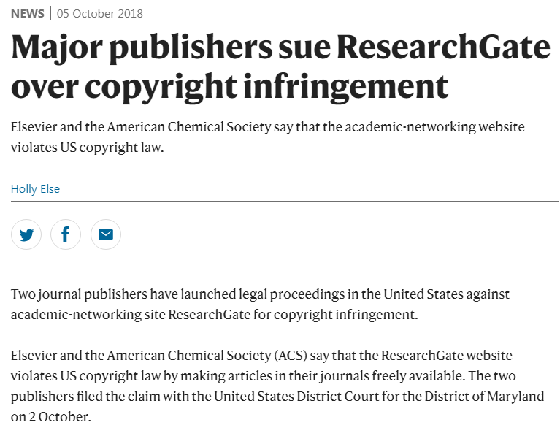

Slide 21
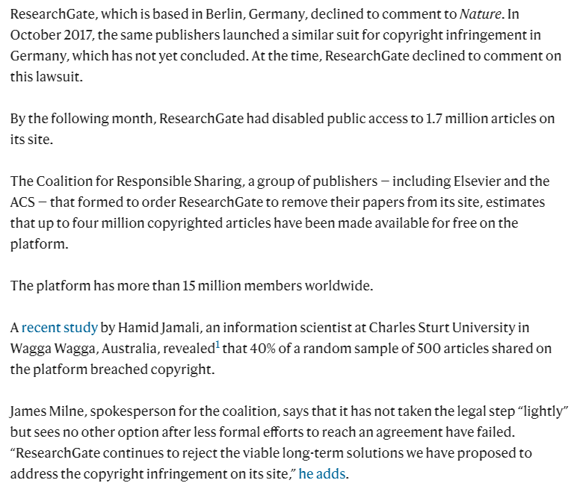

Slide 22
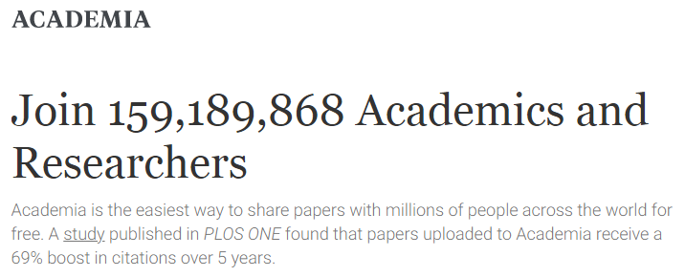
Academia.edu

Slide 23
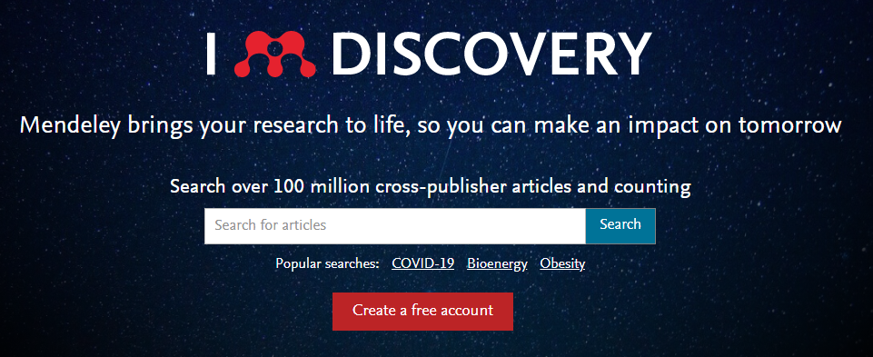
Mendeley

Slide 24
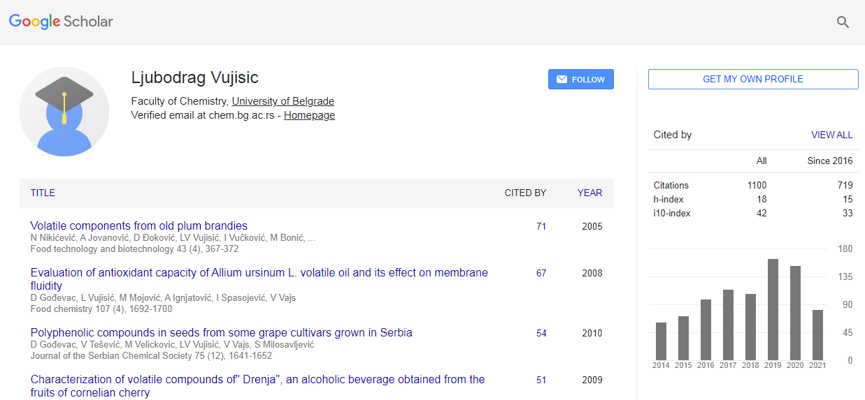
Google Scholar

Slide 25
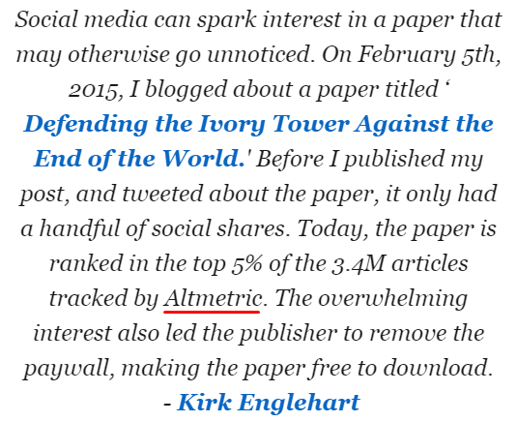
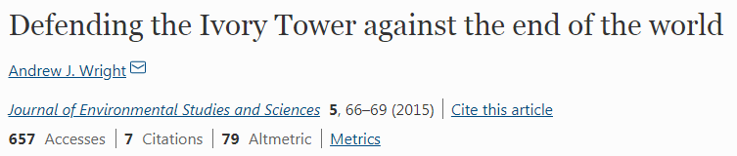
Altmetric

Slide 26
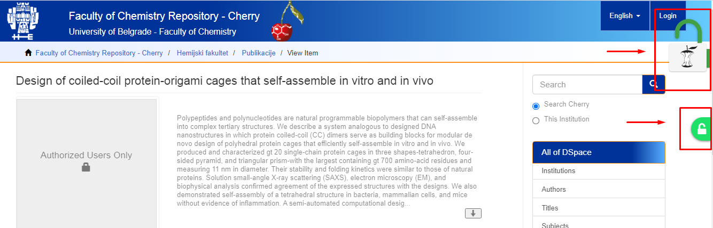
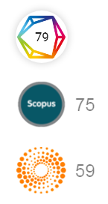
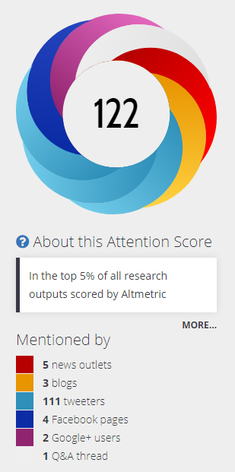
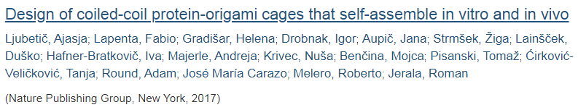

Slide 27
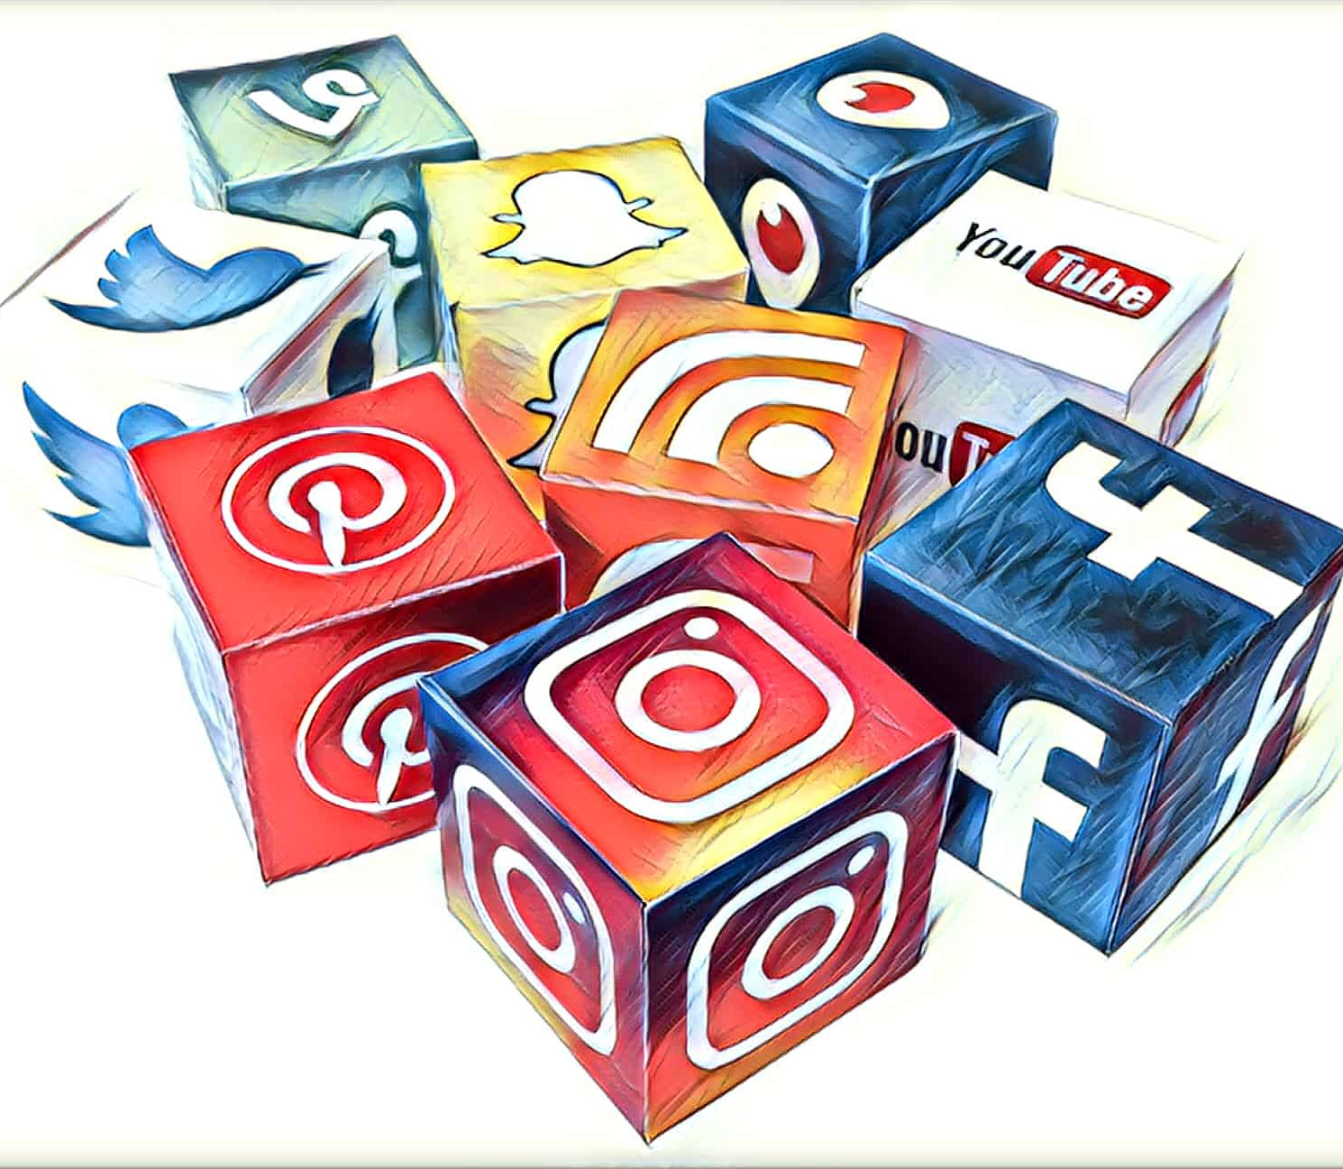
Facts
You don’t need thousands of followers to have an engaged audience, smaller audience can be more engaged.
You have great control over your visibility, not just in terms of privacy, but also in what you choose to share.
The fast-paced and live aspect of social media can lead skeptical researchers not to publish, but good reactions and quick responses can increase a researcher’s credibility.

Slide 28
“Social media is about socioology and psyschology more than technology.”
Brian Solis

Slide 29
Issues Approaches
Explain benefits of using social media
Inertia in accepting technological innovation
The role of librarians in the transition to new technologies –
through trainings and courses
Gap between digital and information literacy
Find and use relevant information with librarian suggestions
Hyperproduction of irrelevant information

Slide 30
Training focus
Motive
increasing reach > be active in multiple communities related to your specialty
Elaboration
benefits
copyright
CC licenses
Support
researchers will know who can help them

Slide 31
Formats
Format | Methods | Technical requirements | Topics
Lecture + demo for researchers (90 min) | Verbal presentation Social media features: demonstration Registration: demonstration Participants are free to ask any questions they may have during the presentation | Computer + video beam Online | Full range
In person (~45 min) | Introduction to social media Platforms for sharing content and searching content Participant is free to ask any questions | Live – in library Online | Depends on researchers’ or librarians’ prior knowledge

Slide 32
References
“Academic Social Networking Sites ... and Journals.” 2017. https://www.ceon.rs/index.php?option=com_content&view=article&id=564:academic-social-networking-sites-and-journals&catid=172&lang=en&layout=post&Itemid=579.
Alstyne, Jennifer van. 2019. “Social Media Platforms for Academics, A Breakdown of the Networks.” The Academic Designer. August 9, 2019. https://theacademicdesigner.com/2019/social-media-platforms/.
“Digital 2021: Global Overview Report.” n.d. DataReportal – Global Digital Insights. Accessed June 13, 2021. https://datareportal.com/reports/digital-2021-global-overview-report.
Jaring, Päivi, and Asta Bäck. 2017. “How Researchers Use Social Media to Promote Their Research and Network with Industry.” Technology Innovation Management Review 7 (8): 32–39.
“Major Publishers Sue ResearchGate over Copyright Infringement.” n.d. Accessed June 14, 2021. https://www.nature.com/articles/d41586-018-06945-6.
Rogers, J. 2019. “The Use of Social Media and Its Impact for Research.” BioResources 14 (3): 5022–24.
Rushforth, Björn Hammarfelt, Sarah de Rijcke, Alexander D. 2016. “Quantified Academic Selves: The Gamification of Research through Social Networking Services.” Text. Professor T.D. Wilson. June 15, 2016. http://www.informationr.net/ir/21-2/SM1.html#.YMknXuAza00.
“Social Media for Scientists.” 2018. Nature Cell Biology 20 (12): 1329–1329. https://doi.org/10.1038/s41556-018-0253-6.
Tankovska, H. n.d. “Social Media - Statistics & Facts.” Statista. Accessed June 15, 2021. https://www.statista.com/topics/1164/social-networks/.
“The A to Z of Social Media for Academia.” 2019. Times Higher Education (THE). October 28, 2019. https://www.timeshighereducation.com/a-z-social-media.
“The ResearchGate Score: A Good Example of a Bad Metric.” 2015. Impact of Social Sciences (blog). December 9, 2015. https://blogs.lse.ac.uk/impactofsocialsciences/2015/12/09/the-researchgate-score-a-good-example-of-a-bad-metric/.
“The Value of Social Media for Researchers | LinkedIn.” n.d. Accessed June 14, 2021. https://www.linkedin.com/pulse/value-social-media-researchers-tamika-heiden/?trk=prof-post.

Slide 33

Questions?
anadj@chem.bg.ac.rs
@ana_carpediem
Ana Đorđević

