Slide 1


Supporting researchers
Milica Ševkušić
Institute of Technical Sciences of SASA,
Belgrade, Serbia
EIFL Open Access Programme Coordinator in Serbia
25 August 2021

Slide 2
Outline
Local context in Serbia
General considerations
Support throughout the research cycle, with examples
Conclusion
Q&A
Focus
Support can be provided despite limited resources.

Slide 3
Brief intro: local context in Serbia
Support to the research process is not explicitly mentioned in LIS regulations,
nor is it properly addressed in the LIS curriculum and certified professional development programmes.
Whether and how librarians should support researchers is still a matter of dispute.
No formal guidelines
In most cases, no dedicated staff
Services: in most cases, traditional (information retrieval; library exchange), citation reports, Ask a Librarian
Support to scholarly publishing (Diamond OA; institutional publishers; researchers as editors and reviewers)

Slide 4

Research support in Serbian libraries
National library consortium
Access to academic databases
Additional (in-house) services
User support
Support to scholarly publishing (doiSerbia)
Training (general)
Training for PhD students supported by the government
Limitation: small team
Scientific Information Departments
Services: information retrieval, library exchange, citation reports, etc.)
Ask a librarian
Training for PhD students (University Library, UoB)
Repositories (recently)
Limitations: limited staff and funding, unclear status and roles (overlaps with public libraries)
University libraries
Mostly focused on services for students
Repositories (recently)
Citation reports, metrics (some)
Support to scholarly publishing (some)
Training (not a regular practice; notable examples: Faculty of Dentistry, Faculty of Chemistry, UoB)
Limitations: limited staff; limited communication between researchers and librarians
Faculty libraries
Mostly one-person libraries, some fully inactive
Repositories (recently)
Training
Services: information retrieval, citation reports, metrics, reporting
Support to scholarly publishing (some)
Libraries at research institutes

Slide 5
What does a librarian need in order to be able to support researchers? (skillset)
Context-related knowledge
Research lifecycle
User needs and behaviours
Open Science
Scholarly publishing
Copyright and licensing
Research evaluation
Skills
Advanced digital skills
Information retrieval
Metadata
Citation analysis
Metrics
Educational and training skills
Data analysis (emerging)
Other
All sorts of soft skills
Tacit knowledge
Advanced knowledge of English (and other languages, in SSH)
Domain-specific knowledge is an advantage
Services and tools
Academic databases
Aggregators and search engines
Reference managers
Text and image editing tools
Repository software
Communication tools
Visualization tools

Slide 6
Main areas of work
Maintaining infrastructure
Designing and maintaining services
Assistance
Training and advocacy
Guiding idea
Connecting people and information.
People may not be aware that they need a particular piece of information.

Slide 7

Know your users...and their needs.
Users’ needs?
Current?
Future?
Tacit?
Anticipated?
Designed?
Unsustainable?

Slide 8
Diverse priorities
Infrastructure
Services
Structured and regular training
Compiling and designing learning resources
Improving the institutional visibility
Open Science
Research Data Management
Assistance in research promotion procedures
Impact factors and rankings
Citation counts and analysis
Increasing the individual visibility
Personal assistance in general (literature search, preparing publications, copyediting, RDM, depositing in the repository)
Customized training as needed
L
R
LIBRARIANS
Focus on supporting the research process
RESEARCHERS:
Focus on supporting individual researchers

Slide 9
Information discovery and evaluation
Sources of information
Available sources
What can be found where?
Aggregators and academic search engines are underused (OpenAIRE, BASE, CORE, LENS)
Using the full range of functionalities (saved searches, alerts, similar articles, etc.)
Searching
Limited searching skills
Misperception of one’s searching skills
Advanced search and filters are insufficiently used
Insufficient adoption of reference managers (saving and organizing search results)
Major training challenge, for many reasons
Finding full text (legally)
Zotero functionality
Google Scholar
Unpaywall plugin
CORE plugin
Aggregators available through the institutional subscription
Information evaluation
Assessing the quality of retrieved resources
Identifying retracted publications (Zotero, RW database)
Post-publication peer-review (Pubpeer, Altmetric)

Slide 10
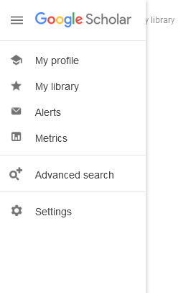
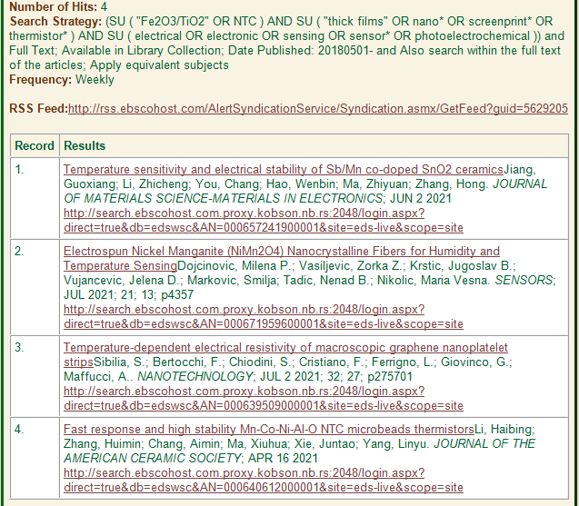
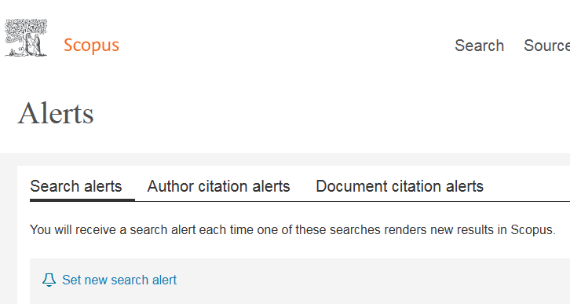
Example: saved searches and alerts
EBSCO Discovery alerts (federated)
Setting up personalized alerts to be delivered directly to users’ inboxes
Training users how to to this

Slide 11
Reference managers
Zotero (free and open-source)
Download: https://www.zotero.org/
Documentation: https://www.zotero.org/support/
Forums: https://forums.zotero.org/discussions
High priority in training!
Importing and exporting references
Organizing references
Formatting lists of references
Inserting citations into text documents
Support for 9000+ citation styles
Profiles and groups (sharing references)
JabRef (free and open-source; BibTeX)
Download: https://www.jabref.org/#download
Documentation: https://docs.jabref.org/
Poor adoption among researchers
Continued support for advanced options and troubleshooting is required
Librarians unfamiliar with academic writing are not likely to provide competent training and support
Mendeley (free, owned by Elsevier)
Download: https://www.mendeley.com/download-desktop-new/
Support: https://www.mendeley.com/guides
Challenges

Slide 12

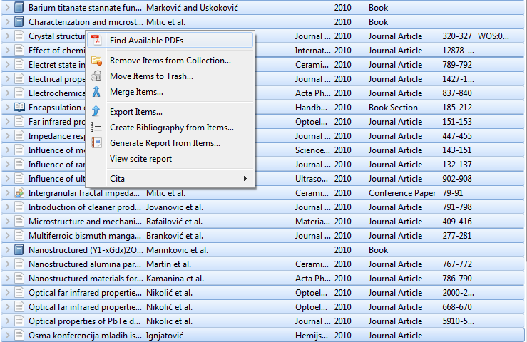

Finding full text
Unpaywall browsers extension
Zotero functionality
https://unpaywall.org/products/extension
CORE Discovery extension
https://chrome.google.com/webstore/detail/core-discovery/ockidfiihjhkngdalfnbeeepgfbmkmlh
Supported by Unpaywall: https://www.zotero.org/blog/improved-pdf-retrieval-with-unpaywall-integration/

Slide 13
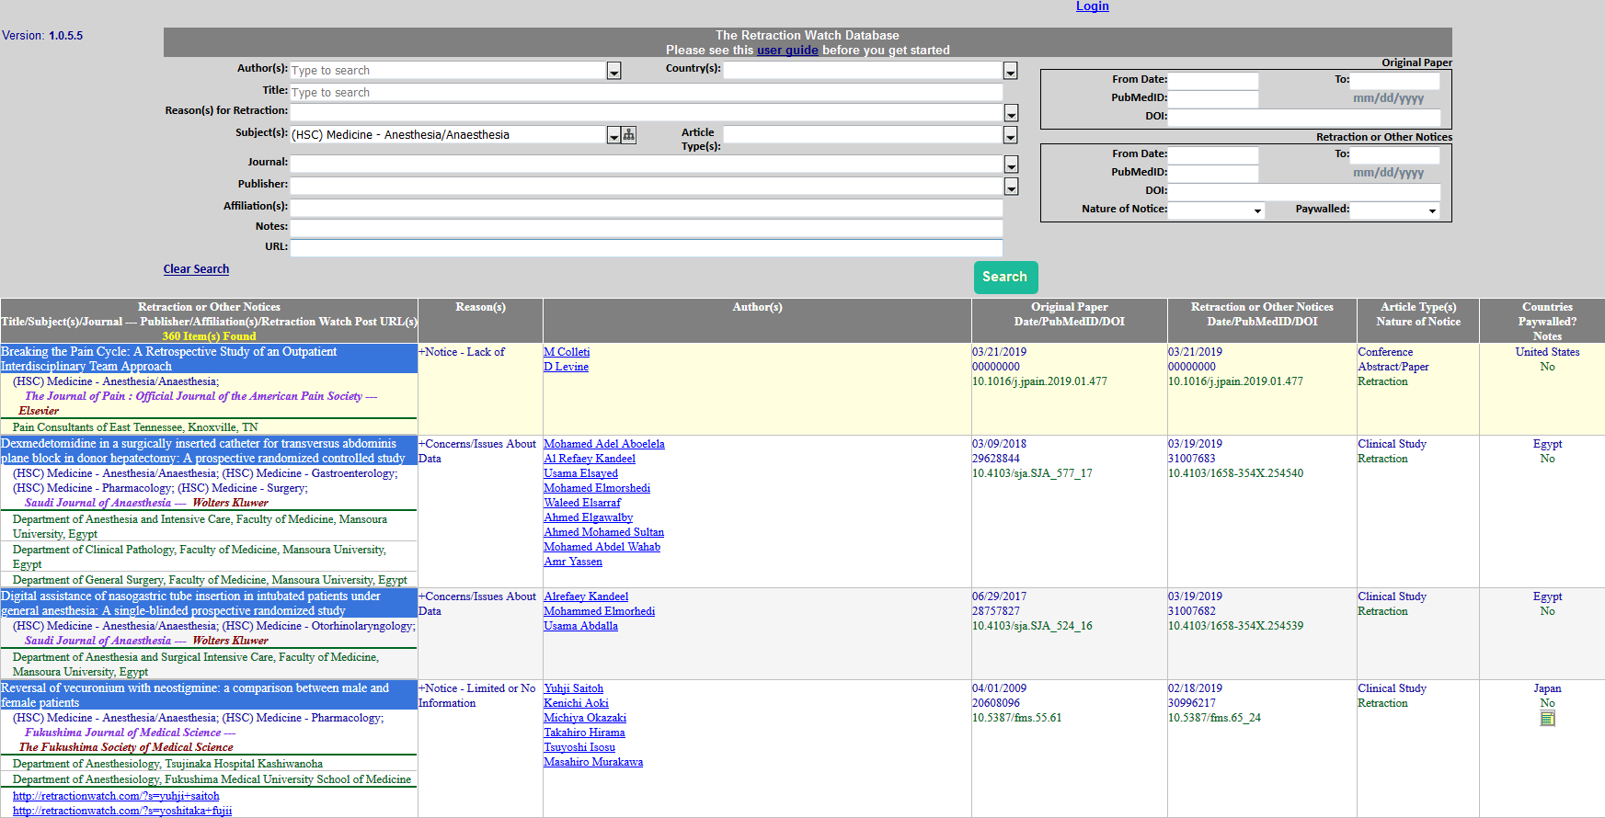
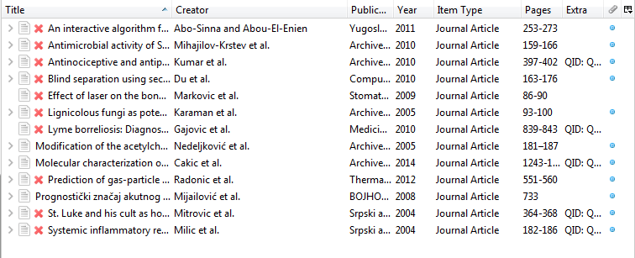
Identifying retracted publications
Retraction Watch database: http://retractiondatabase.org/RetractionSearch.aspx?
Zotero integration: https://www.zotero.org/blog/retracted-item-notifications/

Slide 14
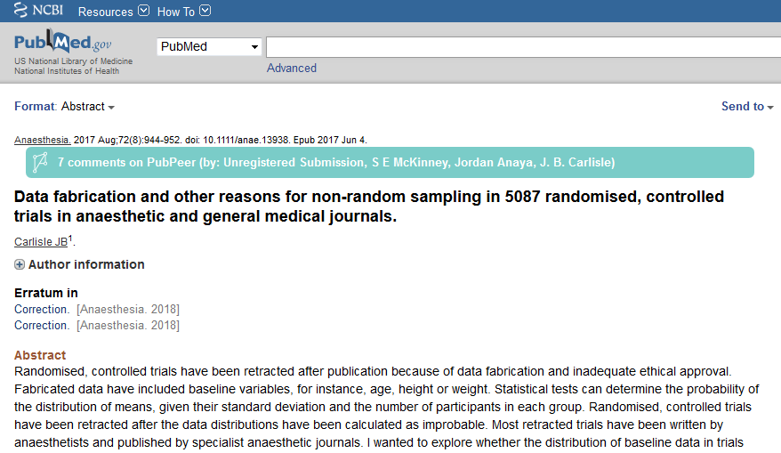
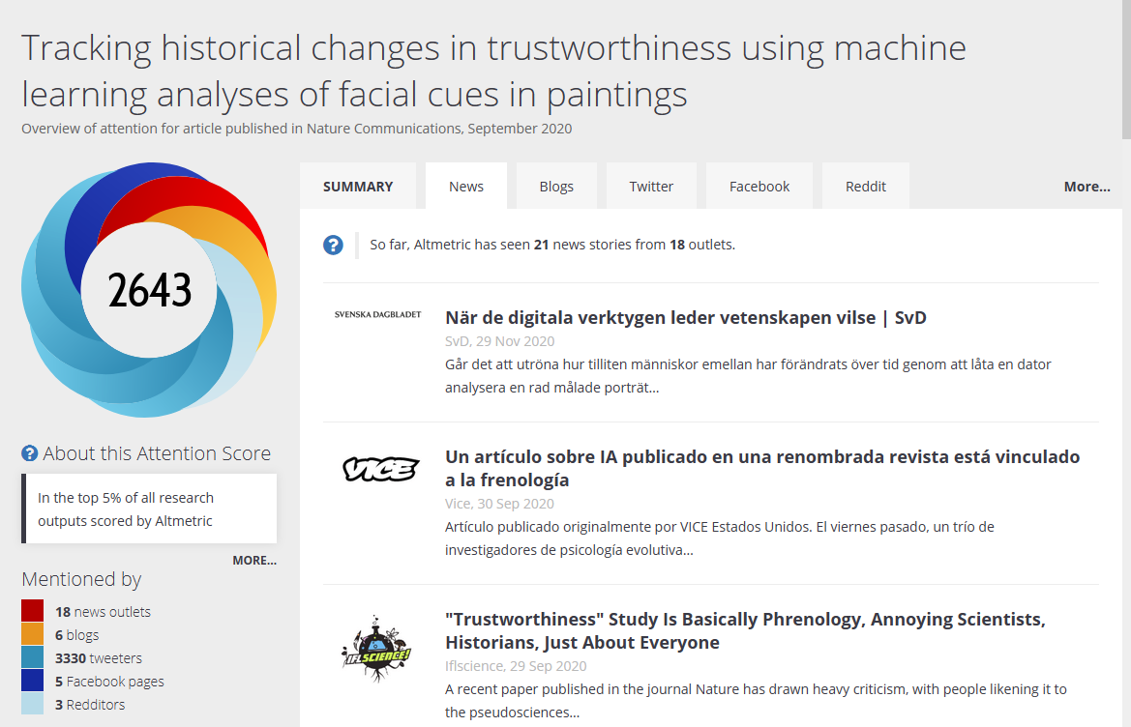
Post-publication peer-review
Altmetric: https://www.altmetric.com
Browser extension: https://www.altmetric.com/products/free-tools/bookmarklet/
Pubpeer: https://blog.pubpeer.com/
Browser extensions: https://pubpeer.com/static/extensions

Slide 15
Research Data Management
Training
FAIR data
writing Data Management Plans
Tools (Argos, DMP Online, Amnesia, etc.)
Support in data management
Choosing sustainable formats
Choosing a repository
Depositing
Creating metadata
A rather new topic
Abundant learning resources, e.g. https://bit.ly/3Dew37m
Poor adoption among researchers, unless they have to comply with a mandate
Superficial approach
Continued support is required
Discipline-specific knowledge is important
Challenges
Local example: Resources created through a project funded by EOSC Secretariat: https://rdm.open.ac.rs/

Slide 16
Preparing and submitting publications
Preparing publications
Handling images (formats, software)
Finding (free) software solutions (e.g. data processing, multimedia and presentations, etc.)
Reading and copyediting
Screening for plagiarism (if you have appropriate tools)
Obtaining permissions for copyrighted materials
Finding and understanding author guidelines
Finding peer-reviewers, if required (using advanced search in bibliography databases)
Publication
Finding a reliable journal
Open Access options (APCs, waivers and discounts, compliance with mandates)
Writing the cover letter
Submitting the manuscript (troubleshooting during the submission procedure)
Communication with editors and peer-reviewers
Using user support provided by publishers

Slide 17
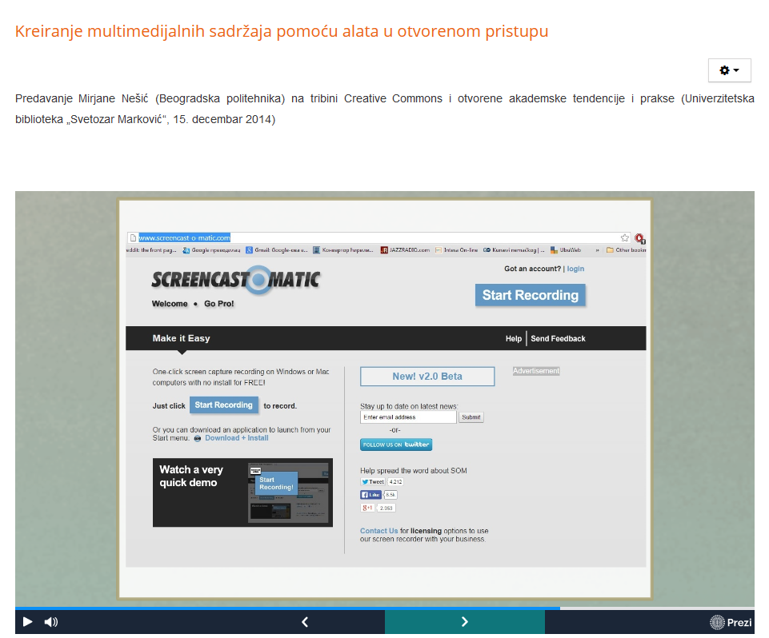
Software tools
Local example:
Training on free multimedia tools by Mirjana Nešić (librarian)
Bitmap images: https://www.gimp.org/
Vector images: https://inkscape.org/
Interactive notebooks: https://bit.ly/3klQnuH
Visualizations: https://d3js.org/
...
Sustainability of software solutions and formats
Researchers are not always ready to learn
Free solutions are sometimes not available
Challenges

Slide 18
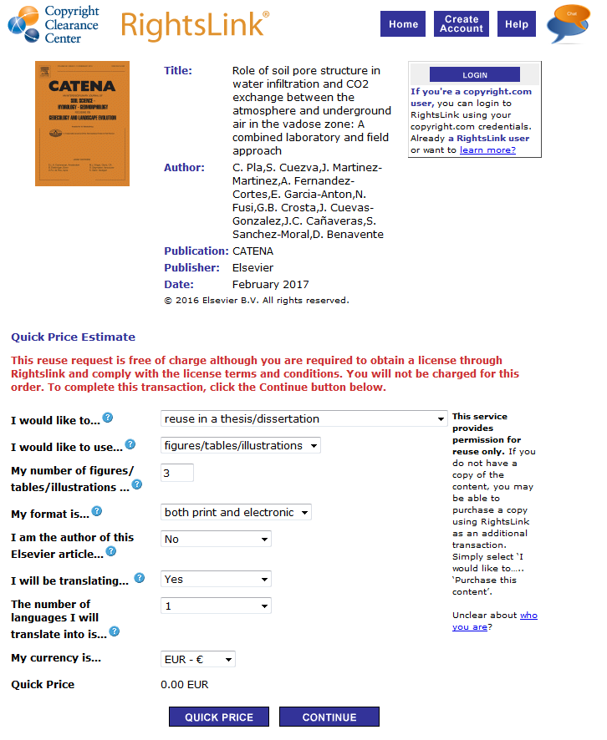
Copyright, licensing, permissions
Using RightsLink to obtain permission
Creative Commons Licenses: https://creativecommons.org/
SherpaRomeo (journal self-archiving policies): https://v2.sherpa.ac.uk/romeo/
Free images (CC0): https://www.pexels.com/, https://commons.wikimedia.org/wiki/Main_Page
Chemical structures: http://www.chemspider.com/
Infographics (freemium): https://infogram.com/
Researchers are often unaware that permission is required.
Intentionally made complicated by publishers.
Legal advice may be required.
Training is not sufficient - personal assistance is required.
Challenges
http://www.copyright.com/publishers/rightslink/

Slide 19
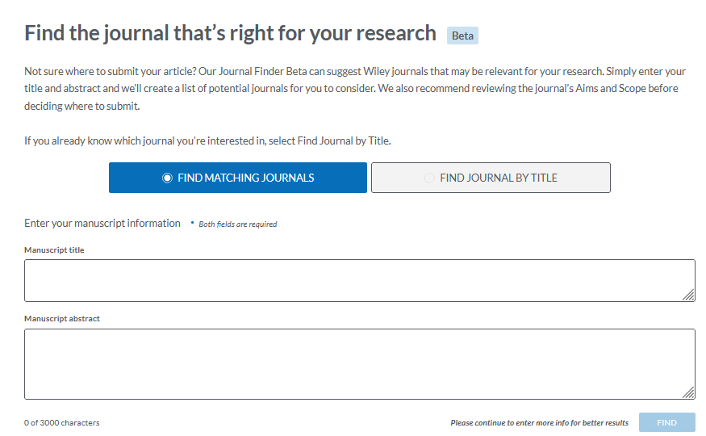
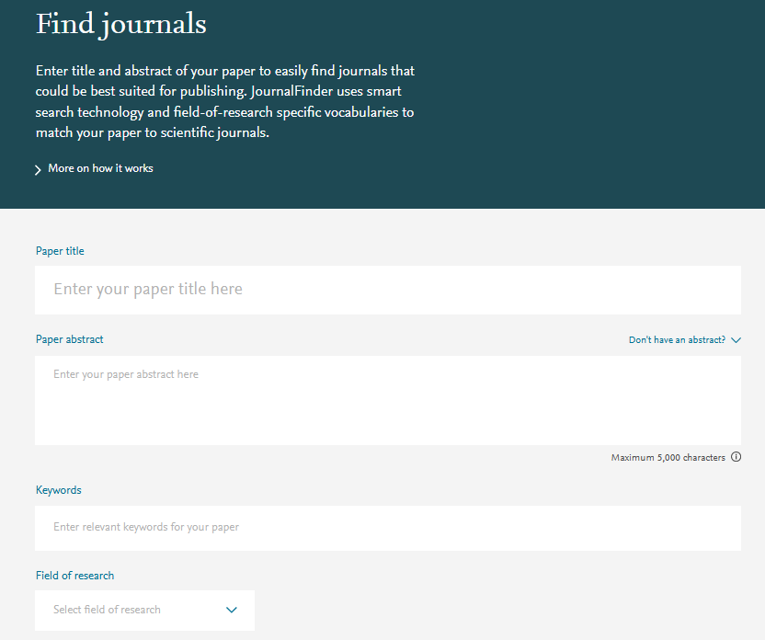
Finding journals
Unsurprisingly, tools developed by publishers will help you find journals published by those specific publishers.
Help researchers find the following information:
Is the journal legitimate?
Does it have clear policies and all relevant information on the website?
Is it published regularly?
Has it been mentioned in a negative context?
Impact factor?
Average length of the peer-review process (based on submission and acceptance dates)?
Are there retracted articles and what were the reasons for retraction?
Is there anything suspicious?
Wiley Journal Finder: https://journalfinder.wiley.com/search?type=match
Elsevier Journal Finder:
https://journalfinder.elsevier.com/

Slide 20

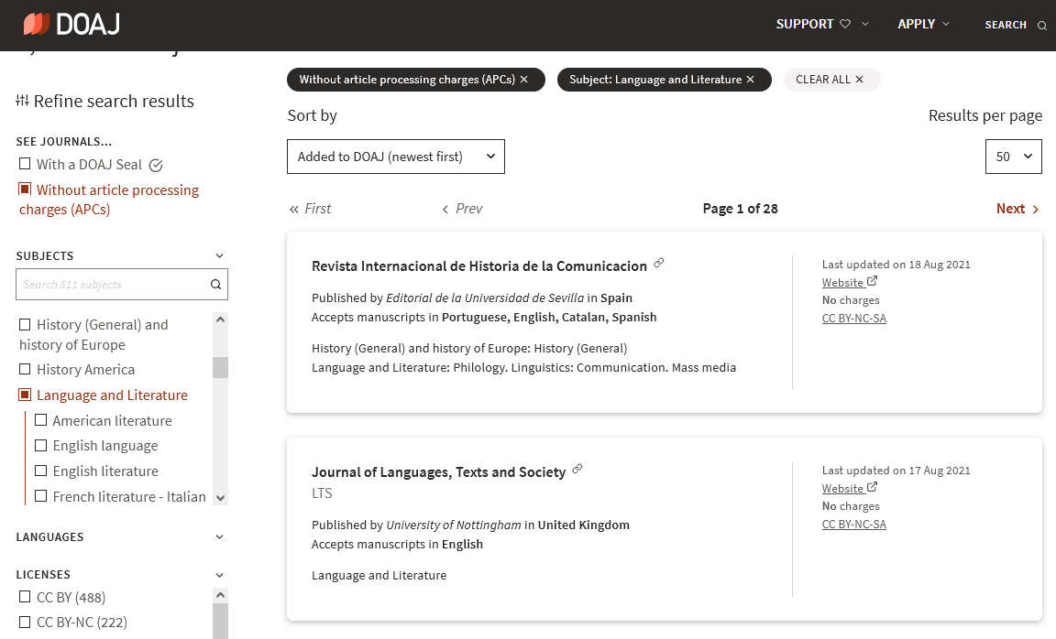
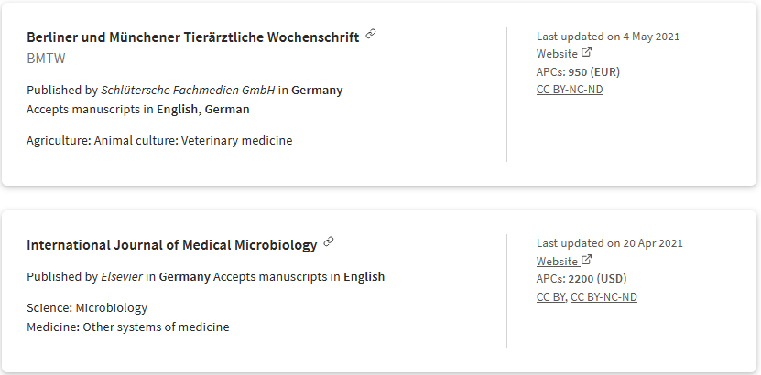
Finding Open Access journals
DOAJ: https://doaj.org/
https://thinkchecksubmit.org/
All sorts of troubles associated with disputable journals, esp. atypical cases.
Researchers are often unaware of no-fee options and waivers and discounts.
Personal assistance is desirable.
Challenges
Waivers and discounts for EIFL members: https://eifl.net/apcs

Slide 21
Dissemination, visibility, impact
Dissemination
Maintaining a repository (interoperability, SEO)
Website
Training about institutional and individual visibility
Social media, if resources and staff are available
Individual visibility
Training about researchers’ identities - ORCID, Scopus ID, Researcher ID (Publons)
Personal assistance for ORCID, Scopus ID,
Research ID (Publons)
Correcting information about researchers in Scopus and WoS...and elsewhere
Facilitating citation tracking
Training on metrics and impact measurement
Citation reports
Training on social networking sites for researchers
Institutional visibility
Institutional profile in Scopus (or other available database)
Saved lists in Scopus related to the institution and its departments
Correcting errors (author information, affiliations, citations) in Scopus and WoS
Using metrics provided by citation databases in reports
Using information available in the repository reports
LENS.org (to do)

Slide 22
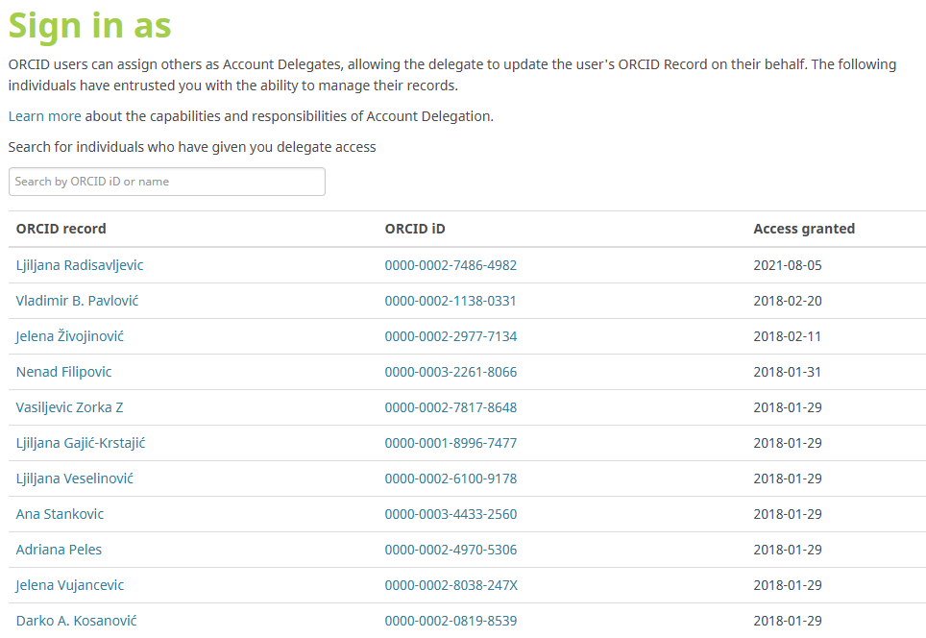
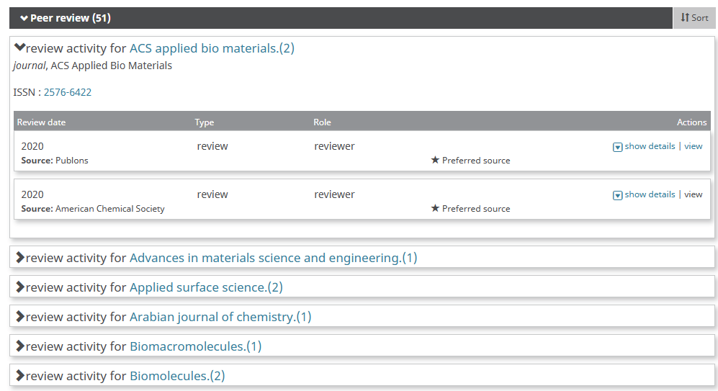
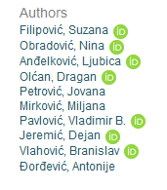
ORCID
Researchers can authorize a librarian to update their ORCID profiles
Making peer-review engagement visible in ORCID (integration with Publons)
https://support.orcid.org/hc/en-us/articles/360006971333-Peer-Review
https://www.eifl.net/events/webinar-researcher-identity-orcid
ORCIDs in the institutional repository

Slide 23
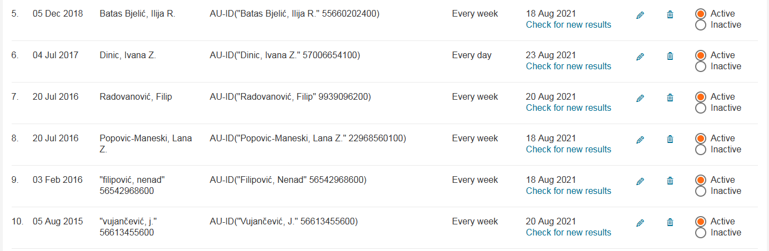
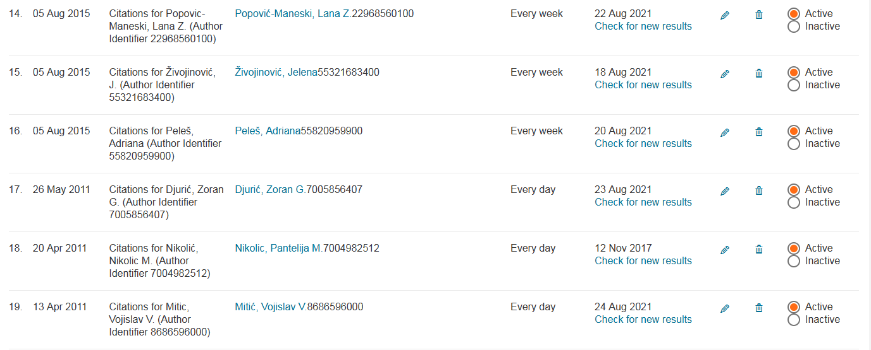
Scopus alerts
Researches get e-mail alerts when their papers get indexed by Scopus
E-mail alerts are delivered to researchers telling them how many new citations their papers have gained
This works only if author profiles are consolidated.
https://blog.scopus.com/posts/check-correct-submit-how-to-ensure-accuracy-in-your-scopus-author-profile
These alerts are set up by the librarian

Slide 24
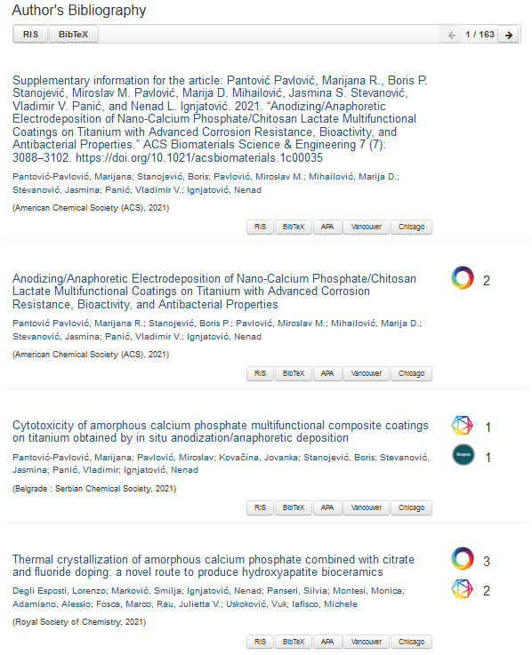
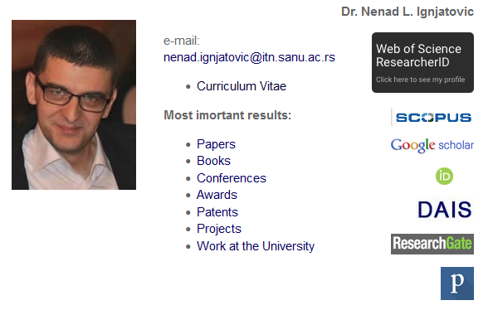
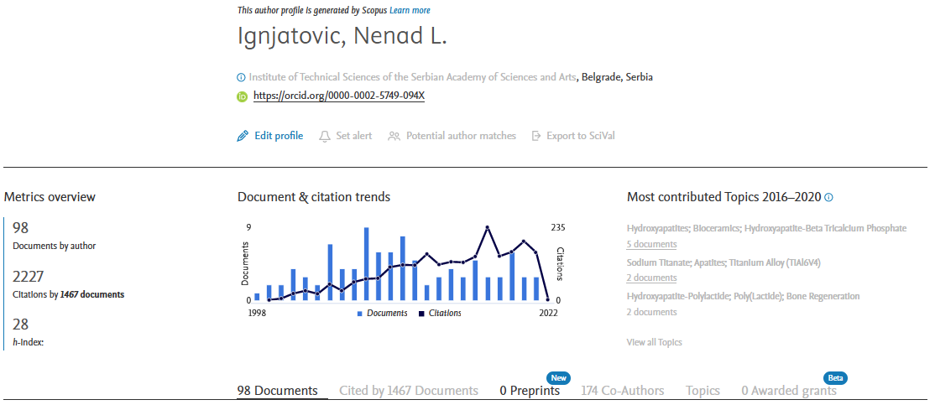
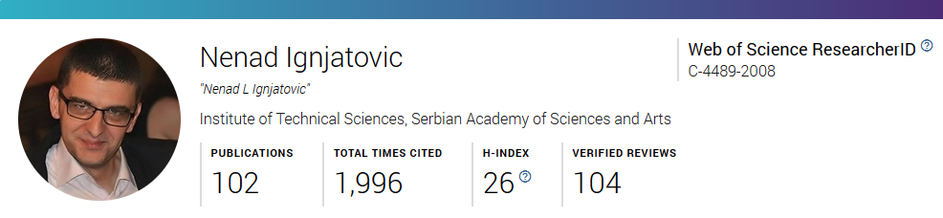
Citation tracking made easy

Slide 25
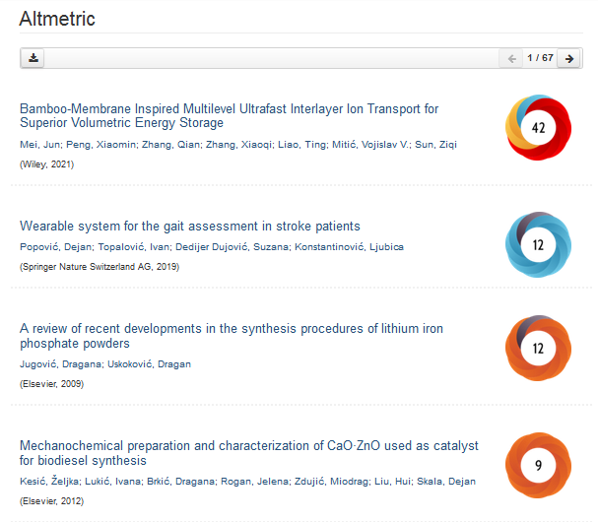
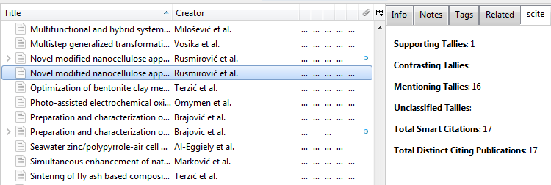
Smart citations and altmetrics
Scite: https://scite.ai/
scite browser extension: https://addons.mozilla.org/en-US/firefox/addon/scite/
Zotero integration
Misconceptions related to metrics
Metrics provided by social networking sites are often taken for granted
Integration with the repository: https://www.eifl.net/events/webinar-enrich-your-dspace-repository-customized-tools
Challenges

Slide 26
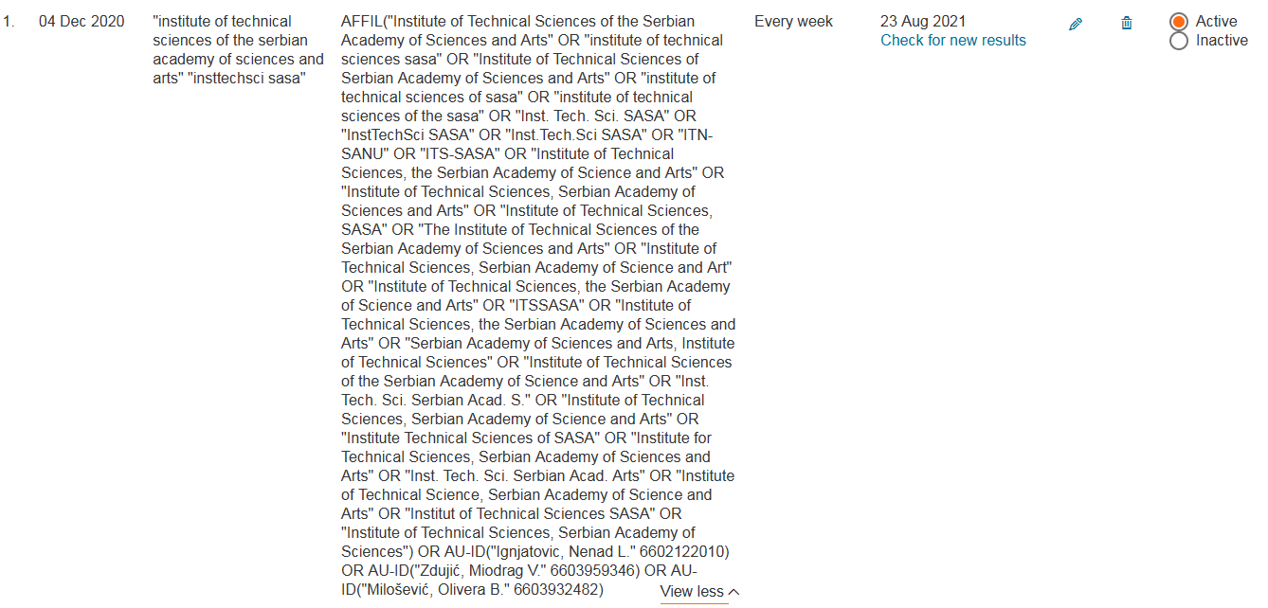
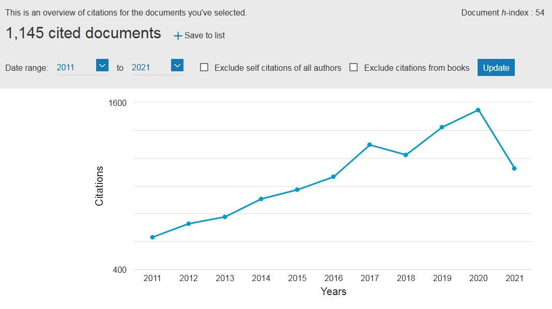
Institutions in Scopus
Saved lists in Scopus (institution and research groups)
Problem:
Limited number of records - not suitable for large institutions!
Citation overview based on a saved list
Alert, based on a saved search, informing the librarian about newly indexed publications affiliated with the institution

Slide 27
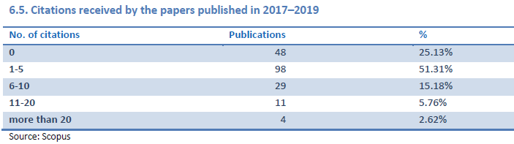
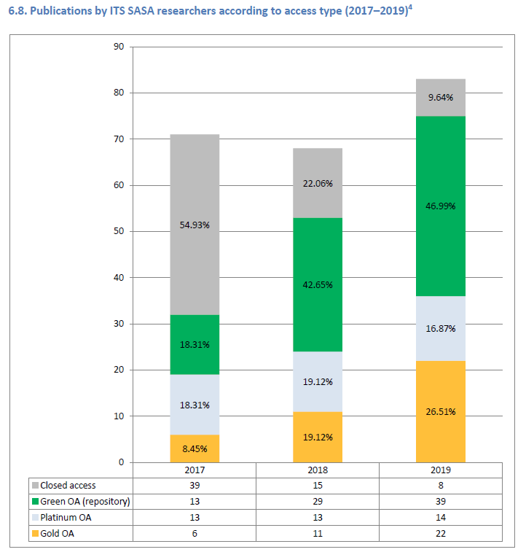
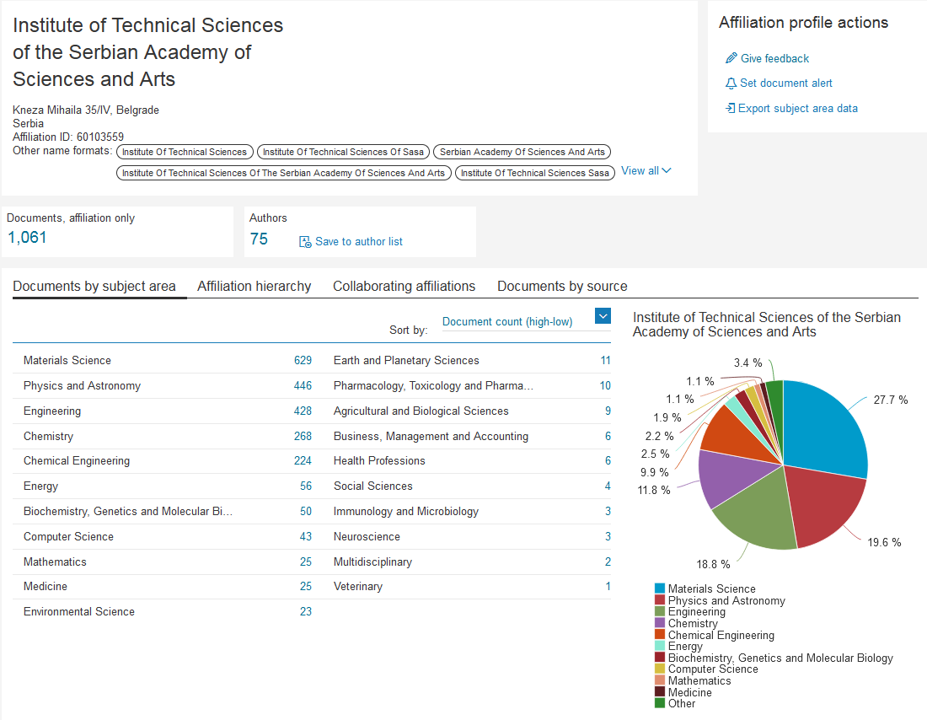
Reports
Institutional profile in Scopus
Based on the information from the institutional repository

Slide 28
Communication
Choose preferred (and feasible) communication paths
Be where your audience is!
Be responsive and reliable!
Establish rules, so that researchers know when they can expect response, but also to protect your private time.
Encourage feedback!
Sending unsolicited news is not always a bad practice.
If you have resources, services like live chat are a great option!

Slide 29
A piece of advice
Test and use advanced functionalities, especially if you are paying for a service
Developing services in not always costly, especially if you build upon what you already have
Test tools in detail before presenting them to researchers
Crowdsource learning resources
Produce learning resources in researchers’ mother tongue
Network with colleagues: you don’t have to be an expert in all areas

Slide 30
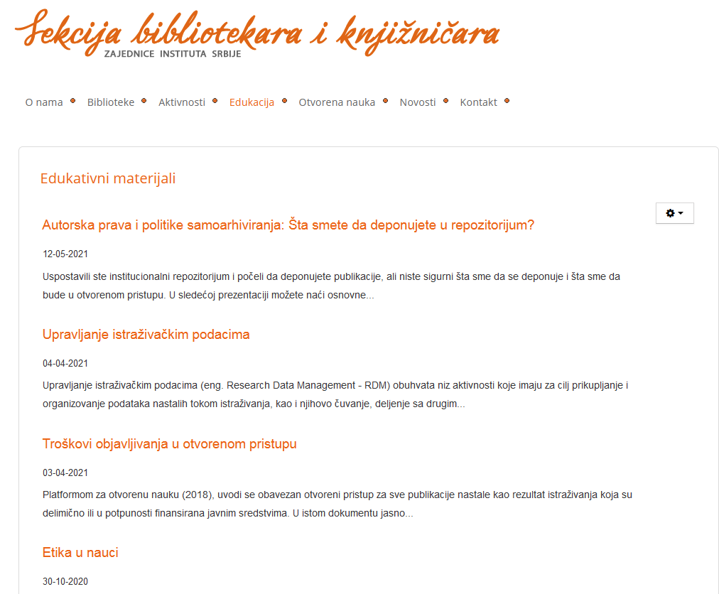
Training programme and training resources for researchers developed by research librarians from Serbia
http://www.itn.sanu.ac.rs/sekcija/index.php/predavanja-i-radionice-za-istrazivace

Slide 31

Questions?
scmilica@gmail.com
Twitter: @lessormore4
Template Green Marketing, designed by Jimena Catalina; Slides Carnival. CC BY.
Images: https://www.pexels.com, CC0.

