Slide 1


USING OJS FOR DOAJ INDEXING AND CONTENT DELIVERY
MARIYA MAISTROVSKAYA
PKP PUBLISHING SERVICES
23 APRIL 2025

Slide 2
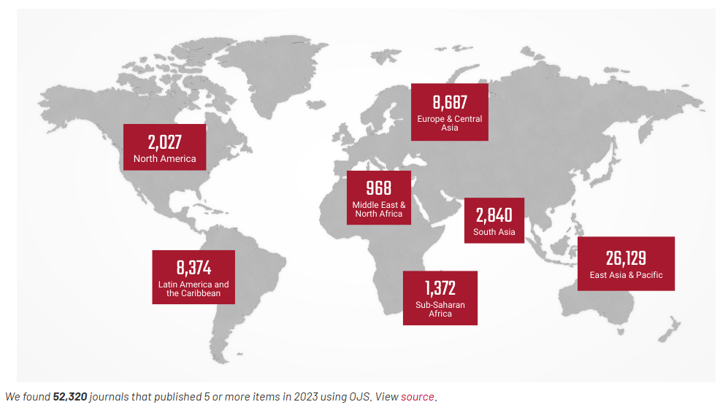
OPEN JOURNAL SYSTEMS BY PKP
Notes:
Public Knowledge Project (PKP) is a non-profit research and development initiative within Simon Fraser University in Canada. It developed open source software for publishing, such as OJS (Open Journal Systems) which can be downloaded and used for free by anyone in the world. Over 52,000 journals use PKP software globally.

Slide 3
HOW OJS CAN HELP WITH DOAJ APPLICATION

Slide 4
ASSESS YOUR DOAJ READINESS
You are ready to apply to DOAJ when your journal meets Basic criteria for inclusion, including but not limited to:
Is online and fully open access
Has a confirmed journal title and ISSN
Follows a quality control processes
Clearly states copyright and licensing terms
Clearly states details about fees
Has published at least 5 research articles in the last year; for new or flipped journals - has a publishing history of more than 1 year, or at least 10 OA research articles
Notes:
Here are a few of the Basic criteria for inclusion - https://doaj.org/apply/guide/#basic-criteria-for-inclusion you journal has to meet in order to apply:
Is Open Access based on DOAJ's Definition of OA
Has a website with a dedicated URL and homepage
Has a confirmed journal title and ISSN
Follows a quality control process for peer review and publishing
Has clearly stated copyright and licensing terms applied to all articles
Has clearly stated details about which fees are charged, including if there are no fees
Has published at least 5 research articles in the last year; for new or flipped journals - has a publishing history of more than 1 year, or at least 10 OA research articles
Check the rest of theBasic criteria for inclusion - https://doaj.org/apply/guide/#basic-criteria-for-inclusion

Slide 5
PREPARE TO APPLY
DOAJ’s guide to applying
  https://doaj.org/apply/guide/
DOAJ’s online application form (requires an account)
  https://doaj.org/account/login?redirected=apply
DOAJ’s list of questions in PDF (for reference only)
  https://doaj.org/static/doaj/docs/DOAJquestions-for-reference-only.pdf
PKP’s DOAJ application guide for OJS journals
  https://docs.pkp.sfu.ca/doaj/en/
Notes:
PKP’s DOAJ application guide for OJS journals https://docs.pkp.sfu.ca/doaj/en/ provides step-by-step instructions on where in OJS to add the info required by DOAJ.

Slide 6
PREPARE YOUR OJS SITE

Slide 7
INFO ON JOURNAL WEBSITE
The following information must be available online, and easily accessible from the journal homepage:
Open access policy
Aims and scope
Editorial board (including institutional affiliations of all members)
Instructions for authors
Editorial process (peer review)
Licensing terms
Copyright terms
Author charges
Contact details
Notes:
In your DOAJ application, you will be asked to provide various links that point to key requested information shown on the screen.
Great new is, if you’re using OJS a good portion this requested information will displayed on your journal homepage when you enter the information on the designated field on your journals setting fields
Most of the information you’ll need to present can be entered in your Journal Settings.
I will highlight a few of the places where you can enter the necessary information. This is not an exhaustive list of all DOAJ requirements - I suggest that you go through each section of the DOAJ application guide for OJS, to ensure your journal is fully prepare for the application.
I will be demonstrating some of these settings on the OJS 3.3 journal, so if you are using a different version then your display may look a little different.

Slide 8
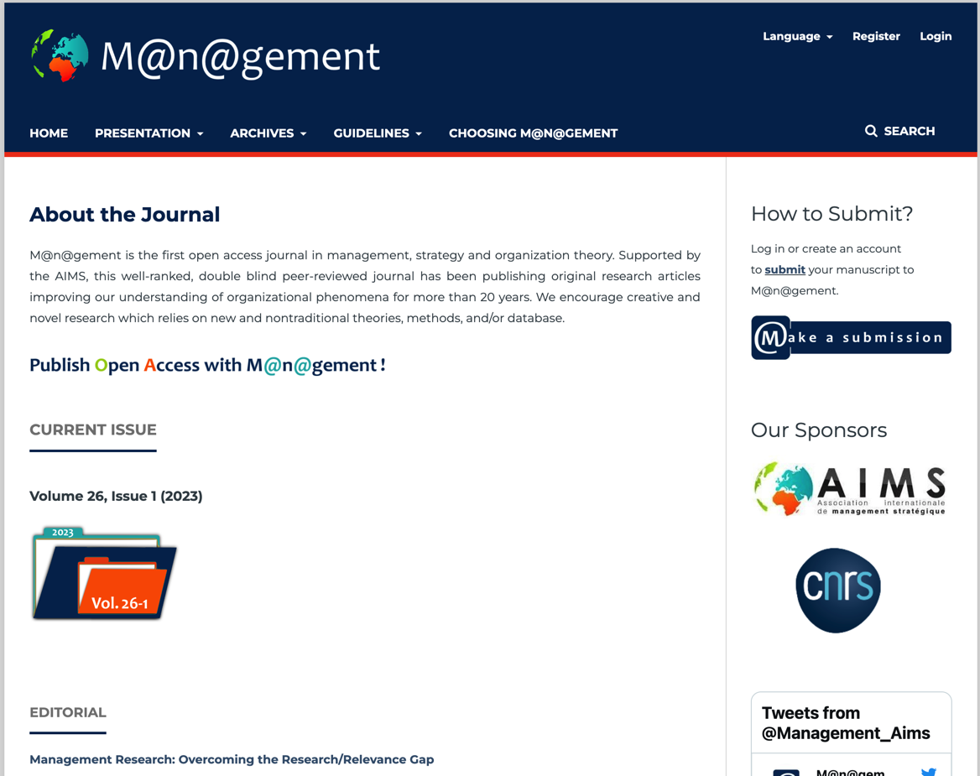
JOURNAL AND PUBLISHER INFORMATION
Include in:
Masthead
  About Journal
  Journal Summary
Contact
Sidebar
Footer
Example: M@n@gement - journal website
Notes:
Starting off with your Journal and Publisher Information.
Your journal and publisher information should be entered on your journal Settings within your Masthead and Contact tab
The publisher information should be entered in two places: under your Publishing Detail and in Contacts. Information about the ownership and management of a journal should be clearly indicated on the journal's website. If a journal is affiliated with a society, institution, or sponsor, links to their website(s) should be provided where available.
Some journals may choose to include an external link to their affiliated body from their navigation page or as an embedded link in the description or logo.
In your About Journal description or summary, you could include following key information such as your open access statement/policy, publication schedule, target readership, practices and policies. As you will likely be displaying a lot of information here, we would recommend utilizing headers to keep the information organized.
You can also choose to display some of this information on your sidebar (if your theme allows) and your footer.
Additional resources on adding journal and publisher information in OJS:
Masthead section of the Learning OJS guide https://docs.pkp.sfu.ca/learning-ojs/en/journal-setup#masthead
Contact section of the Learning OJS guide https://docs.pkp.sfu.ca/learning-ojs/en/journal-setup#contact

Slide 9
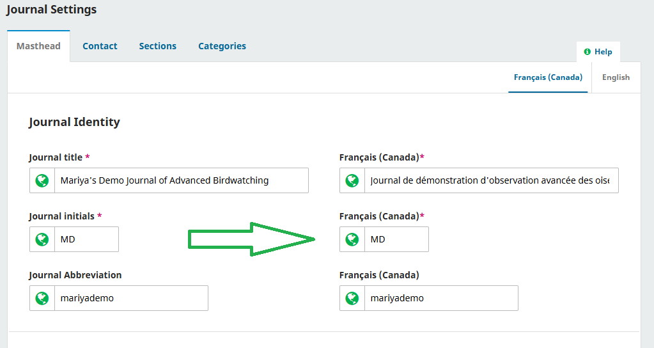
MULTILINGUAL JOURNAL TITLES
Add translated journal title in the respective field for the other language(s)
Notes:
A note re journal title
Make sure the journal title you input here matches the title on your DOAJ application form and ISSN.
If there is a translated or multilingual title, this should be entered as an alternative title (i.e., designated locale field)
Additional resources on multilingual publishing:
https://docs.pkp.sfu.ca/multiling-guide/en/

Slide 10
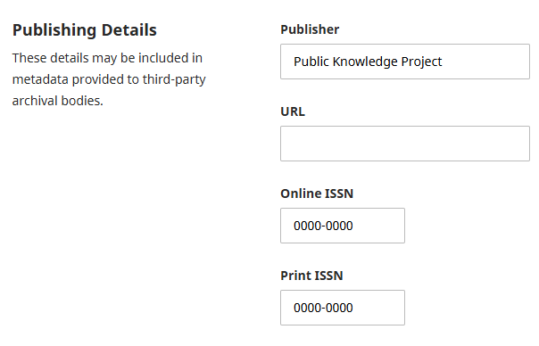
ISSN AND PUBLISHER
“Publisher” and “ISSN” fields in the Masthead are for internal use (not public)
To display this info your public website, include it in About the Journal, in the journal’s footer or sidebar
Notes:
A note re Publisher and ISSN fields in the Masthead
These fields are not automatically displayed on your public site. Rather, they are used for internal purposes like for metadata exports to Crossref
To display your Publisher on your public website for DOAJ to see, you can add them to your About the Journal section or to the Contacts
To display your ISSN, you can add it to you journal’s footer or to the sidebar

Slide 11
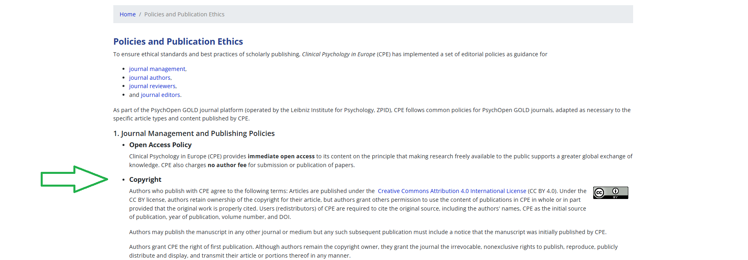
COPYRIGHT AND LICENSES
Set up per-article license in OJS at Distribution Settings > License.
Add general info about journal’s copyright policy to Workflow Settings > Author Guidelines > Copyright Notice or to journal’s About pages.
Example: Clinical Psychology in Europe - journal website
Notes:
Another key piece information you should include in your about the journal description is your copyright.
While OJS does allow you to set up copyright and licence under Distribution Settings, it only gets displayed per article, on article landing pages.
To display general information about your journal’s copyright policy, add it to Workflow Settings > Author Guidelines > Copyright Notice. It will be displayed on the public Submission page where it can be viewed by DOAJ’s reviewers and by authors who are interested in making a submission to your journal.
You can also add it to the journal’s About pages or your policies page.
Copyright and licensing information should also ideally be embedded in the full text of all published articles (HTML and PDF).
Additional resources on copyright and licensing set up for your journal:
Copyright and Licensing guide on PKP Docs https://docs.pkp.sfu.ca/journal-policies-workflows/en/copyright-licensing
PKP Webinar recording “Copyright and Creative Commons Licensing in OJS Journals” https://youtu.be/SkOawr9Ax1g?si=JhpIW_Y2UVub4486

Slide 12
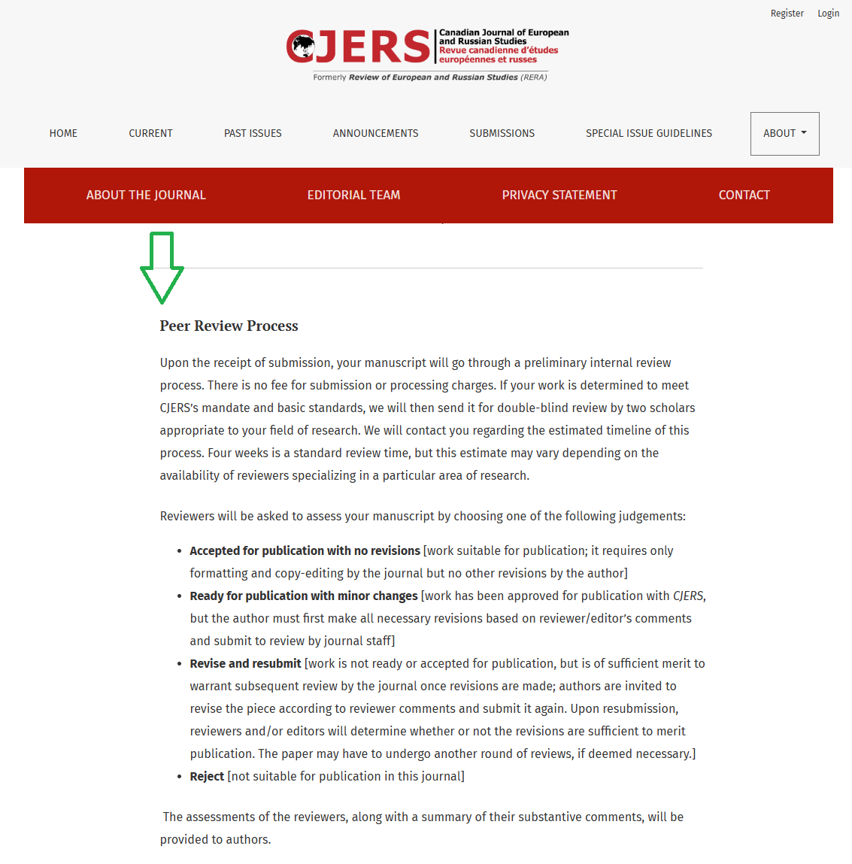
PEER REVIEW POLICY
Include in:
About Journal
Information for Authors
Section-specific policy on Submissions page
Example: Canadian Journal of European and Russian Studies
Notes:
It is important that you clearly convey the journal’s quality control process (i.e., peer review) for the published material. You will need to indicate the type and details of the peer review process, who will be involved, and any key policies around your procedure. Each article should have at least 2 independent reviewers.
Where to add:
Summary on About the Journal page
Additional info on the Information for Authors sidebar block (if you use sidebars)
Sections-specific process in Section Description which will appear on the Submissions page
Additional resources on peer review:
Editorial Workflow and Peer Review guide https://docs.pkp.sfu.ca/journal-policies-workflows/en/editorial-workflow-policies#peer-review-policy
PKP School’s Becoming an Editor course https://pkpschool.sfu.ca/courses/becoming-an-editor/

Slide 13
BEST PRACTICES
Archiving policy
Repository policy
Persistent Article Identifiers
Notes:
In addition to meeting the requirements for indexing in the DOAJ, it's important to note that there is a set of best practices that the DOAJ encourages you to consider for you journal. These are not part of DOAJ application and do not have a bearing on whether your journal will be indexed.
But I would like to highlight them because OJS makes it very easy to achieve 2 of them (archiving and persistent identifiers) through its existing integrations and plugins.
I will not touch on the Repository policy because it’s something you can just add to your About the Journal section - there is no integration needed.

Slide 14
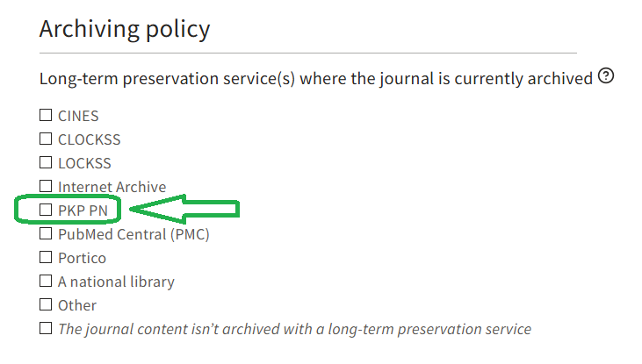
ARCHIVING WITH PKP PN
OJS journals have access to free PKP PN archiving with:
OJS version 3.1.2 or newer
An ISSN, entered under Masthead > Publishing Details
At least 1 published issue
Archiving policy question from the DOAJ application form
Notes:
Additional resources on PKP PN (Preservation Network) and the set up for your journal:
PKP PN information https://pkp.sfu.ca/pkp-pn/
PKP PN plugin guide https://docs.pkp.sfu.ca/pkp-pn/en/

Slide 15
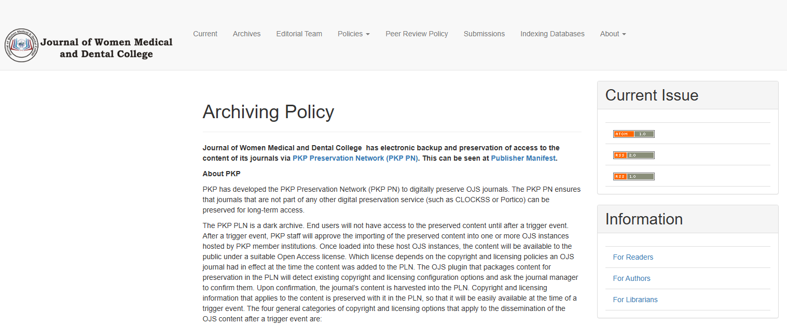
ARCHIVING POLICY EXAMPLE
Example: Journal of Women Medical and Dental College - journal website
Notes:
In addition to enabling the PKP PN plugin, you should add a note somewhere on your website (e.g. in About the Journal) that your content is preserved with PKP PN. It matters to authors that their content is safe and it might matter to your funders and other entities you work with.
BTW, OJS allows you to archive with other services too (CLOCKSS, LOCKSS, Portico) - these might have additional associated services costs.

Slide 16
PERSISTENT IDENTIFIERS
DOI (Digital Object Identifiers)
  Auto-generate DOIs
  Auto-deposit DOIs to Crossref & Datacite
ORCID plugin
  Authenticate and display ORCID iDs for authors
  Send metadata to authors’ ORCID records
ROR (Research Organization Registry)
  Identify affiliated institution by ROR ID
Notes:
Finally, OJS does offer the following integrations for these plugins for various persistent identifiers, which as you may already know are long-lasting reference to a digital resource.
The DOI plugin assigns persistent links to articles and issues that won’t break even if the journal migrates.
DOI plugin guide (OJS 3.3 and earlier) https://docs.pkp.sfu.ca/doi-plugin/
Crossref plugin guide (OJS 3.3 and earlier) https://docs.pkp.sfu.ca/crossref-ojs-manual/en/
DOI & Crossref setup in OJS 3.4 and later https://docs.pkp.sfu.ca/learning-ojs/en/settings-distribution.html#dois
PKP sponsorship for Crossref membership - https://pkp.sfu.ca/hosting-services/other-services/crossref/
The ORCID plugin helps ensure authors and researchers can ensure their work is properly and thoroughly credited.
ORCID plugin guide https://docs.pkp.sfu.ca/orcid/
The ROR Plugin enables authors to add their affiliation in a consistent manner from the list of organizations in the ROR registry.
ROR plugin guide https://docs.pkp.sfu.ca/ror-plugin/en/

Slide 17
AUTOMATICALLY SEND YOUR CONTENT TO DOAJ
Notes:
After your journal is indexed by the DOAJ, you can upload your issue and article metadata to DOAJ to increase the visibility and discoverability of your content.
OJS allows to do this automatically using the DOAJ Export Plugin.

Slide 18
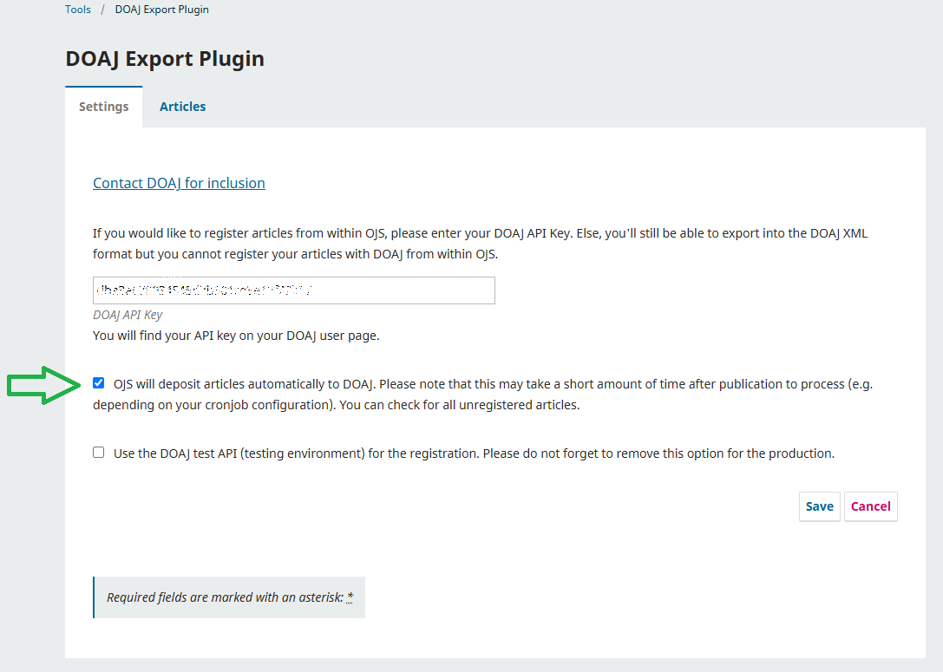
DOAJ EXPORT PLUGIN
Tools > DOAJ Export Plugin >Settings
Notes:
To export journal metadata automatically to DOAJ:
Obtain an API key from DOAJ by going to https://doaj.org/, logging in, and checking your membership number.
Login to OJS as Journal Manager
Go to Tools > Import/Export > DOAJ Export Plugin
Under the Settings tab, enter your DOAJ API Key
Check off “OJS will deposit articles automatically to DOAJ. Please note that this may take a short amount of time after publication to process. You can check for all unregistered articles.”
Click Save
You article metadata will be sent to DOAJ after publication.
Additional resources on exporting content to DOAJ:
DOAJ export plugin for OJS guide https://docs.pkp.sfu.ca/admin-guide/3.3/en/data-import-and-export#doaj-export-plugin
DOAJ Metadata Help https://doaj.org/docs/faq/

Slide 19
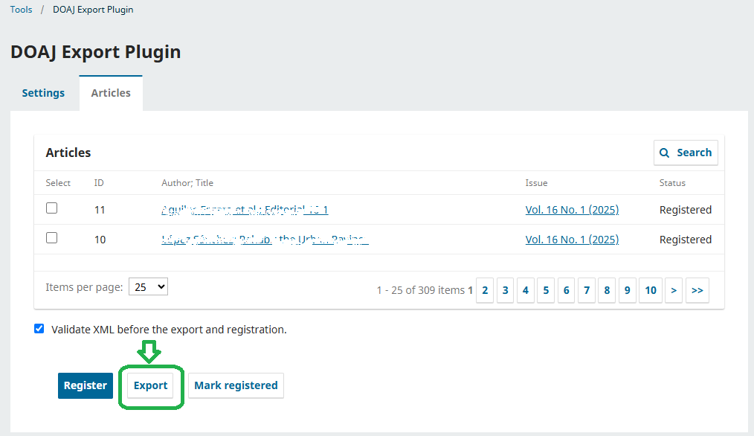
MANUAL UPLOAD TO DOAJ
Tools > DOAJ Export Plugin >Articles
Notes:
To manually export article metadata to DOAJ:
Login to OJS as Journal Manager
Go to Tools > Import/Export > DOAJ Export Plugin
Go to the Articles tab
Select the articles you want to export. They must be published.
Click Export
Visit https://doaj.org/ and login to upload the XML file that was created during the export process
Additional resources on exporting content to DOAJ:
DOAJ export plugin for OJS guide https://docs.pkp.sfu.ca/admin-guide/3.3/en/data-import-and-export#doaj-export-plugin
DOAJ Metadata Help https://doaj.org/docs/faq/

Slide 20
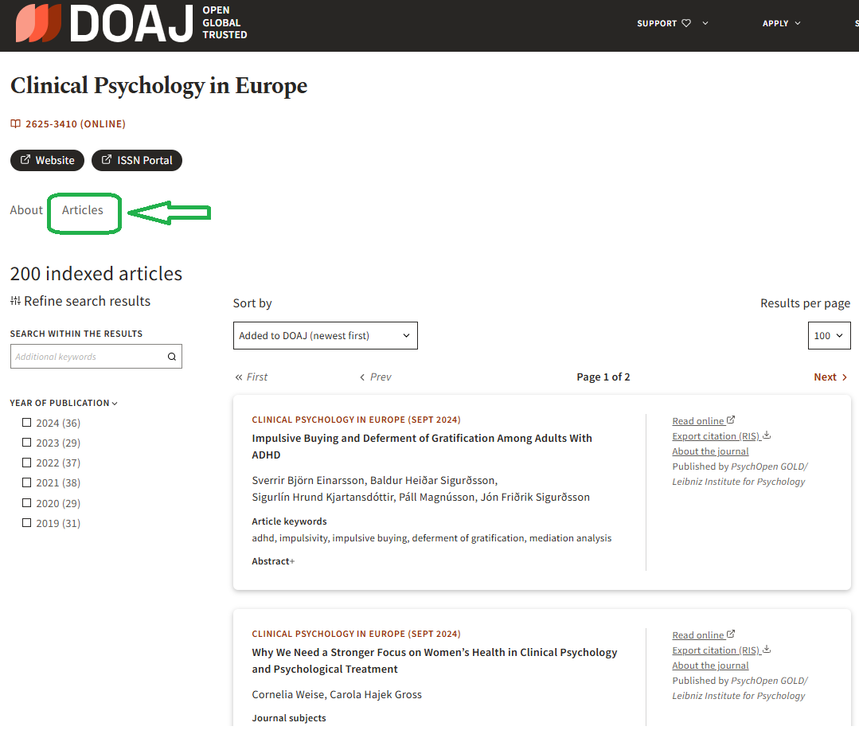
YOUR ARTICLES IN DOAJ
Example: Clinical Psychology in Europe - DOAJ page
Notes:
Here is an example of a journal with articles in DOAJ.

Slide 21
OJS SUPPORT RESOURCES
PKP Community Forum
  https://forum.pkp.sfu.ca/
PKP Documentation Hub
  https://docs.pkp.sfu.ca/
PKP School Courses
  https://pkpschool.sfu.ca/
PKP Publishing Services
  https://pkp.sfu.ca/software/ojs/

Slide 22
HOW TO GET INVOLVED WITH PKP
Contribute a translation
Improve documentation
Collaborate on the PKP Forum
Contribute to software
Join an interest group
Attend a sprint
Become a sustainer
https://pkp.sfu.ca/community/get-involved/

Slide 23
THANK YOU
QUESTIONS?

