Slide 1


Авторське право і ліцензії Creative Commons
Ірина Кучма, Наталя Калюжна, DOAJ Associate Editors
Tom Olyhoek, DOAJ Editor in Chief
Judith Barnsby, DOAJ Senior Managing Editor
SUES Summer School
16 серпня

Slide 2
Авторське право
Авторське право на опублікований твір може належати автору або видавцю
DOAJ рекомендує, щоб авторське право належало автору
  DOAJ приймає журнали, в яких автор передає авторські права видавцю
Додайте положення про авторське право на сайт
Рекомендується надати посилання на Авторський договір

Slide 3
Ліцензування
Використання ліцензій для:
Інформування читачів про допустимі шляхи використання опублікованого матеріалу
Інформування читачів про обмеження у використанні матеріалів
Захист автора та журналу від несанкціонованого використання

Slide 4
Ліцензування (2)
DOAJ рекомендує використовувати ліцензії Creative Commons (або еквівалент)
  Використання CC ліцензій є безкоштовним і зручним
Вкажіть тип ліцензії на сайті
Еквівалент - but only if they have similar terms and conditions to Creative Commons
  Terms must be clearly stated online

Slide 5
Open access - DOAJ definition
A journal where the copyright holder of a scholarly work grants usage rights to others using an open license (Creative Commons or equivalent) allowing for immediate free access to the work and permitting any user to read, download, copy, distribute, print, search, or link to the full texts of articles, crawl them for indexing, pass them as data to software, or use them for any other lawful purpose.

Slide 6
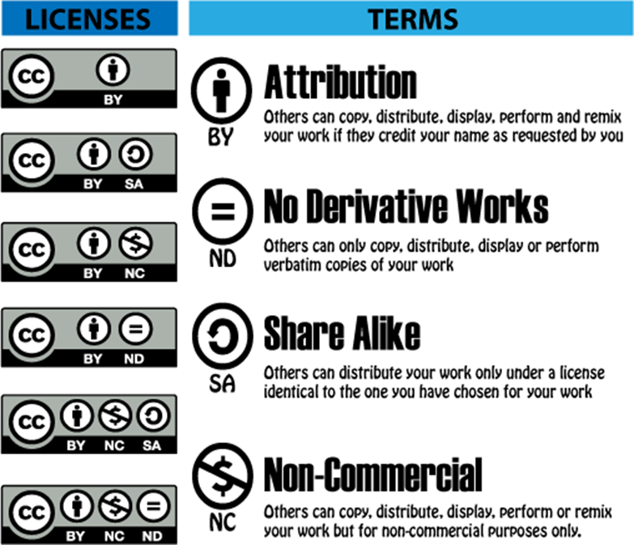
The DOAJ Seal
Журнал має використовувати ліцензії Creative Commons, які дозволяють створення похідних творів.
CC BY
CC BY-SA
CC BY-NC
CC BY-NC-SA
https://doaj.org/apply/seal/

Slide 7
Авторське право (2)
Коли створюється твір – стаття у нашому випадку – автор має автоматичне виключне авторське право на твір
Авторське право захищає від несанкціонованого використання твору
Власник авторського права має дозволити використання твору
Відкритий доступ заохочує використання твору
Ліцензії є інструментом такого заохочення

Slide 8
Ліцензування (3)
Безплатний доступ не завжди означає відкритий доступ!
Відкритий доступ = безплатний доступ + право на використання

Slide 9
DOAJ licensing requirements
Licensing terms must be clearly stated on the journal website
Copyright notice and publishing agreement must not conflict with license
Different licenses may be applied under certain conditions
  Funder requirements
  Author’s employer requirements
Only one license can be applied to an individual article

Slide 10
Licensing best practice
Embed or display licensing information in full text articles
  Useful when articles are downloaded and shared
  Recommended but not required for inclusion in DOAJ
Licenses allowing wide reuse are preferred by many
  CC BY is required by some funders
  But any CC license is accepted by DOAJ

Slide 11
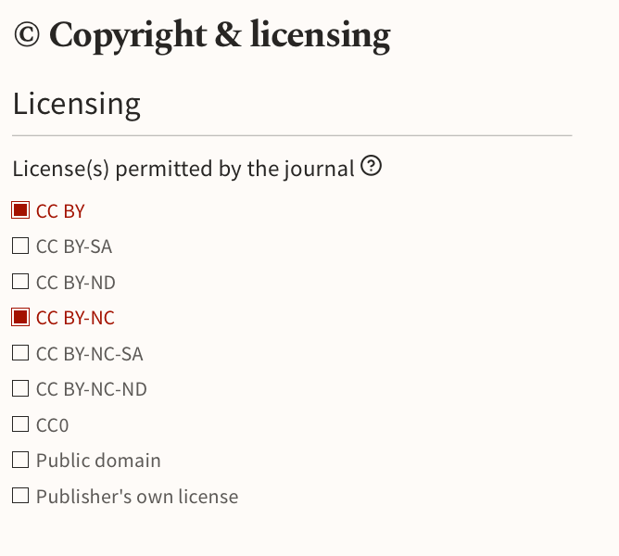

Slide 12
Copyright basics
Copyright is held by the owner of a work - it cannot be shared
The owner may transfer or license copyright to another
Publishers have often required copyright transfer in order to publish articles and protect the publications but this is not necessary
“All rights reserved” is never appropriate in open access

Slide 13

All Rights Reserved
Всі права застережені

Slide 14

Some Rights Reserved
Деякі права застережені

Slide 15
DOAJ copyright requirements
Copyright notice and publishing agreement must not conflict with license
Copyright terms applied to the published content may be different to the copyright of the website as a whole
  Articles - copyright of authors or publisher
  Website - copyright of publisher
A journal’s copyright policy must be clearly stated online

Slide 16
Copyright best practice
Authors retain copyright of their work
  Publisher has right of first publication
  Recommended but not required for inclusion in DOAJ
Authors also retain full publishing rights
  Publisher is granted non-exclusive rights to publish and distribute
  Publishers cannot license rights to third parties
  Authors can reuse their work without restriction
  Recommended but not required for inclusion in DOAJ

Slide 17
Copyright ownership options
Copyright retained by the authors WITHOUT restriction
Copyright TRANSFERRED to the publisher
Some rights transferred or licensed to the publisher
  Usually commercial rights

Slide 18
Copyright without restrictions
If authors retain copyright and full publishing rights
  The author can use their work as they wish
  Not bound by user license or publisher terms
If authors do not retain unrestricted rights
  They are bound by the terms of the publishing agreement
  They may have no more rights than an end-user

Slide 19
Copyright with restrictions
Copyright retained WITHOUT restriction? NO
Copyright retained by the author but…
  Exclusive publishing rights given to the publisher
  Author has granted or transferred exclusive commercial rights
Author no longer retains full rights

Slide 20
Copyright and licensing
Copyright and licensing are not the same thing
Used together to specify
  Ownership of content
  Usage rights
Copyright holder is not bound by the terms of the user license
Copyright holder gives a license to users of their work

Slide 21
Copyright and licensing
Copyright held by author without restrictions
  License applies to readers and publisher
Copyright transferred or exclusively licensed to publisher
  License applies to readers and author(s)
Copyright held by author, but commercial rights by publisher, and non-commercial license used
  License applies to readers and author(s)

Slide 22
Copyright / licensing incompatibilities

Slide 23
Incorrect restriction to fair use 1
Copyright is retained by the author but publishing agreement says…
  Author is only allowed to use work in the classroom or…
  Publish on personal website or university repository
Author cannot be restricted to fair use when they are the copyright holder!

Slide 24
Incorrect restriction to fair use 2
Copyright is transferred to the publisher and publishing agreement says…
  Author is only allowed to use work in the classroom or…
  Publish on personal website or university repository
Author cannot be restricted to fair use - they can use the work according to the CC license, just like any other user

Slide 25
Incorrect restriction on future publication
Copyright is retained by the author but…
  Publisher says author cannot publish the article in another journal AFTER first publication or embargo period applies…….
The publisher cannot impose this restriction on the author
- Open Access permits republication with acknowledgment of first publication

Slide 26
Incorrect restriction on use without permission
Copyright is transferred to the publisher and…
  Publisher says no use of the published work without permission
The publisher cannot impose this restriction - author can use the work according to the CC license, without asking permission

Slide 27
Incorrect restriction to non-commercial use 1
Copyright and unrestricted rights are retained by the author but…
  A CC BY-NC license is applied
  Publisher says author is only allowed to use the work non-commercially
As the author retains unrestricted rights, the license does not apply to them so commercial use by the author is allowed

Slide 28
Incorrect restriction to non-commercial use 2
Copyright is transferred to the publisher but…
  A CC BY license is applied
  Publisher says author is only allowed to use the work non-commercially
The author has the same rights as a reader and can use the work commercially under the CC BY license

Slide 29
Conflicting information
Journal website states authors retain copyright but…
  There is a copyright transfer agreement
  Articles show copyright held by publisher
Ensure your copyright information is correct and consistent

Slide 30
Common reasons for DOAJ rejection

Slide 31
Rejection at triage stage
Journal is not fully open access
ISSN is not fully registered at issn.org
Not enough research content has been published
Individual full text articles are not available
URLs in application don’t lead to the information required
No licensing information

Slide 32
Rejection after full review
Incorrect information is given in application
Required information is unclear or missing from website
Information is not the same in all languages used on website
Peer review process is inadequate
Licensing/copyright policy is unclear
Copyright and licensing policies are incompatible
All rights reserved for published content
Journal makes false claims to be indexed in DOAJ or other services
Journal does not employ good publishing practices

Slide 33
Online Help and Documentation
DOAJ guide to applying https://doaj.org/apply/guide/
Creative Commons license chooser https://creativecommons.org/share-your-work/
Pascal Braak, Hans de Jonge, Giulia Trentacosti, Irene Verhagen, & Saskia Woutersen-Windhouwer. (2020). Guide to Creative Commons for Scholarly Publications and Educational Resources https://doi.org/10.5281/zenodo.4741966
DOAJ helpdesk helpdesk@doaj.org

Slide 34
Наступний вебінар
Best practices in journal publishing
5 вересня, 11:00
Duncan Nicholas і Jadranka Stojanovski з Європейської Асоціації Наукових Редакторів (EASE) розкажуть про найкращі практики публікації журналів, розробки політик, обмін даними, етику публікаційної діяльності та рецензування.
Реєстрація: https://us02web.zoom.us/meeting/register/tZcvcOyqqj4uHN0iS5Yr21h_UYb66t0J00LD
Мова: англійська

Slide 35
Дякуємо!
Запитання?
iryna.kuchma@eifl.net natali.kalyuzhna91@gmail.com

