Slide 1
Open Access Journals Best Practices Meilleures pratiques pour les journaux en libre accès
AJOL, ASSAf, DOAJ, EIFL, LIBSENSE and UCT initiative for African journal editors and publishers
Webinar series 2022
Ina Smith, DOAJ Ambassador Southern Africa
Thomas Hervé Mboa Nkoudou, DOAJ Ambassador West & Central Africa

Slide 2
DOAJ Webinar Series for African Journals Série de webinaires du DOAJ pour les revues africaines
Webinar 1: DOAJ Introduction & Overview/Introduction et aperçu de DOAJ https://youtu.be/Luu1LFN432k
Webinar 2: Editorial Processes & Business Models/Processus éditoriaux et modèles commerciaux https://youtu.be/H4Qs-dgW98I
Webinar 3: Copyright & Licensing/Droits d'auteur et licences https://tinyurl.com/3dztfrf5
Webinar 4: OA Journal Best Practices /Meilleures pratiques pour les revues OA

Slide 3
What is an Open Access Journal? (1) Qu'est-ce qu'un journal en libre accès? (1)
Scholarly journal following an Open Access publishing model Revue savante suivant un modèle de publication en libre accès
Research information is made available to readers at no cost (free), as opposed to the traditional subscription model. A paid-for print version is allowed Les informations sur la recherche sont mises à la disposition des lecteurs sans frais (gratuitement), par opposition au modèle traditionnel d'abonnement. Une version imprimée payante est autorisée

Slide 4
What is an Open Access Journal? (2) Qu'est-ce qu'un journal en libre accès? (2)
A journal where the copyright holder of a scholarly work grants usage rights to others using an open license (Creative Commons or equivalent) allowing for immediate free access to the work and permitting any user to read, download, copy, distribute, print, search, or link to the full texts of articles, crawl them for indexing, pass them as data to software, or use them for any other lawful purpose.

Slide 5
What is an Open Access Journal? (3) Qu'est-ce qu'un journal en libre accès? (3)
Revue dans laquelle le détenteur du droit d'auteur d'une œuvre savante accorde des droits d'utilisation à d'autres en utilisant une licence ouverte (Creative Commons ou équivalent) permettant un accès gratuit immédiat à l'œuvre et autorisant tout utilisateur à lire, télécharger, copier, distribuer, imprimer, rechercher ou créer des liens vers le texte intégral des articles, à les indexer, à les transmettre comme données à un logiciel ou à les utiliser à toute autre fin légitime.

Slide 6
What is an Open Access Journal? (4) Qu'est-ce qu'un journal en libre accès? (4)
Demonstrates high levels of transparency Faire preuve d'un haut niveau de transparence
All articles submitted for possible publication are subjected to peer-review Tous les articles soumis pour une éventuelle publication font l'objet d'un examen par les pairs

Slide 7
Principles of Transparency & Best Practice in Scholarly Publishing Principes de transparence et meilleures pratiques dans l'édition savante

Slide 8
Professional Website (1) Site web professionnel (1)
Adhere to criteria for a professional website, URL (https), central website, language consistent, spelling & grammar, hyperlinks Respecter les critères d'un site web professionnel
Demonstrate care has been taken to ensure high quality ethical & professional standards Démontrer que des mesures ont été prises pour garantir des normes éthiques et professionnelles de haute qualité
Notes:
Website: A journal’s website, including the text that it contains, shall demonstrate that care has been taken to ensure high ethical and professional standards. It must not contain information that might mislead readers or authors, including any attempt to mimic another journal/publisher’s site.
An ‘Aims & Scope’ statement should be included on the website and the readership clearly defined. There should be a statement on what a journal will consider for publication including authorship criteria (e.g., not considering multiple submissions, redundant publications) to be included. ISSNs should be clearly displayed (separate for print and electronic).

Slide 9
Professional Website (2) Site web professionnel (2)
Must not contain info that might mislead readers/authors, or attempts to mimic another journal/publisher’s site Ne doit pas contenir d'informations susceptibles d'induire en erreur les lecteurs/auteurs, ni de tentatives d'imitation du site d'un autre journal/éditeur
Include Focus/Aims & Scope Inclure l'objectif et le champ d'application
Clearly define readership Définir clairement le lectorat
Notes:
Website: A journal’s website, including the text that it contains, shall demonstrate that care has been taken to ensure high ethical and professional standards. It must not contain information that might mislead readers or authors, including any attempt to mimic another journal/publisher’s site.
An ‘Aims & Scope’ statement should be included on the website and the readership clearly defined. There should be a statement on what a journal will consider for publication including authorship criteria (e.g., not considering multiple submissions, redundant publications) to be included. ISSNs should be clearly displayed (separate for print and electronic).

Slide 10
Professional Website (3) Site web professionnel (3)
Coverage/statement of what journal will consider for publication Couverture/déclaration de ce que le journal prendra en compte pour la publication
Authorship criteria e.g. multiple submissions and redundant publications not allowed Critères d'attribution des droits d'auteur : les soumissions multiples et les publications redondantes ne sont pas autorisées
Notes:
Website: A journal’s website, including the text that it contains, shall demonstrate that care has been taken to ensure high ethical and professional standards. It must not contain information that might mislead readers or authors, including any attempt to mimic another journal/publisher’s site.
An ‘Aims & Scope’ statement should be included on the website and the readership clearly defined. There should be a statement on what a journal will consider for publication including authorship criteria (e.g., not considering multiple submissions, redundant publications) to be included. ISSNs should be clearly displayed (separate for print and electronic).

Slide 11
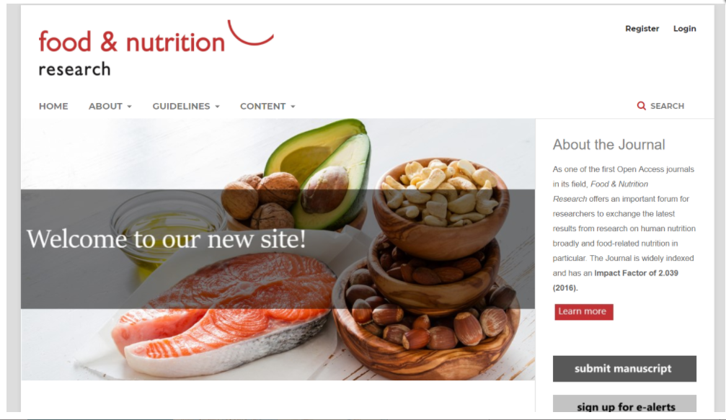
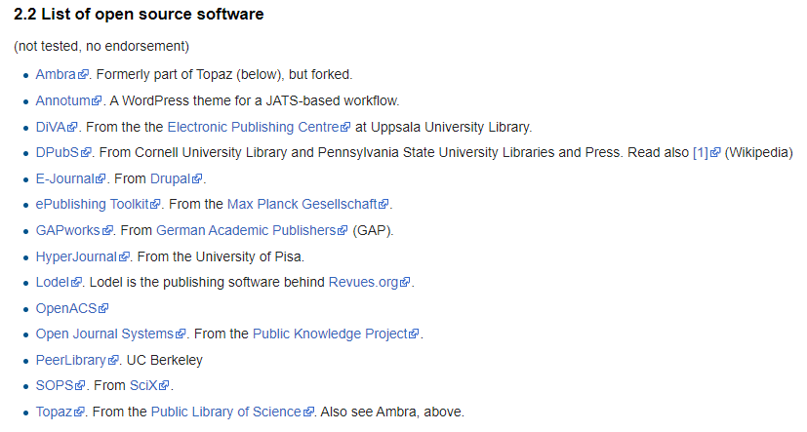
Open Source Journal Management Software Logiciel de gestion de journaux à code source ouvert
Public Knowledge Project (PKP) Open Journal Systems (OJS) https://pkp.sfu.ca/ojs/
http://edutechwiki.unige.ch/en/Journal_management_software
Notes:
Using open source software aligns with open access practices – open source means code is open and can be customised; download code and install on own server
An OA journal is published on a Website – without a website, an OA journal cannot exist (eg print is not OA)
OJS guides you to integrate all important info and setup journal in a trusted way
One journal, or Federated approach – institution, country
Well integrated with DOAJ – export metadata directly from the system to DOAJ

Slide 12
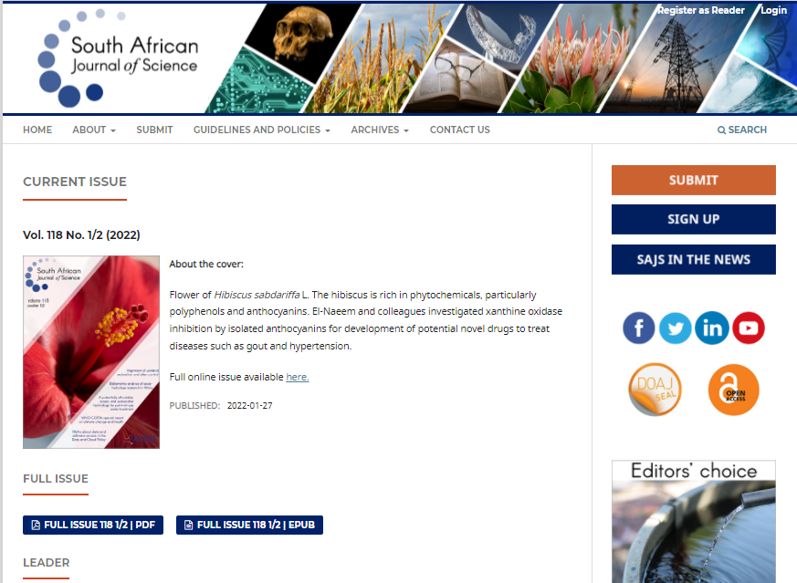
https://sajs.co.za/

Slide 13
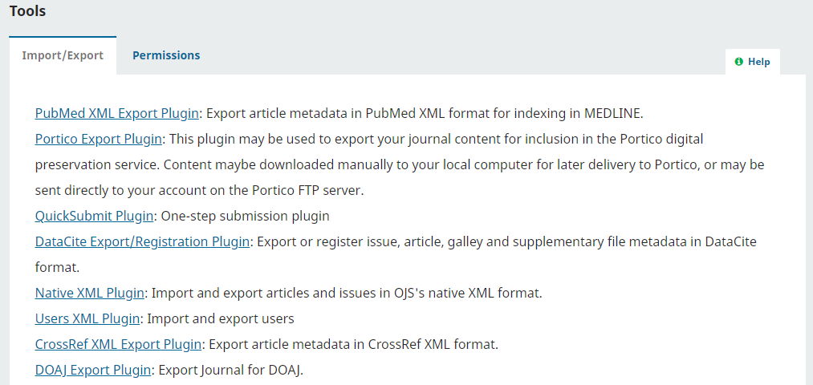
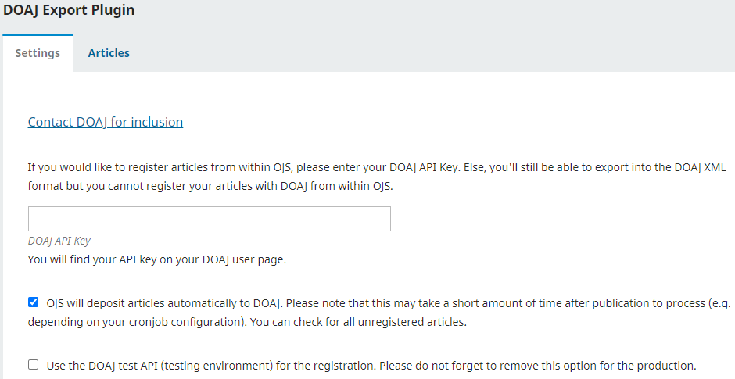
Export metadata from journal using OJS to DOAJ Exporter les métadonnées d'un journal en utilisant OJS vers DOAJ
Notes:
Metadata is "data that provides information about other data", but not the content of the data, such as the text of a message or the image itself. There are many distinct types of metadata, including: Descriptive metadata — the descriptive information about a resource. It is used for discovery and identification.

Slide 14
Name of Journal (1) Nom de la revue (1)
Journal should have unique name, distinct, descriptive, consistent Le journal doit avoir un nom unique
Name should be clearly distinguished – not to be confused with another journal Le nom doit être clairement distingué - ne pas être confondu avec un autre journal
Must not mislead potential users (authors, readers) about journal’s origin or association with other journals Ne doit pas induire en erreur les utilisateurs potentiels (auteurs, lecteurs) quant à l'origine de la revue ou à son association avec d'autres revues
Notes:
Name of journal: The Journal name shall be unique and not be one that is easily confused with another journal or that might mislead potential authors and readers about the Journal’s origin or association with other journals.

Slide 15
Peer review process (1) Processus d'examen par les pairs (1)
Journal content must be clearly marked as whether peer reviewed or not Le contenu du journal doit être clairement indiqué comme ayant fait l'objet d'un examen par les pairs ou non
Peer review process & peer- review policy must be clearly described on journal website (incl. method of peer review) Le processus et la politique d'examen par les pairs doivent être clairement décrits sur le site web du journal (y compris la méthode d'examen par les pairs)
Notes:
3. Peer review process: Journal content must be clearly marked as whether peer reviewed or not. Peer review is defined as obtaining advice on individual manuscripts from reviewers expert in the field who are not part of the journal’s editorial staff. This process, as well as any policies related to the journal’s peer review procedures, shall be clearly described on the journal website, including the method of peer review used. Journal websites should not guarantee manuscript acceptance or very short peer review times.

Slide 16
Peer review process (2) Processus d'examen par les pairs (2)
Journals must apply a rigorous review process Les revues doivent appliquer un processus d'examen rigoureux
Peer review by at least two independent reviewers Examen par les pairs par au moins deux examinateurs indépendants
Editorial review allowed only for journals in arts and humanities La révision éditoriale n'est autorisée que pour les revues d'art et de sciences humaines
Faculty oversight required for student journals Supervision de la faculté requise pour les journaux d'étudiants

Slide 17
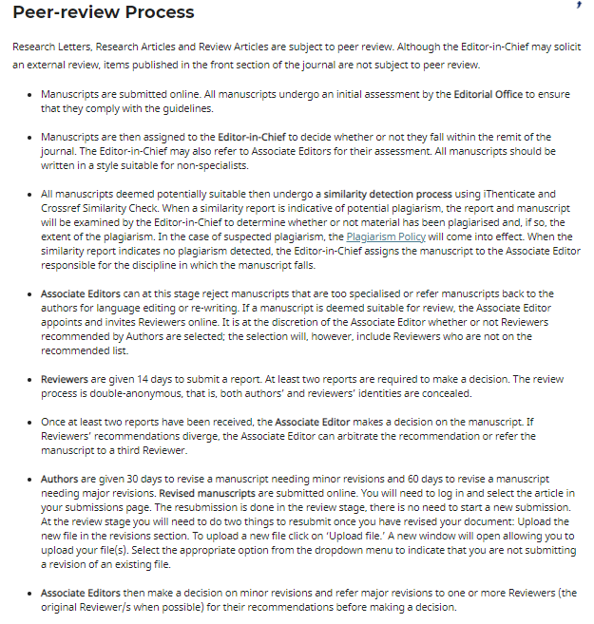

Slide 18
Peer review process (3) Processus d'examen par les pairs (3)
Plagiarism checking recommended but not required for inclusion in DOAJ La vérification du plagiat est recommandée mais pas obligatoire pour l'inclusion dans le DOAJ
State name of checking service or protocol used Indiquez le nom du service de contrôle ou du protocole utilisé

Slide 19
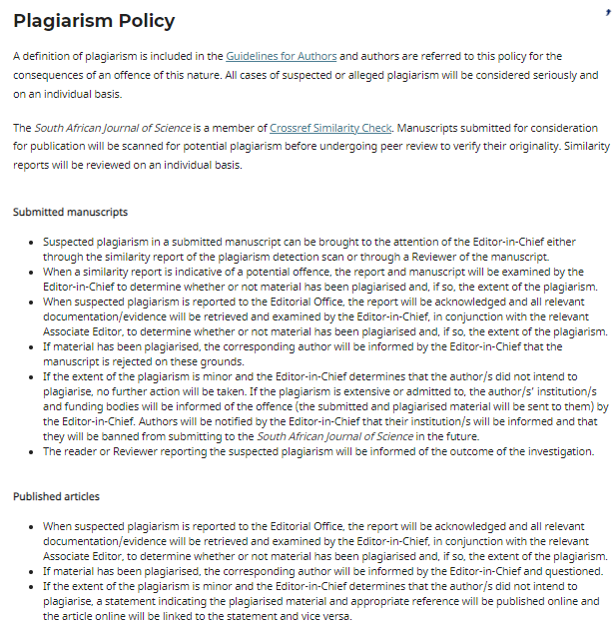

Slide 20
Ownership & Management Propriété et gestion
Information about ownership/publisher & management of journal should be clearly indicated on website (scholarly society) Les informations sur la propriété et la gestion du journal doivent être clairement indiquées sur le site web
Publisher not to use organisational/journal names that would mislead potential authors & editors about the nature of the journal’s owner L'éditeur ne doit pas utiliser de noms d'organisations/de revues qui pourraient induire en erreur les auteurs et éditeurs potentiels sur la nature du propriétaire de la revue
Notes:
4. Ownership and management: Information about the ownership and/or management of a journal shall be clearly indicated on the journal’s website. Publishers shall not use organizational or journal names that would mislead potential authors and editors about the nature of the journal’s owner.

Slide 21
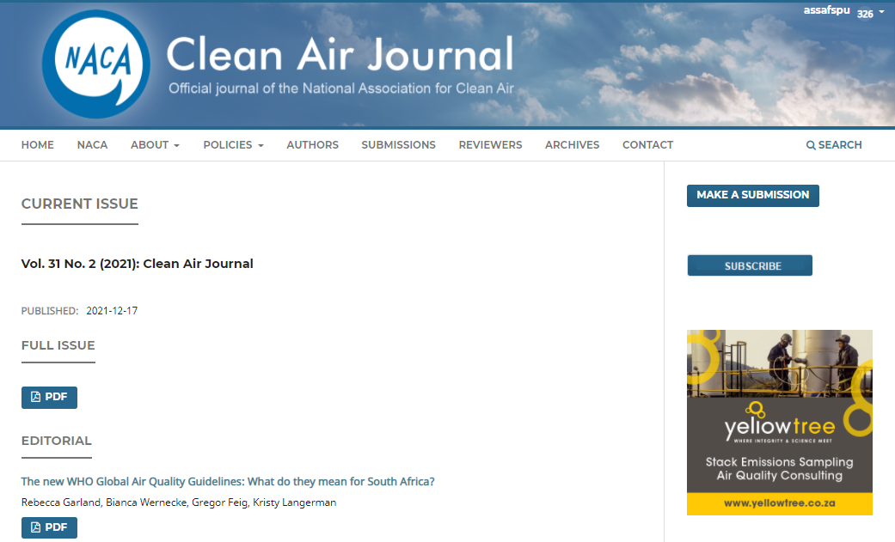

Slide 22
Governing Body Conseil d'administration
Journal must have editorial board/other governing bodies – members must be recognised experts in subject areas included within journal’s scope La revue doit avoir un comité de rédaction/autres organes directeurs - les membres doivent être des experts reconnus dans les domaines couverts par la revue
Full name & affiliations of editorial board/governing body available on website Le nom complet et les affiliations du comité de rédaction/de l'organe directeur sont disponibles sur le site web
Notes:
5. Governing body: Journals shall have editorial boards or other governing bodies whose members are recognized experts in the subject areas included within the journal’s scope. The full names and affiliations of the journal’s editorial board or other governing body shall be provided on the journal’s website.

Slide 23
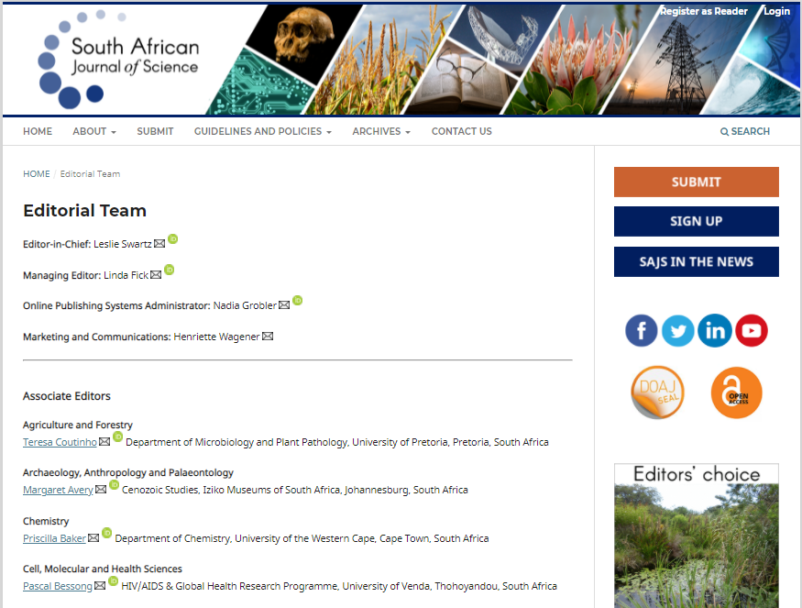

Slide 24
Editorial Team & Contact Information Équipe de rédaction et informations de contact
Full names & affiliations of journal editors on journal website Noms complets et affiliations des éditeurs de la revue sur le site web de la revue
Contact information for editorial office (generic email) Coordonnées de la rédaction
Full address Adresse complète
Notes:
6. Editorial team/contact information: Journals shall provide the full names and affiliations of the journal’s editors on the journal website as well as contact information for the editorial office, including a full address.

Slide 25
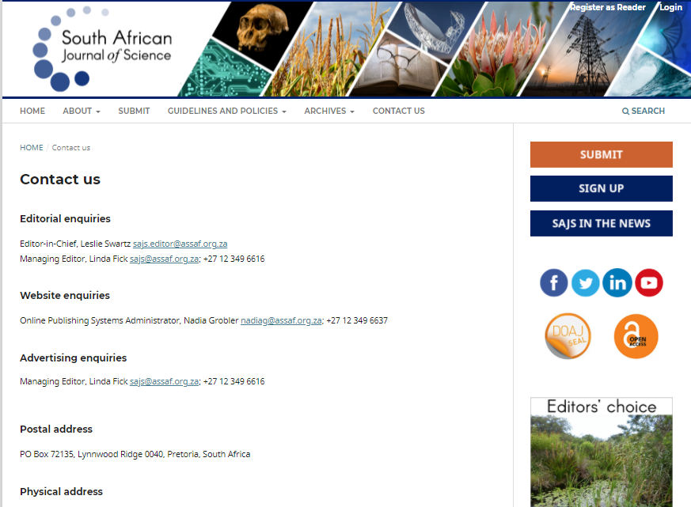

Slide 26
Copyright & Licensing (1) Droits d'auteur et licences (1)
Copyright policy – also as part of author guidelines Politique en matière de droits d'auteur - également dans le cadre des directives à l'intention des auteurs
Copyright holder specified on all published articles Le propriétaire du droit d'auteur est spécifié sur tous les articles publiés
Licensing terms indicated on all published articles (html, pdf, xml) Conditions de licence indiquées sur tous les articles publiés (html, pdf, xml)
Notes:
67. Copyright and Licensing: The policy for copyright shall be clearly stated in the author guidelines and the copyright holder named on all published articles. Likewise, licensing information shall be clearly described in guidelines on the website, and licensing terms shall be indicated on all published articles, both HTML and PDFs. If authors are allowed to publish under a Creative Commons license then any specific license requirements shall be noted. Any policies on posting of final accepted versions or published articles on third party repositories shall be clearly stated.
Licensing: how readers may use content

Slide 27
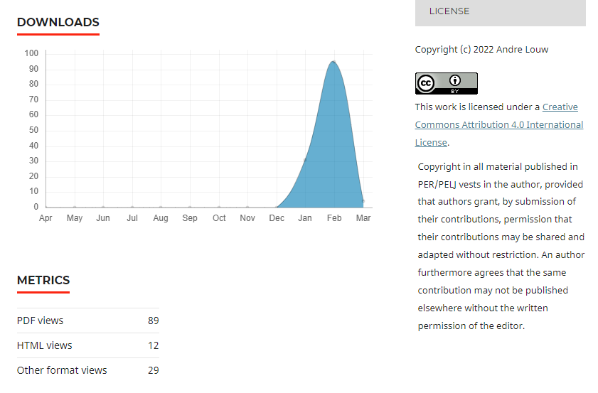

Slide 28
Copyright & Licensing (2) Droits d'auteur et licences (2)
Self-archiving policy – can final accepted versions of published articles be deposited in third party/institutional repositories Politique d'auto-archivage - les versions finales acceptées des articles publiés peuvent-elles être déposées dans des dépôts de tiers/institutionnels?
Link to author agreement Lien vers l'accord de l'auteur
Notes:
67. Copyright and Licensing: The policy for copyright shall be clearly stated in the author guidelines and the copyright holder named on all published articles. Likewise, licensing information shall be clearly described in guidelines on the website, and licensing terms shall be indicated on all published articles, both HTML and PDFs. If authors are allowed to publish under a Creative Commons license then any specific license requirements shall be noted. Any policies on posting of final accepted versions or published articles on third party repositories shall be clearly stated.

Slide 30
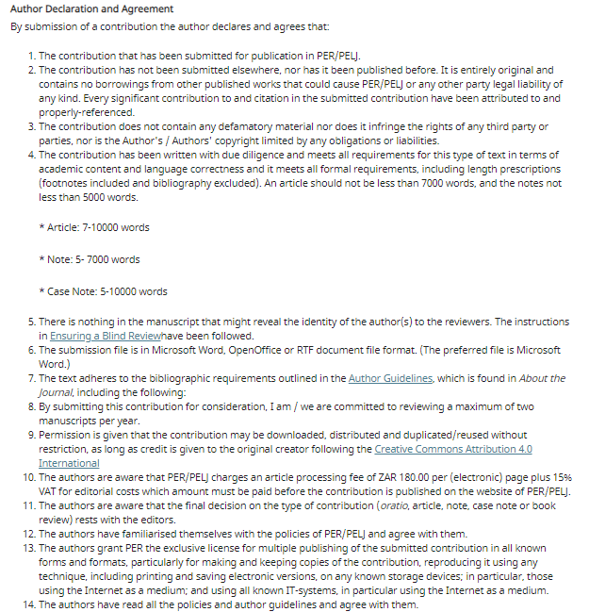

Slide 31
Author Fees Frais d'auteur
Specify any fees/charges required to have manuscript processed/published Précisez les frais/charges exigés pour le traitement/la publication du manuscrit
Info should be easy to find prior to submission Les informations doivent être faciles à trouver avant la soumission
Also indicate if no fees are charged/waivers apply Indiquez également si aucun frais n'est facturé ou si des dérogations s'appliquent
Notes:
8. Author fees: Any fees or charges that are required for manuscript processing and/or publishing materials in the journal shall be clearly stated in a place that is easy for potential authors to find prior to submitting their manuscripts for review or explained to authors before they begin preparing their manuscript for submission. If no such fees are charged that should also be clearly stated.

Slide 33
Allegations of research misconduct Allégations d'inconduite dans la recherche
Misconduct (plagiarism, citation manipulation, data falsification/fabrication, etc) never to be allowed Les écarts de conduite (plagiat, manipulation de citations, falsification/fabrication de données, etc.) ne doivent jamais être autorisés
Where publisher/editor is made aware of any allegation of research misconduct related to a published article, follow COPE guidelines in dealing with allegations Lorsque l'éditeur/rédacteur est informé d'une allégation d'inconduite en matière de recherche liée à un article publié, suivre les directives du COPE pour traiter les allégations
Notes:
9. Process for identification of and dealing with allegations of research misconduct: Publishers and editors shall take reasonable steps to identify and prevent the publication of papers where research misconduct has occurred, including plagiarism, citation manipulation, and data falsification/fabrication, among others. In no case shall a journal or its editors encourage such misconduct, or knowingly allow such misconduct to take place. In the event that a journal’s publisher or editors are made aware of any allegation of research misconduct relating to a published article in their journal, the publisher or editor shall follow COPE’s guidelines (or equivalent) in dealing with allegations.

Slide 34
Publication Ethics Éthique de la publication
Clear policies on publication ethics/ Des politiques claires en matière d'éthique de la publication:
Journal policies on authorship and contributorship/Politiques des revues en matière de paternité et de contribution
How the journal will handle complaints and appeals/Comment la revue traitera les plaintes et les appels
Journal policies on conflicts of interest / competing interests/Politiques des revues en matière de conflits d'intérêts / intérêts concurrents
Journal policies on data sharing and reproducibility/Politiques des revues en matière de partage des données et de reproductibilité
Journal’s policy on ethical oversight/Politique du journal en matière de surveillance éthique
Journal’s policy on intellectual property/Politique de la revue en matière de propriété intellectuelle
Journal’s options for post-publication discussions and corrections/Options du journal pour les discussions et les corrections post-publication
Notes:
10. Publication Ethics: A journal shall also have policies on publishing ethics. These should be clearly visible on its website, and should refer to: i) Journal policies on authorship and contributorship; ii) How the journal will handle complaints and appeals; iii) Journal policies on conflicts of interest / competing interests; iv) Journal policies on data sharing and reproducibility; v) Journal’s policy on ethical oversight; vi) Journal’s policy on intellectual property; and vii) Journal’s options for post-publication discussions and corrections.

Slide 35
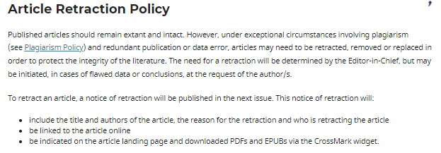
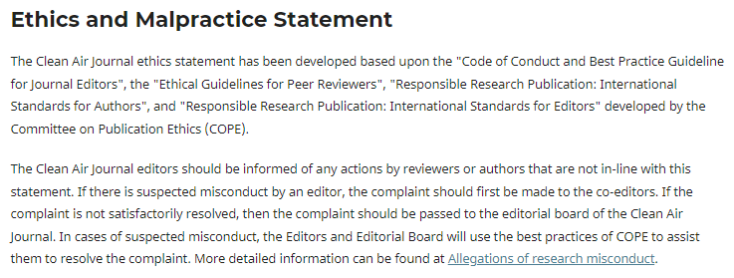

Slide 36
Publishing Schedule Calendrier de publication
Periodicity at which journal publishes shall be clearly indicated La périodicité de publication de la revue doit être clairement indiquée
Uninterrupted publishing Publication ininterrompue
At least 5 research articles per year Au moins 5 articles de recherche par an
New or flipped journals need to publish at least 10 OA articles before applying Les nouvelles revues doivent publier au moins 10 articles OA avant de se porter candidates
Notes:
11. Publishing schedule: The periodicity at which a journal publishes shall be clearly indicated.

Slide 38
Access Accès
Indicate Open Access to articles or whether subscription applies Indiquez si les articles sont en libre accès ou s'ils font l'objet d'un abonnement
Notes:
12. Access: The way(s) in which the journal and individual articles are available to readers and whether there are associated subscription or pay per view fees shall be stated.

Slide 39
Archiving Archivage
Indicate digital backup and preservation plan in case of disaster e.g. via Portico, LOCKSS, CLOCKSS, PubMedCentral Indiquez le plan de sauvegarde et de préservation des données numériques en cas de catastrophe, par exemple via Portico, LOCKSS, CLOCKSS, PubMedCentral
Indicate clearly if journal is no longer published Indiquez clairement si la revue n'est plus publiée
Notes:
13. Archiving: A journal’s plan for electronic backup and preservation of access to the journal content (for example, access to main articles via CLOCKSS or PubMedCentral) in the event a journal is no longer published shall be clearly indicated.

Slide 41
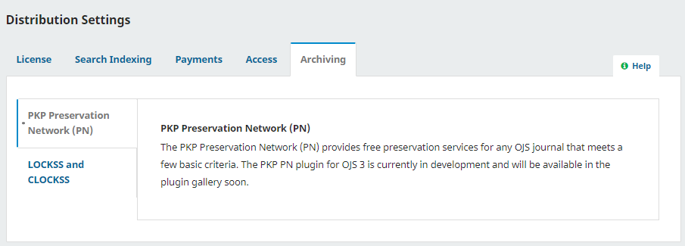

Slide 42
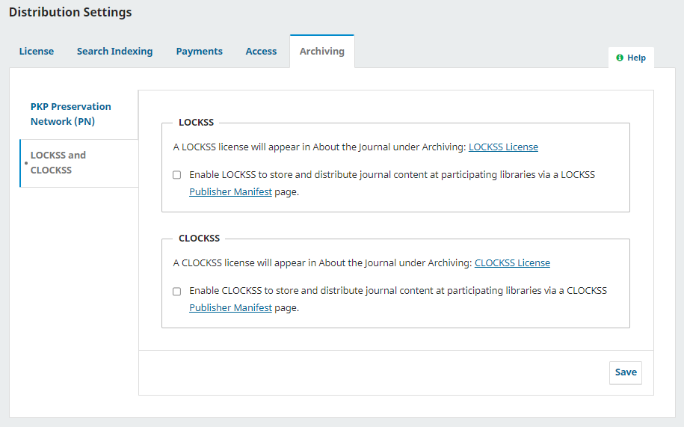

Slide 44
Revenue Sources Sources de revenus
Funding/income/revenue sources (business models) e.g., author fees, subscriptions, advertising, reprints, institutional support, and organisational support must be transparent Les sources de financement, de revenus et de recettes (modèles économiques), par exemple les droits d'auteur, les abonnements, la publicité, les réimpressions, le soutien institutionnel et le soutien organisationnel, doivent être transparentes
Publishing fees or waiver status should not influence editorial decision making Les frais d'édition ou le statut d'exonération ne doivent pas influencer la prise de décision éditoriale
Notes:
14. Revenue sources: Business models or revenue sources (e.g., author fees, subscriptions, advertising, reprints, institutional support, and organizational support) shall be clearly stated or otherwise evident on the journal’s website. Publishing fees or waiver status should not influence editorial decision making.

Slide 45
Advertising Publicité
Advertising Policy: types of adverts, decision makers, content Politique publicitaire : types de publicités, décideurs, contenu
Keep advertisements separate from published content/editorial decision making Garder les publicités séparées du contenu publié/prise de décision éditoriale
Notes:
15. Advertising: Journals shall state their advertising policy if relevant, including what types of adverts will be considered, who makes decisions regarding accepting adverts and whether they are linked to content or reader behavior (online only) or are displayed at random. Advertisements should not be related in any way to editorial decision making and shall be kept separate from the published content.

Slide 46
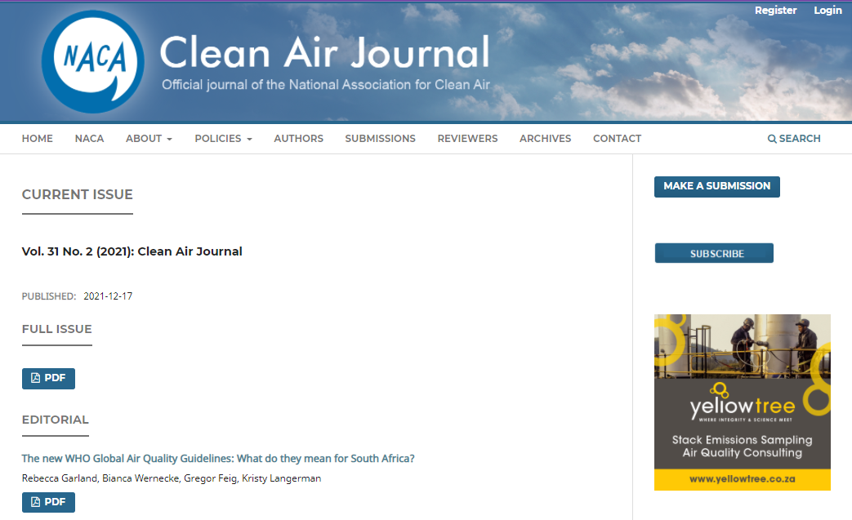

Slide 47
Direct Marketing Marketing direct
E.g. solicitation of manuscripts Par exemple, la sollicitation de manuscrits
Appropriate, well targeted, unobtrusive Approprié, bien ciblé, discret
Information shared about journal should be truthful and not misleading Les informations partagées sur le journal doivent être véridiques et non trompeuses
Notes:
16. Direct marketing: Any direct marketing activities, including solicitation of manuscripts that are conducted on behalf of the journal, shall be appropriate, well targeted, and unobtrusive. Information provided about the publisher or journal is expected to be truthful and not misleading for readers or authors.

Slide 48
Persistent Identifiers: ISSN Identifiants persistants: ISSN
International Standard Serial Number (ISSN)
Search: https://portal.issn.org/
Request an ISSN: https://portal.issn.org/requesting-issn

Slide 49
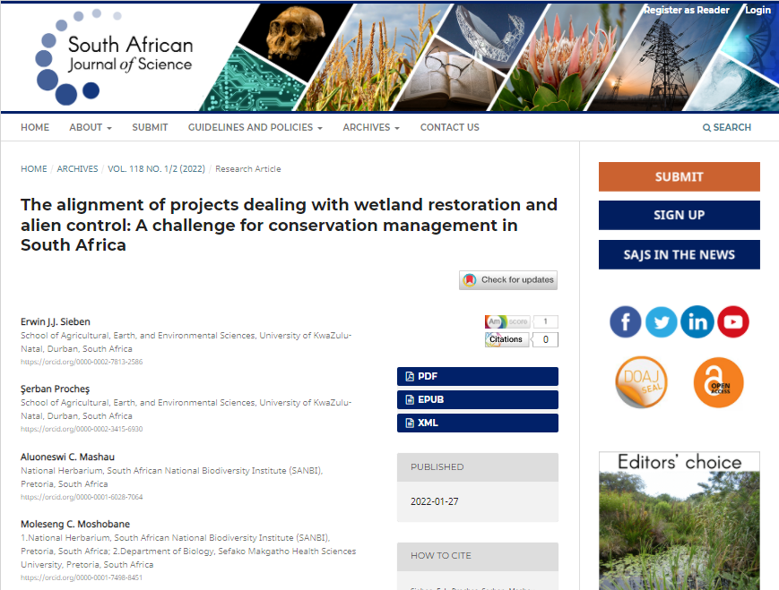
Persistent Identifiers: ORCID Identifiants persistants: ORCID
Open Researcher and Contributor ID (ORCID)
Search: https://orcid.org/
Register: https://orcid.org/register

Slide 50
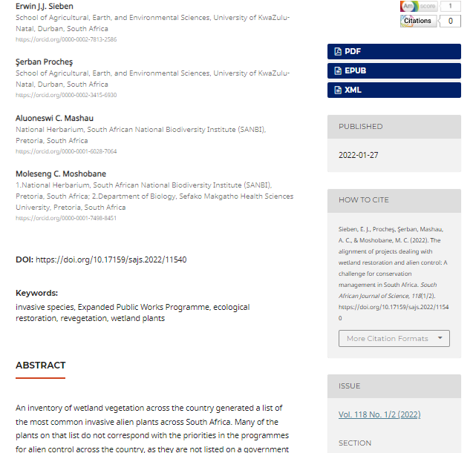
Persistent Identifiers: DOI Identifiants persistants: DOI
Digital Object Identifier (DOI)
Crossref: https://www.crossref.org/
Become a member: https://www.crossref.org/membership/

Slide 51
Compliance (I4OC standards for open citations) (1) Conformité (normes I4OC pour les citations ouvertes)(1)
Initiative for Open Citations promote the unrestricted availability of scholarly citation data L'initiative pour les citations ouvertes promeut la disponibilité sans restriction des données de citations savantes
Notes:
The aim of this initiative is to promote the availability of data on citations that are structured, separable, and open.
Structured means the data representing each publication and each citation instance are expressed in common, machine-readable formats, and that these data can be accessed programmatically. Separable means the citation instances can be accessed and analyzed without the need to access the source bibliographic products (such as journal articles and books) in which the citations are created. Open means the data are freely accessible and reusable.

Slide 52
Compliance (I4OC standards for open citations) (2) Conformité (normes I4OC pour les citations ouvertes)(2)
Citations are primary data that provide both provenance and an explanation for how we know facts Les citations sont des données primaires qui fournissent à la fois la provenance et une explication sur la façon dont nous connaissons les faits
Citations are the most important vehicle for the discovery, dissemination, and evaluation of all scholarly knowledge Les citations sont le moyen le plus important pour la découverte, la diffusion et l'évaluation de toutes les connaissances scientifiques
Notes:
The aim of this initiative is to promote the availability of data on citations that are structured, separable, and open.
Structured means the data representing each publication and each citation instance are expressed in common, machine-readable formats, and that these data can be accessed programmatically. Separable means the citation instances can be accessed and analyzed without the need to access the source bibliographic products (such as journal articles and books) in which the citations are created. Open means the data are freely accessible and reusable.

Slide 53
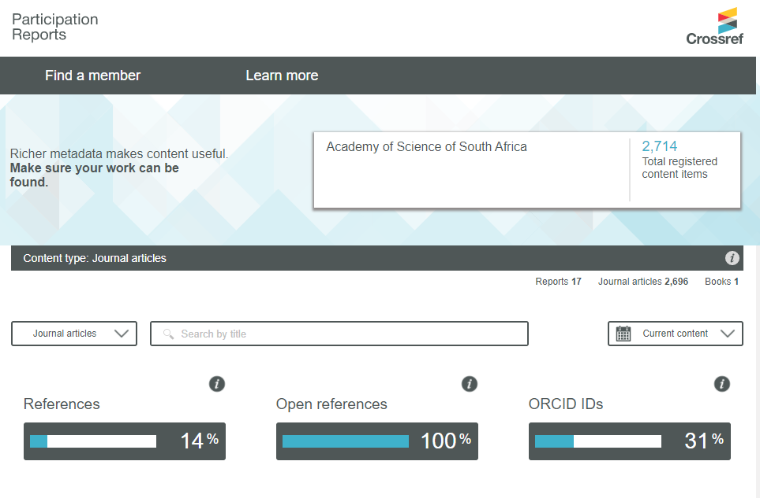

Slide 54
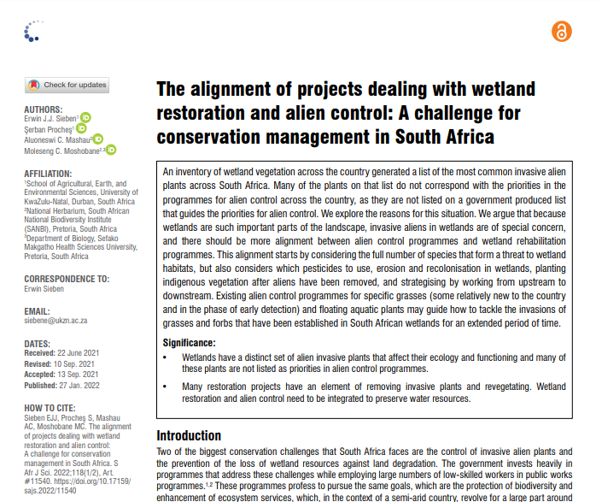
Article Elements Éléments d'article
Crossmark button
Authors & ORCIDs
Author affiliations
Corresponding author
Dates received, revised, accepted, published
How to cite
Notes:
The Crossmark button gives readers quick and easy access to the current status of an item of content, including any corrections, retractions, or updates to that record.

Slide 55
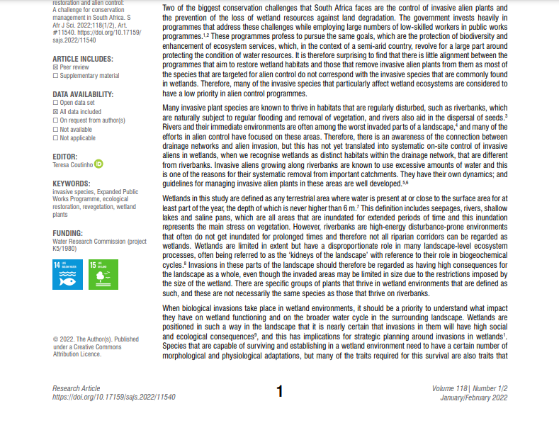
Peer review
Data availability
Editor
Keywords
Funding
SDGs
Copyright & Licensing
DOI, Vol/Issue

Slide 56
African DOAJ Ambassadors – please get in touch! Ambassadeurs africains du DOAJ - veuillez nous contacter!
Kamel Belhamel DOAJ Editor & North Africa Ambassador kamel@doaj.org
Ina Smith Southern Africa ina@doaj.org
Thomas Herve Mboa Nkoudou West & Central Africa thomas@doaj.org
Solomon Mekonnen Eastern Africa solomon@doaj.org

Slide 57
Thank you! Merci!
Ina Smith, DOAJ Ambassador Southern Africa
Thomas Hervé Mboa Nkoudou, DOAJ Ambassador West & Central Africa

