Slide 1



BUILDING EDITORIAL CAPACITY
THROUGH MENTORSHIP
Reflections from the EAJNS Journey
EIFL Webinar Series | 13-05-2026
Felix Mburu Njoroge
Projects Lead , East African Journal of Neurological Sciences

Slide 2

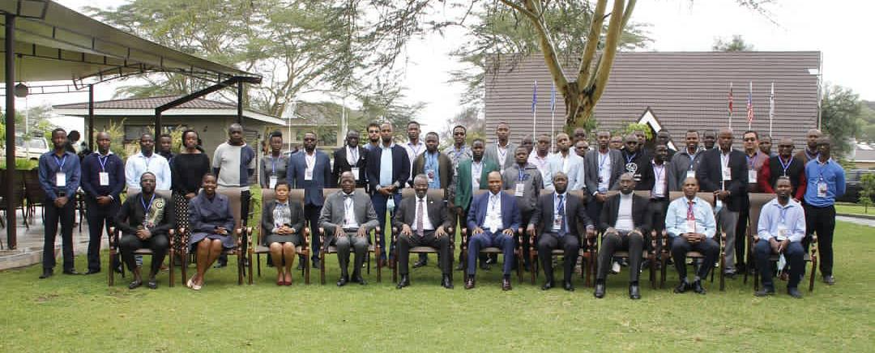

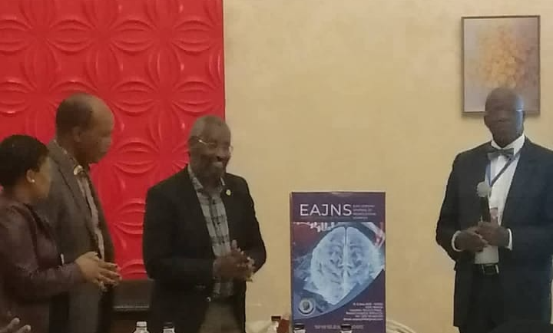
How It Started: My Personal Journey
My entry into academic publishing began in my 2nd year of medical school, fueled by curiosity at a conference where EAJNS was launched.
Volunteer to Editorial Trainee
Shadowing the Editor-in-Chief
Peer review & editorial decisions
Key Message: Mentorship transformed an intimidating field into a learnable skill.

Slide 3





Understanding Editorial Capacity
Core Credibility
Scholarship
Technical Mastery
Ethics, sustainability, and manuscript management at scale.
Ensuring research integrity and contextualized local knowledge.
Leadership, technical publishing skills, and strategic innovation.
Why it matters in Africa: Growing research output requires robust local publishing ecosystems.

Slide 4

Why Editorial Mentorship Matters
Shortens steep learning curves
Transfers vital tacit knowledge
Preserves institutional memory
"Editorial work is learned best by doing — but never alone."
Develops future editorial leaders
Reduces burnout in small teams

Slide 5

My Mentorship Experience at EAJNS
Learning Proximity
Growth Challenges
Participating in real editorial decisions, shadowing leaders, and receiving iterative, constructive feedback on technical workflows.
Limited resources, balancing other commitments with journal responsibilities, burnout, steep learning curve.
The wins: Moving from a mentee to mentor, leadership development, problem solving.

Slide 6
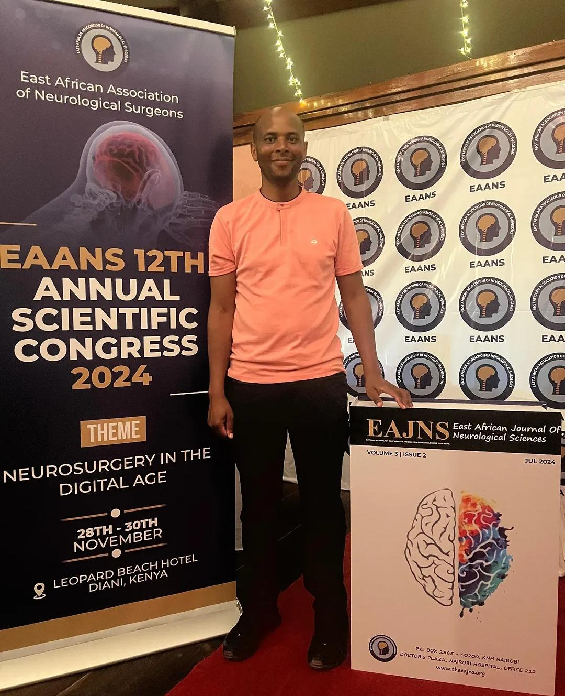
Characteristics of Effective Editorial Mentors
Patient and highly accessible
Delegates responsibility gradually
Encourages independent thinking
Models professional ethics
Invests in long-term career growth

Slide 7

Characteristics of Strong Editorial Mentees
Growth requires more than interest or talent; it demands humble consistency.
100%
High Curiosity
Proactive Initiative
Open to Feedback
Persistent Drive
RELIABILITY

Slide 8





Mentorship Models in Editorial Work
Apprenticeship
Peer Mentorship
Networked
One-on-one learning under senior editors.
Junior editors supporting and teaching each other.
Cross-journal and regional collaborations.

Slide 9

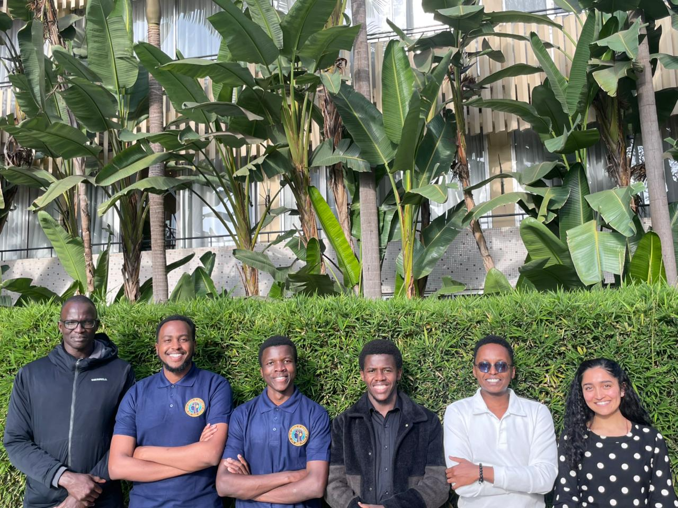
The EAJNS Mentorship Model
1. Recruit
2. Build
3. Maintain
Identify motivated scholars via conferences and academic networks.
Hands-on workflows, technical skills, and progressive responsibility.
Succession planning and continuous leadership engagement.

Slide 10

Looking Ahead: A New Editorial Mentorship Programme
Our vision is to create a pipeline of future African editors and publishing leaders through structured training.
Build regional editorial expertise
Peer review & research integrity
Journal management systems
Open access advocacy

Slide 11
Practical Suggestions for Journals
Strategy | Action Item
Early Start | Identify and recruit mentees during early career stages.
Documentation | Clearly document all editorial workflows for transparency.
Responsibility | Delegate real editorial tasks, not just administrative work.
Recognition | Publicly celebrate and credit contributors to build morale.

Slide 12
Key Lessons & Reflections
“
"Building journals is ultimately about building people."
— Felix Mburu Njoroge
Capacity building must be intentional, not accidental. Young scholars contribute meaningfully when trusted.

Slide 13
Thank You for your attention
Any Questions?
Contact Information:
eajnseditor@gmail.com
felixnjoroge6@gmail.com
https:\\theeajns.org
TheEAJNS

