Slide 1
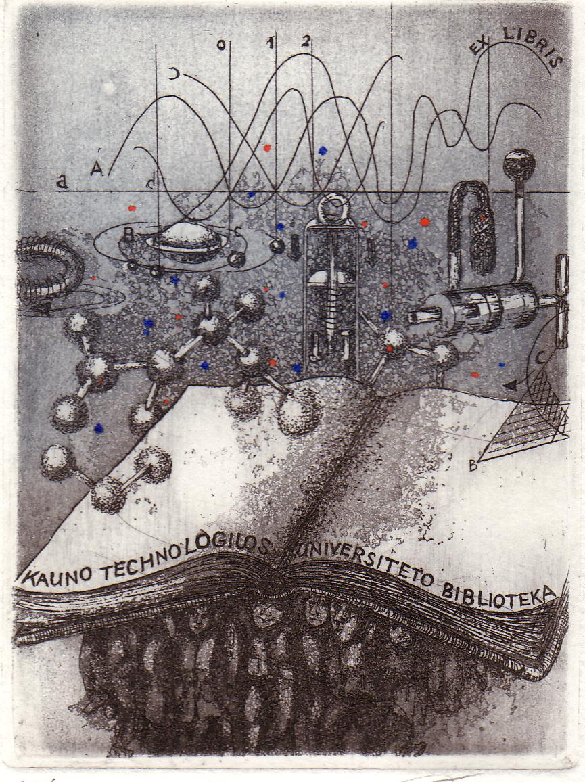
Promoting e-resources
Gintarė Tautkevičienė
Kaunas University of Technology, Lithuania

Slide 2
Outline
About the library
Steps to promote e-resources
Training librarians
Role of subject librarians
Training users

Slide 3

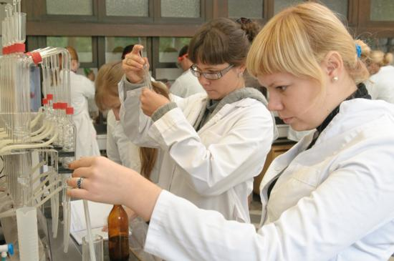
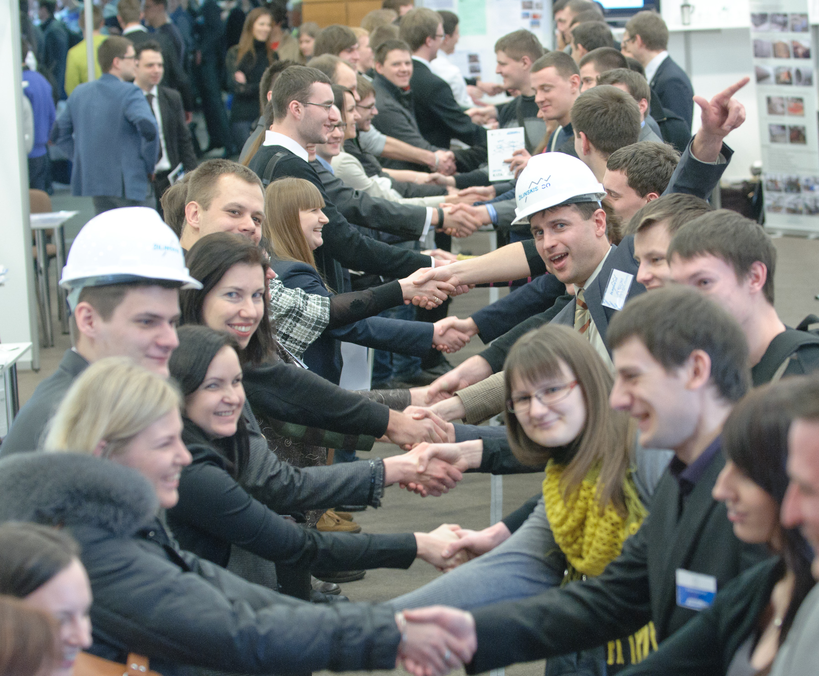

University: Facts and Figures
Number of students: 10 895 (7 895 undergraduate, 2 648 Master‘s, 566 international students and 352 PhD students)
Alumni: ~130 000
Academic Staff: ~1 000
6 main fields of study: technological, physical and social sciences, arts, humanities and biomedicine
Number of study programmes: 156 (including 62 in English, 64 undergraduate, 73 Master‘s, 19 PhD programmes)

Slide 4
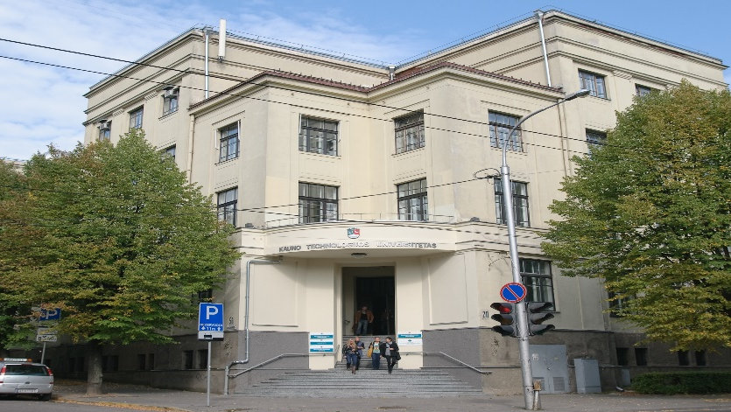
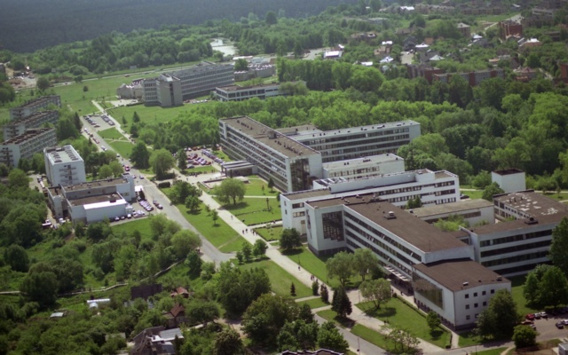
Structure of the Library
Main Library and 5 Branch Libraries
Departments:
Reader Services
Information Services
Research Information Services
Information Resources Management Services
Services are provided in:
  7 loan departments
  10 reading rooms
  group study rooms
  virtually
The School of Economics and Business and Main Library
University campus

Slide 5
The Library in numbers (2015)
Library staff - 59/53
Registered customers - 15 618
Number of visits – 0,48 mln.
Work-places for customers - 588
Computer workstations for users - 113
Print Library Collection - 1,2 mln.
Print acquisitions - 5,3 thousand
Subscribed databases- 44
Connections to the Library information system – 1,6 mln.
Collection turnover – 0,47 mln.
Full-text downloads from subscribed databases – 0,983 mln.

Slide 6
The beginning was…
Free trials since 1996-1997
EBSCO Publishing with the support of the Open Society Foundations, 2001
Support from EIFL
Since 2009: the project ”Opening of Research Databases for Lithuania“ coordinated by the Lithuanian Research Libraries Consortium

Slide 7








Subscribed e-resources
The Library provided access to 44 full-text and reference databases in 2015.
The subscription to the Web of Knowledge, EBSCO Publishing, ScienceDirect, Emerald Fulltext, SpringerLINK, Oxford Journals, IEEE/IEL, ACS, American Institute of Physics, American Physical Society, Institute of Physics Journals, SAGE Journals, Wiley Online Library, Annual Reviews, Ebrary, ScienceOnline, Nature Publishing, and others.
Subscribed databases provide access to about 23 thousand full-text journals and 300 thousand full-text ebooks.

Slide 8
Before the license is signed
Free trial
Communication with the academic community
Getting feedback about e-resources
Analysing the statistics
Making a decision
The major issue:
How to reach users who can help to make decisions?

Slide 9
Basics steps
Establish access (double check if it is available)
Disseminate information about available resources
Increase visibility
Market e-resources
Train librarians
Train users
Get usage statistics
Get feedback from the users
Communicate with the academic community to assess their needs

Slide 10
Disseminate the information about e-resources
Inform library staff, subject librarians in particular
Inform administrative staff, including heads of departments, student office and information desk, student association
Inform academic staff, researchers and students
Use different means and channels (e-mail, website, social media, personal communication)
Publish information about e-resources (new, free trial) on the newsletters of the University, departments and Library
Put information on the information display screens at the Library and institutional departments
Find those who will be lobbying for the Library among the faculty and research staff

Slide 11
Increase visibility
Include MARC records for e-resources in the library catalogue (usually these can be downloaded for free from publishers‘ websites)
Take care about indexing e-resources by library discovery tools (e.g. Virtual Library: http://ktu.lvb.lt)
Include in the subject guides (based on LibGuides, SubjectPlus, e.g. http://temos.ktu.edu/)

Slide 12
Market e-resources
Use vendors‘ free dissemination material (posters, bookmarks, mousepads, leaflets, etc.)
Provide links to e-information from websites of the Departments
Face-to-face communication in the faculty meetings, library introduction sessions, staff in the cafeteria, etc.
Remind them of e-resources you have sent them via e-mail and social media

Slide 13
Librarians’ competence
you need staff who will be responsible for:
licensing
providing access to e-resources
disseminating and sharing information about e-resources
training the librarians
training the users
creating training material (PPT, video tutorials)
collecting feedback from the users

Slide 14
Start with training librarians
  What e-resources are available
  How to use e-resources
  How to organise training for users
  How to prepare training material
  How to promote e-resources among researchers, faculty and students
  …

Slide 15
New position at the Library: Subject Librarians
Provide individualized thematic consultations and assistance
Inform about library resources and services
Develop users’ (students, academic staff and researchers) information competence
Organize educational and cultural events
How to develop training materials?
How to organize and provide training?
How to communicate with users?
How to manage information effectively?
How to share and disseminate information using technologies?
…
Need to improve professional, organizational and educational skills

Slide 16
What can we do without big money?
Training Librarians
Monthly training sessions
Internal resources – librarians (experience, topics)
Guest lecturers from other departments
Weekly English classes
Provided by colleagues (professionals in the English language)
Information providers (workshops)

Slide 17
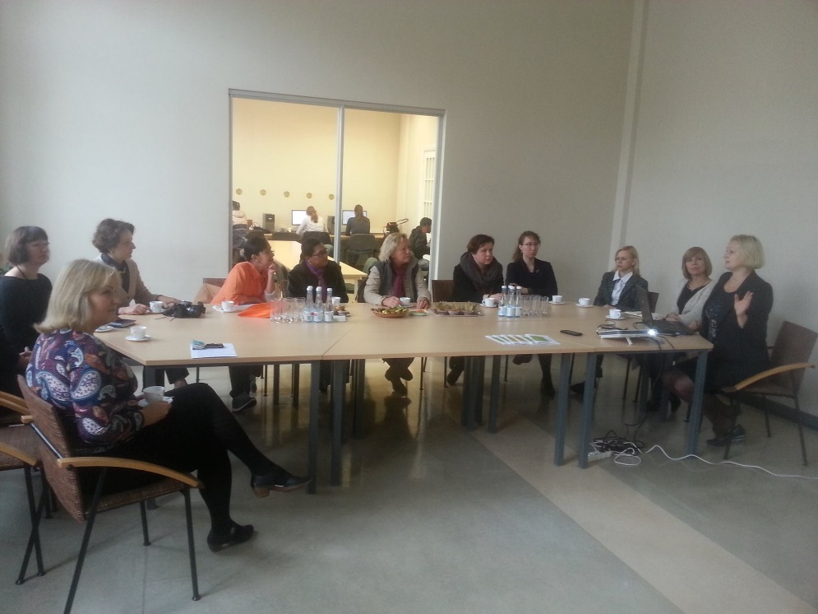
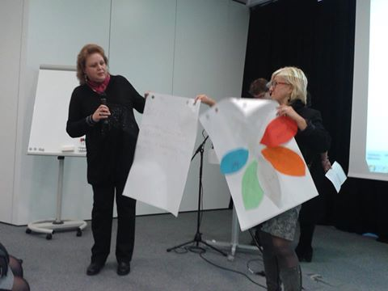
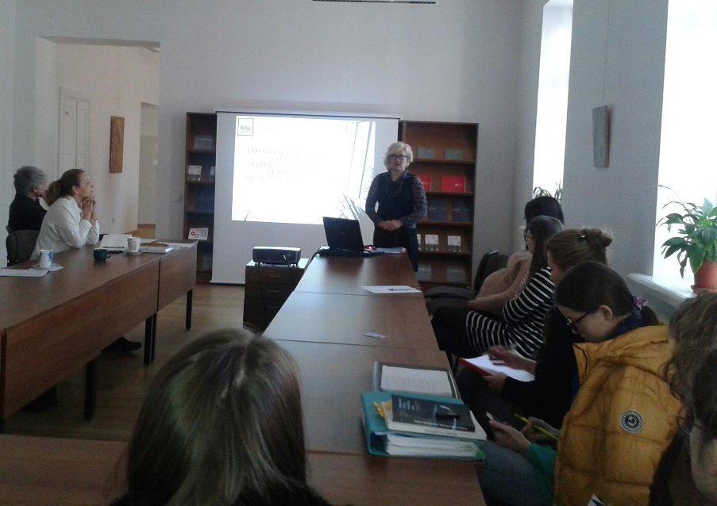
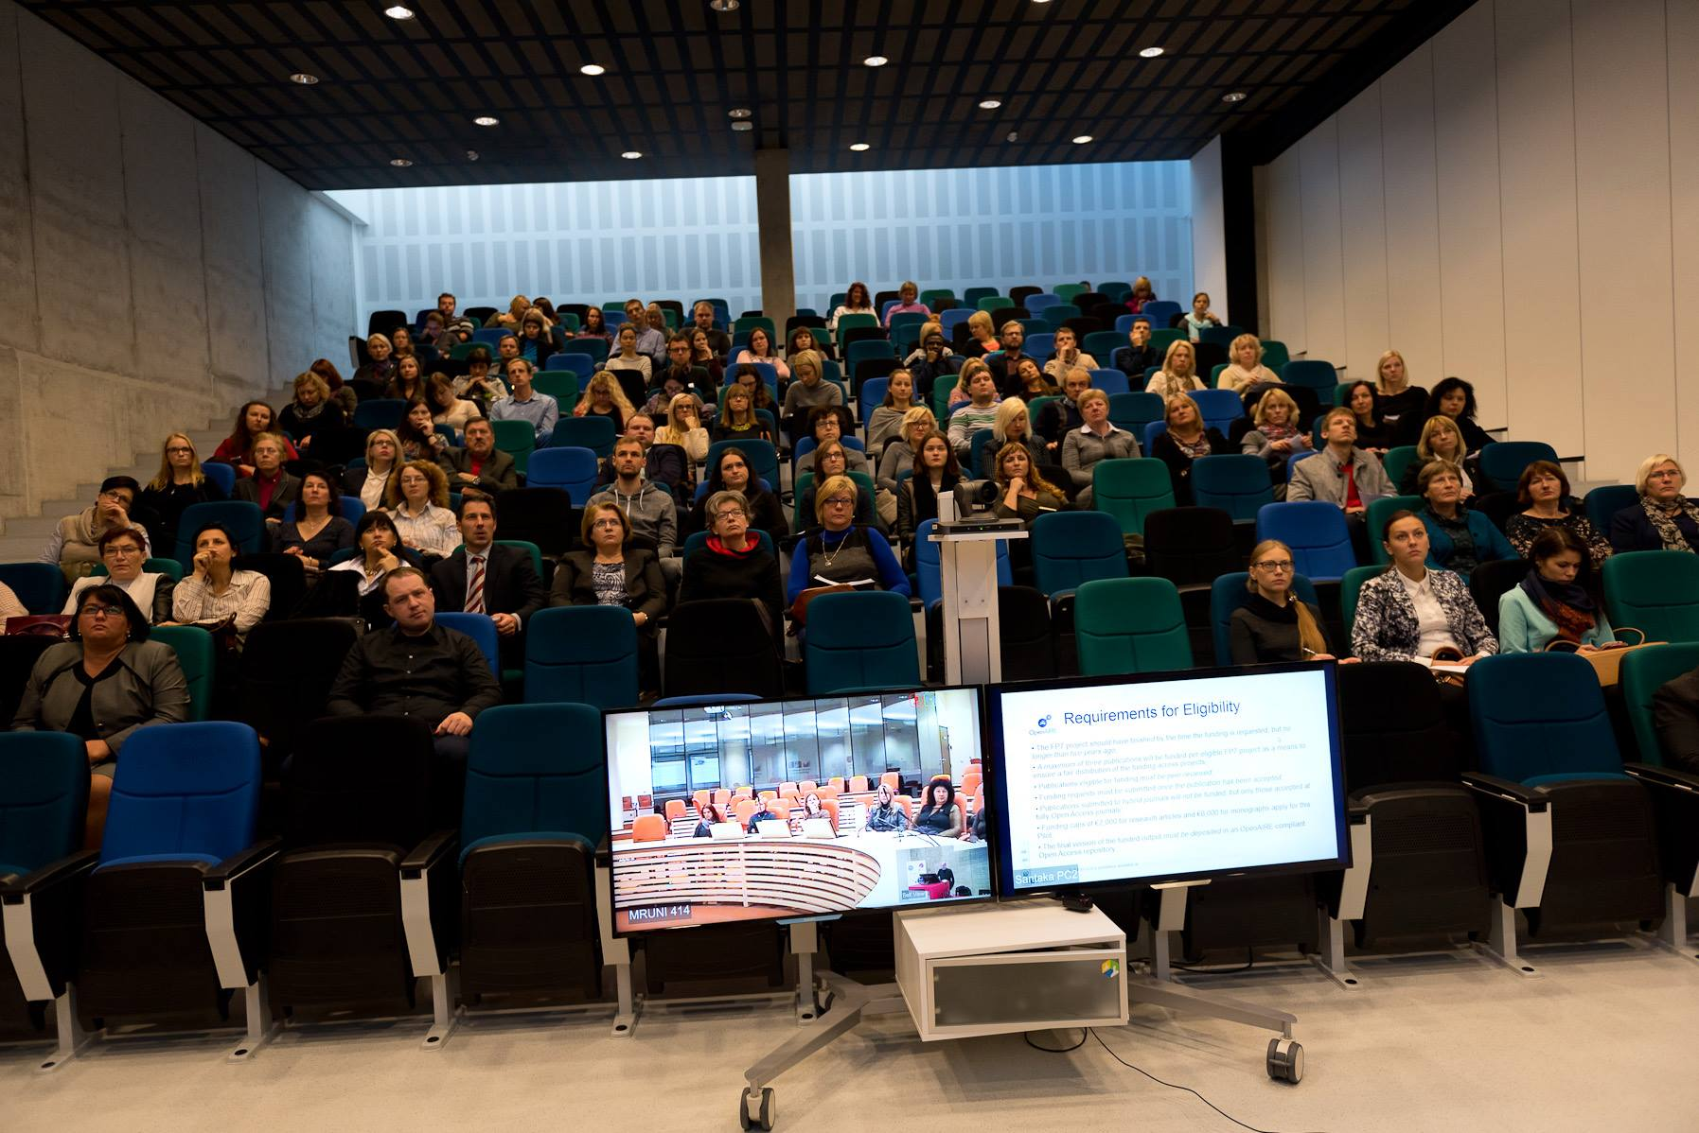
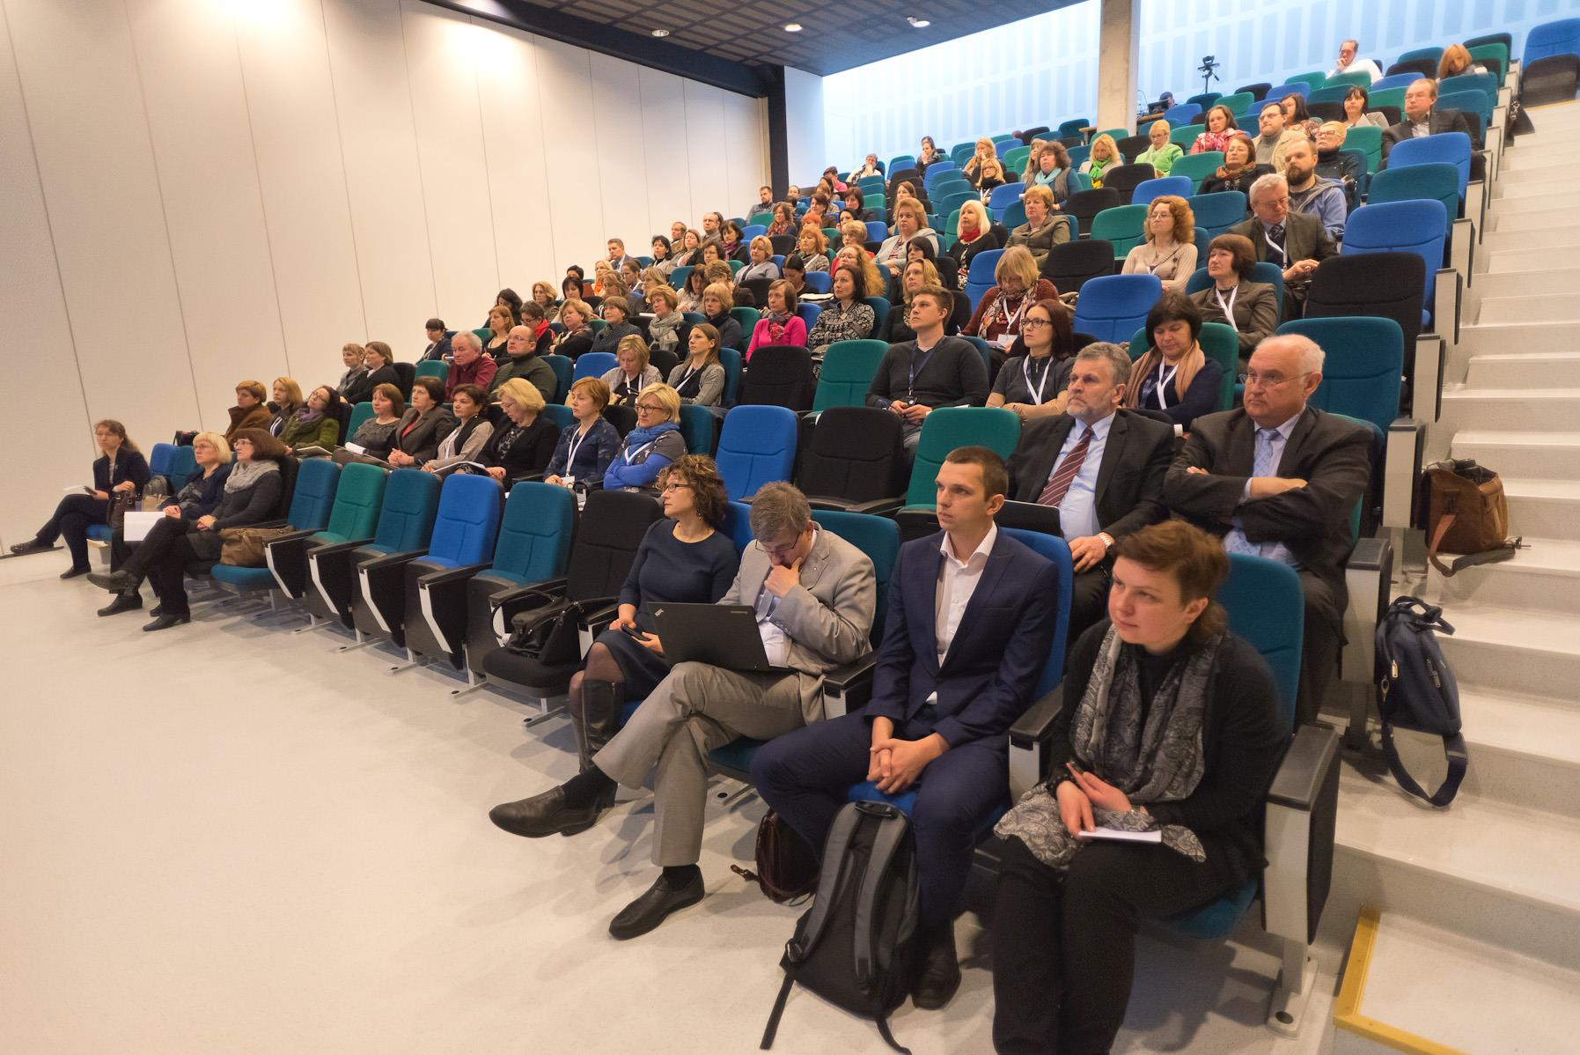
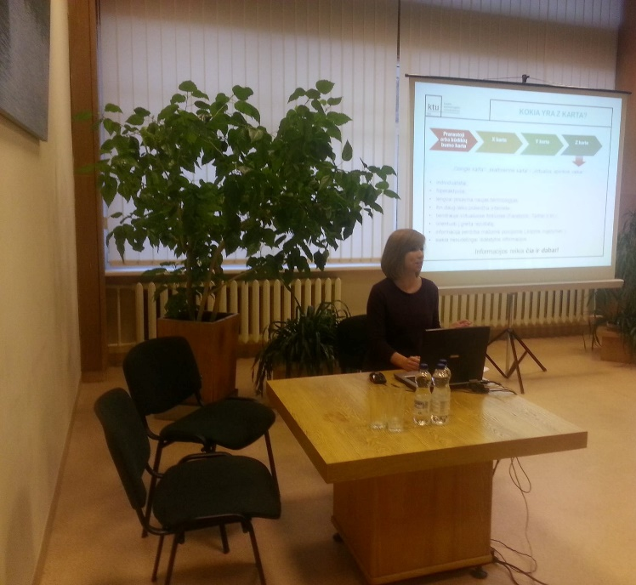
Training sessions for librarians

Slide 18
Access is just the beginning…
  Academics, researchers and students need to know what is available
  They need to understand they will benefit from accessing scholarly e-resources
  They also need the competence of using e-resources through the development of information literacy skills

Slide 19
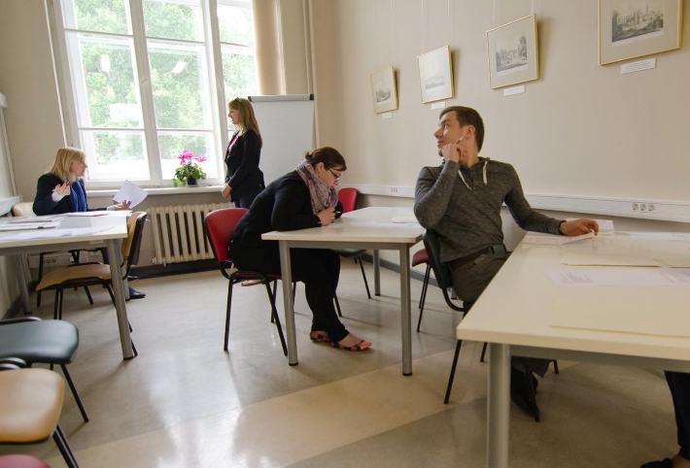
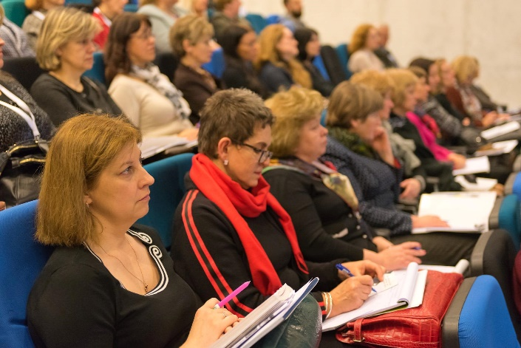
Training sessions for users
Training users
In groups
Individual
Hands-on trainings
Invited publishers
Webinars
Creating supplementary material
Video tutorials
Support and help guides
Subject guides
Go to meet the users rather than wait for them to come

Slide 20
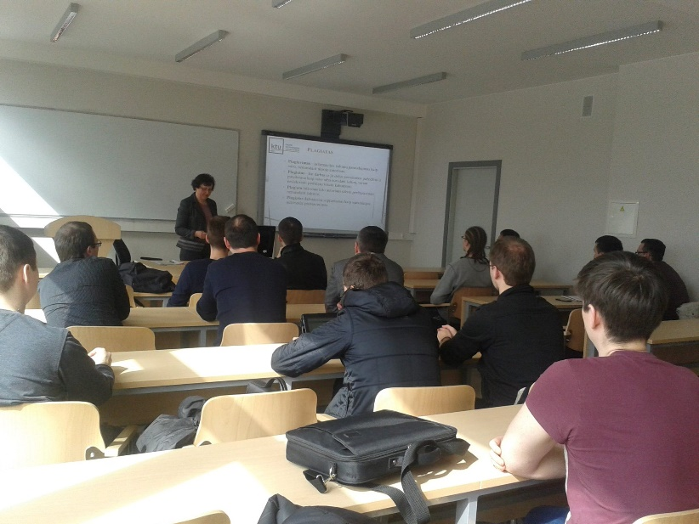
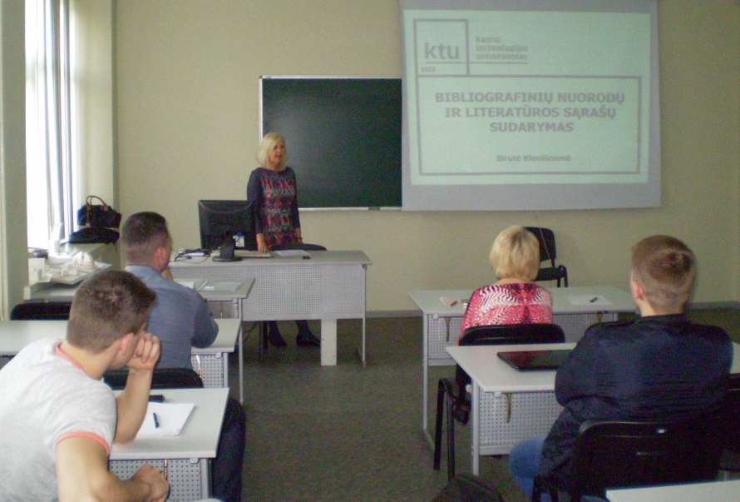
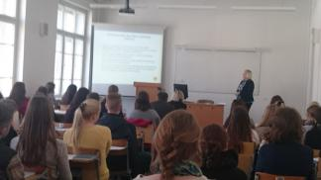
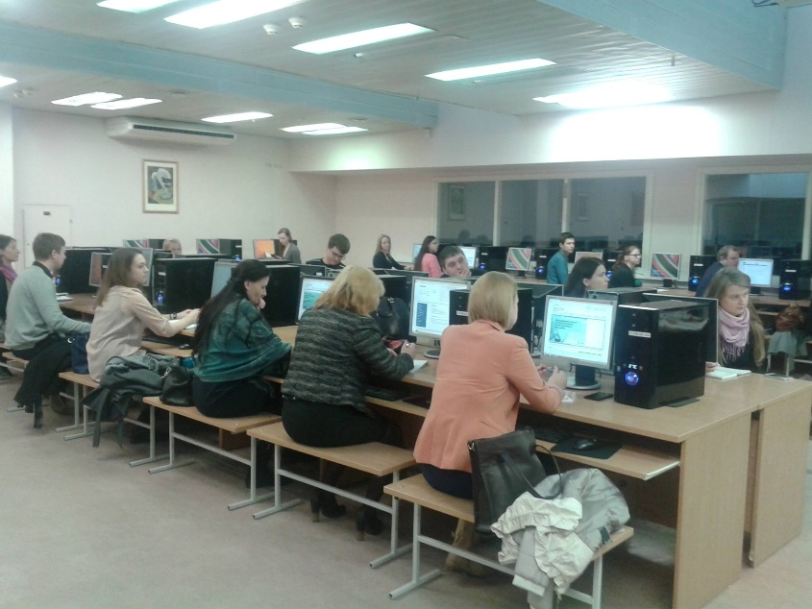
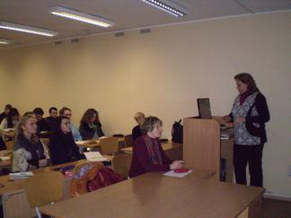
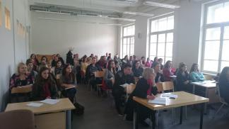
Training sessions for users

Slide 21
Topics of training sessions
Library information system and services;
Library information system (for PhD students);
Search strategy at the Library;
Information search in the Library catalogue and KTU virtual library;
Search and ordering publications in the catalogue;
Scientific information search;
Search e-resources from subscribed databases;
Citation and copyright;
Scholarly communication and open access;
How to find a journal for publishing;
…

Slide 22
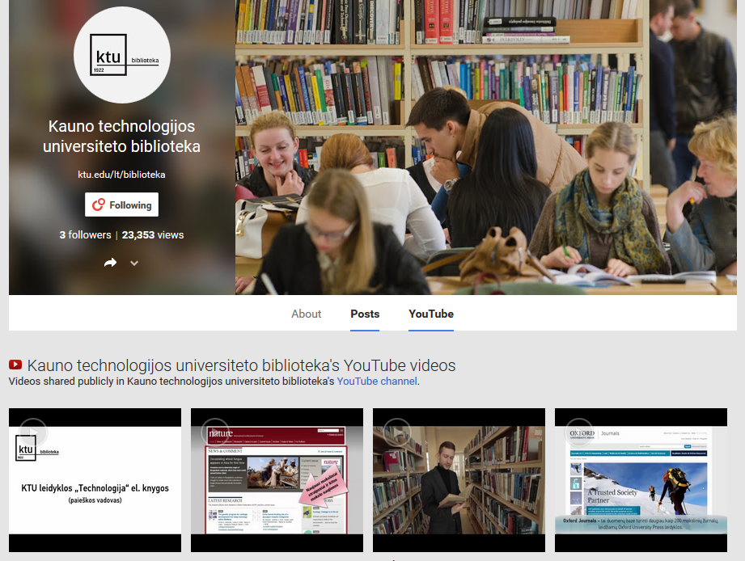
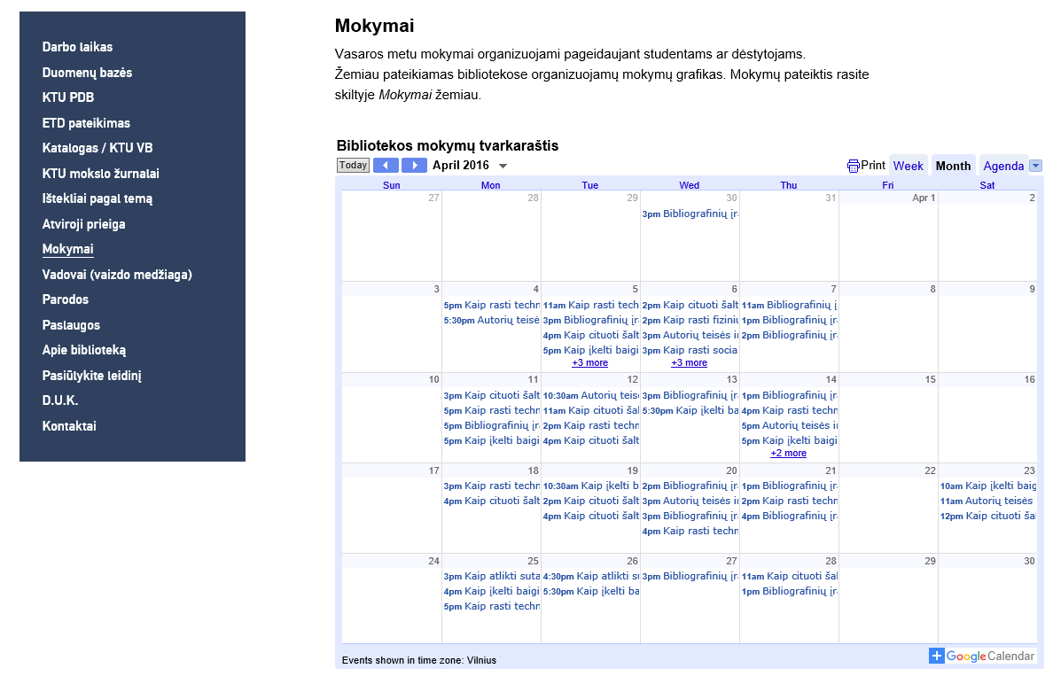
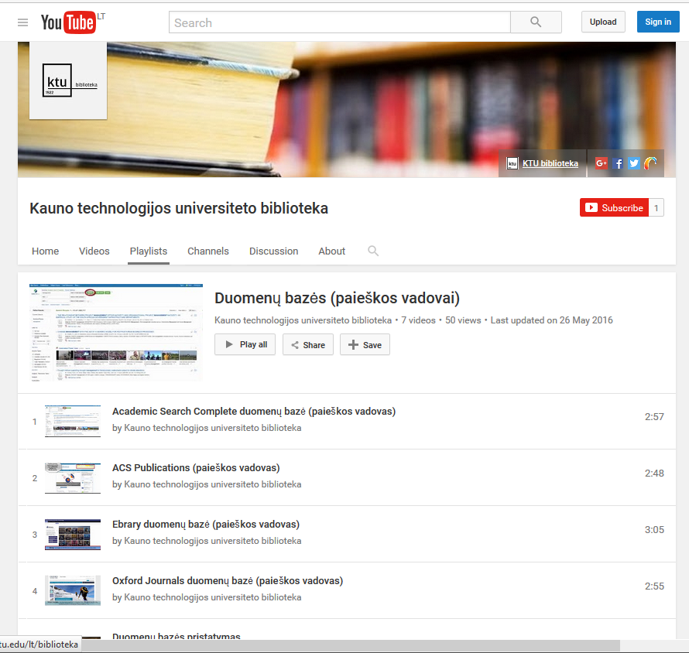
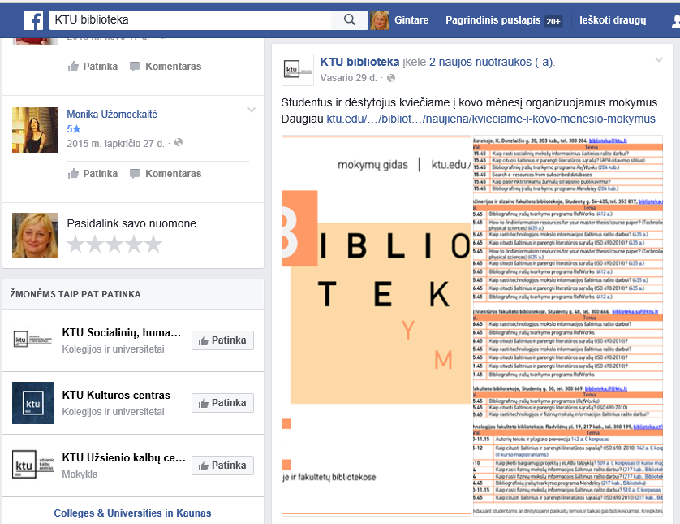
Information about e-resources and training sessions
Information display screens at the Library and departments
on the Library website http://ktu.edu
on Facebook https://www.facebook.com/ktubiblioteka
Video training material on YouTube https://www.youtube.com/channel/UCakUO49Hj-8VntzpSP6Hbxg/featured
GooglePlus https://plus.google.com/107058993393357947665

Slide 23
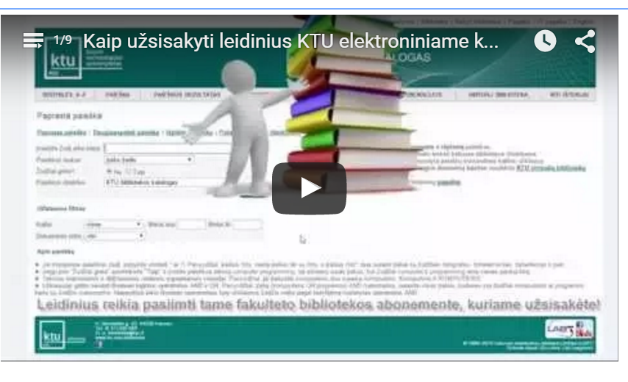
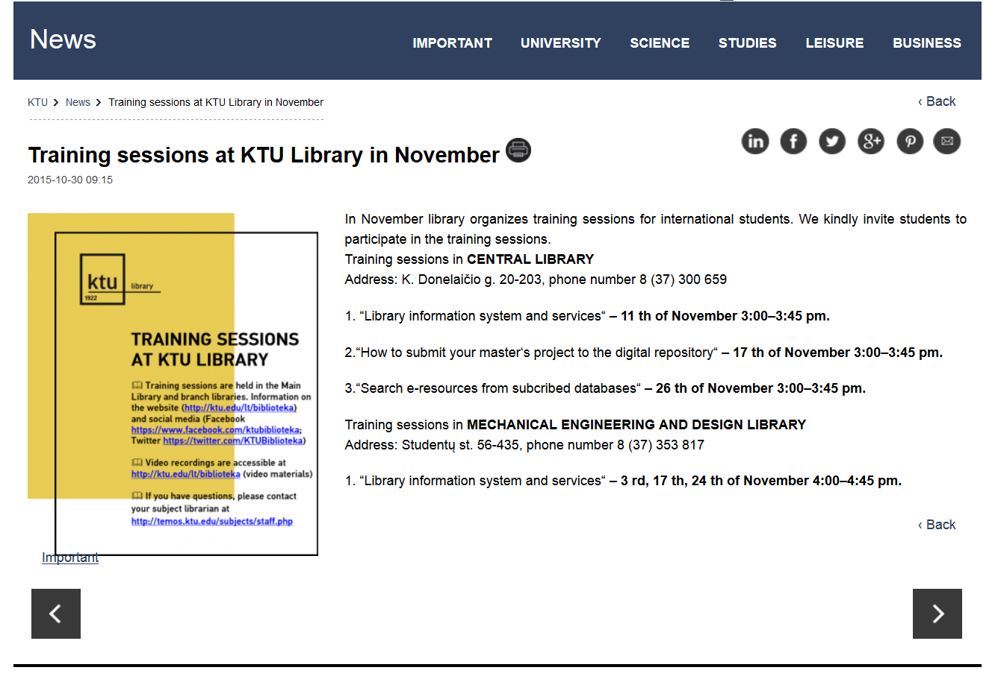
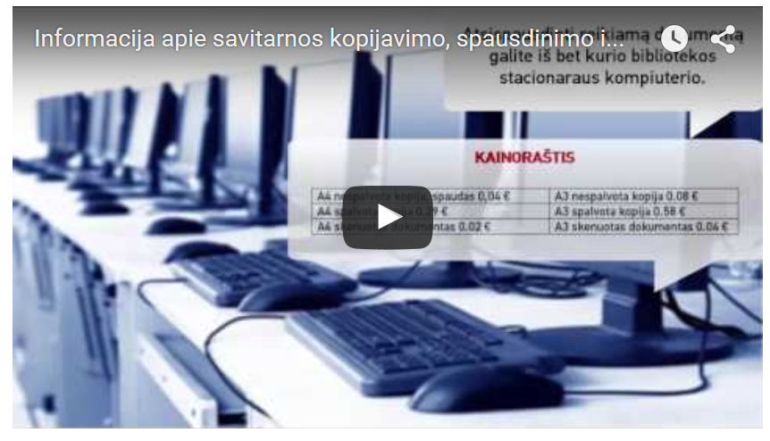
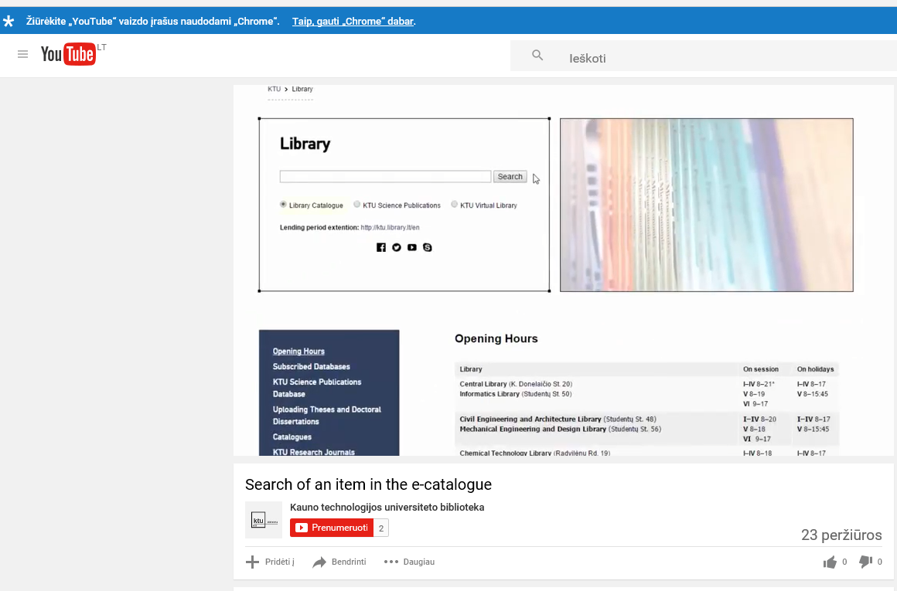
Training sessions for international students

Slide 24
Final remarks
E-resources should meet the users‘ needs.
Use all kinds of communication channels to reach every user.
To be an effective agent in the academic community, the library is responsible for developing a partnership with the academia by being proactive.

Slide 25
Thank you for your attention
More information is available at
www.ktu.edu/en/library
gintare.tautkeviciene@ktu.lt

