Slide 1
Communication and Advocacy for Libraries
By Kaspars Rūklis / Latvia

Slide 2
Why Advocacy? Why Libraries?
Session One

Slide 3
Session Goals
Defining advocacy for libraries in the context of other areas of communication
Agreeing on why advocacy is needed for libraries
Learning to develop advocacy goal for solving your library’s problem

Slide 4
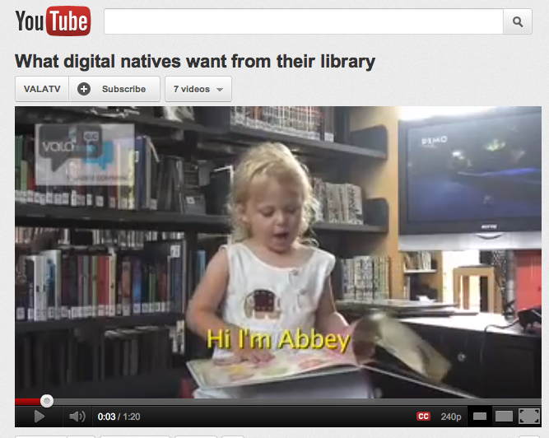
Digital Natives

Slide 5
What we mean by:
Communication = skills of communication and presentation (interpersonal and public)
Awareness Raising = content & techniques for general audiences
Advocacy = content & techniques for decision maker audiences

Slide 6
What is Advocacy?
Advocacy is the actions individuals or organizations undertake to influence decision making at the local, regional, state, national, and international level that help create a desired policy or funding change in support of public libraries.

Slide 7
Why Libraries?
“Isn’t Amazon.com going to put public libraries out of business?”
“Why do libraries need money for books when everything is online?”
“Why do we need a library, when students can do their research on the internet?”

Slide 8
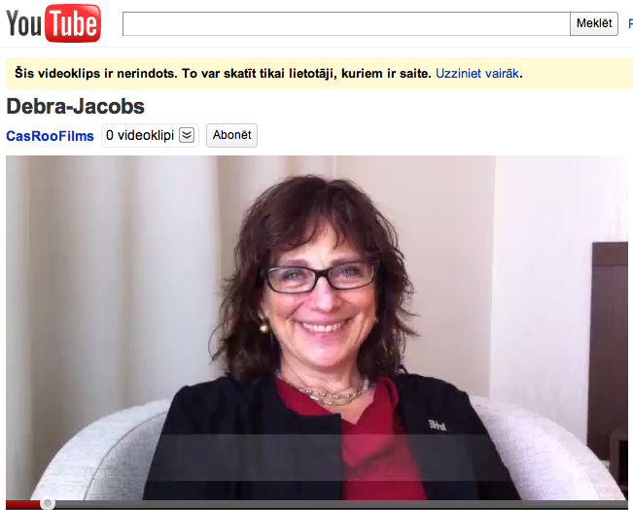
Why Advocacy? Why Libraries?

Slide 9

The Logic
Community needs
Government policies
ICT tools and resources
Impact / outcome assessment
Innovative service
Partners
Social and economic change
Advocacy activities …. more funding for libraries☺
Sustainability
Source: Monika Elbert, EIFL

Slide 10
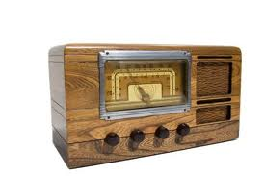
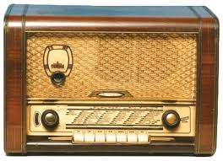
Activities
Outreach
Awareness Raising
Public Relations
Media Relations

Slide 11
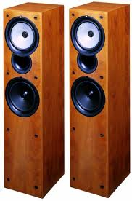
Activities
Marketing
Branding
Fundraising
Advocacy
Notes:
Latvia driver video fragment (?)

Slide 12
Quick Discussion
Which activities your library is using? Please, provide concrete examples!
Which of the activities you are not currently using, seem easiest to adopt, especially in the context of your new service for children/youth?

Slide 13
Library to Me, I for the Library

Slide 14
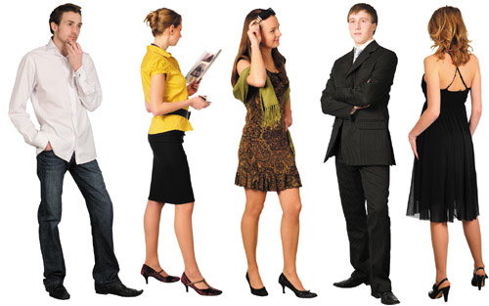
What is Advocacy Goal?
Advocacy Goal is the specific action a library wants people to take to help solve a problem the library faces.

Slide 15

Developing Advocacy Goal
Problem / Challenge →
Solution →
Advocacy Goal

Slide 16
Example
Problem → Libraries have outdated computers and slow internet connection speed
Solution → Public internet access established as core service; funding for new computers, software and internet speed update is allocated
Advocacy Goal → To have local municipality establish internet access in libraries as a core service and allocate continued funding for new hardware, software and internet speed updates X Euros per year

Slide 17
Exercise
Work in groups. Each group agrees on a Problem, Solution and possible Advocacy Goal (connected to your new service)
Groups prepare 2 minute presentation on a flip chart
Groups present their Advocacy Goal to the class

Slide 18
Advocacy in Action

Slide 19
Library Data, Library Message and Library Story
Session Two

Slide 20
Session Goals
Learn about the advocacy target audience vs. library end users as target audience
Identify the connections between library data and advocacy content
Get tips for crafting messages and putting together library stories

Slide 21
What is Target Audience?
Target Audience (for advocacy) refers to a person or group of people that can help bring about the changes to policies, funding, or partnerships that a public library needs to meets its advocacy goal.
Notes:
Olso Library video (?)

Slide 22

Target Audience for Advocacy
Decision makers, such as a mayor or member of the City Council
and
People, who can influence the decision makers

Slide 23
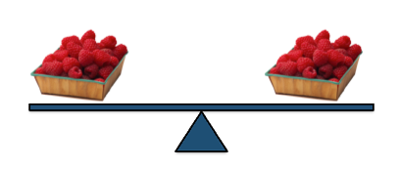
What is a Partnership?
Library partnerships are relationships that provide mutual benefit for both the library and the partner.
Image from Latvia Advocacy Training Presentation

Slide 24
Blitz Exercise
Groups identify advocacy target audiences and partners
Groups present their target audiences (both direct and indirect) and partners (both existing and potential)

Slide 25
Library Data
By understanding how your target audience thinks and feels about the library
you can determine the best way to approach and connect with your target audiences to encourage their involvement

Slide 26
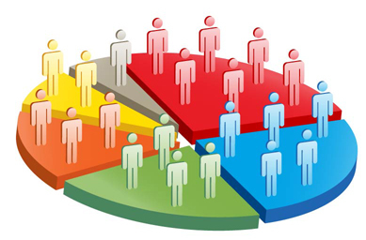
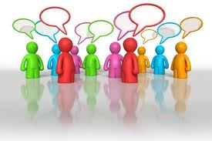
Library Data
Quantitative data =
numbers
Qualitative data =
stories

Slide 27
Libraries for Communities

Slide 28
What is Key Advocacy Message?
Key Advocacy Message is a strong, effective message that can provide people outside of the library with a clear understanding of the library’s advocacy goal and a way to help the library reach that goal.

Slide 29
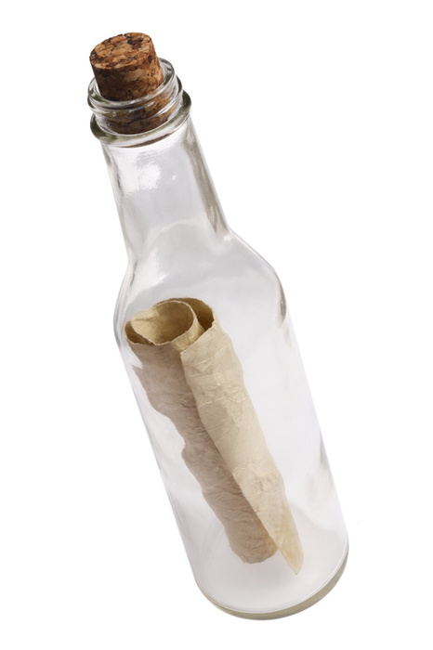
Message
Message is a core statement that explains in a nutshell:
Your problem
Your goal
Why your audience should care
What your audience can do to help

Slide 30
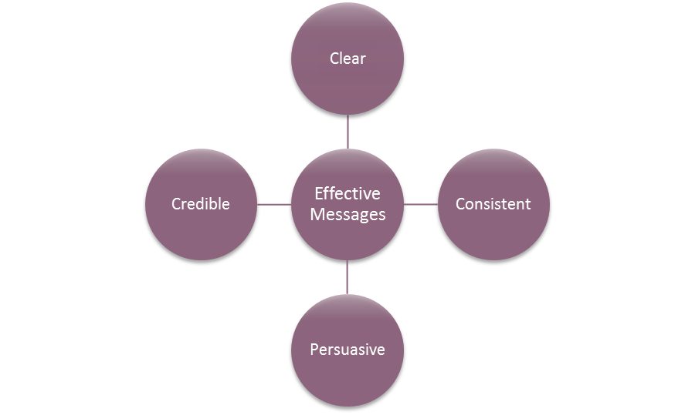
Effective Messages
Image from EIFL Message Toolkit

Slide 31
EIFL-PLIP messages
Core EIFL-PLIP message –
Libraries are proven, trusted development partner.

Slide 32
Supporting Messages
Community Development:
  Access to knowledge is essential for people and communities to develop and thrive.
  Libraries are important community development partners.

Slide 33
Supporting Messages
Impact Evidence:
  Libraries are improving community health and wellness.
  Libraries are empowering people to find jobs.
  Libraries are driving advancements in agriculture development.
  Libraries are keeping at-risk youth on track.
  Libraries are helping to achieve the Millennium Development Goals.

Slide 34
Supporting Messages
Replication:
  Momentum is building for proven, innovative library programs.
Sustainability:
  Despite successes, public libraries are still under-funded.
  Communities need strong public libraries and library leaders.

Slide 35
Blitz Exercise
Groups try to create a message, based on their Advocacy Goal and core message, for their target audience
Groups briefly present their messages to the class

Slide 36
Emotions in the Library

Slide 37

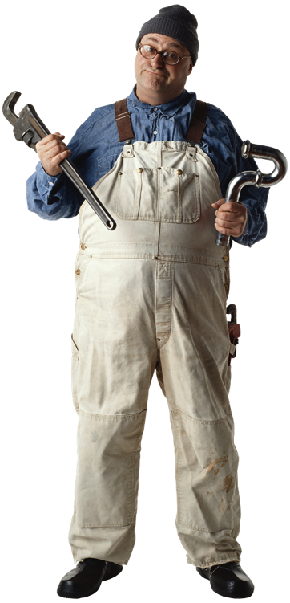
Library Stories
Library factual story
Library anecdotal story
Images from Latvia Advocacy Training Presentation

Slide 38
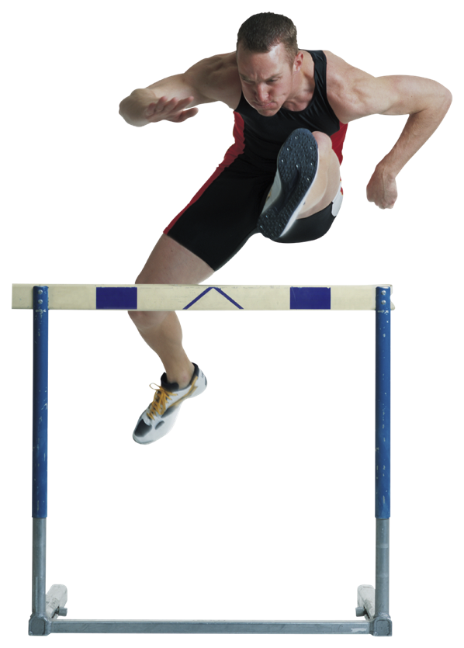
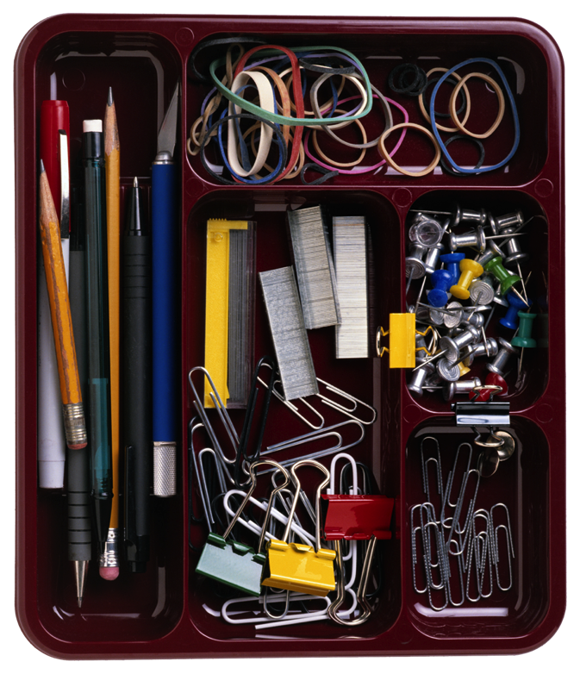
Library Stories
Library inspirational story
Integrated library story
Images from Latvia Advocacy Training Presentation

Slide 39
Empowering Story
Notes:
Video to be added

Slide 40
Blitz Exercise
Groups come up with compelling library stories (each group prepares a different type of story)

Slide 41
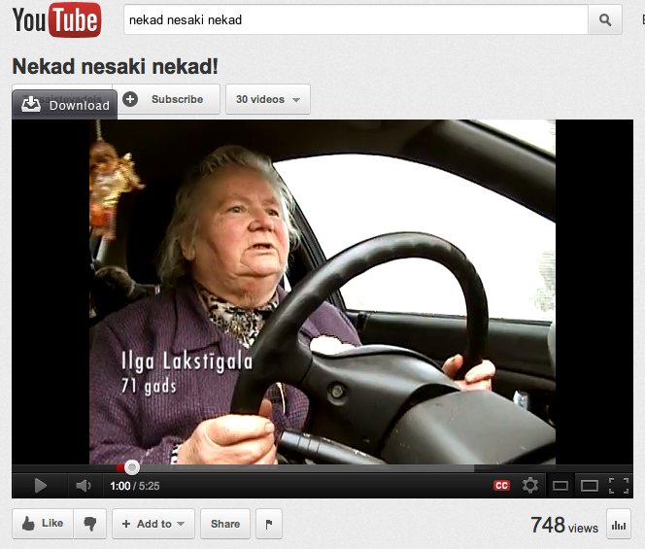
Example: Never Say Never

Slide 42
‘Made to Stick’
Library Presentations
Session Three

Slide 43
Session Goals
Tips on how to make your presentations a smashing success
How to use your message in all kinds of presentations: in ones that are short and also in the ones that are, unfortunately, too long

Slide 44
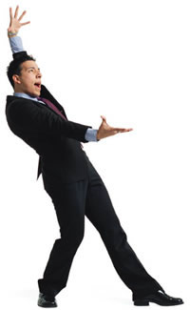
Strong Presentation
Preparation
Introduction
Content organization
Conclusion
Image: Everythingoncamera.com

Slide 45
Words, Body-Language
Body | Voice
Posture | Volume
Facial expressions | Tone
Eye contact | Clarity
Gestures | Pace

Slide 46
Verbal and Nonverbal Communication

Slide 47
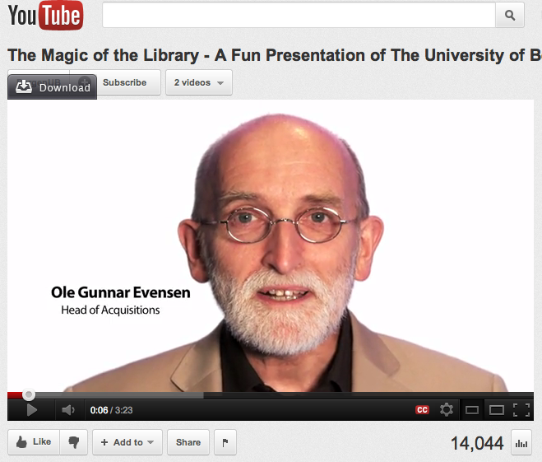
Example

Slide 48
Exercise
Group representatives practice delivering their library story
Others listen carefully, are interested audience, and provide feedback

Slide 49
Pitch for a Decision Maker
Raises decision maker’s awareness of the library programs and services
Demonstrates how the library is meeting community needs and priorities
Reinforces the value of the library to the community

Slide 50

Twenty Powerful Words
Now, Today, Immediately, Free, Save, Health, Safe, Proven, Discover, Learn, Know, Understand, You/Your, Protect, Create, Trust, Powerful, Help, Profit
Source: Stratch INRA Hooper

Slide 51
Two Approaches
Community groups
Sociological characteristics
Interests
Students
Gourmet lovers
New families
Garden lovers
Seniors
Nordic walkers

Slide 52
Exercise
Individually prepare an “elevator pitch” for unexpectedly met decision maker
Present it to your group and hear out feedback

Slide 53
Handling a “No” Response
The decision not to approve the library request is not about you
A rejection, while difficult, also provides an opportunity to learn
A “no” now does not mean a “no” always and forever

Slide 54
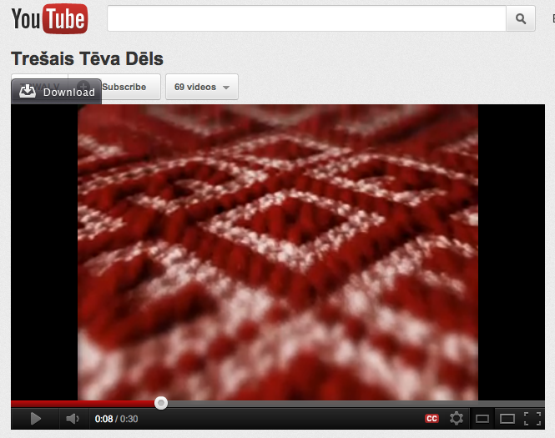
Library Image

Slide 55
Mediated Communication for Libraries
Session Four

Slide 56
Session Goals
Learn about the developments in the media world today
Discover and practice some media planning techniques

Slide 57
It’s a Book

Slide 58

Traditional Media
Radio
Television
Print
Online

Slide 59
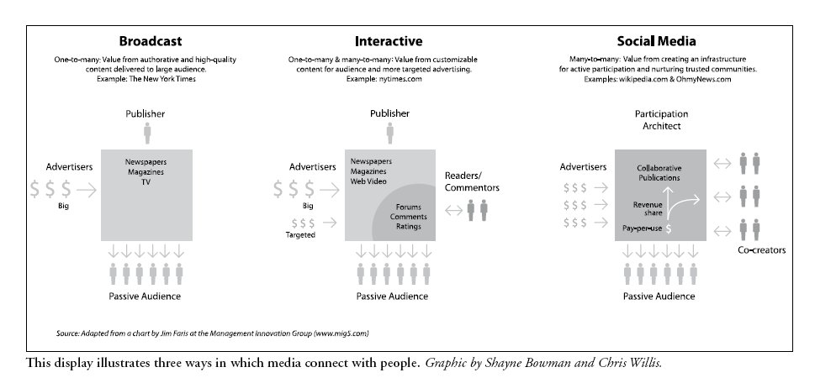
Traditional – Broadcast – Social Media

Slide 60
Media Today and Tomorrow
Today | In the Future
Press and media relations: print media | Online communication
Online communication | Press and media relations: online media
Face to face communication | Social media
Press and media relations: online media | Face to face communication
Press and media relations: TV and radio | Press and media relations: print media
Notes:
EURPRERA

Slide 61
Media Outreach
Raise awareness of library programs and services
Highlight accomplishments
Tell your story your way and amplify your message
Raise the profile of public libraries
Build credibility for the library
Build allies in the media

Slide 62
Press Releases
Be sure there is news
Use facts, stories
Use inverted pyramide style
Write for your audience, do not use “bureaucratic” language

Slide 63

Inverted Pyramid
CATCHY HEADLINE
NEWEST
INFORMATION
What? Where? When? Why? How?
SUPPORTING
INFORMATION
BACGROUND
I N F O
OTHER

Slide 64
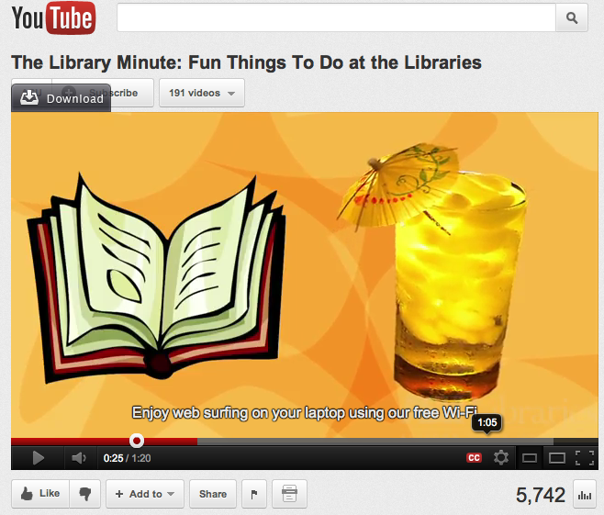
The Library Minute

Slide 65

Social Media
Social media describes the online tools that people use to share content, opinions, insights, experiences, and perspectives, and helps facilitate online conversations between groups of people.

Slide 66



Social Media Examples
 | Facebook is a popular social networking tool with more than 600 million users worldwide. On Facebook, it is important to keep comment fresh, interesting, and engaging to attract and keep fans.
 | Twitter is a “micro blog” that encourages posting frequent but brief (up to 140 characters) messages. Twitter is best used for sharing news and quick updates on our organization – you can shorten links to articles by using a site like bit.ly to more easily stay within the character limit.
 | YouTube is a great way to share videos that relate to your organization. By setting up a page on YouTube you can post and tag videos that are relevant to your audience.

Slide 67
Social Media Revolution
Notes:
http://www.youtube.com/watch?v=3SuNx0UrnEo

Slide 68
What to Use for What?
Image from Pinnacle

Slide 69
Exercise
Draft a simple Media plan for your project
Use your project timeframe and select channels that can be used at various stages of the project

Slide 70
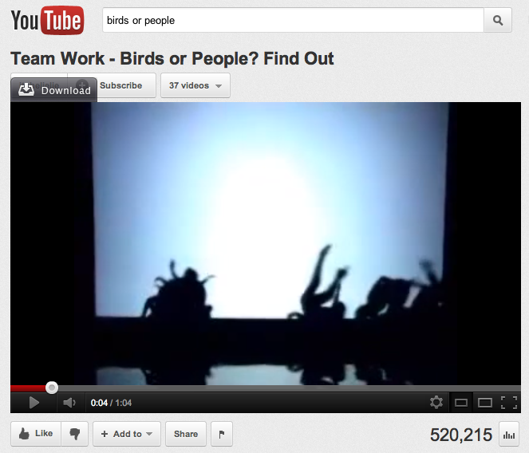
Synergy

Slide 71
Thank you for your attention and participation!
Go and advocate for your libraries!

Slide 72
Credentials
Bill & Melinda Gates Foundation Training Program “Global Libraries Advocacy Training” materials, 2011
Third Father’s Son (Latvia) Advocacy Curriculum for Latvia’s Public Libraries, 2012
American Library Association’s “Library Advocate’s Handbook” , 2008
Interactive Training Ltd material “Newsletters”, 2011
Marguerite Sullivan. “A Responsible Press Office: An Insider’s Guide”, 2008

