Slide 1
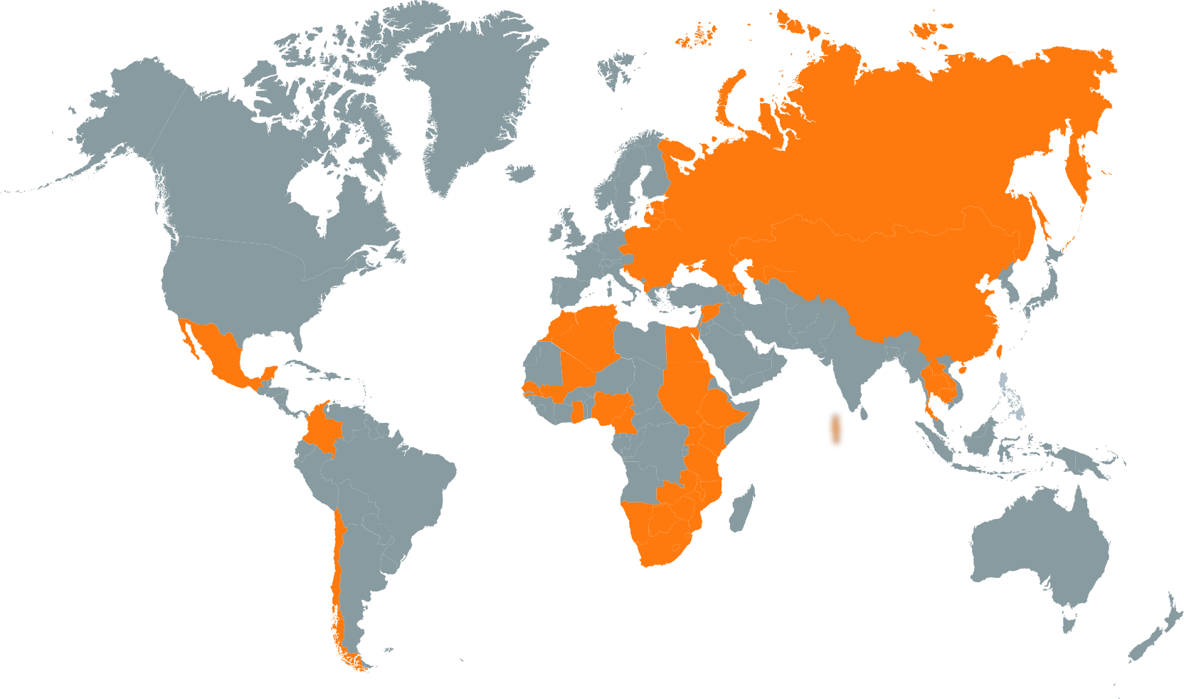

Knowledge
without
boundaries
www.eifl.net

Slide 2

Everything counts: impact stories leading to success
Ramune Petuchovaite
Ugne Lipeikaite
EIFL-PLIP

Slide 3
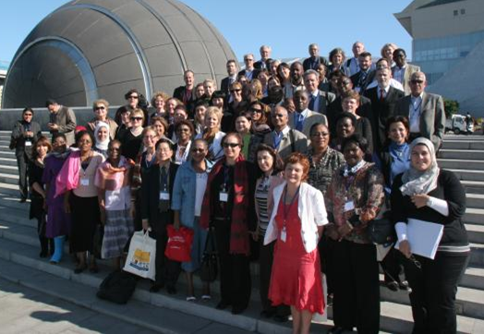
Who we are
EIFL is an international not-for-profit organization dedicated to enabling access to knowledge through libraries in more than 60 developing and transition countries in Africa, Asia, Europe and Latin America.

Slide 4
EIFL Programmes
EIFL-Licensing
EIFL-OA: open access
EIFL-IP: copyright and libraries
EIFL-FOSS: free and open source software
EIFL-PLIP: Public Library Innovation Programme

Slide 5
EIFL-PLIP context
Technology offers public libraries new opportunities to increase access to knowledge, helping to improve standards of living and transform lives.
Yet, in most countries where the need is greatest, public libraries are under-resourced.
EIFL supports public libraries to use technology creatively to develop innovative services to meet the needs of their communities.
Notes:
Public libraries exist everywhere, in almost every country. There are more than 230,000 public libraries in developing and transition countries.

Slide 6
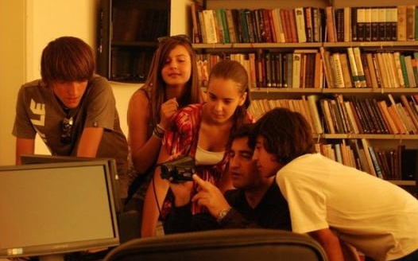
PLIP priority areas
Children and youth at risk
Agriculture
Health
Employment and job creation
an impact in improving socio-economic well-being of individuals and communities
Notes:
Access to information is critical for development:
It allows citizens to stay informed and engaged
It helps people – women and men – access new opportunities, for example, to start business, find job
It connects youth to innovative ideas
It improves children school achievements

Slide 7
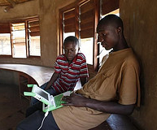
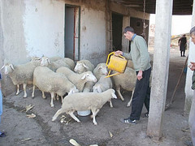
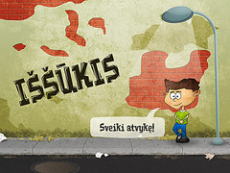
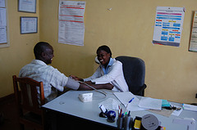
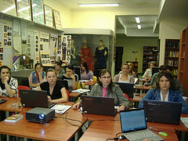
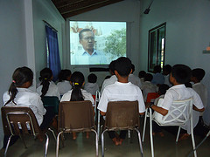
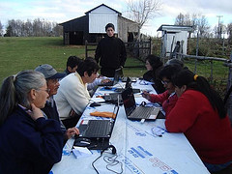
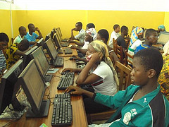
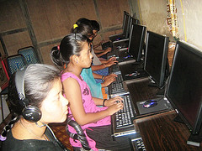
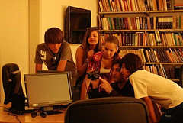
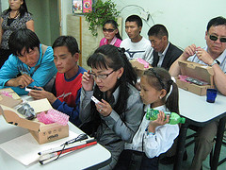
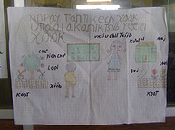
PLIP results and impact
39 public libraries, that employ ICT to meet community needs, in 23 countries in Asia, Africa, Europe and Latin America
Notes:
Libraries turn information into skills and opportunities
1,600 health-workers in Kenya learn online research skills through library e-health service.
43 traditional artists learn modern digital design skills in Nepal.
22 homeless people find jobs after ICT and job seeking training offered by Zagreb public libraries, Croatia
Masiphumelele Public Library in South Africa built ICT skills of vulnerable youth to prepare for jobs and study
They become become an invaluable resource for local people and gain recognition and support by authorities and community.

Slide 8


Project Cycle
Evaluating Needs
Selecting IT tools
Providing New Service
Assessing Impact
Advocating &
Raising Awareness
Public library
Grants
Knowledge Sharing
Case
Study
Generating
Implementing
Sustaining

Slide 9
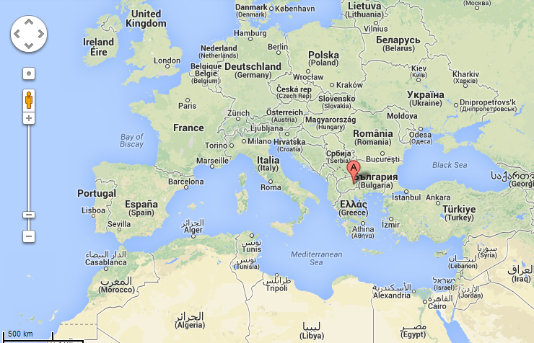

Slide 10
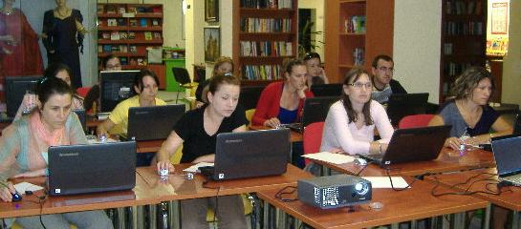
Creative Minds Create Job Opportunities, Public Library Braka Miladinovci, Macedonia

Slide 11
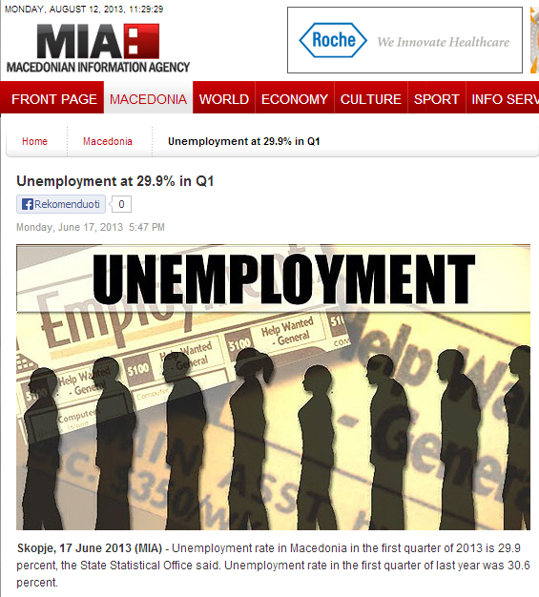
Community need
High level unemploment
Local government makes employment a priority area
Library investigates social profile of an unemployed and designs a new service for them
Source: http://www.mia.mk

Slide 12

Solution
13 laptops, wireless internet routers and a printer
Training curriculum for motivation and confidence-building with computer and job seeking skills
Web page with resources for the unemployed

Slide 13
Impact evaluation
Expected Outcomes | Indicators
Introduction of new service(s) that make(s) use of new technology | Description of new service(s) Data on the use of new service(s)
Increase in library visibility | Number of new library users Number of media mentions Number of mentions by authorities
Increase in library use | Number of weekly visits
Library reaches out to members of community who were previously underserved | Number of new library users from service target group Data on service use by target group
Commitment by library authority and community to sustain the service | Support demonstrating commitments by authorities or community in relation to the service
Strengthened or new partnerships | List of new partners Feedback from partners
Increased social and economic benefits to the individuals and communities | Perceived changes in the lives of target group users

Slide 14
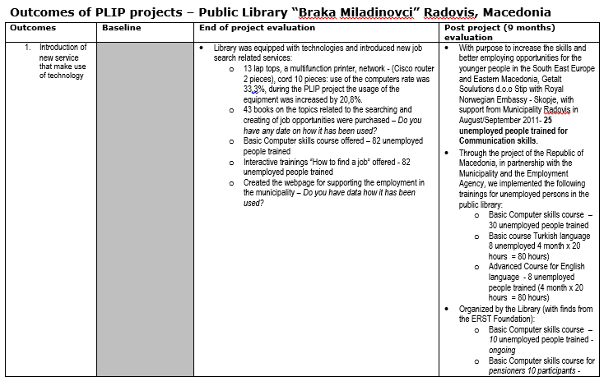
Results map

Slide 15
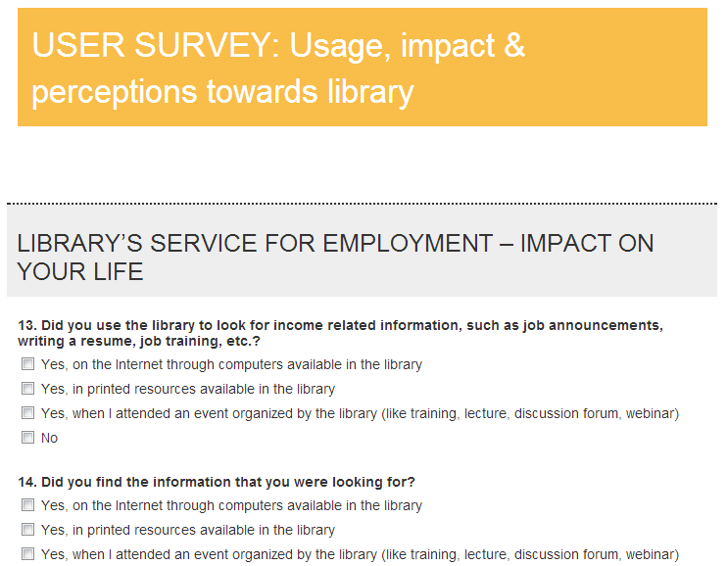
User survey

Slide 16
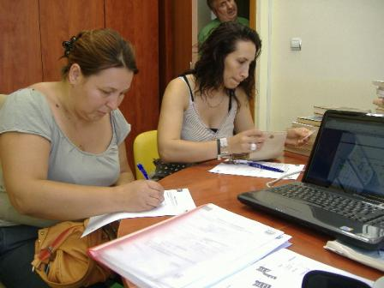
Results and impact
39, just under 50% of the library’s 82 trainees, have found jobs
The number of library users increased by 74%
The number of unemployed library users increased by 176%

Slide 17
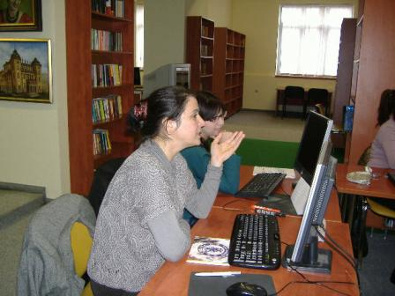
Results and impact
The library won municipality recognition and got new building
The director of Buchim copper mine expressed his support and provided funding to the library’s training
The library won ERSTE Foundation 2011 Award for Social Integration

Slide 18
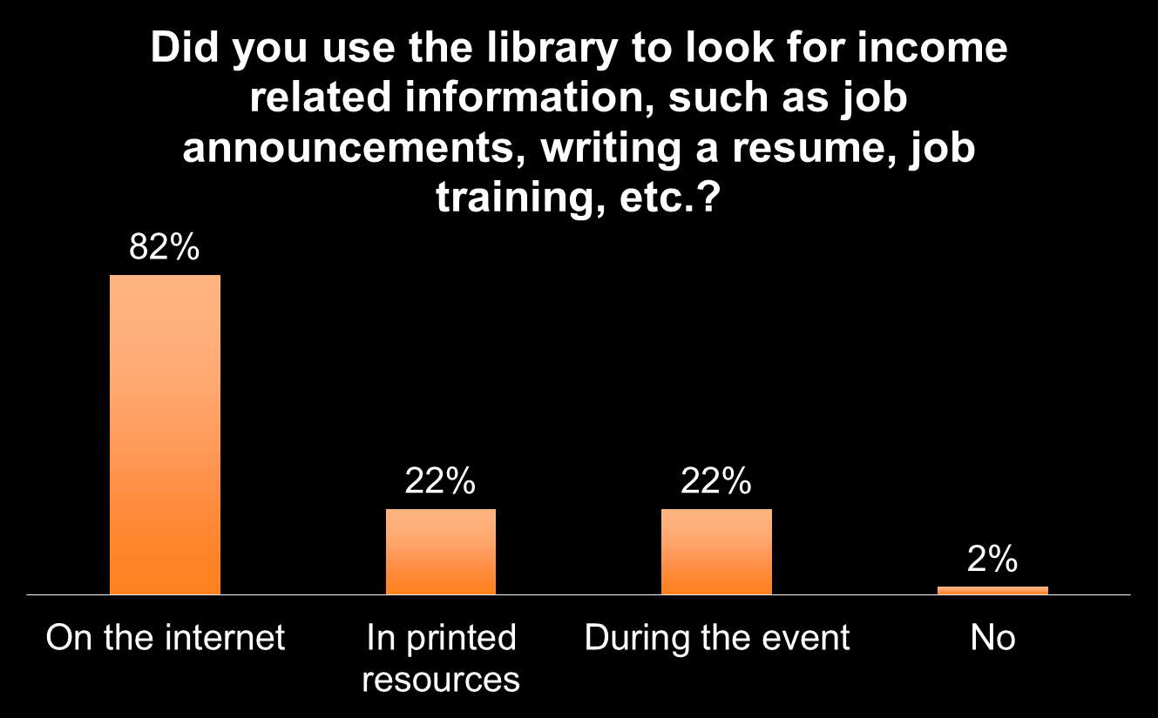
1 year after

Slide 19

1 year after

Slide 20

1 year after

Slide 21
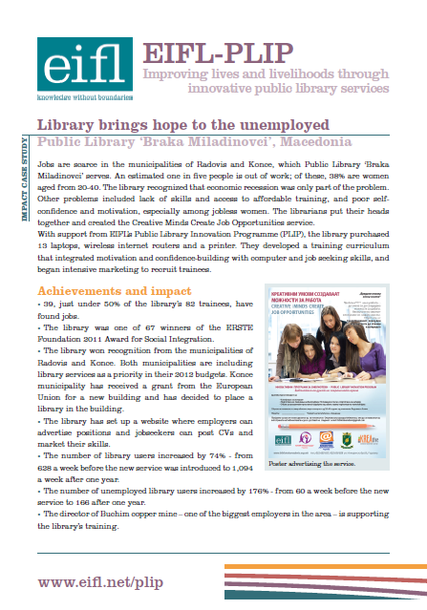
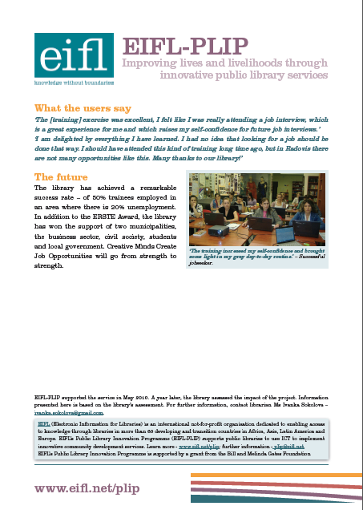
Documenting success

Slide 22

Virus of innovation
New libraries already take up our experience: Bulgaria, Croatia, South Africa, Uganda, etc.
We want new ones to innovate!
Source: http://www.flickr.com/photos/37488016@N08/7154565781/
Check out 36 case studies at:
Notes:
Bulgaria - Lyuben Karavelov Regional Library – employment information service helps 44 long-term unemployed people aged over 40 find work
Croatia - Zagreb City Libraries - ICT training and information service helps 22 homeless people find employment
South Africa - Masiphumelele Public Library – providing free, high-quality ICT access and training and helping vulnerable young people with their careers
Uganda - National Library of Uganda, with Lira and Masindi public libraries – mobile phone opportunities alert service helps young job-seekers find work

Slide 23


Stay connected
Website - www.eifl.net
Online newsletter - www.eifl.net/subscribe
Mailing lists for EIFL programmes
facebook.com/eiflnet
twitter.com/eiflnet

Slide 24
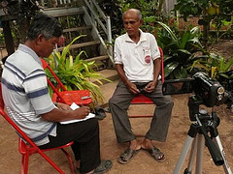
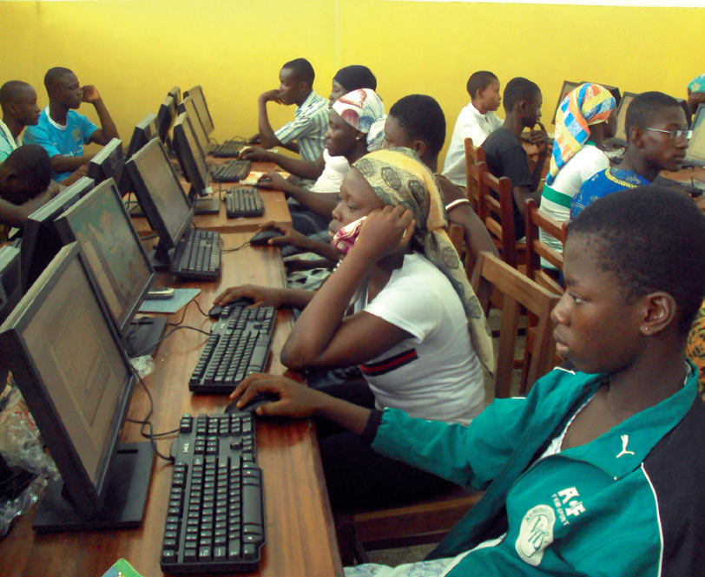
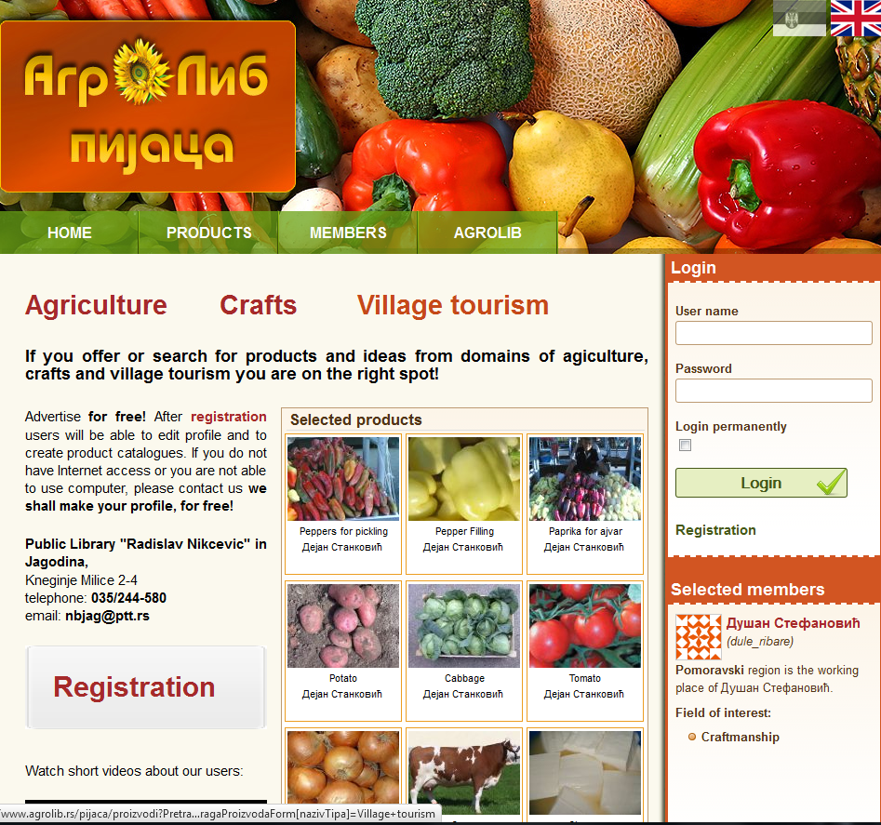
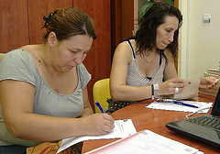
Thank you
ramune.petuchovaite@eifl.net
ugne.lipeikaite@eifl.net
www.eifl.net/plip

