Slide 1
Overview of open access progress globally
Iryna Kuchma, Open Access Programme Manager
Presentation at Open access policy formulation workshop, August 10, 2015, Lilongwe, Malawi
Attribution 4.0 International

Slide 2
Technology enabled networking & collaboration
Over 35% of articles published in journals are based on international collaboration
(25% 15 years ago)

Slide 3
Technology enabled networking & collaboration (2)
Science is increasingly interdisciplinary

Slide 4
Technology enabled networking & collaboration (3)
Novel communication technologies permit modes of interaction that exploit the collective intelligence of the scientific community

Slide 6
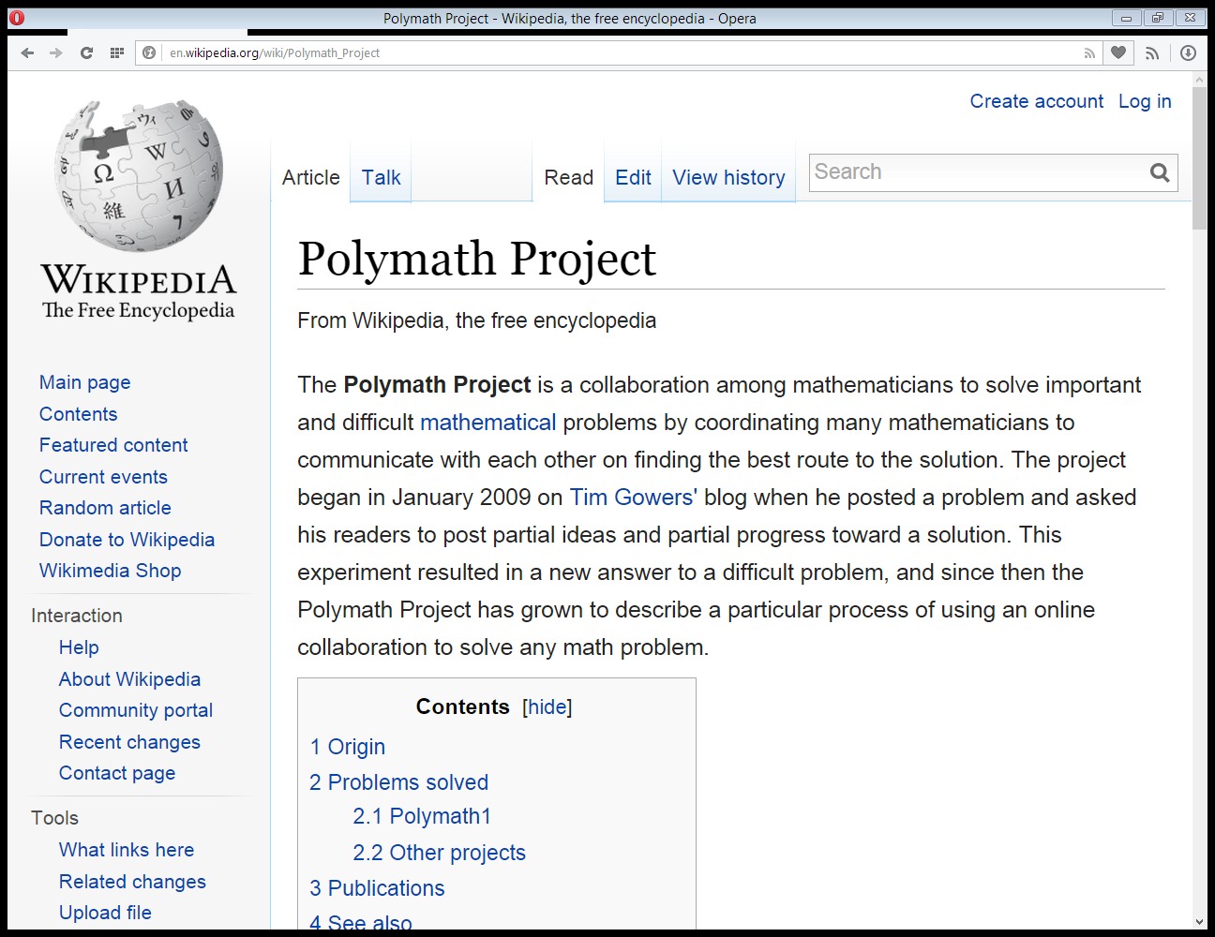

Slide 7
“It felt like the difference between driving a car and pushing it”
(Tim Gowers)

Slide 8
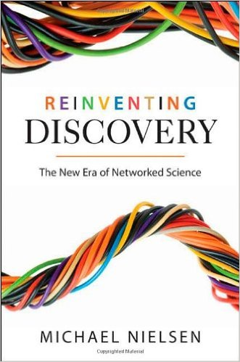

Slide 9
Open access (OA) is free, immediate, online access to the results of research, coupled with the right to use those results in new and innovative ways

Slide 10
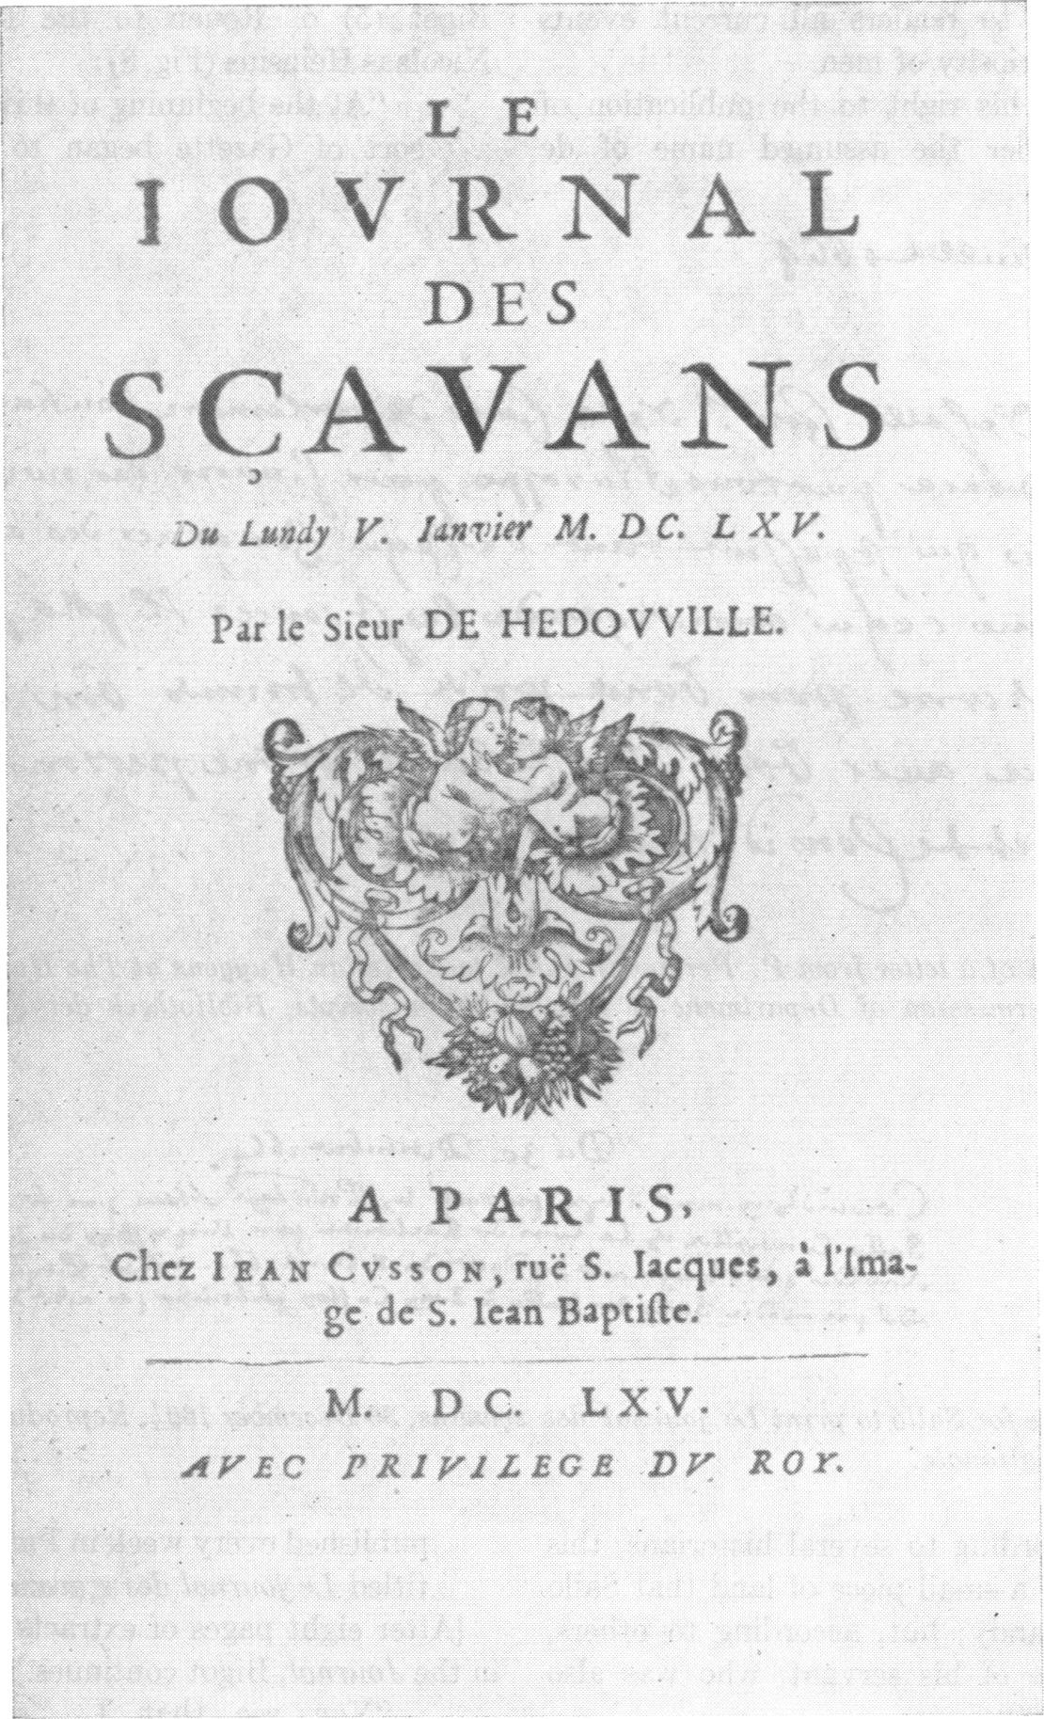
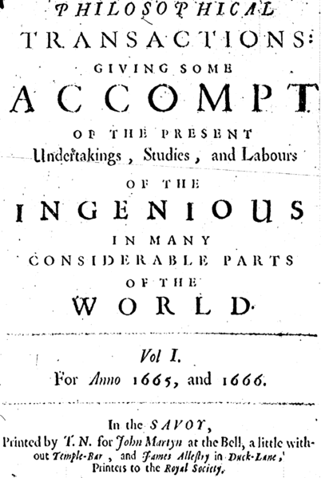

Slide 11
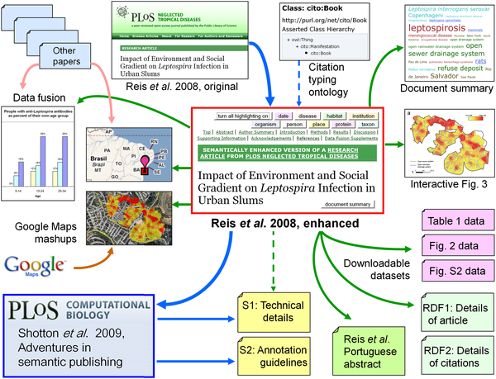
Figure 10. The ecosystem of published articles, documents, spreadsheets, data fusions, and machine-readable RDF data files resulting from our decision to apply semantic enhancements to the PLoS NTDs article by Reis et al. [12].
Shotton D, Portwin K, Klyne G, Miles A (2009) Adventures in Semantic Publishing: Exemplar Semantic Enhancements of a Research Article. PLoS Comput Biol 5(4): e1000361. doi:10.1371/journal.pcbi.1000361
http://127.0.0.1:8081/ploscompbiol/article?id=info:doi/10.1371/journal.pcbi.1000361

Slide 12
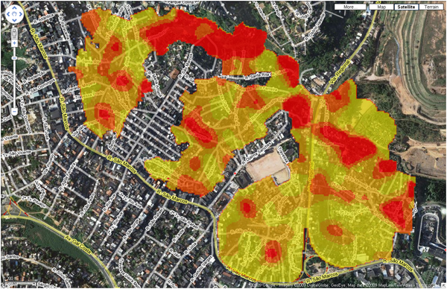
Figure 1. A superposition of Figure 3C of the PLoS NTDs article [12] onto a satellite photo of Salvador with superimposed street plan.
Shotton D, Portwin K, Klyne G, Miles A (2009) Adventures in Semantic Publishing: Exemplar Semantic Enhancements of a Research Article. PLoS Comput Biol 5(4): e1000361. doi:10.1371/journal.pcbi.1000361
http://127.0.0.1:8081/ploscompbiol/article?id=info:doi/10.1371/journal.pcbi.1000361

Slide 13
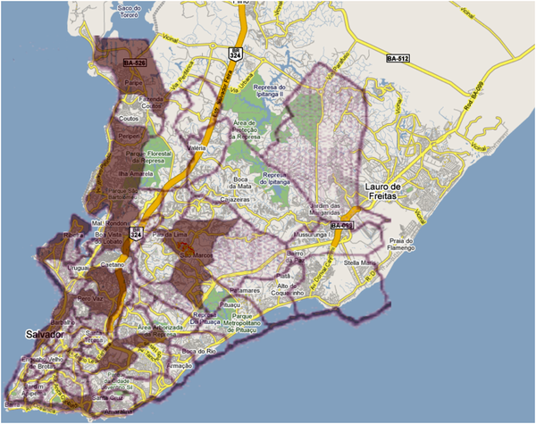
Figure 2. Superposition of Figure 3C of the 2008 PLoS NTDs article [12] and a modified version of Figure 1 from Ko et al. [13] (copyright © Albert Ko, 2008, used with permission) onto a street plan of Salvador.
Shotton D, Portwin K, Klyne G, Miles A (2009) Adventures in Semantic Publishing: Exemplar Semantic Enhancements of a Research Article. PLoS Comput Biol 5(4): e1000361. doi:10.1371/journal.pcbi.1000361
http://127.0.0.1:8081/ploscompbiol/article?id=info:doi/10.1371/journal.pcbi.1000361

Slide 14
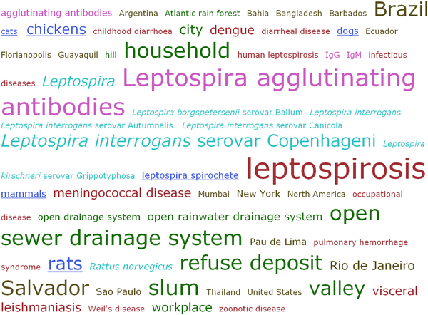
Figure 6. The Tag Cloud for the terms highlighted in the enhanced version of Reis et al. [12].
Shotton D, Portwin K, Klyne G, Miles A (2009) Adventures in Semantic Publishing: Exemplar Semantic Enhancements of a Research Article. PLoS Comput Biol 5(4): e1000361. doi:10.1371/journal.pcbi.1000361
http://127.0.0.1:8081/ploscompbiol/article?id=info:doi/10.1371/journal.pcbi.1000361

Slide 15
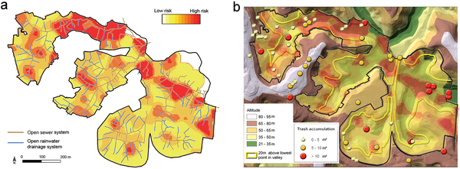
Figure 9. An overlay (a) of panels (C) and (E), and (b) of panels (C), (D), and (F) from the interactive version of Figure 3 of the PLoS NTDs article by Reis et al. [12].
Shotton D, Portwin K, Klyne G, Miles A (2009) Adventures in Semantic Publishing: Exemplar Semantic Enhancements of a Research Article. PLoS Comput Biol 5(4): e1000361. doi:10.1371/journal.pcbi.1000361
http://127.0.0.1:8081/ploscompbiol/article?id=info:doi/10.1371/journal.pcbi.1000361

Slide 16
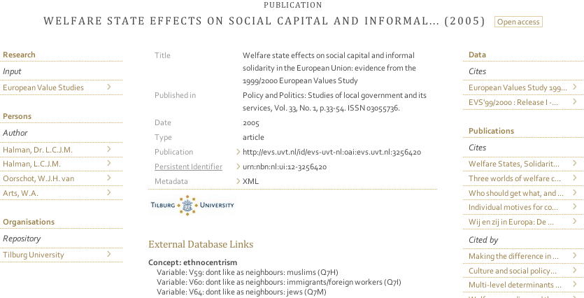

Slide 17
Open access (OA) for researcher
increased visibility
usage
& impact for your work
new contacts & research partnerships

Slide 18
OA for research institutions
publicises University's research
strengths
complete record of the research
output in easily accessible form
new tools to manage University's impact

Slide 19
OA for publishers
increased readership & citations
visibility & impact
the best possible dissemination service for research

Slide 20
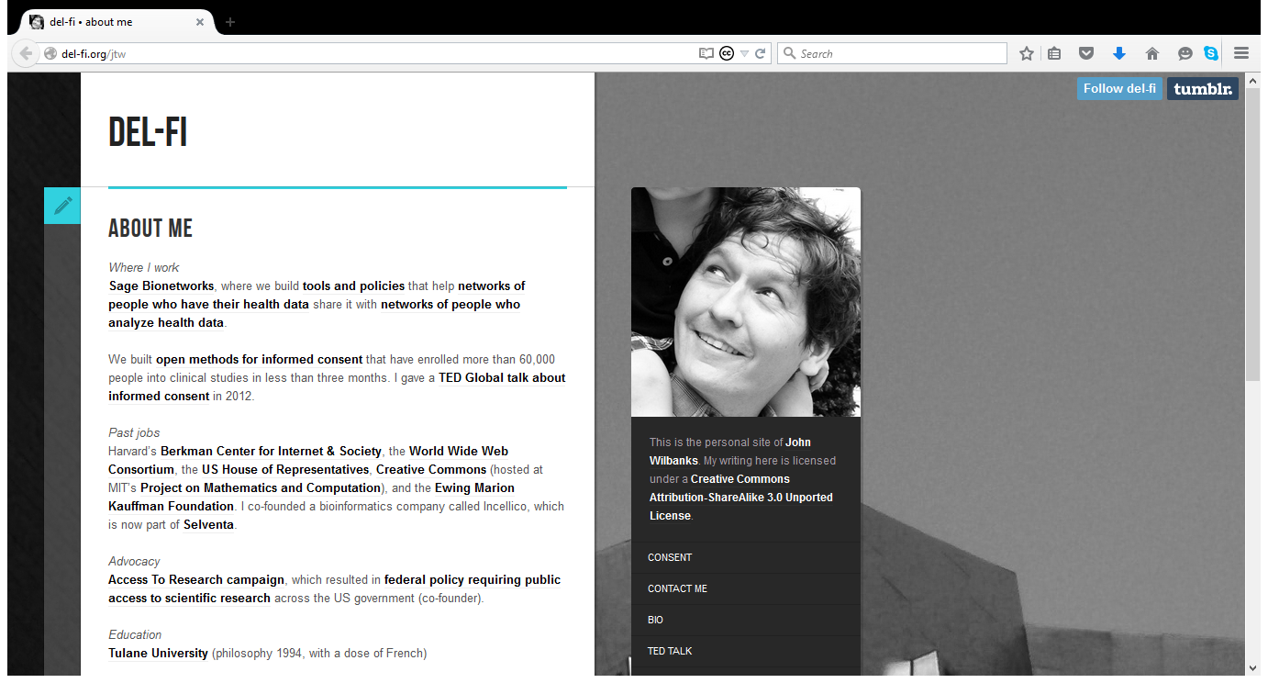

Slide 21
@wilbanks #coarsparc2015
“Is it open? is the wrong question. Does it create more value than a closed version is the right question”
“Reusable content is more valuable to the end user than non-reusable content” “What we know is a lot less stable than it used to be. The right to reuse is the right to be current”
“Thinking in terms of value creation requires a science practice change”

Slide 22
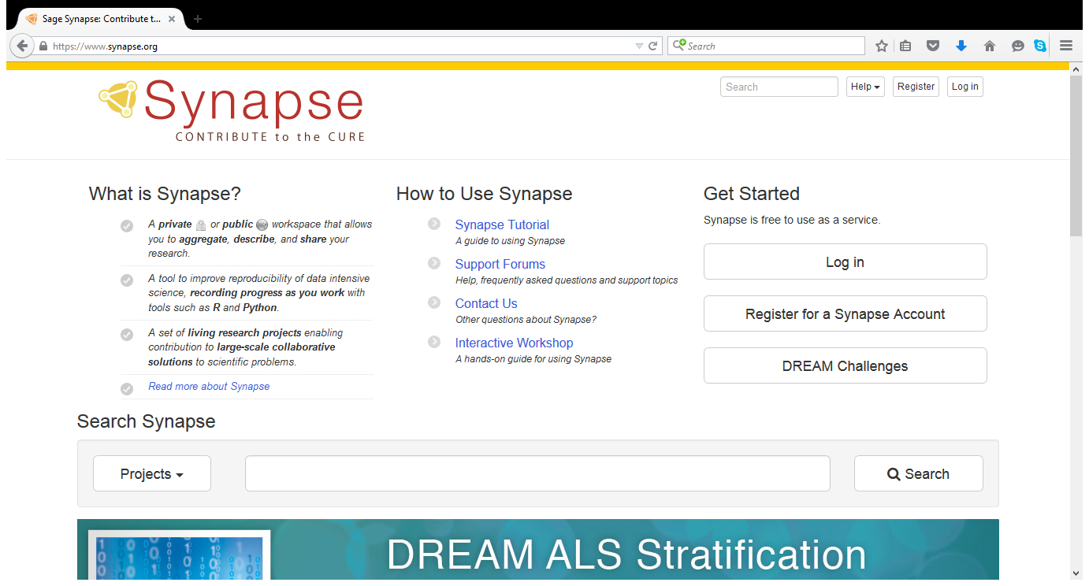

Slide 23
@wilbanks #coarsparc2015
“We need to embrace design to be a platform. Design that prioritizes the users.”
“A different way of knowing requires a different way of teaching. Are we going to have pedagogy that can keep up?”

Slide 24
#OAI9 @michael_nielsen: open access to what exactly?
New media form
A publishing platform that evolves, cognitive media & composable knowledge, new atoms of cognition

Slide 26
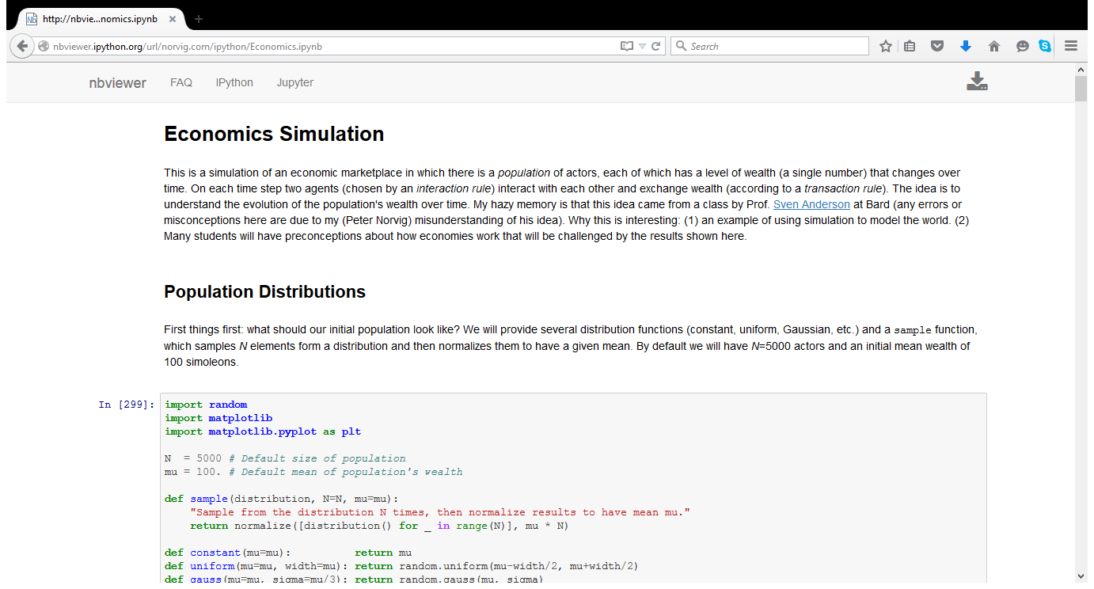

Slide 28
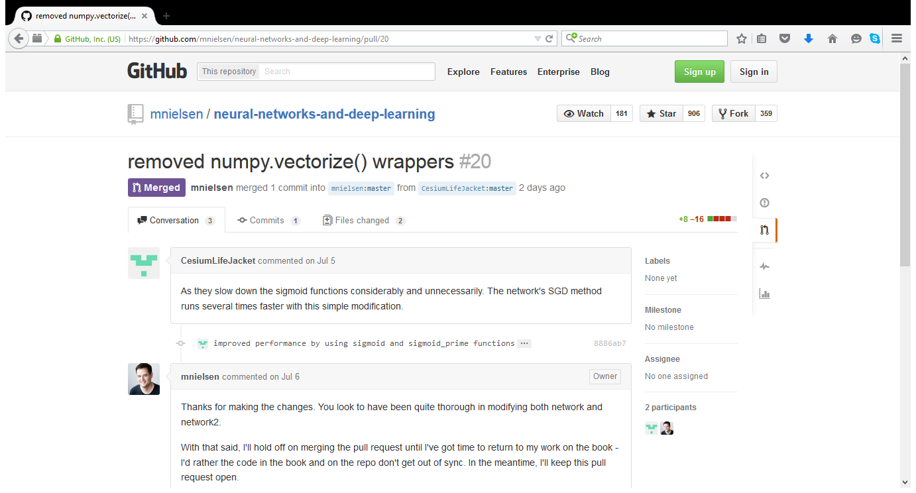

Slide 29
#OAI9 @michael_nielsen: open access to what exactly?
“True open access will allow us to amplify our collective and individual intelligence”

Slide 30
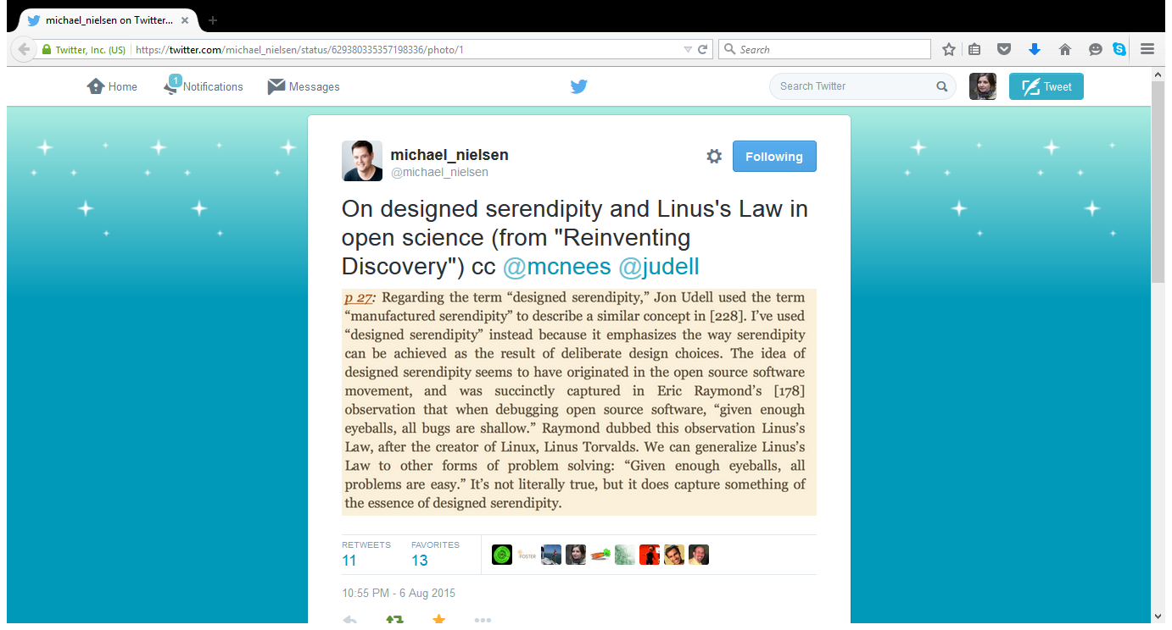

Slide 31
#OAI9 @michael_nielsen: open access to what exactly?
“How should open access policies be crafted to ensure we don't inhibit innovation by constraining experimentation?”

Slide 32
“As of April 2014, more than 50% of the scientific papers published in 2007-2012 can be downloaded for free on the Internet.”
Proportion of Open Access Papers Published in Peer-Reviewed Journals at the European and World Levels—1996–2013
http://tinyurl.com/n4j25yx

Slide 33
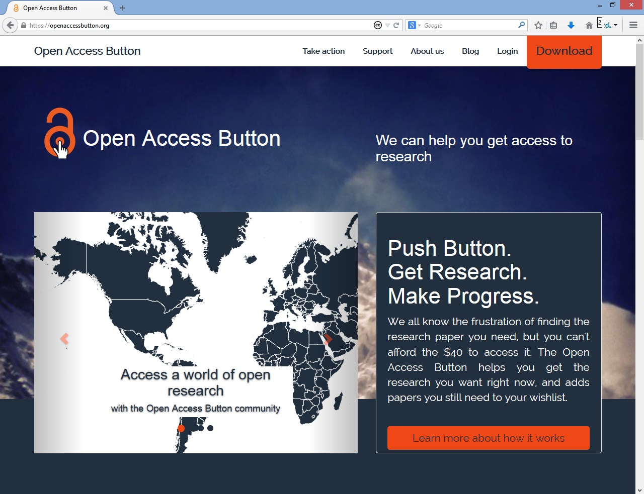

Slide 34
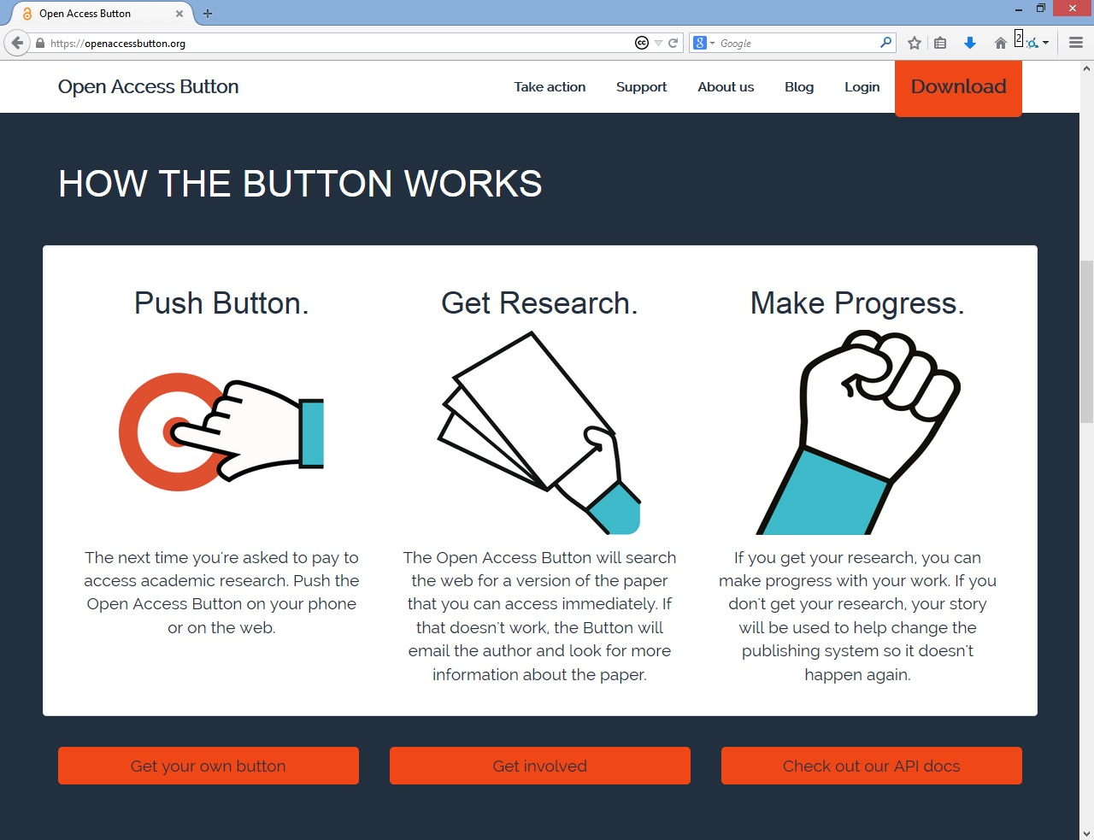

Slide 35
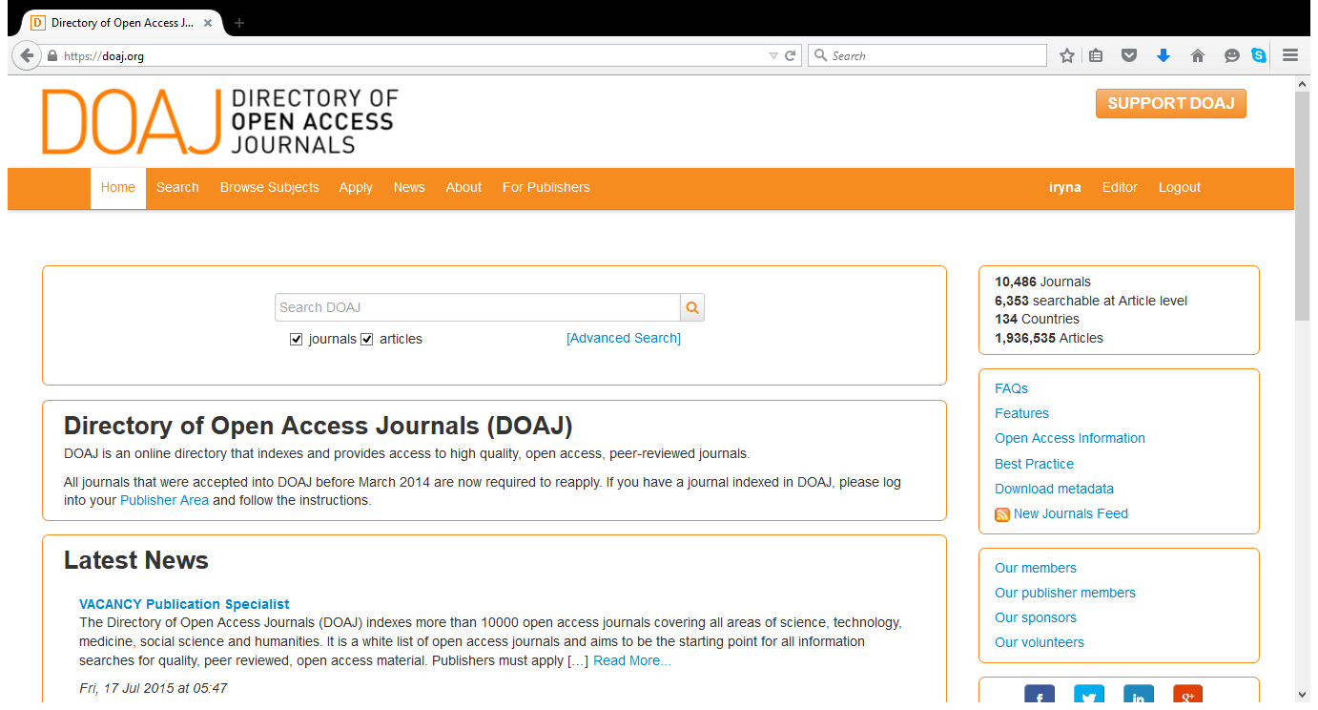

Slide 36
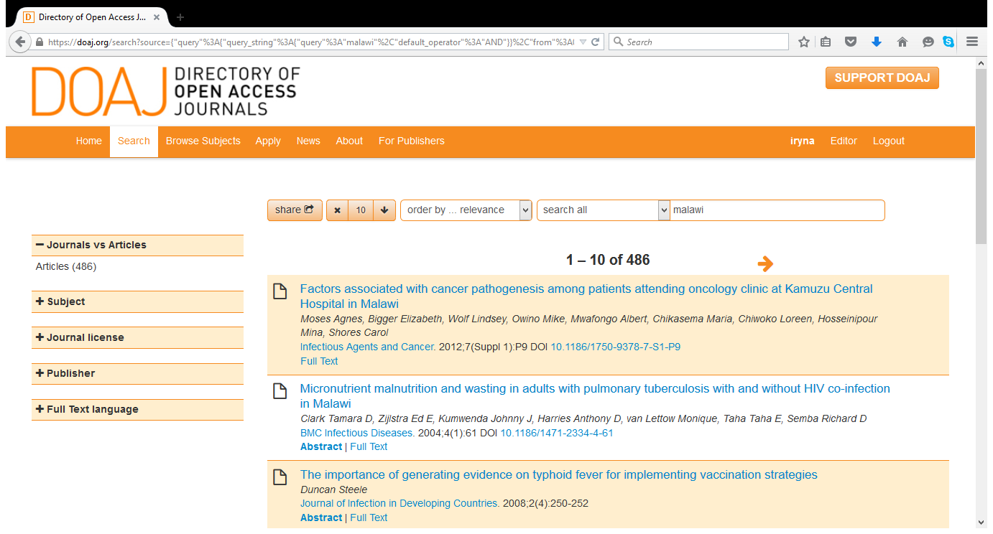

Slide 37
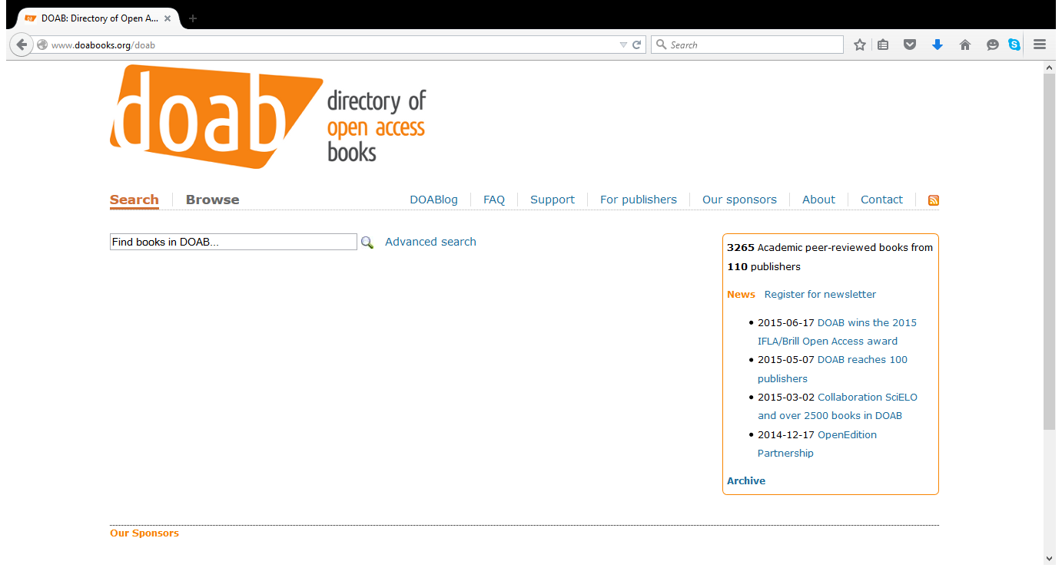

Slide 38
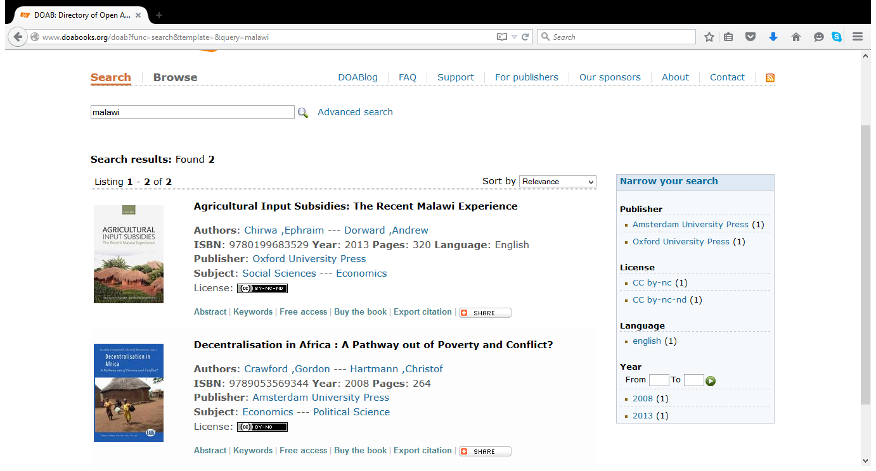

Slide 39
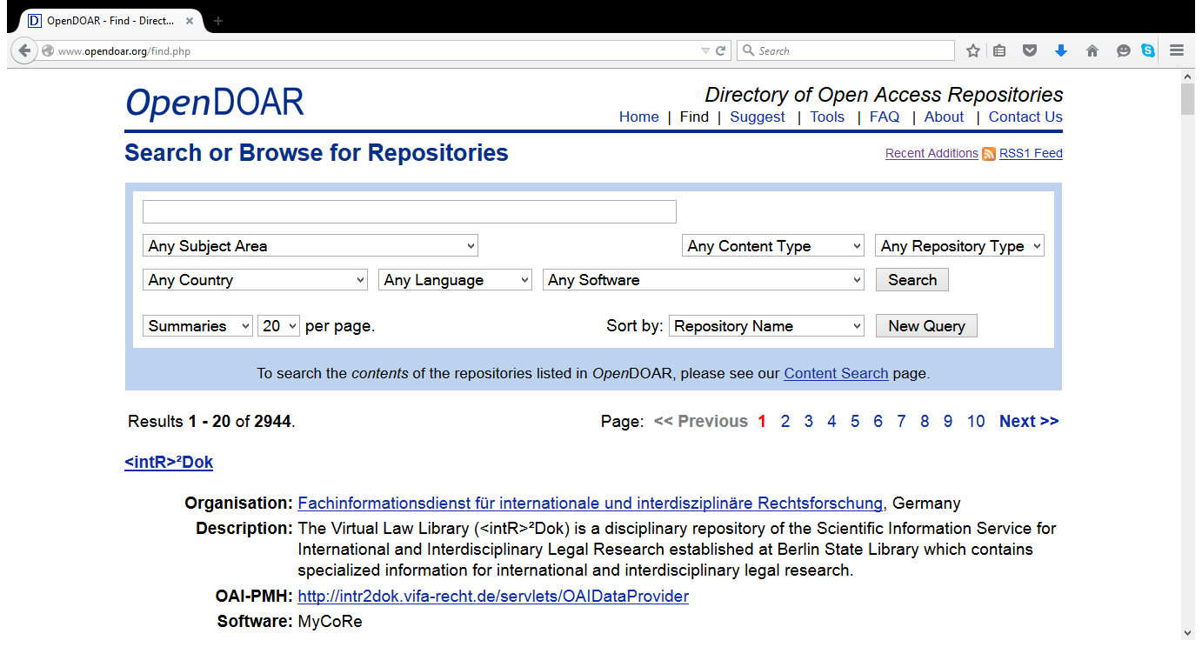

Slide 40
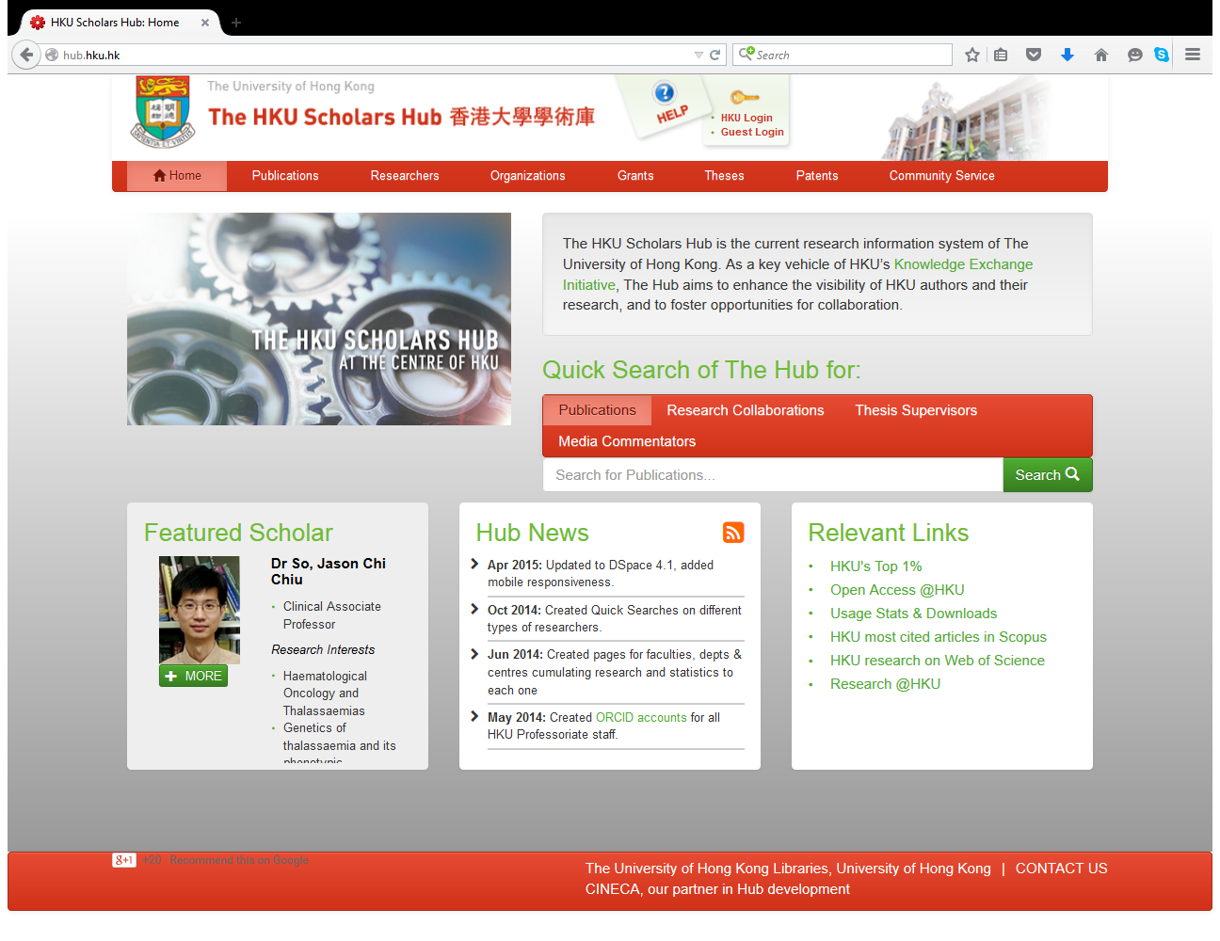

Slide 41
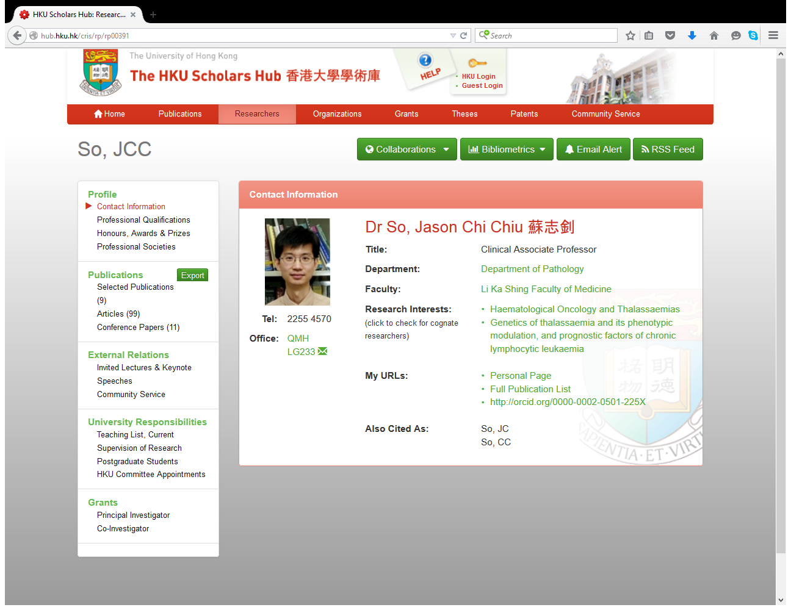

Slide 42
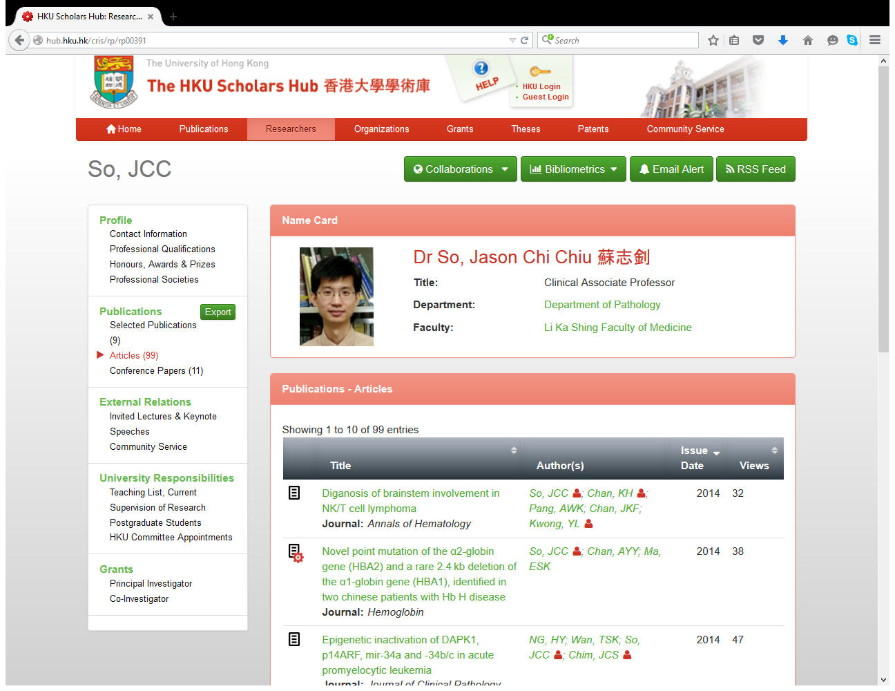

Slide 43
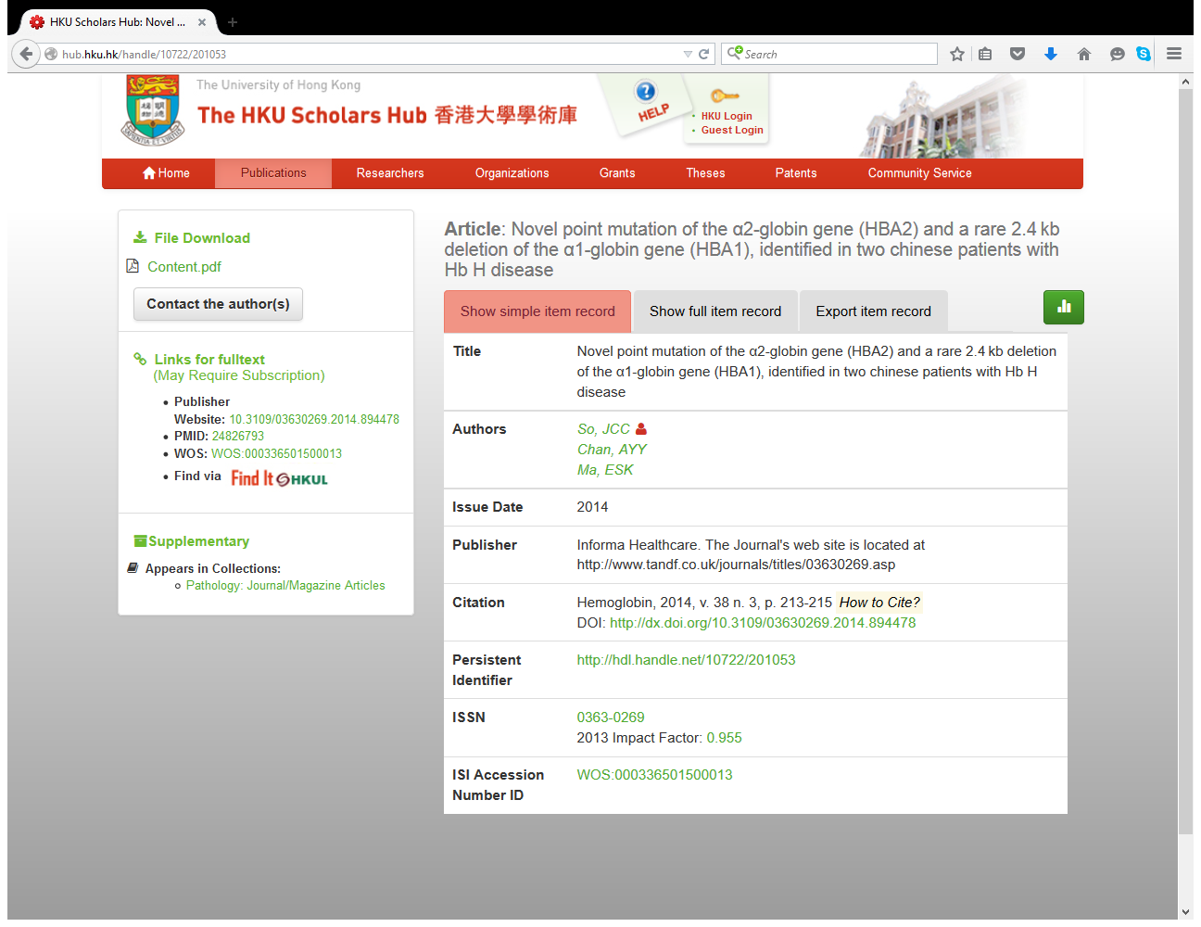

Slide 44
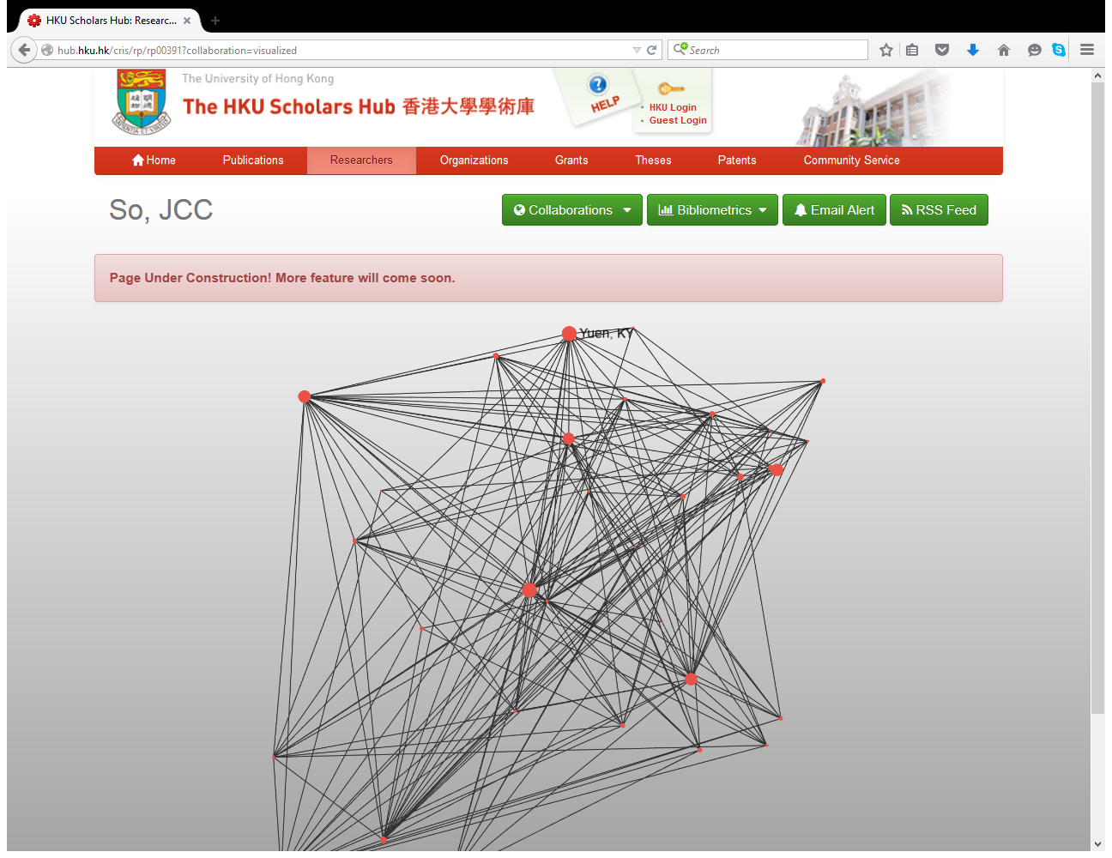

Slide 45
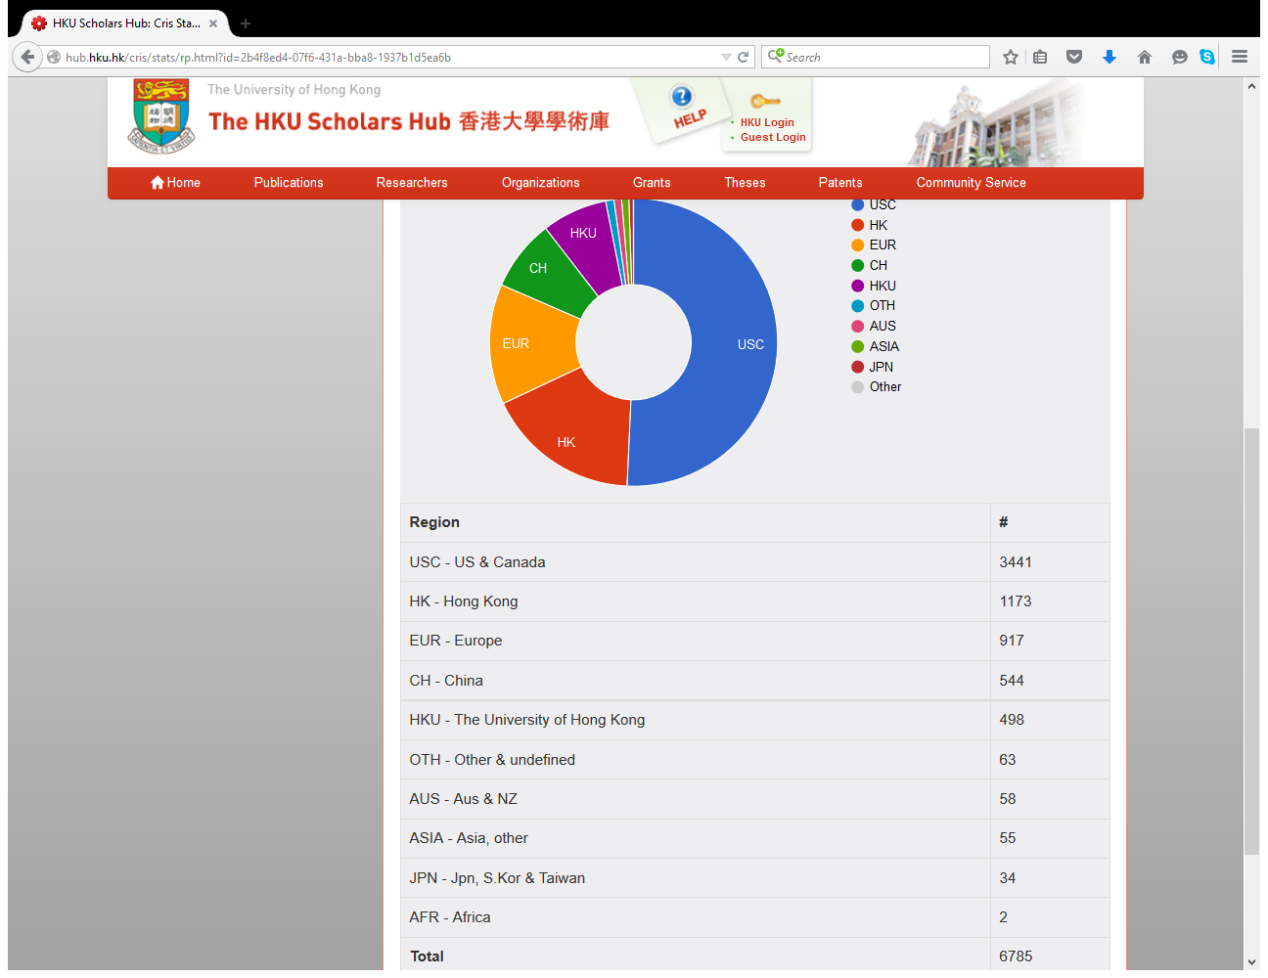

Slide 46
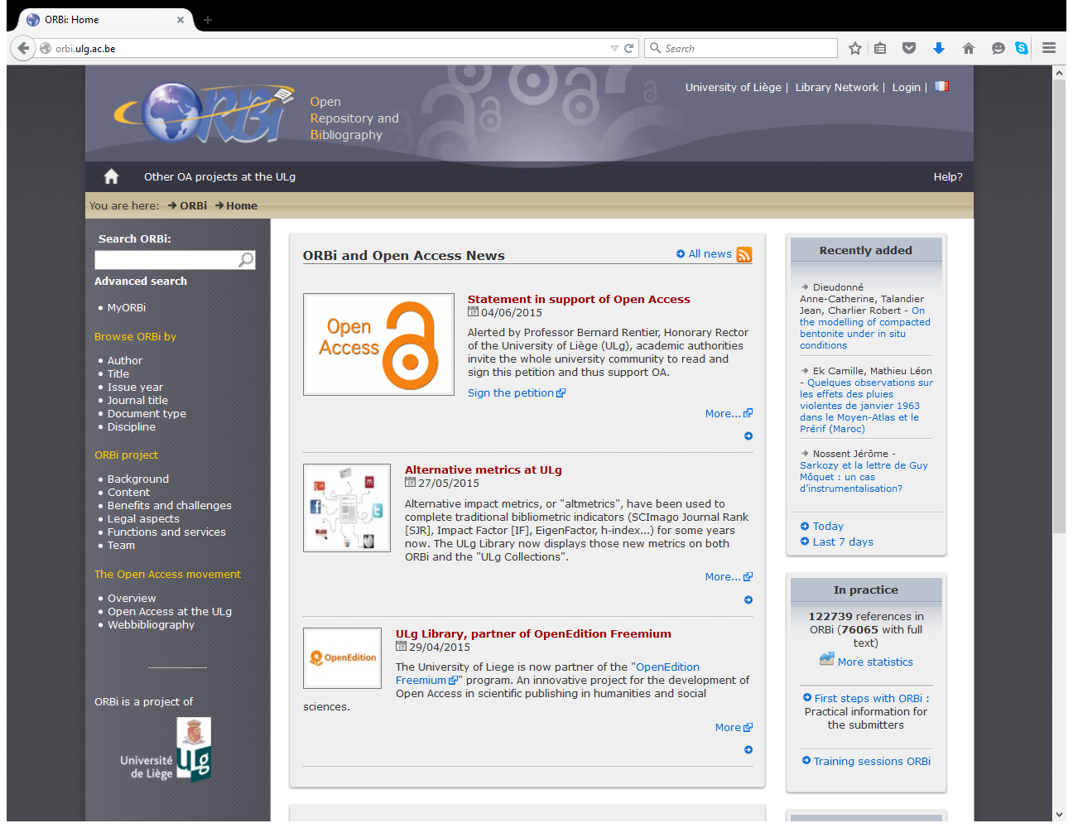

Slide 47
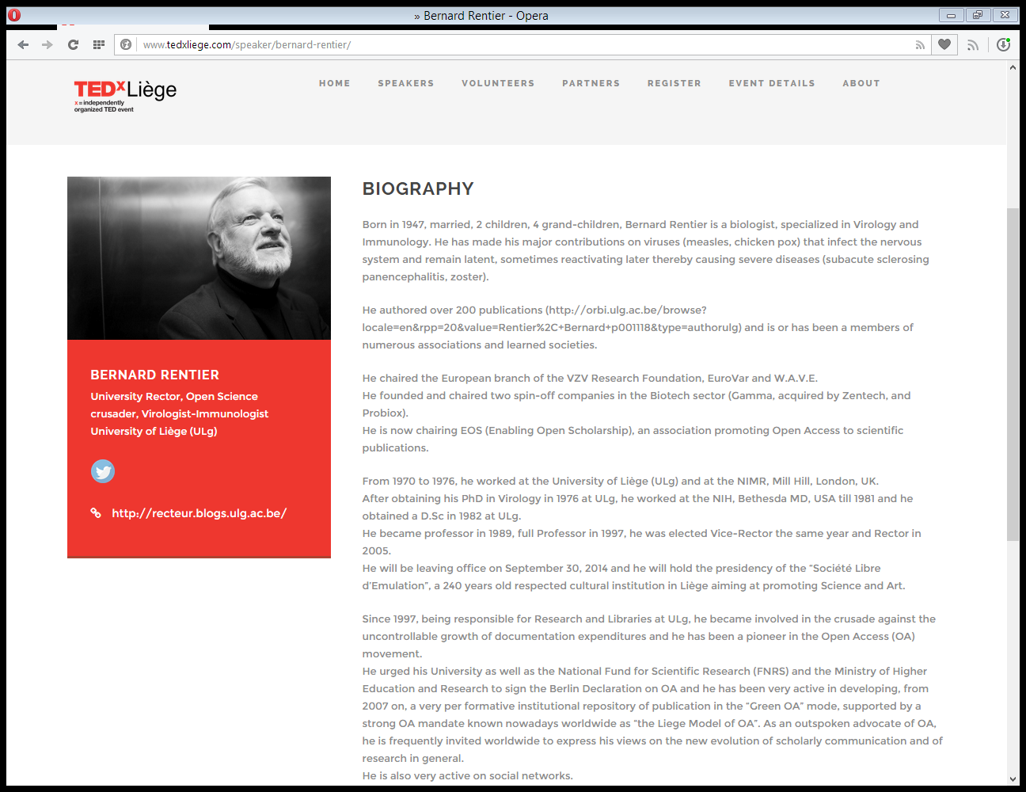

Slide 48
University that doesn't know what papers its faculty publishes is like a factory that doesn't know what it produces
Bernard Rentier

Slide 49
An empty repository is useless; a partly filled repository is partly useless; there is a need for an institutional open access policy
Bernard Rentier

Slide 50
Don't impose, just inform researchers that only publications in the repository will be considered for evaluation
Bernard Rentier

Slide 51
Mandate, keep authors at the core, communicate permanently, be coherent, reduce constraints
Bernard Rentier

Slide 52
@ORBi_ULg – a personal workspace, provides statistics and has a widget to generate publications lists – content in personal/faculties webpages
Bernard Rentier

Slide 54
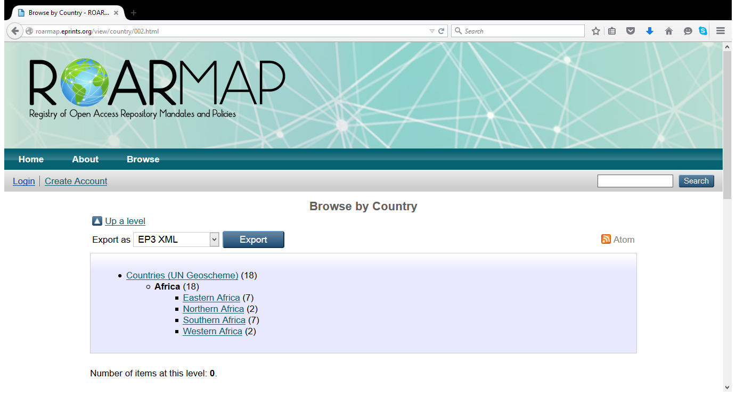

Slide 55
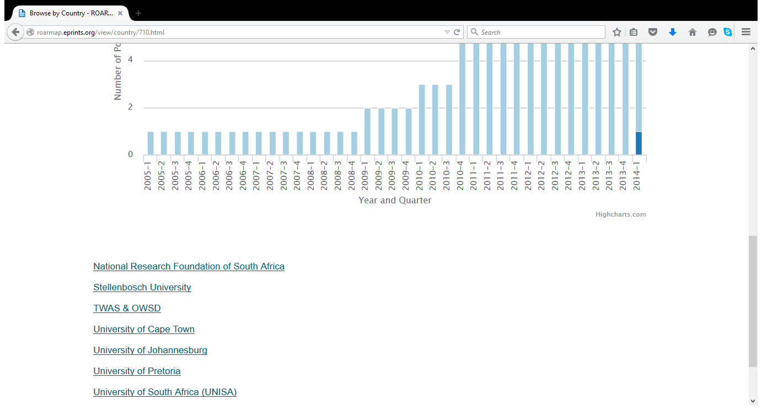

Slide 57
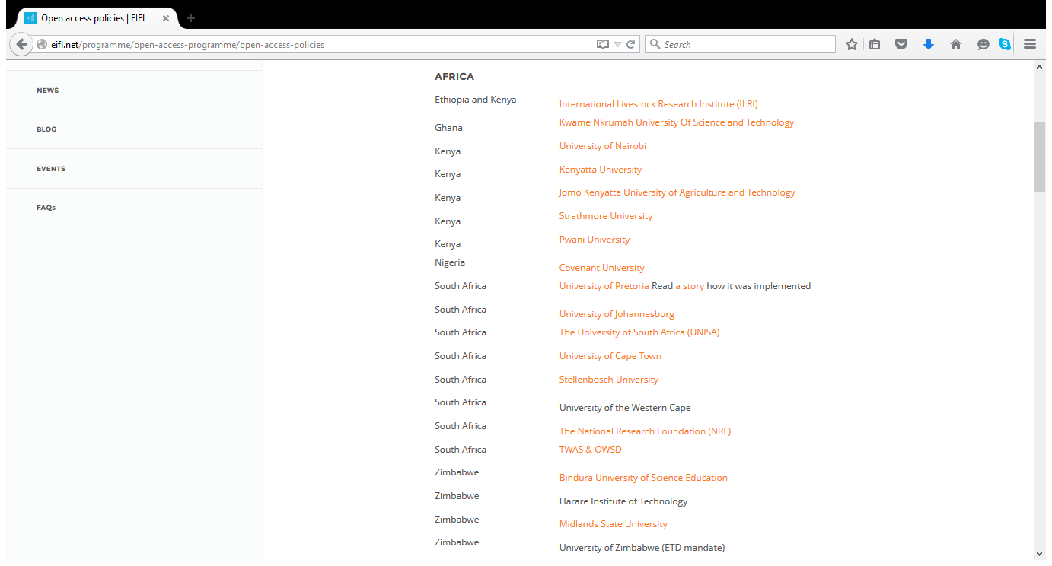

Slide 59
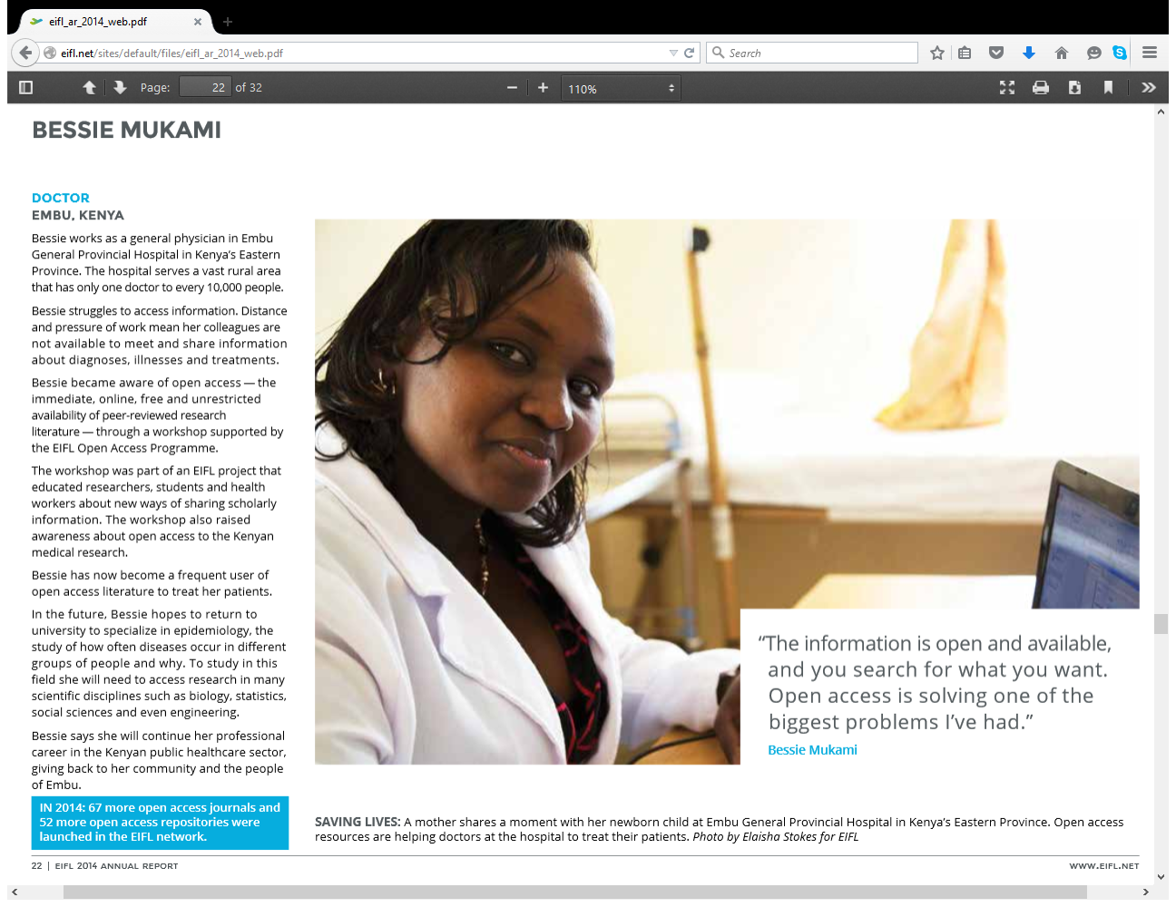

Slide 60
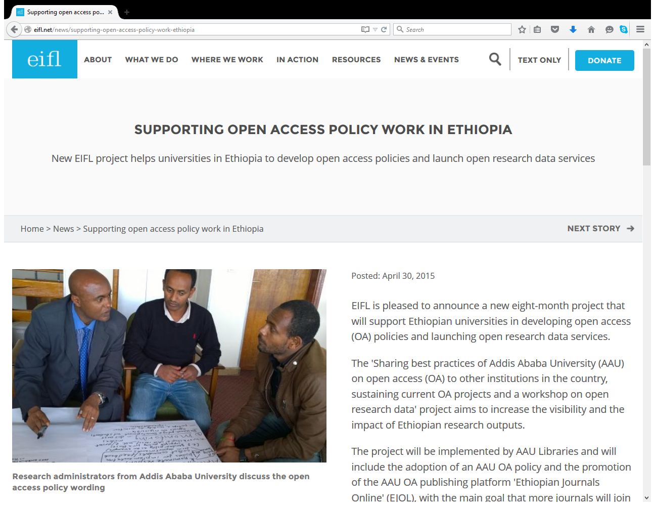

Slide 61
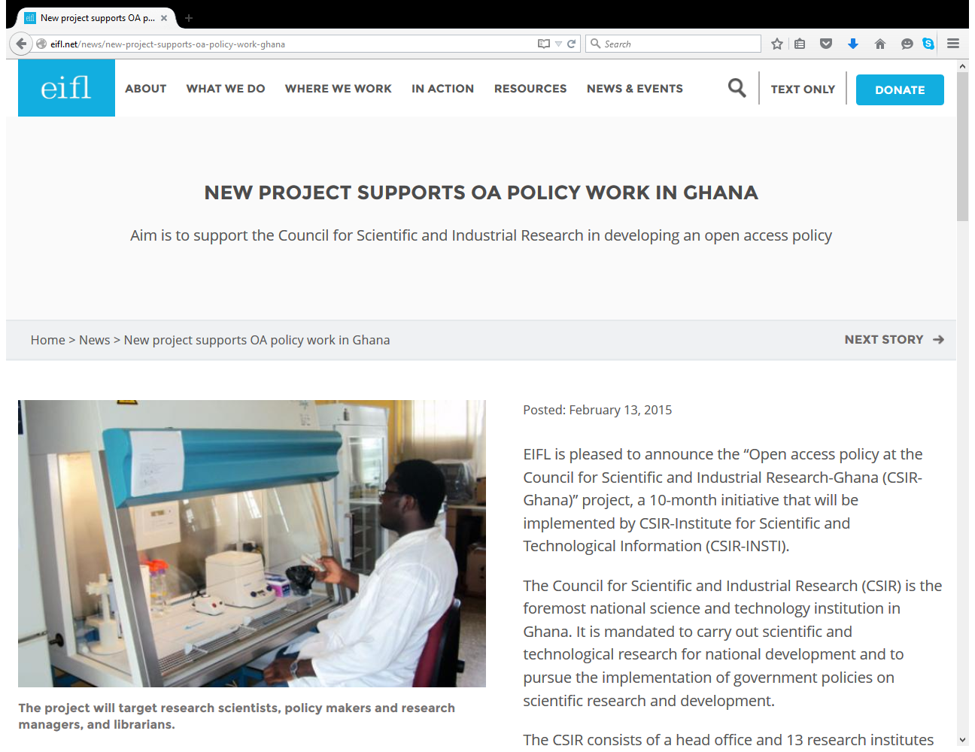

Slide 62
800+ scholarly societies embraced open access
Peter Suber and Caroline Sutton

Slide 63
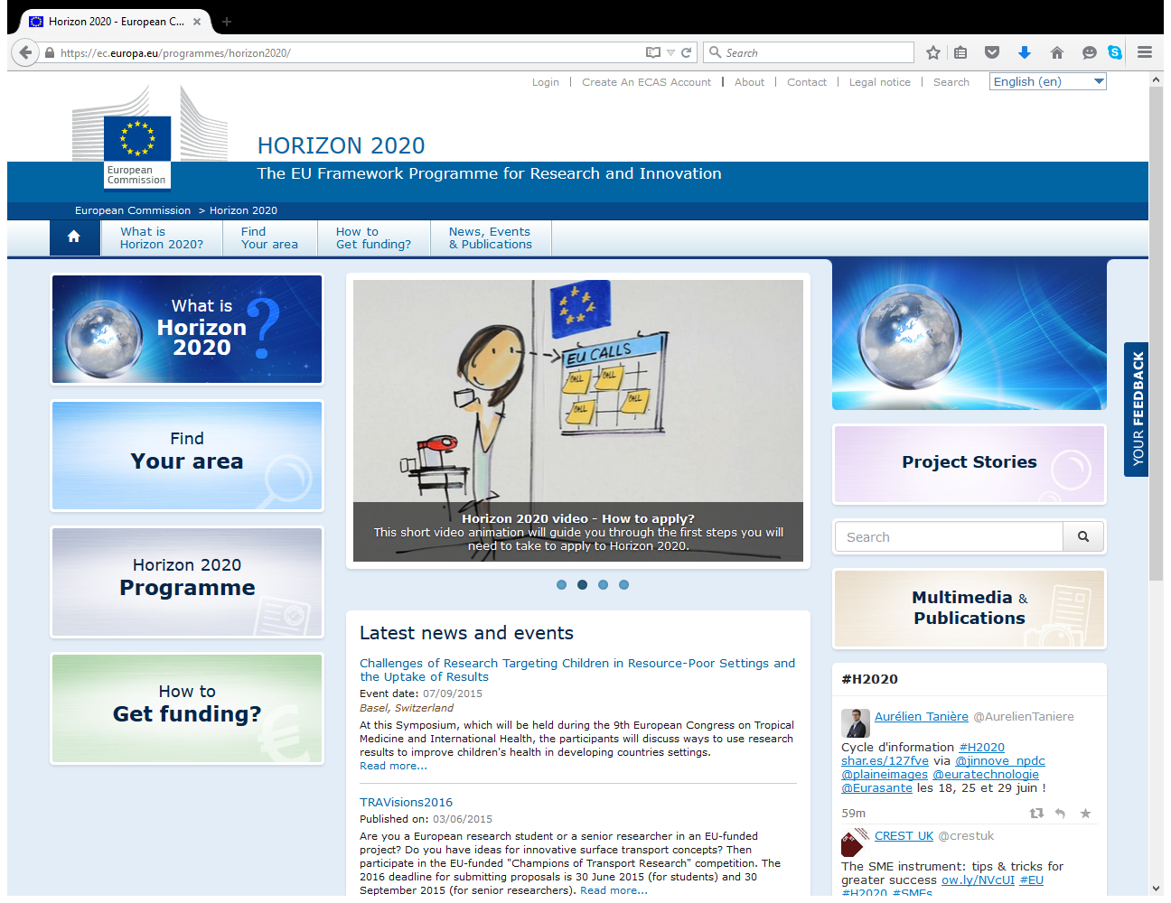

Slide 64
“Putting research results in the public sphere makes science better & strengthens our knowledge-based economy. The European taxpayer should not have to pay twice for publicly funded research. That is why we have made OA to publications the default setting for Horizon 2020, the EU research & innovation funding programme."
Máire Geoghegan-Quinn, European Commissioner for Research, Innovation & Science (2010-2014)

Slide 65
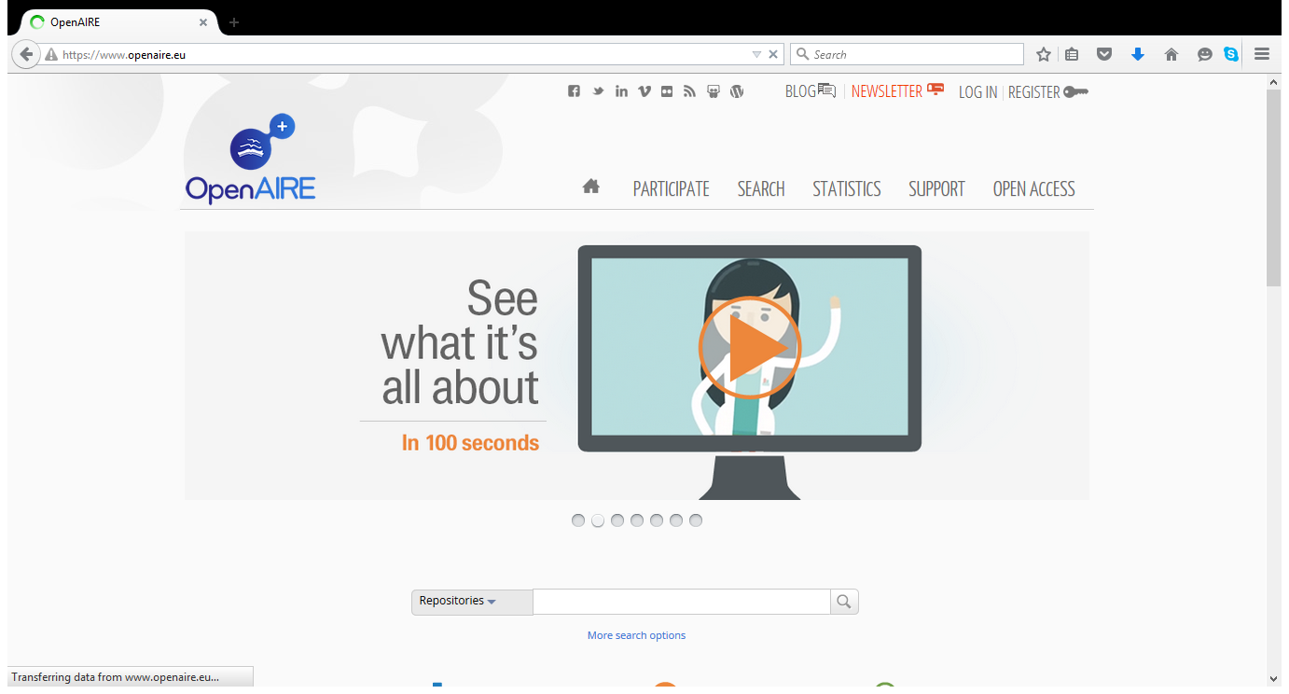

Slide 66
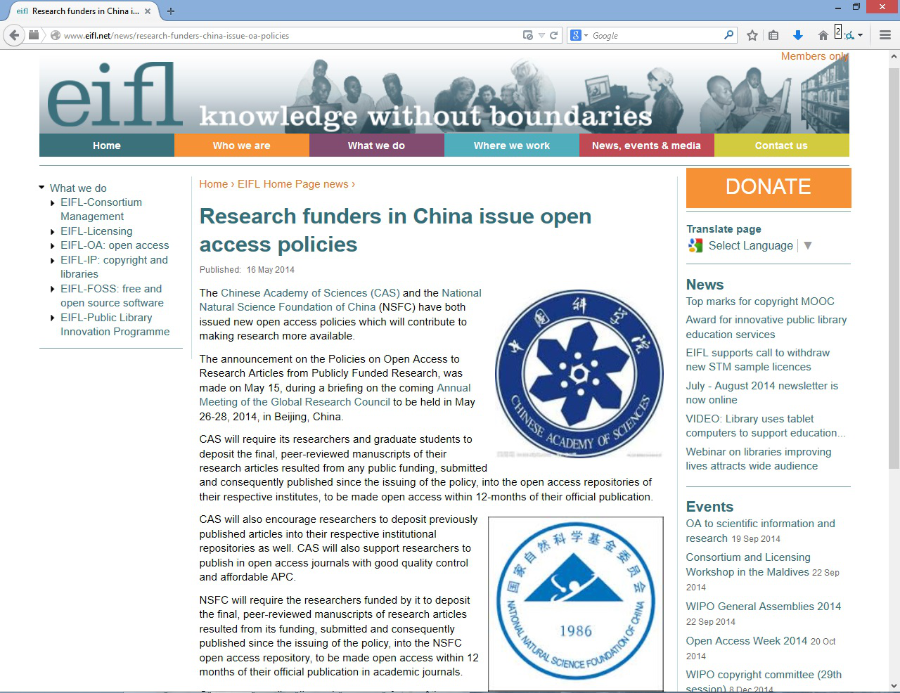

Slide 67
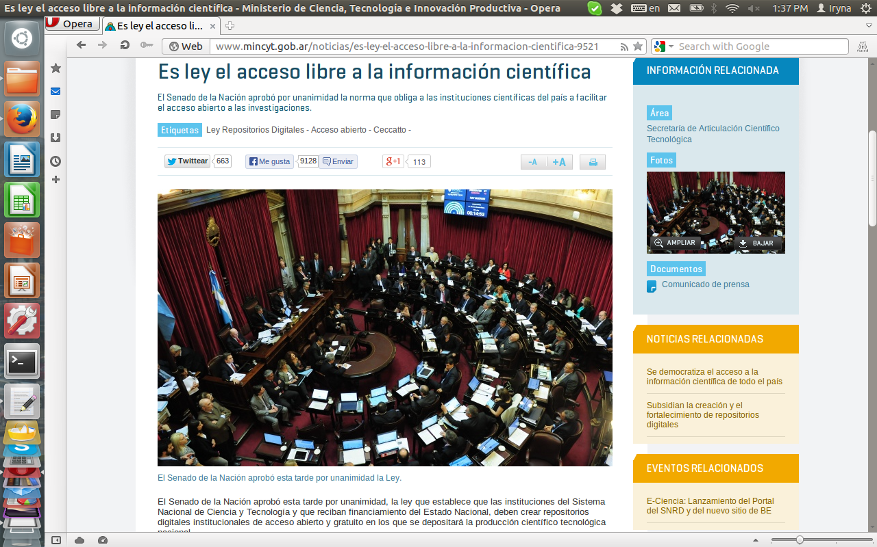
OA is required by law in Argentina

Slide 68
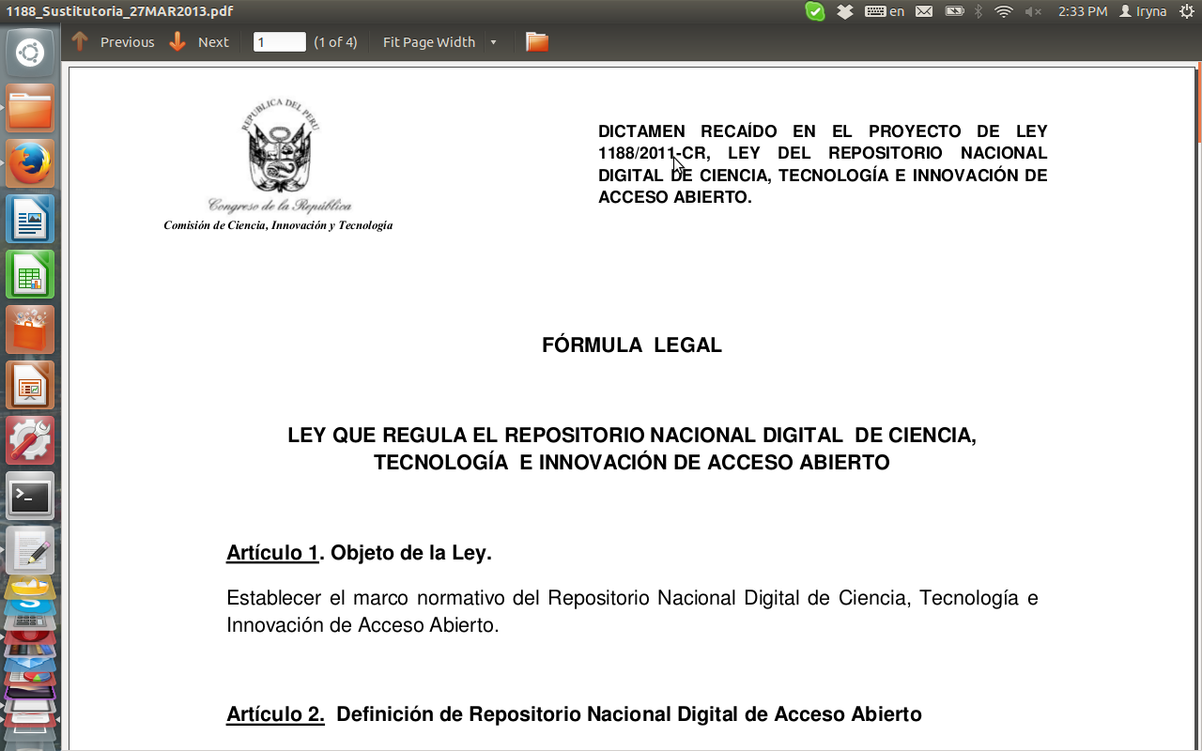
and in Peru

Slide 69
and in Mexico

Slide 71
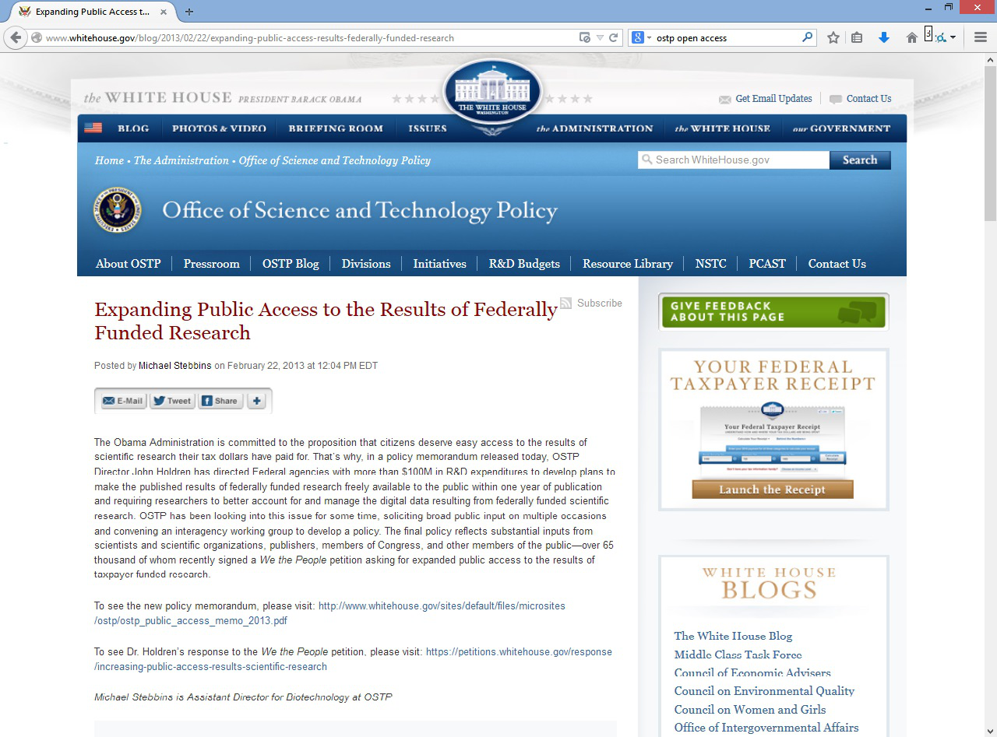

Slide 72
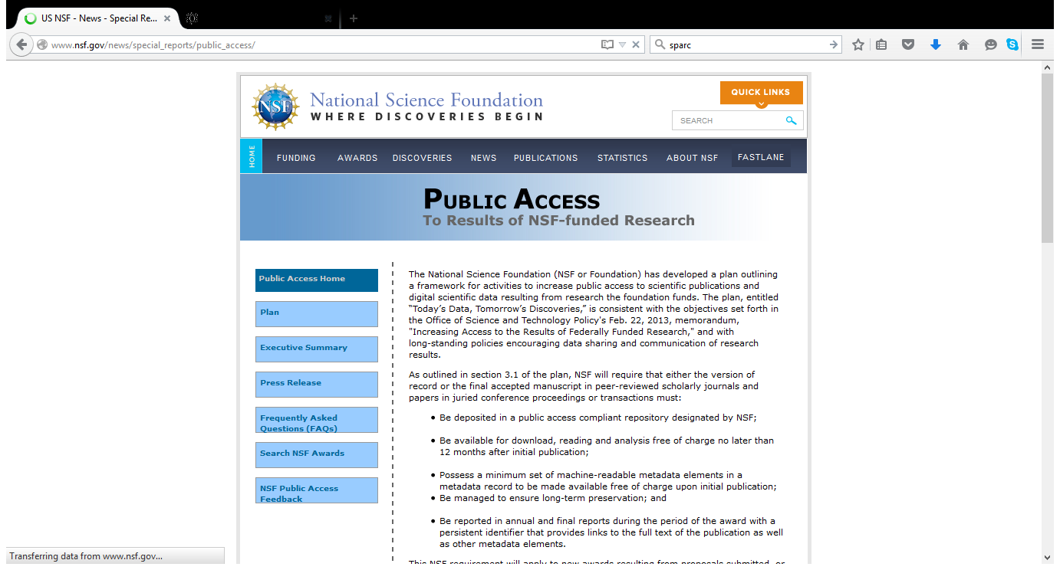

Slide 73
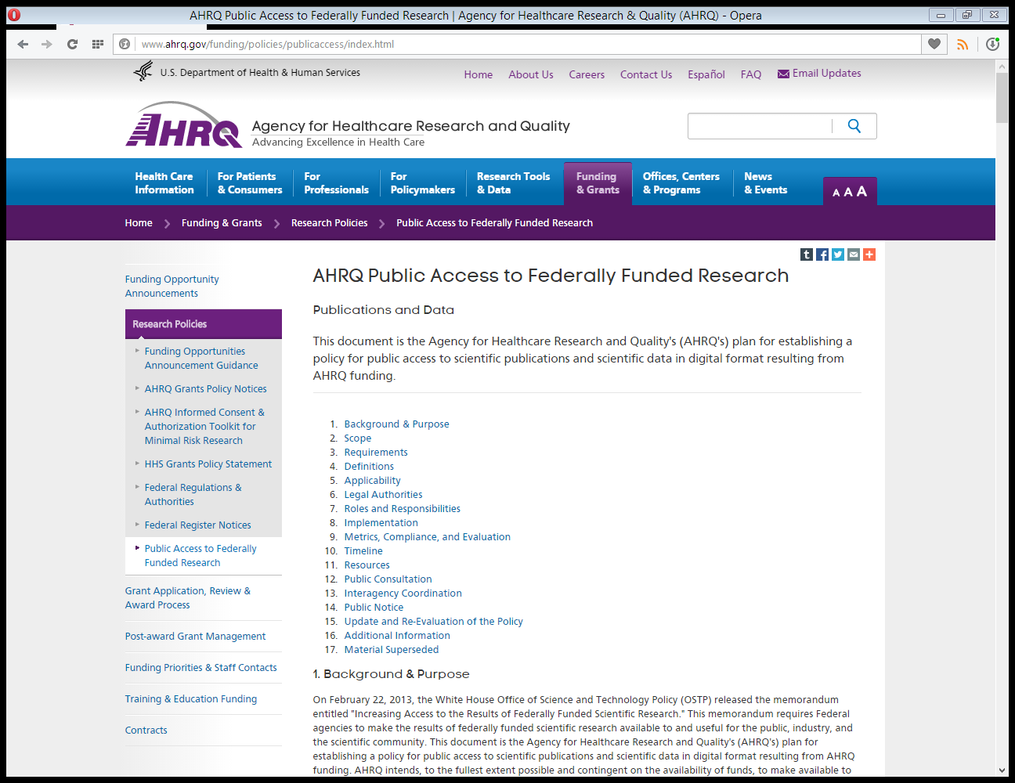

Slide 77
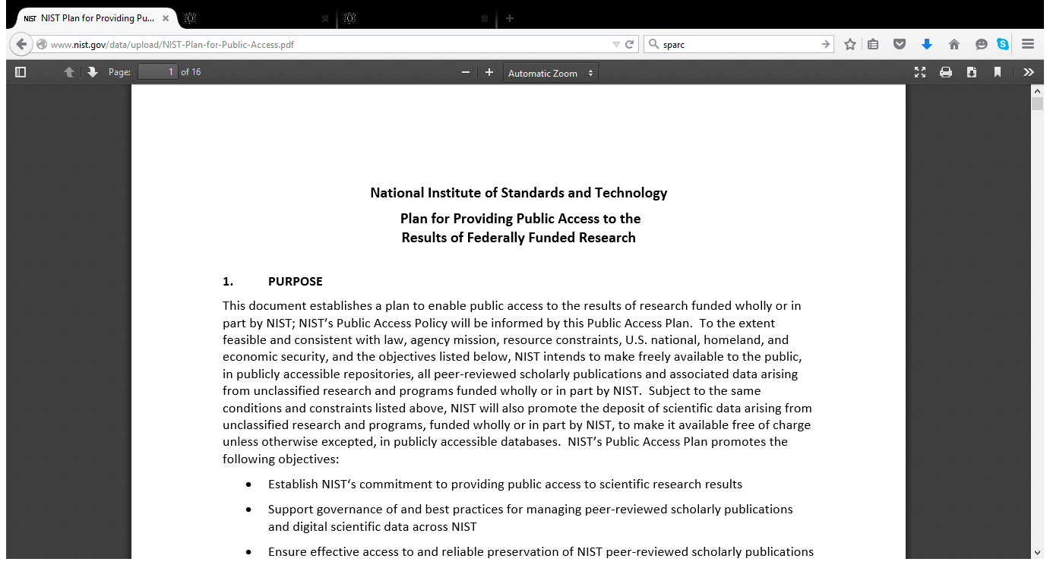

Slide 78
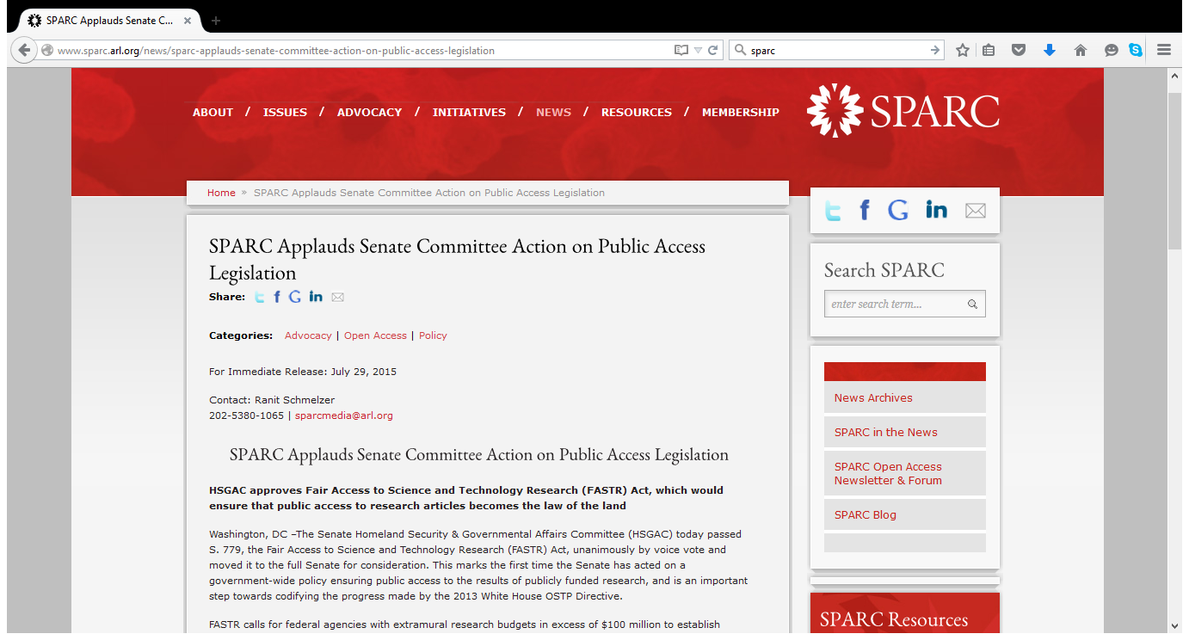

Slide 79
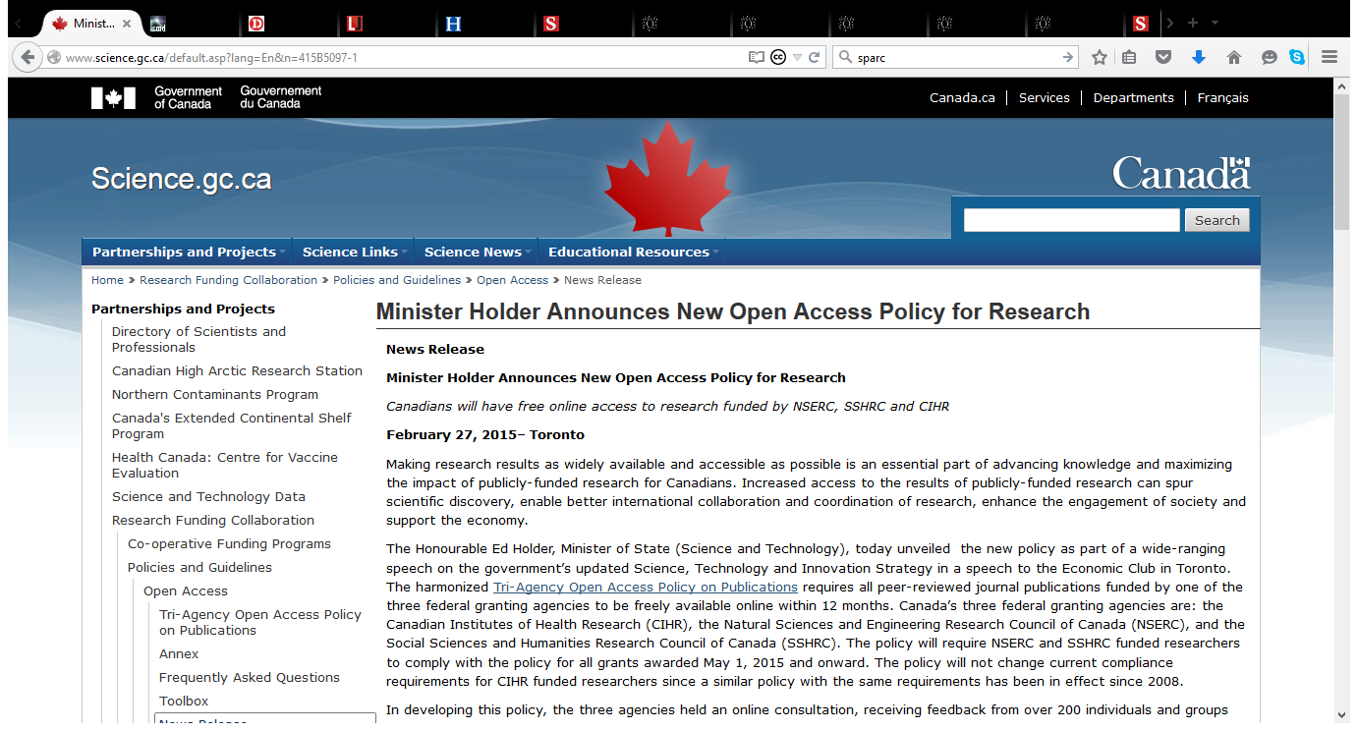

Slide 80
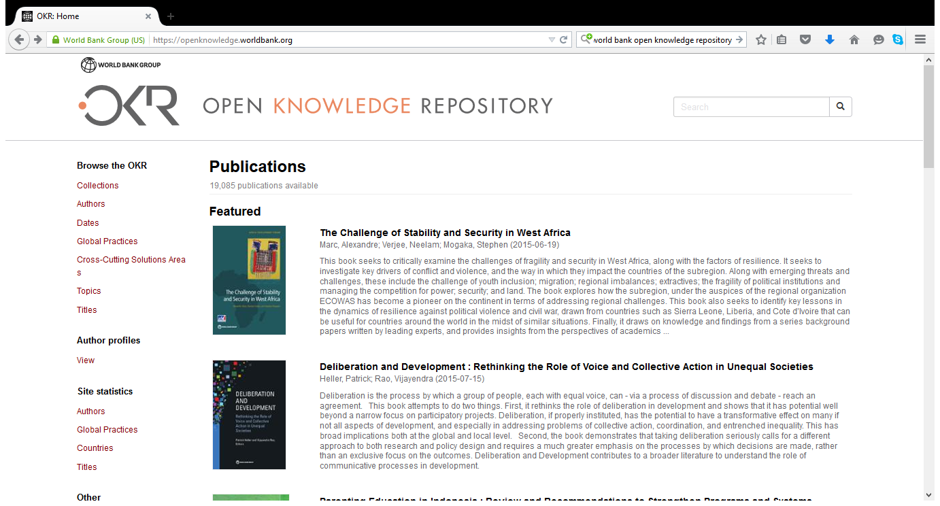

Slide 81
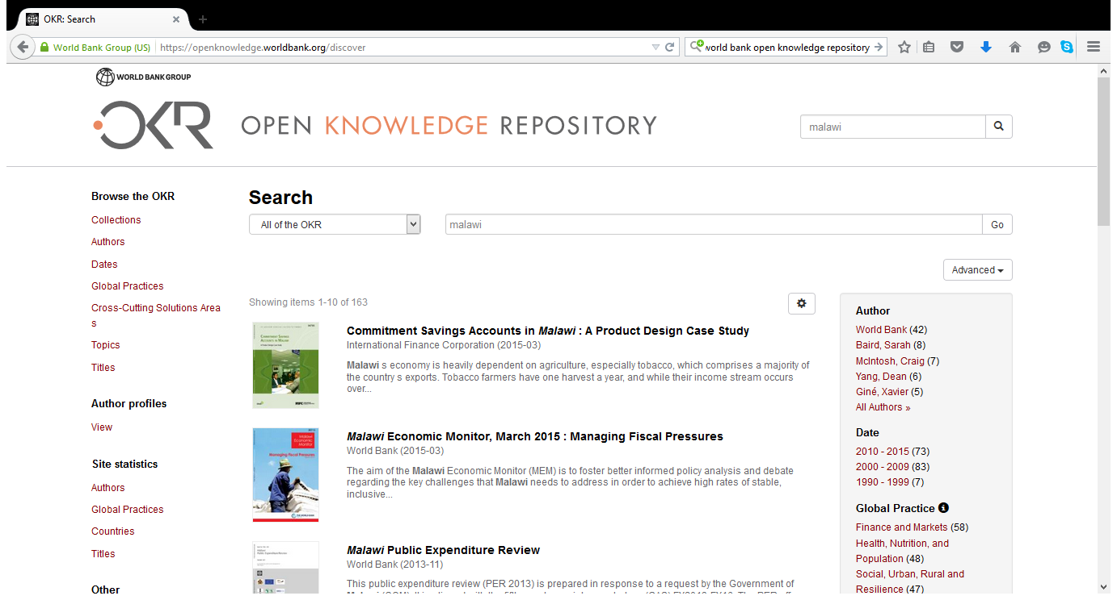

Slide 82
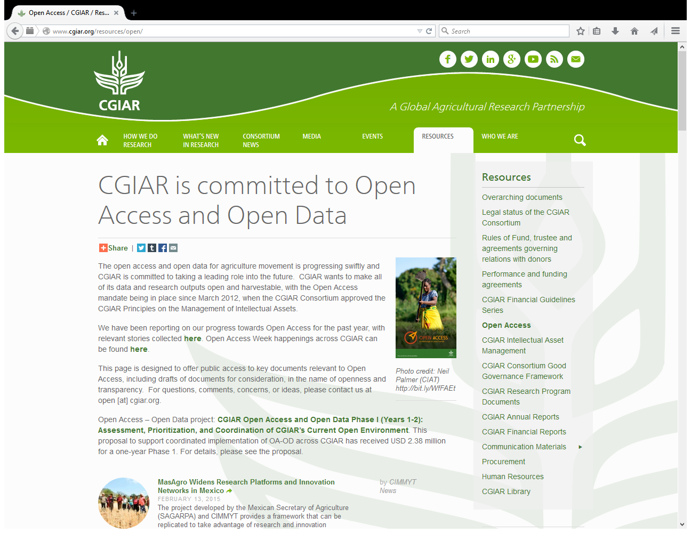

Slide 88
How OA benefits your work and career
Distribution and usage
Immediate access to your research output for everyone upon official publication
More visibility and usage

Slide 89
How OA benefits your work and career
Distribution and usage
Immediate impact of your work
Intensification of research through fast dissemination and use of research;
Possibly a citation advantage as well

Slide 90
There is accumulating evidence that shows that research articles that have been self-archived in open access repositories are cited more often than those that have not
A bibliography of studies on “The effect of open access and downloads (‘hits’) on citation impact” is maintained by the Open Citation Project (http://opcit.eprints.org/oacitation-biblio.html)

Slide 91
How OA benefits your work and career
Plus
Monitoring of your research output
Preservation of your research output by your library
Keep your rights instead of signing them away

Slide 92
Why should authors provide OA to their work?
Making research publications OA means that research has much more impact than before.
Moreover, the research cycle – where work is published, read, cited and then built upon by other researchers – is enhanced and accelerated when results are available on an OA basis.

Slide 93
Why should authors provide OA to their work? (2)
There is growing evidence to show that countries also benefit because OA increases the impact of the research in which they invest public money and therefore there is a better return on investment
(more details are here: http://www.knowledge-exchange.info/Default.aspx?ID=316).

Slide 94
Why should authors provide OA to their work? (3)
Universities are also finding OA repositories valuable in generating management information and reports on their research programmes and in raising awareness of their research profile.

Slide 95
What are the advantages of a repository to a University?
Opens up the outputs of the university to the world
Maximises the visibility and impact of these outputs as a result
Showcases the university to interested constituencies – prospective staff, prospective students and other stakeholders

Slide 96
What are the advantages of a repository to a University? (2)
Collects and curates digital outputs
Manages and measures research and teaching activities
Provides a workspace for work-in-progress, and for collaborative or large-scale projects

Slide 97
What are the advantages of a repository to a University? (3)
Enables and encourages interdisciplinary approaches to research
Facilitates the development and sharing of digital teaching materials and aids
Supports student endeavours, providing access to theses and dissertations and a location for the development of e-portfolios

Slide 98
Discussions & Recommendations Ten years on from the Budapest OA Initiative: Setting the default to open

Slide 99
On policy
Every institution of higher education should have a policy assuring that peer-reviewed versions of all future scholarly articles by faculty members are deposited in the institution’s designated repository

Slide 100
On policy (2)
University policies should respect faculty freedom to submit new work to the journals of their choice.
University policies should encourage but not require publication in OA journals, and should help faculty understand the difference between depositing in an OA repository and publishing in an OA journal.

Slide 101
On policy (3)
Every institution of higher education offering advanced degrees should have a policy assuring that future theses and dissertations are deposited upon acceptance in the institution's OA repository. At the request of students who want to publish their work, or seek a patent on a patentable discovery, policies should grant reasonable delays rather than permanent exemptions.

Slide 102
On policy (4)
Every research funding agency, public or private, should have a policy assuring that peer-reviewed versions of all future scholarly articles reporting funded research are deposited in a suitable repository and made OA as soon as practicable.

Slide 103
On policy (5)
Universities with institutional repositories should require deposit in the repository for all research articles to be considered for promotion, tenure, or other forms of internal assessment and review.

Slide 104
On policy (6)
Insofar as universities, funding agencies, and research assessment programs need to measure the impact of individual articles, they should use article-level metrics, not journal-level metrics

Slide 105
On policy (7)
Similarly, governments performing research assessment should require deposit in OA repositories for all research articles to be reviewed for national assessment purposes.

Slide 107
1. Do not use journal-based metrics, such as Journal Impact Factors, as a surrogate measure of the quality of individual research articles, to assess an individual scientist's contributions, or in hiring, promotion, or funding decisions.
The San Francisco Declaration on Research Assessment (DORA)
http://am.ascb.org/dora/

Slide 110
Funders and universities, too, have a role to play. They must tell the committees that decide on grants and positions not to judge papers by where they are published. It is the quality of the science, not the journal's brand, that matters.
(How journals like Nature, Cell and Science are damaging science by Randy Schekman: http://www.theguardian.com/commentisfree/2013/dec/09/how-journals-nature-science-cell-damage-science

Slide 116
Image courtesy of http://aukeherrema.nl/ CC-BY

Slide 119
Open science in national policies - Finland
open access publications
open research data
open research methods and tools
as well as new skills and support services in open science domain
http://openscience.fi

Slide 123
Thank you! Questions? iryna.kuchma@eifl.net
www.eifl.net

